Slide 1
Presentation Virtualization Overview of Windows Server 2008 Terminal Services
Gopikrishna Kannan
Program Manager | Microsoft Corporation
gopikann@microsoft.com

Slide 2
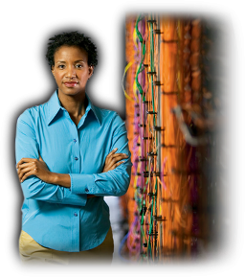
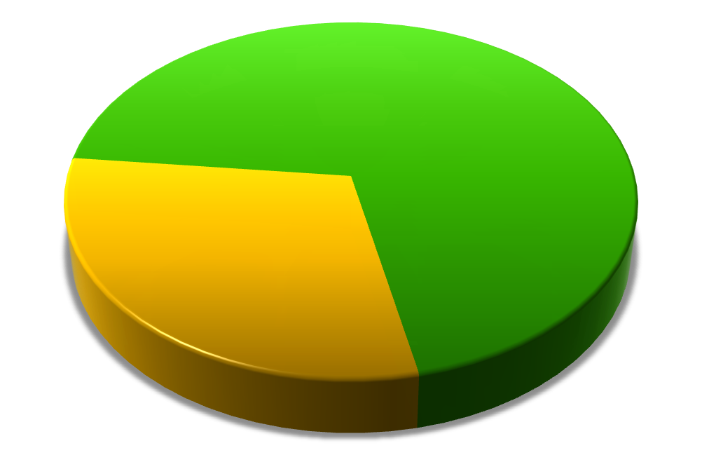





The Business Challenge
Technology Change
Regulatory Compliance
Competition
Security
Cost Reduction
Keep Business Up and Running
Customer
Connection
End User
Productivity
Business Results and New Value
Notes:
In today’s complex business environment, there is more pressure than ever on Information Technology (IT) departments to deliver business value despite challenges such as shrinking budgets, rapidly changing technologies and increasing security issues. As companies grow, their Information Technology (IT) infrastructures typically grow along with them, but more often than not, the pace of that growth is uneven, driven as much by the conditions under which they operate as the model they aspire to. IT is being increasingly viewed as a key value generator for most organizations and the focus is shifting from merely keeping the business up and running to an engine that drives responsiveness and agility across the organization.
Organizations are increasingly looking to implement technologies which allow them to manage their changing workforce and enhance their customer’s experience, as well as meet the demands and regulations imposed on them. A key challenge is ensuring that the right balance is struck between managing the infrastructure and adding business value. Analysts say that each year, more than 70% of IT budgets are being spent on maintaining what is already in place, as opposed to a mere 30% of IT budgets being spent proactively on new initiatives that add business value and increase productivity.

Slide 3


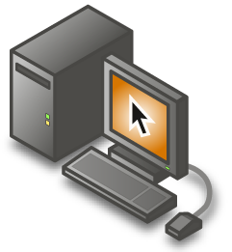
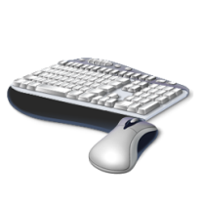
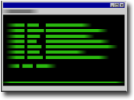
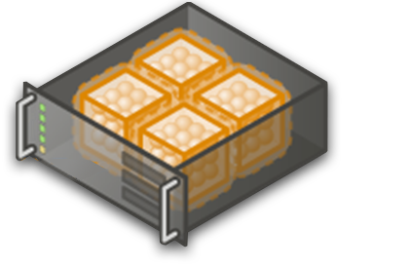
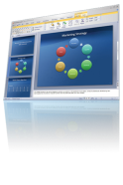
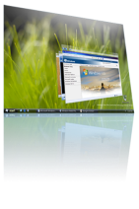



What Is Presentation Virtualization?
Run an application in one location but have it be displayed and controlled in another
Only screen images, keystrokes and mouse movements are sent over the network
Notes:
Title: How Does Terminal Services Work?
Talking Points: For those of you not familiar with how presentation virtualization works, the client computer has a small piece of software installed on it, known as the Terminal Services Client. The user starts the Terminal Services Client and selects which server they want to connect to. (Click 1) Only keyboard and mouse data travel to the Terminal Server and (click 2) just screen data is returned from the server.
Microsoft's Remote Desktop Protocol is used to transfer this data over the network and is optimized to ensure that screen data is efficiently sent over the network resulting in the ability to access a remote machine even over low spee
d links such as modems and wireless connections.

Slide 4
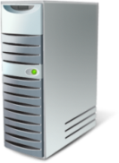
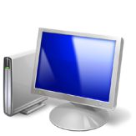
Flexibility
Productivity
End-user productivity receive a performance boost
Management
Update and patch applications just once
TS reduces client-side regression testing, patching, OS to OS conflicts
Rapid application deployments.
Data Center
Desktops

Slide 5

Terminal Services – Connected
Branch office or mobile users
Simplify access & secure delivery
Improve remote user experience
Reduce training costs
Simplify Application deployment
Speed Application deployment
Home
Hub Site
Branch Office

Slide 6
Security and Regulatory Compliance
Reduce Risk
No data stored on the local client
Centrally control access to key data & applications
Compliance
Easier compliance (US-HIPAA, US-SOX, Canada-PIPEDA, etc)
Centralized usage logs and track activities
Simplified application and data control
`

Slide 7
Terminal Services in Windows Server 2008
Areas of focus with Windows Server 2008 – TS
Improving the platform & enabling partner value add
Introducing Presentation Virtualization to new customers
Improvements
PnP Device Redirection Framework
Features
TS Remote App™
TS Gateway
TS Web Access
TS Session Broker
TS Easy Print
Improved management
SSO and Security Improvements
64-bit scaling
Re-factored TS core
Expanded WMI interfaces
Extensibility

Slide 8
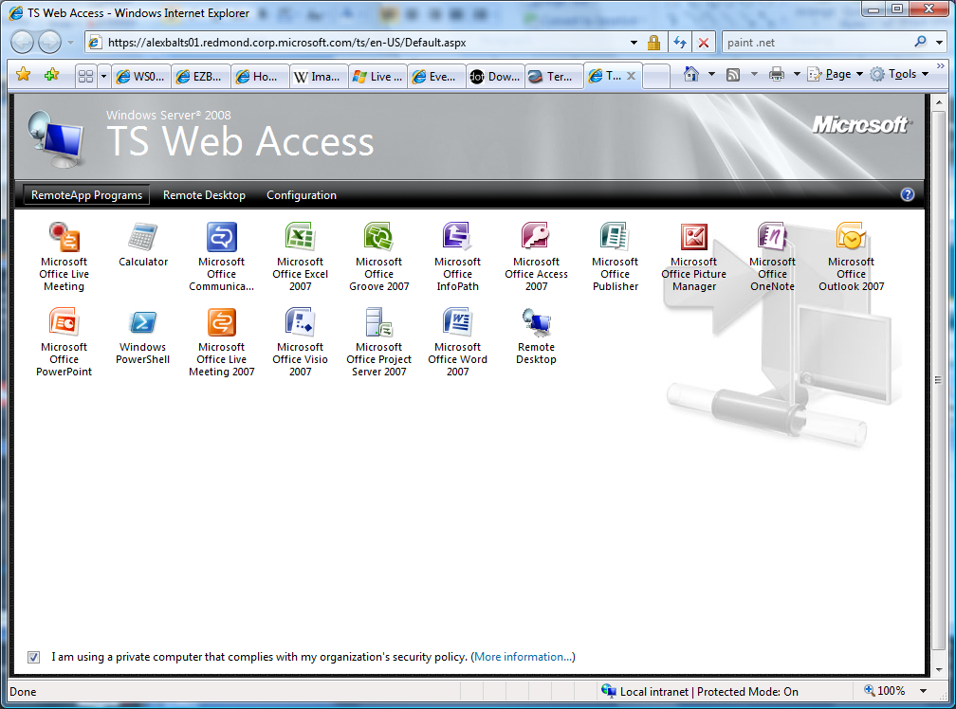
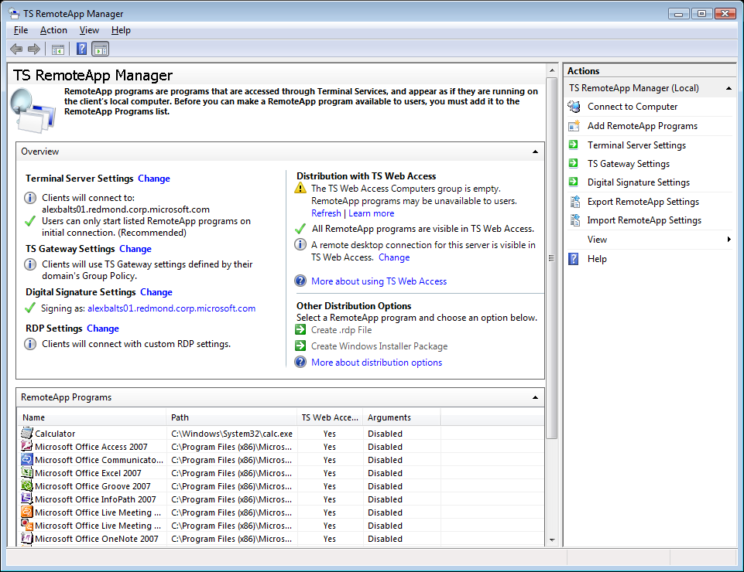
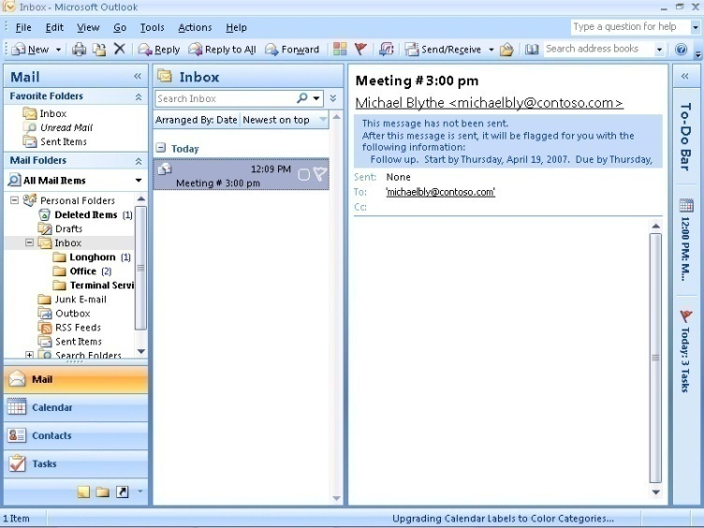


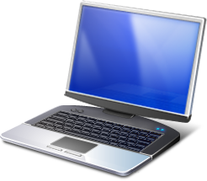
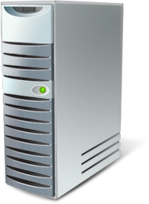

TS RemoteApp Overview
RemoteApp manager
Define program settings
Make programs available via TS Web Access
Create MSI or RDP files
Requires:
Vista SP1 or XP SP3 RDC client (mstsc.exe)
Applications launched from Web Page, RDP files or MSI shortcuts
Programs look like they are running locally
Requires: Remote Desktop Connection client
Terminal Server
Notes:
8
Title: TS RemoteApp Overview
Talking Points: Windows Server 2008 Terminal Services RemoteApp (TS RemoteApp) provides the ability to run both local and remotely-hosted programs on a Windows desktop.
TS RemoteApp provides the ability to run both local and remotely-hosted programs on a Windows desktop. These programs will be fully integrated with the local computer, having their own resizable windows and taskbar entries. The remote program is completely integrated with the user's desktop, and appears to the user as if it is running on the user's local computer. Users can run programs from a remote location side-by-side with their local programs. If the program uses a notification area icon, this icon appears in the client's notification area. Popup windows are redirected to the local desktop. Local drives and printers can be redirected to appear in the remote program. Many users might not be aware that the remote program is any different than a local program.
The Terminal Server Configuration console is the central location from which administrators configure a terminal server to host remote programs.
[BUILD1] RemoteApp Console: From the RemoteApp console, you can select which applications on the terminal server to make available as remote programs as well as deciding whether or not such programs should also be made available by means of Terminal Services Web Access.
[BUILD2] TS Web Access: TS Web Access provides a single convenient location for users to see all the applications on any given terminal server. It is also possible to provide users with MSI based installable packages that create shortcuts on the desktop that can be used to launch RemoteApp programs.,
[BUILD3] Programs Look Like They Are Running Locally: This image demonstrates TS RemoteApp. Microsoft Office Outlook 2007 is running on a terminal server, and yet the launch-tray icon and the reminder tabs are integrated on the client desktop as if it were running locally. This compares to previous versions of Terminal Services where the application was constrained by the frame of internet explorer – which was a terrible user experience.
[BUILD4] Remote Desktop Client: Remote Programs are only supported by the Remote Desktop client 6.0, or later. This client is available for Windows XP SP2, Windows Server 2003 SP1, and Windows Vista, and is distributed free through Windows Update.

Slide 9
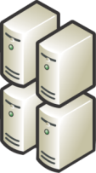
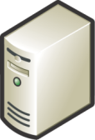


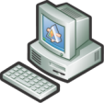










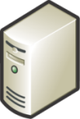








Terminal Services Gateway Overview
Enables Terminal Services-based (RDP) connections without need for the broader capabilities of Virtual Private Network (VPN)
Requires Remote Desktop Connection 6.1
Requires Microsoft Network Policy Server
Optional NAP integration
Needs to be domain joined
Network Policy Server/Domain Controller
Terminal Server or Remote PC
Validate User Access and Client Health
2
RDP over RCP/HTTPS
DATACENTER
3
AD/NP
Internal
Firewall
External
Firewall
RCP/HTTPS Removed
Home
1
Terminal Services Gateway
RDP passed to Terminal Server
Mobile Business
Internet
4
DMZ
Branch Office
Notes:
9
Title: TS Gateway Overview
Talking Points:
Terminal Services Gateway (TS Gateway) is a role service that allows authorized remote users to connect to terminal services based resources on an internal corporate or private network, from Internet-connected devices. The network resources can be terminal servers, terminal servers running RemoteApp programs, or computers with Remote Desktop enabled.
TS Gateway uses Remote Desktop Protocol (RDP) encapsulated in RPC over HTTPS to establish a secure, encrypted connection between remote users on the Internet and the internal network resources on which their productivity applications run.
If your organization makes Terminal Services–based applications and computers that run Remote Desktop available to users from outside your network perimeter, TS Gateway can simplify network administration and reduce your exposure to security risks. TS Gateway can also make it easier for users because they do not have to configure VPN connections and can access TS Gateway servers from sites that can otherwise block outbound RDP or VPN connections.
TS Gateway provides many benefits, including:
TS Gateway enables remote users to connect to internal network resources over the Internet, by using an encrypted connection, without needing to configure virtual private network (VPN) connections.
TS Gateway provides a comprehensive security configuration model that enables you to control access to specific internal network resources.
TS Gateway provides a secure yet flexible RDP connection allowing users access to anything to which their RDP host has access, rather than allowing remote users direct network connectivity to all internal network resources; helping protect the internal resources.
TS Gateway enables most remote users to connect to internal network resources that are hosted behind firewalls in private networks and across Network Address Translation (NATs) devices. With TS Gateway, you do not need to perform additional configuration for the TS Gateway server or clients for this scenario.
The TS Gateway Manager snap-in console enables you to configure authorization policies to define conditions that must be met for remote users to connect to internal network resources. For example, you can specify:
Who can connect to network resources (in other words, the user groups who can connect).
What network resources (computer groups) users can connect to.
Whether client computers must be members of Active Directory® security groups.
Whether device and disk redirection is allowed.
Whether clients need to use smart card authentication or password authentication, or whether they can use either method.
You can configure TS Gateway servers and Terminal Services clients to use Network Access Protection (NAP) to further enhance security. NAP is a health policy creation, enforcement, and remediation technology that is included in Windows XP Service Pack 2, Windows Vista, and Windows Server 2008. With NAP, system administrators can enforce health requirements, which can include software requirements, security update requirements, required computer configurations, and other settings.
You can use TS Gateway server with Microsoft Internet Security and Acceleration (ISA) Server to enhance security. In this scenario, you can host TS Gateway servers in a private network rather than a perimeter network and screened subnet), and host ISA Server in the perimeter network. The SSL connection between the Terminal Services client and ISA Server can be terminated at the ISA Server, which is Internet-facing.
The TS Gateway Manager snap-in console provides tools to help you monitor TS Gateway connection status, health, and events. By using TS Gateway Manager, you can specify events (such as unsuccessful connection attempts to the TS Gateway server) that you want to monitor for auditing purposes.
Terminal Services Gateway securely connects applications and data to users outside the firewall and provides simple and secure delivery of critical applications and data to mobile employees without a VPN.
Monitoring Capabilities: You can use TS Gateway Manager to view information about active connections from Terminal Services clients to internal corporate network resources through TS Gateway. This information includes the connection ID, the domain and user ID of the user logged on to the client, full name of the user logged on to the client, date and time when the connection was initiated, length of time the connection was active, length of time that the connection is idle- if applicable, name of the internal network computer to which the client is connected, IP address of the client.
Group Policy Settings for TS Gateway: You can use Group Policy and Active Directory Domain Services to centralize and simplify the administration of TS Gateway policy settings. You use the Local Group Policy Editor to configure local policy settings, which are contained within Group Policy Objects (GPOs). You use the Group Policy Management Console (GPMC) to link GPOs to sites, domains, or organizational units (OUs) in Active Directory Domain Services. Group Policy settings for Terminal Services client connections through TS Gateway can be applied in one of two ways. These policy settings can either be suggested (that is, they can be enabled, but not enforced) or they can be enabled and enforced. Suggesting a policy setting allows users on the client to enter alternate TS Gateway connection settings. Enforcing a policy setting prevents a user from changing the TS Gateway connection setting, even if they select the Use these TS Gateway server settings option on the client.

Slide 10



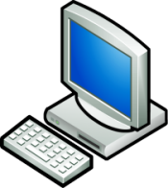


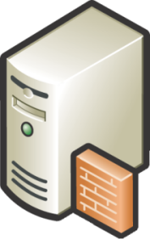








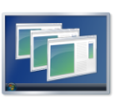

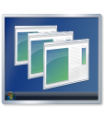
TS Gateway In Action
RDP hosts can now be put behind firewall
HTTP/S used to traverse firewall
AD/NPS/NAP checked before connection allowed
New Remote Desktop Connection client required
AD/NPS/NAP
AD/IAS/NAP checked
Vista RDC (TS) client
TS Gateway
RDP over HTTP/S established to TSG RDP 3389 to host
Terminal Servers or XP/Vista
User initiates HTTP/S connection to TS Gateway
User browses to TS Web Access
TS Web Access
Internet
DMZ
Internal Network
Notes:
Title: What Does the New TS Gateway Architecture Offer Organizations?
Talking Points:
Read Bullets
RDP = Remote Desktop Protocol
AD = Active Directory
NPS = Network Policy Server (a role of Windows Server 2008)
NAP = Network Access Protection a solution provided by Windows Server 2008 that enforces checking of the client health before connection is allows.
So lets see how TS Gateway Works together with multiple elemens of Windows Sever 2008 to provide a complete remote access solution.
Firstly the user browses to the their TS Web Access Server and clicks the link for the application they want.
TS Web Access now sends the connection back to the users client machine, from this point on TS Web Access takes no further part in the proceedings.
The Remote Desktop Connection or RemoteApp client automatically prompts the user for their username and password this coupled with the information supplied by TS Web Access is used to initate the connection to the terminal services gateway, the user is then authenticated by the gateway.
Gateway checks the user has a valid Connection Authorization Policy. TS Gateway checks with the Network Policy Server if the use is allowed to traverse (or connect) to the Gateway and that the user is who they claim to be by using Active Directory; (optionally Network Access Protection is invoked and the client is asked to prove that it is upto date with patch and ant-virus signatures – if not the user will be disconnected). Lastly the user is checked against the resource authorization policy to ensure that traffic is only be sent to authorized host machines.
Once the user has been validated the gateway strips off the HTTPS encapsualtion and passes RDP traffic to the host on the internal network and finally the host determines if the user can logon on. The beauty of this system is that this is all transparent to the user after they have typed the username and password for the first time.

Slide 11
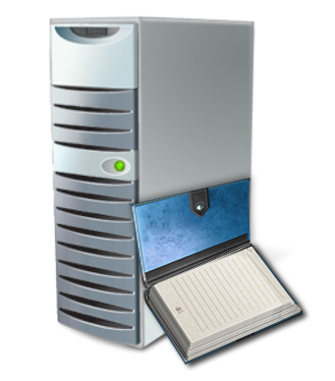
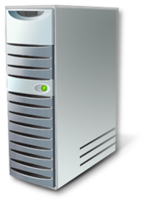
TS Session Broker Overview
Session Broker
2
Terminal Server 2
Terminal Server 1
3
Terminal Server
Terminal Server
5
4
6
1
Server 1 tells the client via RDP to redirect to Server 2
TS: Server 1 contacts the Session Broker to determine where the user should login
Session Broker tells Server 1 that this user has no session and Server 2 has less load
The Client is redirected to Server 2
Session Created on Server 2 for the client
2
Remote User Connects via Terminal Services
3
4
5
6
1
Notes:
Title: TS Session Broker Overview
Talking point:
Terminal Services Session Broker (TS Session Broker) is a role service in Windows Server 2008 that allows a user to reconnect to an existing session in a load-balanced terminal server farm. TS Session Broker stores session state information that includes session IDs and their associated user names, and the name of the server where each session resides.
Windows Server 2008 introduces this new TS Session Broker Load Balancing feature that enables you to distribute the session load between servers in a load-balanced terminal server farm.
Note: In Windows Server 2008, the name of the Terminal Services Session Directory (TS Session Directory) feature was changed to Terminal Services Session Broker (TS Session Broker).
In this scenario the user doesn’t have a pre-existing session.
1 – the user initiates a connection and using network load balancing or DNS round robin their connection is randomly routed to a server – in this case server 1.
2 – the terminal server contacts the Session Broker and asks ‘Where is the least loaded terminal server’?
3 – the session broker returns that server 2 is actually has the least number of sessions.
4 – the initial terminal server tells the client to redirect its connection to terminal server 2.
5 – the client automatically re-directs its connection to Server 2. This is transparent to the user who is unaware this is happening. This redirection process only adds a couple of seconds to the logon process.
6 – the connection is complete and the user can begin using their Remote Desktop or RemoteApp program.
More Talking Notes:
This process is completely transparent to the user.
The Session Broker uses per session load balancing this was introduced because many customers previously used Microsoft Network Load balancing (NLB). However this proved hard fro many customers to setup. Session based load balancing provided by TS is better than the old connection based load balancing of NLB due to the issue of terminal servers often having disconnected sessions consuming resources that NLB did not take into account.
Session Broker still supports the use of MS NLB and 3rd party load balancners in the same way as it did in previous releases (known as session directory functionality)

Slide 12
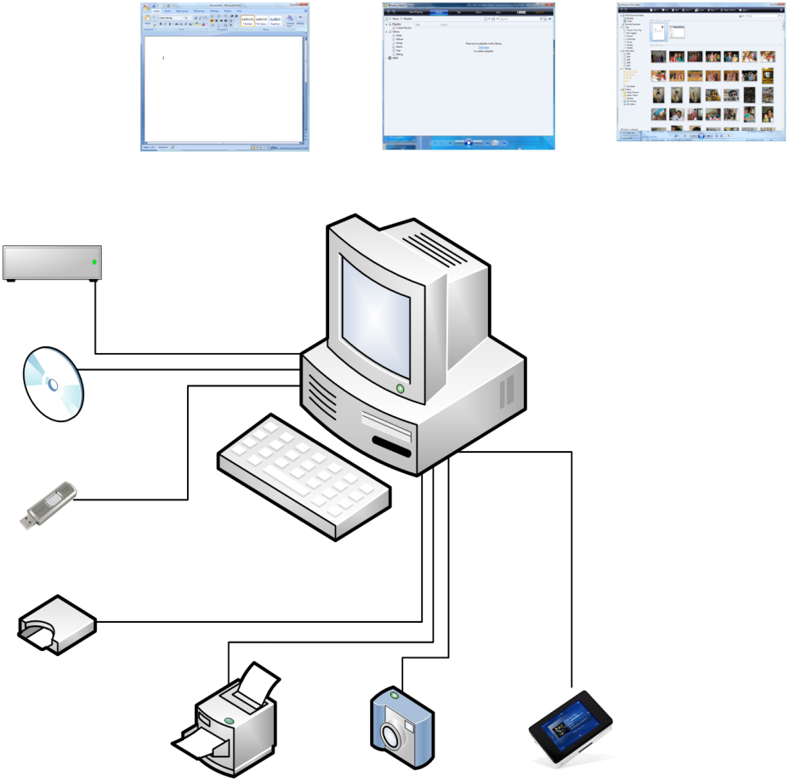



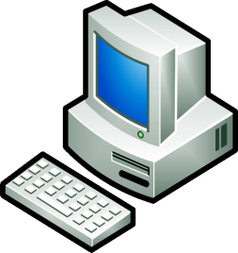
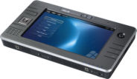





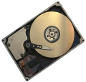






TS Device Redirection
Client Computer
Terminal Server
Remote Desktop Protocol
Notes:
Slide Title: Terminal Services Device Redirection
Summary
Terminal Services Device Redirection ensure that common devices that are used with local applications are also available for use by remote applications provides with presentation virtualization.
Talking Points
Build 1 Users have multiple applications that they run locally that have access different types of devices that the user has locally attached.
Build 2 As application are moved to a central location with RemoteApp it is important that the common devices that users want to use are still available for use when the application is running from the server. Device Redirection and our new Plug and Play Device Redirection framework ensures that these common devices are accessible by the remote applications whilst allowing the user to determine which devices they want to share with the remote applications. Finally with Windows Server 2008 we have improved our device isolation technology to ensure each device is securely accessible only within the user session that the specific user is using.
Out of the box we provide support for device such as DVD & CD-ROM drives, USB and flash memory devices, Cameras and other devices that operate in MTP (media transfer protocol mode). For the retail market we ensure Windows Embedded Point of Service (WePOS) devices can also be fully remoted. The Plug and Plat device redirection framework I mentioned earlier enabled device vendors to easily and quickly provide drivers for their Vista compatible devices to work with Terminal Services device redirection.
Finally the biggest are of imnprovement from our previous version is with printer redirection and is pretty exciting so lets look at that in some more detail now. NEXT SLIDE.

Slide 13












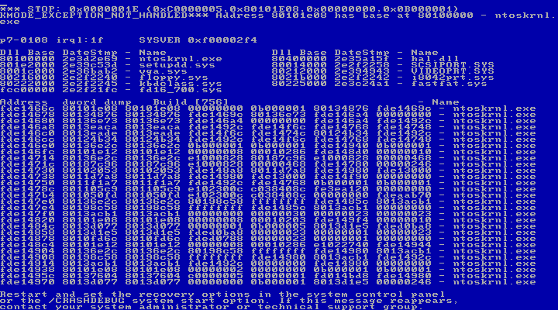
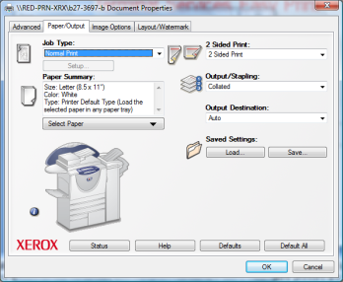







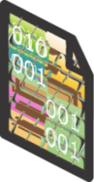











TS Easy Print Overview
Historical Issues
Solution
No Match
Close Match
Bad Match
TS Easy Print
?
☹
Notes:
Title: TS Easy Print Overview
Talking Points:
TS Easy Print Overview
Under normal operations, the user connects to the terminal server
TS Easy Print used instead of a vendor print driver
User prints from application - printer option dialogs are generated on the client NOT the server
Document rendered into XPS format (XML Paper Specification)
Print job sent back to client printer and rendered with client print driver
The new Terminal Services Easy Print driver offers organizations:
Increased reliability of Terminal Services printing for both RemoteApp and remote desktop sessions.
Support for legacy and new printer drivers without the necessity of installing these drivers on the terminal server.
Scalability improvements over Windows Server 2003 in terms of printer enumeration performance. During the Winlogon process, the spooler only enumerates printers that are available for a user in a particular session instead of enumerating all redirected printers. Therefore, printers are enumerated on a per-session basis, instead of on a per-user basis.
Enhanced available printer capabilities in that The Terminal Services Easy Print use the client side driver to ensure that all of the printer capabilities normally available to the user can also be used in remote sessions. All of the physical printer driver's capabilities are available for use when a user views the printing preferences.
Detailed Talking Points:
Terminal Services Easy Print (TS Easy Print) is a feature in Windows Server 2008 that enables users to reliably print from a TS RemoteApp program or from a TS remote desktop session to the correct printer on their client computer.
In previous versions of Terminal Services, a user would connect to the terminal server and the closest matching server print driver would be selected. When a user accessed and ran Microsoft Office Word to print a document, the document would be rendered with the server printer driver and the print job would be sent back to the client printer for printing. Frequently, there would be no close printer driver match. So, although the user may have been running Microsoft Word on Terminal Services, they were not able to print. Or, when the document was rendered with the printer driver and sent back to the client printer, the output appeared corrupted. Another common problem was that upon connecting to Terminal Services, the user would see basic or different printer than would normally be seen on their local machine. This resulted in, for example, the user being unable to print in color even though this functionality was supported by the local printer. Overall, managing unreliable printer drivers was challenging and often resulted in distorted output.
Now, in Windows Server 2008, Terminal Services Easy Print leverages the client-side print driver (no server side driver needed) to enable fast and reliable printing to a local or network-attached printer. End users can more productively work from remote locations. It also enables users to have a much more consistent printing experience between local and remote sessions.
Use the following steps as reference for the build.:
Normal Operation
User connects to the terminal server
Closest match print driver selected
User runs word on TS, selects print and document is printed
Document rendered with printer driver
Print job sent back to client printer
No Driver Match
User connects to the terminal server
No printer driver match
User runs MS Word on TS but can’t print
Odd Behaviour
User connects to the terminal server
Closest match print driver selected
Document submitted on server
Document rendered with printer driver
Print job sent back to client printer and ‘looks odd’ or worse is corrupted
Lack of Options/Feature Mismatch
User connects to the terminal server
Closest match print driver selected
Client sees only basic printer properties / different properties than they see on their client driver
E.g. user unable to print in colour even though the local printer supports it
Drivers of Death
User connects to the terminal server
Closest match print driver selected
Document submitted
Document rendered with printer driver
Consumer grade driver crashes server
Reconnections crash additional servers

Slide 14
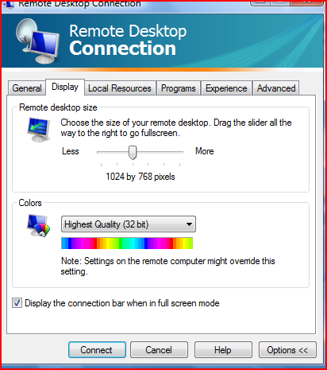
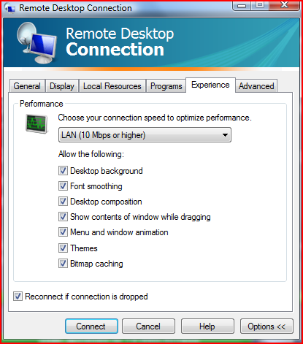
RDC Experience Features
RDP Improvements - RDP 6.1
Desktop experience
Monitor Spanning
Desktop composition
Font Smoothing
Display data prioritization
Notes:
Custom display resolutions
Previously, only 4:3 display resolution ratios were supported, and the maximum resolution supported was 1600 x 1200.
Cleartype
which is a technology for displaying computer fonts so that they appear clear and smooth, especially when you are using an LCD monitor.

Slide 15

Demo

Slide 16
References
Required slide:
Please customize this slide with the resources relevant to your audience.
Terminal Service Home Page http://www.microsoft.com/ts
Terminal Services Blog http://blogs.msdn.com/ts
Terminal Services TechNet Site http://technet.microsoft.com/ts
Terminal Services 2008 Resources http://technet2.microsoft.com/windowsserver2008/en/servermanager/terminalservices.mspx
Microsoft Windows Server 2008 Terminal Services http://www.microsoft.com/windowsserver2008/terminal-services/default.mspx
Windows Server 2008 TS Forum http://forums.microsoft.com/TechNet/ShowForum.aspx?ForumID=580&SiteID=17
Terminal Services and Microsoft Developer Network (MSDN) http://msdn2.microsoft.com/en-us/library/bb892075.aspx http://microsoft.com/ts
Notes:
Title: For More Information, Please Refer to the Following Resources
Talking Points:

