Slide 1
Presentation Guidelines
You can and should customize this presentation to speak to your local business audience. Insert your information where there is currently red text and feel free to add or delete anything else as suits your needs.
Here are some suggestions:
Add your own products that are relevant to the customer issue you are discussing (Slide 24).
Add your own offers for your products or Microsoft products (Slide 25).
Update the next steps for each Microsoft product with the latest offers from www.mslocaloffers.com (Slides 17, 19, 21).
Remove any Microsoft product slides that you do not want to feature (Slides 16-21, 27-31).
This presentation is designed to be an interactive session between the speaker and attendees. Use the speaker notes to guide the discussion and encourage everyone to participate in sharing their experiences.

Slide 2
Today I’ll be the manager, accountant, and computer geek – all before lunch.
Presenter’s Name
Partner Name
Date
Insert Partner Logo
Insert Partner Logo
Insert Partner Logo
Insert Partner Logo
Notes:
Does this title resonate with you? As a business owner, every day is full of activities that only you can do. In the morning, you’ve got to assure the team is ready to produce, the afternoon is full of meetings with customers and, of course, you are the chief computer geek.

Slide 3
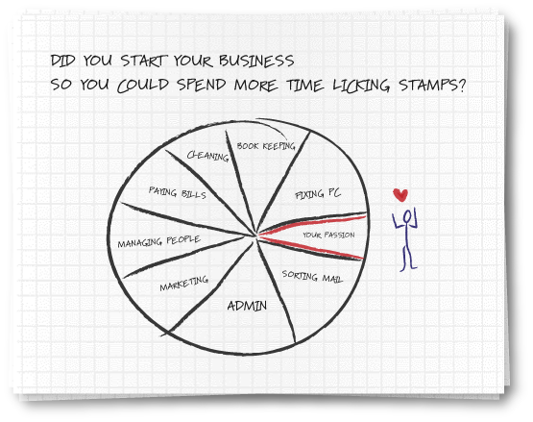
Notes:
Many businesses have to summarize problems into simple diagrams. So did you really think you’d be running your business by doing the varied activities described here?
If your passion is serving customers, why can’t you spend more time doing it? Why is it squeezed into becoming the small piece of the pie when you know, in your heart, it should consume the majority of your time? Because, you are the owner - the buck stops with you. Your mission is to find the tools, partners and engagements that can free up more of YOU.

Slide 4
Welcome to your local team
Meet other small business people in your area
Share stories and insights
Find solutions to some of your biggest challenges
Tap into a local network full of resources
  [List Presenters & Introduce them here]
Notes:
We want you to explore relationships, develop a network, initiate a dialogue with people sharing your problems. Guess what? They may help you create your own solutions. AND, you’ll help them think more clearly about their problems.

Slide 5









How the Local Engagement Team works
130,000+
Microsoft Partners
Local Business Community Organizations
Strategic Alliances
Microsoft Partners, complementary companies, and business community organizations are brought together at a local level to cater to customers’ needs.
Local Engagement Team Model

Slide 6
What challenges are you facing today?
No time to become an expert in every role
  Many tasks keep you from your real passion
Managing IT issues is time-consuming
Need to get more done in less time
Notes:
Let me ask for a volunteer. (Select) What business problem is keeping you awake at night?
How about some other business problems? Anyone worried about technology issues? What are your top three technology problems? Anyone had success solving any of these problems?

Slide 7
Two-thirds of small business owners work more than a standard 40-hour work week.
Reuters
Notes:
I doubt if anyone is surprised by this statistic. Perhaps if you’re like most business owners, it’s not the hours but the productivity during the hours that count. We hear countless businesses say that they have to “major on the minors” in their business. Something we’ve heard is “If I could get a dollar back for every hour I spent fixing something that I could have done better, I’d be a lot richer.”

Slide 8
No time to become an expert in every role – and many tasks keep you from your real passion
Let technology do work that doesn’t interest you
Put simplified business processes in place
Streamline your record-keeping
Make use of templates where possible
Get help from marketing tools to generate demand
Notes:
So, has technology actually allowed you to do more in your personal life? Has the web enabled you to explore new things, learn new things, find bargains, get exposed to communities? Has technology allowed you to explore more of your passion? Now you need to explore ways in which exploiting the benefits of technology can make you more productive at work. Installing just a handful of business technology solutions can free up more of your time to devote to your passion.

Slide 9
In 2005, 24% of small business owners considered their Internet presence to be very important for driving their businesses.
In 2008, that rose to 48%.
Warrilow Weekly
Notes:
How many of you have a web site? Do you manage it yourself or have someone else manage it for you? How do you feel about managing your own IT issues?

Slide 10
Managing IT issues is time-consuming
Offload technical tasks to experts
Explore outsourcing options
Put an integrated system in place that’s easy to manage
Work with your Microsoft Small Business Specialist
to get all the technology help you need
Notes:
Can you offload some of your business critical tasks to an outside expert? Can you reduce, replace, repackage existing business critical applications to become more productive? Anyone in the audience have a recent experience of “biting the bullet” and securing outside assistance to enable greater productivity?

Slide 11
Forty-nine percent of small business owners say they make business calls and check e-mail while driving.
Reuters
Notes:
Guess there’s a reason for this. You have to use every minute. But can you imagine a more relaxing way to drive to the office???!!
If you could use technology to free up 30 minutes of your time every day, that translates into 150 more hours a year. That’s the vacation you never take, folks!! OR, that’s 50 more sales calls that enable 5 more sales a year. That’s coaching little league for the season!

Slide 12
Need to get more done in less time
Use business productivity tools to leverage
your knowledge of your business
Real-time reporting solutions help analyze business processes and clarify next steps
Make sure you’re retaining good employees
Tracking business costs is key to maintaining
a healthy margin
Notes:
Of course, technology can also mean greater profitability for your firm - manage expenses better, track projects better, develop better management reporting.

Slide 13
Notes:
So today you only spend a little time on your passion that was the reason why you started a small business to begin with…

Slide 14
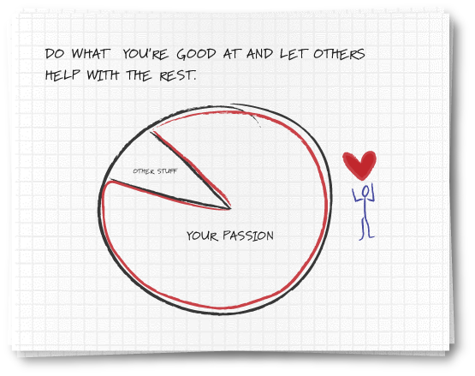
Notes:
But technology can help create more time to sell, recruit, deliver service, manage the P&L, or simply think of the next innovation for your business.
All research we see suggests that small businesses do not spend enough time thinking of the next innovation necessary to grow their business. If that’s not your passion, perhaps it should be.

Slide 15
Today I’ll be the manager, accountant, and computer geek – all before lunch.
Microsoft Solutions

Slide 16
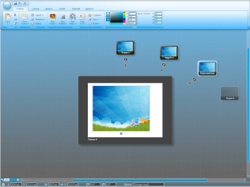
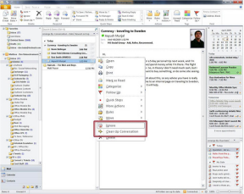
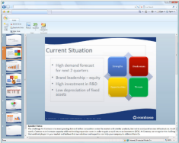

Microsoft Office Professional 2010
Increase productivity. Make it easier for employees to find and use the software features they need most often.
Give your business a competitive advantage. Deliver proposals and reports to customers faster. Edit documents at the same time and see who else is working on which sections.
Save time and money. Effortlessly produce compelling presentations, proposals and reports yourself.
Notes:
Increase productivity. Make it easier for employees to find and use the software features they need most often.
Give your business a competitive advantage. Deliver proposals and reports to customers faster. Edit documents at the same time and see who else is working on which sections.
Save time and money. Effortlessly produce compelling presentations, proposals and reports yourself.

Slide 17
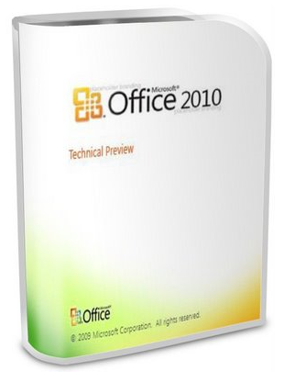
Microsoft Office Professional 2010
Next steps
Check www.mslocaloffers.com for current offers
www.mslocaloffers.com

Slide 18
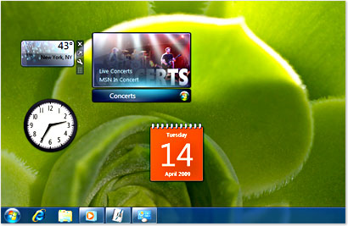
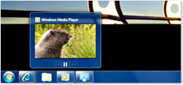
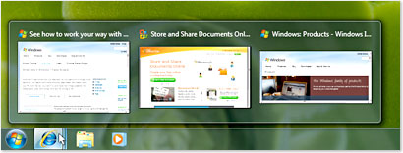
Windows 7 Professional
Works the way you want. You can start using your PC quickly with fast startup, shutdown, sleep, and resume from Standby.
Get more done. Access all your computer programs, files, and network resources. Whether at work, at home, or on the road, you can now easily connect to other networks or even other computers within your home.
Safeguard your work. Better protect your confidential information with powerful encryption technologies that let you encrypt your files and folders.
Notes:
Works the way you want. You can start using your PC quickly with fast startup, shutdown, sleep, and resume from Standby.
Get more done. Access all your computer programs, files, and network resources. Whether at work, at home, or on the road, you can now easily connect to other networks or even other computers within your home.
Safeguard your work. Better protect your confidential information with powerful encryption technologies that let you encrypt your files and folders

Slide 19
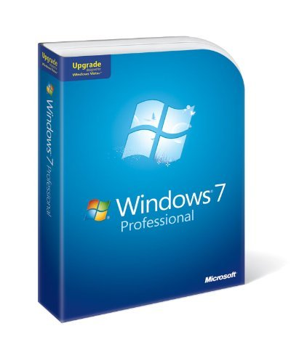
Windows 7 Professional
Next steps
Check www.mslocaloffers.com for current offers
www.mslocaloffers.com

Slide 20

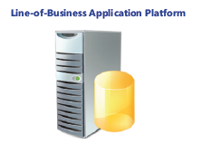
Windows Small Business Server 2008
Use an affordable, integrated solution. SBS 2008 brings together the Microsoft® technologies that small businesses need most into a single solution.
Protect your business data. Automatically back up the PCs and servers in your network and recover accidentally deleted files.
Grow your business capacity. Get secure access to important desktop resources from any Internet-connected PC, from virtually anywhere at any time, so you can be productive while you’re away from the office or on the road.
Notes:
Get remote access to the information you need from any PC. Just log on and you can access email, internal websites, network files and business applications.
Provide one central location to store and access business information. Help your employees easily find, use and share the information they need. Integrates with Windows Mobile-based devices, too.
Automatically back up your business information. Prevent data loss and enable your employees to easily retrieve accidentally deleted files and restore previous versions.
Cost-effectively share resources. Get the most value out of your printers, fax machines and phone lines.

Slide 21
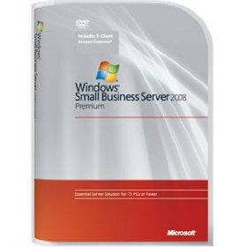
Windows Small Business Server 2008
Next steps
Download the demo
www.mslocaloffers.com

Slide 22
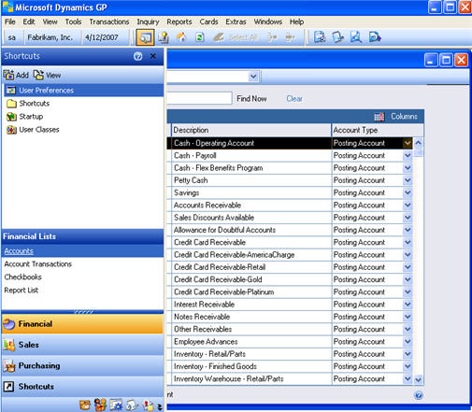
Microsoft Dynamics GP
Peace of Mind. Dynamics GP provides accountability by tracking every change made by every person.
Instant Knowledge. Dynamics GP will instantly alert you of pertinent financial situations.
Freedom to Grow. Dynamics GP supports over 1,000 simultaneous users vs. QuickBooks Pro’s 5.
Notes:
Microsoft Dynamics GP
Peace of Mind. Dynamics GP provides a secure audit trail that shows every change made by every person. However, it is possible for someone to make changes to the general ledger or subsidiary journal in QuickBooks without any record of who made the change or what was changed.
Instant Knowledge. Dynamics GP will alert you of financial situations that you want to know about immediately.
Freedom to Grow. Dynamics GP supports more than 1,000 simultaneous users; QuickBooks Pro only 5.

Slide 23

Microsoft Dynamics GP
Next steps
Get a free QuickBooks Replacer Kit and learn how Microsoft Dynamics® can help you meet your growing business needs
www.mslocaloffers.com

Slide 24
Additional Products
[Partners – add your own products here, related to the customer issues you are addressing at this event]

Slide 25
Additional Offers
[Partners – add your own offers here, related to the products you are demonstrating during the event]

Slide 26
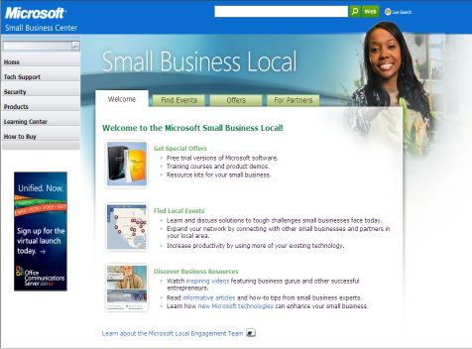
Take the Next Step
Go to www.mslocalbiz.com for complete information about Microsoft solutions for small businesses
Demo software
Download free trials

Slide 28
Insert Partner Logo
Insert Partner Logo
Insert Partner Logo
Insert Partner Logo

Slide 29
EXTRA SLIDES

Slide 30
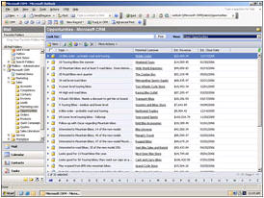
Microsoft Dynamics CRM Online
Get started fast. Dynamics CRM Online is a full-featured subscription CRM solution that you can get up and running quickly.
Maximize the value of your CRM solution. Optimize your campaigns and manage all your customer information online.
Enjoy simple and affordable pricing. Just $39 per user per month.
Smooth migration path. Easily migrate to the on-premise version as your business grows.
Notes:
Microsoft Dynamics CRM Online
Get started fast. Dynamics CRM Online is a full-featured subscription CRM solution. It’s the perfect choice for customers who want to get up and running quickly.
Leverage what you already know. Take advantage of rich CRM capabilities within a familiar Microsoft Office environment.
Maximize the value of your CRM solution. Optimize your marketing campaigns and promotions, gain new insights into your customers, and centrally manage all your customer information online. Flexible design and process automation make it easy.
Enjoy simple and affordable pricing. Just $39 per user per month.
Smooth migration path. You can start out with the Microsoft-hosted version and easily migrate to the on-premise version a your business grows.

Slide 31

Microsoft Dynamics CRM Online
Next steps
Get a free 30-day trial
www.mslocaloffers.com

Slide 32
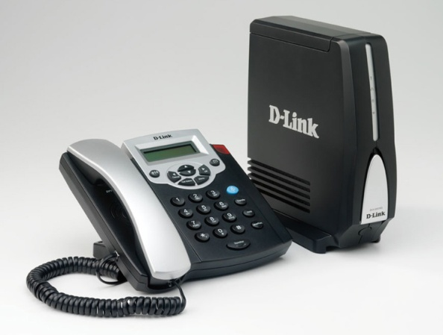
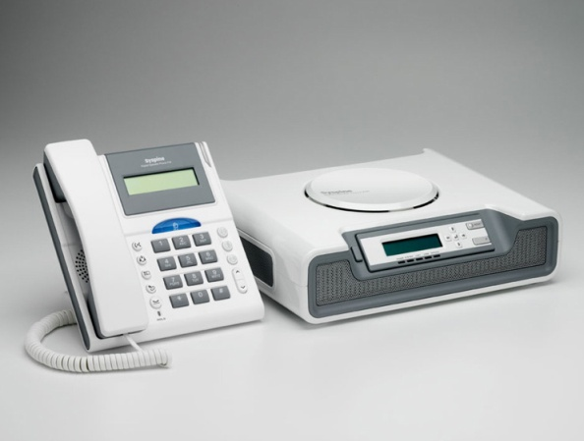
Microsoft Response Point
Fully integrate your phone system with your computer network. Have your voice mail delivered via email, and see Caller-ID on your screen.
Use your phone as a tool for customer satisfaction. Assign special phone numbers to your most important customers.
Create a local presence. Set up unique phone numbers in different locations, so you look local.
Enjoy complete flexibility. Includes a customizable voice attendant and automatic forwarding to your cell or
home phone.
Notes:
Microsoft Response Point
Fully integrate your phone system with your computer network. Have your voice mail delivered via email, and see notifications of incoming calls on your screen with Caller-ID.
Use your phone as a tool for customer satisfaction. You can assign a specific phone number to your most important customer. And it’s possible to see call history at a glance, including the number of times in and out. Importing contacts from Outlook and other solutions is easy, too.
Create a local presence. By having different phone numbers in different locations, you can look local.
Enjoy complete flexibility. Response Point comes with voice activation for FAQ, a customizable voice attendant and on-hold music, and automatic forwarding to your cell or home phone.

Slide 33

Microsoft Response Point
Next steps
Get a Microsoft Response Point phone system for as little as $12/month through Microsoft Financing
www.mslocaloffers.com

