Slide 1
Presentation Guidelines
You can and should customize this presentation to speak to your local business audience. Insert your information where there is currently red text and feel free to add or delete anything else as suits your needs.
Here are some suggestions:
Add your own products that are relevant to the customer issue you are discussing (Slide 26).
Add your own offers for your products or Microsoft products (Slide 27).
Update the next steps for each Microsoft product with the latest offers from www.mslocaloffers.com (Slides 17, 19, 21, 23).
Remove any Microsoft product slides that you do not want to feature (Slides 16-25).
This presentation is designed to be an interactive session between the speaker and attendees. Use the speaker notes to guide the discussion and encourage everyone to participate in sharing their experiences.

Slide 2
Keep your customer, your customer.
Presenter’s Name
Partner Name
Date
Insert Partner Logo
Insert Partner Logo
Insert Partner Logo
Insert Partner Logo
Notes:
They’re your customers today, right? Well, are you concerned about keeping those customers yours? If you’re not, the back door of your business is wide open…

Slide 3
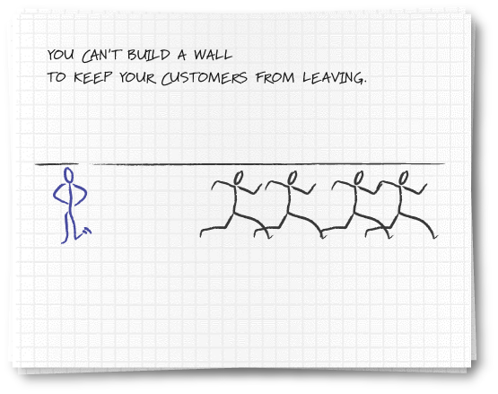
Notes:
You can’t build a wall to keep them against their will, can you? But you can understand what it takes to satisfy them, exceed their expectations, truly deliver surprisingly great service.

Slide 4
Welcome to your local team
Meet other small business people in your area
Share stories and insights
Find solutions to some of your biggest challenges
Tap into a local network full of resources
[List Presenters & Introduce them here]
Notes:
We’re holding these events so you can create new, interesting networks of people with very similar challenges. Consider this a forum to share ideas and insights. It is also a place to find answers to critical business problems, with the help of local assistance.

Slide 5









How the Local Engagement Team works
130,000+
Microsoft Partners
Local Business Community Organizations
Strategic Alliances
Microsoft Partners, complementary companies, and business community organizations are brought together at a local level to cater to customers’ needs.
Local Engagement Team Model

Slide 6
What challenges are you facing today?
Customers can leave at any time
The market is always changing, so customers are always being offered other opportunities
Limited time – do you spend time with existing customers or try to find new ones?
Notes:
What keeps you awake at night regarding keeping your customers? Many businesses tell us that customers can leave at any time, no matter what they do. That’s right, customers are offered all kinds of new options, but you have a better than fair shot at keeping your customers. Why? Because today, nobody has the opportunity to deliver them good service like you do. In your limited time, do you spend more time finding new customers or keeping existing customers? What’s keeping you awake at night?

Slide 7
It costs four to ten times as much to capture a new customer as it does to provide good service to an existing one.
Thompson Group Marketing
Walnut Creek, CA
Notes:
If you have one dollar to spend in marketing, spend it on keeping a customer happy. Spend it on making a second sale to an existing customer. If your customer makes more purchases from you, they will be less likely to leave. Loyalty doesn’t just happen; it comes with frequency of doing business.

Slide 8
Your customers can leave at any time
Show your customers why you’re the right choice
Keep in touch to continue to build a relationship with your customers
Set a predictable rhythm of communication
Leverage your brand presence throughout everything you do
Notes:
Retention isn’t automatic. Keep in touch with relevant communications. Nobody likes to be sent messages about products or services they don’t need. Junk and spam are two words connected to irrelevant communications. When communication is relevant based on your knowledge of the customer, the chance of a positive impact improves substantially.

Slide 9
In 2004, only three out of five customers (59%) were satisfied with the response they received when contacting a company for assistance.
Portland Research Group
Notes:
That means that potentially 2 out of every 5 customers you connect with will have an unsatisfactory experience. Do you really know how you measure up on this issue? Do any of you actually measure customer satisfaction?

Slide 10
The market is always changing, so customers are always being offered other opportunities
Keep your customers as satisfied as possible
Understand the customer’s history and be able to reference it quickly
Set and meet (or exceed) expectations
Leverage word-of-mouth advertising to drive new business
Notes:
Don’t waste your customer’s time - be able to immediately access their records. You should know more about your customer’s history than they do! Exceed their expectations with the speed and accuracy of your response. Above all, don’t be embarrassed to ask for a referral. If you need to, create cards that your customers can give their friends. What other ideas do you have to increase your customer’s satisfaction?

Slide 11
“Companies who used a search engine marketing site saw an average gain of 73% in site traffic within 6 months.”
MarketingSherpa
Notes:
Search marketing has become the most extraordinary marketing technique developed since the advent of television and zip codes! Show of hands: how many of you have used a search engine in the last 24 hours? Amazing, isn’t it?
Just 3 years ago, a third of the hands would have been raised. How many of you actually bought something from a company you didn’t know existed until your web search?

Slide 12
Limited time – do you spend time with existing customers or try to find new ones
Build customer loyalty
Deliver on time, every time
Go the last mile: Provide good post-sale support and communication
Set up a system to maintain contact automatically
Notes:
If you have to pick, spend more time with current customers. They are your best source of future business. Use a systematic way to communicate to them with relevant and timely messages.

Slide 13
Notes:
Of course, you can’t build a wall, but…

Slide 14
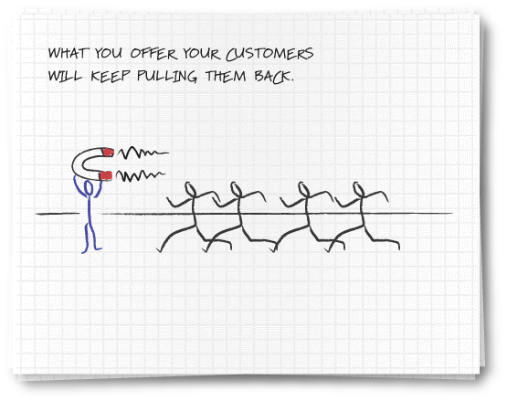
Notes:
You can secure a super charged magnet of focus, information, relevancy and response to make sure you keep your customers, your customers.

Slide 15
Keep your customer, your customer.
Microsoft Solutions

Slide 16
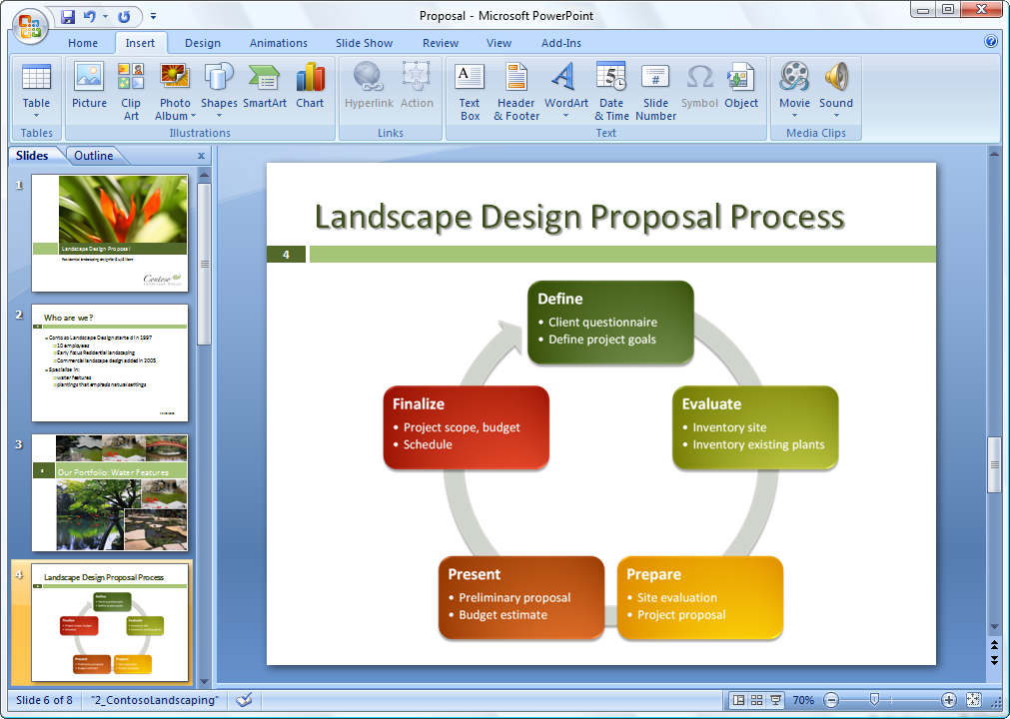
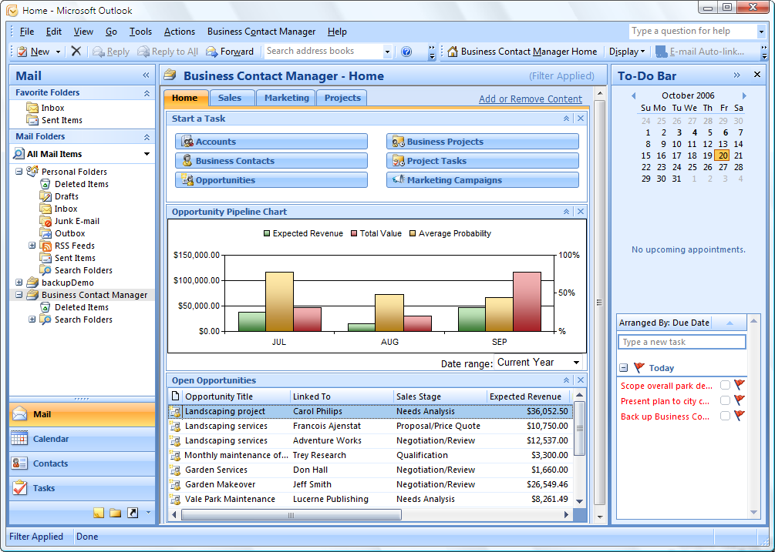


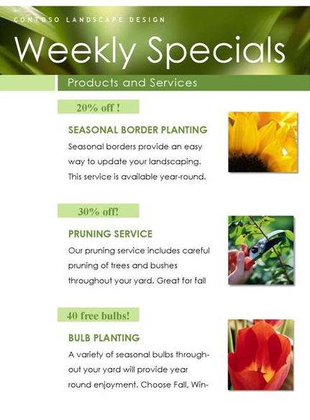
Microsoft Office Small Business 2007
Work more efficiently and effectively. New tools help you work faster and create more professional documents and presentations.
Get started with CRM capabilities. Microsoft Office Outlook with Business Contact Manager includes a complete contact management solution.
Produce professional marketing materials and campaigns in-house. Create impressive marketing materials and campaigns for print, e-mail, and the web.

Slide 17
Microsoft Office Small Business 2007
Next steps
Download a FREE 60-day trial
www.mslocaloffers.com

Slide 18
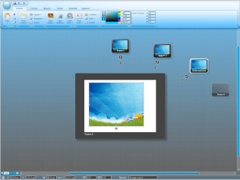
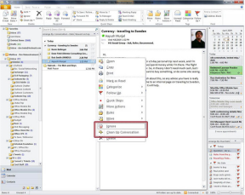
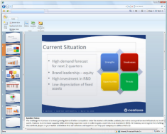

Microsoft Office Professional 2010
Coming soon in 2010!
Increase productivity. Make it easier for employees to find and use the software features they need most often.
Give your business a competitive advantage. Deliver proposals and reports to customers faster. Edit documents at the same time and see who else is working on which sections.
Save time and money. Effortlessly produce compelling presentations, proposals and reports yourself.
Notes:
Increase productivity. Make it easier for employees to find and use the software features they need most often.
Give your business a competitive advantage. Deliver proposals and reports to customers faster. Edit documents at the same time and see who else is working on which sections.
Save time and money. Effortlessly produce compelling presentations, proposals and reports yourself.

Slide 19
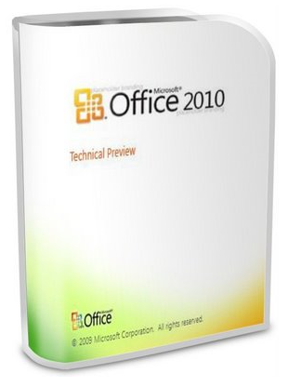
Microsoft Office Professional 2010
Next steps
Check www.mslocaloffers.com for current offers
www.mslocaloffers.com

Slide 20
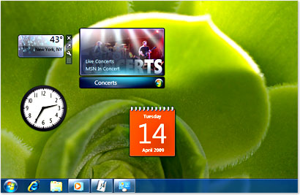

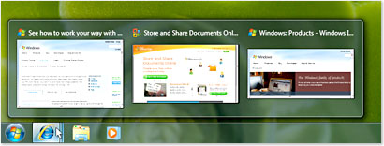
Windows 7 Professional
Works the way you want. You can start using your PC quickly with fast startup, shutdown, sleep, and resume from Standby.
Get more done. Access all your computer programs, files, and network resources. Whether at work, at home, or on the road, you can now easily connect to other networks or even other computers within your home.
Safeguard your work. Better protect your confidential information with powerful encryption technologies that let you encrypt your files and folders.
Notes:
Works the way you want. You can start using your PC quickly with fast startup, shutdown, sleep, and resume from Standby.
Get more done. Access all your computer programs, files, and network resources. Whether at work, at home, or on the road, you can now easily connect to other networks or even other computers within your home.
Safeguard your work. Better protect your confidential information with powerful encryption technologies that let you encrypt your files and folders

Slide 21
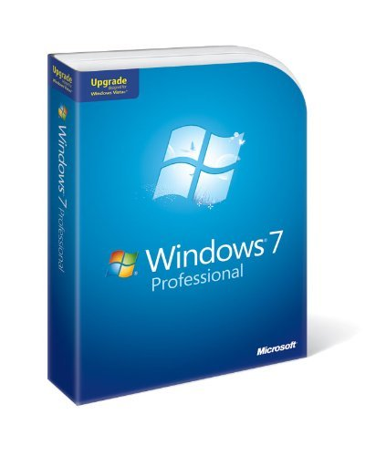
Windows 7 Professional
Next steps
Check www.mslocaloffers.com for current offers
www.mslocaloffers.com

Slide 22

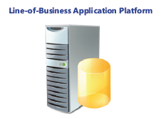
Windows Small Business Server 2008
Use an affordable, integrated solution. SBS 2008 brings together the Microsoft® technologies that small businesses need most into a single solution.
Protect your business data. Automatically back up the PCs and servers in your network and recover accidentally deleted files.
Grow your business capacity. Get secure access to important desktop resources from any Internet-connected PC, from virtually anywhere at any time, so you can be productive while you’re away from the office or on the road.
Notes:
Get remote access to the information you need from any PC. Just log on and you can access email, internal websites, network files and business applications.
Provide one central location to store and access business information. Help your employees easily find, use and share the information they need. Integrates with Windows Mobile-based devices, too.
Automatically back up your business information. Prevent data loss and enable your employees to easily retrieve accidentally deleted files and restore previous versions.
Cost-effectively share resources. Get the most value out of your printers, fax machines and phone lines.

Slide 23
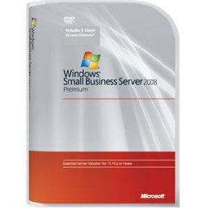
Windows Small Business Server 2008
Next steps
Download the demo
www.mslocaloffers.com

Slide 24
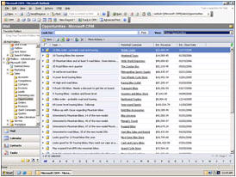
Microsoft Dynamics CRM Online
Get started fast. Dynamics CRM Online is a full-featured subscription CRM solution that you can get up and running quickly.
Maximize the value of your CRM solution. Optimize your campaigns and manage all your customer information online.
Enjoy simple and affordable pricing. Just $39 per user per month.
Smooth migration path. Easily migrate to the on-premise version as your business grows.
Notes:
Microsoft Dynamics CRM Online
Get started fast. Dynamics CRM Online is a full-featured subscription CRM solution. It’s the perfect choice for customers who want to get up and running quickly.
Leverage what you already know. Take advantage of rich CRM capabilities within a familiar Microsoft Office environment.
Maximize the value of your CRM solution. Optimize your marketing campaigns and promotions, gain new insights into your customers, and centrally manage all your customer information online. Flexible design and process automation make it easy.
Enjoy simple and affordable pricing. Just $39 per user per month.
Smooth migration path. You can start out with the Microsoft-hosted version and easily migrate to the on-premise version a your business grows.

Slide 25

Microsoft Dynamics CRM Online
Next steps
Get a free 30 day trial
www.mslocaloffers.com

Slide 26
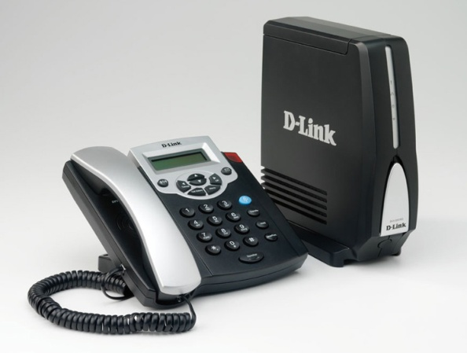
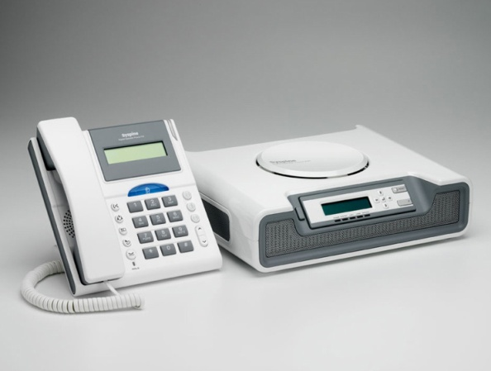
Microsoft Response Point
Fully integrate your phone system with your computer network. Have your voice mail delivered via email, and see Caller-ID on your screen.
Use your phone as a tool for customer satisfaction. Assign special phone numbers to your most important customers.
Create a local presence. Set up unique phone numbers in different locations, so you look local.
Enjoy complete flexibility. Includes a customizable voice attendant and automatic forwarding to your cell or home phone.
Notes:
Microsoft Response Point
Fully integrate your phone system with your computer network. Have your voice mail delivered via email, and see notifications of incoming calls on your screen with Caller-ID.
Use your phone as a tool for customer satisfaction. You can assign a specific phone number to your most important customer. And it’s possible to see call history at a glance, including the number of times in and out. Importing contacts from Outlook and other solutions is easy, too.
Create a local presence. By having different phone numbers in different locations, you can look local.
Enjoy complete flexibility. Response Point comes with voice activation for FAQ, a customizable voice attendant and on-hold music, and automatic forwarding to your cell or home phone.

Slide 27

Microsoft Response Point
Next steps
Get a Microsoft Response Point phone system for as little as $12/month through Microsoft Financing
www.mslocaloffers.com

Slide 28
Additional Products
[Partners – add your own products here, related to the customer issues you are addressing at this event]

Slide 29
Additional Offers
[Partners – add your own offers here, related to the products you are demonstrating during the event]

Slide 30
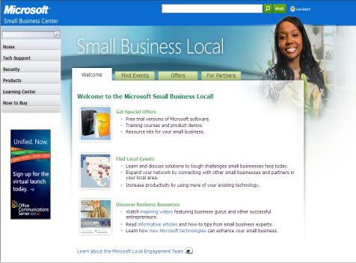
Take the Next Step
Go to www.mslocalbiz.com for complete information about Microsoft solutions for small businesses
Demo software
Download free trials

Slide 32

Insert Partner Logo
Insert Partner Logo
Insert Partner Logo
Insert Partner Logo

