Slide 1

Bridging enterprise and cloud
Régis Mauger
Infrastructure Architect
regisma@microsoft.com
Pierre Couzy
Technical Architect
piercou@microsoft.com

Slide 2
Agenda
Cloud computing is coming
Preparing the enterprise for the Cloud
Protocols : Windows Communication Foundation
Hosts : Dublin
What’s Dublin, and how do you manage Dublin
Security
How do we extend to the cloud ?
WCF endpoint projection
WF projection
Data and application projection
Identity, the next big challenge

Slide 3



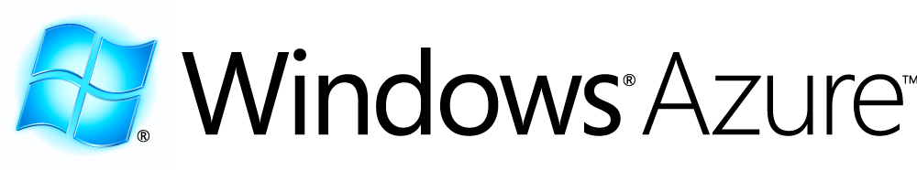
What’s exactly in Azure ?
…
Service Bus
Workflow
Database
Analytics
Identity
Contacts
Access Control
…
Reporting
…
Devices
…
Compute
Storage
Manage
…
...plus tooling & debugging locally.

Slide 4
Demo
Developing a Hello World Application
Visual Studio projects
Local Fabric deployment
Debugging
Publishing to the Cloud
Production / Staging environments.

Slide 5
What’s the impact of Cloud Computing on your infrastructure ?
What’s the scope of cloud computing today ?
Hosting (web/worker process)
Data - Storage (Azure Storage or Sql Services)
Data - Messaging (.Net Services)
Processus (.Net Services)
Identity and Access (.Net Services)
By the way, How would you analyze your SOA needs ? Here is our view :
The cloud structure mimics the enterprise organization.
Messaging
Identity and access
Your needs
Interaction
Processus
Data

Slide 6
Preparing the enterprise for the cloud
Your mission as an IT professional, is to ensure that your enterprise won’t go to the cloud without you !
You MUST understand some of
WCF (and WF to a lesser extent)
The application server role (Dublin)
Data stores and synchronization
Security concerns when you don’t have a trusted subsystem
Our mission at Microsoft is to ensure that you get the right tools to deploy and manage on both worlds.

Slide 7
What’s the « Lingua Franca » for Connected Systems ?
SOAP ?
REST ?
JSON ?
XML ? + XSD ?

Slide 8





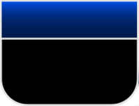

Too many technological stacks ?
ASMX
.NET Remoting
Interop
with other platforms
Extensible
Binary mode
Transaction
Performance
Message oriented
programming
WS-* stack
Enterprise Services
System.Messaging
WSE

Slide 9
Too many protocols?
Evolve and Extend
Secure, Reliable, Transacted
Fundamentals
WS-I formed
WS-I BP 1.0
As of 2/2004
Interopérabilité
Security Roadmap
SRT Web Services Whitepaper
Reliable Messaging Roadmap
Whitepapers
WS-Coordination
WS-Transaction
WS-AtomicTransaction
WS-BusinessActivity
Transactions
WS-ReliableMessaging
WS-Security
WS-Federation
WS-Federation Active Requestor Profile
Reliability
WS-Trust
Security
WS-Security Addendum
WS-Security Profile for
Tokens
WS-Security SOAP Message Security
WS-Security Username Token Profile
WS-Security X.509 Certificate Token Profile
WS-Security Kerberos Binding
UDDI 1.0
UDDI 2.0
UDDI 3.0
WS-Policy 1.1
WS-PolicyAttachments 1.1
WS-PolicyAssertions 1.1
WSDL
WS-Inspection
Metadata
WS-Policy
WS-PolicyAttachments
WS-PolicyAssertions
WS-SecurityPolicy
WS-Discovery
WS-MetadataExchange
SOAP 1.1
SOAP 1.2
WS-Referral
WS-Routing
WS-Addressing
Messaging
WS-Eventing
SOAP Messages
with Attachments
DIME
WS-Attachments
MTOM
2000
2001
2002
2003
2004
2005

Slide 10
Demo : WCF fundamentals

Slide 11
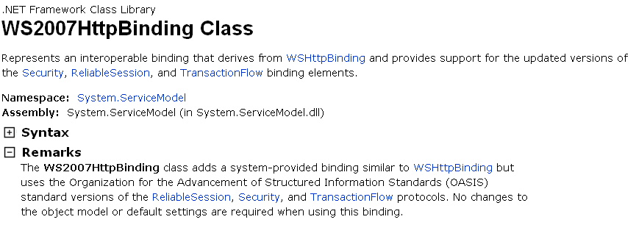
WCF : the basics
Achieve a balance between evolution and stability
Define contracts independently of implementation
Detail endpoint structure and behavior independently of the implementation
Basically, WCF is all about endpoints
Adress, Binding, contract
Do we need more ?

Slide 12
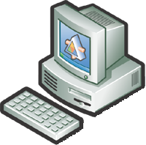


Composing an endpoint
Client
Service
A
B
C
C
B
A
A
B
C
A
B
C
Address
where?
« Binding »
How?
Contract
What?

Slide 13
Behaviors: Throttling in WCF
<?xml version=“1.0” encoding=“UTF-8” ?> <configuration> <system.serviceModel> <behaviors> <behavior configurationName=“NormalLoad” <throttling maxConcurrentCalls="10"
maxConnections="3"
maxInstances=“3"
maxPendingOperations=“100" />
</behavior> </behaviors> </system.serviceModel> </configuration

Slide 14
From behaviors to Host
A behavior is just a local implementation detail
We need a « behavior aware » environment
Transaction context
Identity flow
Correlation between messages
Queuing, error handling, resource allocation, etc.
Monitoring & standardized administration
Long running processes

Slide 15
Introducing Dublin
The building blocks are already there
IIS and WPAS provide the hosting platform
SQL Express can store running instances of workflows
The administration tooling has simple requirements :
Integration with MMC
Powershell commandlets
Web services interface
Monitoring abilities (performance/health/error)
Dublin is the name for those capabilities

Slide 16
Design goals for Dublin
“I want to get my WF and WCF services up and running easily - Why doesn’t it just work?”
“I want to easily monitor and control running WF and WCF services.”
“I really want better tooling and scripting.”
“I want built-in extensions for enterprise-readiness.” – RSP: Reliability, Scalability, Performance

Slide 17
Windows Application Server Extensions (Code name “Dublin”)
Visual Studio
Evolution of WPAS/IIS and Windows App Server role to run and manage WF and WCF services
Initial release is a web download
Ships soon after VS10
Windows Server
“Dublin”
Administration Tools
WF and WCF services
System Center
.NET Framework
IIS/WAS

Slide 18
Demo #1 The Dublin Pizza App
1. Submit
Order
Pizza Order Form
Pizza Order Service
Credit Card Service
2. Confirm
Order
3. Charge
Card

Slide 19
Windows, IIS, .NET 4.0 “Powerfull Application Server Technologie”
Windows/IIS/.NET 4.0
Visual Studio
IIS Manager
WF and WCF Project Templates
IIS/WAS
Hosting
Persistence
Monitoring
Messaging
System Center
WF and WCF Frameworks
Windows Application Server Role

Slide 20
Dublin “it just works!”
Dublin adds
Dublin enhances
Windows/IIS/.NET 4.0
Visual Studio
IIS Manager
WF and WCF Project Templates
WF and WCF Management
Modules
App Server SCOM Pack
Management APIs (PowerShell command-lets)
IIS/WAS
Hosting
Persistence
Monitoring
Messaging
Discovery & Control
Scale-out & Reliability
Application Monitoring
Versioning, Partitioning, Routing
System Center
WF and WCF Frameworks
Durable Timer Service
Discovery Service
SQL Persistence Provider
WF SQL Tracking Provider
WCF SQL Tracking Behaviors
Forwarding Service
Runtime Databases
Persistence schema
Monitoring schema
Windows Application Server Role

Slide 21
Demo #2 The Dublin Pizza App
Deployment 1:
PizzaOrderService
Pizza Client
NLB
Deployment 2:
PizzaOrderService

Slide 22
Demo #3 The Dublin Pizza App
Version 1:
PizzaOrderService
Pizza Client
NLB
Version 1:
PizzaOrderService
Version 2:
PizzaOrderService

Slide 23
Conclusion
For many years, IIS has been the major candidate for enhancements on the Connected Systems stack
Because it was the perfect candidate for Web Service hosting !
Now that Web Services are mature, new concerns emerge
Performance
Long running processes
Enterprise-wide management
Dublin is the new major step in our Application Server
You don’t have to choose between TCP and HTTP
You get the capabilities and the tools
The standardization you define is the right way to go to cloud.

Slide 24
Moving to the Cloud
Moving endpoints
Moving processus
Moving Data
Moving Apps
What about Identity ?

Slide 25
Moving Endpoints
WCF gets new bindings in .NET 4
The cloud counterparts of current bindings
Those bindings allow for 2 important patterns
Solving “Rendez-vous” issue
Enable Pub/Sub model in WCF
Corresponding WCF Binding | Service Bus Relay Binding
BasicHttpBinding | BasicHttpRelayBinding
WebHttpBinding | WebHttpRelayBinding
WSHttpBinding | WSHttpRelayBinding
WS2007HttpBinding | WS2007HttpRelayBinding
WSHttpContextBinding | WSHttpRelayContextBinding
WS2007HttpFederationBinding | WS2007HttpRelayFederationBinding
NetTcpBinding | NetTcpRelayBinding
NetTcpContextBinding | NetTcpRelayContextBinding
n/a [loosely related to NetMsmqBinding] | NetOnewayRelayBinding
n/a [loosely related to NetTcpPeerBinding] | NetEventRelayBinding

Slide 26
Demo
Moving an endpoint to the cloud
Define a relay binding on the server
Reuse the same binding on the client
Connectivity now flows through the cloud

Slide 27
Example : Tcp/Relayed binding
Service Bus
sb://servicebus.windows.net/services/solution/a/b/
Backend Naming
Routing Fabric
Oneway
Rendezvous Ctrl Msg
Frontend Nodes
Ctrl
NLB
2
3
TCP/SSL 818
Ctrl
1
outbound socket connect
outbound socket rendezvous
Socket-Socket Forwarder
Sender
Receiver
4

Slide 28
What about Dublin ?
In its current version (CTP 1 !), Dublin does not contain the cloud bindings
Expect to see them in an upcoming version

Slide 29
Moving a processus to the cloud
As of today, this is less of an issue
… because P2P integration is still the rule in enterprise deployments
Enterprise Service Bus is not the most frequent mediation pattern in the enterprise
Because of this, moving orchestrations to the cloud serves only a few scenarios
Availability
« firewalled messaging interface »
New collaboration scenarios B2B

Slide 30
Demo : ping application
Ping a server from the cloud
Use Powershell to deploy
Show the MMC Azure Console sample

Slide 31
Moving Data and Apps
Data
Easy as long as your protocols are the same on premise and in the cloud
Can work with hybrid data layer
Writes to your enterprise, read on the cloud
Apps
If you know how to move data, you’ll want apps on the cloud

Slide 32
Identity & Access Control
This is by far the hardest challenge you’ll face
Identity is taken for granted in the enterprise world, but ..
How many identities do you assume everyday ?
How do ensure that nobody can impersonate you ?
How can a web site trust what you say about yourself ?
Identity must rely on Claims
Assertions that someone makes about you
Those assertions flow between 3 actors
The subject (you, your app)
An Identity Provider (knows things about the subject)
A Relying Party (wants to know things about the subject)

Slide 33
Identity: Fundamental changes
Claims Provider
(Security Token Service)
Application
(requires Claims)
Relationship
1. Require claims
2. Get claims
3. Send claims
SUBJECT

Slide 34
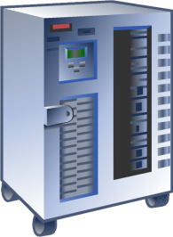



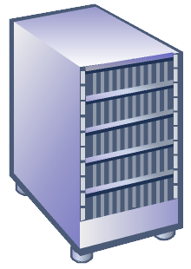


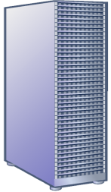



Adventure Works
Azure™ Services
LiveID
Access Control
Mesh
Service
Bus
Workflow
SQL Data
Contoso
SAP
AD
Litware
Cory
Sandy@hotmail.com
Geneva
Mail
ASP.NET
Fabrikam
Hosted at Rackspace
AD
Lane@Litware.com
Services
Connector
Francis

Slide 35
Demo
Using CardSpace to define access to a web site
Using the Relying Party Policies to enable Relying Parties

Slide 36
Identity
Explanation of the main concepts (meaning we have 3 actors instead of 2),demo along « using a 3rd party identity provider on a web app », and allowing a RP to access an IdP
and if time permits « using standard asp.net security stack against a 3rd party security provider »
Conclusion : the challenges of Federation & Geneva Roadmap

Slide 37
Conclusion & Call to action
The enterprise must prepare for S+S scenarios
Because they lower the total cost of ownership
Because they enable new business scenarios
As of many major changes in the past years,
Cloud computing will happen whether we want it or not
It will be driven by Business Requirements.
Prepare now for those changes
You’ll be able to guarantee SLA, Security & Maintenability
We’ll provide you with the tools
You have a major role to play, IF you accept it.

Slide 38


