Slide 2
Archiving & Retention in Exchange Server 2010
Chris Antonakis (chant@microsoft.com)
Messaging Premier Field Engineer
Microsoft South Africa

Slide 3







World Today: Where is your e-mail?
SharePoint
Outlook PSTs
Exchange Server
Webmail
Backups
Third Party Archive
Notes:
So how did we get to where we are today, as you can see data that generally originated or was stored in Exchange is bleeding off into all these other locations make it an administrative as well as compliance nightmare to look after. Back when Exchange first started out we had smaller low use mailboxes, where we did not store that much data and the sizes of messages was particularly small, but now as we have evolved emails and the storage of them is just getting larger and larger. So one of the first questions we asked when looking into this archiving problem was where in the world is your email today and what are the reasons it goes to those repositories? And we found it was in a number of places:
3rd party archive is usually deployed for two reasons that we have found:
Compliance, legally having to keep data for a period of time and mailbox quota management i.e. to reduce the size of the mailbox.

Slide 4

World Today: Email Repositories
Mailbox
Highly Available/Reliable
Rich Client Access
PSTs
Circumvent Quota
Highly Portable
Personal Archive
Circumvent Quota
Allow Org Control
Organization Archive
Keep all E-mail
Allow Org Control
Optimized for Search
Exchange DB
End User Access
Exchange
(MBs)
Outlook PSTs
(GBs)
Org Archive
(PBs)
Personal Archive
(TBs)
Backup
Backup
Replicated Backups
Replicated Backups
Tape/Disk Backups Common
Item Level Backups Common
Backups uncommon and hard
Users do manual backups
IT does unsupported backups
Replication Common
Backups Less Common
Replication Only Choice
Datasets Require Replication
Notes:
We did a survey of a number of customers and found that email data is usually stored in 4 different places:
So who uses backups as there archiving solution?

Slide 5
World Today: Pain Points
Mailbox | PSTs | Personal Archive | Org Archive
Poor End User Experience
Quotas painful Forwards to keep mail User burden of legal hold | Only available locally Search degraded Data Loss (>5GB PST) | OLK/OWA Integration No user search for data Issues with stubs | NA
Cost and Compliance Toolset for IT Pro/Records Mgr
SANs cost limits size Backup costs limit size High new mail inflow SLAs hard to achieve No org-wide mail search No guaranteed legal hold Info. Disclosure risk | No Discovery No Legal Hold Corruption caused loss No Backup/Recovery Manual Backups Backup to share | >Twice CAPEX/OPEX Delays Office upgrades Add-in perf. problems Backup costs limit size | No generic feature set >Twice CAPEX/OPEX
Notes:
Summarize – change this slide into less content

Slide 6
Exchange 2010: E-mail in Exchange
Archiving and Retention
SharePoint
Outlook PSTs
Exchange Server 2010
Webmail
Backups
Third Party Archive
Notes:
So the overall goal is to try and provide you with the capabilities that will allow you to keep your information within the mail store.
Exchange 2010 Archive builds features into Exchange that will allow IT Admins to bring e-mail back under their control while providing a consistent User experience
80% of customers have not deployed an email archive – email tracker
70% do not have an adequate email archive – Osterman

Slide 7
Exchange 2010: Preserve and Discover Archiving, Message Retention and Discovery
Personal Archive
Archive in Outlook/OWA
Move & Delete Policy
Move and Delete Policies in OLK/OWA
Hold Policy
Multi-Mailbox Search
CMDLet and Discovery GUI Support
Archive Mgmt with CMDLets and EMC
Folder/Item Level Policy
Edited/Deleted items preserved
Single Item Restore
Role-based Access
Preserve
Discover
Prove
Notes:
The notion is you will have a PST like experience

Slide 8
Preserve: Archiving
User and IT Pro Experience

Slide 9
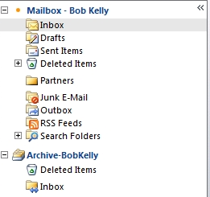
Preserve: Personal Archive
Better PST and Mailbox management
An alternate mailbox configured by the administrator
Appears alongside a user’s primary mailbox in Outlook or Outlook Web Access.
PSTs can be dragged and dropped to the Personal Archive
Mail in primary mailbox can be moved automatically using Retention Policies
Archive quota can be set separately from primary mailbox
No stubs!
No requirement to backup the archive.
Notes:
Objective: Summarize Personal Archive as a simple way to better manage PSTs and mailbox quota.
Exchange will provide a new archive mailbox type which can be automatically provisioned for a user when archiving is enabled. This mailbox will be accessed through Outlook just like a delegate mailbox. This means the mailbox will only be available when Outlook is online with the Exchange server or through OWA. However, since the archive is stored on the server, it will be accessible from anywhere you have internet access.
Mail can be moved automatically to Personal Archive through Retention Policies
In this way, the archive works much like auto-archive in Outlook to help users manage quota; difference, of course, is that mail remains centralized on the server for compliance purposes.
Quota notes:
Administrators have option to set separate archive quota
Archive quota does not count against mailbox quota
Out of the box archive quota is set at 10GB; archives over 10GB trigger an alert email to admin

Slide 10
Preserve: Archive and the User
User Goals and Assumptions
Preserve or improve PST experience for the User
Preserve or improve workflow for the User irrespective of regulatory or storage constraints.
Users will only have one Archive in E2010
Archive is Online Only
Mail Folders automatically moved to archive by default
Delete Policies are Global (they travel with messages as they move to Archive)
Explicitly Set Policies evaluated on longest wins basis
Notes:
Key Points:
These frame our story – they are the tenants we constantly refer back to when making decisions around User archiving
Some of these may be controversial
3) Key points specific bullets:
1) PST: Since late in the cycle did not try to improve on PST Experience, but provide similar, well-understood functionality
2) 1 Archive: They may be able to open additional Archives, but a user only “owns” one archive (1:1 mapping between mbx and archive)
3) Global Delete Policies: This is important so the user can know exactly when a message expires – it doesn’t magically change underneath them just because it is moved to the archive.

Slide 11
Preserve: Archive and the User
Scenarios
  Copy/Move Items to/from the Archive
  View Items and Folders in the Archive
  Reply to Items in Archive
  Search mail in the Archive
  Delete Items from the Archive
  Categorize/Flag items in Archive

Slide 12
Setting up the Archive
demo

Slide 13
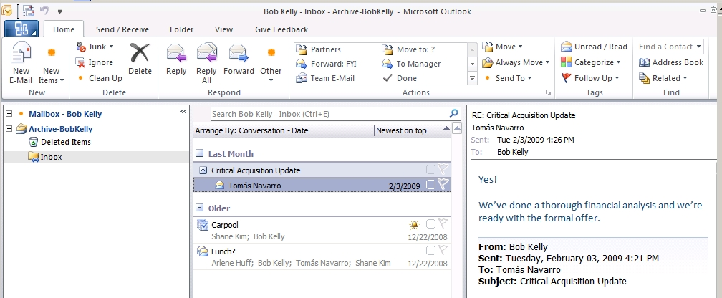
Preserve: Archive and the User
Read, Reply, Navigate
Folder hierarchy from primary mailbox maintained
User can view, read, navigate, flag and reply to archived mail same as live mail
Reply to message in archive puts message in live mail sent items (same as PSTs)
User gets conversation view scoped to Archive (same as PSTs)
Notes:
Objective: Demonstrate the familiar experience within the Personal Archive (vis-à-vis the primary mailbox and PST folder).
The user will have a very similar experience with their archive as they do with their primary mailbox (when online) or a delegate mailbox. The user can access folders using the Navigation Pane as well as create, modify and delete folders as normal. The top level default folders (Inbox, Calendar, Notes, Tasks, Journal, etc) will be ACLed so they do no show up in the view.
Automatically archived items will be moved in the corresponding folder under the user’s archive mailbox. Hierarchy will be maintained – if the folder does not exist, it will be created. For example, if an item from the inbox is automatically (by MRM) moved from the primary mailbox into the archive mailbox and there is no “Inbox” folder in the archive mailbox, one will be created an the item will be moved into. The same behavior will work for any folder and the hierarchy will be preserved.
Note:
Resulting behavior for certain actions slightly different for items in the Archive
Delete - Items deleted from the archive are put in Archive’s Deleted Items.
Reply - Replies to items in the archive are put in the primary sent items folder
Flag – Reminders are not fired for items in archive

Slide 14
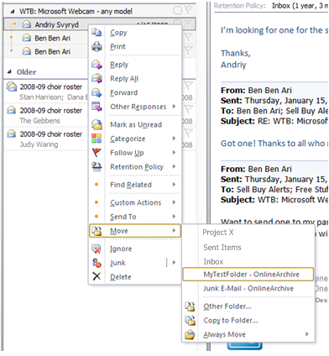
Preserve: Archive and the User
Move Mail
Move menu has latest used folders, including archive folders.
Move menu has latest used folders, including archive folders.
Notes:
Objective: Highlight ability to search both archive and primary mail at once.

Slide 15
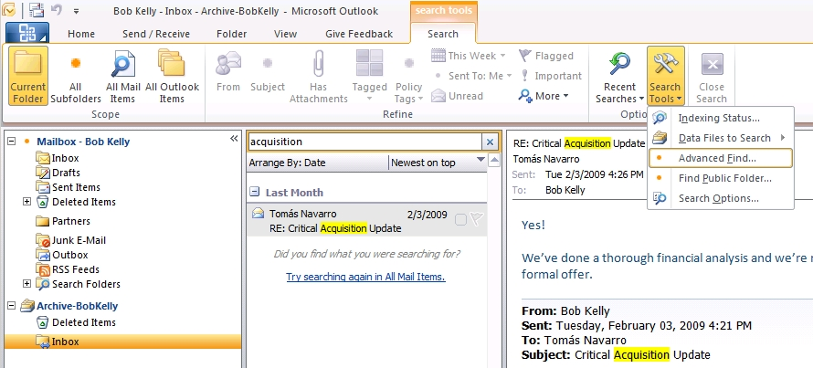
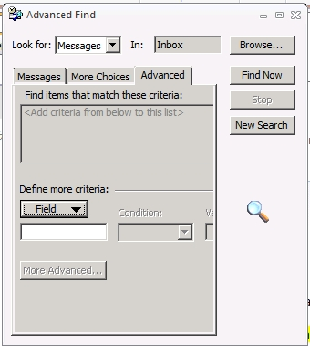
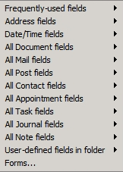
Preserve: Archive and the User
Search
Option to search archive only or both live and archived mail
Advanced search options work across live and archived mail
Notes:
Objective: Highlight ability to search both archive and primary mail at once.
All Mail Items search will span archive/live mail
Ability to up-scope search across live mail and archive
Choosing to search in All Mail Items will include the Archive, even if you are viewing your primary mailbox

Slide 16
Preserve: Archive and the IT Pro
IT Pro Goals and Assumptions
Preserve mailbox management experience across primary and archive for the IT Pro.
Archive is associated with a primary mailbox.
Archive and primary share the same user account.
IT-Pro can provision only one archive per user.
Outlook and OWA should work against the archive exactly the same as the primary.
Notes:
We already have the management experience for managing current mailboxes and we can now use this with the archive as well.

Slide 17
Preserve: Archive and the IT Pro
Scenarios
Add the archive to a user
  New: Create an archive mailbox for a new user
  Enable: Enable an archive mailbox for an existing user
  Connect: Connect an existing archive to a user
Remove the archive from a user
  Disable: Disconnect the archive for a user
  Remove: Remove the archive mailbox from a user
View and Manage the Archive
  Get: View archive properties (e.g. quota) for a user
  Get: View archive statistics (for e.g. size) for a user
  Get: Enumerate all archives in a DB or an org
  Set: Set archive properties (e.g. quota) for a user
  Set: Legal Hold
Migrate the Archive and the Primary Mailbox
  Move: Migrate the archive and primary mailbox

Slide 18
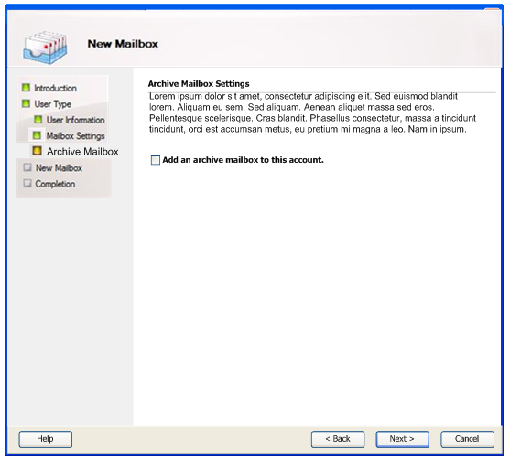
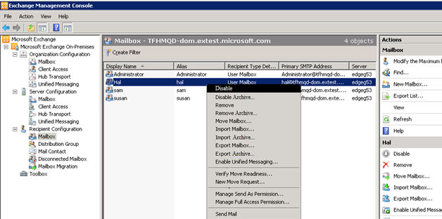
New-Enable-Connect Archive GUI
Adding the archive requires a simple checkbox in the new-mailbox wizard
Archive can be disabled together or separate from the mailbox
Archive auto-discover requires no Outlook restart to activate archive

Slide 19
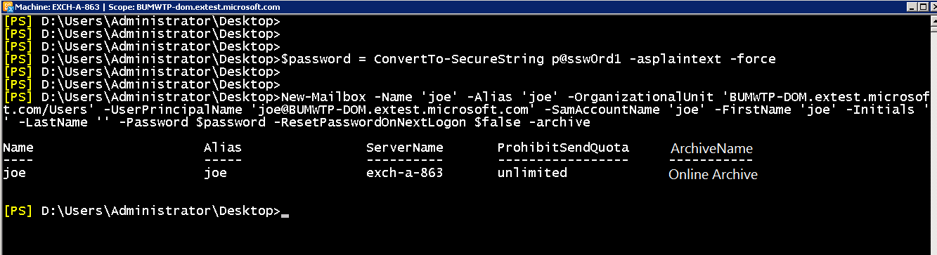
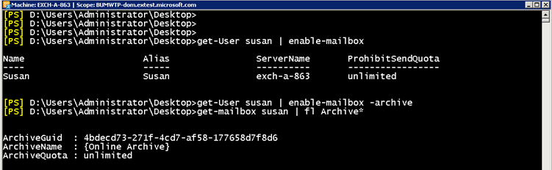
New-Enable-Connect Archive CMDLet
Adding the archive requires passing in a single new parameter
Enabling the archive for an existing mailbox enabled user

Slide 20
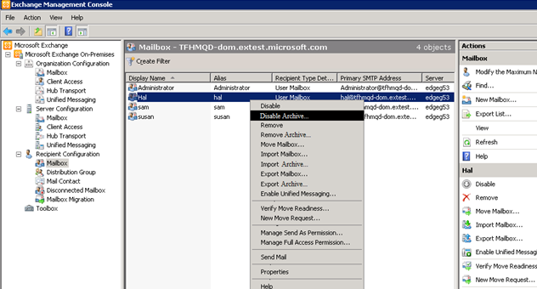
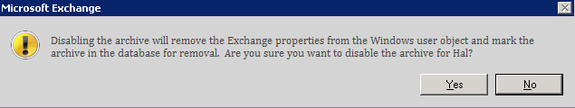
Remove-Disable Archive GUI
Disconnect the primary and archive
Disconnect the archive

Slide 21
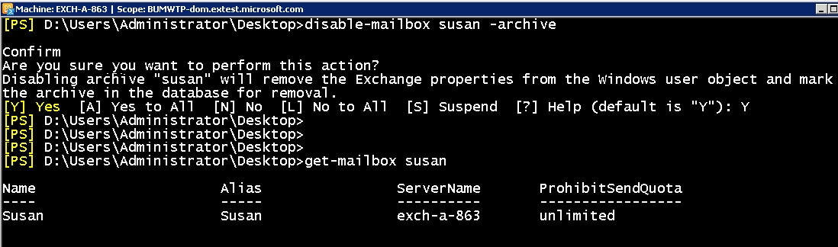
Remove-Disable Archive CMDLet
Only the Archive can be disabled; Warning modified

Slide 22
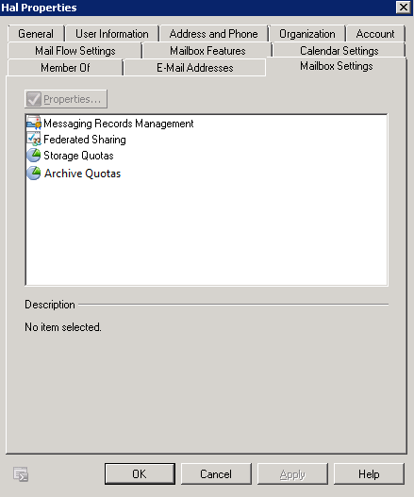
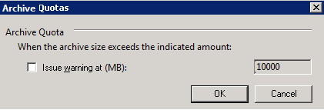
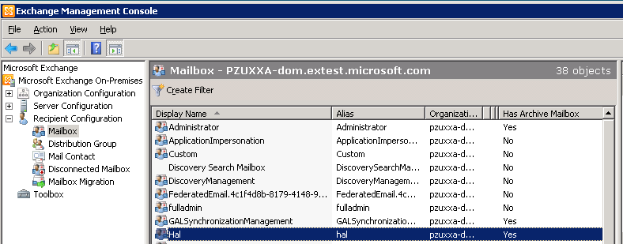
Get-Set Archive GUI
Select archive quota to change default settings
The default quota warning for the Archive is 10 GB
Click on Archive enabled user to change properties like Archive name

Slide 23
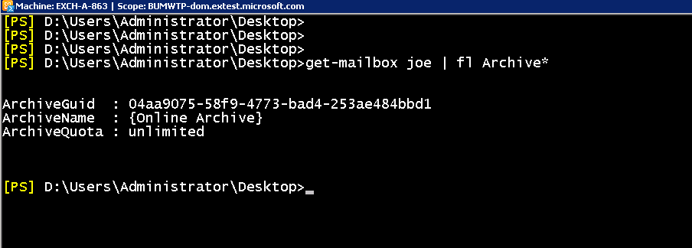
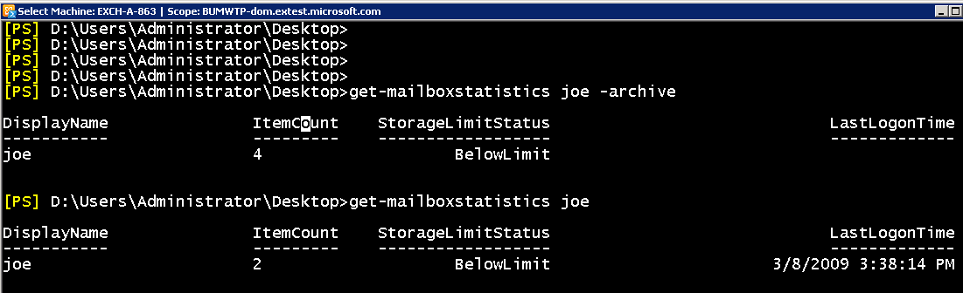
Get-Set Archive CMDLet
Archive properties are returned with mailbox properties
Get statistics for the Archive

Slide 24
Get-MailboxStatistics Cmdlet Execution
Statistics for only the Archive

Slide 25
E2010 AD Schema for Archive
Archive is an extension of the mailbox.
Properties to enable the Archive:
Archive GUID
Archive Name
Archive Database
Archive Quota
User Object in AD
Exchange User Properties
Legacy-Exchange-DN
ms-Exch-ADC-Global-Names
ms-Exch-AL-Object-Version
ms-Exch-Configuration-Unit-BL
ms-Exch-CU
ms-Exch-Dirsync-ID
ms-Exch-Edge-Sync-Cookies
ms-Exch-Edge-Sync-Source-Guid
ms-Exch-Heuristics
ms-Exch-Hide-From-Address-Lists
ms-Exch-Inconsistent-State
ms-Exch-OU-Root
ms-Exch-Provisioning-Flags
ms-Exch-Recipient-Validator-Cookies
ms-Exch-Replicated-Object-Version
ms-Exch-Replication-Signature
ms-Exch-Server-Association-BL
ms-Exch-Server-Association-Link
ms-Exch-Setup-Status
ms-Exch-Unmerged-Atts
ms-Exch-Unmerged-Atts-Pt
ms-Exch-Version
Show-In-Address-Book
ms-Exch-Archive-Name
ms-Exch-Archive-Warn-Quota
ms-Exch-Archive-Quota
ms-Exch-Archive-GUID
ms-Exch-Archive-Database-Link
ms-Exch-Archive-Database-BL
ms-Exch-Availability-Org-Wide-Account-BL
ms-Exch-Availability-Per-User-Account-BL
ms-Exch-Delegate-List-BL
ms-Exch-Device-Access-Control-Rule-BL
ms-Exch-Mailbox-Move-Source-MDB-BL
ms-Exch-Mailbox-Move-Target-MDB-BL
ms-Exch-Mobile-Remote-Documents-Allowed-Servers-BL
ms-Exch-Mobile-Remote-Documents-Blocked-Servers-BL
ms-Exch-Mobile-Remote-Documents-Internal-Domain-Suffix-List-BL
ms-Exch-Organizations-Address-Book-Roots-BL
ms-Exch-Organizations-Global-Address-Lists-BL
ms-Exch-Organizations-Template-Roots-BL
ms-Exch-OWA-Allowed-File-Types-BL
ms-Exch-OWA-Allowed-Mime-Types-BL
ms-Exch-OWA-Blocked-File-Types-BL
ms-Exch-OWA-Blocked-MIME-Types-BL
ms-Exch-OWA-Force-Save-File-Types-BL
ms-Exch-OWA-Force-Save-MIME-Types-BL
ms-Exch-OWA-Remote-Documents-Allowed-Servers-BL
ms-Exch-OWA-Remote-Documents-Blocked-Servers-BL
ms-Exch-OWA-Remote-Documents-Internal-Domain-Suffix-List-BL
ms-Exch-OWA-Transcoding-File-Types-BL
ms-Exch-OWA-Transcoding-Mime-Types-BL
ms-Exch-Parent-Plan-BL
ms-Exch-RBAC-Policy-BL
ms-Exch-RMS-Computer-Accounts-BL
ms-Exch-Server-Association-BL
ms-Exch-Server-Site-BL
ms-Exch-SMTP-Receive-Default-Accepted-Domain-BL
ms-Exch-Supervision-DL-BL
ms-Exch-Supervision-One-Off-BL
ms-Exch-Supervision-User-BL
ms-Exch-User-BL
ms-Exch-X500-Access-Control-List
ms-Exch-Availability-Org-Wide-Account-BL
ms-Exch-Availability-Per-User-Account-BL
ms-Exch-Delegate-List-BL
ms-Exch-Device-Access-Control-Rule-BL
ms-Exch-Mailbox-Move-Source-MDB-BL
ms-Exch-Mailbox-Move-Target-MDB-BL
ms-Exch-Mobile-Remote-Documents-Allowed-Servers-BL
ms-Exch-Mobile-Remote-Documents-Blocked-Servers-BL
ms-Exch-Mobile-Remote-Documents-Internal-Domain-Suffix-List-BL
ms-Exch-Organizations-Address-Book-Roots-BL
ms-Exch-Organizations-Global-Address-Lists-BL
ms-Exch-Organizations-Template-Roots-BL
ms-Exch-OWA-Allowed-File-Types-BL
ms-Exch-OWA-Allowed-Mime-Types-BL
ms-Exch-OWA-Blocked-File-Types-BL
ms-Exch-OWA-Blocked-MIME-Types-BL
ms-Exch-OWA-Force-Save-File-Types-BL
ms-Exch-OWA-Force-Save-MIME-Types-BL
ms-Exch-OWA-Remote-Documents-Allowed-Servers-BL
ms-Exch-OWA-Remote-Documents-Blocked-Servers-BL
ms-Exch-OWA-Remote-Documents-Internal-Domain-Suffix-List-BL
ms-Exch-OWA-Transcoding-File-Types-BL
ms-Exch-OWA-Transcoding-Mime-Types-BL
ms-Exch-Parent-Plan-BL
ms-Exch-RBAC-Policy-BL
ms-Exch-RMS-Computer-Accounts-BL
ms-Exch-Server-Association-BL
ms-Exch-Server-Site-BL
ms-Exch-SMTP-Receive-Default-Accepted-Domain-BL
ms-Exch-Supervision-DL-BL
ms-Exch-Supervision-One-Off-BL
ms-Exch-Supervision-User-BL
ms-Exch-User-BL
ms-Exch-X500-Access-Control-List
Garbage-Coll-Period
ms-Exch-Alternate-Mailboxes
ms-Exch-Approval-Application-Link
ms-Exch-Archive-Database-Link
ms-Exch-AutoReply
ms-Exch-Delegate-List-Link
ms-Exch-Deleted-Item-Flags
ms-Exch-Dumpster-Quota
ms-Exch-Dumpster-Warning-Quota
ms-Exch-ELC-Expiry-Suspension-End
ms-Exch-ELC-Expiry-Suspension-Start
ms-Exch-ELC-Mailbox-Flags
ms-Exch-External-OOF-Options
ms-Exch-Home-MDB
ms-Exch-Home-Server-Name
ms-Exch-Mailbox-Guid
ms-Exch-Mailbox-Move-Flags
ms-Exch-Mailbox-Move-Remote-Host-Name
ms-Exch-Mailbox-Move-Status
ms-Exch-Mailbox-Move-Target-MDB-Link
ms-Exch-Mailbox-OAB-Virtual-Directories-Link
ms-Exch-Mailbox-Template-Link
ms-Exch-Mailbox-Url
ms-Exch-Max-Blocked-Senders
ms-Exch-Max-Safe-Senders
ms-Exch-MDB-Over-Hard-Quota-Limit
ms-Exch-MDB-Over-Quota-Limit
ms-Exch-MDB-Rules-Quota
ms-Exch-MDB-Storage-Quota
ms-Exch-MDB-Use-Defaults
ms-Exch-Mobile-Allowed-Device-IDs
ms-Exch-Mobile-Blocked-Device-IDs
ms-Exch-Mobile-Debug-Logging
ms-Exch-Mobile-Mailbox-Flags
ms-Exch-Mobile-Mailbox-Policy-Link
ms-Exch-Pf-Root-Url
ms-Exch-Previous-Home-MDB
ms-Exch-UM-Addresses
ms-Exch-UM-Audio-Codec
ms-Exch-UM-Audio-Codec-2
ms-Exch-UM-Enabled-Flags
ms-Exch-UM-Enabled-Flags-2
ms-Exch-UM-Fax-Id
ms-Exch-UM-Mailbox-OVA-Language
ms-Exch-UM-Max-Greeting-Duration
ms-Exch-UM-Operator-Number
ms-Exch-UM-Phone-Provider
ms-Exch-UM-Pin-Checksum
ms-Exch-UM-Server-Writable-Flags
ms-Exch-UM-Template-Link
ms-Exch-Use-OAB
Notes:
The logical model for the archive has only 4 properties in AD.
AD user object contains all mailbox attributes.
Exchange DB contains physical mailboxes
Archive implemented as:
Four additional attributes on existing AD user object.
Additional mailbox on Exchange DB.

Slide 26
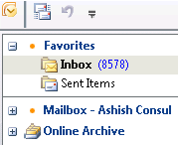
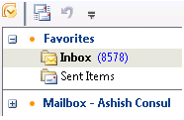
E14 Archive Auto-discover
(4) OLK connects to the Archive
(3) OLK receives Archive props in Auto- Discover response
(1) OLK does Auto-
Discovery
No Outlook Restart!
AD
CAS
User Object
Mailbox Props
Archive Props
MRM Props
(2) Auto-Discover reads Archive props

Slide 27
Migrate Primary and Archive
Move in Pairs
(6) Outlook connects to target CAS server
CAS for Target DB
(5) Auto-Discover finds new database
AD
(4) OLK does Auto
Discovery
User Object
Mailbox Props
Archive Props
CAS for Source DB
Move Request Service
(3) MRS updates AD with new target database
MRS starts
move request
E2010 Source DB
(2) MRS moves data to target
E2010 Target DB
Primary Mailbox
Archive Mailbox
Primary Mailbox
Archive Mailbox

Slide 28
Migrate Primary and Archive:
Load Balance from E2010 to E2010
Scenario | Move user , primary and archive from E2010 DB1 to E2010 DB2
Input | New-MoveRequest Hal –Targetdatabase DB2
Output | Command Prompt
Scenario | Move primary and archive for a group of users to E2010 DB2
Input | Get-Mailbox -Filter { Department –eq Sales } | New-MoveRequest –Targetdatabase DB2
Output | Command Prompt
Scenario | Move primary and archive from DB1 to DB2 (Decommission DB)
Input | Get-Mailbox –Database db1 | New-MoveRequest –targetdatabase DB2
Output | Command prompt
Notes:
UI and Wizards for the move-request cmdlets
Cross-forest moves

Slide 29
Move and Delete Policy
Preserve: Message Retention

Slide 30
Preserve: Message Retention
Archive Policy: Automatically moves messages to the archive
  User Impact: Helps keep mailbox under quota
  Works like Outlook Auto-Archive – without PSTs!
Delete Policy: Automatically Deletes Messages
  User Impact: Removes unwanted items
  Helps keep mailbox under quota
  Delete policies are Global (they travel to the Archive)
  Longer policies take priority over shorter policies
Hold Policy: Automatically preserves a message for recovery
  User Impact: None
Notes:
Key Points:
Archive Policy populates the archive automatically.
Delete Policy allows the user to comply with company directives. Positive + Negative User effects.
Hold Policy useful for legal hold or to recover deleted items without backups – NOT User so we won’t cover here.
Objective: Describe advantages of new Retention Policies over Exchange 2007 Managed Folders.
Retention polices in Exchange 2010 build on Exchange 2007 Managed Folders in a number of ways:
Policies – not folders - are configured by administrators and pushed out to users. This enables administrators to set retention polices without interfering with a user’s a folder hierarchy (as was the case with Managed Folders)
Policies can be applied them to BOTH items and folders.
Two types of Message Retention polices for users:
Archive Policy – Automatically move the data from the primary to the archive when its older than x days
(not show here, available at RTM)
Delete Policy – Automatically delete data when its older than x days
Both can be applied to the same item/folder, e.g. move to archive in x days and delete after y days
4) Expiration date is labeled on message.
5) An longer duration policy overrides a shorter policy, i.e. if an email with a 3-year policy is placed into a folder with a 5-year policy, the 5-year policy applies.

Slide 31
Preserve: Archive and Delete Policy
Scenarios
Out of Box Experience (Archive Policy Only)
  Options: 6 months, 1 year, 2 years (default), 5 years, Never
  Apply explicit Archive Policy on Folder or Item
Archive Policy + Delete Policies
  Apply explicit Archive Policy on Folder or Item
Migrating from Managed Folders

Slide 32
Message Retention: Move/Delete Policy
demo

Slide 33
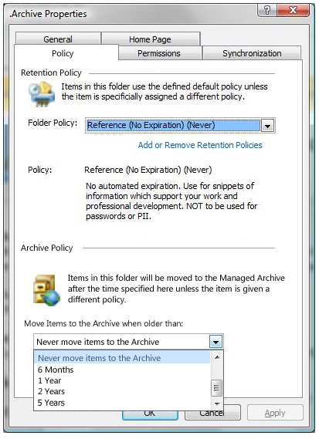
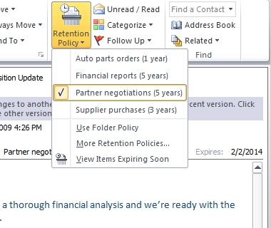
Preserve: Message Retention
Archive and Delete Policies
Policies can be applied directly within an email
Policies can be applied to all email within a folder
Delete
policies
Archive policies
Expiration date stamped directly
on e-mail

Slide 34
Preserve: Archive Policy
Initial message flow
Message delivered default Policy applied
Mailbox
Online Archive
1-2 yrs of E-mail
Size 2-10GB
Online and Offline
Message moved by Default Policy after 2 Years
2-10 yrs of E-mail
Size 10-30GB
Online Only
Inbox
Inbox
…
…
Deleted Items
Deleted Items
Notes:
Key Points:
1) All mail comes in and all mail is automatically moved to the archive in 2 years (unless it was emptied from deleted items before then)

Slide 35
Preserve: Archive Policy
Set Archive Policy on a folder
Message moved to Project X folder
Mailbox
Online Archive
1-2 yrs of E-mail
Size 2-10GB
Online and Offline
Message moved by Default Policy after 2 Years
2-10 yrs of E-mail
Size 10-30GB
Online Only
Inbox
Inbox
…
Message moved by Explicit Policy after 5 Years
…
Project X
Project X
Deleted Items
Deleted Items
Message moved by Default Policy after 2 Years
I’m a filer, keeping all items about the X project in my “Project X” folder.
I want to keep items about X in my mailbox for 5 years so that I have offline access to them.
Notes:
Key Points:
1) The Only thing that changed from the initial message flow is that items in the Project X folder are no longer moving after 2 years, but instead are moving after 5 years as explicitly set by the User

Slide 36
Preserve: Archive Policy
Set Archive Policy on a item
Message delivered and explicit Policy applied
Mailbox
Online Archive
1-2 yrs of E-mail
Size 2-10GB
Online and Offline
Message moved by Default Policy after 2 Years
2-10 yrs of E-mail
Size 10-30GB
Online Only
Inbox
Inbox
Contract
Message moved by Explicit Policy after 5 Years
Contract
…
…
Deleted Items
Message moved by Default Policy after 2 Years
Deleted Items
I’m a piler, keeping all items in my inbox.
I want to keep a specific mail about an important contract in my mailbox for 5 years so I have offline access to it.
Notes:
Key Points:
1) The Only thing that changed from the initial message flow is the “Contract” item in inbox is no longer moved after 2 years, but instead are moved after 5 years as explicitly set by the User

Slide 37
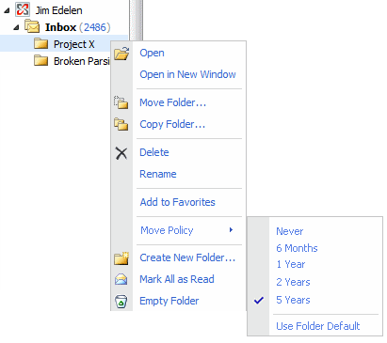
Set Explicit Archive Policy on a Folder
No Delete Policy
Outlook OWA
User selects 5 Years from set of Policies
User selects 5 Years from set of Policies
Notes:
Key Points:
In Outlook: User will right click folder and open the properties dialog to set the policy.
In OWA: User will right click folder and

Slide 38
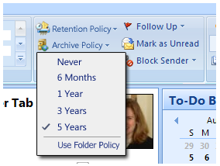
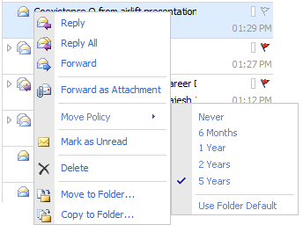
Set Archive Policy on an Item
No Delete Policy
Outlook OWA
User selects 5 Years from set of Policies
User selects 5 Years from set of Policies

Slide 39
Preserve: Move + Delete Policies
Initial message flow
Message delivered default Policy applied
Mailbox
Online Archive
1-2 yrs of E-mail
Size 2-10GB
Online and Offline
2-10 yrs of E-mail
Size 10-30GB
Online Only
Message moved
by Default Policy after 2 Years
Inbox
Inbox
…
…
Deleted Items
Deleted Items
Notes:
Key Points:
All mail comes in and all mail is automatically moved to the archive in 2 years (unless it was emptied from deleted items before then)
This is the same as before because this is the Out of the Box experience.

Slide 40
Preserve: Move + Delete Policy
After delete policy deployed
Message delivered default Policies applied
Mailbox
Online Archive
1-2 yrs of E-mail
Size 2-10GB
Online and Offline
2-10 yrs of E-mail
Size 10-30GB
Online Only
Message moved
by Default Policy after 2 Years
Inbox
Inbox
…
…
Message deleted by Default Policy after 5 Years
Deleted Items
Deleted Items
Dumpster 2.0
Dumpster 2.0
Recoverable Items
Recoverable Items
Notes:
Key Points:
All mail comes in and all mail is automatically moved to the archive in 2 years (unless it was emptied from deleted items before then)
Items are deleted after 5 years.

Slide 41
Preserve: Move + Delete Policies
On a folder
Message moved to the Project X folder
Mailbox
Online Archive
1-2 yrs of E-mail
Size 2-10GB
Online and Offline
2-10 yrs of E-mail
Size 10-30GB
Online Only
Message moved
by Default Policy after 2 Years
Inbox
Inbox
Message deleted by Default Policy in 5 Years
…
…
Deleted Items
Deleted Items
Project X
Project X
Message moved by Explicit Policy after 5 Years
Message deleted by Explicit Policy in 10 Years
Dumpster 2.0
Dumpster 2.0
Recoverable Items
Recoverable Items
Scenario:
I want to keep items about X in my mailbox for 5 years so that I have offline access to them.
I want to keep items about X for 10 years before they are deleted because they are critical research documents.
Notes:
Key Points:
Items in project X moved in 5 years rather than 2 years
Items in project X deleted after 10 years rather than 5

Slide 42
Preserve: Move + Delete Policies
On an Item
Message delivered and explicit Policies applied
Mailbox
Mailbox
Online Archive
Online Archive
1-2 yrs of E-mail
Size 2-10GB
Online and Offline
2-10 yrs of E-mail
Size 10-30GB
Online Only
Message moved
by Default Policy after 2 Years
*
Inbox
Inbox
Contract
Contract
Message deleted by Default Policy in 5 Years
Message moved by Explicit Policy after 5 Years
Message deleted by Explicit Policy in 10 Years
…
…
*
Deleted Items
Message moved by Default Policy after 2 Years
Deleted Items
Dumpster 2.0
Dumpster 2.0
Recoverable Items
Recoverable Items
Scenario:
I want to keep a specific mail about an important contract in my mailbox for 5 years so I have offline access . I want to keep that same specific mail from being deleted for 10 years because it is important to the business
Notes:
Key Points:
The Only thing that changed from the initial message flow is the “Contract” item in inbox is no longer moved after 2 years, but instead are moved after 5 years as explicitly set by the User and it is no longer deleted in 5 years, but rather 10 years
The * essentially means that the other folders are also deleted in 5 years, but the lines did not go nicely

Slide 43
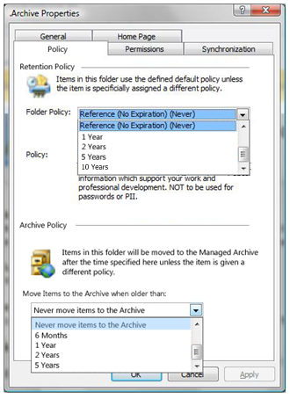
Set Archive Policy on a Folder
With Delete Policy
Outlook OWA
OWA does not have Delete Policies in R4
User selects 10 Years fro m set of Delete Policies
User selects 5 Years from set of Policies
User selects 5 Years from set of Move Policies
Notes:
Key Points:
The UI for this in OWA is not yet in, but is targeted for SP1.
2) Same entry points for setting Archive Policy and Delete Policy

Slide 44
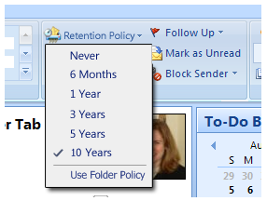
Set Archive Policy on an Item
With Delete Policy
Outlook OWA
User selects 5 Years from set of Policies
User selects 5 Years from set of Move Policies
OWA does not have Delete Policies in R4
User selects 10 Years from set of Move Policies
Notes:
A\

Slide 45
Hold Policy
Preserve: Message Retention

Slide 46
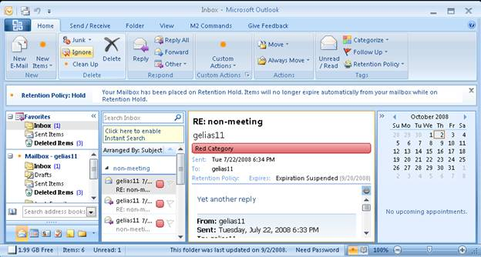
Preserve: Hold Policy
Feature | Benefits
Hold Policy is applied to user for ‘n’ duration. | All edits and deletes preserved within the user’s mailbox and then expired out ‘n’ days after mail was received.
User Workflow unchanged (Same as E2K7) | Mail stored in Dumpster 2.0 Once on hold, all data is preserved irrespective of user or Admin access. Multi-mailbox search can retrieve items indexed in dumpster folder
Admin can recover and discover all items
Configurable alert notification | User can receives alerts s that they are on hold; eliminates manual process
Notes:
Objective: Discuss differences between E2007 Retention Hold and new E2010 Legal Hold.
When reasonable expectation of litigation exists, organizations are required to preserve e-mail relevant to the case as part of discovery. This expectation can occur well before one knows the specifics of the case and preservation is often broad. Frequently, organizations will preserve all e-mail relating to a specific topic (or all e-mail, period) for certain individuals. In some cases, end users are instructed to carry out the preservation themselves by not deleting certain e-mail. This can lead to insufficient preservation. In other instances, e-mail is copied or moved to an archive. This can increase costs by requiring manual effort to copy items and/or third party products to collect and store e-mail.
E2007 scenario:
Retention Hold executed through Powershell, placing workload on IT rather than legal team. It stops automatic deletion but does not stop the user from moving or deleting items. Also, users must be informed of Hold manually, through email. This places the burden on the end user to remember what to do and can lead to insufficient preservation if he/she forgets. The search capabilities are limited and the process is slow because export-mailbox copies the entire mailbox (regular mail and dumpster) to the destination and then searches it. There’s no way to search the dumpster directly.
E2010 scenario:
Retention Hold can now be carried out on a per mailbox basis
Feature makes copy of both user- deleted and edited items. It also enables setting of Outlook litigation hold comment for each mailbox to inform the user of the hold.
The user continues to read e-mail and soft-delete it when it is no longer needed.
Each time an item is soft-deleted or modified (certain message properties only, detail below), a copy is placed in the dumpster. Since the user hardly ever goes to the dumpster, he does not realize that items are no longer purged from it or that he can no longer manually empty it.
When the two litigating organizations have agreed on what must be produced, the legal team performs a discovery search that includes the dumpster.
If the mailbox is moved, items that are on hold are moved with it (today, dumpster data is lost during move mailbox)
Dumpster 2.0
Used to simply be a query
Now an indexed folder
Can be configured like a managed folder with specific retention policies

Slide 47
Preserve: Hold Policy Message Flow
Exchange 2007 Behavior
(1) Message delivered
Mailbox
1-2 yrs of E-mail
Size 2-10GB
Online and Offline
Inbox
(2) Message deleted by User
…
Deleted Items
(3) Message eliminated by User
Dumpster 2.0
Recoverable Items
(4) Message purged by user

Slide 48
Preserve: Hold Policy And Item Restore Hold (N Days) Policy where N=14
(1) Message delivered
Mailbox
1-2 yrs of E-mail
Size 2-10GB
Online and Offline
Inbox
(2) Message deleted by User
…
Deleted Items
(3) Message eliminated by User
Dumpster 2.0
Hold = 14 Days
Recoverable Items
(4) Message “purged” by user
Edits
Purges
(5) Message removed from system after 14 days

Slide 49
Preserve: Hold Policy and Legal Hold
Hold (N=Indefinite) + Move and Delete Policies
(1) Message delivered default Policy applied
Mailbox
Mailbox
1-2 yrs of E-mail
Size 2-10GB
Online and Offline
2-10 yrs of E-mail
Size 10-30GB
Online Only
Inbox
Inbox
(2) Message deleted by User
…
(5) Message moved
…
(6) Message deleted by User
by Policy or User
Deleted Items
Deleted Items
(3) Message eliminated by User
Dumpster 2.0
Hold = Indefinite
Dumpster 2.0
Hold = Indefinite
(7) Message eliminated by User
Recoverable Items
Recoverable Items
(4) Message “purged” by user
Edits
Edits
(8) Message “purged” by user
Purges
Purges

Slide 50
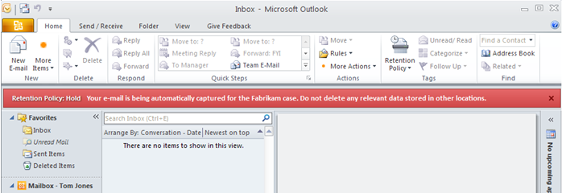
Preserve: Hold Policy
Command line experience
  Set-mailbox –HoldEnabled $true –HoldPeriod n days
User Experience
Notes:
Make sure we have a few canned holds (15 day, 2 year, indefinite) out of the box. One can create more. Call out that the low touch admin could just use these. Should we put the low touch admin option before creating a new hold policy? That would be consistent with retention.

Slide 51
Preserve: Journaling
IT Pros can continue to journal to mailbox or archive
Feature | Benefit
Transport Journaling | Ability to journal individual mailboxes or SMTP address (hosted archive) Detailed reports per To/Cc/Bcc/Alt-Recipient and DL expansion
Journal Report de-duplication | Customers report up to 40% duplication of journal reports (Example: internal/external recipients on same DL) E2010 creates one report per message Can dramatically reduce hosted archive storage costs
Notes:
Objective: Clarify that Exchange 2010 offers both native archiving as well as journaling to third party archives.
Along with its own archiving capabilities, Exchange 2010 also offers enhanced journaling functionality, enabling organizations to leverage third-party on premise and hosted archive products.
Transport Journaling
Envelope journaling first appeared in Exchange 2003 and has since become the De facto standard for capturing email communications for compliance purposes on Exchange. When envelope journaling is enabled and Exchange encounters a message which should be captured, Exchange creates a journal report and the original message is made an attachment to the report. The P2 headers of the original message are copied to the report’s P2 headers and the original message’s P1 sender and recipient addresses along with the message subject, are copied into a list in the report body.
The E2K7 implementation of journaling is vastly different than its predecessor. In E2K7 journaling has moved off of the mailbox and now runs completely in transport on the HUB server role. This change enabled a variety of design improvements such as never NDRing a journal report, directing journal reports to any smtp address, as well as more granular control over which users are journaled. Unlike E2K3, in which journaling was only configurable on a per-mdb level, E2K7’s journaling may be enabled for individual recipients, members of a group, the entire organization as well as on a per-mdb bases. The report format in E2K7 journaling has also been modified to include detailed To/Cc/Bcc/Alt-Recipient and DL expansion information.
Report De Duplication:
With Exchange 2007 journaling, if a message meets the criteria specified in a journal rule a new journal report will be generated for the message. If CAT bifurcates a message prior to the journaling agent receiving the message, the journaling agent will generate multiple journal reports.* With many archive vendors charging based on the amount of data they store, generating multiple journal reports for a given message drastically increases organizations’ cost of archiving and discovery. Customers have reported they see a approximately a 40% duplication in journal reports.
In E2010 if there are no DL expansion servers, transport journaling will create only one journal report per message. If a DL expansion server exists this should create no more than 1 extra journal report (per DL expansion server). This will dramatically decrease duplication.
Note: Note: M1 will not address multiple journal reports which are genereated due to DL chipping (i.e. When a message is sent to a large DL, CAT bifurcates the message into multiple pieces, each of which contain a subset of recipients). This will be addressed in M2 with journaling aggregation.
*The journaling agent will generate multiple journal reports. In E2K7 CAT bifurcates messages for several reasons:
DL Chipping size
Per-recipient properties are not transmittable. To work around this CAT bifurcates to divide up recipients and stamps a per-message property.
Alt-recipients
Content Conversion – which occurs if a message is sent to both internal and external recipients

Slide 52
Multi-Mailbox Search
Discover:

Slide 53
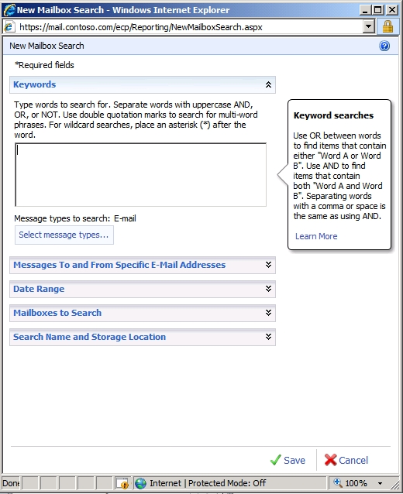
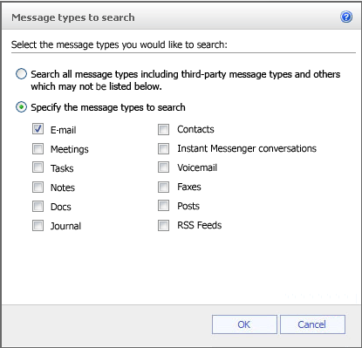
Multi-Mailbox Search
Simple, role-based GUI
Delegate access to search to HR, compliance, legal manager
Search all mail items (email, IM, contacts, calendar) across primary mailbox, archives
Filtering includes: sender, receiver, expiry policy, message size, sent/receive date, cc/bcc, regular expressions, IRM protected items
Notes:
Objective: Highlight new multi-mailbox search GUI and advanced search features.
Traditional e-mail systems require complex access control policies and provide hard to use tools in order to meet the growing needs of eDiscovery and requirements of Human Resources departments relative to searching corporate communication throughout the e-mail infrastructure. Those responsible for these tasks are non-IT users who are unfamiliar with e-mail administration tools and do not have access to the e-mail servers. These compliance officers and HR representatives are having to follow complex processes and use complex tools, aided by IT, to handle what is already a complex problem due to legal and corporate governance. Solutions are required which empower these individuals to go about their business without IT intervention and which ensure that only those assigned by the organization to perform such tasks are able to.
Multi-Mailbox Search enables multi-mailbox searches of mailbox items across both primary mailboxes and personal archives with an easy-to-use control panel. Mail located through discovery search is copied and moved to a specified mailbox or external store, as defined within the control panel.
Cross-mailbox search user interface enables compliance officers and HR to perform searches based on select e-mail attributes across the entire mail infrastructure
Searches includes multiple mailbox items (including e-mail, attachments, calendar items, tasks and contacts)
Advanced filtering capabilities include: sender, receiver, expiry policy, message size, sent/receive date, cc/bcc and regular expressions.
Roles based administration allows for easy delegated access to this tool with no complex Access Control Requirements
Delegating this search does not place any new load on the server
Word stemming feature: when appropriate, it will search not only for your search terms, but also for words that are similar to some or all of those terms. If you search for finance reports, MMS will also search for financial reporting, and other related variations of your terms.

Slide 54
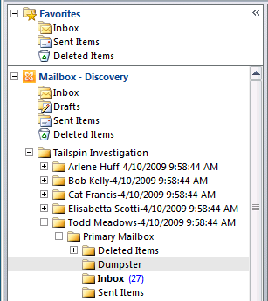
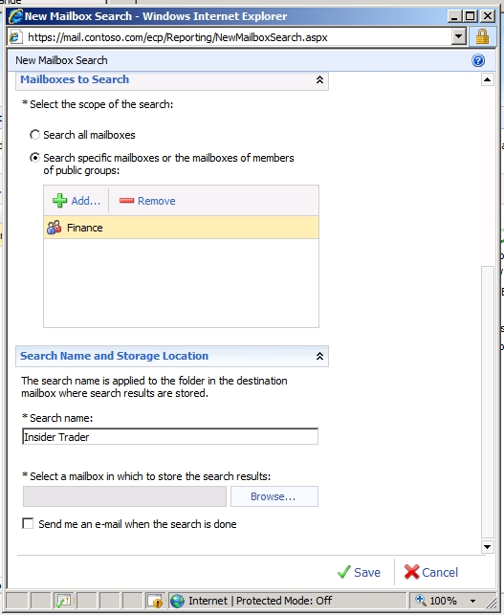
Multi-Mailbox Search
Additional eDiscovery features
Search specific mailboxes or DLS
Export search results to a mailbox or SMTP address
Search results organized per original hierarchy
Request email alert when search is complete
API enables 3rd tool integration with query results for processing
Notes:
Objective: Touch on additional features in MMS that support more efficient eDiscovery.
The Multi-Mailbox Search GUI also includes new features designed to further streamline the eDiscovery processes, including:
Easy export to a specified destination (PST, mailbox or SMTP address)
Option to request email alert when search is complete (useful for enterprise-wide searches that can take longer)
Search results can be exported to a mailbox in Outlook or OWA
API enables access to query results by third-party tools for further processing (concept searching, etc.)

Slide 55
Hold and Discover
demo
Notes:
If you would like to host your demo on the Virtual Server, please use the myVPC demo slide, not this slide.

Slide 56
Archive Summary
Exchange 2007
  Managed Folders
  Export Mailbox for Discovery
Archive in Exchange 14 RTM
  Archive Mailbox
  Message Retention (Archive and Delete)
  Message Retention (Hold)
  Multi-Mailbox Search
Archiving Futures, Post RTM
  Import/Export PST
  Archive in the Cloud (Separate DB and Hosted)
  Journaling metadata
  Configuration and Mailbox Auditing

Slide 57




Exchange 2010 Archiving and Retention
Key Benefits Summary
Seamless User Experience
Move PSTs manually into Personal Archive folder for discovery
Move mail in primary automatically into Personal Archive to manage quota
Access archive through Outlook or OWA
Apply retention policies, Search across primary mailbox and Personal Archive
Streamlined Administrative Experience
Leverage familiar Exchange management tools across all primary and archive mailboxes (retention policies, litigation hold, multi-mailbox search)
Delegate compliance-related functions to non-IT compliance officers, legal, HR through easy-to-use GUI
Reduced Costs
  No additional archive licenses (archive is part of Exchange 2010 ECAL)
  No separate archive to manage = lower administrative costs
  Option to use DAS-SATA storage architecture to reduce storage costs
Notes:
Objective: Summarize E2010 archiving and retention features. Touch on cost and storage benefits.
Enable seamless user experience
End users can simply drag and drop PSTs into a Personal Archive folder located next to their other mailbox folders in Outlook or OWA
Much like auto-archive in Outlook, Mail in primary mailbox be moved automatically into Personal Archive to manage quota
Users can access, search and manage their archive folder directly from Outlook or OWA
Policies applied to mail in the primary mailbox move seamlessly to mail moved to the Personal Archive
Streamlined administrative experience
Use Exchange UM to index and centralize all mail items and attachments, including voicemail, IM – even IRM-protected mail
Both primary mailboxes and Personal Archives can be managed centrally from one management panel (EMC and/or ECP)
Administrators can search primary mailboxes and Personal Archives across the organization using multi-mailbox search
Administrators can configure retention polices (including Litigation Holds) that apply to both primary mailboxes and Personal Archives – per individual, group, or across the organization
Auditing and reporting can be applied to all mailboxes, including Personal Archives
Administrators can delegate access to retention policy management, litigation hold and multi-mailbox search to non-IT administrators such as compliance officers, litigators and HR managers
Reduced costs
Archiving, MMS, retention policies are all part of Exchange 2010 ECAL)
No separate archive to manage = lower administrative costs
Option to use DAS-SATA storage architecture to reduce storage costs
To optimize use of less expensive storage:
Exchange 2010 delivers a 50% reduction in disk IO over Exchange 2007, lowering the bar for minimum disk performance required to run Exchange.
Additionally, IO patterns are optimized so that disk writes are less bursty and more suitable for Serial Advanced Technology Attachment (SATA) disks and Exchange is more resilient to storage problems.
When corruption is caused by minor disk faults, Exchange automatically repairs the affected database pages using a copy of the database that is configured for high availability.
When an entire drive fails, fast database-level failover makes it possible for administrators to swap failed drives with minimal impact to users. These advances make Redundant Array of Inexpensive Disks (RAID)-less disk configurations feasible for some organizations.

Slide 58
question & answer

Slide 59




Resources
Required Slide
Speakers,
TechEd 2009 is not producing
a DVD. Please announce that
attendees can access session
recordings from Tech-Ed website. These will only be available after the event.
  Tech·Ed Africa 2009 sessions will be made available for download the week after the event from: www.tech-ed.co.za
www.microsoft.com/teched
  International Content & Community
www.microsoft.com/learning
Microsoft Certification & Training Resources
http://microsoft.com/technet
  Resources for IT Professionals
http://microsoft.com/msdn
  Resources for Developers

Slide 60
Related Content
Required Slide
Speakers,
please list the Breakout Sessions,
TLC Interactive Theaters and Labs
that are related to your session. Any queries, please check with your Track Owner.
Microsoft Exchange Server 2010 Architecture (UNC308) – Already done

Slide 61




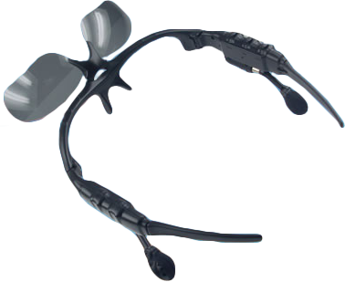
Required Slide
10 pairs of MP3 sunglasses to be won
Complete a session evaluation and enter to win!

Slide 62

Required Slide
© 2009 Microsoft Corporation. All rights reserved. Microsoft, Windows, Windows Vista and other product names are or may be registered trademarks and/or trademarks in the U.S. and/or other countries.
The information herein is for informational purposes only and represents the current view of Microsoft Corporation as of the date of this presentation. Because Microsoft must respond to changing market conditions, it should not be interpreted to be a commitment on the part of Microsoft, and Microsoft cannot guarantee the accuracy of any information provided after the date of this presentation. MICROSOFT MAKES NO WARRANTIES, EXPRESS, IMPLIED OR STATUTORY, AS TO THE INFORMATION IN THIS PRESENTATION.

