Slide 2
Unified Communications End-User Experience
Name
Title
Microsoft Corporation
Notes:
Welcome to the Unified Communications End-User Experience presentation.
This session focuses on how business environment and end-user experience have changed and how we – Microsoft –address these changes.
We will see how we can communicate from inside applications with integrated communications tools using Office Communications Server 2007 and Office Communicator 2007.
Introduce yourself…

Slide 3
Session Objectives
In this session, you will…
Experience how to communicate from within applications
Learn about integrated communication tools and devices
See how end-users can access information from anywhere
Notes:
The Key objectives for this presentation are the following ones:
Experience how to communicate from within applications: We will see how easy it is to start an IM, voice or video conversation by clicking on the presence indicator next to a contact within our applications. Presence is integrated with Microsoft Office (including Outlook and SharePoint) as well as with third party line of business applications.
Learn about integrated communication tools and devices: Live demos will help us to understand the Microsoft Unified Communications end-user experience. This experience includes Office Communicator, Communicator Mobile and Communicator Web Access and last but not least a wide range of devices.
See how end-users can access information from anywhere: More and more information workers work from home, from hotels or from remote locations. We will see how easy and intuitive we can use integrated communications with Office Communicator even when we are not in the office.

Slide 4






Enterprise Communications
Current end-user experience
Video
Conferencing
Cell Phone
E-Mail
Fax
Voice Mail
Desk Phone
Multiple communication modalities
Different interfaces and technologies
Lack of integration
Notes:
Information technology has brought huge gains in organizational productivity but it has also brought an overload of information. For years most organizations have had two separate but parallel investments in terms of communications:
one around a voice network (telephone - fax - voicemail), and
another around a data network (data - internet - e-mail).
New communication methods like mobile telephony and video conferencing were added. But they have remained separate silos and therefore increased the complexity once again. So we end up with
Multiple communication modalities,
Different interfaces and technologies, and
Lack of effective integration.
Examples:
Wouldn’t it be great to answer an e-mail with a call without looking up the phone number?
Wouldn’t it be great to know that my business partner is not in the office before I call him on his land line so I don’t have to call again on his mobile phone?

Slide 5




Today’s Business Environment
What customers are telling us
PCs are disconnected from communications tools
Hard to transfer data between PC and other devices
No integration between devices and PC applications
Time-consuming to transition from PC to other devices
Communications tools don’t work well together
Multiple directories are inconvenient
Switching between tools is awkward
PC and phone are not integrated
Can’t access data from many locations and devices
Phone
Web browser
Mobile device
Notes:
Our personal computers are disconnected from communications tools. A Microsoft study made in 2006 says that the average information worker gets 51 messages a day in up to 7 different places because their personal computers are disconnected from communications tools. Our customers tell us that:
It is hard to transfer data between PC and other devices,
there is no integration between devices and PC applications, and
that it is time-consuming to transition from PC to other devices.
Our Communications tools don’t work well together: The same Microsoft study from 2006 shows that for 50% of the calls workers make, they have to look up the phone number. Again our customers tell us that:
multiple directories are inconvenient,
switching between tools is awkward, and
PC and phone are not integrated.
We cannot access data from many locations and devices. A Gartner Group Report from March 2006 makes clear what we always somehow knew: 60% of all business phone calls go to voice mail. And why it that? Because we are not in the office. And again our customers tell us that they would like to access all their data, including real-time communication from
the phone,
a web browser, or
a mobile device.

Slide 6

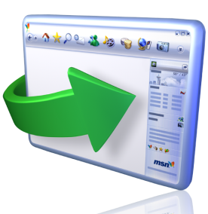

Microsoft’s Investment Themes
Unified Communications end-user experience
Communicate from inside applications
Rich presence throughout Microsoft Office applications
Ability to find right person and use right mode
Shared context and content
Integrated communications tools
Integrated e-mail, presence, IM, voice, video
Seamless transitions between modes
Wide range of devices
Anywhere access
From any telephone
From any Web browser
From Windows Mobile devices
Notes:
9/6/2007 8:24 AM
© 2004 Microsoft Corporation. All rights reserved.
This presentation is for informational purposes only. Microsoft makes no warranties, express or implied, in this summary.
6
The way in which business people communicate and collaborate has seen rapid change recently, with new demands and capabilities today that were hardly a consideration a few short years ago. Communicating directly from the context of your task and contacting the right person using the more effective method increases productivity and reduces «time-to-decision».
Let’s take a brief look at the investments we’ve made around these core themes…
Communicate from inside applications
Whether making a phone call right from Outlook or identifying the availability of a business document’s author, users can find who they need and communicate using the best method because we provide rich presence throughout Microsoft Office applications.
Context and content can be shared right from within the communications experience
Integrated communications tools
Integrated e-mail, presence, IM, voice, video
Seamless transitions between modes
Wide range of devices
Anywhere access
Provides access to rich presence and communications capabilities from various devices, whether your PC, a Windows Mobile device, or via a Web browser

Slide 7
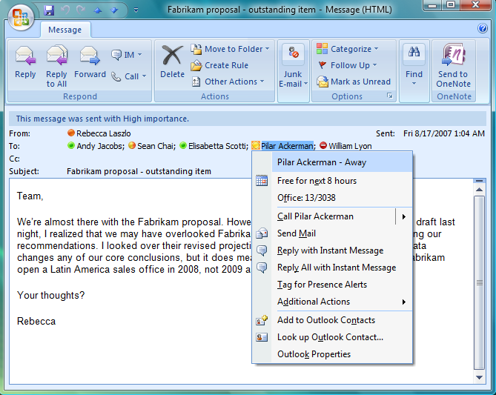

Communicate from within Applications
Throughout Microsoft Office
  Integral presence
  Communicate and share content
Click to communicate within Office Outlook
  Reply to e-mail with real-time communication
  Keep conversation history
  Schedule conferences
Extend LOB applications
Information Workers waste 30 minutes per week in phone tag; for 50% of calls Information Workers make, they have to look up the phone number.
—Harris, June 2006
Notes:
According to a Harris Study made in June 2006, information workers waste 30 minutes per week in phone tag and again, for 50% of their calls, they have to look up the phone number.
Office Communications Server 2007 helps to improve users’ productivity by enabling streamlined communications from within the applications they use most. It provides integrated presence throughout Microsoft Office. Context and content can be shared right from within the communications experience.
Whether making a phone call right from Office Outlook or identifying the availability of a business document’s author, users can find who they need and communicate using the right method. They can click to communicate within Office Outlook. It is possible to answer an e-mail with a phone call with the sender or with a conference call with all the involved parties.
Telephone conferences or live meetings can be scheduled with one click within Outlook. And last but not least all the conversation history including IMs is kept within Outlook for further use.
Even line of business applications can be extended to access these streamlined, rich communications capabilities for your users.

Slide 8
Communicate from within Applications
demo
Notes:
The following demo shows a day in the life of an information worker and how streamlined communications from within applications helps to be more efficient and productive.

Slide 9
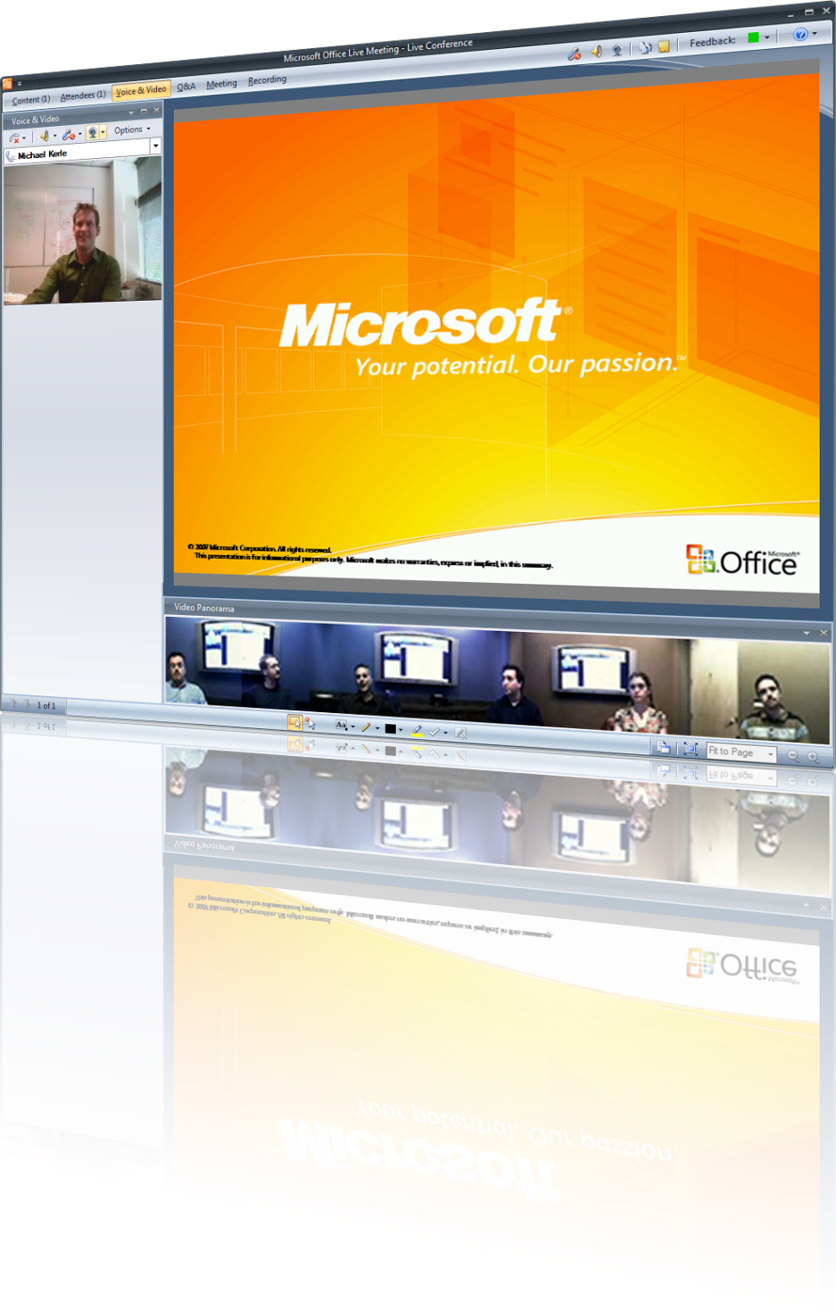
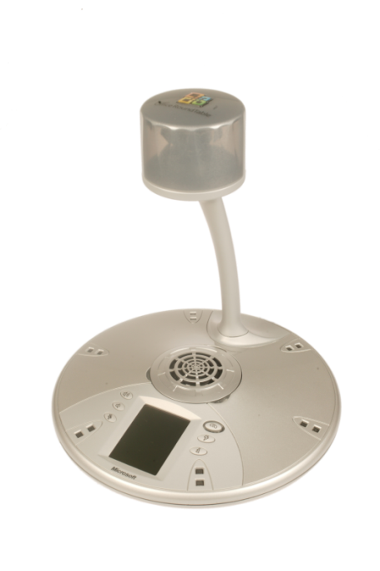
Integrated Communication Tools
Enterprise presence
Instant messaging
Software-powered VoIP
Integrated device experience
Audio and video conferencing
Web conferencing
Notes:
Unified Communications is the future of business voice communication. Our approach is software based and provides streamlined communications to information workers, enabling them to initiate communications from the context of the application they are working in.
Presence, IM, group IM, software-powered Voice over IP, voice, video and web conferencing form the core feature set of Office Communications Server 2007. Using Communicator 2007 as the principal client application, the solution provides a rich, integrated communications experience for enterprise users.

Slide 10
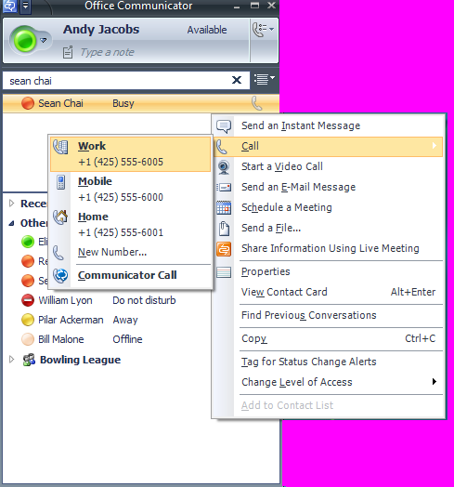
Integrated Communication Tools
High quality of experience
Call from your applications
High voice/video quality
Rich call management
  Intuitive user interface
  Intelligent call routing
  Integrated with IM and video
Notes:
Office Communications Server 2007 delivers high quality software-powered VoIP right from within Microsoft Office applications so users can communicate with a single click from their personal computer.
It enables VoIP communications on many networks with optimized quality for connection type – without VPN access to the corporate network. The only thing you need is Internet access. So, wherever you are, simply start Communicator and experience high voice and video quality.
Call management capabilities like call forwarding, hold, dynamic routing, and simultaneous ringing on all commonly used phones are easily configured by users.
Intelligent call routing capabilities help to make life easier. For instance: if you are in do-not-disturb mode or during a full screen presentation, calls will be routed automatically to your voice mail.
And finally Office Communicator enables rich communications with other Office Communicator users by enhancing a phone call with IM and video along with a subject and other information.

Slide 11
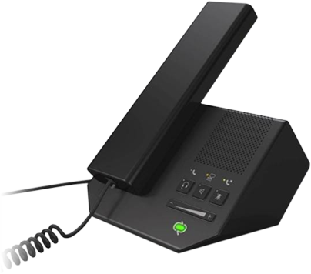
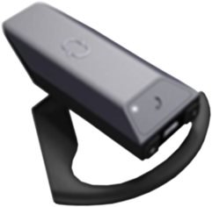
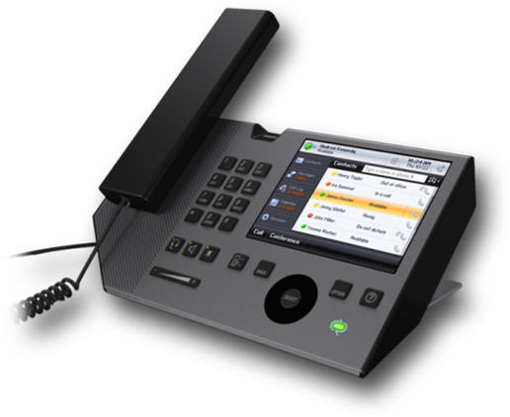
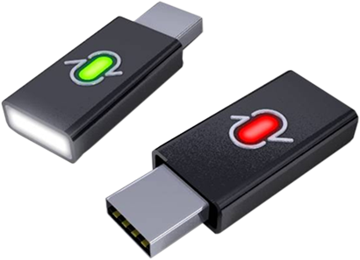
Integrated Communication Tools
More Innovation
  Voice integrated into applications
  Rich user experience
Greater Cost Reduction
  Significant device cost savings
  Software business model
Qualified Devices Ecosystem
  Wideband audio
  Plug-and-play
  Office Communicator 2007 integration
Notes:
With our integrated communication tools we offer more innovation, greater cost reduction and a qualified devices ecosystem.
More Innovation
IM, voice and video are integrated into applications and easily accessible with one click. Integrated presence helps to find the right way to communicate before the actual conversation starts.
Software based graphical user interfaces guarantee rich and intuitive user experience throughout all applications and devices.
Greater Cost Reduction
Our communications tools are software rather than hardware based. Unlike the legacy telephone systems we do not require expensive proprietary hardware.
Furthermore devices are significantly cheaper because we offer a wide range of devices from many different vendors.
Then our software business model allows for lower installation and maintenance costs. Costly moves and changes are not required anymore.
Qualified Devices Ecosystem
Currently more than 15 devices are available that are plug-and-play and offer a superior voice quality due to our wideband audio codec.
All the devices’ functionality and buttons are seamlessly integrated with Office Communicator. For example the off-hook button or lifting the handset from its cradle causes Communicator to open. Different devices’ volume controls or mute buttons are supported as well.

Slide 12
Integrated Communications Tools
demo
Notes:
The next demo continues with a day in the life of our information worker and focuses on integrated communications tools and the use of different devices.

Slide 13

Anywhere Access
Take your office on the road
Encrypted signaling and media
No VPN required
Codecs optimized for variable conditions
Extending Office Communicator 2007
  Laptop
  Web browser
  Innovative IP phones
  Windows Mobile devices
By 2007, “telework” will be practiced by more than 60 million people.
—Gartner
Notes:
Gartner says that by the end of 2007 tele-working will be practiced by more than 60 million information workers worldwide.
Office Communications Server and Office Communicator let us take our office on the road. They assure for encrypted signaling and media like security enhanced VoIP, IM, and Conferencing. Communications are possible on a wide range of networks without requiring a VPN connection into the corporate network.
The voice and video codec is optimized for variable conditions on different networks and can adapt to changing network conditions. Like this high quality of experience is guaranteed.
Office Communicator provides access to rich presence and communications capabilities from various devices:
our laptops using Communicator
web browsers using Communicator Web Access,
innovative IP phones using the Communicator experience, and
Windows Mobile devices using Communicator Mobile.

Slide 14
Anywhere Access
demo
Notes:
This last part of a day in the life of our information workers shows a couple of scenarios where anywhere access is required in order to stay connected and fulfill all the tasks of a challenging work day.

Slide 15
Key Takeaways
In this session, you learned…
How to communicate from within applications
  About communication tools that work well together
  How to communicate from any location
Notes:
9/6/2007 8:24 AM
© 2004 Microsoft Corporation. All rights reserved.
This presentation is for informational purposes only. Microsoft makes no warranties, express or implied, in this summary.
15
Let me summarize. In this session we learned
How to communicate from within applications. Integrated presence throughout Microsoft Office and line of business applications makes it easy to find the right person and start to communicate using the right media with a simple click.
We learned how communications tools work well together. It is very simple to add voice or video to an IM conversation. Devices are plug-and-play and support many of the Office Communicator capabilities like mute or off-hook.
Then we have seen how easy it is to communicate from any location by simply taking our offices on the road.

Slide 16
Q&A

Slide 17
Resources
  Devices Optimized For Office Communicator
  www.microsoft.com/presspass/presskits/uc/partners.mspx
  Visit the OCS 2007 and Exchange Server 2007 Tech Centers
  http://technet.microsoft.com
Notes:
9/6/2007 8:24 AM
© 2005 Microsoft Corporation. All rights reserved.
This presentation is for informational purposes only. Microsoft makes no warranties, express or implied, in this summary.
17

Slide 18
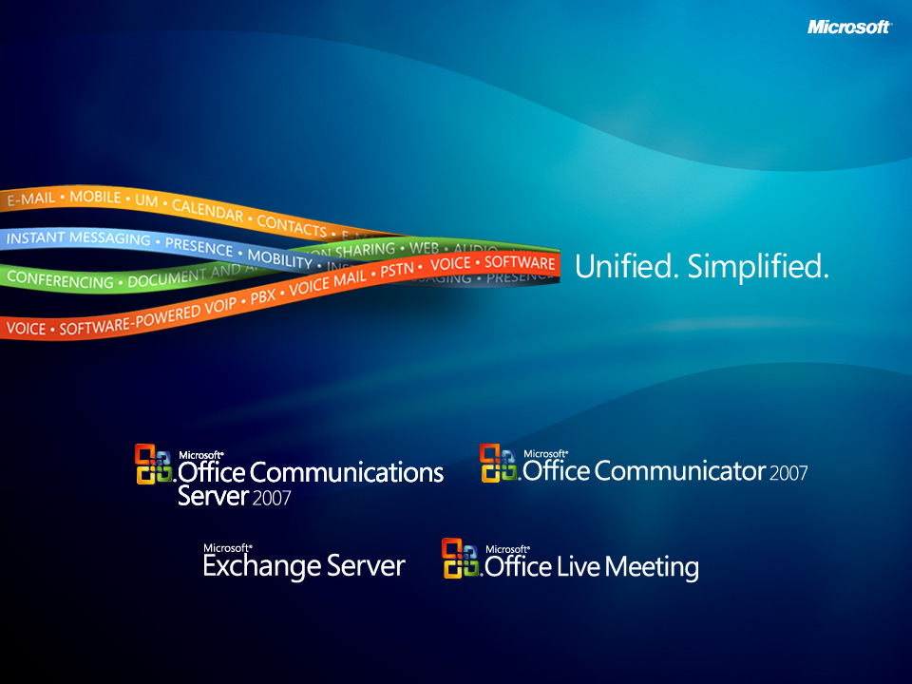

Slide 19

© 2007 Microsoft Corporation. All rights reserved. Microsoft, Windows, Windows Vista and other product names are or may be registered trademarks and/or trademarks in the U.S. and/or other countries.
The information herein is for informational purposes only and represents the current view of Microsoft Corporation as of the date of this presentation. Because Microsoft must respond to changing market conditions, it should not be interpreted to be a commitment on the part of Microsoft, and Microsoft cannot guarantee the accuracy of any information provided after the date of this presentation.
This document may contain information related to pre-release software, which may be substantially modified before its first commercial release.
Accordingly, the information may not accurately describe or reflect the software product when first commercially released
MICROSOFT MAKES NO WARRANTIES, EXPRESS, IMPLIED OR STATUTORY, AS TO THE INFORMATION IN THIS PRESENTATION.

