Slide 1
Extensibility:
Embedding Unified Communciations in LOB Applications

Slide 2
Session Objectives
In this session, you will…
Learn the capabilities of Microsoft’s Software-powered UC
Understand the benefits of embedding UC in your applications
See many demos of Software-powered UC in action
Experience the ease of embedding UC in LOB applications

Slide 3











Old Telecommunications World
Many heterogeneous, proprietary systems
Many “islands” of communications
  Closely tied to hardware
  Hard to integrate
  Multitude of clients
No or limited public APIs
  Hard to customize
  Hard to extend
Requiring specialized resources
  For development
  For maintenance
Voice Mail
Audio
Conference
Web
Conference
Instant
Messaging
E-Mail
Enterprise
Telephony
Video
Conference
Notes:
3

Slide 4












The Microsoft UC Platform
Software-powered Unified Communications
Unified User Experience
  Leverages rich User Interface
Built on extensible software
Unified Software Platform
Rich set of APIs
  For the client
  For the server
Windows and web based
Great Visual Studio support
Leverages .NET skills
Telephony
  Integral part of platform
Unified
User Experience
Common Management
E-Mail and
Unified Messaging
Instant
Messaging
Enterprise
Telephony
Conferencing
Software Platform
Notes:
4

Slide 5
The Microsoft UC Platform
Software-powered Unified Communications
Unified User Experience
  Leverages rich User Interface
Built on extensible software
Unified Software Platform
Rich set of APIs
  For the client
  For the server
Windows and web based
Great Visual Studio support
Leverages .NET skills
Telephony
  Integral part of platform
Unified
User Experience
Common Management
E-Mail and
Unified Messaging
Instant
Messaging
Enterprise
Telephony
Conferencing
Software Platform
Notes:
5

Slide 6
The Microsoft UC Platform
Software-powered Unified Communications
Unified User Experience
  Leverages rich User Interface
Built on extensible software
Unified Software Platform
Rich set of APIs
  For the client
  For the server
Windows and web based
Great Visual Studio support
Leverages .NET skills
Telephony
  Integral part of platform
Unified
User Experience
Common Management
E-Mail and
Unified Messaging
Instant
Messaging
Enterprise
Telephony
Conferencing
Software Platform
Notes:
6

Slide 7
The Microsoft UC Platform
Software-powered Unified Communications
Unified User Experience
  Leverages rich User Interface
Built on extensible software
Unified Software Platform
Rich set of APIs
  For the client
  For the server
Windows and web based
Great Visual Studio support
Leverages .NET skills
Telephony
  Integral part of platform
Unified
User Experience
Common Management
E-Mail and
Unified Messaging
Instant
Messaging
Enterprise
Telephony
Conferencing
Software Platform
Notes:
7

Slide 8
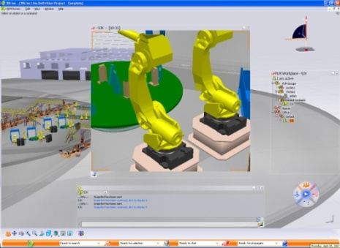


Unified Communications Platform Capabilities
Enable integration of collaborative experiences in software
Contextual
Collaboration
Business
Process
Communications
Anywhere
Information
Access
Notes:
When we think about the Unified Communications platform, we typically think about three main categories of capabilities:
The ability to embed presence and communications right into your desktop applications, or as we call it: contextual collaboration.
The ability to embed communications into your business process running on the server: BPC
And the possibility to extend the reach of these capabilities to communications clients like plain phones or Communicator clients outside the firewall, providing anywhere information access.
Contextual Collaboration
“In situ”
integration of presence, IM, voice, video, data
Enhance team productivity
Rich and Reach Clients
Client and Middle Tier
Anywhere Information Access
Enable any* access to enterprise information and services
Increase information transparency for customers, partners, and information workers
Business Process Communications
Communications enable business processes
Reduce human latency
Presence aware, multi-modal notifications
Middle Tier workflow design environment

Slide 9
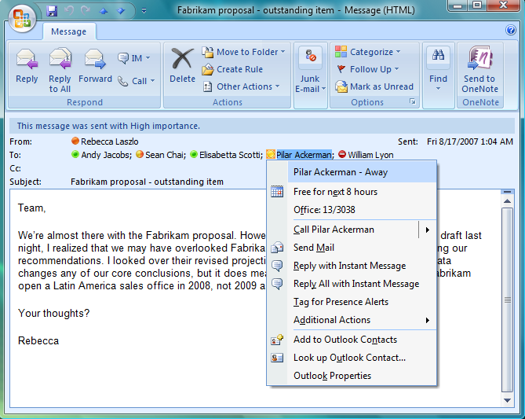
Contextual Collaboration In Outlook
UC Platform Capabilities
Contextual
Collaboration
Business
Process
Communications
Anywhere
Information
Access

Slide 10
Contextual Collaboration
What can you do with this?
UC Platform Capabilities
Contextual
Collaboration
Business
Process
Communications
Anywhere
Information
Access
Streamline Communications
  Build “Presence” into any application
      Shows the relevant contact list
      Shows availability
  Power up “Click to Communicate”
      Availability drives communication time and mode
  Offer everyone the full choice of communications
      Messaging
      Voice and Video
      Conferencing
      Data sharing, desktop sharing and white boarding
  Build task-tailored collaboration client software

Slide 11
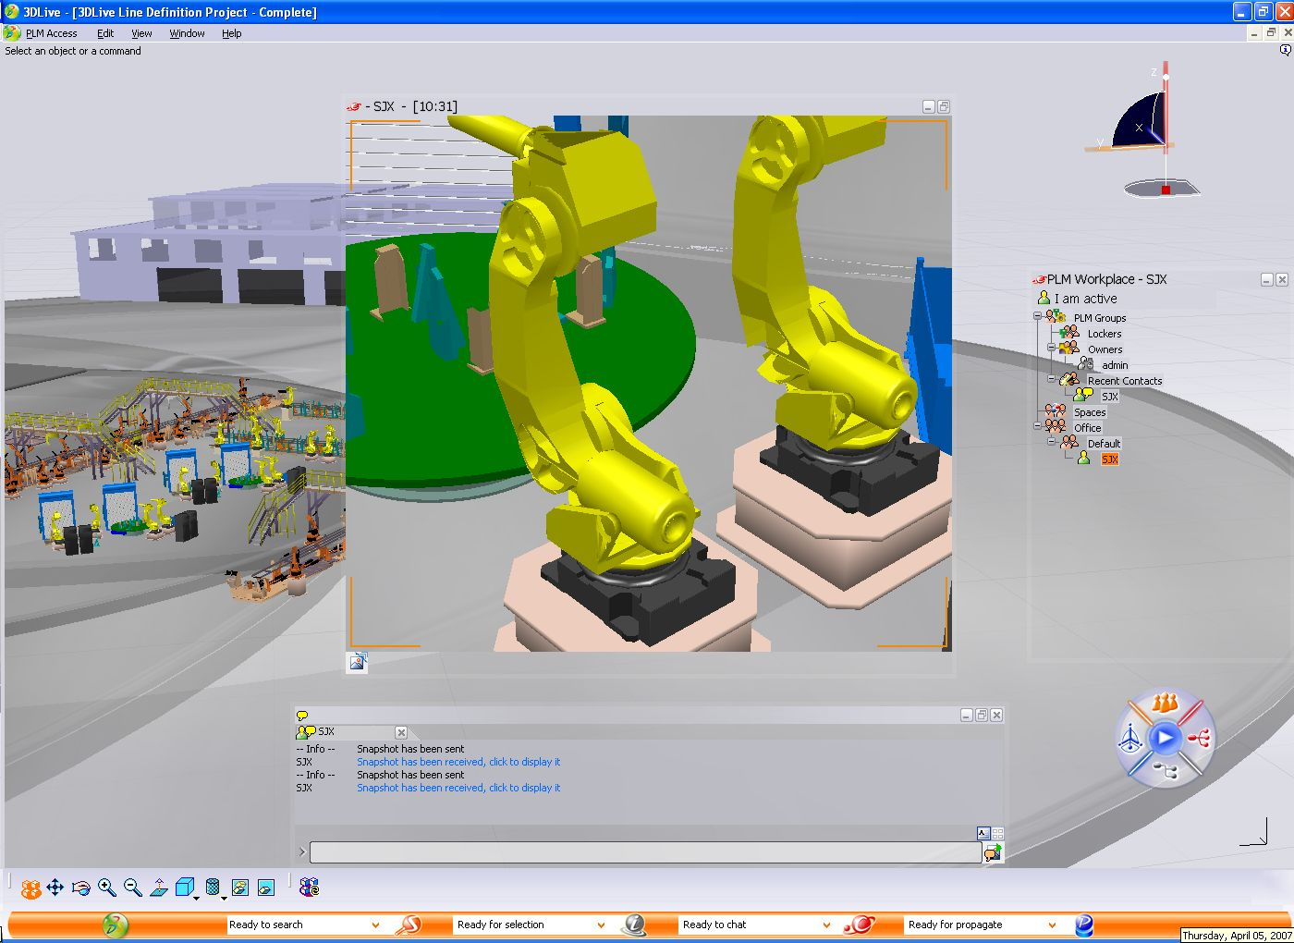
Dassault Systems 3D Live

Slide 12
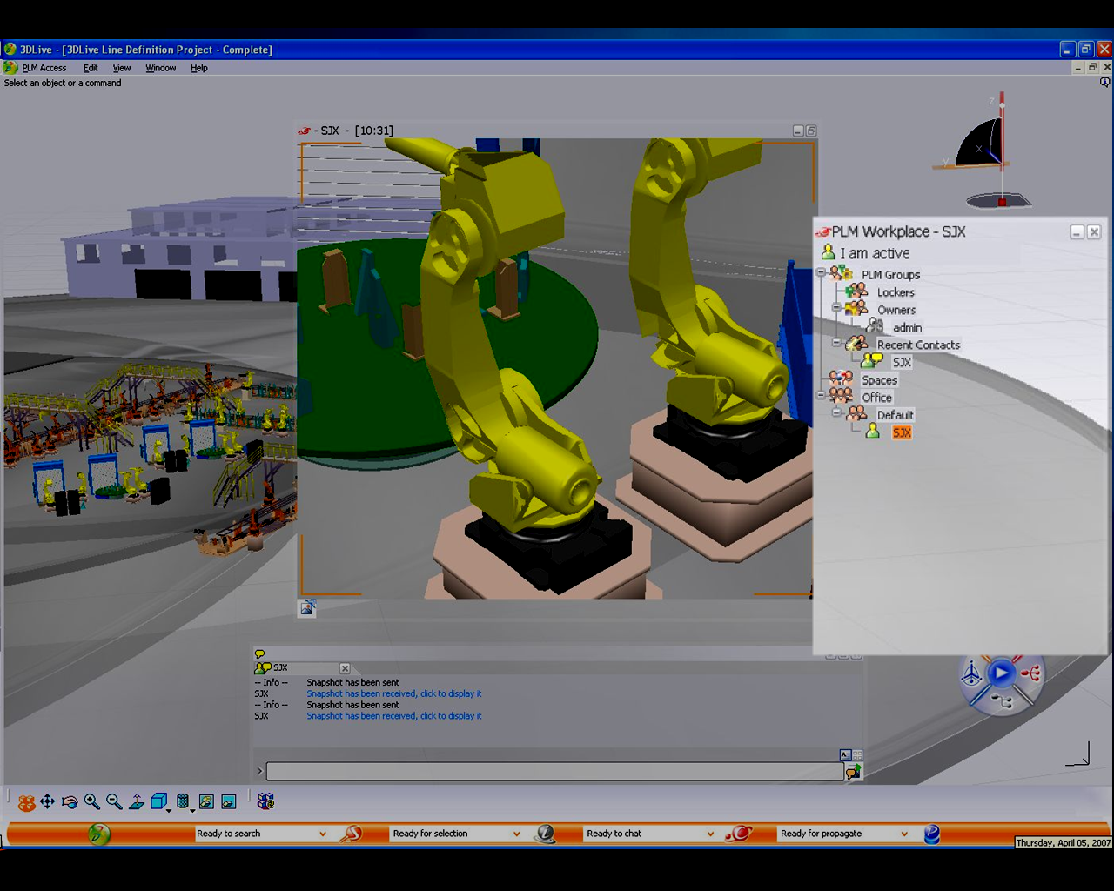
Contacts window

Slide 13
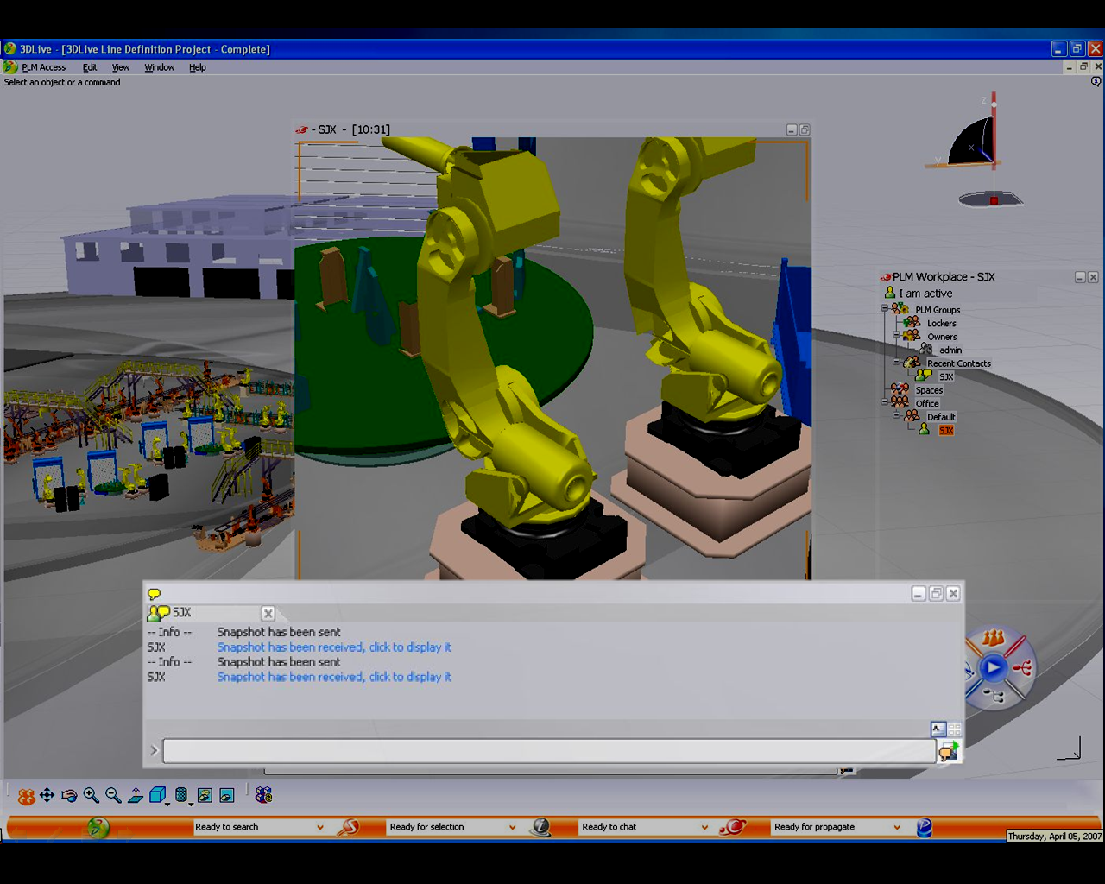
Chat Window
Notes:
…

Slide 14
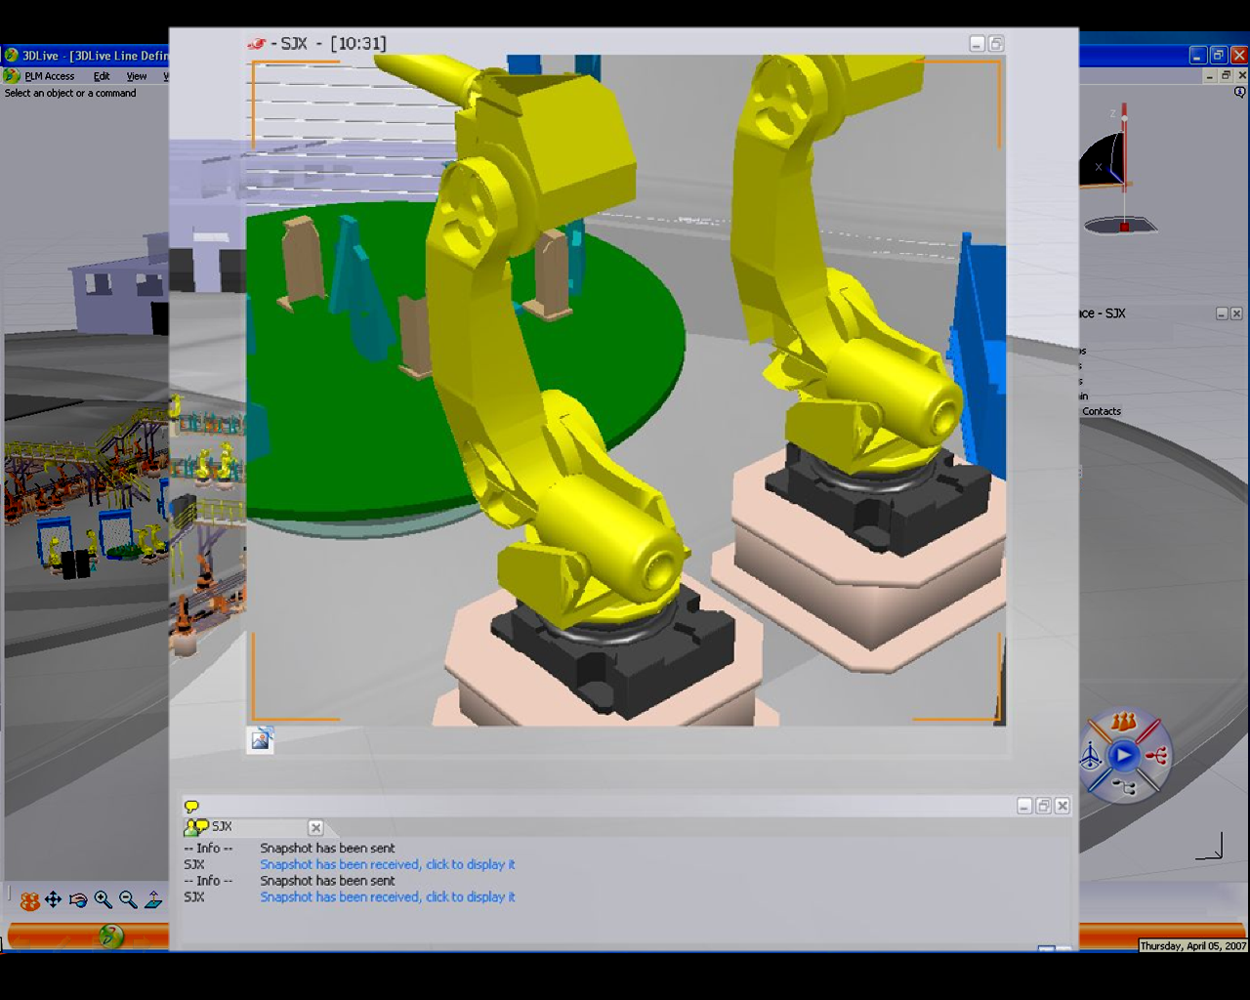
Collaboration in the client
Notes:
And this is what people are collaborating on that is transmitted…
Should have a red frame, and ideally greying out the surrounding

Slide 15
Business Process Communications
What can you do with this?
Platform Capabilities
Contextual
Collaboration
Business
Process
Communications
Anywhere
Information
Access
Speed up business processes
Automates business processes through communications
  Role agents that broker communications when needed
  Outbound form filling requests via chat or the phone
High volume outbound notifications and alerts
  Via e-mail
  Via the IM client
  Via the phone
  Broadcast IM

Slide 16
Anywhere Information Access
What can you do with this?
UC Platform Capabilities
Contextual
Collaboration
Business
Process
Communications
Anywhere
Information
Access
Enable anywhere access to information
Make information accessible via communications clients
  Extend the reach of your application to the phone
  Access information inside the firewall via Communicator
Automate the access to information
  Build IVR touch tone, speech information or self-service applications
  Build chat self-service applications
  Build Query/Response Bots

Slide 17
Unified Communications Opportunity
What can this mean for your organization?
Microsoft Unified Communications software
  Offers a flexible, scalable and secure platform
  Takes out the complexity of the communications plumbing
  Integrates with your existing applications
  Uses familiar development paradigms to your developers
  Provides excellent tools and developer support

Slide 18
Unified Communications Opportunity
What can this mean for your organization?
And that can
  Streamline communications
  Speed up business processes
  Extend the reach of your applications

Slide 19
End To End Demo
The Litware Inc. Server Control Room

Slide 20






Litware Inc.
Exchange, SharePoint, OCS and Communicator
SharePoint
Server
Exchange
Server 2007
IT Portal
Messages,
Calendar
Office
Communications Server 2007
OCS
Speech Server
Communications
IVR
Information Worker (UC endpoints)
Office Communicator Devices

Slide 21






Litware Inc. Architecture
Exchange, SharePoint, OCS and Communicator
Remote
Workers
SharePoint
Server
Exchange
Server 2007
Active Directory
Perimeter Network (DMZ)
Messages,
Calendar
MOM/MMC
Federated Businesses
IT Portal
Office
Communications Server 2007
OCS
Speech Server
Edge Servers
Existing
PBX Network
PSTN and
Mobile Phones
IVR
Information Worker (UC endpoints)
Office Communicator Devices

Slide 22
The Litware Inc. Control Room
A SharePoint server dashboard application
Consolidates information of the branches
  Server health status
  Staffing schedules
  Service Level Agreement status e-mails
Provides access to
  Communications information
  Business processes

Slide 23
Litware Inc. Architecture
Exchange, SharePoint, OCS and Communicator APIs
SharePoint
Server
Exchange
Server 2007
SharePoint
Web Parts
Exchange
Web
Services
Office
Communications Server 2007
OCS
Speech Server
UC
Managed
API
Windows
Workflow
Information Worker (UC endpoints)
Communicator Automation
Office Communicator Devices

Slide 24
Software Powered Unified Communications
SharePoint Web Parts
  To embed UC information in the LOB Portal app
Communicator Automation
  To enable presence and communications
Exchange Web Services
  To use data in the Exchange store
UC Managed API
  To enable communications services like bots
Windows Workflow Foundation
  To enable speech applications

Slide 25
End To End Demo
Demo
The Litware Inc. Server Control Room

Slide 26
Embedding Presence
Leveraging the Microsoft Presence Controls

Slide 27
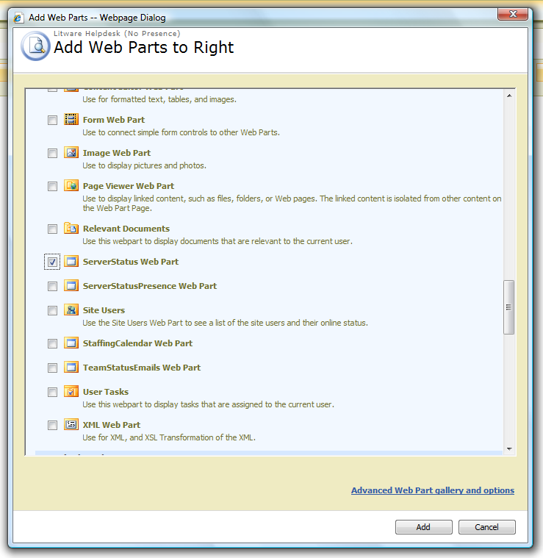
Leveraging SharePoint Web Parts

Slide 28
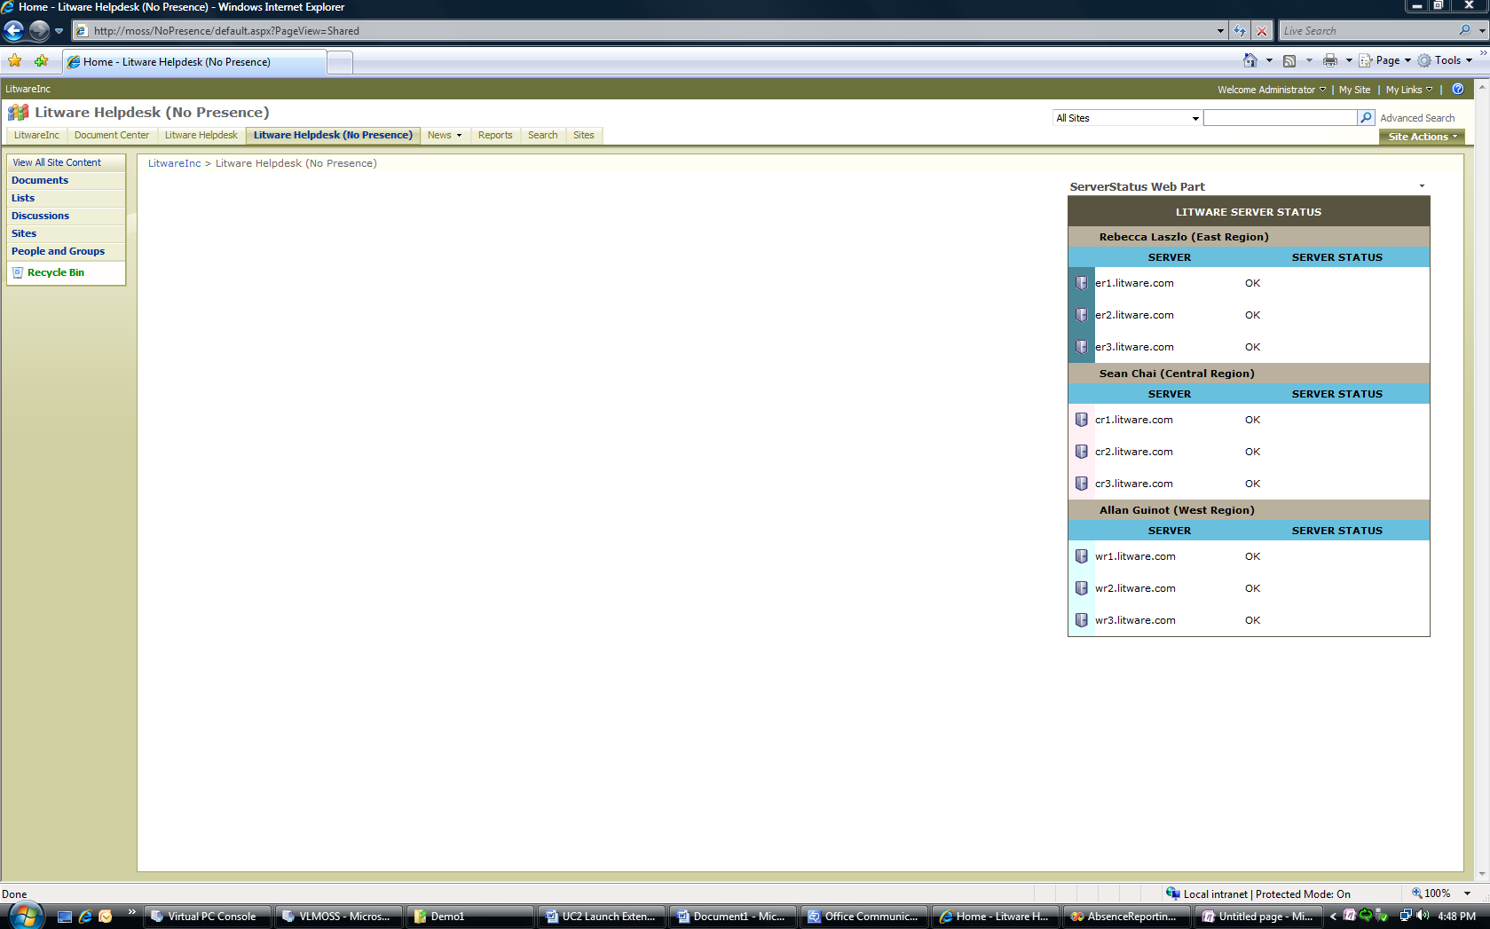
Not presence enabled

Slide 29
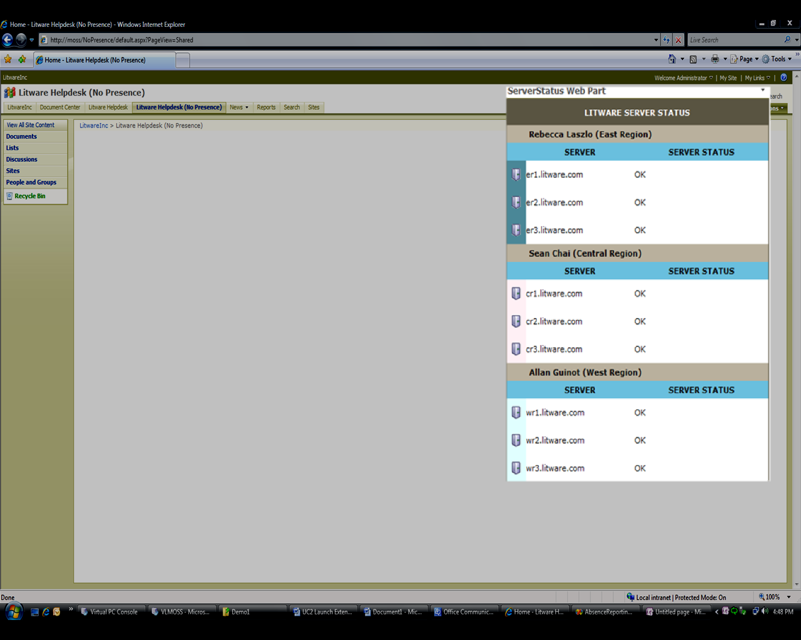
Web part

Slide 30
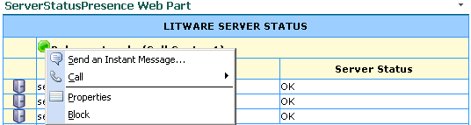
Click To Communicate…

Slide 31
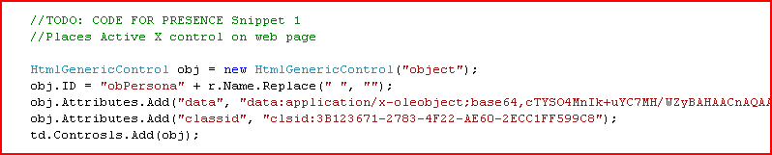
Embedding Presence in 5 Lines of Code
Using the ActiveX presence controls

Slide 32
Embedding Presence
Demo

Slide 33
Embedding Exchange Data
The power of Exchange Web Services

Slide 34
What is Exchange Web Services
Standards-based API to the Exchange store
  Mail
  Voice mail
  Calendar
  Free/Busy
  Contacts
  Notifications (new mail, reminders, etc.)
Can provide secure access through https
  Also outside the firewall

Slide 35
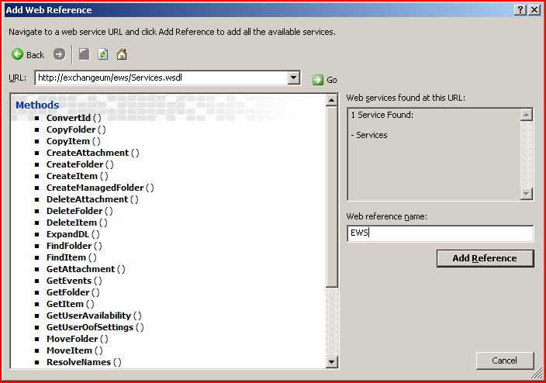
Exchange Web Services Reference

Slide 36
Exchange Web Services Reference

Slide 37
Embedding Exchange Data
Demo

Slide 38
Building A Response Bot
Retrieving information automatically

Slide 39
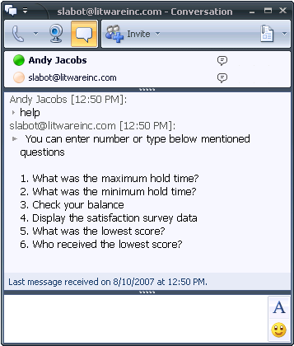
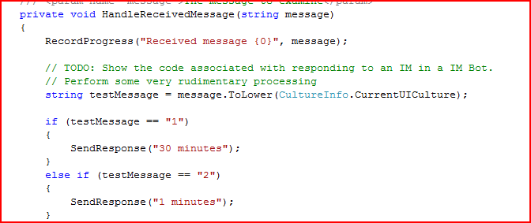
Response Bot in Managed Code

Slide 40
Building A Response Bot
Demo

Slide 41
Building A Voice Response App
The ease of Windows Workflow

Slide 42
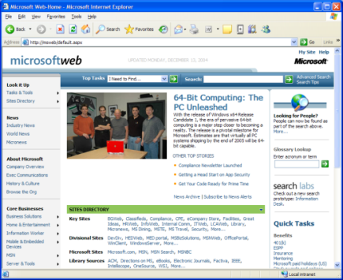

Building A Voice User Interface
Voice User Interface
Graphical User Interface
Application Logic and Business Rules
Focus on the presentation layer
Same application logic
Same back-end data
Same development tools
Same management tools
Same monitoring tools
Back-end Data

Slide 43
Speech Application Development Steps
Define the dialogue flow
  Statements, questions and answers…
  Other activities
Specify possible answers (grammars)
Record questions (prompts)
Integrate into the back-end (Web services)
Deploy, test and tune application

Slide 44
VS Plug-Ins For Each Development Step

Slide 45

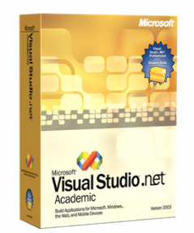

VS Plug-Ins For Each Development Step
Dialog Workflow Designer
Windows Workflow
Extended for Speech
Toolbox of VUI Activities
Custom Activity Support
Extensible with
other Workflows

Slide 46
VS Plug-Ins For Each Development Step
Dialog Workflow Designer
Conversational Grammar Builder
Windows Workflow
Extended for Speech
Toolbox of VUI Activities
Custom Activity Support
Extensible with
other Workflows
Easy-to-use UI
Natural Language
Multi-lingual

Slide 47
VS Plug-Ins For Each Development Step
Dialog Workflow Designer
Conversational Grammar Builder
Windows Workflow
Extended for Speech
Toolbox of VUI Activities
Custom Activity Support
Extensible with
other Workflows
Easy-to-use UI
Natural Language
Multi-lingual
Prompt Management
Prompt
Recording Studio
DB Prompt
Management
Prompt Validation

Slide 48
VS Plug-Ins For Each Development Step
Dialog Workflow Designer
Conversational Grammar Builder
Windows Workflow
Extended for Speech
Toolbox of VUI Activities
Custom Activity Support
Extensible with
other Workflows
Easy-to-use UI
Natural Language
Multi-lingual
Integrated Speech Debugger
Prompt Management
WF and VS Integration
Speech Debugger UI
Prompt
Recording Studio
DB Prompt
Management
Prompt Validation

Slide 49
VS Plug-Ins For Each Development Step
Dialog Workflow Designer
Conversational Grammar Builder
Windows Workflow
Extended for Speech
Toolbox of VUI Activities
Custom Activity Support
Extensible with
other Workflows
Easy-to-use UI
Natural Language
Multi-lingual
Integrated Speech Debugger
Prompt Management
WF and VS Integration
Speech Debugger UI
Prompt
Recording Studio
DB Prompt
Management
Prompt Validation
Managed Code DLL

Slide 50
Speech Application Development Steps
Define the dialogue flow
  Statements, questions and answers…
  Other activities
Specify possible answers (grammars)
Record questions (prompts)
Integrate into the back-end (Web services)
Deploy, test and tune application

Slide 51
Design The Dialog Flow
Visual Studio Dialog Workflow Designer
Lets you quickly define a workflow graphically
  Drag activities from Toolbox onto design surface
  Configure activity properties in Properties window
  Code-beside for business logic (your code)
  Provides a mechanism for compiling workflows
  creating new activities
  Integrated workflow and code debugging

Slide 52
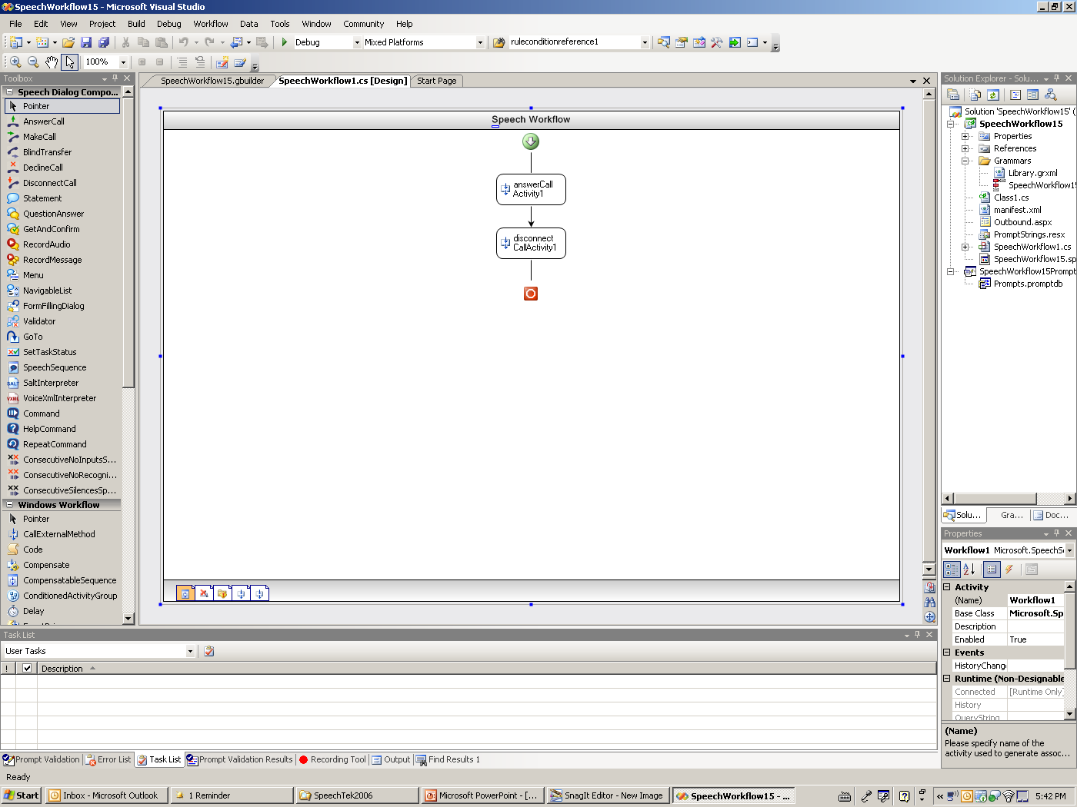
Dialog Workflow Designer

Slide 53
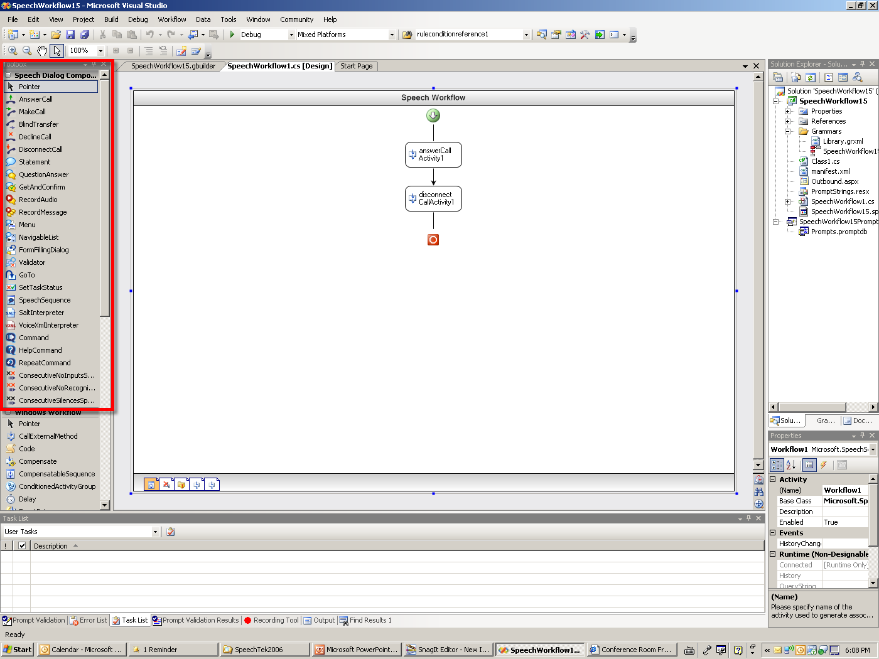
Dialog Workflow Designer

Slide 54
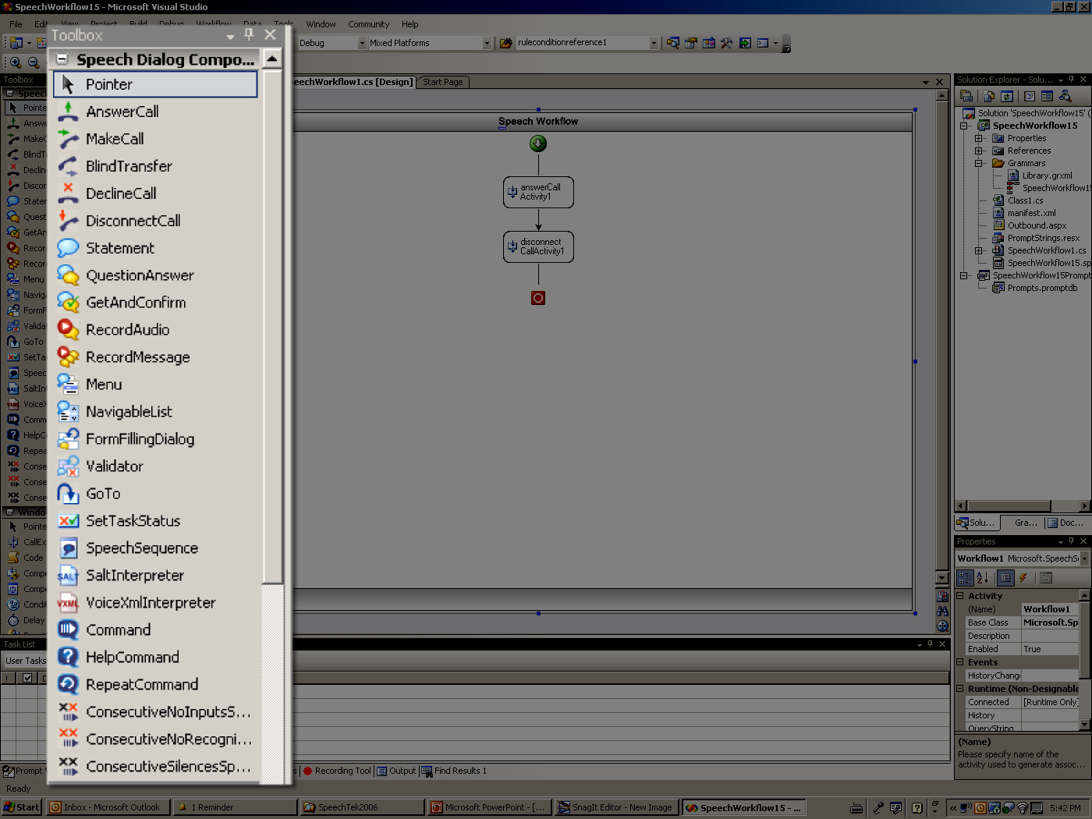
Dialog Workflow Designer

Slide 55
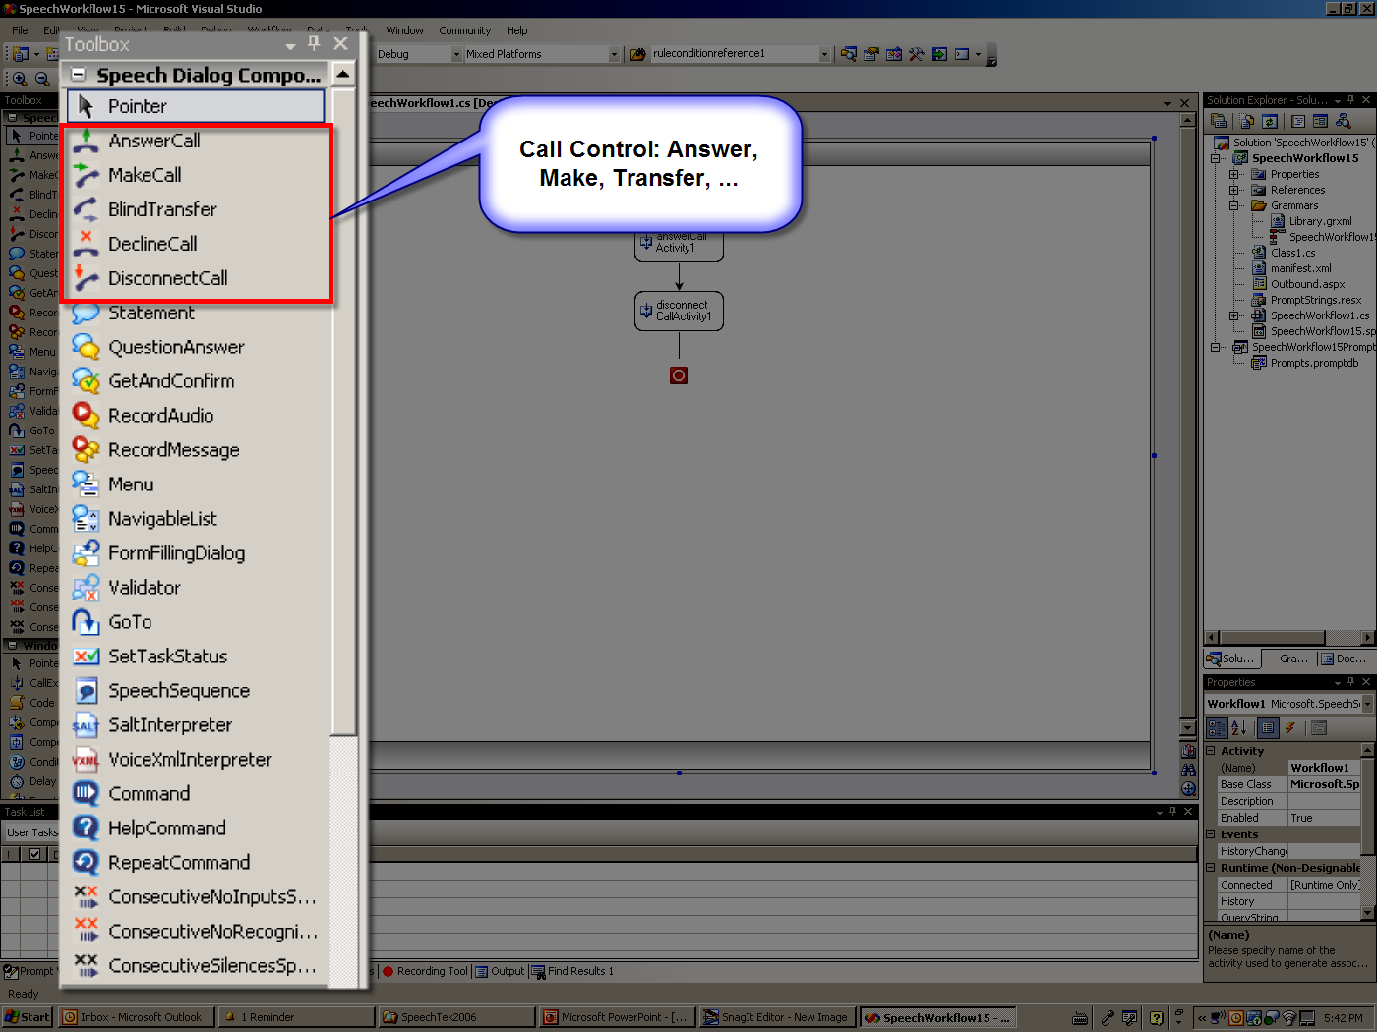
Dialog Workflow Designer

Slide 56
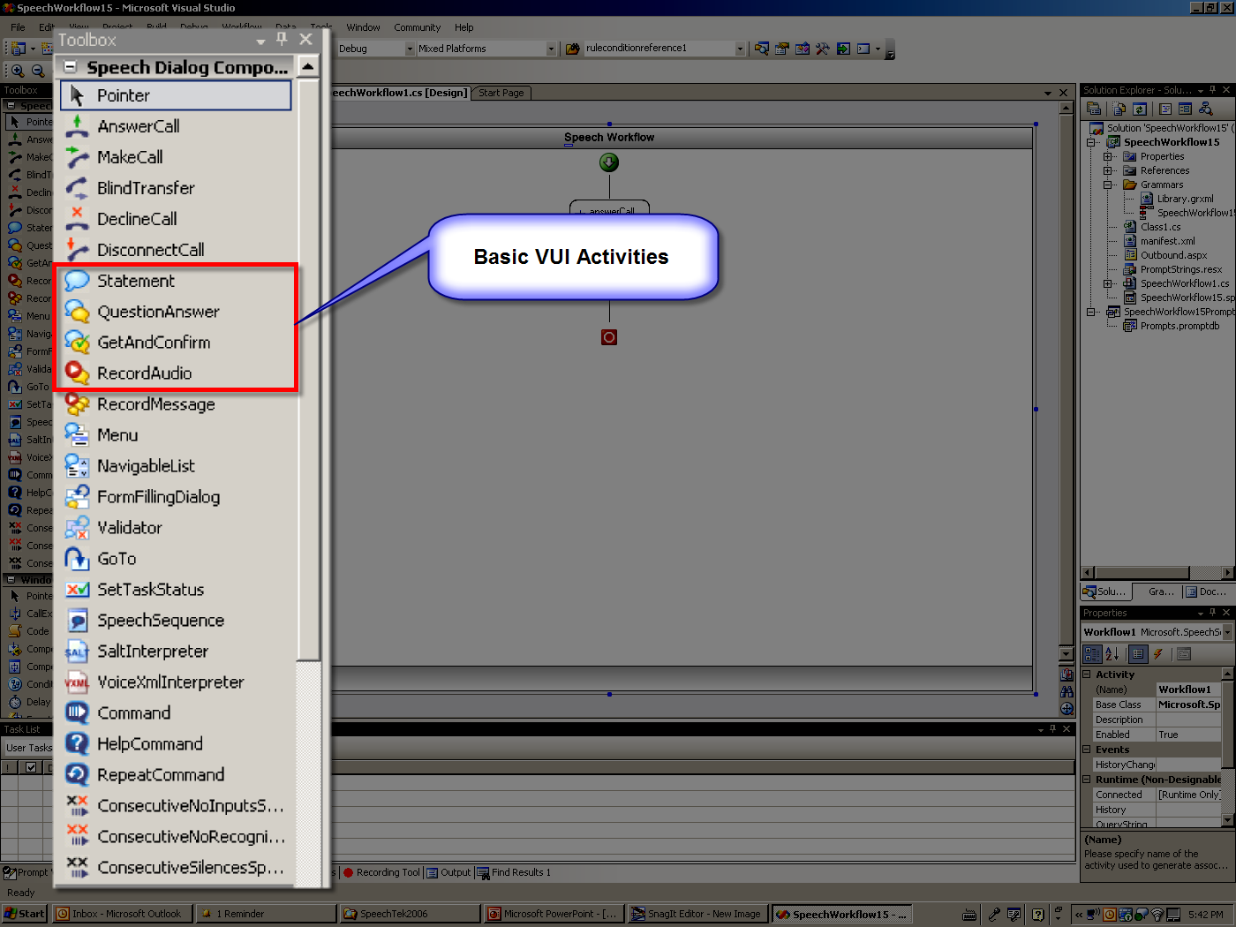
Dialog Workflow Designer

Slide 57
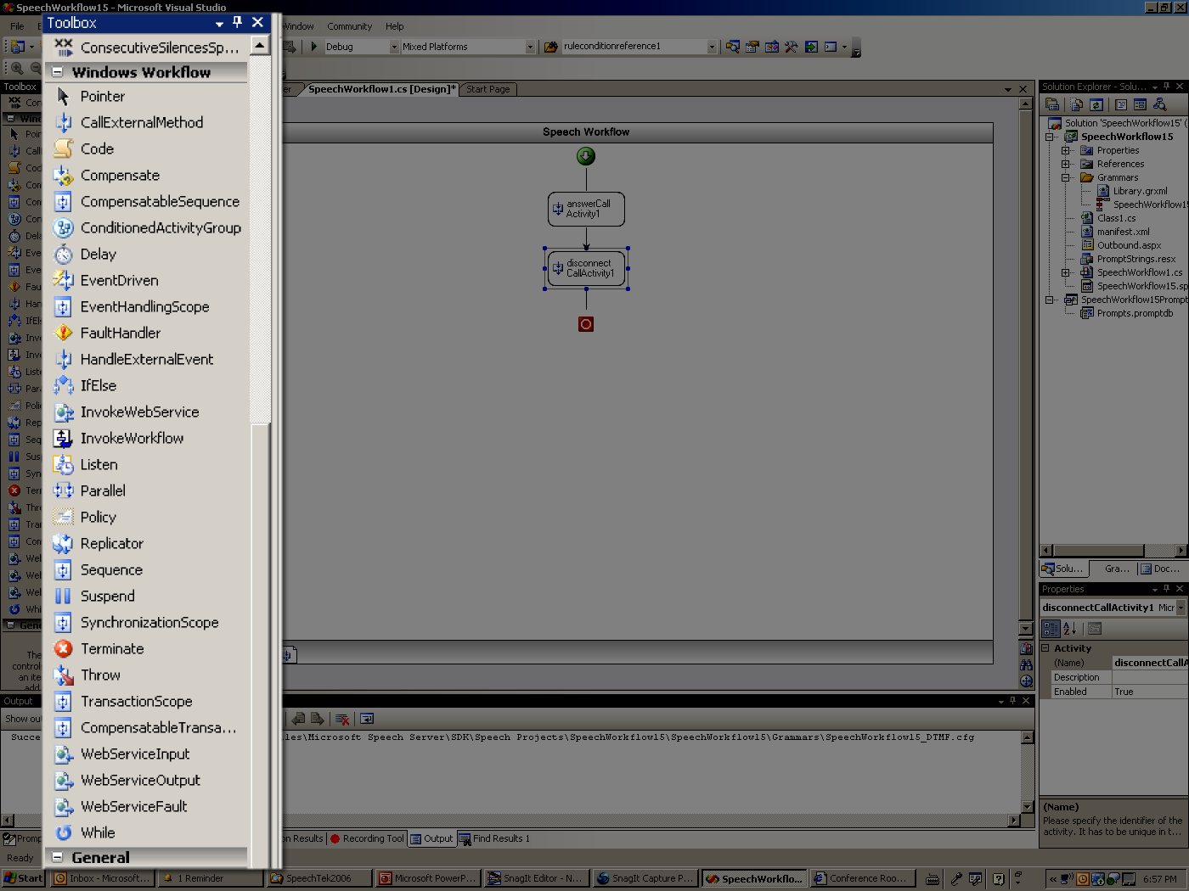
Dialog Workflow Designer

Slide 58
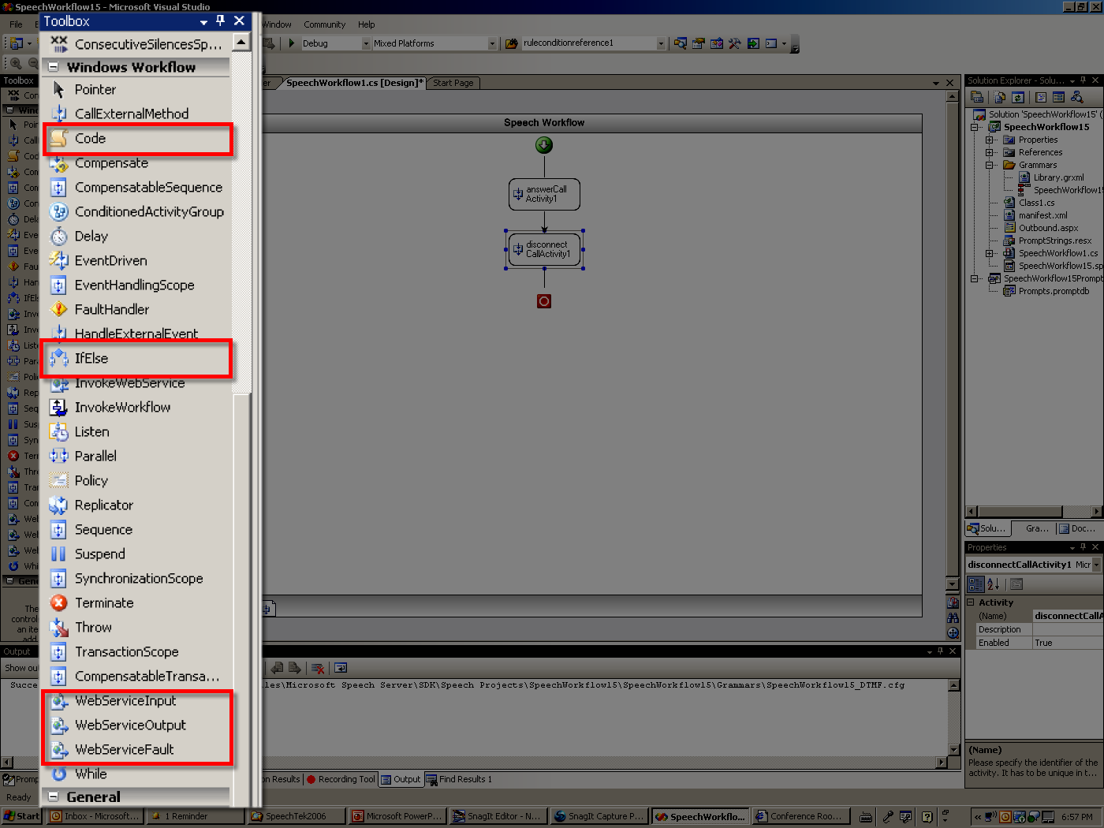
Dialog Workflow Designer

Slide 59
Building a Voice Response App
Demo

Slide 60
Key Takeaways
In this session you learned about…
Microsoft’s Software-powered Unified Communications
Sample uses of Unified Communications in an enterprise
How easy it is to embed UC in your applications
That you can fully leverage your developers’ .NET skills

Slide 61
Q&A

Slide 62
Resources
Visit the Microsoft Unified Communications Developer Portal
http://msdn2.microsoft.com/en-us/office/aa905374.aspx
  Visit the Microsoft Exchange Developer Center
  http://msdn2.microsoft.com/en-us/exchange/default.aspx
  Visit the OCS 2007, and Exchange Server 2007 Tech Centers
  http://technet.microsoft.com
Notes:
9/6/2007 8:25 AM
© 2005 Microsoft Corporation. All rights reserved.
This presentation is for informational purposes only. Microsoft makes no warranties, express or implied, in this summary.
62

