Slide 1
ADO.NET Entity Framework
技術指引與應用
奚江華
作家／微軟講師／技術顧問

Slide 2
Agenda
OOP vs. Relational database
Entity Data Model（EDM）
ADO.NET Entity Framework架構
Entity Framework程式設計

Slide 3

OOP vs. Relational Database
Discusses
窺探Entity Framework架構
OOP vs. Relational Database
Objects != Relational Data

Slide 4
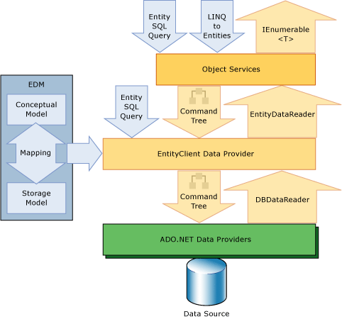
Entity Framework資料存取架構圖
程式設計
VS 2008 SP1 EDM工具

Slide 5
OOP v.s. Relational Database
Object Oriented Programming
has been around for decades
Relational databases have been
around for even longer
Bridging the gap between these
two has been a mostly manual task
  Modulo 3rd party solutions
The core problem remains

Slide 6
Objects != Relational Data
The fundamental problem is that relational data and objects in a programming language aren’t the same!
  They have different semantics, languages, etc
Both are needed – how many applications don’t use a relational database, or have some type of data model?
Object / Relational Mapping

Slide 7
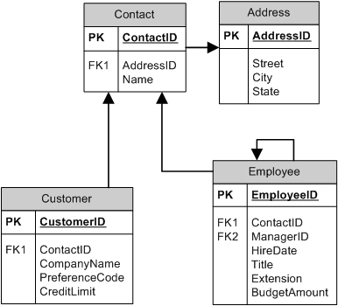
OOP to Data Engine Disconnect
Relational Model

Slide 8
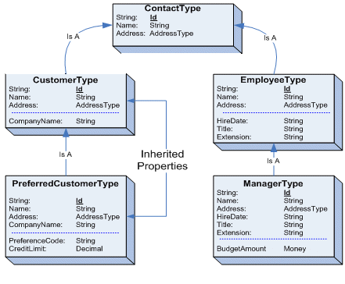
OOP to Data Engine Disconnect
Object Model
Notes:
Diagram from MSDN – Development Tools and Languages – Visual Studio 2005 – Technical Articles – Visual Studio – ADO.NET Tech Preview: Entity Data Model

Slide 9
Entity Data Model（EDM）
Discusses
E-R Model & Entity Data Model
EDM設計目標
EDM主要成員
一體通用的Data Model資料模型

Slide 10
什麼是Entity Data Model?
A abstract conceptual model of data
  Based on Entity-Relationship Model by Dr. Peter Chen (1976)
  Entities and Relationships between those Entities
    Entity Types
    Association Types
    Navigation Properties
  The EDM is able to bring relational
  data and OOP together

Slide 11
EDM設計目標
EDM可以讓Domain Model與組織使思考與使用資料達成一致性。
EDM也是微軟對於橫跨開發人員／伺服器技術之核心資料模型的主要目標。
EDM Models可應用於
  ADO.NET Entity Framework
  ADO.NET Data Services Framework
  ADO.NET Dynamic Data Framework
  Input to Reporting
  Visualization applications
  Intranet portal applications
  workflow applications

Slide 12
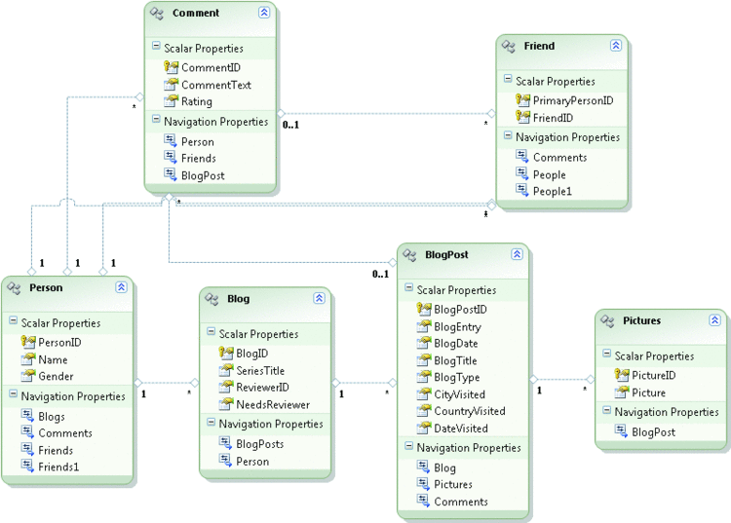
Sample Entity Data Model for a Blogging Database
Application-level Domain
Notes:
Application-level Domain

Slide 13
Entity Framework And EDM
How does it bridge the gap?
  A model that works for both
  Common type system
  Inheritance
  Complex types
EDM is not focused on application design as a whole, but on the design of your data

Slide 14
Entities As Objects
Like an object
Known type
Distinct identity
Properties hold
scalar values
Properties hold references to
other entities
Unlike an object
Entity identity (A.K.A. primary key)
Associations to
other entities
Lives within a collection

Slide 15
Entities As Relational Data
Like relational data
Primary key
No behavior defined
Relationships (associations) to other entities
Lives within an entity set
Unlike relational data
No physical storage knowledge (tables, indexes, etc)
Supports inheritance
Complex types

Slide 16
What Does This Mean?
Every layer in an application has unique requirements of the data, but they all use
data in terms of Entities
The EDM is the Lingua Franca of the
stack – it bridges the gap between OOP
and relational data
Your data model is no longer tightly bound
to your database or your application

Slide 17
一體通用的Data Model資料模型
Where you create a single model…
  Can be stored in your database
  That represents your business,
  but can be specialized
  That is used in your Web sites, Rich Client Applications, Mid tier solutions, etc
  That can be exposed via Web services
  That you can base your reports on
  That can be used as the model for your data cubes

Slide 18
Entity Framework架構
Discusses
Entity Framework介紹
Entity Data Model工具
建立Entity Data Model
EDM主要定義檔成員

Slide 19
ADO.NET Entity Framework介紹
目的
  EF能夠讓開發人員以Domain-Specific物件及屬性來處理資料，例如顧客、顧客地址等等
  不必擔心底層儲存的Database、Tables及Column
  讓開發人員在進行資料處理時可以提升抽象層次
  減少建立及維護以資料為中心AP所需的程式碼
實作
  EF負責Conceptual Model / Storage Model Mapping
  開發人員只需與Conceptual Model物件互動
  EF 負責轉換Query與Database之查詢作業

Slide 20
ADO.NET Entity Framework
Features
Entities
  Properties – primitive types or complex types
  Navigation property – represents relationship between entities
  Methods – implemented with partial classes
LINQ to Entities
  Translates object queries to data store query
  Alternate method based query syntax

Slide 21
ADO.NET Entity Framework
Benefits
Developers work with business objects
  No requirement of relational structure knowledge
  Relational structure changes don’t mean recode
  Navigation of relationships by properties
  Does not require writing SQL DML queries
  Interaction with data store managed by framework
  IntelliSense
Performance
  Deferred loading of data when needed

Slide 22
The Entity Framework
ADO.NET Entity Framework是第一個實作EDM的產品
EF是一個應用程式開發的framework
  EDM Modeling tools
  Mapping EDM model to/from DB and CLR
  Object Services

Slide 23
Entity Data Model工具
Entity Data Model Wizard
Entity Data Model Designer
Update Model Wizard

Slide 24
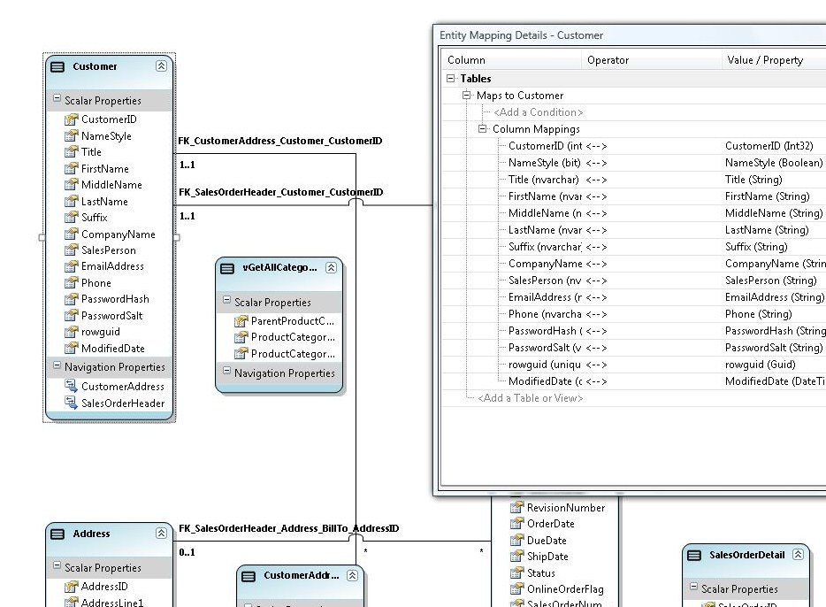
建立Entity Data Model

Slide 25
以EDM Wizard建立EDM
demo
Application-Level
Domain
Notes:
這個示範要一一呈現傳統Web Services所不能達到的困境

Slide 26
EDM主要定義檔成員
Conceptual Model
  定義Entities及Relationships
  Conceptual schema definition language file (.csdl)
Storage Model（Logical Model）
  目的是為了關聯式資料庫，將Entities及Relationships正規化成具有foreign key constrains的Table資料表
  Store schema definition language file (.ssdl)
Mappings
  定義Storage 及Conceptual Model二者間的對應
  Mapping specification language file (.msl)

Slide 27
檢視EDM定義檔
demo
.csdl
.ssdl
.msl
Notes:
這個示範要一一呈現傳統Web Services所不能達到的困境

Slide 28
Entity Framework程式設計
Discusses
Entity Framework細部架構圖
Object Services服務
ObjectContext & ObjectQuery
Ｏbject Query查詢的三種方法

Slide 29
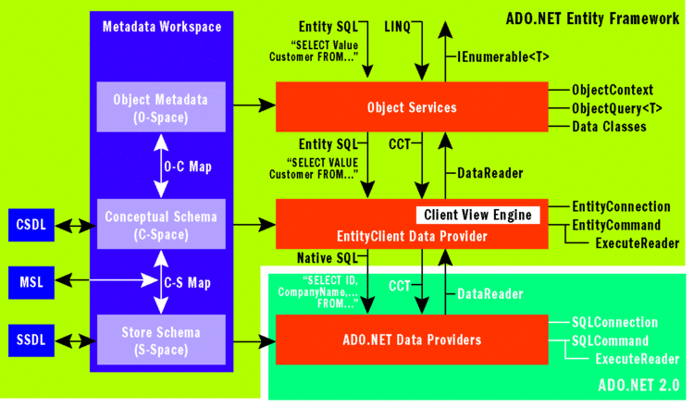
Entity Framework細部架構圖

Slide 30
Object Services物件服務
它是EF的一個元件System.Data.Entity.dll
在System.Data.Objects & System.Data.Objects.DataClass兩大命名空間實作
兩大命名空間中包含一群服務類別
對EDM中Entity Types作業之中介服務
Query、Insert、Update、Delete
Notes:
ms-help://MS.MSDNQTR.v90.en/wd_entityframework/html/43014cf9-c9cb-4538-bfbb-197820b60038.htm

Slide 31
System.Data.Objects類別
CompiledQuery
CurrentValueRecord
ObjectContext
ObjectParameter
ObjectParameterCollection
ObjectQuery
ObjectQuery<T>
ObjectResult<T>
ObjectStateEntry
ObjectStateManager
MergeOption列舉
RefreshMode列舉

Slide 32
System.Data.Objects.DataClass類別
ComplexObject
EdmComplexPropertyAttribute
EdmComplexTypeAttribute
EdmEntityTypeAttribute
EdmPropertyAttribute
EdmRelationshipAttribute
EdmRelationshipNavigationPropertyAttribute
EdmScalarPropertyAttribute
EdmSchemaAttribute
EdmTypeAttribute
EntityCollection<TEntity>
EntityObject
EntityReference
EntityReference<TEntity>
RelatedEnd
RelationshipManager
StructuralObject
介面
列舉

Slide 33
Object Services物件服務功能
Querying data as objects
Shaping query results
Composing queries using builder methods
Adding, changing, and deleting objects
Saving changes to the data source
Binding objects to controls
Attaching objects / Detaching objects
Serializing objects
Notes:
ms-help://MS.MSDNQTR.v90.en/wd_entityframework/html/43014cf9-c9cb-4538-bfbb-197820b60038.htm

Slide 34
Object Services物件服務功能.續
Managing object identities and tracking changes
Managing concurrency
Managing connections
Using custom objects with an Entity Data Model
Notes:
ms-help://MS.MSDNQTR.v90.en/wd_entityframework/html/43014cf9-c9cb-4538-bfbb-197820b60038.htm

Slide 35
ObjectContext類別
EDM中Entities Type的Instance
對於Entity資料提供Object型式互動的能力
ObjectContext類別中包含了：
  Connection to database
  MetadataWorkspace物件
  ObjectStateManager物件
Notes:
1.MetadataWorkspace物件是一個可以與應用程式Context中的EDM Metadata互動的中央Runtime服務元件。
2.ObjectStateManager是負責管理保存在快取中的物件。

Slide 36
ObjectQuery類別
ObjectQuery泛型類別代表了回傳零或多個強型別Entity Objects的查詢。
一個Object Query永遠屬於一個既存的Object Context，意即在使用ObjectQuery之前，一定要先建立一個Object Context。
因為Object Context提供了建構與執行查詢所需的Connection連線及Metadata資訊。

Slide 37
Object Query之執行
預設為遞延查詢（Defered Execution）
立即執行（Immediate Execution）
foreach (C#) or For Each
fill a List collection
Execute method
LINQ query operator- First or Any

Slide 38
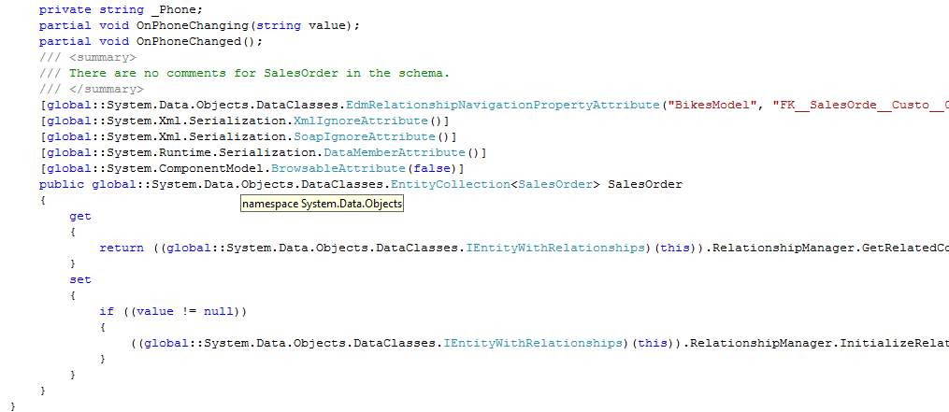
Programming The Entity Framework

Slide 39
三種Object Query查詢語法類型
LINQ to Entity（Language-Integrated Query ）
Entity SQL
Object Query Builder Methods
Notes:
這裡的Query查詢是指EDM所回傳的Entities物件的查詢，而此部分是由ObjectContext類別所負責，再者Query查詢編寫的語法有三種類型

Slide 40
以LINQ To Entities進行查詢
Queries against the generated classes
All the benefits of LINQ
  Compile time type checking
  Intellisense
  Etc
Query results are materialized objects
  Entity Types
  Anonymous Types
  Scalar values

Slide 41
LINQ to Entity運作流程
Step 1：建立ObjectContext
Step 2：建立ObjectQuery & LINQ Query
Step 3：LINQ Query ➔ Command Tree(EDM)
Step 4：EntityClient ➔ Command Tree(DBMS)
Step 5：將結果以物件型式回傳
Notes:
1.ObjectQuery在使用前，必須先建立好ObjectContext，因為它提供Connection及Metadata給ObjectQuery
2.
4.EntityClient Data Provider將Command Tree（EDM）轉換成DBMS的Command Tree，執行Query查詢

Slide 42
以LINQ to Entity查詢
demo
以Products資料表為例
Notes:
這個示範要一一呈現傳統Web Services所不能達到的困境

Slide 43
以Entity SQL進行查詢
SQL variant for working with Entity Data Model
  Understands inheritance, associations, etc
String based, but not dynamic SQL
Results can be either objects, or EntityDataReader
  Allows for higher performance
  when you don’t need objects

Slide 44

EF的未來

Slide 46

© 2008 Microsoft Corporation. All rights reserved. Microsoft, Windows, Windows Vista and other product names are or may be registered trademarks and/or trademarks in the U.S. and/or other countries.
The information herein is for informational purposes only and represents the current view of Microsoft Corporation as of the date of this presentation. Because Microsoft must respond to changing market conditions, it should not be interpreted to be a commitment on the part of Microsoft, and Microsoft cannot guarantee the accuracy of any information provided after the date of this presentation. MICROSOFT MAKES NO WARRANTIES, EXPRESS, IMPLIED OR STATUTORY, AS TO THE INFORMATION IN THIS PRESENTATION.

