Slide 1
Whats New in Internet Explorer 8?
Ranjana Jain
IT Pro Evangelist
Microsoft India
MCSE, MCT, RHCE, CIW Security Analyst, CISSP

Slide 2
Agenda
Have a Look
Why Internet Explorer 8
Peace of Mind
Faster and Easier
Reach Beyond the Page

Slide 3
Lets See…

Slide 4
Agenda
Have a Look
Why Internet Explorer 8
Peace of Mind
Faster and Easier
Reach Beyond the Page

Slide 5
Put the Web at Your Service
Reach Beyond the Page
Faster, Easier
Peace of Mind
Experience integrated online services and information you care about most
Quickly and easily access the power
of the Web
Browse confidently you’re using the safest, most reliable and compatible browser
Summary
Marquis Support Features/TPs
Consumer
Best browser for what you do every day – navigation, most secure and private
Web Slices, Accelerators,
InPrivate, Search
Enterprise
Enterprise class security and manageability
SDL, SmartScreen, GPO, Slipstream
Developers
Standards, built-in dev tools, and compatibility
Dev Tools, CSS 2.1, AJAX
layout versioning
Partners
Largest user platform with richest
service integration
80% WW; WebSlices,
Accelerators; Search

Slide 6
Agenda
Why Internet Explorer 8
Peace of Mind
Faster and Easier
Reach Beyond the Page

Slide 7

Enhancing Online Trust & Confidence
Social Engineering, Browser & Site Exploites
Social Engineering & Exploits
Reduce unwanted communications
  Freedom from intrusion
International Domain Names
Pop-up Blocker in IE7
Increased usability
  Browser & Web Server Exploits
  Protection from deceptive websites,
  malicious code, online fraud, identity theft
  Protection from harm
Secure Development Lifecycle
Extended Validation (EV) SSL certs
SmartScreen® Filter
Domain Highlighting
XSS Filter/ DEP/NX
ActiveX Controls
  Choice and control
  Clear notice of information use
  Provide only what is needed
  Control of information
User-friendly, discoverable notices
P3P-enabled cookie controls
Delete Browsing History
InPrivate™ Browsing & Blocking

Slide 8


Peace of Mind
Safety
  From Phishing
  From Malware
  From Bogus Domains
Privacy
  InPrivate Browsing
  InPrivate Blocking
Reliability
  More Stable
  More Reliable
  Faster Recovery
Browse with Confidence
Surf without Leaving Tracks
Explore with Peace of Mind

Slide 9
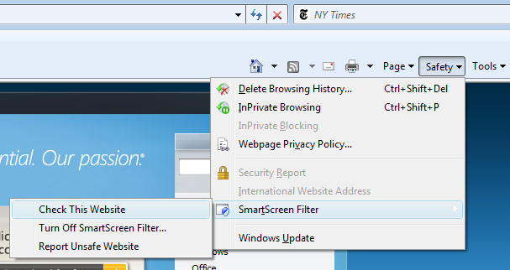


SmartScreen® Filter
SmartScreen® Filter
  Increases anti-phishing and anti-malware protection
  Allows you to report unsafe sites to Microsoft

Slide 10
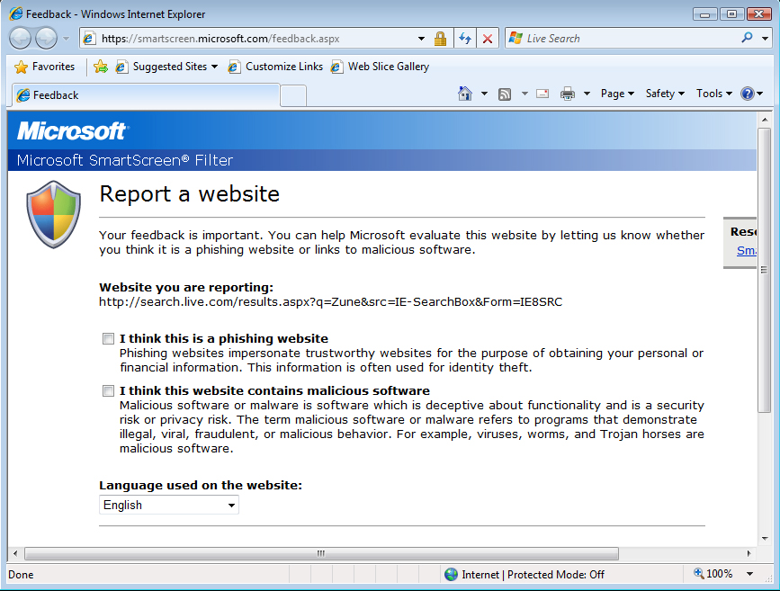
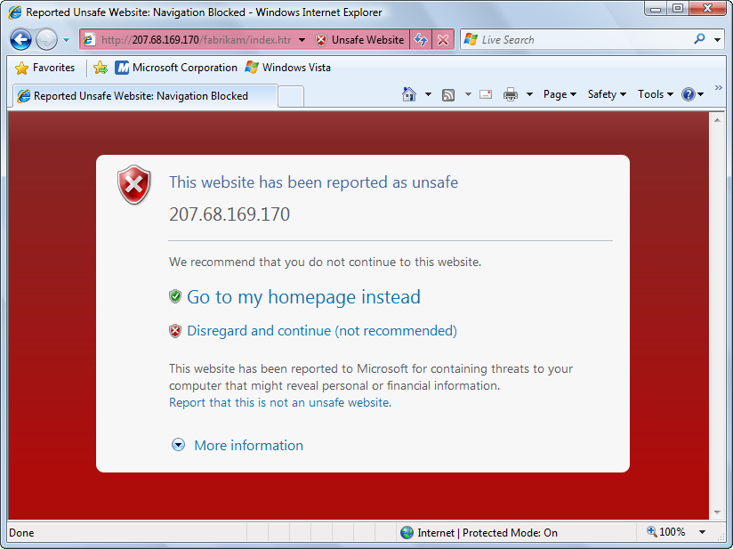

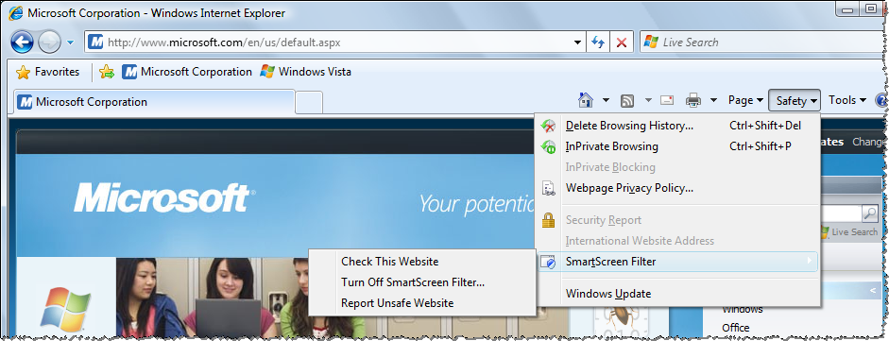
Security Enhancements
Domain Highlighting
SmartScreen Filter
Reporting Sites

Slide 11
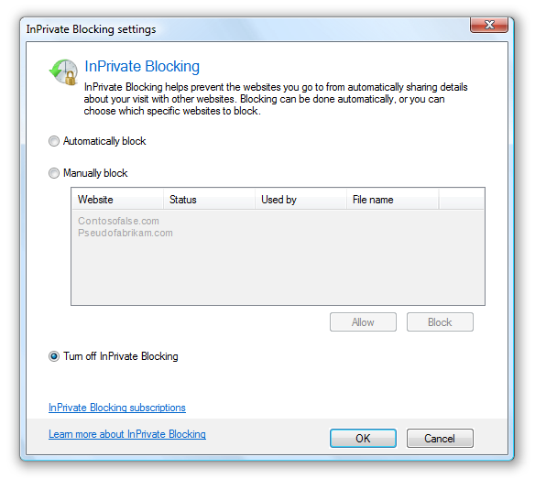
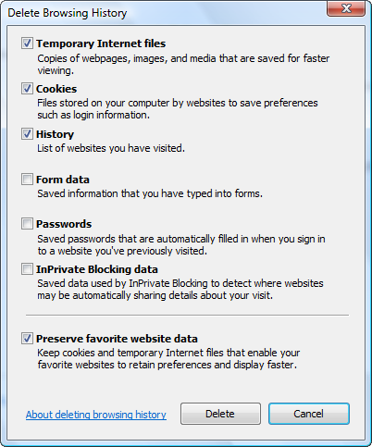

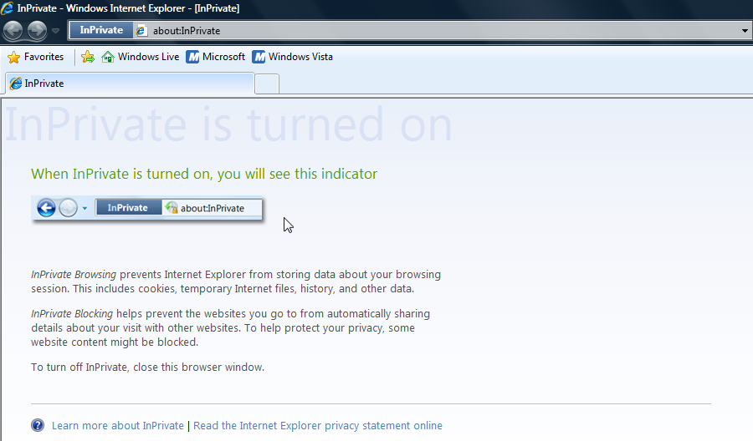

Privacy Enhancements
InPrivateTM Browsing
Enhanced Delete Browsing History
InPrivateTM Blocking

Slide 12
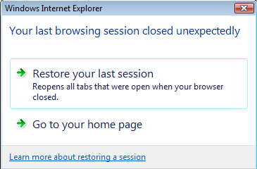
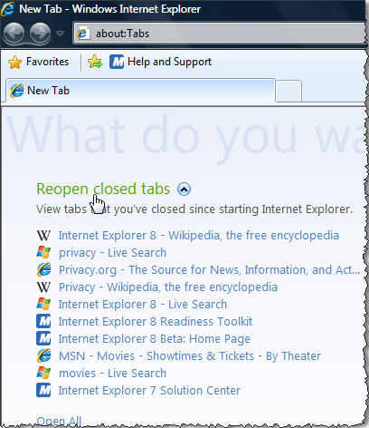
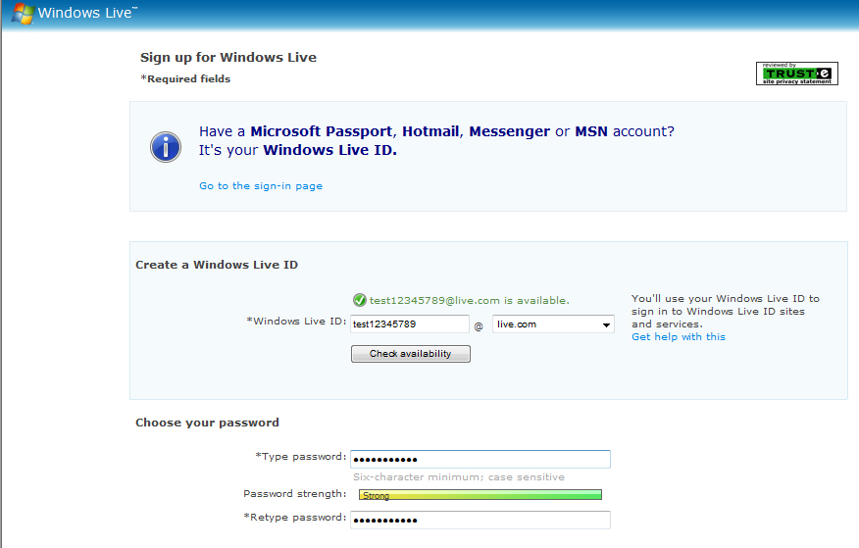
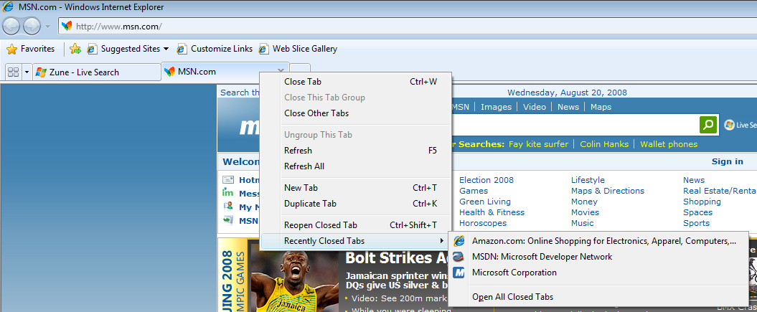
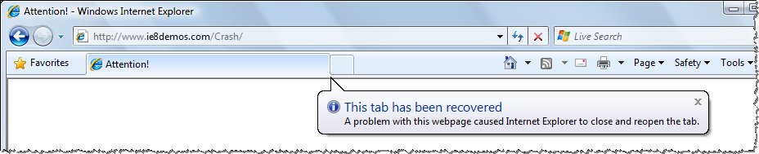
Reliability Enhancements
Reopen Closed Tabs
Tab Isolation
Automatic Crash Recovery
Forms Recovery

Slide 13
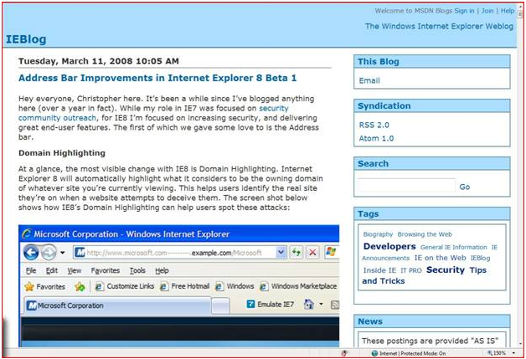
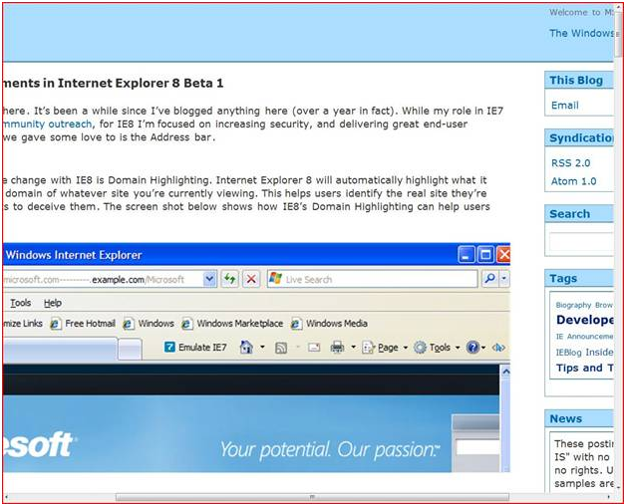

Accessibility
ARIA and UI
IE7 150% Zoom
IE8 150%
Adaptive Page Zoom

Slide 14
Agenda
Why Internet Explorer 8
Peace of Mind
Faster and Easier
Reach Beyond the Page

Slide 15
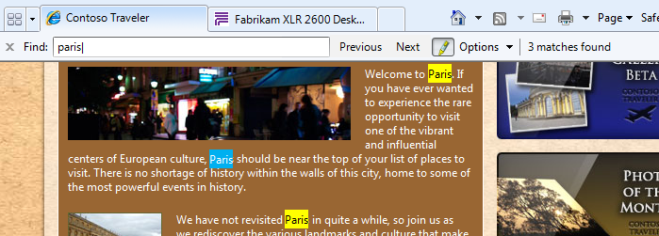
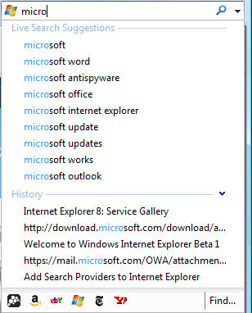
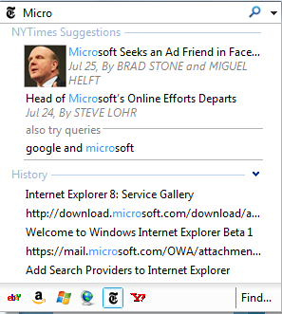
Faster and Easier
Search Suggestions
Enhanced Find on Page

Slide 16
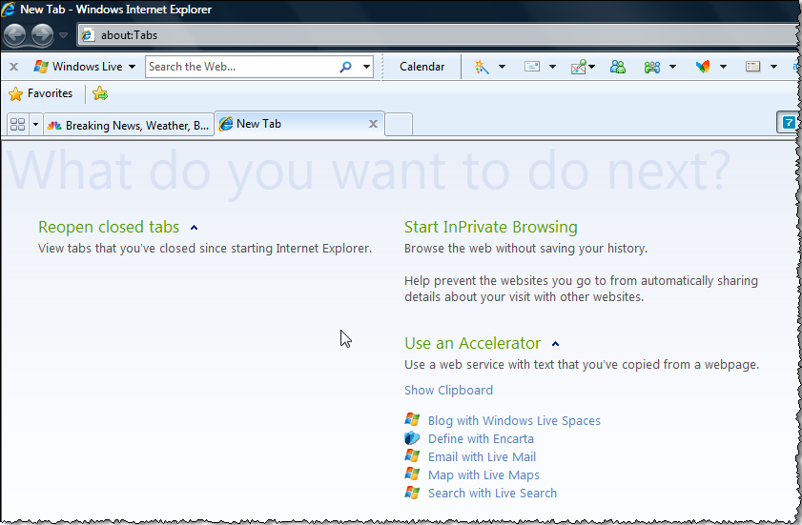
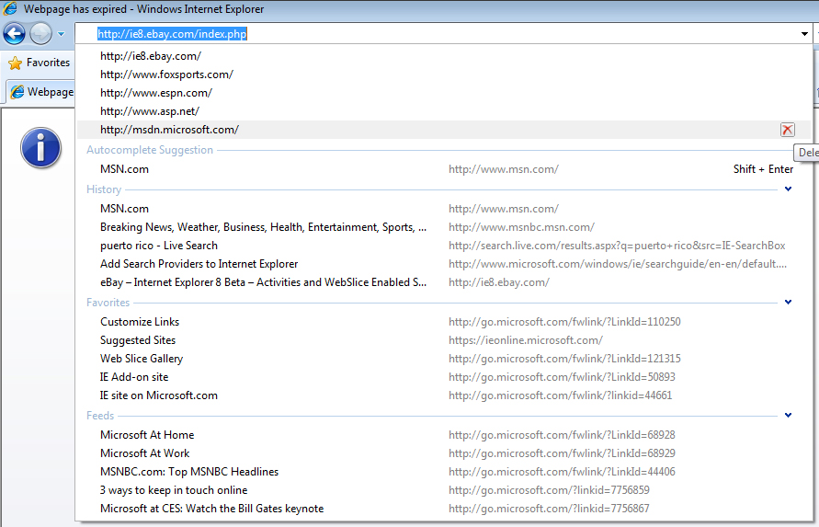

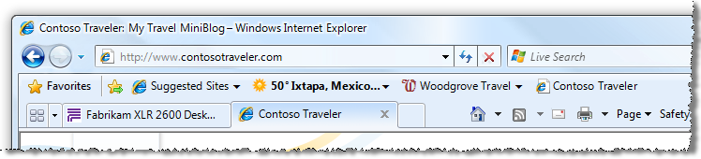

Features
Improved Performance
Smart Address Bar
Enhanced Favorites
Redesigned New Tab Page
Tab Grouping
Better Back Button
1-Click Favorites

Slide 17
Agenda
Why Internet Explorer 8
Peace of Mind
Faster and Easier
Reach Beyond the Page

Slide 18
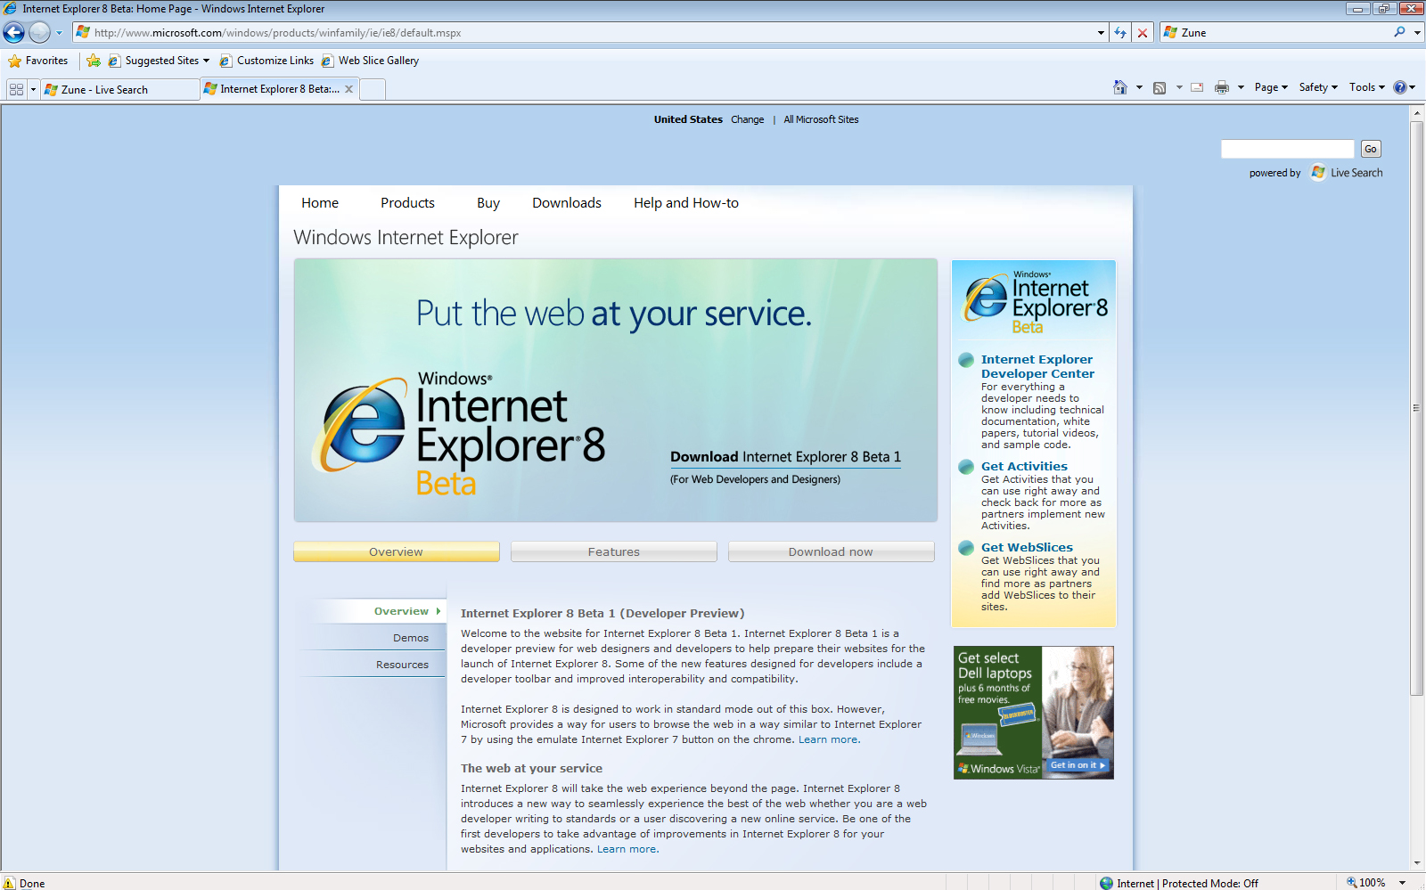
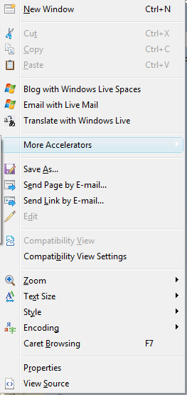
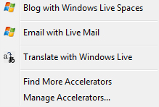
Accelerators
Ready Access to Online Services You Use Most
  Email
  Blog
  Shop
  Map
  Share
  Translate
  Find
  Define

Slide 19
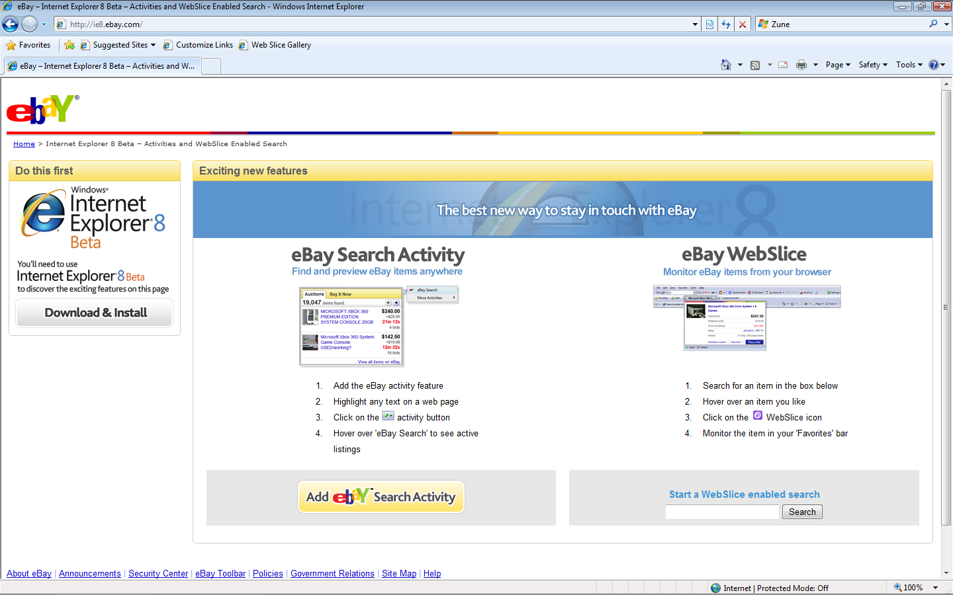
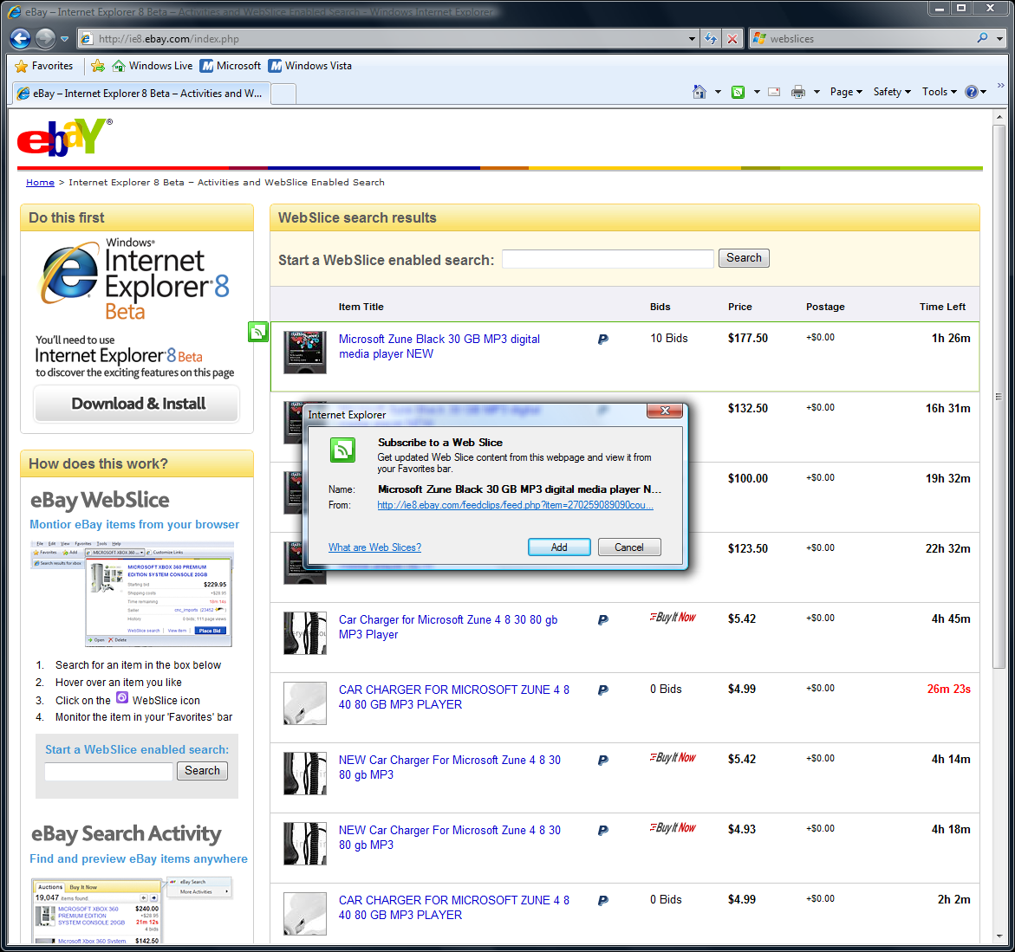
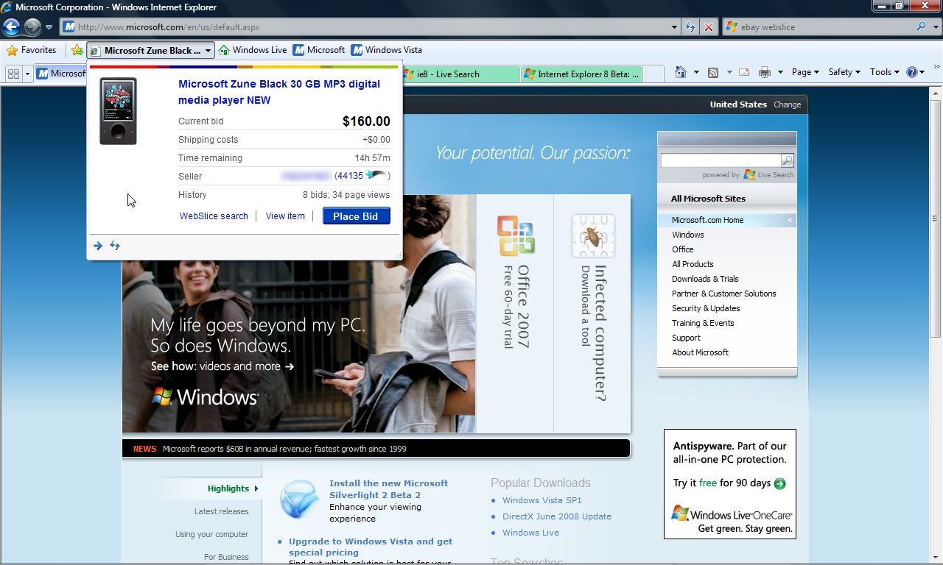
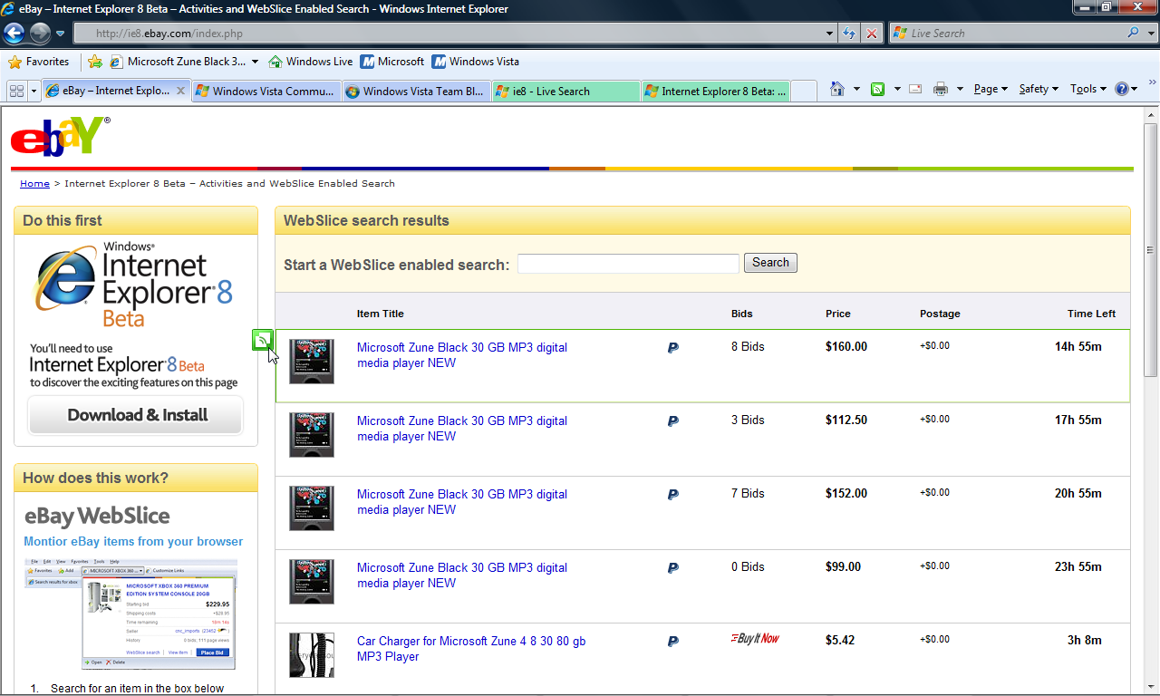
Web Slices
Rich, Real-time Integration of Online Services
Zune

Slide 20
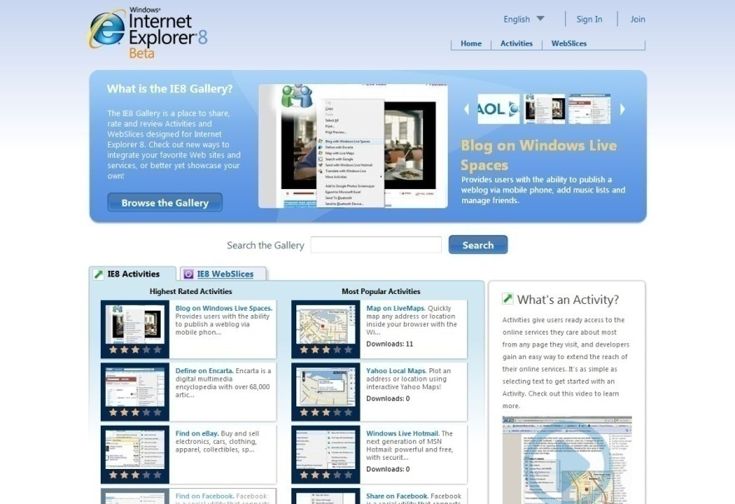
Internet Explorer Gallery
Currently Launching in US, GER, China
Generate excitement, drive adoption of the Internet Explorer 8 platform, and provide enhanced customer experience
Increase Partner incentive
Plans in place for US, GER, and China Galleries; need local Sub leadership on broadening program with Corp funding support

Slide 21
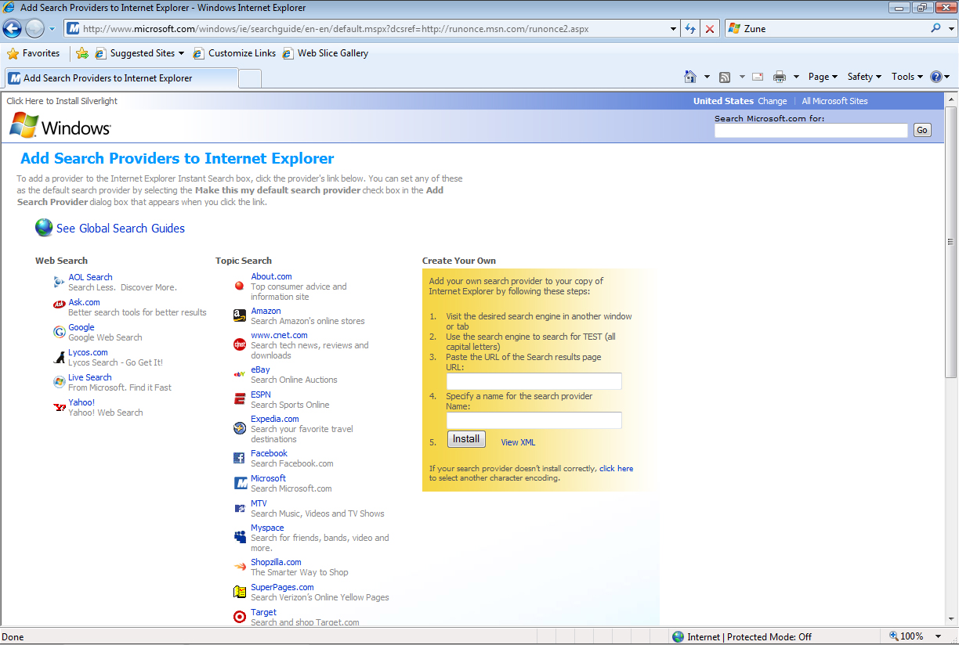
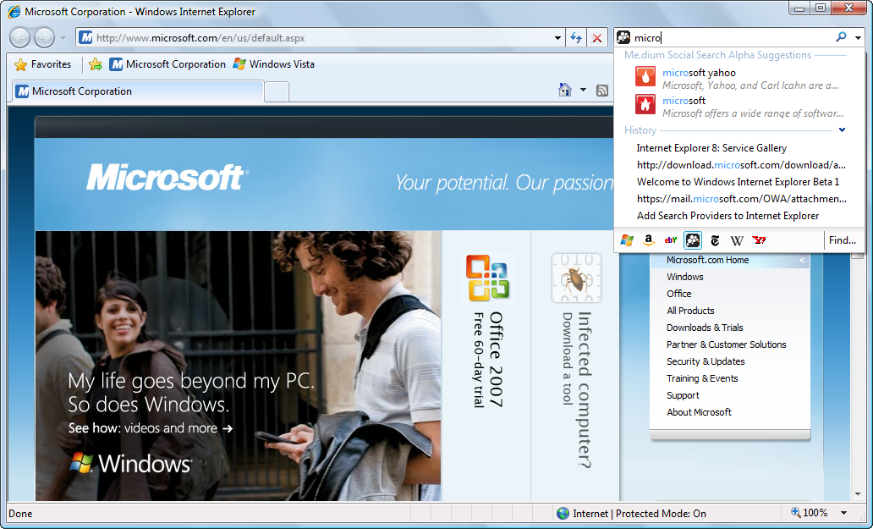
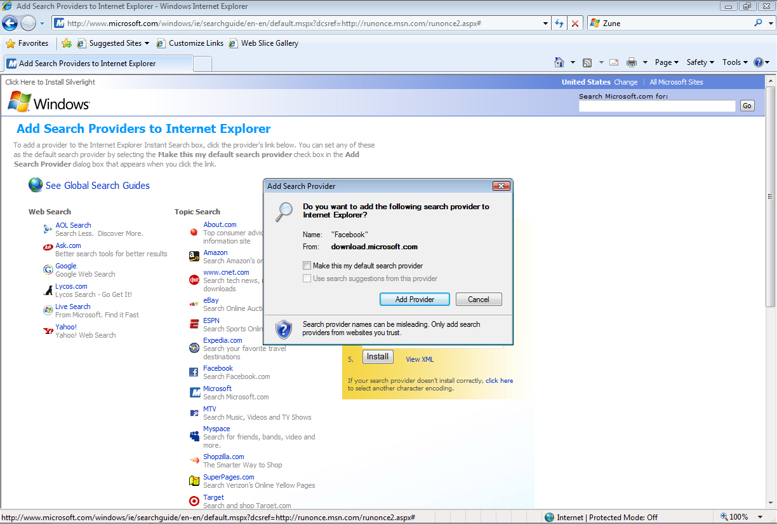
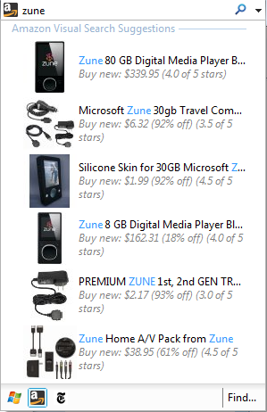
Improved Search
Suggestions with Results from History
Configure Multiple Search Providers
Quickly Specify Search Provider
Visual Search Returns Images with Results

Slide 22

Download Internet Explorer 8
Download Internet Explorer 8 Beta 2 now to experience the power of the web, visual search, and navigation
www.microsoft.com/ie8

Slide 23
Feedback / QnA
Your Feedback is Important!
  Please take a few moments to fill out our online feedback form at:
  << Feedback URL – Ask your organizer for this in advance>>
  For detailed feedback, use the form at http://www.connectwithlife.co.in/vtd/helpdesk.aspx
  Or email us at vtd@microsoft.com
Use the Question Manager on LiveMeeting to ask your questions now!

Slide 24
Contact (optional slide)
Blog Address
http://ranjanajain.spaces.live.com
Email Address
ranjanaj@microsoft.com

Slide 25

© 2008 Microsoft Corporation. All rights reserved. Microsoft, Windows, Windows Vista and other product names are or may be registered trademarks and/or trademarks in the U.S. and/or other countries.
The information herein is for informational purposes only and represents the current view of Microsoft Corporation as of the date of this presentation. Because Microsoft must respond to changing market conditions, it should not be interpreted to be a commitment on the part of Microsoft, and Microsoft cannot guarantee the accuracy of any information provided after the date of this presentation.
MICROSOFT MAKES NO WARRANTIES, EXPRESS, IMPLIED OR STATUTORY, AS TO THE INFORMATION IN THIS PRESENTATION.

