Slide 1
¿Hablan de Negocios tus Sistemas?
Juan Tonda
Director División Servidores y Plataforma
Microsoft

Slide 2



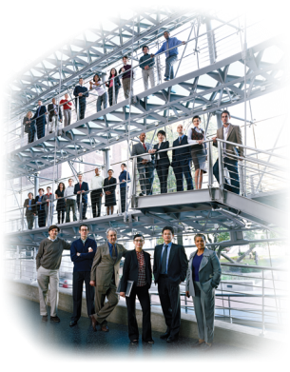

Construyendo el Éxito del Negocio
Los Requisitos del Negocio Transforman TI
TI Responde a los Requisitos del Negocio
Negocio
TI

Slide 3












Dynamic IT
Gestionar la complejidad,
conseguir agilidad
Avanzar el negocio con soluciones TI
Unified Communications And Collaboration
Business Intelligence
Enterprise Content Management
Proteger la información, controlar el acceso
Amplificar el impacto de las personas
Business Data Catalog
Open XML File Formats
Website and Security Framework
Workflow
Search
Extensible UI
Soportando procesos, basado en modelos
Orientado a servicios
Integrado y virtualizado
Plataforma segura e interoperable
Enfocado al usuario
Secured, Well-Managed Infrastructure
Principales áreas de innovación
Notes:
3

Slide 4
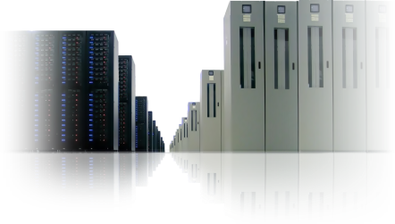
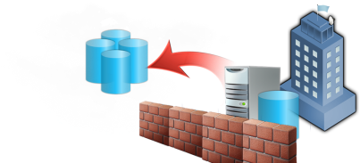

Dynamic IT La Próxima Generación de Aplicaciones y Centros de Datos
{
}
{
}
CENTRO DE DATOS
APLICACIONES
De físico a lógico
Gestionado por modelos y políticas
Auto-diagnóstico y auto-reparación
Disponible, seguro y tiempo real
Federadas, compuestas, servicios
Experiencias ricas y conectadas
Locales, remotas, virtualizadas
Desarrollo-Producción eficiente

Slide 5

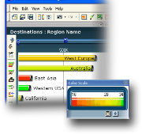

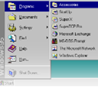









Evolución de las Aplicaciones Agregación de múltiples tecnologías durante más de 30 años
Aplicaciones Mainframe
Informática Personal
Aplicaciones Conectadas
Aplicaciones Conectadas en Internet
Aplicaciones Basadas en Servicios
Connected
Applications
Connected
Applications
Internet-
Connected
Applications
Personal
Computing
Mainframe
Applications
Mainframe
Applications
Mainframe
Applications
Mainframe
Applications
Personal
Computing
Personal
Computing
Host Systems
Early – mid 1980s
Client Server
Late 1980s – mid 1990s
Internet-Enabled
Mid 1990s
Composite / Services-Based
Mid 2000s – . . .

Slide 6




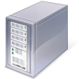

Effective Application Delivery
Personas
Proceso
Familiar, flexible y herramientas productivas
Gestión de Proyecto y Proceso
Gía clara de proceso
Gestión de conformidad y riesgo
Soporte de procesos estructurado y semi-estructurado
Tecnología
Flexible
Escalable
Interoperable
Solido, Seguro
Manejable
Heterogeneo

Slide 7
¿Qué aspecto tiene hoy TI? Respondiendo a las necesidades del negocio
Prioridades del Negocio
Clientes
Innovación
Rendimiento
Gobierno corporativo
Operaciones
Areas de Solución TI
Ventas
Gestión de la Innovación
Enterprise Performance Mgmt
Gestión de documentos y registros
Planificación
Marketing
Ciclo de Vida de Productos
Análisis de Procesos de Negocio
Cumplimiento y control Regulatorio
Gestión de la cadena de Suministro
Atención al Cliente
Análisis de Riesgos
Servicio de Pagos
Inteligencia Negocio
Finanzas, Tesoreria

Slide 8

Un Ejemplo Común Servicio al cliente
Prioridades empresariales
Cliente
Innovación
Rendimiento
Gobernanza, Riesgo, & Conformidad
Operaciones
IT Solution Areas
Sales
Innovation Management
Enterprise Performance Mgmt
Document & Records Mgmt
Supply Chain Planning & Execution
Marketing
Product Life-Cycle Management
Business Process Analysis
Regulatory Compliance & Controls
Supply Chain Visibility & Collaboration
Jack in Customer Service needs:
Herramientas para la decisón de servicios por parte del cliente:
Datos cliente
Historial
Información de producto e inventario
Información de cuente
Customer Service
Risk Analytics & Reporting
Payment Services
Customer Insight
Treasury & Cash Management

Slide 9






Procesos Empresariales Requieren Varias AplicacionesBusiness Servicio al cliente
Customer Information
Product Life-Cycle Mgmt
Supply Chain Mgmt
Aplicaciones
Empresariales
Existentes
Desktop interface
Web & desktop interface
“Green screen” interface
Custom proprietary application
Flat file data store
EDI
Client application
Web server
MySQL & Linux
Application DB
Jack in Customer Service needs:
Herramientas para la decisón de servicios por parte del cliente:
Datos cliente
Historial
Información de producto e inventario
Información de cuenta
Custom integration with LOB
Custom API
Aplicaciones
Coorporativas
ERP
Finance
Inventory
CRM
Operations
Other
Partners &
Customers
???
SQL DW
Windows
Oracle
Solaris
SQL DW
Windows
Oracle DB
Unix
DB2
Z/OS
???
???
Infraestrucuta

Slide 10




Explosión de Soluciones Diferentes
Usuarios
de Negocio
Sales forecasts and reports
New product idea portal
Regulatory compliance portal
Supply chain integration
Financial reporting
Sales force automation
Operations
New product portfolio analysis
Compliance reports
Trading partner portal
Customer service
TI
Aplicaciones
Corporativas
ERP
Finance
Inventory
CRM
Operations
Other
Partners &
Customers
???
SQL
Windows
Oracle
Solaris
MS SQL
Windows
Oracle DB
Unix
DB2
Z/OS
???
???
Infrastructura

Slide 11



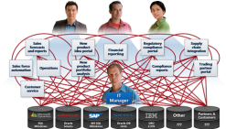
Soluciones Silo Crean Retos
Aproximación Tradicional
Inversión a
corto plazo
Retos de innovación
Cada solución tiene una nueva interfaz
Solution delivery toma mucho timepo
Soluciones no encuadran con las necesidades de engocio
Retos operacionales
Inversiones existentes no funcionan bien con otras
Cada solucion requiere nuevas habilidades de gestión y herramientas
Standards de seguridad incoherentes llevan a cumplimiento (compliance) y otras cuestiones
Soluciones Silo dirigidas a necesidades individuales

Slide 12








¿Existe un modelo mejor?
Innovación y desarrollo del negocio
Interfaz de usuario familiar e intuitiva
Plataforma unificada e integrada para múltiples aplicaciones
Aplicaciones Corporativas
ERP
Finance
Inventory
CRM
Operations
Other
Partners &
Customers
???
Infraestructura Optimizada
Reducción del coste de propiedad (TCO)

Slide 13







Una Infraestructura Optimizada es:
Segura
Protege sus datos y simplifica el cumplimiento(compliance)
Fiable
Disponibilidad Sistema Misión Crítica
Escalable
Optimiza Rendimiento y escala

Slide 14

















Modelo de Optimización de Infraestructura
Básico
Estandarizado
Avanzado
Dinámico
€
Centro de Coste
Centro de Coste Eficiente
Facilitador del Negocio
Activo Estratégico
Coste de TI
Valor para el Negocio
Tiempo

Slide 15


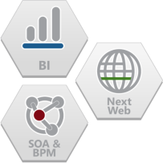



Plataforma de Aplicaciones Microsoft Una plataforma integrada para múltiples aplicaciones
Services for improving the usability of applications with the goal of increasing user productivity and satisfaction.
Customer Information
Product Life-Cycle Mgmt
Supply Chain Mgmt
Business intelligence and data management services for analyzing, reporting, and sharing information with familiar, easy-to-use tools.
Aplicaciones
Existentes
Desktop interface
Web & desktop interface
“Green screen” interface
Custom proprietary application
Flat file data store
EDI
Client application
Web server
MySQL & Linux
Business process management services for connecting and orchestrating processes and integrating systems.
Application DB
Custom integration with LOB
Custom API
Application life-cycle management including development tools, processes, and services for the team-based design, development, and management of applications.
Aplicaciones
Corporativas
ERP
Finance
Inventory
CRM
Operations
Other
Partners &
Customers
???
Infraestructura Optimizada

Slide 16









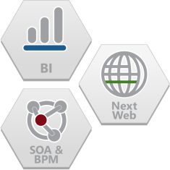

¿Por qué una Plataforma de Aplicaciones?
Usuarios
De Negocio
Interfaz de usuario familiar e intuitiva
Sales forecasts and reports
Processes (ALM, IT & Security Processes)
New product idea portal
Regulatory compliance portal
Supply chain integration
Financial reporting
Application and Business Productivity Platform
Sales force automation
Operations
New product portfolio analysis
Compliance reports
Trading partner portal
TI
Customer service
IT Manager
Aplicaciones
Corporativas
ERP
Finance
Inventory
CRM
Operations
Other
Partners &
Customers
???
Infraestructura Optimizada

Slide 17







Platforma Integrada
Clientes
Innovación
Rendimiento
Gobierno Corporativo
Operaciones
Experiencia de Usuario
Familiar e Intuitiva
Procesos (ALM, IT & Security Processes)
Desarrollo
Aplicaciones Corporativas
Plataforma de Aplicaciones
Local
ERP
Remoto
CRM
Partners
Others
Gestión de Datos
Infraestructura Optimizada(Seeguridad y Gestión)

Slide 18
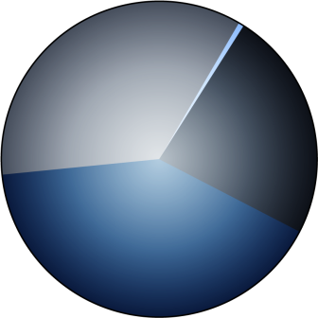
El Cambio hacia Plataforma de Aplicaciones
Desconocido 0.5%
Prevé la convergencia de estas capacidades de infraestructura de aplicación —incluyendo business intelligence, application servers, development tools, portals, integration, SOA, y BPM—ocurran en su organización?
Yes, pero no
está planeado 35%
No 24%
Organizaciones con usos dispares, aplicaciones aisladas y sistemas están convergiendo en plataforma de aplicación unificada e integrada.
En efecto, de acuerdo con Forrester Consulting, 75 peorciento de los IT leaders a través de 412 companías en Norte América, Europa, Asia-Paciíico, y Latino America anticipa un cambio hacia plataformas de aplicación, con 41 por ciento de respuestas comentando que su estrategia de Plataforma de Aplicación esta actualmente en proceso.
SI, Actualmente
estamos en ello 41%
Forrester Research 2007
“Many Organizations Embrace Converged Application Platforms, But Adoption Barriers Remain”, a commissioned study conducted by Forrester Consulting on behalf of Microsoft, October 2007; http://download.microsoft.com/download/b/3/5/b3561c68-e641-4137-abdd-df09ac51742c/Forrester Consulting - Application Platform Optimization Study 10-2007 - 2.pdf

Slide 19
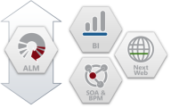
La Aproximación de Microsoft Construyendo el camino hacia Dynamic IT
Usuarios
De Negocio
Interfaz de usuario familiar e intuitiva
Local
Remoto
Plataforma Integrada para Múltiples Aplicaciones
Aplicaciones Corporativas
ERP
Finance
Inventory
CRM
Operations
Other
Partners &
Customers
???
Infraestructura Optimizada

Slide 20
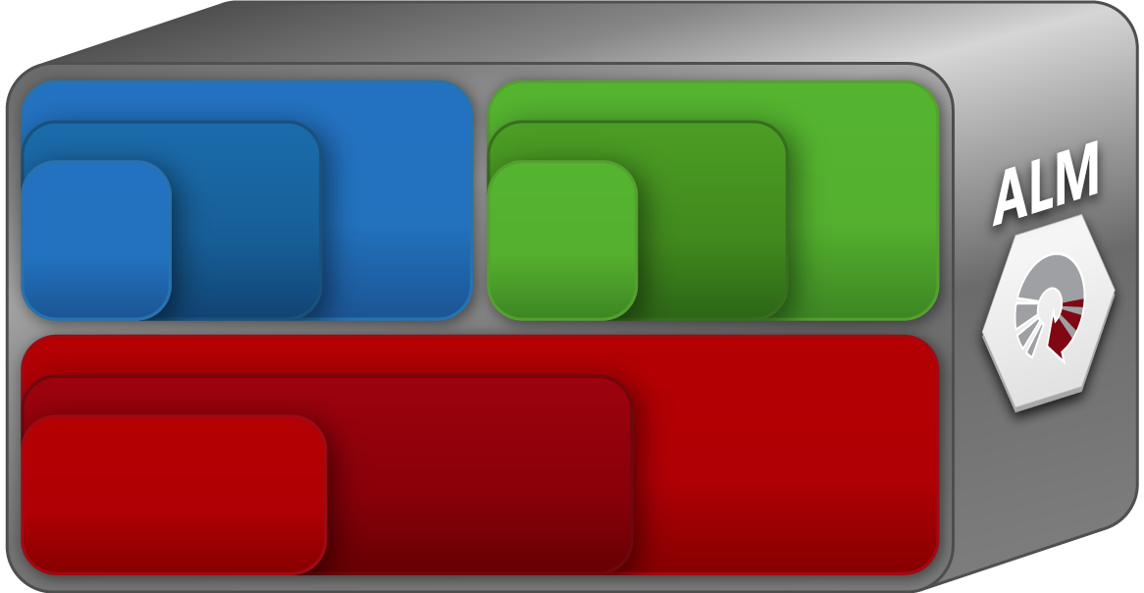



Plataforma de Aplicaciones Microsoft
Information Reporting
Information Analysis
Performance Management
Standard Web
Rich Media Web
Social Computing
Service Enablement
Connectivity
Composite Applications
Aplicaciones Corporativas
ERP
Finance
Inventory
CRM
Operations
Other
Partners &
Customers
???

Slide 21


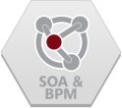

Iniciandose con Plataformas de Aplicación: BPM Usando SOA
Aplicaciones Compuestas
Workflows
Automatización de porceso de negocio
Contenido Dinámico
Conectividad
Mensa
Transformacion
Encaminamiento
Establecimiento de Servicio
Interoperabilidad
Descubrimiento
Seguridad y acceso
Standards-based interoperability
Business process services
Aplicaciones Empresariales
ERP
Finance
Inventory
CRM
Operations
Other
Partners &
Customers
???

Slide 22


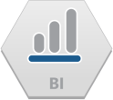

Iniciandose con Plataformas de Aplicación: Business Intelligence & DM
Gestión del Rendimiento
Scorecards y dashboards
Supervisión iniciativas de Negocio
Reporte KPI
Analisis de Información
Data mining
Information aggregation
Tendencia y relación de descubrimiento
Reportando Información
Visualización Información
Extracción de Datos
Standards-based interoperability
Information integration services
Enterprise Applications
ERP
Finance
Inventory
CRM
Operations
Other
Partners &
Customers
???

Slide 23



Iniciandose con Plataformas de Aplicación : WEB Próxima Generación
Computación Social
Comunicativo, Colaborativo y Compartir
Comunidades y Miembros
Workflow y notificación
Web Rica en Contenidos
Experiencias ricas y que enganchen
Contenido dinamico e interesante
Marketing digital
Standard Web
Standards compliance and interoperability
Aplicaciones de negocio escalables
Rapid development and deployment
Standards-based interoperability
Information integration services
Business process services
Enterprise Applications
ERP
Finance
Inventory
CRM
Operations
Other
Partners &
Customers
???

Slide 24



Gestión el Ciclo de Vida de Aplicación
BPM Usando SOA
Business Intelligence
WEB Próxima Generación
Individual
Equipo
Organizacion
Gestión el Ciclo de Vida de Aplicación
Proceso y Guia
Herramientas

Slide 25












Plataforma de Aplicaciones Microsoft Una plataforma unificada e integrada para múltiples aplicaciones
Aplicaciones Corporativas
ERP
Finance
Inventory
CRM
Operations
Other
Partners &
Customers
???

Slide 26
Beneficios de la Plataforma Microsoft
Beneficios Innovación
Beneficios Operación
Tiempo
Flexibilidad para responder rapidamente a los cambios
Diferenciación de la solución mediante experiencia de usuario
El mayor ecosistema de partners para aplicaciones empaquetadas y a medida
Alto rendimiento, escalabilidad y fiabilidad
Herramientas y procesos de gestión comunes
Inversiones en tecnología que trabajan bien entre ellas
Estándares de seguridad consistentes
Plataforma de Aplicaciones Integrada

Slide 27

































Microsoft Platform Momentum

Slide 28
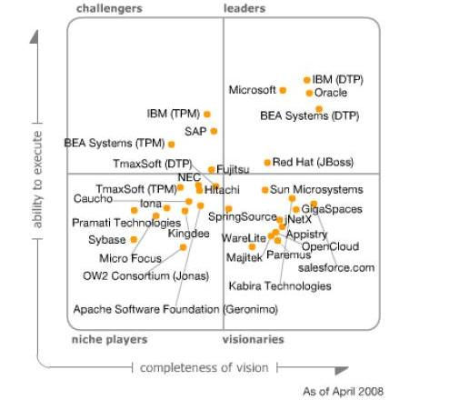
Liderazgo Microsoft
Gartner Magic Quadrant for Enterprise Application Servers, 2Q08
Microsoft
“The Magic Quadrant is copyrighted April, 2008 by Gartner, Inc. and is reused with permission. The Magic Quadrant is a graphical representation of a marketplace at and for a specific time period. It depicts Gartner’s analysis of how certain vendors measure against criteria for that marketplace, as defined by Gartner. Gartner does not endorse any vendor, product or service depicted in the Magic Quadrant, and does not advise technology users to select only those vendors placed in the “Leaders” quadrant. The Magic Quadrant is intended solely as a research tool, and is not meant to be a specific guide to action. Gartner disclaims all warranties, express or implied, with respect to this research, including any warranties of merchantability or fitness for a particular purpose.
This Magic Quadrant graphic was published by Gartner, Inc. as part of a larger research note and should be evaluated in the context of the entire report. The Gartner report is available upon request from Steven Armstrong (stevar@microsoft.com), Microsoft.”

Slide 30






Real-World SOA Clientes
Advanced MD delivers medical office management capabilities to over 4400 offices using a SaaS model
Their solution is supported by the complete stack of Microsoft products, including Windows Server, SQL, BizTalk and MOM
An AJAX-enabled browser client provides a very lightweight and responsive user experience
Vital developed an ESB for composing new products by exposing their existing systems as web services
They chose BizTalk as the foundation of their ESB
Reusable service components are expected to save $2.4 million in development costs for the next application deployed
Tight integration between SQL, BTS & VS improved dev productivity
CBA’s business processes were paper based and data fragmented
BizTalk Server and Host Integration Server exposed customer data as standards-based web services
A .NET framework-based client provides a productive, intuitive graphical environment for accessing customer data
This application has been successfully deployed to 30,000 users

Slide 31




Real-World SOA Customers
Moved to SOA as a result of integrating dozens of diverse medical and financial systems
Implemented an Enterprise Connectivity(ESB) architecture based upon BizTalk Server and .NET
Results: more reliable systems, and insurance claim processing time has been cut in half
Existing B2B infrastructure was mainframe-based, inflexible and expensive to maintain
Implemented a new Connectivitybased upon BizTalk Server, accessible through SharePoint and ASP.NET based portals
Results: improved production planning, greater supply-chain visibility by partners, enhanced end to end system reliability
Outsourced reservation system management for over 20 airlines, required absolute 100% uptime and throughput of 18 -20,000 transactions per second
Implemented a new SOA infrastructure based on .NET and the Microsoft Application Platform
Results: 10-25% savings on new services, $3M savings from legacy modernization, 67.9% lower TCO vs. mainframe

Slide 32





Business Intelligence and DM Customers
PREMIER Bankcard needed an end-to-end BI solution to conduct complex analyses of its credit card customer base.
Have nearly 25 terabytes of data and growing by 300 gigabytes per month accessed by over 2000 users.
TDC needed to create a data warehouse to support an ever growing number of analysts and do it efficiently and economically
Have a 6 Terabyte data warehouse today with 30% projected annual growth accessed by over 2000 analysts
One of Europe's largest grocery chains, Danske Supermarket needed to centralize and analyze data from nearly 1000 stores
Have an 8 Terabyte data warehouse with many mainframe data sources. Largest SSAS cube is 500 gigabytes
Barnes & Noble wanted to extract more business intelligence from its operational systems, including sales and inventory data, to make better business decisions for greater profitability
5 Terabyte Retail Data Warehouse on a 20 way HP Superdome

Slide 33




Business Intelligence and DM Customers
Faced with increased POS data loads from 300 million to 4 billion rows, Crossmark chose SQL Server 2005 to handle the increased volume of the data warehouse.
4 terabytes of data in a single instance with 25 TB of raw storage accessed by over 350 power users.
SAS migrated its aging DB2 mainframe data warehouse to a new server environment based on Microsoft® SQL Server™ 2005
2 Terabyte data warehouse being migrated from an IBM Mainframe
With its covered member base expected to triple in 2006, HMC was confident their SQL Server data warehouse could handle the increased capacity
6 Terabyte data warehouse helps improve patient care
Clalit Health Services needed a data mining solution to help it identify which members would most benefit from proactive intervention to prevent health deterioration.
Created a 5 Terabyte data warehouse to serve the 2nd largest global HMO with over 3000 OLAP users.

Slide 34




Business Intelligence and DM Customers
The Veterans Health Administration created a Data warehouse using SQL Server to consolidate all of it’s member and hospital data
17 terabytes of storage with the largest instance at 1.1 terabytes
To comply with the Basel II Capital Accord, Nationwide has to store and maintain business information dating back at least seven years.
Nationwide uses a 2 terabyte Data warehouse to help comply with the Basel II accord
TUEV NORD needed a 64-bit computing environment to support its business intelligence data warehouse and other databases used in support of its business.
Have a 3.5 Terabyte SAP Business Warehouse system supporting over 500 users
Retail chain Talbots needed to give everyone from store managers to executives a more up-to-the-minute picture of business activities in each store
1 TB data warehouse, using SQL Server 2005 for continuous real-time trickle data with >1 million sales trans/day.

Slide 35

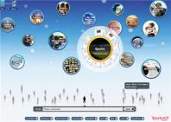
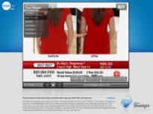
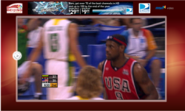
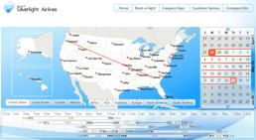
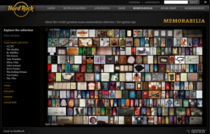
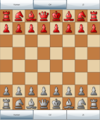
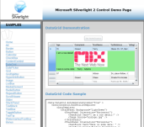
Next Generation Web Silverlight Customers

Slide 36


Application Life-Cycle Management Customers
EDS, a global business and technology services company, realized a 286% ROI in four months by using Visual Team System to support a more efficient global development strategy and to realign its internal software development assets.
Over six months, Dell, a leading manufacturer of personal computers and technology-related products realized a 225% ROI by deploying a centralized global source code management platform to provide developers with source code on a just-in-time basis regardless of their location.
Improved source code management has also enabled Dell to consolidate its source code onto fewer servers, redeploy 100 system administrators, and improve the productivity of its developers.
CME and The Chicago Board of Trade merged to form CME Group, one of the world’s largest and most diverse exchanges.
The solution lets auditors work in the familiar interface of the 2007 Microsoft Office system, to automate tasks like retrieving supporting documentation, and to synchronize data more quickly and easily between the field and headquarters. The solution was developed 20 percent faster than it would have taken using earlier tools, speeds audit reviews up to 20 percent, and boosts accuracy and collaboration.

