Slide 2
SharePoint Online Overview
Name
Title
Company

Slide 3
Agenda
Positioning and Messaging
The Power of Choice: On-Premises vs. Online
Supported Features & Licensing
Planning and Assessing move to cloud and migration
Extensibility and Customization
Hybrid Deployment Scenarios
Security and Privacy in a Cloud Environment
Delegated Administration

Slide 4
Supported Features and Licensing

Slide 5
SPO Positioning and Messaging
SharePoint Online is ‘the business collaboration platform for the Enterprise and the Internet’ hosted by Microsoft.
Customer Expectations:
Trusted collaboration service
Enterprise-grade capabilities
Quick Time-to-Market, Great value
Agility, Flexibility and control
Key Benefits:
Ease of access anywhere
Simplified extranet capabilities
Full SharePoint, hosted/managed by Microsoft
Outsource some IT management, Lower TCO, solid SLA
Core SharePoint Themes Persist:
Connect and Empower People
Cut Costs with a Unified Infrastructure
Rapidly respond to business needs

Slide 6







Solid Value, Solid Security Business Productivity Online Suite (BPOS)
Anywhere* access—desktop, mobile, Web
Seamless user experience across workloads
Team collaboration and conferencing
Real-time communication
Streamlined
Communication
Always up-to-date technology
Lower rollout and run rate cost
Improved agility and resource utilization
Active Directory® synchronization
Simplified
Management
$
Data hygiene supported by multi-layered antivirus and spam filtering
Highly secure data access for users via HTTPS
Geo-redundant data center architecture with Cyber-trust and SAS70 compliance
Business-Class Security and Reliability
* Anywhere internet access is available

Slide 7
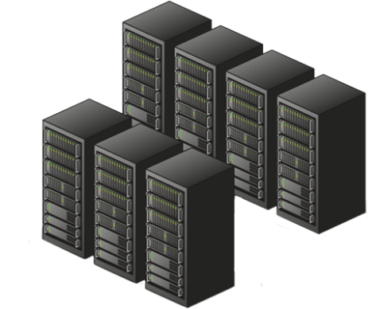




The Power of Choice!
On-Premises and Online Hosting
On-Premises Deployments
SharePoint Online Standard
SharePoint Online Dedicated
Self-hosted and managed
Direct access to physical machines
Central admin access
Hosted within own data centers
Entire environment customizable
All accounts, machines, and data within a single AD Forest
Available to companies of any size.
Multi-tenant hosting
Shared Hardware
Outsourced IT management
Hosted within MS data centers
Partial trust code support
Support for SharePoint Designer based customizations
Certificate authentication (today) or Forms based authentication (2010)
Available for companies of any size.
Dedicated Hosting
Dedicated Hardware
Outsourced IT management
Hosted within MS data centers
Most of the environment is customizable (Full and Partial Trust Code Support)
Machine and Process accounts in a different AD Forest
NTLM Authentication
Designed for companies with 5000+ seats

Slide 8
Summary of Features
SharePoint Online – Standard
Pre-beta
Sites | Communities | Content | Search | Insights | Composites
Audience Targeting
Cross-Browser Support
Enterprise Management Operations
Fluent UI / Ribbon
Mobile Connectivity
Multi-Lingual Support
Office Client Integration
OOB Web Parts
Scalability
SharePoint Workspace Integration
Tagging
Video Support, REST, and Silverlight
Ask Me About
Blogs
Colleague Suggestions
Colleagues and Memberships
Discussion Forums
Enterprise Wikis
Keyword Suggestions
My Network
My Sites: People Profiles and Personal Sites
Note Board
Organization Browser
Outlook Social Connector
Photos and Presence
Ratings
Recent Activities
Social Bookmarks
Status Updates
Surveys
Tag Clouds
Tag Profiles
Tags
What's New
Wikis
Document Sets
Metadata Driven Navigation
Multi-stage Disposition
Office Integration
Office Web Apps
Rich Media Management
Shared Content Types and the Managed Metadata Service
Support for Accessibility Standards
The Content Organizer
Unique Document IDs
Word Automation Services
Best Bets
Duplicate Results
Metadata-based Refinement
People and Expertise Search
Phonetics & Nickname Expansion
Recently Authored Content
Search a Single Site Collection
Search Across Site Collections
Search Scopes
Site Search
Social Behavior Improves Relevance
Taxonomy and Term Store Integration
View in Browser
Chart Web Parts
Data Connection Library
Excel Services
Filter Framework
Status Indicators
Visio Services
Access Services
Browser-Based Customizations
Customization via SharePoint Designer
Forms: Out-of-box workflows and customization via SharePoint Designer 2010
InfoPath Forms Services
Sandboxed Solutions
Workflows
BCS
Records Center
Legal Holds
Key:
W14
Future Features
Unsupported

Slide 9
Summary of Features
SharePoint Online – Dedicated
Pre-beta
Sites | Communities | Content | Search | Insights | Composites
Audience Targeting
Cross-Browser Support
Enterprise Management Operations
Fluent UI
Mobile Connectivity
Multi-Lingual Support
Office Client Integration
OOB Web Parts
SharePoint Workspace Integration
Tagging
Video Support, REST, and Silverlight
Ask Me About
Blogs
Colleague Suggestions
Colleagues and Memberships
Discussion Forums
Enterprise Wikis
Keyword Suggestions
My Network
My Sites: People Profiles and Personal Sites
Note Board
Organization Browser
Outlook Social Connector
Photos and Presence
Ratings
Recent Activities
Social Bookmarks
Status Updates
Surveys
Tag Clouds
Tag Profiles
Tags
What's New
Wikis
Document Sets
Metadata Driven Navigation
Multi-stage Disposition
Office Integration
Office Web Apps
Rich Media Management
Shared Content Types and the Managed Metadata Service
Support for Accessibility Standards
The Content Organizer
Unique Document IDs
Word Automation Services
Best Bets
Common Connector Framework for Indexing and Federation
Duplicate Results
Federated Search
Metadata-based Refinement
People and Expertise Search
Phonetics & Nickname Expansion
Query Suggestions, "Did You Mean?", and Related Queries
Recently Authored Content
Relevancy Tuning by Document or Site Promotions
Search a Single Site Collection
Search Across Site Collections
Search Scopes
Site Search
Social Behavior Improves Relevance
Taxonomy and Term Store Integration
View in Browser
Windows 7 and Windows Mobile Federation
Business Data Web Parts
Chart Web Parts
Data Connection Library
Excel Services
Filter Framework
Office Client Sync (BCS)
PerformancePoint Services
Status Indicators
Visio Services
Web Analytics Customization
Access Services
Browser-Based Customizations
Business Connectivity Services (BCS) - Rich Client Extensions & Web Parts
Business Connectivity Services (BCS) - Search on External Data
Business Connectivity Services (BCS) - Framework
Customization via SharePoint Designer
Forms: Out-of-box workflows and customization via SharePoint Designer 2010
InfoPath Forms Services
Sandboxed Solutions
Workflows
PerformancePoint Services
Records Center
Legal Holds
IRM Integration
Site Variations
BCS Search (via indexing)
FAST
Configure Crawled File Type
Key:
W14
Future Features
Unsupported
Email-Enabled Lists

Slide 10


SharePoint Online Licensing Bringing SharePoint Server 2010’s business collaboration platform capabilities to the cloud
Intranet
Internet/Extranet
SharePoint Online Standard User Subscription License (USL)
SharePoint Online Deskless Worker functionality available as part of the “BPOS Deskless” User Subscription License (USL)
Internet Sites Offer
Partner Access (Extranet) Offer
Improved
Future
Future
Moving towards parity between on-premises and online
W14 reduces feature gap between on-premise and online
New feature highlights: WACs, MySites, Sandbox, Ribbon, tags/comments/ratings…
Futures: Internet Sites, and Partner Access (Extranet) offers
Purchase standalone or part of BPOS suite
SharePoint Online Standard: $5.25/user/month
BPOS Standard Suite: $10/user/month
Volume discounts apply
Licensed via online subscription (USL) or add-on to SA
USL available direct through Microsoft website or partner / VL
SA step-up to online available by adding to existing agreement
SPO-Dedicated hosting available
Requires one-time Server Setup License purchase + USL costs (minimum 5000)
Contact Microsoft Online Dedicated sales team for pricing and contract details

Slide 11




Wave 14 Deskless Hero Offers
Deskless Workers
Targeted for Roles Such as
Bank tellers
Call center workers
Healthcare clinicians
Manufacturing floor
Retail POS workers
Seasonal workers
Usage Scenarios
Deskless Hero Offers
1. Exchange Deskless Worker
Essential Corporate Notifications & Communication
Corporate Announcements
Example: A department store needs to notify employees of a change in hourly wage.
Provides | Does not include
500MB Mail OWA Premium Exchange Calendar | Outlook Anywhere Access
Inbox rules
Delegate access
IM integration
SMS integration
POP/IMAP Access
Active Sync
Web services
$2.00/mo.
$1.64/mo.
List
Select C
2. Deskless Worker Plus
Information Access & Simple Data Input/Editing
Distributing information
Example: Retail workers view corporate HR information and update benefits during open enrollment period. Review training manuals and provide feedback.
Provides | Does not include
Exchange Deskless Wikis Corporate Portals Forms and Web Access Workflow Office Web Applications | My Site Incremental Storage No create or administration rights on Sites, Lists, Pages and Libraries Personalization of views, web parts or sites
$7.50/mo.
$6.00/mo.
List
Select C

Slide 12
Planning and Assessing the Move to the Cloud and Migration

Slide 13
Ensuring a Successful Launch
Don’t just move everything from old system
Leverage or roll out the service in stages
Archive content that doesn’t belong in SharePoint
What content needs to be available to external partners?
Estimate storage requirements and evaluate against BPOS quotas
Review blocked file types (examples, no: *.exe, *.vbs, *.com, *.chm)
Establish development/test environments that match production
Define a meta-data strategy before you import content or allow new content
Generate a Web site map sites and sub-site collections (available Visio SharePoint Site Map)
Think about how users will find content
Plan for administration delegation hierarchy
Understand the custom code policy and deployment schedule (SPO-D only)
Submit high level designs before you begin coding (SPO-D only)

Slide 14
Example Approach
Sell Cloud value, portals & collaboration strategy and planning
Prepare with Cloud seminars, S+S workshops and assess Active Directory
Migrate: plan, stage and deliver
Enhance with custom solutions, deliver integration services, consider ALM
Run and support, admin on-behalf
Main Goals:
Reduce friction
Simplify sales
Drive down costs
Decrease TTM
Improve CSAT
Sell
A: Prepare
B: Migrate
C: Enhance
Run

Slide 15

Migration
Out
In
Migration to SharePoint Online relies on our strong Partner ecosystem
System Integrators (SIs) can help plan/assess move to MS Cloud
Independent Software Vendors (ISVs) tools for actual migration
Quest, Binary Tree, Metalogix
Not free, aim is to present as predictable costs
‘Migration Mode’ via SharePoint Online Administration center, aka ‘tenant admin,’ provides metadata integrity
Microsoft does not yet have official offboarding tools
A customer who wants a copy of their data, or to leave the service, can call Support and create a case to have backup db provided.

Slide 16
Extensibility and Customization

Slide 17
Opening the Black Box
What you can do OOTB
Content Editor and Data View web parts
Master pages, templates, lists, libraries, workflows
Web services
SharePoint Designer 2010
No-code workflows
Theming and branding
Composite Apps, Mash-Ups
Visual Studio 2010 SharePoint tools
Sandboxed Solutions
Silverlight web part (.XAP files)
Inclusion of Enterprise features (Access Services, Excel Services, InfoPath Forms Services, Visio Services)
SharePoint Workspace for offline scenarios

Slide 18
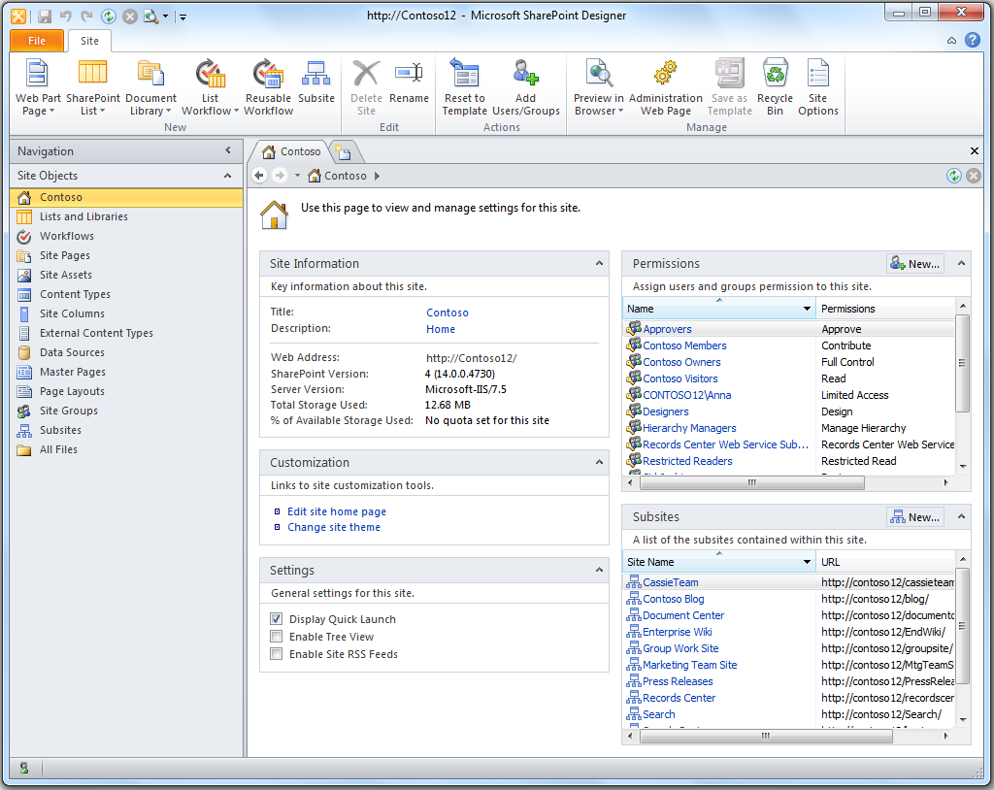
SharePoint Designer 2010 Rapidly Application Development (RAD) to for No-Code Solutions
Create and connect to data internal and external to SharePoint
Create templates, data views, forms, dashboards, mashups
Design custom workflows to manage business processes
New features in SharePoint Designer 2010
Full screen workflow designer, reusable workflows, Task Designer (for human workflow)
Powerful data views with new XSLT List View Web Part
Integrate with external data using External Content Types and BCS
Save lists, workflows, and sites as solution files (WSP)
Seamlessly integrate with other tools
Use with in-browser customizations
Hand of templates to Visual Studio 2010
Integrate with InfoPath forms and Visio-authored workflows
Easily manage SharePoint Designer in your organization
Restrict who can detach pages from the site definition
Restrict who can edit master page and page layouts
Restrict who can edit files in URL site hierarchy
Prevent SharePoint Designer 2010 from editing sites
It's FREE!
Can be downloaded for free and used with any SharePoint 2010 site

Slide 19

Sandboxed Solutions – Why?
SharePoint Online Customers
Microsoft Online Operations & SLA
Security & Stability
Business Agility
Essential Agility
Essential Stability
Easy deployment
Iterative development
Access to Shared Servers
Safe
Limited API Access
Monitored Resources

Slide 20
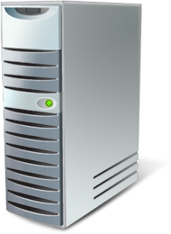

The Sandbox
A separate process where the solution runs
User Code Service (SPUCHostService.exe)
Sandbox Worker Process (SPUCWorkerProcess.exe)
Sandbox Worker Process Proxy (SPUCWorkerProcessProxy.exe)
Exposes a subset of Microsoft.SharePoint namespaces
Essentially all the classes below SPSite (SPSite, SPWeb, SPList, SPListItem)
Code Access Security (CAS) policy limits functionality
Site Collection Solution Gallery for deployment
Central Administration for managing and monitoring solutions
Functionality is in ‘tenant admin’ (derived from CA).

Slide 21
Solution Examples
Link to the online SharePoint 2010 SDK:
http://msdn.microsoft.com/en-us/library/ee557253(office.14).aspx
Namespaces and Types in Sandboxed Solutions:
http://msdn.microsoft.com/en-us/library/ee537860(office.14).aspx
Code components:
Event & Feature receivers
Navigation
Web parts
InfoPath forms logic
SharePoint Designer Workflow activities
Declarative components:
Declarative workflows
Content types, site columns
Lists and list definitions
Non-visual Web Parts
Custom actions, ribbon extensions
Client-side technologies
Web templates, Site pages, page layouts, and master pages
What’s not supported from the Sandbox
No access to Internet to make Web service calls
No access to a hard drive to read/write files; you can read/write to lists/libraries
No Web Application-scoped features, no Farm-scoped Features
Cannot add assemblies to the GAC
Cannot run security-related functionality (RunWithElevatedPriviledges, SPSecurity methods, etc..)

Slide 22
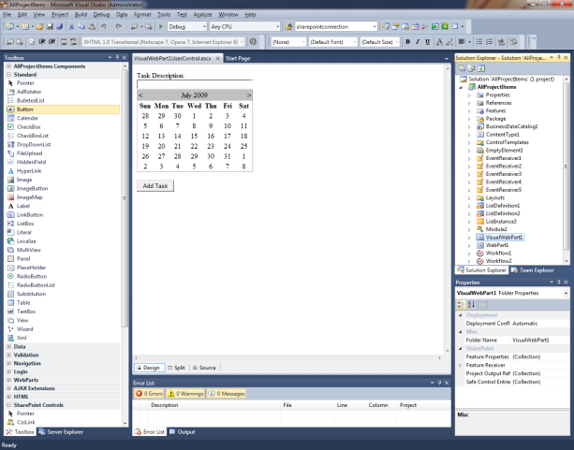
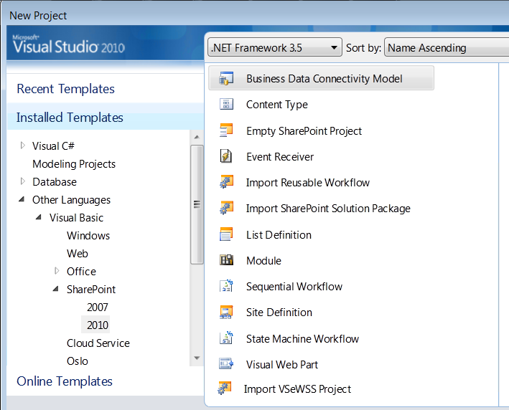
Visual Studio 2010 Developer Tools for SharePoint
Develop, Deploy and Debug
Web Part, BCS and Workflow designers
Package and Deploy SharePoint projects
Generate WSP for Production Deployment
View SharePoint site in Server Explorer
Team Foundation Server Integration
Web Part Designer
Broad SharePoint Support
Support for SharePoint Sandboxed Solutions; Sandbox is the default project type.
Import WSP from SharePoint Designer including Workflow
Build Workflow Steps for SharePoint Designer
Extensibility for Development of Additional SharePoint Artifacts
SharePoint Business Connectivity Services support
Project Types

Slide 23
Silverlight
A Web Part can be a host for Silverlight
SharePoint ships with Silverlight web part
Need only build a Silverlight control or app
The web part can contain custom properties that are sent to Silverlight via the InitParameters property
The XAP file can be deployed to LAYOUTS and loaded at run time
The Silverlight application can then make use of the Client OM to access SPOnline data.
Programs running on the client can add and remove lists, add, update, and delete list items, modify documents in document libraries, create sites, manage permissions of items, add and remove web parts from a page, and much more.

Slide 24
Extensibility Overview SharePoint Online – Standard vs. Dedicated
Area | Dedicated | Standard
Custom Solutions (Full-trust code)
Sandboxed Solutions (Partial-trust code)
Silverlight Web Part (.XAP files)
BCS (backend LOB integration)
SharePoint Designer 2010
Client Object Model
Web Services
OOB Browser Configuration (Web Parts, Theming)
Visual Studio 2010 (SharePoint Tools) | (Farm and Sandbox) | (Sandbox only)
List of approved solutions
InfoPath Forms | (Admin and Sandbox) | (Sandbox only)
Workflows | (Custom and Declarative) | (Declarative only)

Slide 25
Hybrid Deployment Scenarios

Slide 26

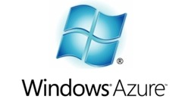

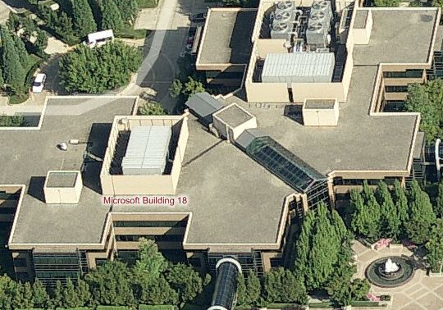

Hybrid Deployment Distributed workloads, no integration
Present
Future
Data
Services
Company Portal
HRWeb
Extranet
Marilee
LOBi
ERP
CMS
SSO, VPN
@Work, @Home, @Caffeine
MIX UI potential (2003. 2007. 2010)

Slide 27
Hybrid Deployment Distributed workloads, read-only integration
Present
Future
Data
Services
read-only
Company Portal
HRWeb
Extranet
Marilee
LOBi
ERP
CMS
SSO, VPN
@Work, @Home, @Caffeine
MIX UI potential (2003. 2007. 2010)

Slide 28
Hybrid Deployment Distributed workloads, read/write integration
Present
Future
Data
Services
read-write
Company Portal
HRWeb
Extranet
Marilee
LOBi
ERP
CMS
SSO, VPN
@Work, @Home, @Caffeine
MIX UI potential (2003. 2007. 2010)

Slide 29
Hybrid Deployment SharePoint Online + ….
Scenario | Front-ending Backend LOB data | Federated Search | SharePoint Extensibility/ISVs | SharePoint On-Prem “deploying” to BPOS (and vice-versa) | SharePoint Online Authentication Integration | Client integration w/ BPOS*
Examples | Surface LOB data living on premises in SharePoint Online | Holistic search across Online and on-prem farms | Sandboxed solutions Full-trust code More compute Greater API access | Authoring/collaborating on-premises and deploying to SharePoint Online | Authentication integration to Live ID, OpenID, SAML support | Office client Silverlight Other – where other can be another “server”/mobile/client/etc
Technology | BCS | Search federation Search indexing | Sandboxed Solutions Silverlight Azure BCS | Content Deployment “Replication” | Claims/SSO

Slide 30
Security and Privacy in the Microsoft Cloud Environment

Slide 31




Highly Secured Datacenters
Business Class Reliability and Security
Delivering highly secure, private, and reliable computing experiences based on sound business practices
Key Features
Geo-redundant datacenters
N+1 architecture
9 layers data security
CyberTrust certified
Secure access via SSL
ITIL/MOF operational practices
24x7x365 support
Backed by 99.9% uptime SLA
Filtering Routers
Firewalls
Intrusion Detection System
System Level Security
Application Authentication
Application Level Counter-measures
Virus Scanning
Separate Data Networks
Authentication to Data
BPOS Security whitepaper: http://www.microsoft.com/downloads/details.aspx?FamilyID=5736aaac-994c-4410-b7ce-bdea505a3413&displaylang=en

Slide 32

Security Program
Strategy: employ a risk-based, multi-dimensional approach to safeguarding services and data
Security Management
Threat & Vulnerability Management, Monitoring & Response
Data
Access Control & Monitoring, File/Data Integrity
User
Account Mgmt, Training & Awareness, Screening
Application
Secure Engineering (SDL), Access Control & Monitoring, Anti-Malware
Host
Access Control & Monitoring, Anti-Malware, Patch & Config Mgmt
Internal Network
Dual-factor Auth, Intrusion Detection, Vulnerability scanning
Network perimeter
Edge Routers, Firewalls, Intrusion Detection, Vulnerability scanning
Facility
Physical controls, video surveillance, Access Control

Slide 33
Identity and Access
In the current service, all identities are managed in MS Online
Directory Sync with your Active Directory (AD)
In 2010, we will have two choices:
Managed identities in MS Online
Federated identity to your on premises AD
No longer have a sign-in client application
You are in complete control of your users

Slide 34


BPOS “certification” roadmap Regulations and Standards with which BPOS is/will be formally and explicitly in compliance
NIST 800-53/FISMA: BPOS Services, infrastructure & facilities
“GxP” - 21 CFR Part 11: SharePoint-D
2010
ISO 27001 certification: BPOS services
2009-10
ISO 27001 certification: infrastructure & facilities
*exception: LiveMeeting deployments in 2 3rd party facilities
2008-09
2008
SAS 70 Type II: BPOS-D services, infrastructure & facilities

Slide 35
Privacy
Microsoft is committed to protecting our customers’ privacy, while delivering services and software that bring the performance, power, and convenience that organizations desire.
Privacy for MS Online and Azure Platform services is prescribed by the “Trustworthy Services Lifecycle” or “TSL”
TSL is employed for the purposes of
Reflecting requirements in MS Online Information Security Policy
Leveraging familiar best practices (Security Development Lifecycle (SDL), Trustworthy Computing / Privacy, Enterprise Risk Management (ERM), LCA etc.) by
Aligning services with ISO 27001 information security standard
Helping ensure compliance with relevant Regulations, Laws and best practices

Slide 36
Delegated Administration
SharePoint Online – Standard

Slide 37
SharePoint Online Administration
Responsibilities include …
… in SharePoint Online Administration Center, aka ‘tenant admin’
Convert intranet to extranet
Delegate site collection ownership
Manage My Sites
Manage site collections and ownership
Manage storage allocation
Set migration mode
View extranet usage reports
… in Microsoft Online Administration Center
Add and verify a domain name
Create, change, or delete user accounts
Create a security group
Establish Active Directory sync
Escalate issues to Microsoft Online Services Support
Manage passwords
Monitor service licenses
Monitor service health
Site Collection Owners (same capabilities as on-premises)
Site level Owners (same capabilities as on-premises)
Multi-Tenant
Modular Services Applications
Farm Administrator
Central Administration
Tenant Administration
Site Collection Admin
Site Collection Admin
Site Collection Admin
…
Managed by Microsoft
Managed by Customer and/or Partner

Slide 38
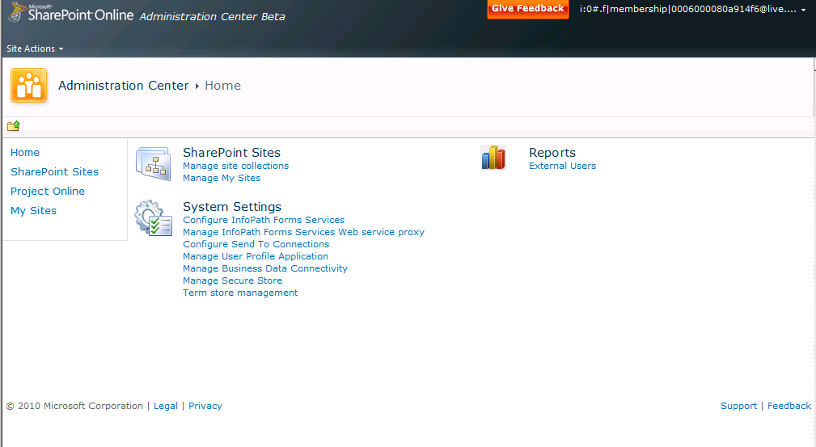
A look at SPO Admin Main starting page (beta screenshot)

Slide 39
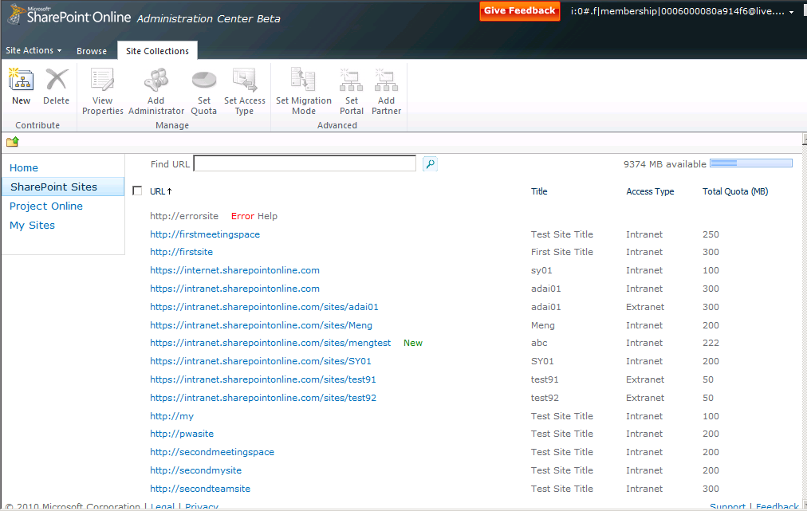
A look at SPO Admin Creating and Configuring site collections (beta screenshot)

Slide 40
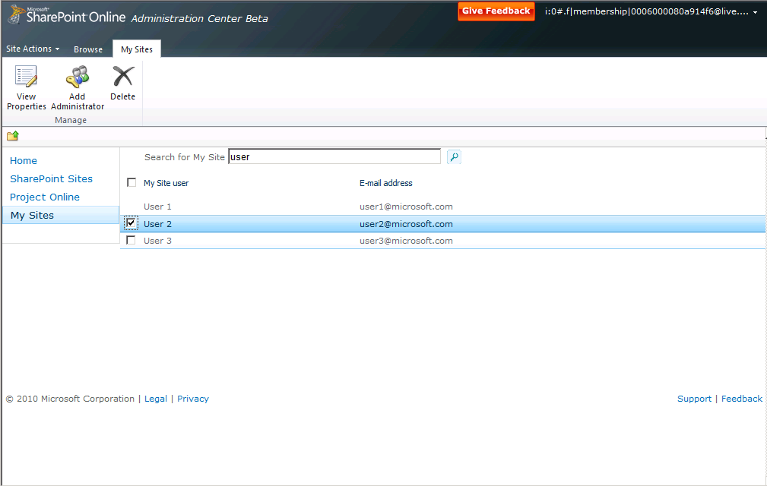
A look at SPO Admin Working with My Sites

Slide 41
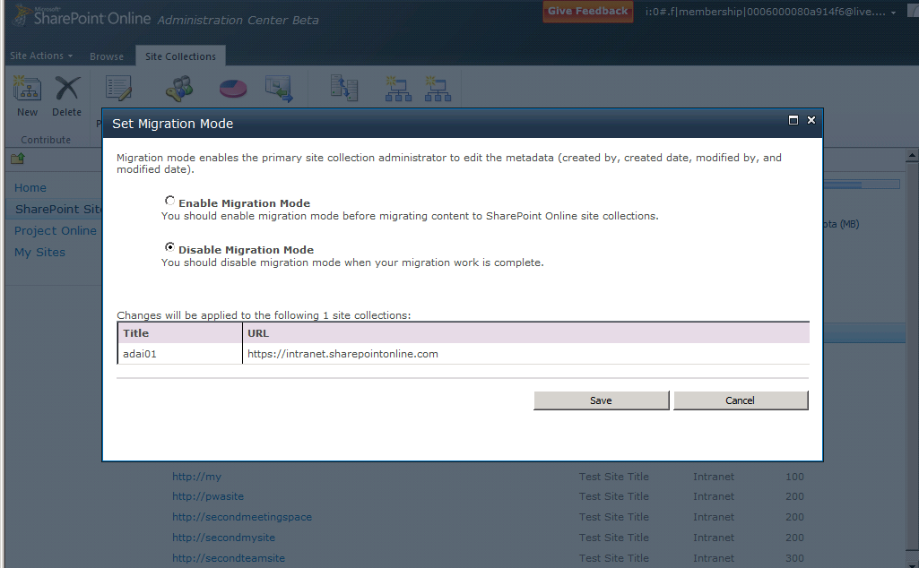
A look at SPO Admin Enabling Migration Mode

Slide 42
Microsoft Online Administration Center
vNext in Wave 14

Slide 43
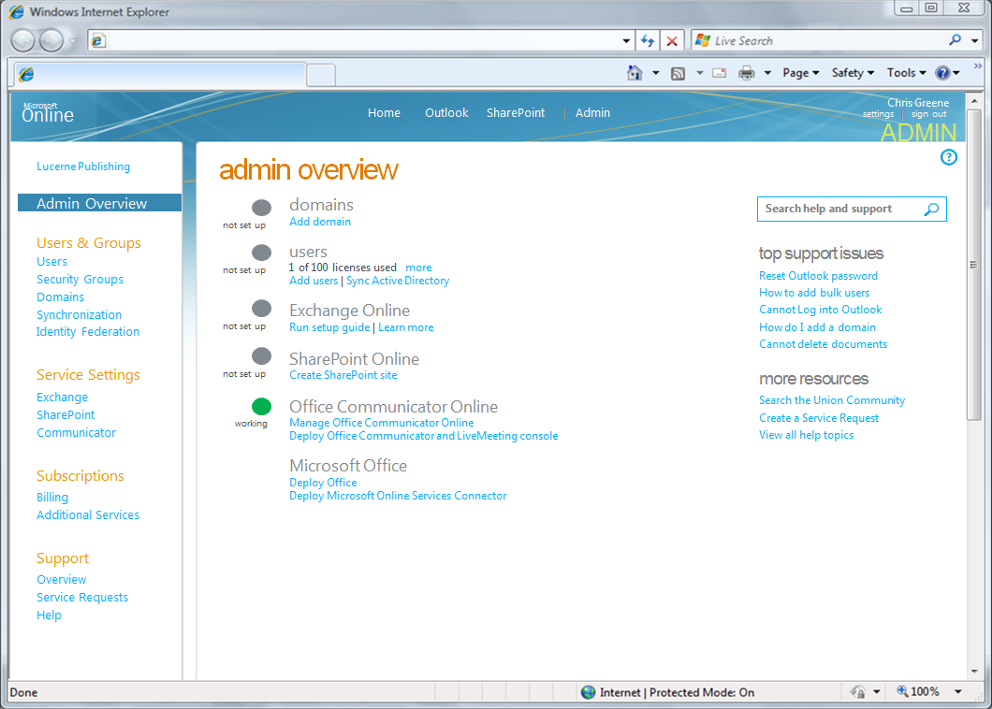
A look at MSO Admin Working across services with BPOS

Slide 44
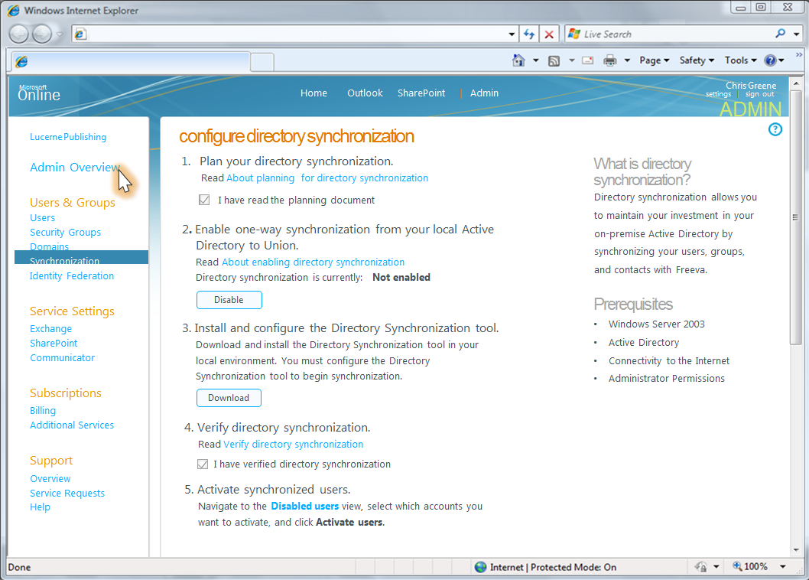
A look at MSO Admin Configuring Active Directory Sync

Slide 45
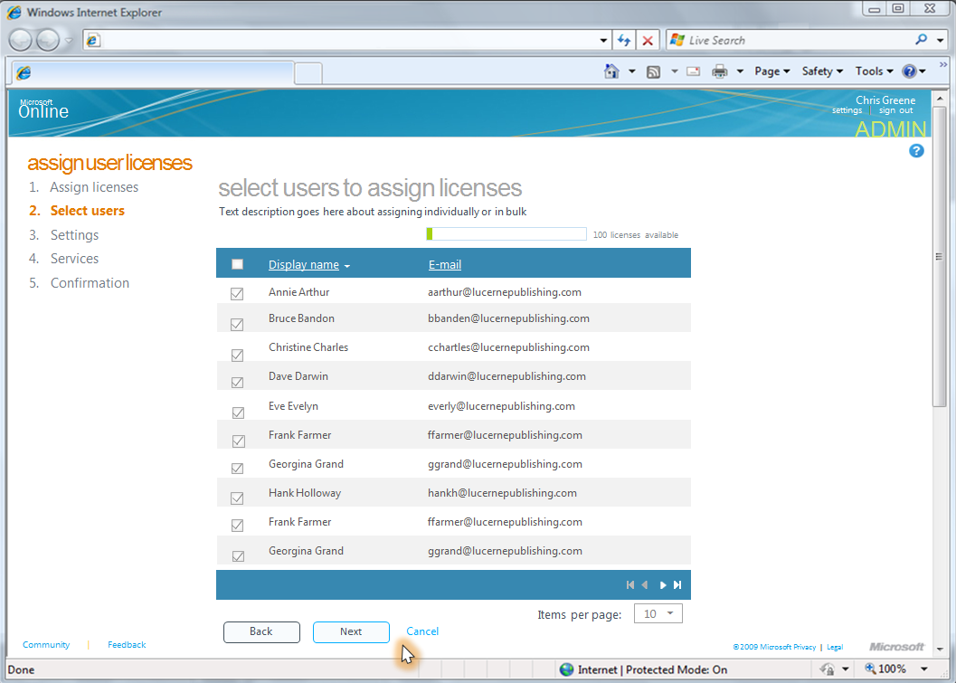
A look at MSO Admin Add, Assign, Invite, Delete End-Users

Slide 46
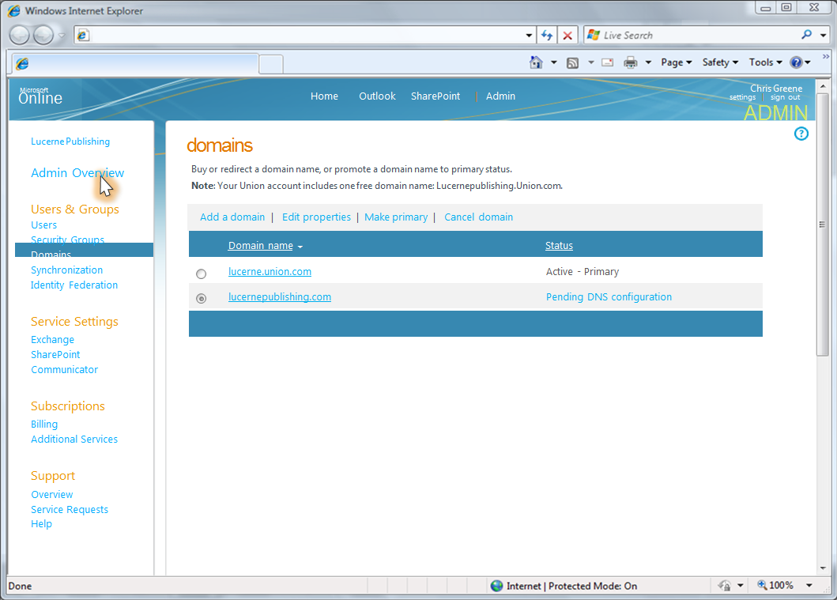
A look at MSO Admin Associating Domain URLs

Slide 47
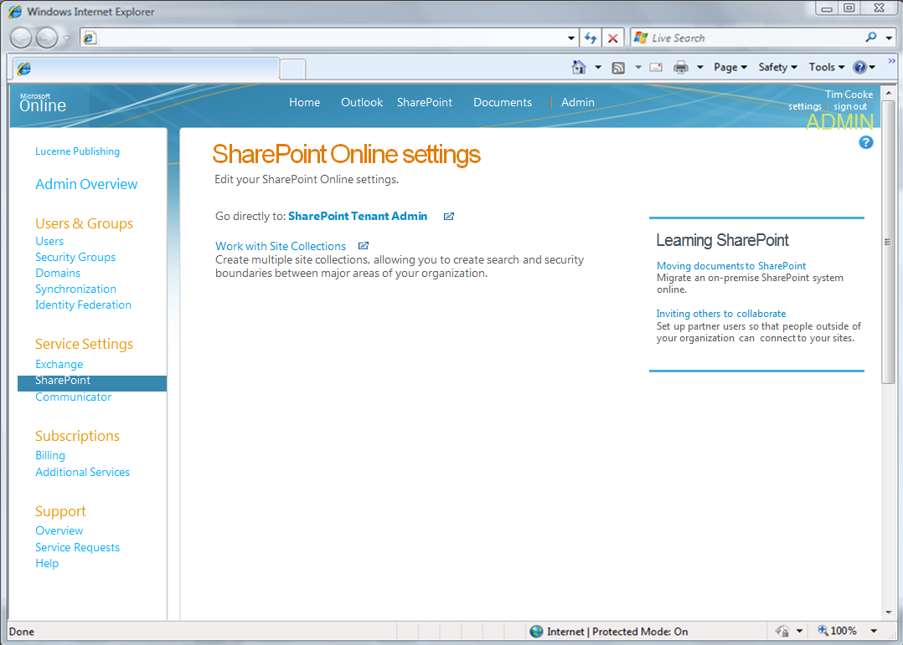
A look at MSO Admin Launch into SPO

Slide 48
Resources
Main marketing site: http://sharepoint.microsoft.com
And for 2010: http://sharepoint2010.microsoft.com
http://www.microsoft.com/Online
Trials, 100-200 level customer-facing info
Contains info about BPOS and SPO
30-Day trial: http://www.microsoft.com/online/products.mspx
New Because It’s Everybody’s Business campaign focused on BPOS:
http://www.microsoft.com/everybodysbusiness/en/us/products/cloud-services.aspx
SPO-D docs
http://go.microsoft.com/fwlink/?LinkId=140276
TechNet ‘Help and How to’ (SPO-S): http://www.microsoft.com/online/help/en-us/helphowto/Homepage.htm

Slide 49

Privacy Resources
MS Online Services Privacy Statement
http://go.microsoft.com/fwlink/?LinkID=149485
Privacy and MS Online Services White Paper
http://go.microsoft.com/fwlink/?LinkID=149486
MS Online Services Privacy FAQs
http://go.microsoft.com/fwlink/?LinkID=149487
MS Online Services Technical Deep Dive
http://go.microsoft.com/fwlink/?LinkID=149488
TwC’s Guidelines For Developing Software and Services
http://go.microsoft.com/fwlink/?LinkID=149489

Slide 50


Slide 51

© 2010 Microsoft Corporation. All rights reserved. Microsoft, Windows, Windows Vista and other product names are or may be registered trademarks and/or trademarks in the U.S. and/or other countries.
The information herein is for informational purposes only and represents the current view of Microsoft Corporation as of the date of this presentation. Because Microsoft must respond to changing market conditions, it should not be interpreted to be a commitment on the part of Microsoft, and Microsoft cannot guarantee the accuracy of any information provided after the date of this presentation. MICROSOFT MAKES NO WARRANTIES, EXPRESS, IMPLIED OR STATUTORY, AS TO THE INFORMATION IN THIS PRESENTATION.

