Slide 2
Search Capabilities and Features in SharePoint 2010
Name
Title
Company

Slide 3
Agenda
SharePoint Search
Capabilities
Architecture
FAST Search
Capabilities
User Centric Search
Architecture
Common features
Search UI Customization

Slide 4
Enterprise Search Product Portfolio with Wave 14
Solutions for Internet Business
Solutions for Business Productivity
FAST Search
for SharePoint Internet Sites
FAST Search
for SharePoint
Integrated
with
SharePoint
SharePoint Server for Internet Sites
SharePoint Server
FAST Search
For Internet Business
FAST Search
for Internal Applications
Stand-alone
Entry-Level
Solutions
Search Server
Search Server
Express

Slide 5
SharePoint Search: Capabilities

Slide 6
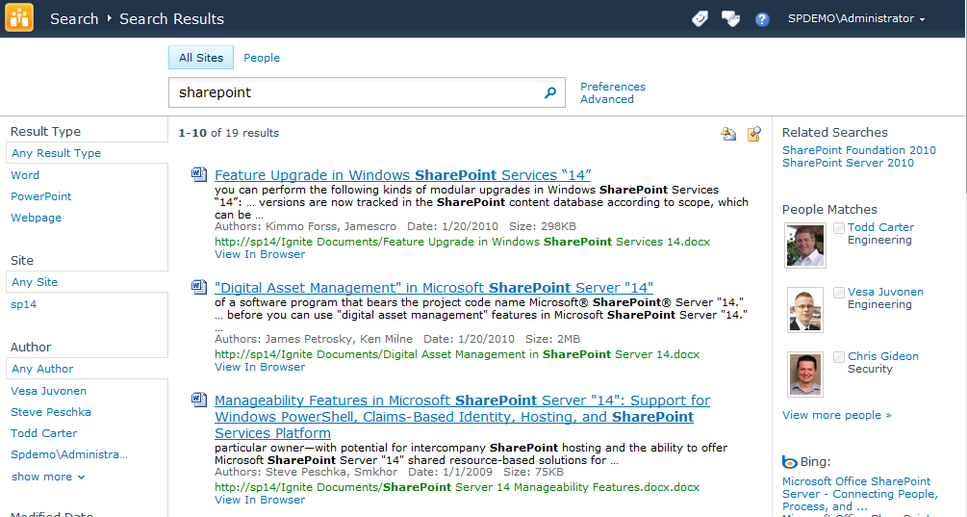
End-User UI
Out-of-box refinement
Refine over key results properties
Metadata, taxonomy and social tags based results refinement
Easy to extend over custom properties
One-stop Search Center
Scopes, web parts, best bets, top answers , advanced search
Query federation brings together results from all over - native support for OpenSearch
Core search experience
Improved did you mean suggestions
New pre-query and post related query suggestions
“View in browser” link (for most office docs)
Improved query syntax

Slide 7


End-User UI
Improved relevance ranking
New ingredients: URL fuzzy matching, social tags, results click through, implicit phrase matching, extracted metadata, etc.
Improved low-noise snippets in summaries
Enhanced multi-lingual support
Automatic detection of language of many document types and part of documents
Compound word handling - e.g., Innovationszyklen” and ”innovation“, “zyklen”
Improved ranking of documents in multilingual collections
New form factors
Mobile search from Smartphone browsers
Desktop search integration in Windows 7

Slide 8
New Query Syntax
Support for Boolean operators for FreeText queries and Property queries
(“SharePoint Search” OR “Live Search”) AND (title:“Keyword Syntax” OR title:”Query Syntax”)
Prefix matching support for keywords and properties
Micro* author:bill*
Improved operator support for property restrictions
=, >, <, <=, >=
Can create range refinements

Slide 9
Great Search Experience OOB
Win7 Connector
Get more relevant results
through a search center with hit highlighting, results summaries, related queries, and enhanced query syntax
Related searches
Find information faster
with metadata-driven refinement, query suggestions, search scopes, and federated results which help pinpoint information
Launch in Office Web Apps
Search from anywhere
Including mobile and desktop integration; Office Web Apps speed access to results; enhancements for multi-lingual
Refinement panel
Federated results

Slide 10
New Search Experience
demo

Slide 11
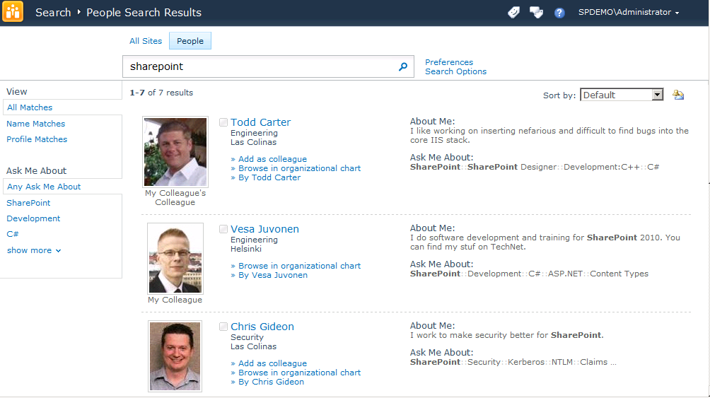
Search is Social
People finding experience
Front door to the office social network
Better expertise & interest search
Email mining to bootstrap profiles with interests and colleagues
“Address book style” search
Phonetic name matching
Nickname matching
Relevance models tuned specifically for people search
Metadata refinement, better hit highlighting, recently authored content

Slide 12
Search is Social
Social behavior drives search quality
Search click through behavior drives relevance ranking
Query suggestions mined from search logs
Social tagging influences relevance ranking
Self search - to drive people to participate content
Social definitions extracted from indexed content

Slide 13
Amplify the Impact of Knowledge & Expertise
Connect with expertise
using improved matching from mined Outlook mailbox data and SharePoint My Site profiles
Refine by focus, expertise, and other attributes
Phonetic and nickname matching
Improve relevance with use
based on how people tag content in SharePoint and on click-through of search results
Recently authored content
Expertise identification
Find people
through nickname and phonetic matching, people specific refinement, tuned relevance models

Slide 14
Search Use in Social Data Delivery
Search is used for data retrieval and trimming in other SharePoint social features
Feature | Action | Query
My Site Host home page | What’s New web part | Retrieves up to 40 recent activities from colleagues
Profile Page (person.aspx) | Recent Activities web part | Retrieves up to 10 recent activities for user
Tags and Notes page | Activities for Month web part | Retrieves up to 40 tags or notes based on activities for the specified month for user
Outlook Social Connector | OSC synchs every hour for every user. The response sends updates for colleagues since the last time OSC synched | Retrieves all recent (since the last synch) activities from colleagues

Slide 15


Search Depends on Social
Some of the functionality in Search also depends on data from Social
Only difference between SS and FS for social FS doesn’t index social tags
Feature | SS | FS
Core Results Page showing social tags (up to 5) for search results
Core Results Page Refinement by social tags
Core Results Page Refinement by Taxonomy data / Authoritative tags
All features on the people search tab - searching for people, searching for expertise, refining by people properties etc.

Slide 16
Social Search
demo

Slide 17
SharePoint Search: Architecture

Slide 18
Architecture and Design
Deployment and management
Scale-Out architecture
Introduction to concepts
Scale-out features and options
Other engine enhancements

Slide 19
Advances in Deployment and Management Lowering the TCO for Search
Simplified Installation, Topology Design, and Deployment
Taking search sizing and deployment from an art to a recipe
Virtualization and native 64-bit simplify deployment
Industrial Strength Search at High Scale
Easier Administration, Better Monitoring
Administrative Web parts and Consolidated administration UI dashboard
PowerShell support for scripted administration
Built-in user and system monitoring, support for SCOM monitoring
Index partitioning enables sub-second latency at 100M item indexes
Cooperative indexing enables fresher indexes
Full failover support for indexers, query servers, and databases

Slide 20
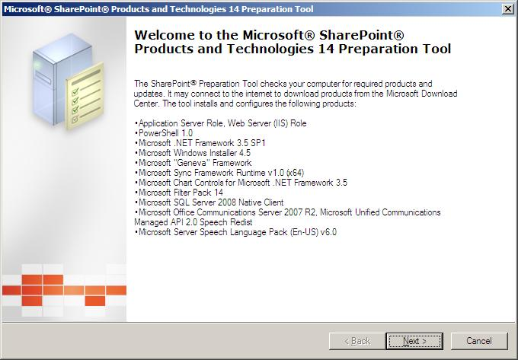
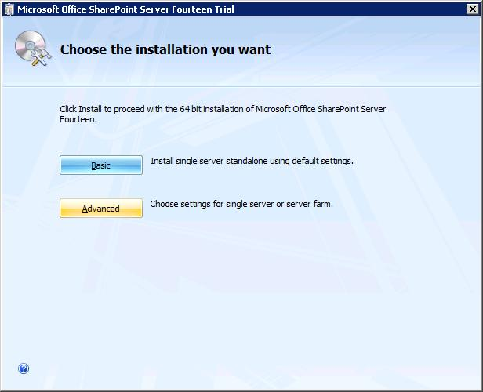
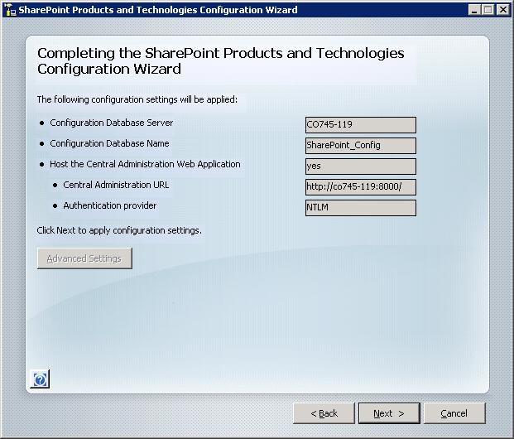
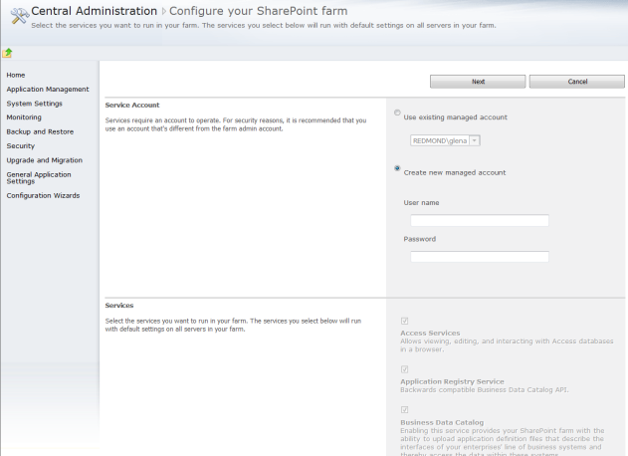
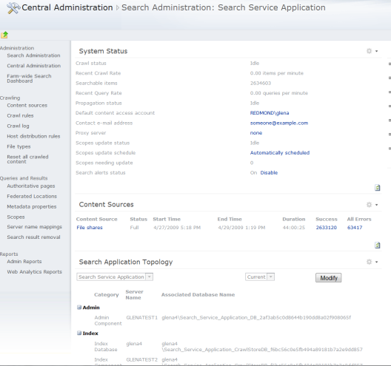
Deployment simplicity
SharePoint Server Setup
SharePoint Server post setup config
Farm Config Wizard
Search Dashboard
Prerequisite Tool

Slide 21
Scale-Out Architecture
2010 Core Engine tenets:
Sub-second query latencies at large scale
Fresher indexes
Better resiliency/higher availability
Basic philosophy
Componentize the system
Remove system bottleneck through scale-out

Slide 22


Search Technology Concepts
Concepts
Search Center - UI for users to issue queries and interact with results
Query Object Model
OpenSearch Source
Query Servers - Accept query requests from users and return results
Query Servers
Query Federation - Return results from non-SharePoint Indexes
Index Partition
Indexing - Extract information from items to enable efficient matching
Indexer
Index Partition - Subset of the overall index
Crawling - Traverse URL space to record items in search catalog
Scaling
Crawler
Connectors - Know how to process different content sources
Content Sources - Host the content we want to return in main results
Content
Content
Content

Slide 23
MOSS 2007 search scale-out
“The whole index”
“Bottleneck”
“Single point of failure”
“Bottleneck”

Slide 24
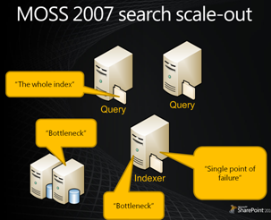
SharePoint Search 2010 Scale-out
Multiple Index Partitions
Stateless Crawlers
Crawl Distribution
Query Mirroring
Query Components
Multiple Property DBs
“The whole index”
Admin Database +
Admin Component
“Bottleneck”
“Single point of failure”
“Bottleneck”

Slide 25
Content Distribution
Crawl Distribution
Built-in load balancer distributes hosts to crawl databases
Crawlers crawl content that is covered by crawl database
Default configuration can be overwritten using host distribution rules
E.g. purchasing a new connector
Query Distribution
Low query latency if all index partitions equal in size
Distribution by hash of documentId
Crawlers partition indexed data and propagate to query servers

Slide 26
Industrial Strength Resiliency
2007 style mirroring for index partitions
Redundant components provide failover
Ability to add multiple crawlers to minimize crawl downtime
Machine down doesn’t result in crawl downtime
Native support for SQL mirroring
Synchronous Mirroring support only

Slide 27
Scale-out from an art to a recipe
To improve this… | Take these actions
Index freshness/crawl times | If crawler machine is saturated , add more crawler machines If Crawl Database is I/O bound on SQL Server, add additional crawl database on same SQL Server If SQL server is Memory/CPU bound, add additional SQL Server with additional crawl databases
Query Latency/Throughput | If time spent in executing queries in full-text query is high, partition the index into smaller index partitions. Each index partition can contain ~10M items. If query throughput is low, add query components to mirror index partitions. If Property Database is I/O bound on SQL Server, add additional property database on same SQL Server If SQL server is Memory/CPU bound, add additional SQL Server with additional property databases
Query Availability | Deploy multiple query servers with multiple index partitions, multiple query components and mirrors and property store databases. Use clustered or mirrored database servers to host property databases.
Crawl/Indexing Availability | Use multiple crawlers on redundant crawler servers, and add crawl databases. Crawlers associated with a given crawl database can be distributed across crawl servers for availability and load distribution. Generally limit to 2 crawlers per crawl database.

Slide 28
Search Administration
demo

Slide 29
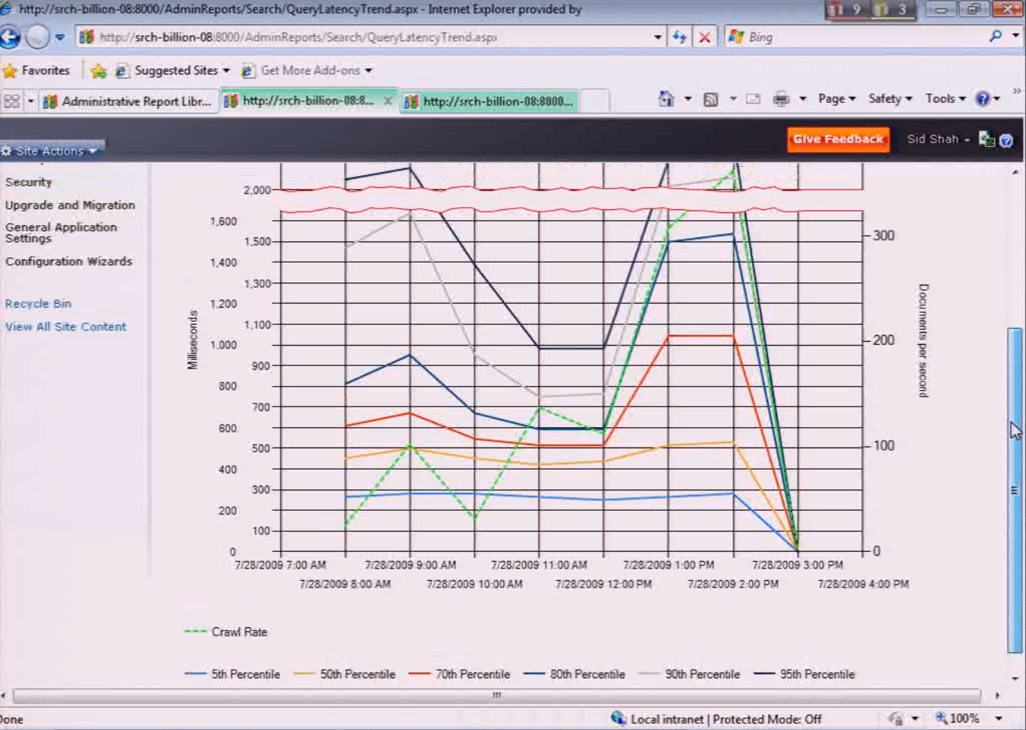
Query Latency
95% of queries are taking 2 seconds or more at times

Slide 30
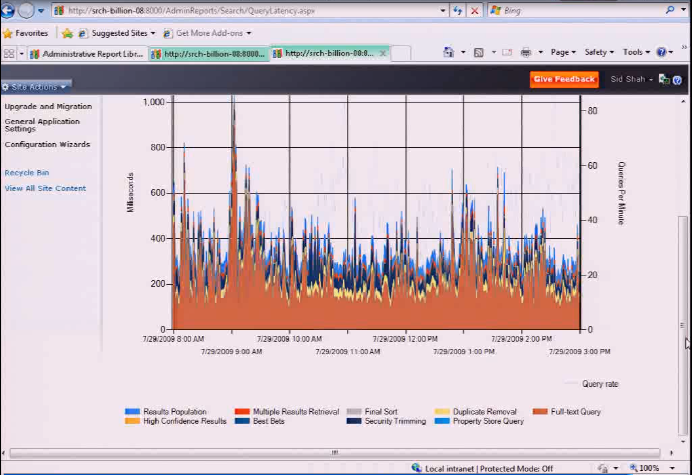
Query Breakdown
Vast majority of time is in Full-Text Query (which happens in the query component)

Slide 31
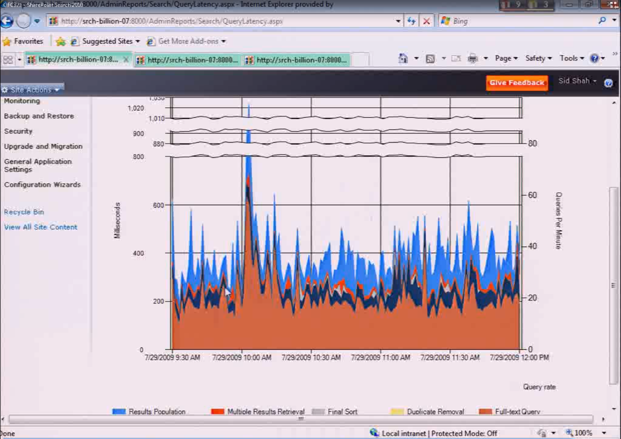
Query Breakdown
Added index partition and query component and mirror. Full text query time dropped from nearly 400ms avg to close to 200ms avg

Slide 32
Search Scale Out Examples
Scenario exercise! Let’s look at a few examples

Slide 33
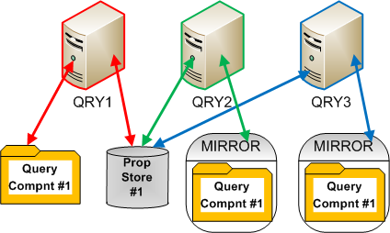
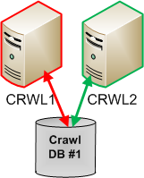
Scenario 1
Crawling 8mm items over 20 host names
Adding a new content source with 7mm items
Changes?

Slide 34
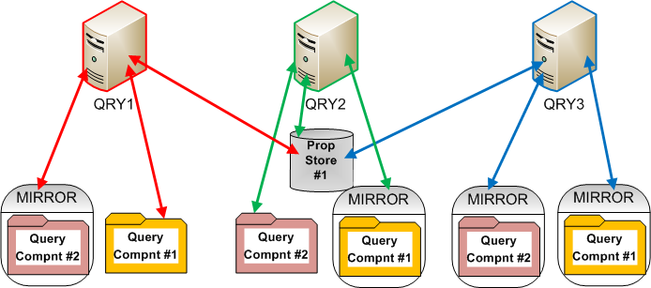
Scenario 1 – One Possible Answer
Add a new index partition
Keep # items < 10mm per index partition
Add multiple query component mirrors for redundancy
Reallocate mirrors and components

Slide 35
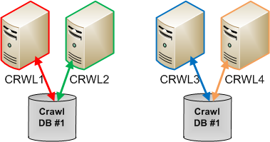
Scenario 1 – Part II
Add another crawl database
Add new crawlers and split the crawl load between them

Slide 36
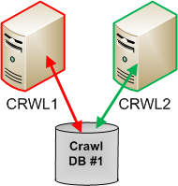
Scenario 2
Crawling 8mm items over 20 host names
New content taking too long to show in search results
Changes?

Slide 37
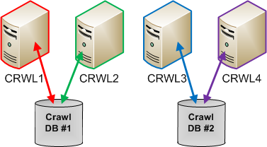
Scenario 2 – One Possible Answer
Add another crawler database
More machines to divide crawling between
Add another additional crawlers (for failover and freshness)

Slide 38
Scenario 3
Latency on queries for 15mm corpus is too long
Not sure yet where bottleneck is
Changes?

Slide 39
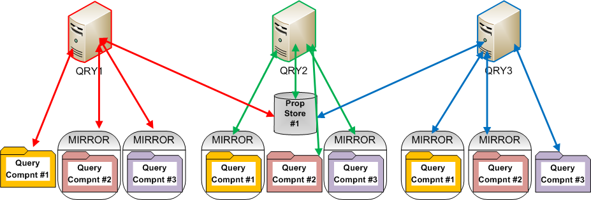
Scenario 3 – One Possible Answer
Add another index partition
Smaller partition size means easier to load into memory, quicker to search through

Slide 40
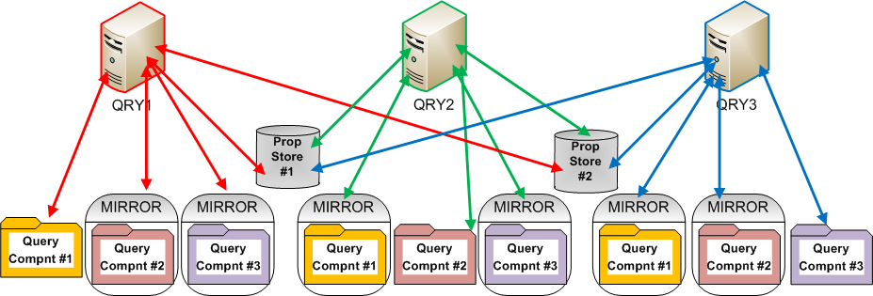
Scenario 3 – Possible Answer Two
Add another property store database
Relieve pressure on the property store – add another, possibly even on a different SQL Server

Slide 41
Query Reports
Use the new query reports to identify bottlenecks and assess changes
Administration Reports
Covers things like crawl rate, query latency, crawl queue, crawl processing per component, etc.
Web Analytics Reports
Covers things like total # of queries, # per day, top queries, queries that returned 0 results, etc.

Slide 42
Other Engine Enhancements
Support for regular expressions in Crawl Rules
Native support for crawling case sensitive repositories
Ability to prioritize Content Sources so as to distribute crawler resources
New ‘Crawl Policy’ to define how crawler treats error conditions
Low indexing downtime Search Backups

Slide 43
FAST Search: Capabilities

Slide 44
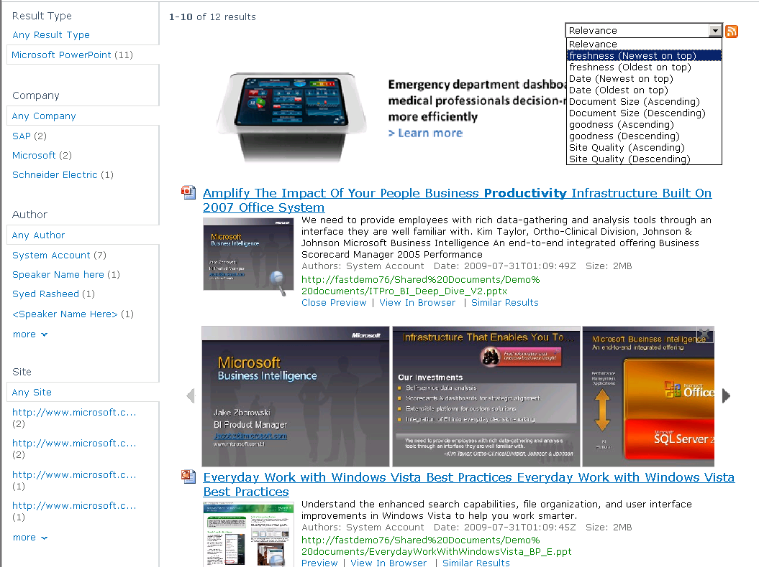
Go Beyond the Search Box Visual, Conversational Search
Sorting on any property
Visual Best Bets
Refinement with counts on any property
Scrolling PowerPoint
Previews
Thumbnails

Slide 45
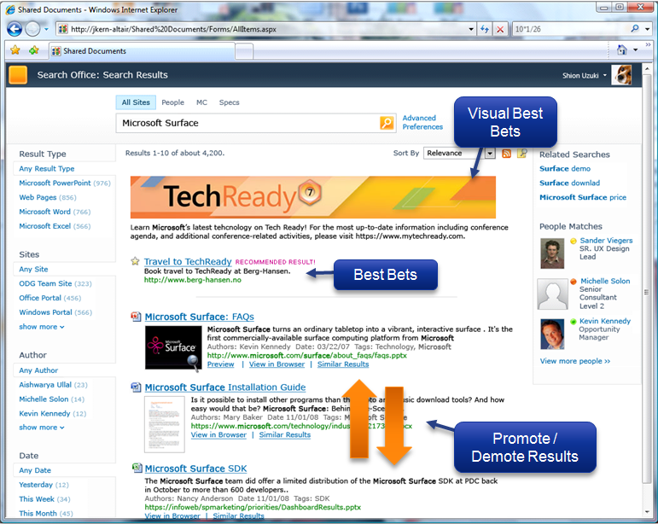
Go Beyond the Search Box Shaping the User Experience
Site admin/Search admin control
Visual Best Bets
Promote/Demote documents and sites
UI extensibility (web parts, ..)
Relevancy profiles and parameters
User Context parameter & admin
End User Control
Sorting, Ranking, and Navigation
Admin-enabled controls
Linguistics and term control
Keywords, phrases, synonyms, spellcheck
Multilingual searching control
Lists for metadata extraction
Search similar (based on document vectors)
Index based did you mean suggestions

Slide 46


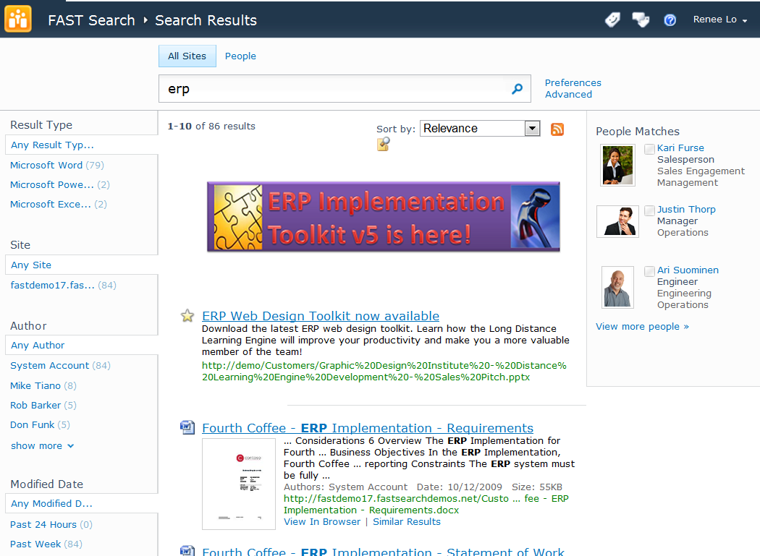
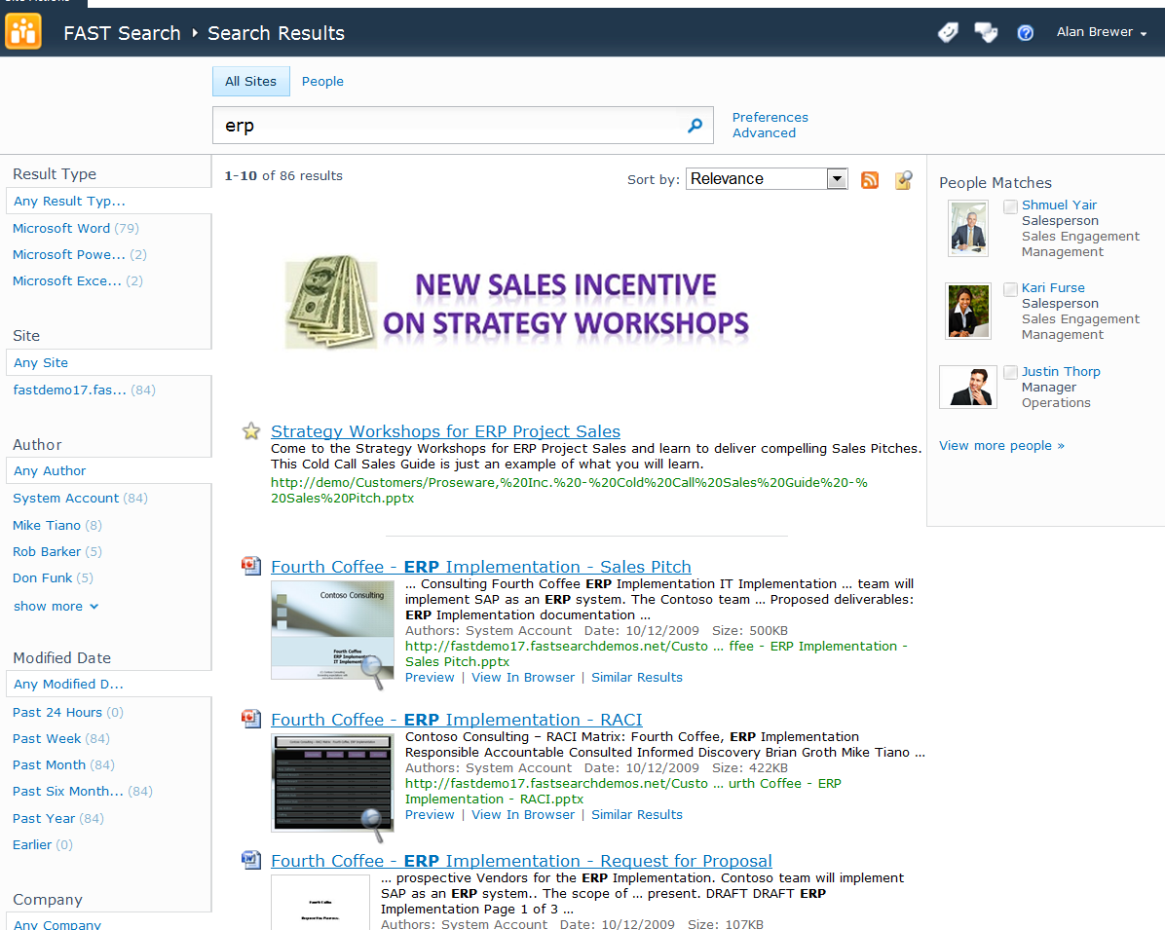
User Context Matters
Renee Lo, Engineer
What should I know about implementing ERP?
Alan Brewer, Sales
What should I know about selling ERP consulting?

Slide 47
Go Beyond the Search Box Broader, Better Language Coverage
Afrikaans | Hausa | Pashto, Pushto
Albanian | Hebrew | Persian
Arabic | Hindi | Polish
Armenian | Hungarian | Portuguese
Azerbaijani | Icelandic | Punjabi
Basque | Indonesian | Rhaeto-Romance
Bengali,Bangla | Irish | Romanian
Bosnian | Italian | Russian
Breton | Japanese | Sami (Northern)
Bulgarian | Kannada | Serbian
Catalan | Kazakh | Slovak
Chinese-S | Kirghiz | Slovenian
Chinese-T | Korean | Sorbian
Croatian, | Kurdish | Spanish
Czech | Latin | Swahili
Danish | Latvian, Lettish | Swedish
Dutch | Letzeburgesch | Tagalog
English | Lithuanian | Tamil
Estonian | Macedonian | Telugu
Faroese | Malay | Thai
Finnish | Malayalam | Turkish
French | Maltese | Ukrainian
Galician | Maori | Urdu
Georgian | Marathi | Uzbek
German | Mongolian | Vietnamese
Greek | Norwegian | Welsh
Greenlandic | Norwegian-B | Yiddish
Gujarati | Norwegian-N | Zulu
Can search in any language
84 languages detected to allow language-specific handling
Lemmatization improves recall
(‘better’ includes ’good’)
Phrase search includes stopwords
(“a room with a view”)
Only nouns and adjectives are expanded (higher precision)
(‘book’ -> ‘books’, not ‘booked’)

Slide 48
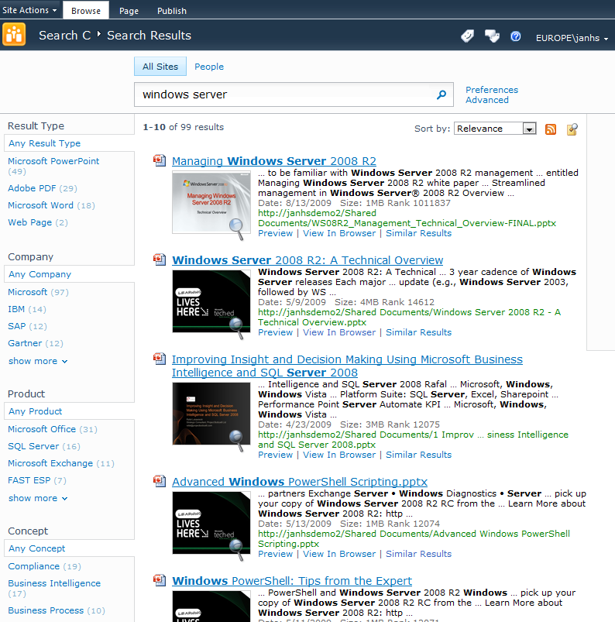
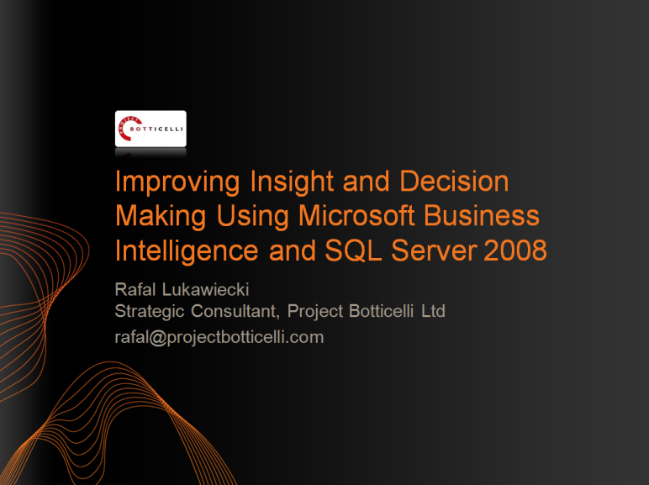
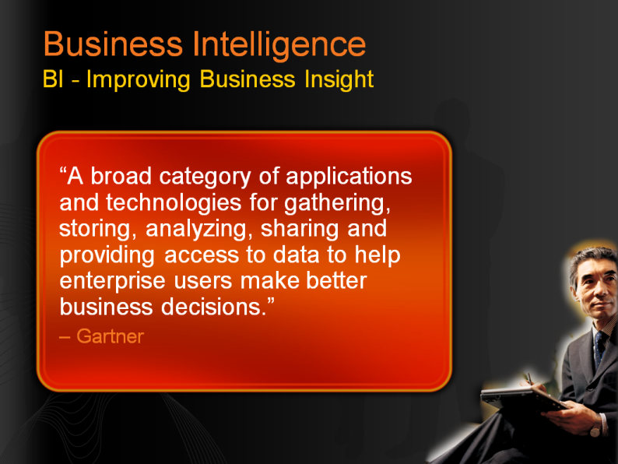
Advanced Content Processing
PRODUCT (Custom)
CONCEPT (Custom)
COMPANY (OOTB)
Extract properties to be used for refinement

Slide 49
FAST User Experience
demo

Slide 50
FAST Search: Architecture

Slide 51
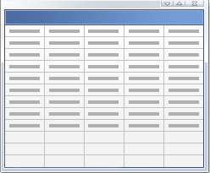


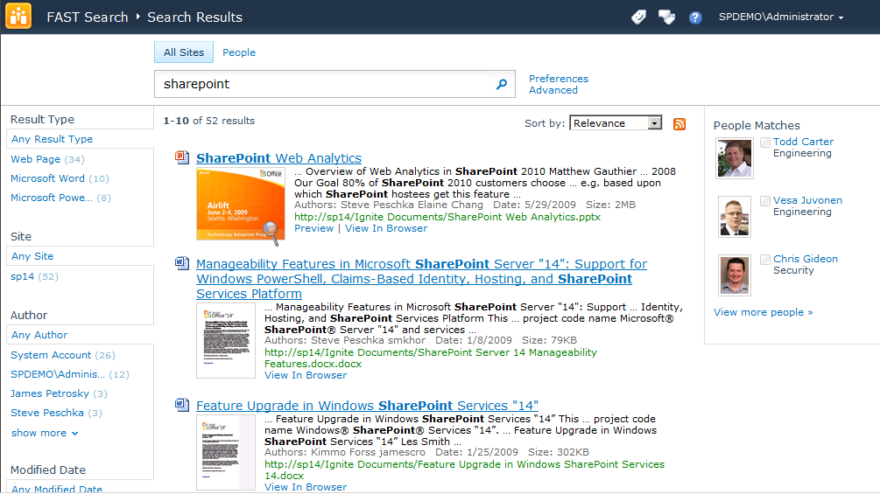
FAST Extends Capabilities of SharePoint Server Superset of capabilities; common base functionality and platform
Common
Connectors
Documents, Sites, Database Content
User Profiles
High-End
Content Search
FAST Search
for SharePoint
SharePoint Server
Common
Web Parts

Slide 52
Richer extensibility for FAST Search for SharePoint
Extensions for high-end search capabilities
Configurable and extensible content processing
Custom property extractors; Pipeline configuration & extension
FQL (FAST Query Language)
Extensive relevance control per query (Xrank); Multilevel sorting and formula sorting; Near () and symbolic searching
Additional capabilities for custom rank models
Anchor Authority; Query Authority (click-through); Freshness; Quality (based on value on specific managed properties); Full-text index rank
Extensions to Query Object Model and Web Service
Refinement; Sorting; Find Similar; User Context; Filter (FQL, restriction on query, more “advanced scope”); Visual Best Bets; Zero result handling (resubmit flags); Spellchecking (did you mean, automatically re-write query)
Extensions to shared Web Parts
Core results Web Part; Search Action WebPart

Slide 53
FAST Search for SharePoint Summary of architectural elements
Search Service Applications
FAST Search for SharePoint
Web Frontend
Site Collection Level Admin UI
- Keyword Management
- User Context Management
- Site Promotion/Demotion
PowerShell
Schema configuration
Admin configuration
Deployment configuration
Central Administration UI
Property mapping
Entity extracton
Spell-checking
Administration and Schema Object Model
SharePoint
Front-end
Security
Access
Module
Indexing
Content
Processing
And
Linguistics
Connectors:
- SharePoint
- BDC
- Exchange
Content
Content
Custom
front-end
Query Object Model
Connectors:
- Web Crawler
JDBC
Lotus Notes
Query Web Service
Query and
Result
Processing
Search
Content
Federation
Object Model
Monitoring Services
OpenSearch or other Sources
People Search
Microsoft System Center Operations Manager
!
!

Slide 54
Content Processing Flow A new level of search quality
OpenSearch Source
Content
End Users
Query Processor
Indexer
Content Processor
Crawler
Federation
Search Center
Index Partition
Profiles
User
Context
Relevance
Control
Metadata
Indexing
Connectivity
Data moves from content source to end user queries
It gets crawled, processed and refined, an index is created
User executes queries and retrieves data, metadata, and federated search results

Slide 55
Content Pipeline Stages
Default
Optional
XML Properties mapper
Offensive Content Filter
Verbatim extractor
Loads dictionary for custom extraction, e.g product names
Field Collapsing
Format Conversion
Language detection and encoding
Lemmatizer
Linguistics normalization
Tokenizer
Word breaking
Entity Extraction
Persons, companies, locations, email, date/time, URL, prices, file names
DateTimeNormalizer
Date normalization
Vectorizer
Create document vector for similarity searching
WebAnalyzer
Anchor text and link cardinality analysis
PropertiesMapper
Map to crawled properties
PropertiesReporter
Report detected properties
Mapper
…
Configurable
Stages
Entity Extraction
Language
Detection
Format
Conversion
These are plug-ins available OOB
You can enable/disable them
You can write custom plug-ins and add to end
Manage through UI or config files

Slide 56
Content Processing and Schema
Extracted document attributes reported as Crawled Properties
Crawled Properties mapped to Managed Properties
Characteristics are defined for Managed Properties, e.g.
Refiners
Sorting
Queryable
Type
Definition and mapping done via UI or Powershell
Admin UI
Schema CmdLets
Custom Client
Schema Object Model
Update configuration
Schema Service (hosted in IIS)
Report discovered crawled properties
Persistence
Update Tools
Property backend
configserver
bliss
psctrl
Document Processing Pipeline
PropertiesMapper
PropertiesReporter

Slide 57
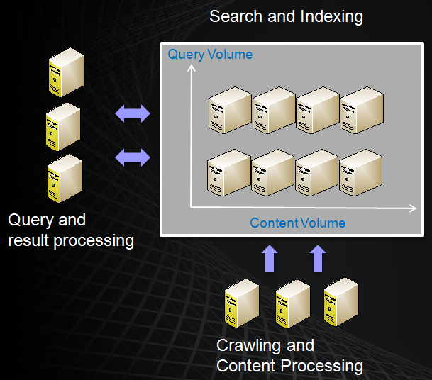

FAST Search for SharePoint Scaleout
Back-end with extreme and flexible scale out options
Scale-out in different “dimensions”
Query Volume
Content Volume
Processing power
Indexing freshness
Redundancy options
Search
Indexing
Performance targets*
30 mDocs/node
50 QPS/node
35 docs/sec
* Dependent on document and HW characteristics

Slide 58
Managability
Central Admin UI for core configurations
Managed Properties
Entity extraction
Spell check
Powershell support for scripted administration
Schema
Rank
Crawling
Site Admin UI for search management
Keyword management
Extensible search analytics reporting

Slide 59
FAST Administration
demo

Slide 60
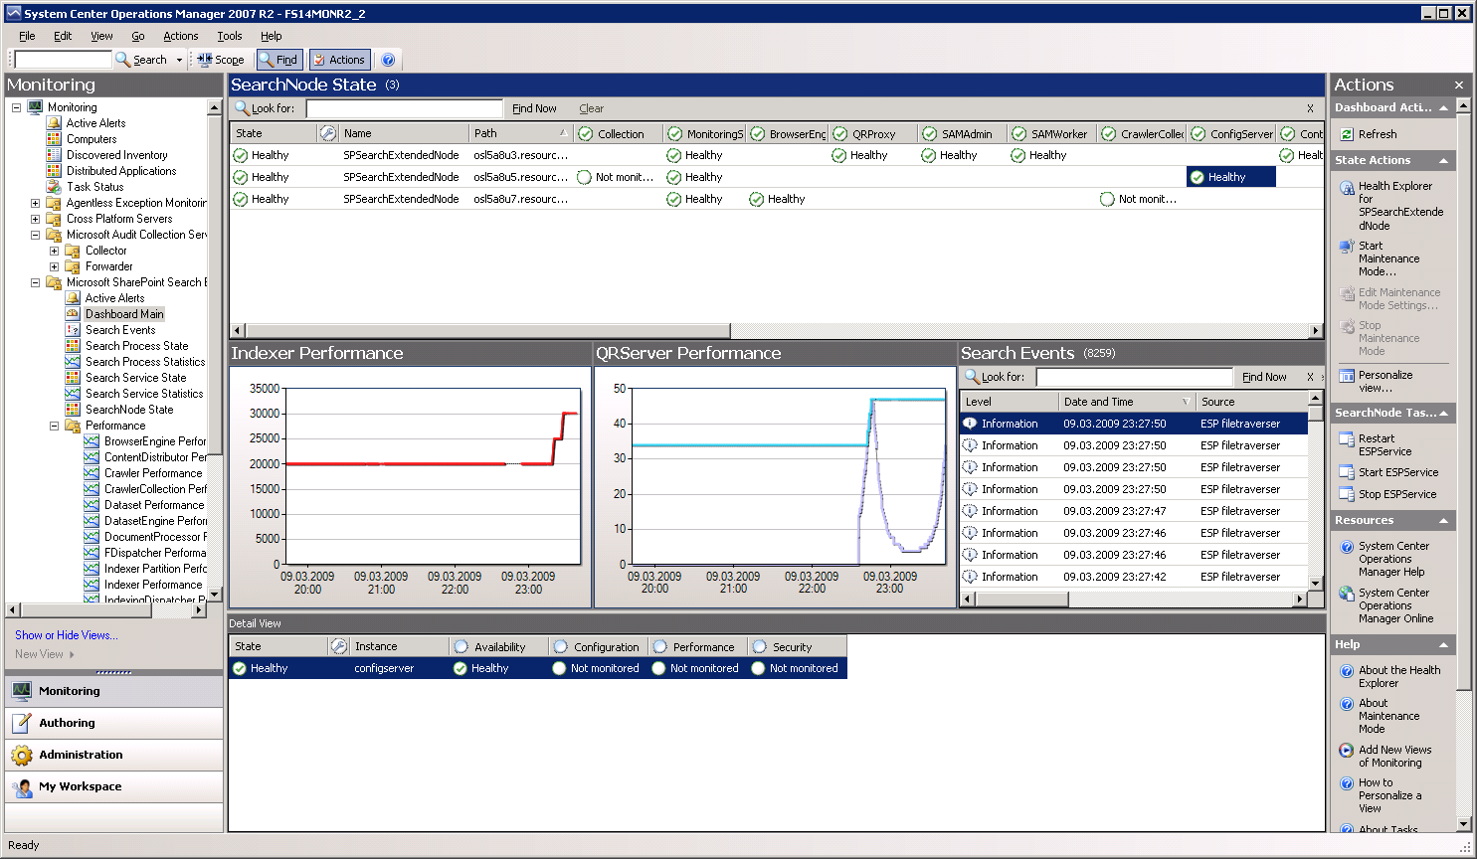
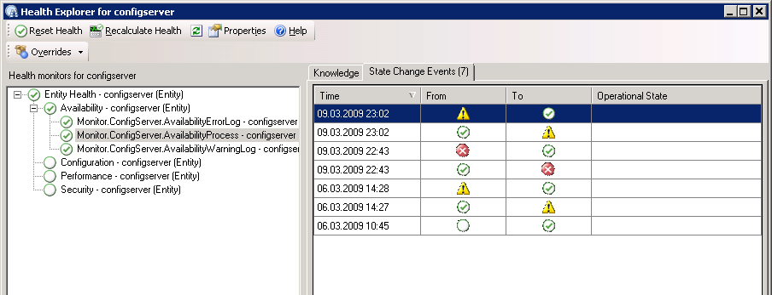
Monitoring and Alerting
Granular state, performance and alerting overview
Dedicated Management Pack in System Center Operations Manager 2007
Support of standard Windows monitoring services
Detailed monitoring of state and performance at node level
Extensive alerting options

Slide 61
FAST Search Differentiators
The features above and beyond SharePoint Search
Conversational
User Experience
Precise Control
Content Processing
Platform
Visual Cues
Thumbnails & Previews
Visual Best Bets
Exploration
Deep refiners
Similarity Search
Multilevel Sorting
…on any property
Context-Based Results
Promote/Demote
User Context
Relevance Control
Multiple profiles
Word/Term control
Custom/Extensibility
Property extraction
Prebuilt
Custom/Extensibility
Content coverage
400+ document types
82 languages
Advanced Linguistics
Offensive content filter
Extreme scale
in 3 dimensions
at best footprint
Query Expressiveness (FQL)
Relevance and sorting
Symbol & proximity search
Features
Provide the best, most productive, user experience
Maximize productivity through control
Make the most of all your content
Tackle the most demanding search challenges
Benefit
The best search from Microsoft
Conversational, Visual, Actionable
Extracted metadata -> better search
Social Search (Integrated w/ SharePoint)
One platform for many applications
Scale as you grow with no few limits

Slide 62
Common Features

Slide 63
Crawling
Both SharePoint Search and FAST Search use the same crawling infrastructure
Authentication type matters for crawling!
Claims: we store claims for objects
NTLM: we store ACLs for objects
Exception – when NT ACLs are converted to claims:
One-way trust
Size of ACL greater than 64K
This impacts Alerts
Alerts only fired on items with NT ACLs

Slide 64
Richer Manageability
Consolidated administration UI dashboard
Automated service password management through “managed accounts”
PowerShell support for scripted administration
Built-in system health monitoring, support for SCOM monitoring and alerting
Built-in and extensible search analytics reporting

Slide 65
Connectors - Query and Index
Common strategy for indexing connectors and query federation connectors
Indexing connectors
SharePoint, Web/HTTP, File share, Exchange PF, Lotus Notes DBs supported out of box
Business Connectivity Services (BCS) framework for adding indexing connectors including LOB
Deprecating protocol handlers
Exchange PF and Lotus Notes re-implemented in BCS
Query federation
Any OpenSearch compliant search source
Any connector supported through extensibility

Slide 66
Connector Framework
New features
Support for attachments
Item level security
Crawl through entity associations
Inline caching + Batching for better citizenship
Richer crawl options
Regular full crawl (like 2007)
Time Stamp based incremental crawl
Change log crawl + Deleted count
Change log + delete log crawl
* Protocol Handler API still supported, but deprecated

Slide 67
Connector architecture
Search page points to Profile Page or custom page to show search result
Search user queries
Search results page – results based on metadata
Search Engine/Index
BCS Profile Pages or External Lists
Protocol Handlers
Search BCS Runtime
Fetch data from repository
Execution call routing through Business Data Connectors using model file
WCF
Databases
.NET Assembly Connector
Custom Connector

Slide 68
How to write connectors
Use OOB Connectors (Database/WCF/.NET)
Create/Deploy model file using SPD and use Search UI to configure crawls
Create/Deploy .NET classes with entities and methods using VS.NET and use search UI to configure crawls
Recommended if backend structure is static
Write Custom Connector+ Model file
Implement ISystemUtility, optionally ITypeReflector
Useful for dynamic back-end structures, e.g. Exchange Public Folders

Slide 69
.NET Assembly Connector vs. Custom Connector
.NET CONNECTOR
CUSTOM CONNECTOR
Uses entities and methods for finder, update, etc.
Deploy as a WSP to BCS
When data structure changes, need to update & redeploy
Doesn’t require GAC
Supports client-side deploy for offline list support
OOB support in VS.NET 2010
Custom class must implement ISystemUtility
Must be put in GAC
Separate setup process needed
Offline support breaks if assembly not in GAC
When data structure changes doesn’t require redeploy unless code needs update
No specific tooling support

Slide 70
Custom Search UI and Applications

Slide 71
Search Extensibility: End-user UI
Change WebPart properties – No Code
Modify XSLT
Modify config XML
Refinement Panel – Control metadata available for refinement
Advanced search – Control metadata available for advanced search queries
Extend OOB Web parts programmatically
Most OOB Web parts are public
Extend web parts to change default behavior
E.g. Extend core results Web Part to show result colleague’s docs
Extend Search Center with vertical experiences
All Web Parts communicate through public interface (SharedQueryManager object) - No more hidden query object!

Slide 72
Search Extensibility - Federation
Query Federation
Bring external search results into the SharePoint experience
Based on Open Search standard
Exposed through UI + public federation Object Model
Enables scenarios like Bing and Yahoo, could even be extended to scenarios like custom web services

Slide 73
Developer Enhancements Advances in level of access, tooling, and developer experience
Common dev platform across SharePoint Search and FAST
UI extension and customization
Query federation
Indexing connector framework - based on BCS
SharePoint Designer for “experience designers”
UI, web parts, layout, workflows
BDC tooling built-in
Licensing now free
Visual Studio 2010 release
Office and SharePoint tools integrated (VS for applications)
Developer environment
SharePoint 2010 now runs on client OS for developers
Sandboxed deployment makes usability testing and pilots simple

Slide 74
Customizing the Search UI
demo

Slide 75
SharePoint Search and FAST Search Superset of capabilities; common base functionality and platform
SharePoint Server Search
FAST Search
for SharePoint
+
Great core search experience
Unique social search features
Broad content reach including BDC
Industrial strength platform
Strong developer experience
Conversational and rich user experience
Precise control of the user experience
Enhanced content processing capabilities
Deep platform flexibility and scale
Highly configurable and extensible
Key
Capabilities
+
OOB intranet + site search
OOB people + expertise search
Custom search verticals
Target
Applications
+
High end (custom) search applications
Common
Developer and IT Pro foundation
APIs and developer experience
End user and site administrator enablement
SharePoint platform integration
Social search features and integration
Admin & deployment capabilities
Operations advantages (SCOM, scripting)

Slide 76
Summary
SharePoint Search
Capabilities
Architecture
FAST Search
Capabilities
User Centric Search
Architecture
Common features
Search UI Customization

Slide 77


Slide 78

© 2010 Microsoft Corporation. All rights reserved. Microsoft, Windows, Windows Vista and other product names are or may be registered trademarks and/or trademarks in the U.S. and/or other countries.
The information herein is for informational purposes only and represents the current view of Microsoft Corporation as of the date of this presentation. Because Microsoft must respond to changing market conditions, it should not be interpreted to be a commitment on the part of Microsoft, and Microsoft cannot guarantee the accuracy of any information provided after the date of this presentation. MICROSOFT MAKES NO WARRANTIES, EXPRESS, IMPLIED OR STATUTORY, AS TO THE INFORMATION IN THIS PRESENTATION.

