Slide 2
Using the SharePoint 2010 Security Model - Part 1
Name
Title
Company

Slide 3
Agenda
Administration Roles
XSS Prevention
ECM Lockdown
Explorer View
Anti Virus API Improvements
Managed Accounts
Password Management
Least Privilege Farms
Inter Server Communications
AD DS Integration

Slide 4
Administration Roles
Farm Administration
Non-local machine Administration
Local Machine Administration
SharePoint_Shell_Access
Service Administration
Services can have unique Roles
Delegation Granularity
Feature Administration
Administer a subset of a Service
Tenant Administration

Slide 5
Anonymous Users lockdown
Web.Config
Login.aspx, /_vti_bin/*
Standard ASP.NET Authorization
Lockdown Mode for Publishing Sites
Consistent with 2007 functionality
<location path="_layouts/viewlsts.aspx">
<system.web>
<authorization>
<deny users="?" />
</authorization>
</system.web>
</location>

Slide 6
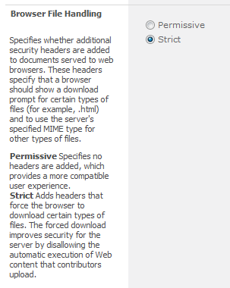
XSS Security
Non-ASPX pages
2007: HTM to DOCX
2010: New HTTP Headers
Force download
Can be turned off
List and Web App
Safe List by Mime type
ASPX Pages
2007: Contributors upload pages
2010: Contributors can’t upload pages
Can create a wiki page
It’s about change
No more designer for you

Slide 7

XSS Security
Web Parts
2007
No script safety
Contributors can edit
2010
Contributors can’t edit
Read-only
SafeAgainstScript=“True” and by Type
RequiresDesignerPermission
Content Editor Web Part

Slide 8
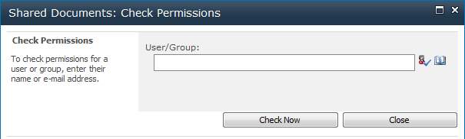

Other End User Security Features
Security policy reports (ECM)
Check Effective Permissions UI

Slide 9
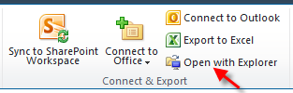
Explorer View
Is gone
Now opens Windows Explorer Window instead of Explorer View in Internet Explorer
Not a security feature
Common perception that this issue was security related (Authentication)

Slide 10
Anti Virus API Improvements
Updates to support new versions of antivirus for SharePoint 2010.
Enhanced UI detailing files with virus, blocked files etc
No longer all in one “bucket”
API now provides antivirus software with file details
Allows for Quarantine steps
Bypass option for large files

Slide 11
Managed Accounts
Domain Accounts “registered” with SharePoint
Along with Built In accounts
Credentials validated during registration
Credentials can be modified post registration
Managed Account includes a description
Improves
Use within Central Admin (e.g. Creating new apps)
Eases “Service Account Granularity”

Slide 12
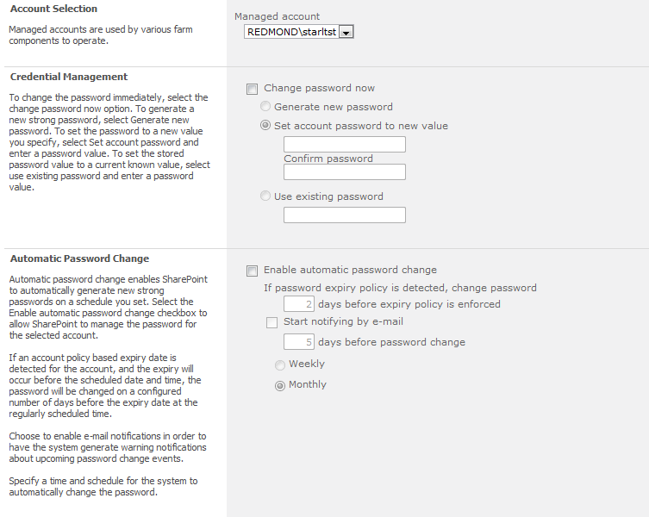
Managed Accounts

Slide 13
Password Management
Managed Accounts enable Password Management
a.k.a. “Password Roll”
Can Detect Account Policies
Password changed X days before expiry
Email Notification
Automatic Change Schedule
Implemented as Timer Job
Wait time notifies services of impending change
Pass Phrase (PSConfig)
Allows credentials to be retrieved
Password Retrieval via custom code no longer possible!

Slide 14
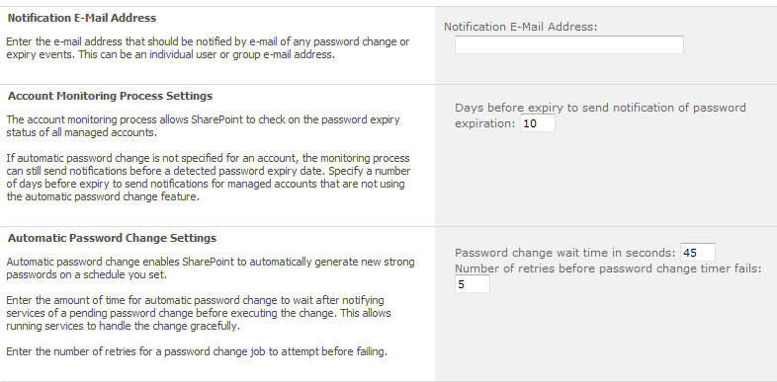
Password Management Settings

Slide 15
Least Privilege Farms
Entirely possible and recommended
Very similar to SharePoint 2007
More User and Service granularity
Tenant Admin, Enhanced Farm Admin, Service Accounts
Password Management reduces burden significantly
Most common reason given not to deploy 2007 using Least Privilege
New SQL Role: SHAREPOINT_SHELL_ACCESS

Slide 16

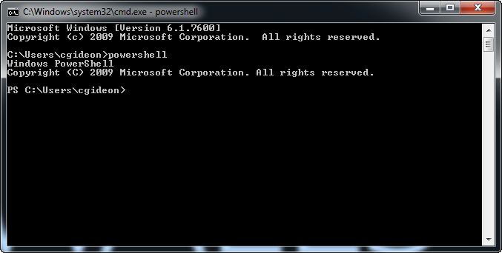




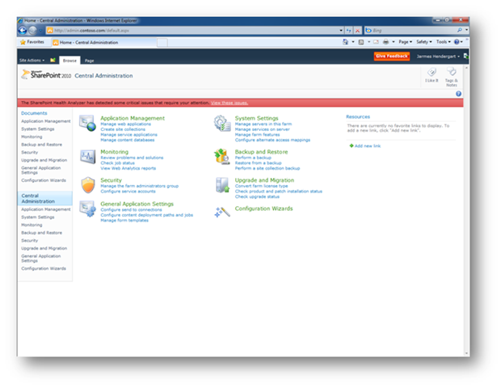

Shell Access Account
Add-SPShellAdmin

Slide 17
Inter Server Communications
Very similar to SharePoint 2007
Shared Services now uses:
32843, 32844
Watch out for self signed SSL Cert issues

Slide 18
Web Server Port Requirements
External Communications
Protocol | Port | Type
HTTP | 80 | TCP
HTTPS | 443 | TCP
SMTP | 25 | TCP
Internal Communications
Protocol | Port | Type
HTTP | 32843 | TCP
HTTPS | 32844 | TCP
SMB | 445 | TCP/UDP

Slide 19

Active Directory
New policy denies installation on servers
AD Inventory

Slide 20
Summary
Administration Roles
XSS Prevention
ECM Lockdown
Explorer View
Anti Virus API Improvements
Managed Accounts
Password Management
Least Privilege Farms
Inter Server Communications
AD DS Integration

Slide 21


Slide 22

© 2010 Microsoft Corporation. All rights reserved. Microsoft, Windows, Windows Vista and other product names are or may be registered trademarks and/or trademarks in the U.S. and/or other countries.
The information herein is for informational purposes only and represents the current view of Microsoft Corporation as of the date of this presentation. Because Microsoft must respond to changing market conditions, it should not be interpreted to be a commitment on the part of Microsoft, and Microsoft cannot guarantee the accuracy of any information provided after the date of this presentation. MICROSOFT MAKES NO WARRANTIES, EXPRESS, IMPLIED OR STATUTORY, AS TO THE INFORMATION IN THIS PRESENTATION.

