Slide 1
Microsoft Systems Management Strategy: System Center

Slide 2
Microsoft in Systems Management
1994
2000
2003
2006
2007
2008
Essentials debuts
SMS debuts
Extend portfolio - MOM debuts
DPM debuts
VMM debuts
VMM manages ESX
System Center Milestones:
MOM 2005 ships
Cross-platform Connectors released
System Center portfolio launches
Systems management tools introduced
ITIL gains traction worldwide
WS 2003 grows in the data center
Widespread management vendor consolidation
ITIL v3 and MOF v4
Virtualization goes mainstream
Industry Milestones:
System Center Revenue Trend Line

Slide 3
Industry Trends
Macro Trends
Current Indicators
Virtualization Acceleration
#1 CIO priority in 2008 (up from #17)
Compliance
CIOs expect 10% of IT budget to be dedicated to compliance
IT Service Management
IT orgs can currently only correlate 30% of IT alerts to business problems
Anywhere Access
Converged mobile phones (Smartphones) growing two times faster than mobile PCs
22% New
Software as a Service
>1/3 of TDMs interested in using SaaS to support customer-facing business processes
78% Maintenance
Data Center Build Outs
74% of enterprises mandate all servers
must reside in the data center
Implication
78% of IT budgets spent on maintenance activities, trends increase pressure
Notes:
3
© 2008 Microsoft Corporation. All rights reserved. Microsoft, Windows, Windows Vista and other product names are or may be registered trademarks and/or trademarks in the U.S. and/or other countries.
The information herein is for informational purposes only and represents the current view of Microsoft Corporation as of the date of this presentation. Because Microsoft must respond to changing market conditions, it should not be interpreted to be a commitment on the part of Microsoft, and Microsoft cannot guarantee the accuracy of any information provided after the date of this presentation. MICROSOFT MAKES NO WARRANTIES, EXPRESS, IMPLIED OR STATUTORY, AS TO THE INFORMATION IN THIS PRESENTATION.

Slide 4







Core Infrastructure Optimization
Basic
Standardized
Rationalized
Dynamic
Uncoordinated, manual
infrastructure
Managed IT
infrastructure with limited automation
Managed and
consolidated IT
infrastructure with maximum automation
Fully automated
management,
dynamic resource
usage, business
linked SLA’s
Dynamic IT
Cost Center
More Efficient Cost Center
Business Enabler
Strategic Asset
Manage Complexity and Achieve Agility

Slide 5









Dynamic IT Enabling IT Pros and development across the IT lifecycle
Unified and Virtualized
Service
Enabled
Process-Led,
Model-Driven
User
Focused
Basic
Standardized
Rationalized
Dynamic
Cost center
Efficient
cost center
Business enabler
Strategic asset
People. Process. Technology.

Slide 6









System Center Solutions: People, Process, & Technology
Management Packs
Connectors for Interoperability
Knowledge
Solution Accelerators
Microsoft Operations Framework (MOF/ITIL)
Partner Ecosystem
Microsoft Consulting Services
Data Center Management
Products
Solutions
Desktop & Device Management
Windows Platform
Infrastructure
Virtualization Technology
Open Standards
Mid-Market
Notes:
6
© 2006 Microsoft Corporation. All rights reserved. Microsoft, Windows, Windows Vista and other product names are or may be registered trademarks and/or trademarks in the U.S. and/or other countries.
The information herein is for informational purposes only and represents the current view of Microsoft Corporation as of the date of this presentation. Because Microsoft must respond to changing market conditions, it should not be interpreted to be a commitment on the part of Microsoft, and Microsoft cannot guarantee the accuracy of any information provided after the date of this presentation. MICROSOFT MAKES NO WARRANTIES, EXPRESS, IMPLIED OR STATUTORY, AS TO THE INFORMATION IN THIS PRESENTATION.

Slide 7



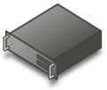






Virtualization Managing a virtualized infrastructure with a common management platform
Profile
Virtualization
Document redirection
Offline files
Presentation
Virtualization
Server
Virtualization
Desktop
Virtualization
Application
Virtualization

Slide 8


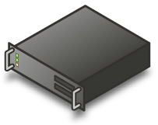

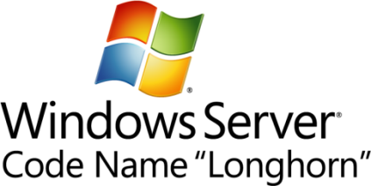
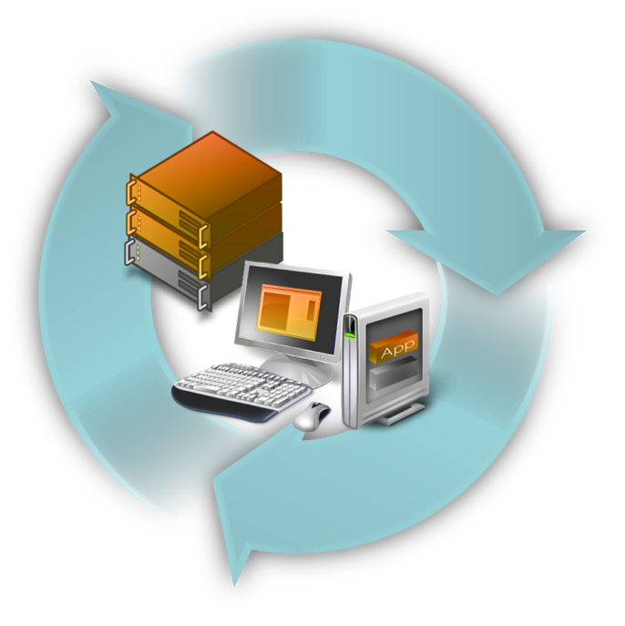

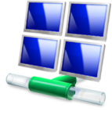
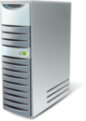
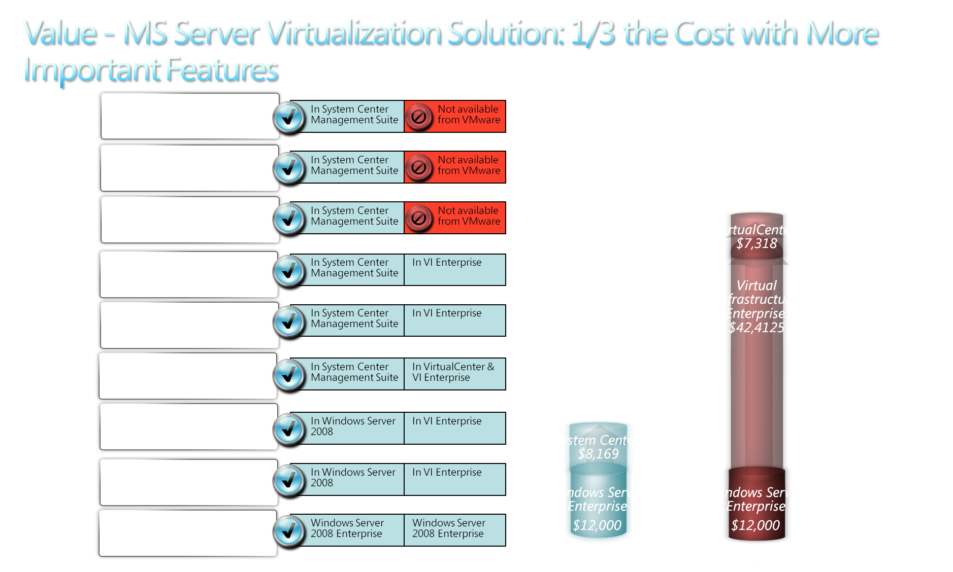
Microsoft strategy for virtualization
It’s Windows
Full 360⁰ View
Best TCO
Integrated Management
Key feature of platform
Data center to desktop
Integrated platform
Physical and logical
Environment you know
Flexible choices
1/3 the price upfront
Tools you already know
Mass-market adoption
Partners (OEM, ISV)
Lower ongoing costs
Interoperability

Slide 9
System Center Solutions: People, Process, & Technology
Management Packs
Connectors for Interoperability
Knowledge
Solution Accelerators
Microsoft Operations Framework (MOF/ITIL)
Partner Ecosystem
Microsoft Consulting Services
Data Center Management
Products
Solutions
Desktop & Device Management
Windows Platform
Infrastructure
Virtualization Technology
Open Standards
Mid-Market
Notes:
9
© 2006 Microsoft Corporation. All rights reserved. Microsoft, Windows, Windows Vista and other product names are or may be registered trademarks and/or trademarks in the U.S. and/or other countries.
The information herein is for informational purposes only and represents the current view of Microsoft Corporation as of the date of this presentation. Because Microsoft must respond to changing market conditions, it should not be interpreted to be a commitment on the part of Microsoft, and Microsoft cannot guarantee the accuracy of any information provided after the date of this presentation. MICROSOFT MAKES NO WARRANTIES, EXPRESS, IMPLIED OR STATUTORY, AS TO THE INFORMATION IN THIS PRESENTATION.

Slide 10
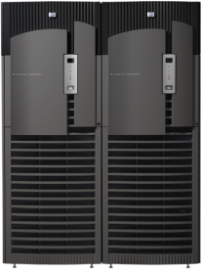




Data Center Management Solutions
Configuration Management
End to End
Monitoring
Server Compliance
Data Protection and Recovery
Automated Provisioning and Updating of Physical and Virtual Environments
Server Consolidation Through Virtualization
Proactive Platform Monitoring
Application & Service Level Monitoring
Interoperable and Extensible Platform
Configuration Controls and Reporting
Centralized Security Auditing
Comprehensive Security & Identity and Access Mgmt
Business Continuity Through Virtualization Mgmt
Backup and Recovery of Physical and Virtual Resources
Disaster Recovery

Slide 11
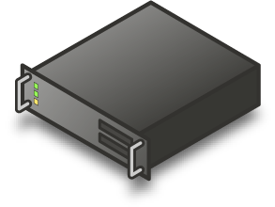

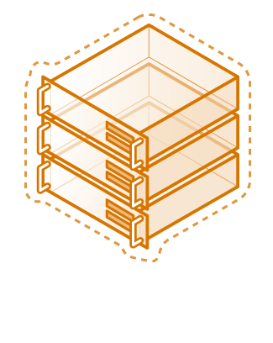
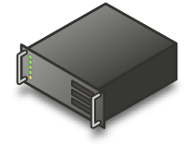

Configuration Management Automated provisioning and server consolidation through virtualization
Challenges Addressed
Power, space and maintenance costs forcing more efficient use of resources
Dispersed servers and applications difficult to manage and update
Key Capabilities
Manage virtual machines to consolidate physical servers
Provision operating systems, applications, and patches in the data center
“We understood that if we consolidated servers we would reduce energy consumption. [System Center is a] one-stop, single-point approach to managing hundreds of Virtual Server–based virtual machines and all the hosts, while also easily performing physical-to-virtual migrations.”
- Jason Foster, Systems Architect Sr. Manager of Technology, Continental

Slide 12








End to End Monitoring Proactive platform, application and service-level monitoring
Challenges Addressed
IT services, applications and servers must run smoothly
Increasing pressure for service levels that ensure optimal uptime and responsiveness
ERP Application
Key Capabilities
Proactively monitor availability, performance and configuration across heterogeneous platforms
Perform deep application and service-level monitoring
Databases
Servers
Web Servers
Order Tracker DB
DN-App1
OTW-IIS-01
OTW-IIS-02
“I can provide our system administrators with more in-depth monitoring and more explicit alerting. We can configure server reports to show downtime warnings, downtime events, and the start time and end time of every occurrence. We can also quickly learn why a server experienced downtime—whether it was a power outage, a hardware or software malfunction, or a server maintenance issue.”
Paul Johnson, Windows Monitoring Architect & Systems Engineer, Gates Corp

Slide 13
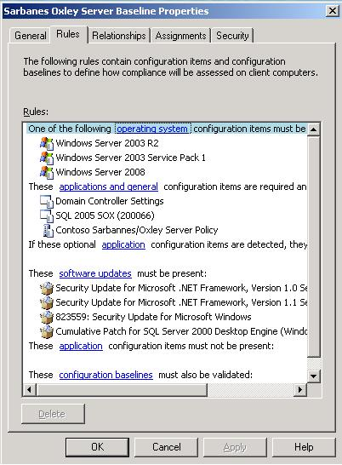

Server Compliance Configuration controls and centralized audit of system security
Challenges Addressed
Increasing compliance and audit requirements associated with business policies and regulatory requirements
Security pressures in the data center
Key Capabilities
Create, maintain and report on configuration controls for the data center environment
Gather and report security related events
Manage identities and access and improve security in the data center
SAS 70 is a huge initiative for us with regard to our data centers and all of our applications, and SOX is obviously important as well. With [System Center] my team has reduced the amount of time that we spend collecting security log information. For example, we just completed an investigation and pulled the security report in less than 5 minutes. In the past it would have taken days.”
Jeff Skelton, Manager, Enterprise Management Center, Stewart

Slide 14


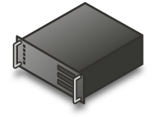

Data Protection and Recovery Backup & restore and business continuity through virtualization mgmt
Challenges Addressed
High availability and business continuity needed to meet service levels and optimal uptime
Simple disaster recovery and backup & restoration of data and information
Backup and Restore
Key Capabilities
Dynamically replicate and move virtual machines and applications to distribute workloads in the event of an outage
Recover and restore the physical and virtual environments in the data center through continuous data protection
Data Center A
Data Center B
“We really liked the looks of [System Center] for three key reasons, its disk-to-disk-to-tape design, the fact that we could eliminate full backups altogether and simply take snapshots, and its disaster recovery features.”
Ed Olson, Lead Windows Infrastructure Engineer, AutoNation

Slide 15
Data Center Management Futures Next 18 months
Configuration Management
End to End
Monitoring
Server Compliance
Data Protection and Recovery
Enhanced OS provisioning with multicast and unknown computer support
VMware ESX server support
Service desk change and configuration management workflows
Cross-platform monitoring of Unix, Linux
Native Connectors for interoperability
Network-aware service monitoring
Automated incident generation direct from operational alerts
Baseline Compliance Solution Accelerator
Support for service management based compliance practices via IT Service Desk
Increased onsite and offsite data protection capabilities
Additional Windows workloads protected
Dynamically manage virtual hosts to avoid downtime using PRO tips

Slide 16
System Center Solutions: People, Process, & Technology
Management Packs
Connectors for Interoperability
Knowledge
Solution Accelerators
Microsoft Operations Framework (MOF/ITIL)
Partner Ecosystem
Microsoft Consulting Services
Data Center Management
Products
Solutions
Desktop & Device Management
Windows Platform
Infrastructure
Virtualization Technology
Open Standards
Mid-Market
Notes:
16
© 2006 Microsoft Corporation. All rights reserved. Microsoft, Windows, Windows Vista and other product names are or may be registered trademarks and/or trademarks in the U.S. and/or other countries.
The information herein is for informational purposes only and represents the current view of Microsoft Corporation as of the date of this presentation. Because Microsoft must respond to changing market conditions, it should not be interpreted to be a commitment on the part of Microsoft, and Microsoft cannot guarantee the accuracy of any information provided after the date of this presentation. MICROSOFT MAKES NO WARRANTIES, EXPRESS, IMPLIED OR STATUTORY, AS TO THE INFORMATION IN THIS PRESENTATION.

Slide 17
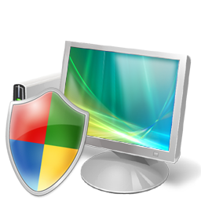


Desktop Management Solutions
Streamlined Application and Desktop Delivery
Optimized Client Health and Performance
Ease User Access Without Compromise
Adaptive Application Delivery
Client Infrastructure Monitoring
End-Point Security Management
Managed client application delivery via traditional and virtual methods
Client health monitoring and proactive issue identification
Enforced compliance with system health policy definitions via remediation
Simplified Windows Vista Deployment
Remote PC Diagnostics & Repair
Configuration Compliance
Automated OS deployment via image standardization
Zero-touch remote diagnosis and remediation with Intel® vProTM
Assess systems compliance against established configuration baselines

Slide 18


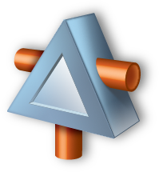


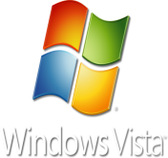
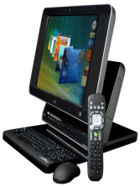

Adaptive Application Delivery Managed client application delivery via traditional and virtual methods
Challenges Addressed
Application compatibility and run time conflicts complicate deployments and regression testing
New delivery models make asset inventory and reporting difficult
Data, User settings
Application
Application
Key Capabilities
Natively deploy virtual applications to reduce or eliminate runtime conflicts
Separate user state from computer hardware, OS, application data and user settings for anywhere access
Centrally manage traditional, virtual and streamed applications from a single console
OS
Hardware
“We have significantly accelerated the testing of new programs by using virtualization. There are no more installs, and virtualized programs have no effect on the operating system or other applications.”
- Frank Walburg, Department Manager of Desktop Software Services, BASF IT Services

Slide 19
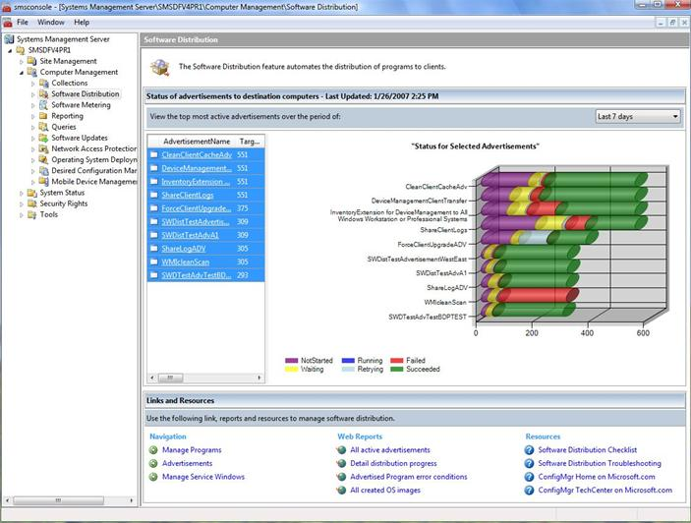

Simplified Windows Vista Deployment Automated OS deployment via image standardization
Challenges Addressed
Multiple hardware, OS and application configurations cause costly deployments
Offline and low bandwidth environments make automated deployment methods less effective
Streamline Windows Vista deployment planning thru hardware assessment and application compatibility testing
Standardize on a single hardware independent image to reduce OS deployment complexity
Deployment support for highly distributed environments
Key Capabilities
“Deploying a new infrastructure and installing operating systems, applications, and drivers on thousands of computers across 50 locations and several countries, all within a year, is a massive task…we’re succeeding—and Configuration Manager is an essential part of our success.”
-- Poul Westmose, Chief Technology Officer, DONG Energy

Slide 20
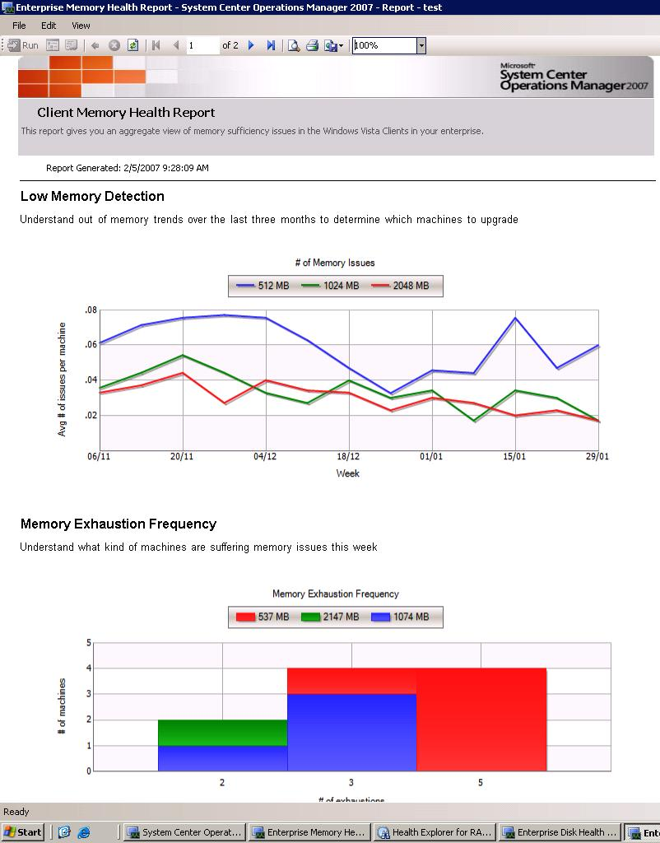

Client Infrastructure Monitoring Client health monitoring and proactive issue identification
Challenges Addressed
Majority of hardware, application and OS crashes unreported until large number of end users impacted
Configuration and user setting changes impact performance and security standards
Proactively monitor and identify OS, application and hardware issues to minimize support costs and impact to end-user productivity
Report on configuration compliance and collective system health to identify trends
Improve reliability and security by reducing configuration drift
Key Capabilities
“We catch problems before our users see them. That’s a significant way to contribute to our mission.”
- Xavier Coppin, Systems Engineer, Skyguide.

Slide 21


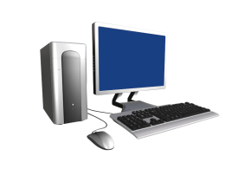


Remote PC Diagnostics and Repair Zero-touch remote diagnosis and remediation with Intel® vProTM
Challenges Addressed
Troubleshooting and repairing PCs is mostly a manual and costly effort
PCs that are powered off or that won’t boot cannot be diagnosed or repaired
Key Capabilities
Accelerate problem resolution time with diagnostic, configuration and performance monitoring tools
Reduce onsite service calls with zero touch remote management, including PCs that won’t boot or are powered off
“Having the ability to wake devices up and run updates via a standard technology…will only enhance the security posture that the VA has been working to meet”
- Charles de Sanno, Executive Director of Enterprise Technology and IT Engineering, Veterans Affairs Department

Slide 22

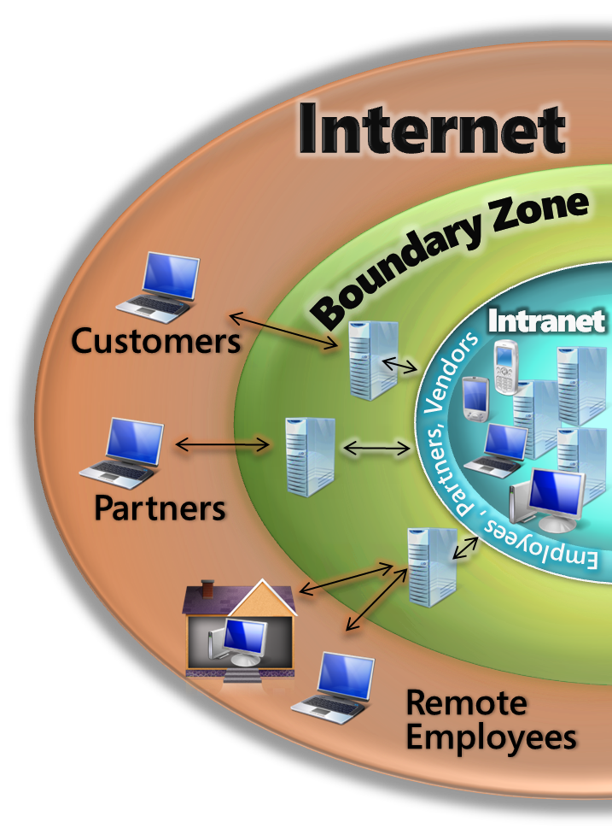
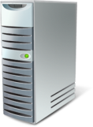
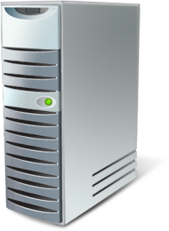

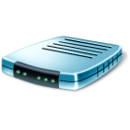
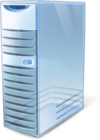


End-Point Security Management Enforced compliance with system health policy definitions via remediation
Challenges Addressed
Mobile and distributed users present unique network security and compliance challenges
Must identify vulnerabilities, enforce policies and remediate threats
Policy Servers e.g.., Patch, AV
1
Microsoft NPS
3
Not policy compliant
5
Provide secure access across your remote, LAN and wireless connections
Automatically assess vulnerabilities and security compliance
Enable automatic enforcement and remediation of security parameters to ensure ongoing compliance
Restricted Network
Remediation Servers e.g., Patch
Key Capabilities
2
Policy compliant
DHCP, VPN
Switch/Router
4
Corporate Network
“We envision an IT environment that’s easy to maintain, with computers that automatically download updates and other required software every time they boot up, from the first day they’re on the network”
- Noah Johnson, Senior Systems Engineer, Freightliner

Slide 23
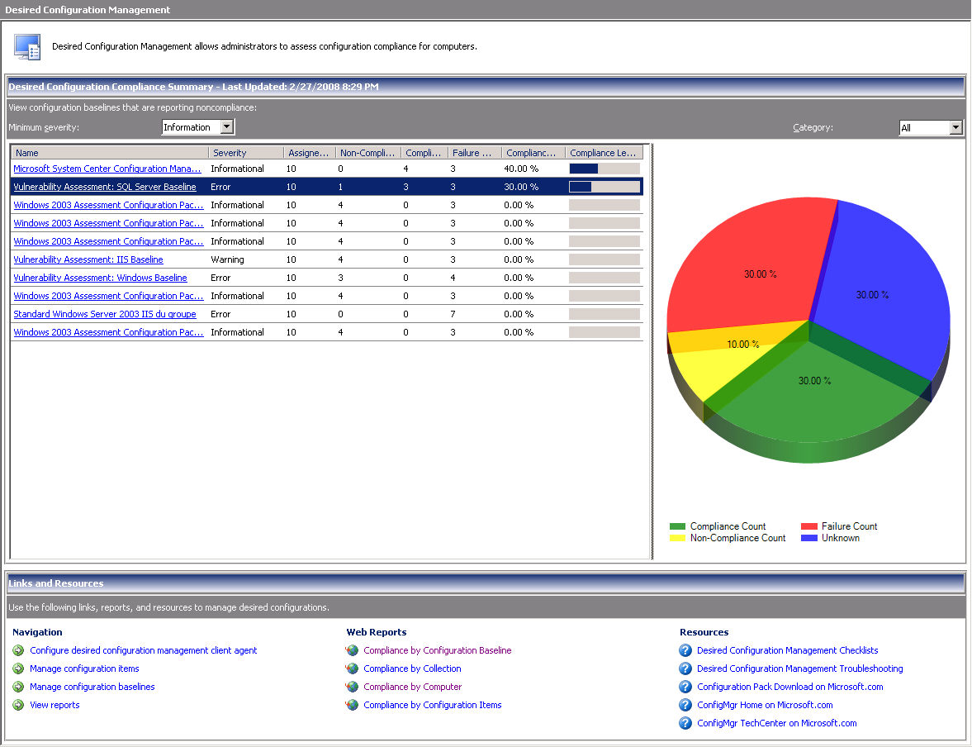

Configuration Compliance Assess systems compliance against established configuration baselines
Challenges Addressed
Misconfigured desktops represent compliance and security risks
Desktop configuration drift (settings changes, account permissions, etc.) from multiple administrators changing policies
Key Capabilities
Create, maintain and report on configuration controls for your desktop environments
Automate process for desired configuration management
Utilize best practices built directly into the solution
“We’ll have our first-ever 100 percent compliance and lock-down, which translates into greater reliability and availability, better helpdesk operations, and faster and smoother updates and deployments, because we’ll be building on up-to-date, same-state servers, workstations, and devices.”
- Richard Page, IT Project Manager, Shoprite

Slide 24
Desktop Management Futures Next 18 months
Streamlined Application and Desktop Delivery
Optimized Client Health and Performance
Ease User Access Without Compromise
Application Virtualization* integration into Configuration Manager
Enterprise Desktop Virtualization* – central management of virtual OS and applications
Desktop Error Monitoring* - Custom Reporting
Diagnostics and Recovery Toolset* – including offline anti-malware diagnostics
Advanced Group Policy Management* – cross domains, fully scriptable
Full incident and problem management through Service Manager
Forefront Client Security integration
Asset Inventory Service* – single reporting with Configuration Manager
Baseline Compliance Solution Accelerator
Support for service management best practices via IT Service Desk
* Part of the Microsoft Desktop Optimization Pack

Slide 25



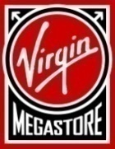
Managing Complexity Customer success stories
Basic
Standardized
Rationalized
Dynamic
Simplified Vista Deployment
Saved $500K in deployment costs
Server Consolidation
Reduced server costs
by $2M per year
Data Protection and Recovery
Reduced back-up times by 50%
Danish
Foreign
Ministry
Configuration Management
Cut update time by 90%
Configuration Management
Cut deployment time by 73%
Client Infrastructure Monitoring
Cut helpdesk
costs by 35%
MEGA PHARMA
Dynamic IT

Slide 26


System Center Roadmap
2008
2009
2010
2008
V3
Rollup/SP1
V3
2007 SP1/R2
V5
2007 SP1
2007 SP2
V4
V1
2008
2009
2010
2008
2008 SP1
SP1
Notes:
26
© 2008 Microsoft Corporation. All rights reserved. Microsoft, Windows, Windows Vista and other product names are or may be registered trademarks and/or trademarks in the U.S. and/or other countries.
The information herein is for informational purposes only and represents the current view of Microsoft Corporation as of the date of this presentation. Because Microsoft must respond to changing market conditions, it should not be interpreted to be a commitment on the part of Microsoft, and Microsoft cannot guarantee the accuracy of any information provided after the date of this presentation. MICROSOFT MAKES NO WARRANTIES, EXPRESS, IMPLIED OR STATUTORY, AS TO THE INFORMATION IN THIS PRESENTATION.

Slide 27
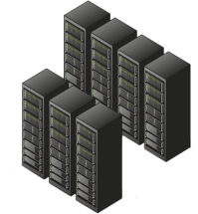
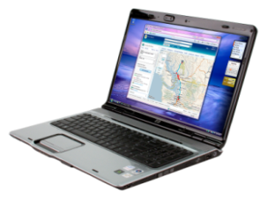



Dynamic IT Management
Use knowledge-based, automated in-line tasks to deliver rapid, high quality service
Maximize the use of the IT department’s existing Windows Server expertise
Improve visibility and control through integrated management
Manage multi-hypervisor technologies and monitor cross-platform environments
Time to Value
Desktop to Data Center
Physical and Virtual
Knowledge Driven
Out of the box, build on deep domain knowledge from both Microsoft and our strong partner community
Implement templated best practices through Solution Accelerators
Reduce complexity through seamless management of logical IT environments
Manage your virtual environments down to the application level

