Slide 1
The Business Case for Business Intelligence
Grant Hunkin
HP BI Practice Lead

Slide 2
Agenda
HP’s Business Intelligence Maturity Model
How to approach a BI Project
Choosing and appropriate BI solution

Slide 3

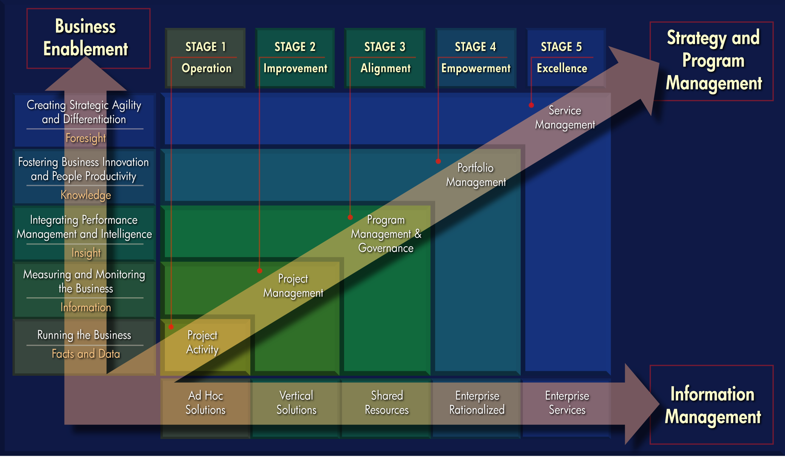
3
5 December 2007

Slide 4
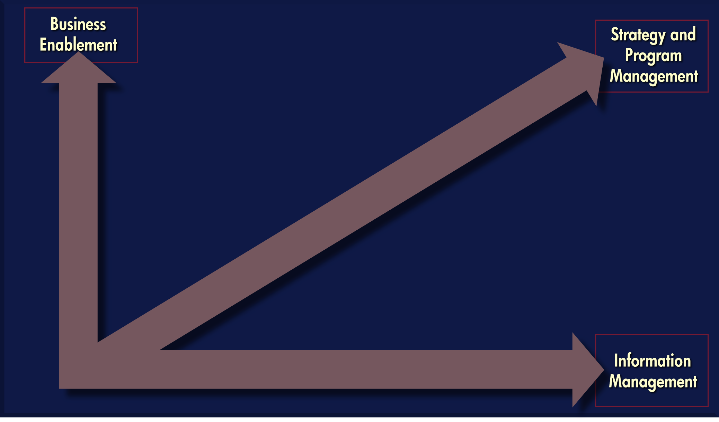
The Three Dimensions of the Model
4
5 December 2007

Slide 5
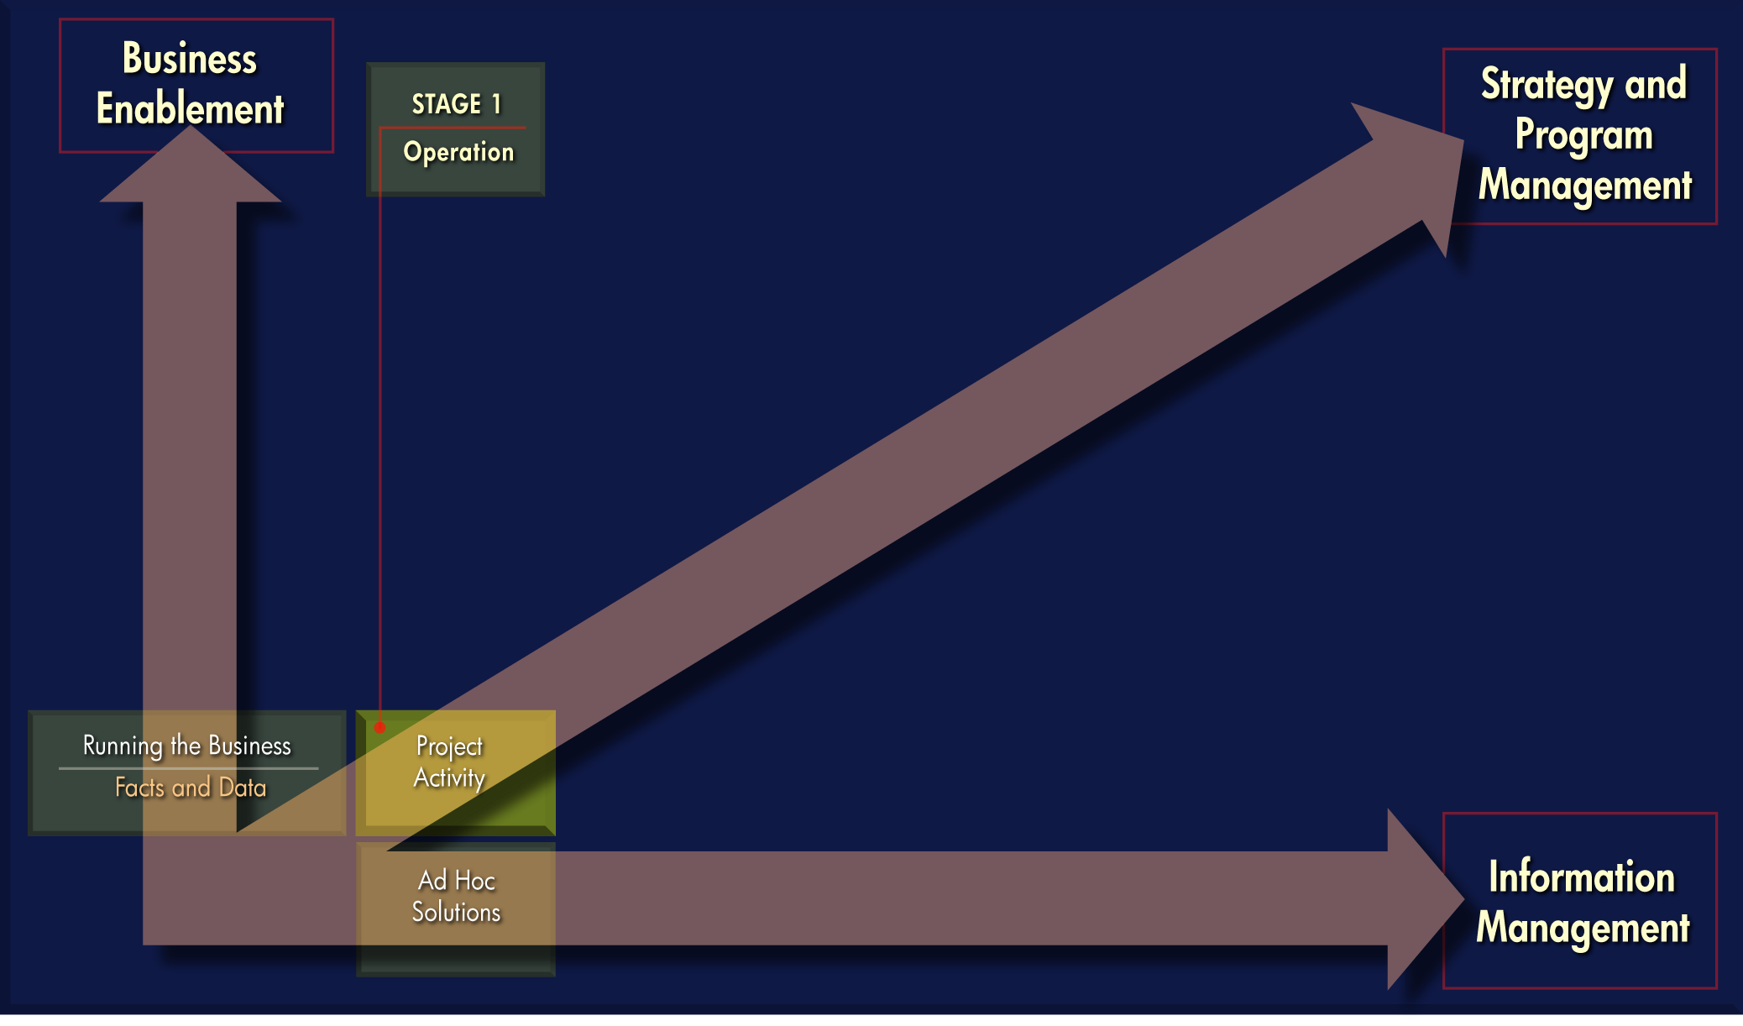
Stage 1: Operation
5
5 December 2007

Slide 6

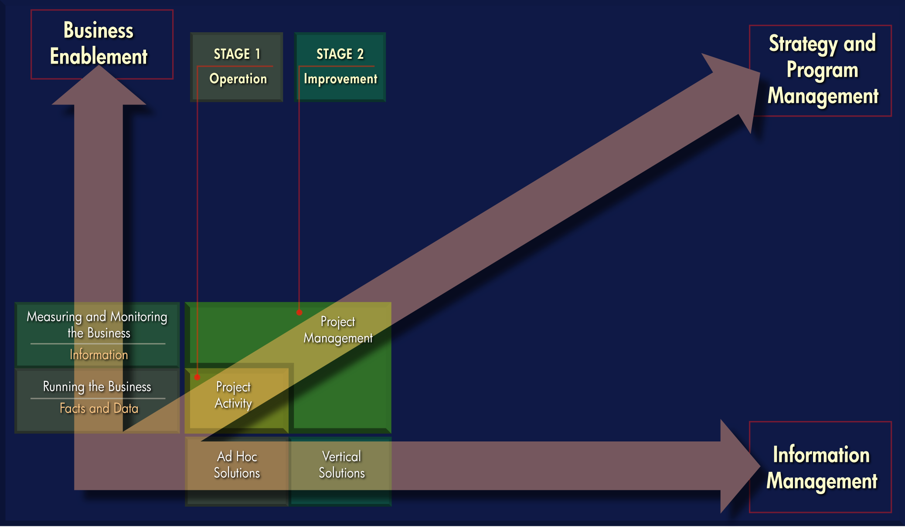
Stage 2: Improvement
6
5 December 2007

Slide 7
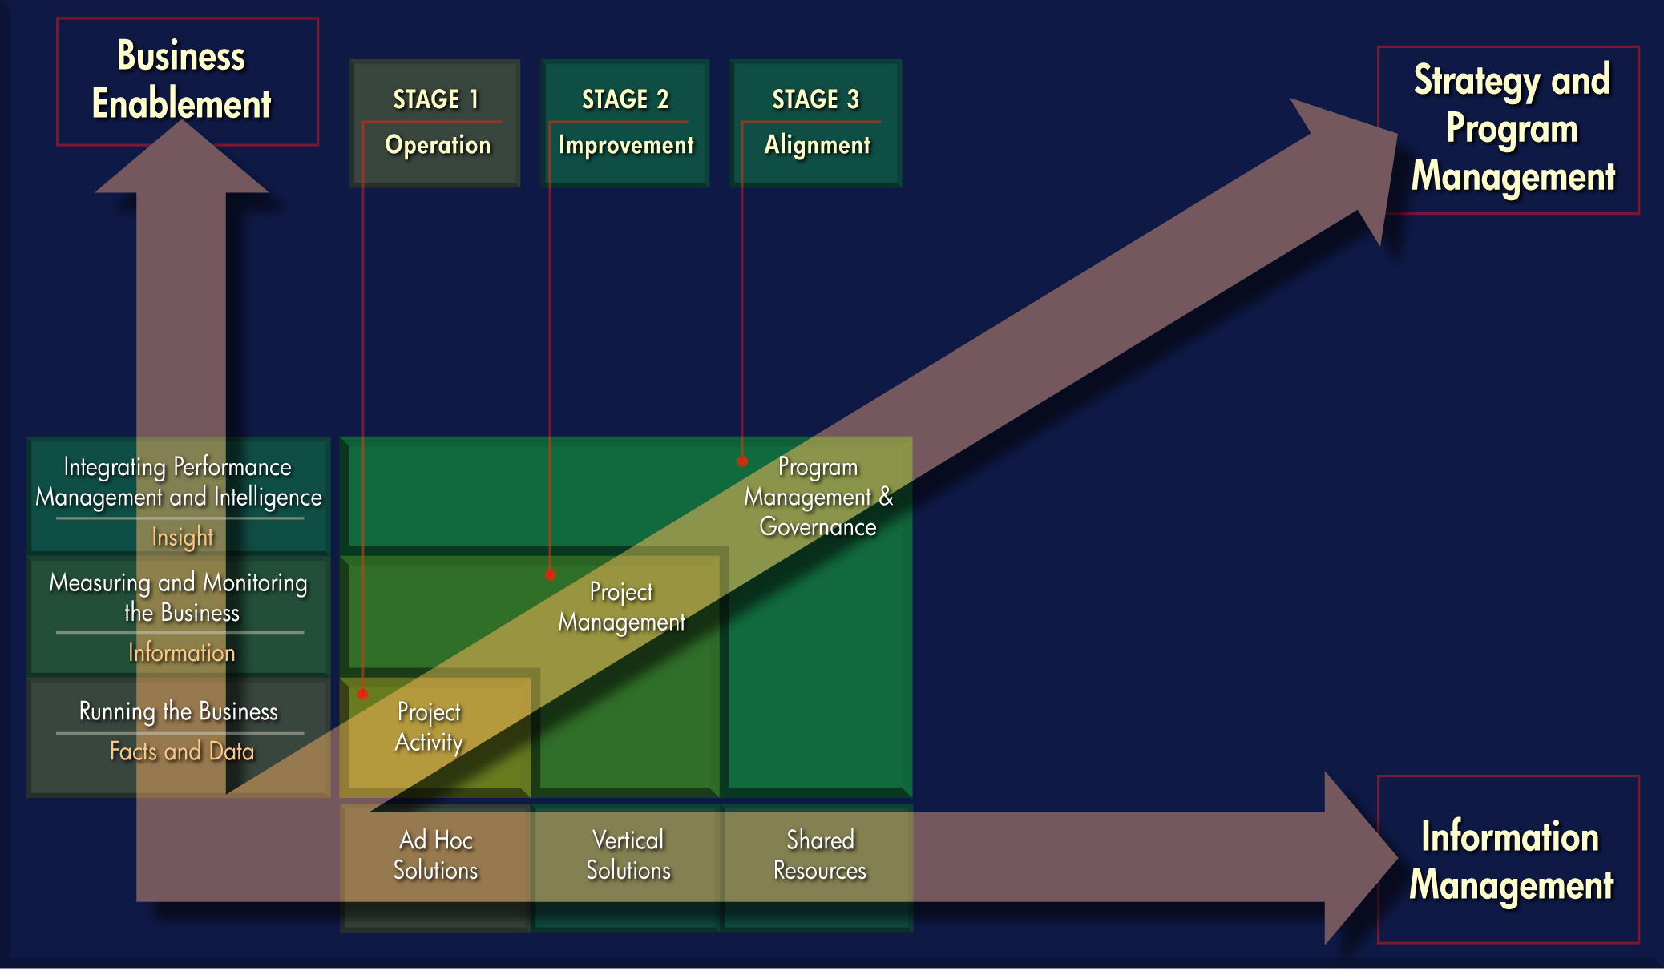
Stage 3: Alignment
7
5 December 2007

Slide 8
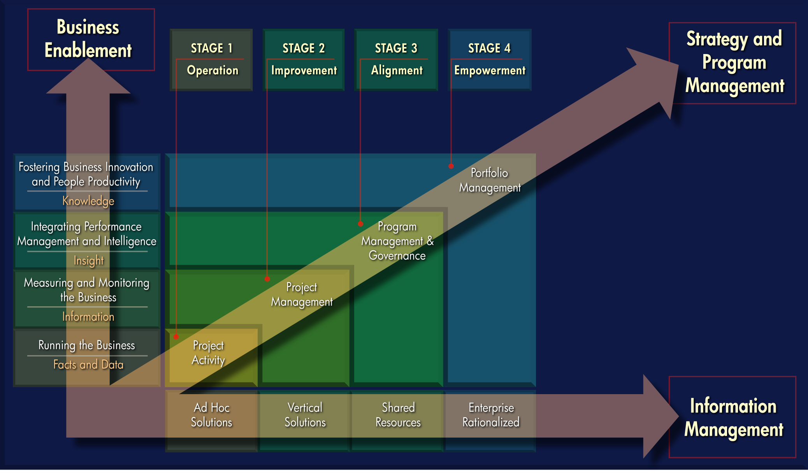
Stage 4: Empowerment
8
5 December 2007

Slide 9
Stage 5: Excellence
9
5 December 2007

Slide 10
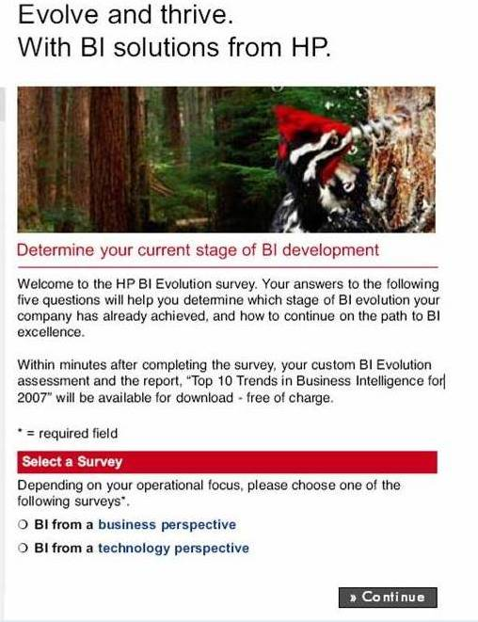
BI Maturity Model Online Survey
Sample business questions
Who uses the business reporting and/or score cards?
What is driving your company’s Business Intelligence initiatives?
What business value is being derived from Business Intelligence?
Sample technical questions
What is the nature of your Data Integration and Information Quality environment?
What is the nature of your Data Warehousing environment?
What is the nature of your information delivery environment?
10
5 December 2007

Slide 11

How to approach a BI project
Invest in defining a BI Strategy!
Aligns BI with the business strategic goals and priorities
Articulates the value proposition for BI
Provides a step by step roadmap to move up the maturity model
Aligns the solution architecture with the requirements
Identifies appropriate tools and platforms
Identifies opportunities to rationalise variant tactical projects

Slide 12
Choosing an Appropriate BI Solution
Information gathering
Business assessment workshops
Business drivers
Analytical requirements
Executive summary
Technical requirements
Program analysis & planning
Solution Architecture
Need s assessment
Strawman vision
Inputs
Filters
Planning documents
Information architecture
Functional requirements
Current state environment and gaps summary
Review current state
Best Practices
Organisation architecture
Relevant client experiences
Technical architecture
Industry trends
Information gathering
Analysis and documentation

Slide 13
HP’s Master Plan for BI
Aligns IT with business needs | Formally aligns IT and business Documents current state, identifies improvements
Uses BI-specific methodologies, experience | Follows BI-specific methodology Taps deep Business Intelligence knowledge
Yields robust, actionable deliverables | Provides interim deliverables Delivers detailed project plans
Draws on expertise, experience | Taps experts focused on high-performing, complex BI solutions Draws expertise from hundreds of successful BI implementations

Slide 14
Wrap-up
Assess your organisations BI Maturity– Go online and do the survey
https://h30046.www3.hp.com/campaigns/2007/promo/1-3NKTV/index.php
Taking a strategic approach to BI will help your organization
Define the business case for BI
Select the appropriate solution for your business
HP’s Master Planning Service can help

Slide 15
How to Contact HP
www.hp.co.nz/bi
Grant Hunkin
Email: grant.hunkin@hp.com
Cell: +64 29 289 9955
Come and talk to us on the HP Stand

