Slide 1
SQL Server 2005 Real World Data Warehouses
Peter Newey
ASB Bank, Manager Information Solutions
Notes:
12/5/2007 4:42 PM
© 2007 Microsoft Corporation. All rights reserved. Microsoft, Windows, Windows Vista and other product names are or may be registered trademarks and/or trademarks in the U.S. and/or other countries.
The information herein is for informational purposes only and represents the current view of Microsoft Corporation as of the date of this presentation. Because Microsoft must respond to changing market conditions, it should not be interpreted to be a commitment on the part of Microsoft, and Microsoft cannot guarantee the accuracy of any information provided after the date of this presentation. MICROSOFT MAKES NO WARRANTIES, EXPRESS, IMPLIED OR STATUTORY, AS TO THE INFORMATION IN THIS PRESENTATION.
1

Slide 2
ASB – Brief History
First Data warehouse 1993
Initial IT / business partnership, worked well
Managing size and complexity
Technology isn’t the only answer
Links to business strategy and direction
Fostered a cottage industry of TSQL coders within the business
“Data rich and information poor”
Notes:
2

Slide 3
ASB – A New Direction
New project to support Basel II regulatory requirements
Large team of developers and designers
SQL Server 2005 and SSIS
Project got stuck with design, implementation issues, unable to engage at the correct level with the business.
What point do you know you are unable to deliver the project ?
Notes:
3

Slide 4
ASB – DWH Project
WhereScape RED
Project to redevelop key data mart
Prototype and iterate
Involve Business representatives
Successfully delivered
Ongoing support and enhancements
Technologies used are:
SQL Server 2005 utilising partitioning, Analysis Services 2005 and Reporting Services and Dundas Controls
Notes:
4

Slide 5
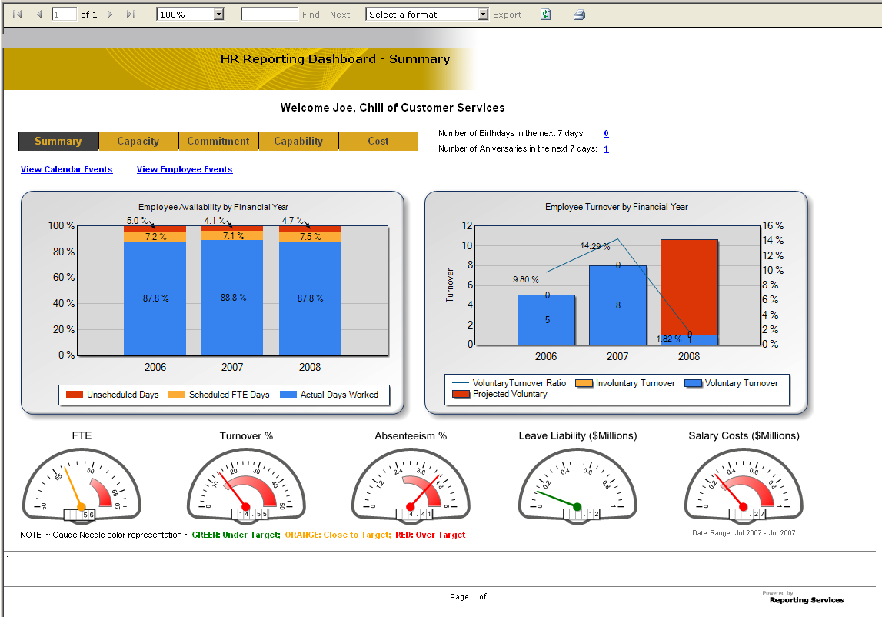
ASB – DWH Ongoing
Creating a culture within the organisation
Start asking the hard questions
Work towards a group wide governance
Manage information as a corporate asset
Deliver the information that has
true business value
Technology is the enabler
Business Intelligence implies
business ownership
Notes:
5

Slide 6
Lessons learnt
Questions?

