Slide 1
SQL Server 2008

Slide 2
Meeting Customer Expectations
Improved Server Management
Faster ETL
Enhanced Reporting

Slide 3

Management Problem
How can I reduce the number of database servers?

Slide 4



Resource Governor
Differentiate workloads
  Based on application, user, etc.
Define resource utilization limits
  CPU
  Memory
Covered Scenarios:
  Preventing runaway queries
  Predictable concurrent execution of different-size workloads
  Workload prioritization

Slide 5
Management Problem
Why do my server configurations never align?

Slide 6
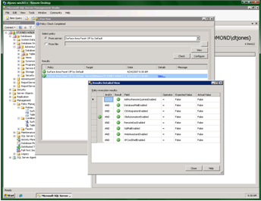

Declarative Management Framework
Define policies on one instance, and apply to many instances
Enforce policies:
  Proactively through triggers
  After changes through Service Broker
  On a scheduled basis through SQL Server Agent
  On an ad-hoc basis

Slide 7
Data Problem
Which data was changed, and by whom?

Slide 8



Change Data Capture
Generalize log-reading capability for all applications, notably DW
Improves DW scale
  Provide change information upfront for efficient processing of dimensions
  Eliminate expensive lookups
  DW can be loaded throughout the day or at specific intervals
Changes are captured and placed in change tables
  Log based capture with minimal impact on source
  Captures complete content of changes & maintains cross table consistency
  Change Metadata stored as part of the changes
  ETL process calls functions to retrieve changes
  Works even across schema changes!
OLTP
Change
Tables
DW

Slide 9
Data Problem
Is there an easier way to merge this data?

Slide 10
SQL Merge
MERGE Stock S
USING Trades T
ON S.Stock = T.Stock
WHEN MATCHED AND (Qty + Delta = 0) THEN
DELETE -- delete stock if Qty reaches 0
WHEN MATCHED THEN
-- delete takes precedence on update
UPDATE SET Qty += Delta
WHEN NOT MATCHED THEN
INSERT VALUES (Stock, Delta)

Slide 11
Data Problem
Where are my customers? My assets?

Slide 12
Spatial Data Types
Geometry
Geography
Geometry can store instances of various types
  Points, Line strings, Polygons
  Collections of the above
Methods for computing
  Spatial relationships: intersects, disjoint, etc.
  Spatial constructions: intersection, union, etc.
  Metric functions: distance, area
  Planar is conceptually simpler, but more specialized
Very similar interface to geometry
  Some methods have different semantics
Most data commonly available user data is geodetic
Spatial Indexing supported for both data types

Slide 13
Visualisation Problem
I need better presentation of this complex data!

Slide 14
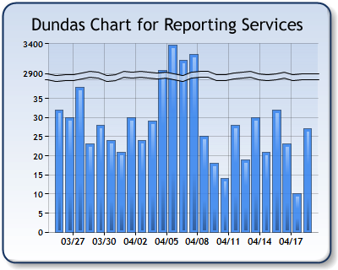
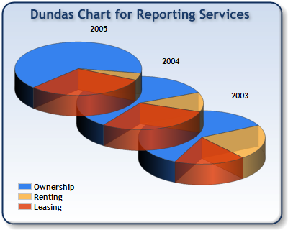
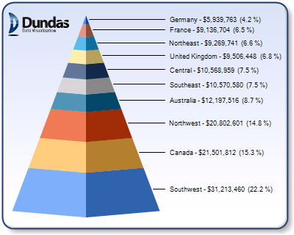
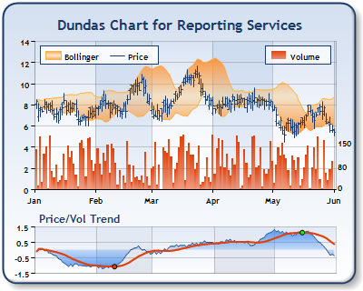
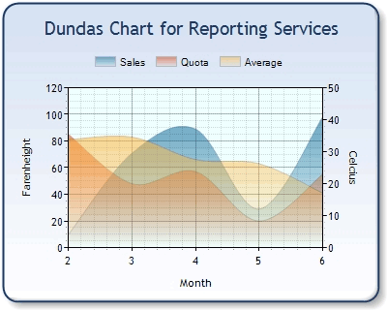
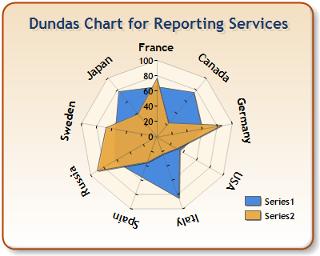
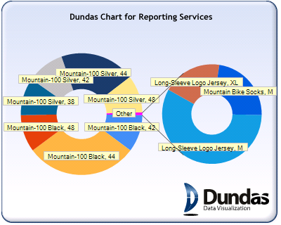
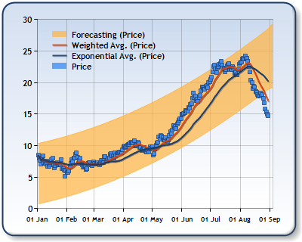
Charts

Slide 15


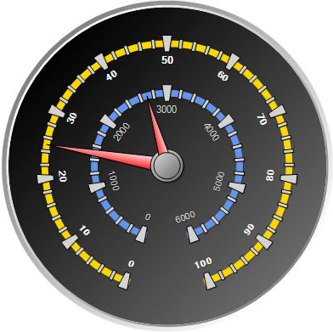
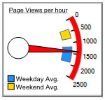
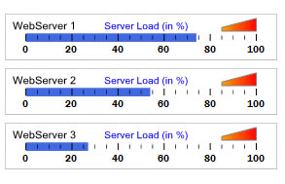
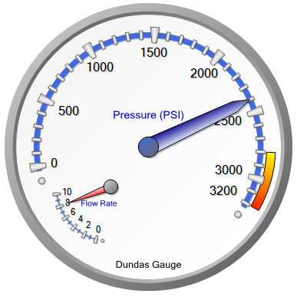
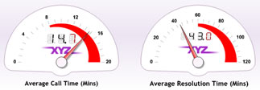

Gauges

Slide 16
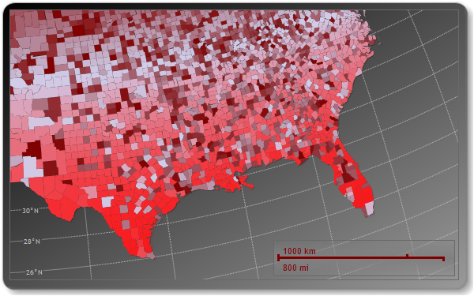
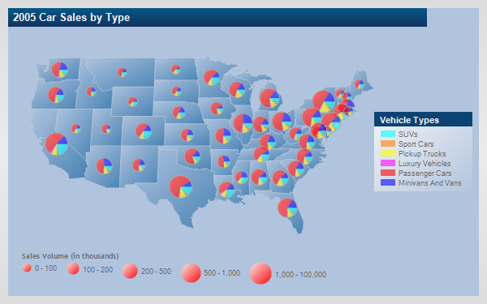
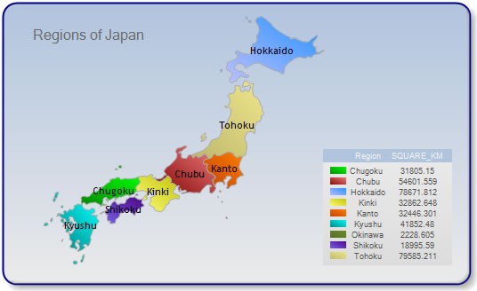
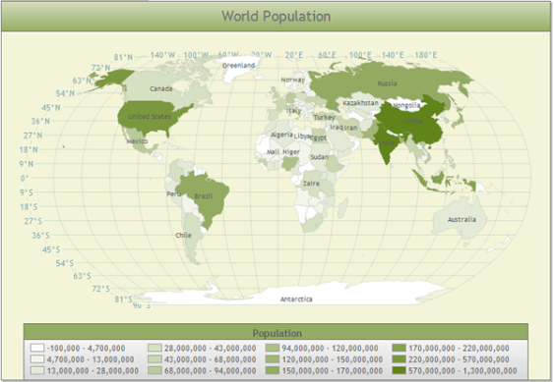
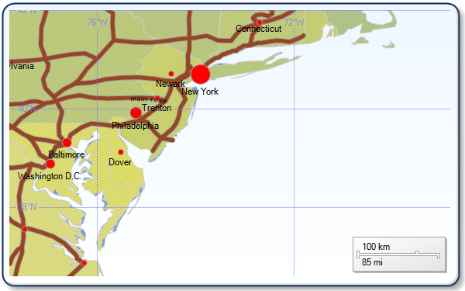
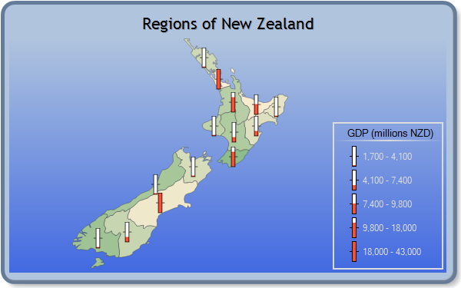
Maps

Slide 17
Visualisation Problem
Word and Excel are my favourite tools – why can’t I get this report within Word?

