Slide 1
Mural – Digital Marketing for Software+Services
Microsoft FY09 Hosting Days

Slide 2
What makes marketing different today?
Search
Find
Qualify
Order
Manage
Up-sell
Support
Refer
Try
Activate & Engage
The Web has fundamentally changed the way that customers engage with businesses, products, and communities
Customer engagement – deep involvement with your brand and products – is made possible, and more complex, by this shift in customer behavior
Based on this belief and our experience, Mural has created the Web-Centric Customer Lifecycle framework as the foundation of what we do: customer engagement marketing
Web-Centric
Customer Lifecycle
Framework
Belief
Customer Engagement Marketing
Notes:
Has changed, and continues to change at an incredible pace.
Customer engagement is more possible than ever, and is THE goal, THE metric for marketing today.
This core belief – and the Web-Centric Customer Lifecycle framework – are at the core of our expertise, experience and the tools that we use.

Slide 3
WEB CENTRIC CUSTOMER LIFECYCLE FRAMEWORK
A framework for digital marketing and engagement, from lead generation to customer support and advocacy

Slide 4
Web-Centric Customer Lifecycle Framework
Search
Find
Qualify
Order
Manage
Up-sell
Support
Refer
Try
Activate & Engage
The web-centric user wants to be fully serviced throughout the entire customer lifecycle

Slide 5

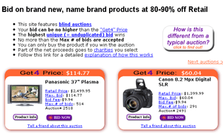

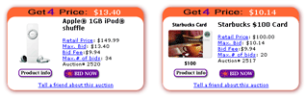
Search
Custom URLs
Remember people misspell
Optimize for competitor names
Optimize for your name
Capitalize on cultural crazes

Slide 6
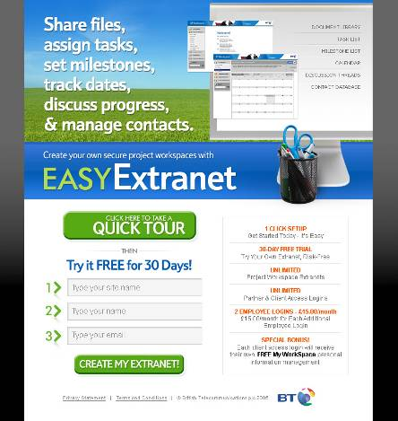
Find
Highly targeted landing pages
Answering the burning question (in 12 words or less)
Is the information provided in the best format for the audience?

Slide 7
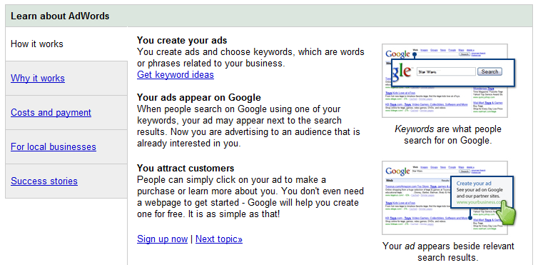
Qualify
Is all the required information available to allow the user to self-qualify?
Qualification of the company
Qualification of the offering
Qualification of price
Qualification of service/support
Is all the required information accessible within 2-3 clicks?
Are there simple calls to action for providing sales support (e.g. click to chat, click to call)?

Slide 8
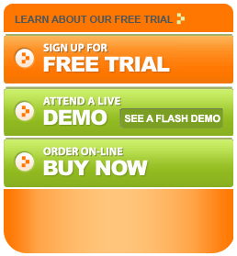
Try
Free trial (if and only if value can be realized during the trial)
Most valuable trials are real (real data, real users, real value)
No credit card requirements
Quick and easy trial signup
Don’t require full personally identifying information
Consider lazy signup options to quick-capture email address and accelerate time-to-value for end-user
Instant provisioning/access to the offering
Getting started experience to accelerate realization of value
Integrated support

Slide 9
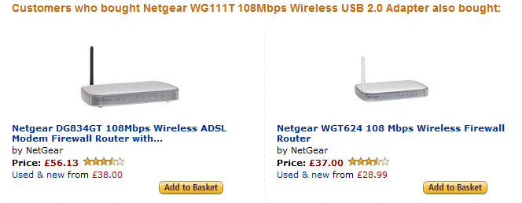
Order
Is the ordering process simple to understand and relatively short? (3-5 page signup process)
Experience before systems – Implement online ordering even if manual processes are involved on the back-end
Order is important: 1. Offer selection, 2. Personally identifying information, 3. Billing information
Up-sell and pro-active recommendations based on selections during the sign-up process
Position up-sell items as order customization/configuration through-out the process
Clear and concise order confirmation
Integrated support

Slide 10
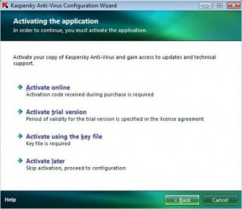
Activate & Engage
Automated provisioning and instant access
Recorded webinar
Live chat support
E-mail tips campaigns
Remote access support

Slide 11
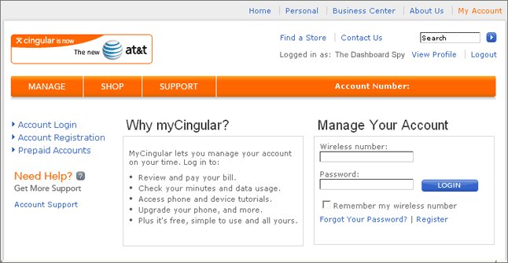
Manage
Online management of all account and billing information
Online management of settings/configuration of features
Delegation of administrative capabilities to other users
Support for all moves, adds, changes, deletes, cancellations
Full account/support history
Integrated support

Slide 12
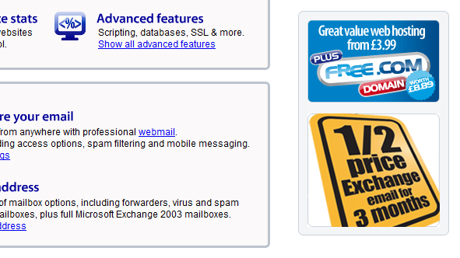
Up-Sell
Up-sell offerings and opportunities are integrated through-out the customer experience
Initial order
Online account management
Within the product/service
General up-sell offers
Context-sensitive up-sell offers based on user actions
Context-sensitive up-sell offers based on support history
2-click up-sell (request + confirmation)
Integrated support

Slide 13
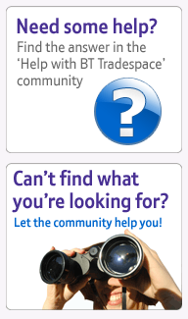
Support
Multiple support options to meet the user where they are
Phone
Chat
E-mail
Contact, FAQs, and knowledge-base options at the same level
Do not obscure support access points
Encourage self-support through customer forums
You must also be a participant in these forums
Online/offline support options integrated into every steps of the life-cycle
Up-sell integrated into support

Slide 14
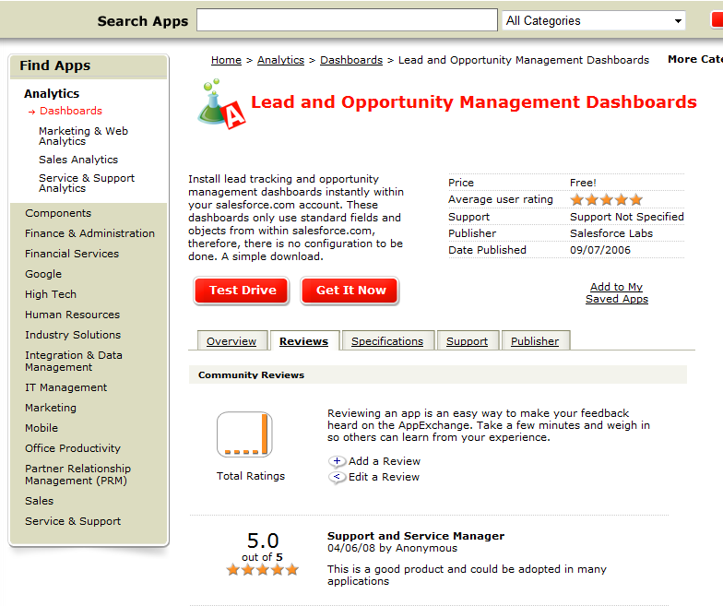
Refer & Review
You can’t control the “naked conversation” – Embrace and respond to it
“Tell Your Friends” options within the product
Content federation-based reviews within the product
Automatic or user initiated
Federation to other sites (e.g. Yelp, Digg)
ASK for SEO “value”
Link to us
Put our Facebook Application on Your page
Upsell-integrated referrals
E.g. “First month of new service free with referral NOW”

Slide 15
THANK YOU

