Slide 2
Growing your
S+S Business

Slide 3
S+S ISVs today, and the challenge of growth
Introduction

Slide 4
SaaS ISVs In 2008
Technical
Architecture | 50% multi-tenant, 50% single-tenant
Installation | 50% support on-premise installation
Hosting | Over 50% use a hosting partner
App Platform | Over 2/3 prefer to own all the IP and do not build on a 3rd party business platform
Business
Product Mix | 50% Pure-play SaaS, 50% mixed. 50% sell complementary human services.
Target market | Enterprise first, Midmarket second. Very few target SMB.
Sales Strategy | “Land and Expand”. Average initial sale < 10 seats.
Channel Strategy | 2/3 primarily sell direct. 50% have resellers, mostly a small number of VARs for integration and business consulting.

Slide 5
ISV Growth Curves
Traditional ISV
Growth with market
$
High-growth
High net margin
Break-even
YEAR
1
2
3
4
Cash-flow positive
Longer to break even, OK growth, low net margins
SaaS ISVs:
The reality
so far
SaaS ISVs:
The vision
Faster growth, high margin
$
$
YEAR
1
2
3
4
YEAR
1
2
3
4
Deeper initial investment
Deeper initial investment

Slide 6
Four Strategies for Growing
Your Software+Services Business
Position against the right customer needs
Land and expand:
Acquire users quickly, grow ARPU systematically
Target customers by value, not size
Finance creatively for growth

Slide 7
1. Position against the right customer needs
Positioning your Software+Services product in the market

Slide 8

For Mature ISVs: “Embrace S+S” Workshops
Microsoft Technology Centers (MTC) provide our customers everything they need – technology experts, industry leaders, and an outstanding environment – to help them envision, architect, and prove secure, customized solutions, based on Microsoft and partner technologies.
http://www.microsoft.com/mtc

Slide 9
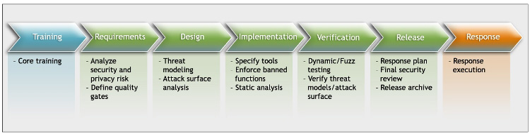








Make Security a Competitive Differentiator
Engage the SDL Pro Network
Security Development Lifecycle experts
Training and Consulting on SDL implementation
http://msdn.microsoft.com/en-us/security/dd219581.aspx

Slide 10
2. Land and Expand
Attracting and landing the right
Software+Services customers in quantity

Slide 11
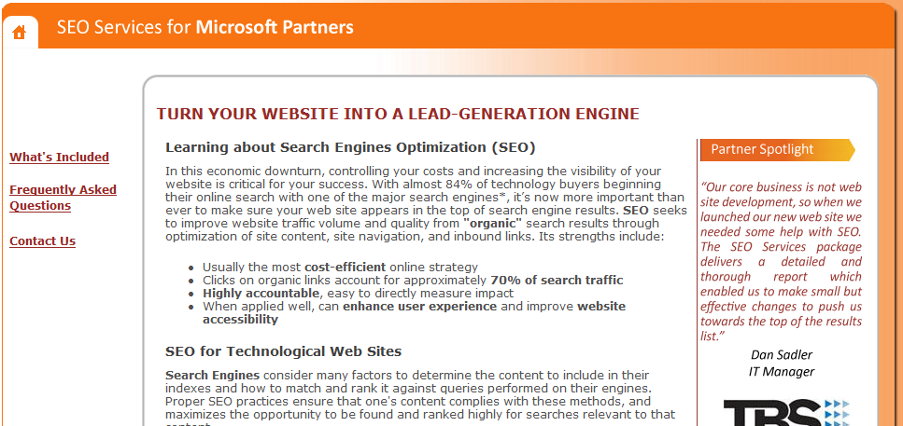
Turn your Web site into a lead engine special search engine optimization offer for partners
Optimize your site for organic searches
http://www.seoservicesformspartners.com/SEOWelcome.aspx

Slide 12
Web Selling Versus Traditional Selling
 | Traditional ISV | Web ISV | Benefit
Selling | Independent reps, distributors and resellers | Direct inside telesales, up-sell of captured accounts | Fast time to value, low integration cost
Marketing | AR/PR, events, trade advertising | SEM, e-mail marketing, viral marketing (blogs, rating engines), mobile marketing | Gets customers where they spend their time
Customer Acquisition | 9–12 month presales, long system integration | Fast/free signup, try before buy | Low acquisition cost, grow MRR over time
Sell a standard product. All configurability should be part of the basic feature set
Consider a strategy of SEM demand gen to a telesales close
Acquire the customer quickly, monetize them systematically over time

Slide 13

Using the Rule of 78s to set quota
A sale in month 1 = 12 months of revenue that fiscal year
A sale in month 12 = 1 month of revenue that year
1+2+3 … + 12 = 78
To calculate monthly sales quotas:
(annual revenue goal) / 78 * (# months left in FY)
Example: your annual revenue target is $10M
  Month 1 target: ($10M)/78 * 12 = $1.54M
  Month 2 target: ($10M)/78 * 11 = $1.41M
  . . .
  Month 12 target: ($10M)/78 * 1 = $129K
Deals closed sooner are worth more (on an annual income statement). Incent this in your monthly quota setting!

Slide 14
Software+Services Businesses Live on MRR
Monthly recurring revenue (MRR) is total monthly subscription revenue
    Don’t include one-time fees or services.
    MRR is your run-rate revenue only
You must understand your churn rate
    Customers who rent software as a service are free to leave. Guess what? Some do. You need to know who, how many, and why
    Churn rate = % of subscription revenue you have
    this month that you will not have next month
    (from customers leaving or downgrading service)
    What is good? Churn rate under 10% annually
    Don’t calculate it as a % of total revenue. It is a % of recurring revenue
Committed MRR (CMRR) = MRR – monthly churn
For more information see Bessemer: www.bvp.com/saas

Slide 15

Converting MRR to Cash
Software+Services ISVs need more working capital than traditional ISVs
  Datacenter/hosting operations
  Customer support
MRR is only as good as your ability to collect it
  Do you know the average age of your receivables?
  Can you accurately forecast your collections rate?
  Can you rank your customers by payment performance?
Incent customers to prepay when it improves CMRR
Incent your sales force to focus on MRR,
not one-time revenue
Optimize billing and collections, incent timely payment

Slide 16
Customer Satisfaction Drives Renewal Rates
To contain churn, you must insure customer satisfaction
Key warning signs
  Low product usage (low rates of login or
  low session times per seat for a customer)
  High access of help files, high rate of support calls
  Late payment
How do you measure satisfaction
  ASK: Survey your customers regularly online
  TRACK: Using usage monitoring software

Slide 17
Runtime Intelligence Service (RIS) Offer
From PreEmptive Solutions
RIS is a Software+Services solution that tracks application usage and user behavior
  No programming required – logic is injected into your code
  Includes support for SaaS, Silverlight, client, mobile, asp.net, etc.
  Emerging as de facto standard – light-weight version to be included in Visual Studio 2010
The offer – 60 days of complimentary RIS usage
  No commitment and full support is included
  Ideal scenarios include
    Beta cycle management, Evaluation process management, customer experience improvement programs
  Visit www.preemptive.com/hostingdays.html

Slide 18

Sales Incentive Compensation Planning a joint offer from Microsoft and KeyChain Logic
Accelerate sales cycles, maintain positive cash flow, and grow committed revenue
Download Keychain Logic’s
SaaS Sales Compensation Scoring Tool
at www.KeychainLogic.net/Scoring.htm
Answer 10 questions about sales plans for a SaaS incentive compensation assessment
grab the SaaS Sales Compensation Guide from the
Resources page at www.KeychainLogic.net

Slide 19
3. Target Customers by Value, not Size
Measure customer lifetime value and put your profitable customers first

Slide 20
Understanding Customer Lifetime Value
Contribution
Margin ($)
Retention Rate (%)
CLV =
*
1 + Discount Rate (%) - Retention Rate (%)
Contribution Margin ($)
=
Customer Revenue ($) – Customer Variable Costs ($)
Retention Rate (%)
=
1 – Churn Rate (%)
Example:
Customer X has 5 seats of your application at $100/seat/year.
Your average operating cost per customer is $300/year.
Your marketing, sales and support costs average $50/customer/year.
Your annual churn rate is 15%. Your CFO discounts at 10%/year.
Contribution Margin = $500 - $350 = $150
Retention Rate = 100% – 15% = 85%
CLV of X = $150 * (85%) / (110% - 85%) = $150 * 85/25 = $510
For more info see Wharton Press:
Marketing Metrics: 50+ Metrics every Executive should master

Slide 21
Segmenting Customers by Value
Get your sales and support costs out of
SG&A and into COGS
  Track key deal metrics that allow you to estimate sales & marketing cost by customer (lead source, time to close, number of interactions, etc.)
  Separate fixed from variable datacenter costs and calculate variable operating & support costs by customer
Sample your customer base across key segments (company size, location, account age, revenue, etc.)
  You need 30 random customers in each segment
Calculate CLV for each customer in the sample
Calculate average CLV by segment
Focus your spend on your most profitable segments

Slide 22
Where are Your Operating Costs?
It’s not whether you’re single or multi-tenant, or how complex your application is
It’s about how many
people it takes to keep
your customer running
How much custom code per customer?
How many support calls per customer?
How many change orders per customer?
Sell a standard product and automate as much as possible

Slide 23
4. Finance Creatively for Growth
Accelerate beyond organic growth
using alternative financing

Slide 24
Organic Growth Model
Hire reps, make sales
Wait until profit high enough to support more reps
Hire more reps
Repeat
Example of a way to forecast organic growth: Omniture’s “Magic Number”
“Magic Number” = Annualized incremental forward quarterly revenue growth divided by sales and marketing spend
4 * (Most recent Quarter to Quarter revenue increase)
Most recent Quarter sales and marketing spend
When regressed against actuals, this ratio
correlated well to actual % growth
Source: Josh James, Omniture, presentation at OpSource SaaS Summit 2008

Slide 25
It is Very Slow to Build a Software+ Services Business on Organic Growth
$
Traditional ISV
S+S ISV
YEAR
1
2
3
4
S+S ISVs require greater up-front investment, and take longer to break even because revenue is deferred
You can’t significantly reduce your up-front investment.
How can you bring revenue forward to accelerate growth sooner?

Slide 26
Comparing Sources of Capital
Source | Pros | Cons
Operating Profit (i.e., organic growth) | Safe | slow
Customer prepayments | 1-3 years $ up front on subset of customers | Discounted price; higher customer expectations; uneven cash flow
Outside equity | No repayment schedule, large $$ available, VC connections/expertise | Loss of control, dilution of ownership, push to profit too soon?
Bank loans | Proven, straightforward, inexpensive (relative to venture equity) | Banks are risk-averse, collateral required, Repayment required
“Subscription Credit” | Borrow against anticipated subscription revenue, no dilution, no collateralization | More expensive than bank loans. Payments go through lock-box

Slide 27
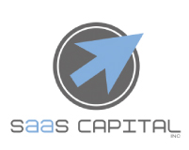
One Example of “Subscription Credit”
SaaS Capital will advance you 30-50%
of future SaaS contract values
You get a revolving line of credit
with 30-36 month amortization
Total LOC value: $1M–$8M
You draw down on the LOC to hire more sales reps sooner, generating more revenue sooner
As your revenue grows, your LOC increases
http://www.saas-capital.com

Slide 28
In Summary
Growth Strategy | Best Practices | Call to action
Position for Customer Needs | Integrate into customer environment Connect Price to Value Separate core platform from extensions Promote trustworthy computing | MTC workshop SDL Pro Engagement
Land and Expand | Embrace Web marketing, emphasize SEM Optimize for CMMR Understand and control Churn Convert revenue to cash quickly | MSPP SEO service Pre-emptive Usage Monitoring Offer Sales Planning with KeyChain Logic

Slide 29
In Summary
Growth Strategy | Best Practices | Call to action
Target customers by value, not size | Understand and calculate CLV Target your most expensive function (Customer Support) directly at your most profitable customers Understand operating costs by customer Make sure your billing is efficient | Wharton Press: 50+ Marketing Metrics …
Finance creatively for growth | Customer prepayments are your cheapest source of capital Subscription Credit can be a valid strategy for high-margin, low-churn products | Investigate subscription credit
Tell us what you need to succeed: email the Software+Services ISV Sales Office (ssisvoff@microsoft.com)

Slide 30

© 2008 Microsoft Corporation. All rights reserved. Microsoft, Windows, Windows Vista and other product names are or may be registered trademarks and/or trademarks in the U.S. and/or other countries.
The information herein is for informational purposes only and represents the current view of Microsoft Corporation as of the date of this presentation. Because Microsoft must respond to changing market conditions, it should not be interpreted to be a commitment on the part of Microsoft, and Microsoft cannot guarantee the accuracy of any information provided after the date of this presentation.
MICROSOFT MAKES NO WARRANTIES, EXPRESS, IMPLIED OR STATUTORY, AS TO THE INFORMATION IN THIS PRESENTATION.

