Slide 1
Microsoft in Small & Medium Business

Slide 2
Agenda
Market Size and Trends in SMB
Targeting Buyers for Success
Channels of Influence
Microsoft Communication Services

Slide 3
Understanding who I am selling to build to the needs of the customer
 | Lower Small Business | Core Small Business | Low Mid Market | Core Mid Market | Upper Mid Market
Characteristics | < 5 PCs | 5-24 PCs | 25-49 PCs | 50-250 PCs | 250-~500 PCs
 | 0-10 emp | 11-49 emp | 50-99 emp | 100-500 emp | 500-1,000 emp
# US Entities | 3.5M | 1.9M | 182K | 103K | 11K
Avg Software Spend | $500 | $1,800 | $10K-50K | $100K – $300K | $300K – $2MM
Decision Maker | Owner/ Manager | IT Influencer Owner/ Manager | IT Pro | BDM/ IT Manager | BDM/ IT Manager
Business Owners
IT Buyers

Slide 4
Small businesses desire these solutions, hosted by their provider.
Customer Segment
Need Advanced Messaging Collaboration and Communication Capabilities
Potential Adopters of Hosted Messaging and Collaboration within 5 years
500 PCs
Worldwide Organizations
42K
Upper Mid-Market
(16.5 avg. servers
per org.)
15%
Worldwide PC Installed Base
14M
250 PCs
Worldwide Organizations
290K
Core Mid-Market
(9.5 avg. servers
per org.)
30%
Worldwide PC Installed Base
47M
50 PCs
Worldwide Organizations
666K
Lower Mid-Market
(1.5 avg. servers
per org.)
48%
Worldwide PC Installed Base
22.2M
25 PCs
Worldwide Organizations
40M
Small
Business
42%
Worldwide PC Installed Base
142M
1 PC
50%
100%
% of Companies in Segment
Source for Source for SMB Needs and Adoption, Edge Strategies Inc.

Slide 5




Microsoft Communication Services
$
Unified
Communications
Business Applications
Web
Conferencing
Document
Collaboration
Mail
Web access through to full client & mobile push
Document sharing and collaboration
Web Conferencing
Integrated e-mail, IM and VoIP capabilities
Business Apps like Dynamics CRM
$5-$20/month
$5-$50/month
$5-$20/month
$25-$75/month
$40-$75/month

Slide 6
End-customer sweet spot
Propensity
to Outsource
48%
30%
Sweet Spot
Complexity
of Needs
15%
50-100
100-500
500-1000
# of emp.

Slide 7



Discovery and Positioning
Buyer Type | Positioning | Objection | Handling
Innovator | Productivity (Anywhere access, collaboration, speed) & growth Premium | Will I really get the benefit? Can I trust my service provider | Productivity – 8 mailboxes & better performance for organization
Pragmatist | Features You Need At Best price (Faster speed, scheduling, domain name, mobile e-mail, free Outlook) Preferred | Why does that feature make my staff’s life easier? Is it difficult to use? How good is support? | Easy to use features – get started with 4 mailboxes and enough bandwidth – domain name, mailbox, Outlook cost avoidance with support.
Minimalist | Reliability (Backups, security, reliability, value) Starter | Aren’t all the providers the same? | Reliability & strength of support for not just the network but the applications that you rely upon to do business.

Slide 8



Owner Manager Attitudes Help Sales with Customer Conversations
40% of market
Attitude of IT is strategic to growth
65% of IT spending
40% of market
Attitude of IT is a tool for doing business
25% of IT spending
20% of market
Attitude of IT is a necessary evil
10% of IT spending

Slide 9
Spending on IT: Driven by Innovators and Integrators In the SB market these two segments drive 60% of the opportunity
Ratio of IT* Spending Proportion to
Segment Proportion
Total IT* $46,456 Million
Avg. IT Spend
Per Firm - $6,389
Avg. IT Spend
Per Firm - $11,003
Avg. IT Spend
Per Firm - $18,283
Avg. IT Spend
Per Firm - $20,930
Note: IT spending on PC hardware/software, networking, Internet, peripherals
2007 (U.S.) (SB) Slide Code (5001)

Slide 10
Best Targets
People with telecom service provider’s email 30% of market – 70% switch just by becoming aware
People with in-house servers 20% of market – 50% switch just by becoming aware.
People with strictly web portal based email – 30% of market – 50% switch when made aware

Slide 11
SMBs to Consume Enterprise Apps Channel Evolves to Serve
High
Configuration
SaaS Provider Channel strategy is often dictated by the genre of software
Business
Applications
CRM
System
Infrastructure
Software
ERP
HR
Customer
Service
SFA
Other
Security
Expense
Management
Desktop
Management
IT
Problems
Intrusion
Detection
Business
Problems
Anti-
Virus
Communications
Security
Storage
Archiving
Collaboration
Backup
Online
Meetings
Email
Application
Infrastructure
Low Configuration

Slide 12
High
Complexity
Business
Domain
Specialists
Business
Applications
System
Infrastructure
Software
GSI / RSI
Business
Services
Providers
VAR
MSP
GSI
IT
Problems
Managed Hoster
Business
Problems
VAR
Infrastructure
App. Hoster
Microsoft
Mass Mkt Hoster
Telcos
Application
Infrastructure
Low Complexity

Slide 13
Channel evolution
Advisor/VAR/SI
Service Provider
Security
Email
Collaboration
Billing & Customer Ownership
Sales & Relationship
Trusted Advisor
Microsoft Hosted
Application Aggregation
LOB Applications
CRM
Customization and Bundling
Low ----------------------------------------------------------------- High
Complexity
End-Customer

Slide 14

Better Together
Like consumers, smaller companies prefer to acquire services from a service provider such as a cable operator, wire-line phone company, or mobile phone company. As a company grows in size, so does its preference for acquiring services direct from a manufacturer, or directly from an ISV or VAR.
Microsoft is considered relatively strong in the larger market segments as a content provider.
** Sample sizes shown include the total small business population, however the percentages are based only on respondents who had an overall preference.
0-10

Slide 15

Aligning to Customer Needs
Enterprise
BPO Dedicated
BPO Standard
Microsoft Communication Services
Exchange | SharePoint | CRM
High Customization
Low Customization
Geographic requirements
Regulatory compliance
Utility Pricing | Transitory needs
Customized SLA
Custom code
Contract flexibility
Tailored features – Encryption | Archiving | Storage
Streamlined Communications and Collaboration
Security and Reliability
Simplified Management
SMB

Slide 16
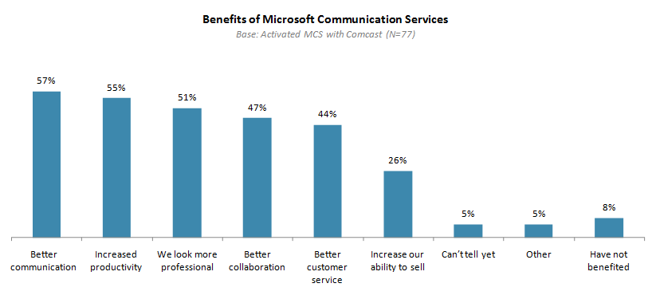
Why Better Communications?

Slide 17
Microsoft Online Services Business Productivity Online Suite
Exchange Online
Standard – $10 USL/month
Business Productivity
Online Suite
$15 USL
SharePoint Online
Standard – $7.25 USL
Office Communications Online
(IM & Presence) – $2.50 USL
Office Live Meeting
Standard – $4.50 USL
Exchange Online
Deskless Worker – $2 USL
Deskless Worker Suite
$3 USL
SharePoint Online
Deskless Worker – $2 USL

Slide 18
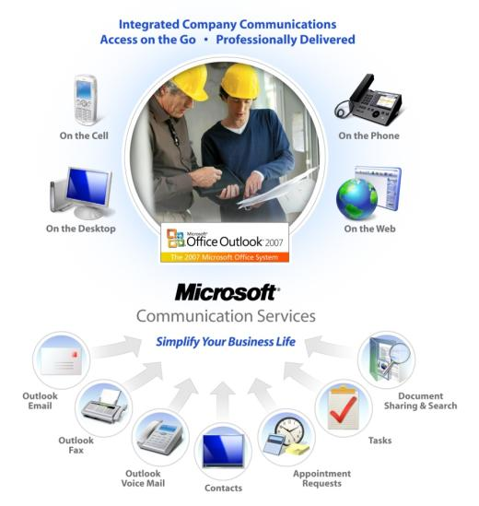
Microsoft Communication Services

Slide 19




What Is Microsoft Communication Services
Server Product
End Customer
Experience
Experiences
Enabled
Richest Client Experience
Email and personal information management
including calendaring, contacts, presence
Full Outlook Web Access
IE-based equivalent to rich client
Basic Web Access
Limited inbox functions without collaboration
Access via Speech Recognition
Read email, change appointments,
Send voice messages
Outlook / Internet Explorer
Windows File System
Document Collaboration
Provides teams with easy-to-use document
collaboration, versioning and editing space
IM / Presence / Voice
Know online and offline status, as well as
Interact in with real time chat, voice, video
SIP Telephones with
PBX Attach
VoIP Phone
Know online and offline status, as well as
Interact in with real time chat, voice, video

Slide 20


Selling Business Decision Makers
Email is a primary means of communicating with customers & suppliers.
Business owners need the ability to receive customer communications everywhere and have the personal and company resources easily available to take action quickly.
You have made a long term bet with Microsoft and Partner to support and manage these services.

Slide 21

© 2008 Microsoft Corporation. All rights reserved. Microsoft, Windows, Windows Vista and other product names are or may be registered trademarks and/or trademarks in the U.S. and/or other countries.
The information herein is for informational purposes only and represents the current view of Microsoft Corporation as of the date of this presentation. Because Microsoft must respond to changing market conditions, it should not be interpreted to be a commitment on the part of Microsoft, and Microsoft cannot guarantee the accuracy of any information provided after the date of this presentation. MICROSOFT MAKES NO WARRANTIES, EXPRESS, IMPLIED OR STATUTORY, AS TO THE INFORMATION IN THIS PRESENTATION.
Available programs, features, and functionality vary by device, Windows Mobile operating system version, and version of Exchange Server used. For some devices, Microsoft Office Mobile must be purchased separately. Connectivity and synchronization may require separately purchased equipment and/or wireless products (e.g., Wi-Fi card, network software, server hardware, and/or redirector software). Service plans are required for Internet, Wi-Fi, and phone access. Features and performance may vary by service provider and are subject to network limitations. See device manufacturer, service provider, and/or corporate IT department for details.

Slide 22
Appendix

Slide 23
Partner Hosted Compared to MOS
Category | Microsoft Online Services | Microsoft Communication Services (varies by provider)
Branding | Respect and Trust of the Microsoft Online Brand | Reseller can private brand or co-brand. Many hosters have been in the Exchange hosting business for more than five years
Billing | Bill directly by Microsoft. Avoid building your own billing infrastructure and debt risk | Reseller responsible for billing and retain billing relationship. White-label hosters support channel billing
Revenue | Revenue share: 12% first year and 6% recurring | Receives top line revenue – wholesaler model delivering 20-40% margins
SLA | Microsoft SLA: 99.9% uptime with up to 100% service credit | SLAs vary from simple to the robust (up to 99.999%) including financial guarantees
Data Location | Geographic location depends on customer ship-to address (US, Dublin, Singapore) | Hosting providers are located in most countries
Industry Compliance | SOX-70 Compliant but customer is responsible for any industry compliance | Many providers are Sox-70 compliant and provide other regulatory compliance support.
Pricing | Twelve month commitment with fixed price | Monthly, quarterly or annual pricing is available. Most do not require time commitment. Most allow down-grades
Bundled Offering | Standalone offering; Cannot be packaged with other offerings. | Flexibility to package with other offerings and applications
Security and Availability | CyberTrust Certified; Geo-redundant datacenters; <24 hours RTO/RPO | Professionally managed datacenters and Geo redundancy typical
Extensibility | Extend through web services and SharePoint customization allowed except for server-code* | Extend through web services and SharePoint customization . Few offer server-code*
Support | Microsoft provides IT-Pro 24x7 electronic and phone support | End-user and IT Pro Support via phone and electronic. Many offer 24/7 support
Localization | US English Only for service components with French, German, Japanese, Spanish, International English support in H1-CY2009 | Local Service Providers will provide local language support

Slide 24







Software plus Services – Power of Choice
Microsoft Communication Services
On-Premises
Microsoft Online Services
Control & ownership
Strategic capabilities
Advanced integration
Outsourced IT
Industry / Vertical configuration
Solution Flexibility
Rapid implementation
Anywhere-access
Packaged Solutions

Slide 25
Key Takeaways
Simple Apps are naturally moving to less customization as customer knowledge increases
This is countered by the customer’s desire for an integrated experience and more complex apps… requiring a higher degree of configuration
Most effective channel is service-dependent
Service providers systematically moving up-market
Power will shift to the trusted advisor

Slide 26
Key Takeaways
Microsoft Online Services (MOS) will never be all things to all segments
Large opportunity
Room for differentiation
MOS will evolve
Differentiation is a moving target

Slide 27
Key Takeaways
Consider BPOS where Hosted Exchange compliments your offers
Those capable of differentiation have a large opportunity
Basic communication services are being commoditized
Trusted Advisors role and influence will grow…build a your white label channel
Build continual innovation into your DNA…to grow and thrive
Bundling is strategic

Slide 28
Start-Up Hosting
PROFIT
LOSS
TIME

Slide 29
Sawtooth

Slide 30
Sawtooth

Slide 31
Sales Outpaces Expense

Slide 32
Small Businesses know Microsoft Office Outlook & want productivity
78% of Small Businesses have Microsoft Outlook on their computer
85% of Small Businesses are connected to the internet and email is #1 application
70% use or desire to use scheduling
Roughly 30% of small businesses still need a domain
More than 80% of enterprise's digitized information reside in individual hard drives and in personal files.
35% of small business owners (0-25) and 52% (25-100) say they use mobile email on a daily basis
25% of small businesses (0-50) and 52% of larger businesses 50-500) have multiple locations – Multiple locations correlates highly to using hosted services

Slide 33
Big Opportunities in Small Business
Current small businesses who desire advanced solutions can afford to purchase and operate them.
Roughly 40-50% are ready now to consume these services though less than 5% do today.
When they do consume them they are very loyal with very low <1% churn rates worldwide.
Sources: 1) AMI Partners. 2) PSB market research. 3) Canalysis, Telephia. 4) Radicati

