Slide 2
Web Hoster Sales & Marketing Kit

Slide 3
Web Hoster Sales Kit v1.0
What is it?
A set of easily customizable collateral
Why?
Provides knowledge from a business perspective and a technical perspective
Helps sales people articulate Windows based hosting solutions
Helps marketing people build better materials and campaigns

Slide 4
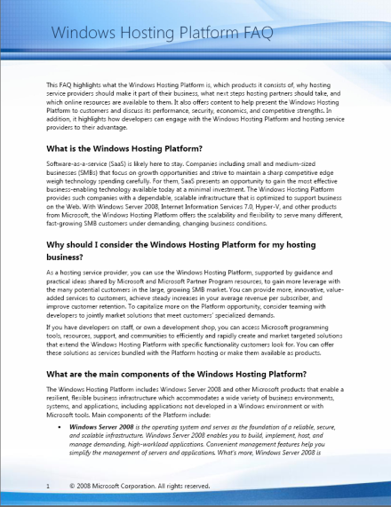
Sales FAQ
A concise, point by point reference to position Windows Hosting
Platform against the competition

Slide 5
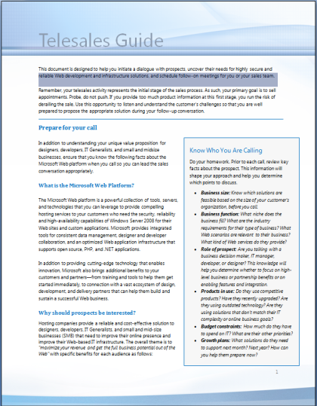
Telesales Script
A telesales script template to help position, sell, and overcome objections in sales conversations

Slide 6

Customizable Sales Deck
A persuasive set of slides for you to talk to SMBs
as well as Web developers and designers about your offerings

Slide 7

Customizable Brochure
A four-page, color document to be used as a handout at a trade show, a leave-behind with customers after a sales call, or as a follow-up to a telesales call

Slide 8
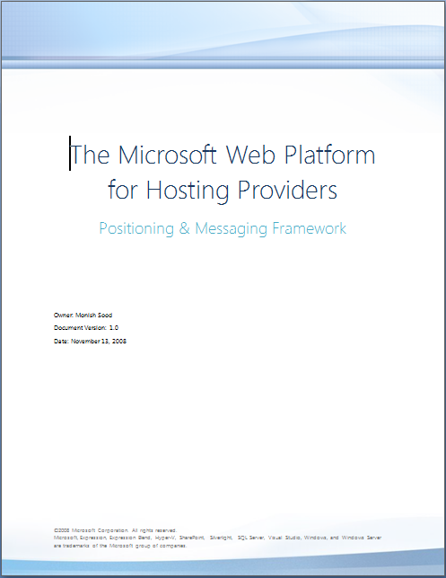
Messaging Framework
A framework that provides key messages to use in marketing materials that communicate the value of hosting services

Slide 9
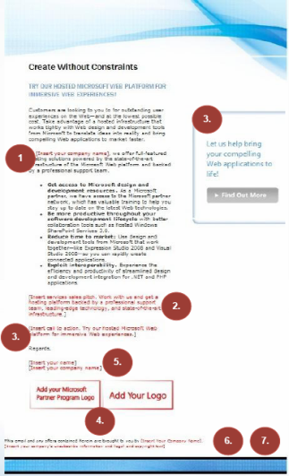
Customizable Email Templates
A set of e-mails that you can customize to create compelling outbound communications to drive demand using special offers and promotions

Slide 10
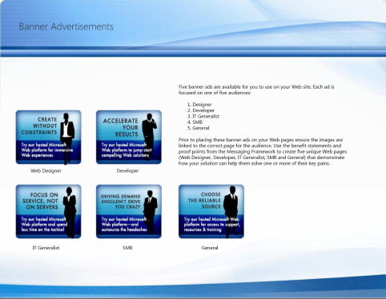
Banner Ads
A set of static banner ads that you can use on your Web site, in customer communications, e-mail signatures, and campaigns

Slide 11
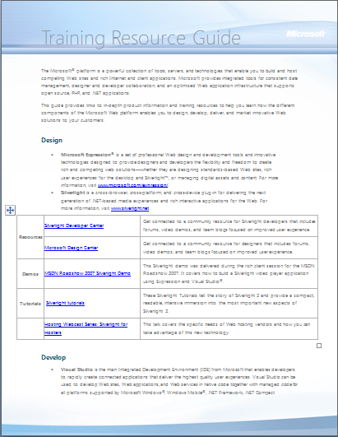
Training Resource Guide
A list of online training resources, demos, tutorials, and product information to help you get the technical depth you need to build and sell hosting solutions

Slide 12
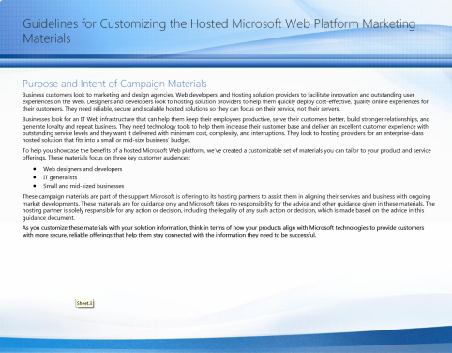
Sales Kit Guidance
An outline of the set of materials available in the kit along with practical guidance on customizing and using the materials

Slide 13
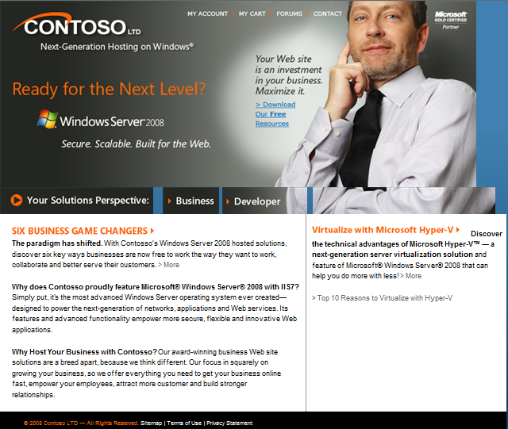
Windows Server 2008 Marketing Site

Slide 14
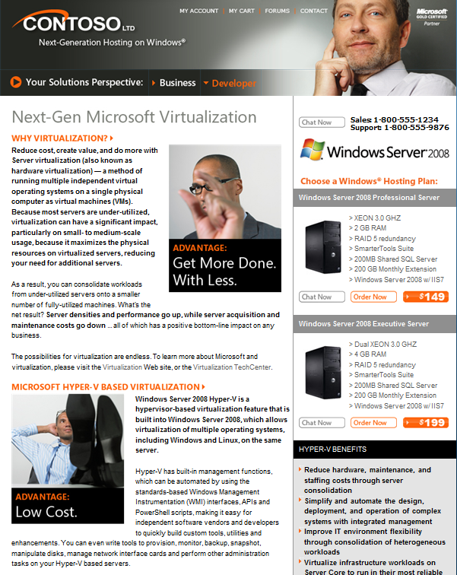
Hyper-V Marketing Web Site

Slide 15
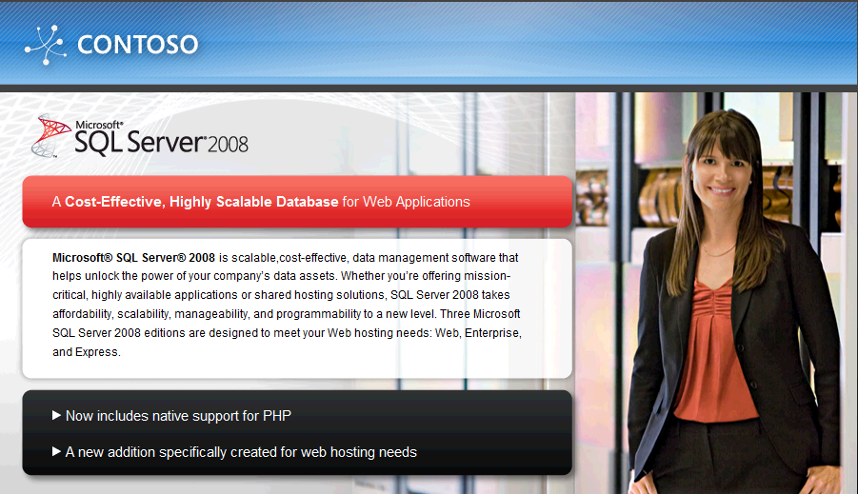
SQL08 Marketing Web Site

Slide 16
Materials mentioned in this module are posted on the Microsoft Partner Portal

