Slide 2
How Does Unified Communications Help Firms Save Money?
Larry Velez, Director Industry Initiatives
Unified Communications Group
1 December 2008

Slide 3
Agenda
Industry trends
Microsoft simplifies UC Solutions through software
Case studies
Key value propositions for cost savings
What’s new with Microsoft UC?
How do hosters get involved?
Call to action!

Slide 4
Industry Trends
UC means something different to everyone
Small businesses overwhelmed with technology trends
A packaged custom and standard UC solutions to eliminate complexity is growing

Slide 5









Microsoft Simplifies “UC Solutions” Through Software
E-mail and Calendaring
Unified
Messaging
Software-
powered
VoIP
IM and Presence
On-premise and Hosted Conferencing
Customers standardizing on Microsoft software get new functions at much lower costs compared to stand-alone systems
Notes:
6/18/2009 5:55 PM
5

Slide 6
Case Study: Telekom Austria
Aug ‘06 OCS Enterprise TAP Member
Feb ‘07 Finished Design & Plan
Apr ‘07 completed migration to OCS
Sep ‘08 UC Lighthouse with 250 Users & Voice Specialized Partner
Sep ‘08 OCS R2 TAP member
“The integration of Office Communications Server 2007 with Active Directory was very swift. Once the new servers were installed, users were easily migrated.”
“By holding video and audio conferences with several participants, internal communications between sites have vastly improved and we no longer have to travel to face-to-face meetings,“
“Being able to set up Web conferences in Office Communications Server 2007 is a major step forward for us.”
“By using the Polycom handsets and Office Communications Server 2007, you don’t require a second IP address and you can call directly from your computer,”
“We might even consider replacing our PBX system somewhere down the line, provided Office Communications Server 2007 can deliver the same features.”
Hannes Krall, Systems Manager

Slide 7

Many Firms are Unifying Communications with Software
www.microsoft.com/casestudies

Slide 8



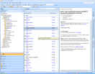









Access E-mail, Fax, Calendar, Contacts Anywhere To Reduce Time in Getting Work Done
Built-in: no special server or services required
Rich access for the many, not the few

Slide 9
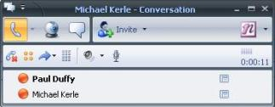
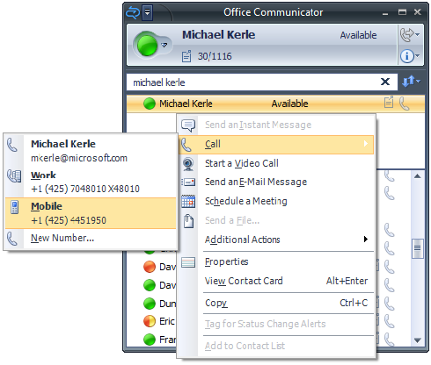
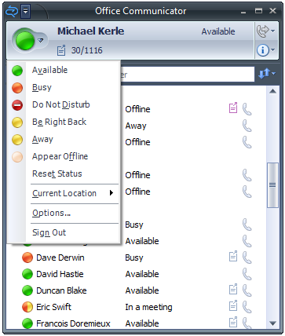
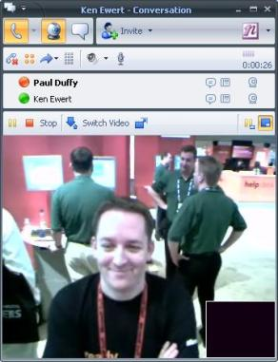


Communicate Over the Internet To Save Phone Charges
Check availability from any
Microsoft Office application
Windows Mobile device
Browser
See and/or Talk from your PC with off the shelf devices
One Number Calling ^{New!}
Do it securely…
…with no network complexity
…with trusted third parties
…from office, home or hotel
…SIP trunk to IP network ^{New!}

Slide 10
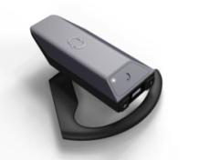
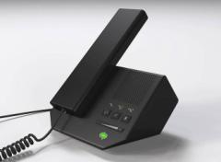
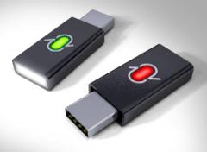
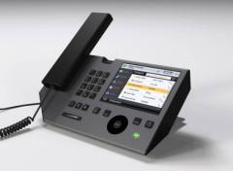
UC Devices Cut up to 60% off Typical IP Telephony Costs
Extending Communicator experience
Personal computer, Web and mobile devices
Dedicated communications devices
Software for innovative IP phones
Implementations design with embedded software
Partners deliver production devices

Slide 11
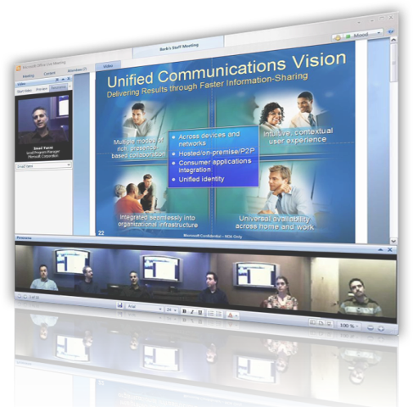





Conference Anytime with People To Reduce Travel Costs with High Quality Virtual Meetings
Schedule or “Meet Now!” to:
Make decisions
Report progress
Fix problems
Record and playback to:
Keep everyone updated
Learn the business
Conference innovation
Panoramic video with RoundTable
Schedule with Outlook
Works with Communicator
OCS manage 3rd party attendees ^{New!}

Slide 12
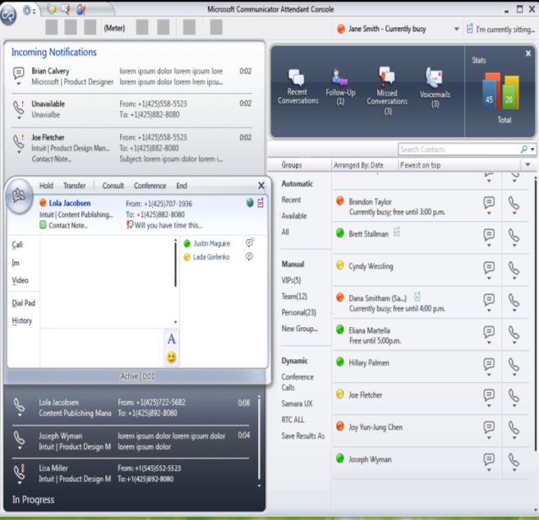
Coordinate with Office Administrator To Streamline Office Communications
Office Communicator Attendant Console ^{New!}
All incoming calls centrally managed by
Receptionist
Operator
Office manager
Secretary
Executive admin
Use IM to find people, and route calls to them
Organize the attendant by established team contact lists

Slide 13
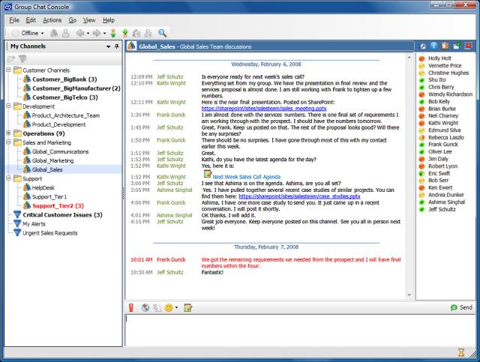
Persistent Group Chat to Improve Team Sharing To enable people to carry on topic-specific, multi-party discussions that persist over time

Slide 14













How Do Hosters Get Involved?
Customer Premises
Dedicated Hosted UC
Full Enterprise UC solution
Custom design
Dedicated
Offered in SPLA
Hosters will
Host & ‘Run’ solution
Subcontract Voice Partners
UC Voice Partners will
Plan, and Build solution
Subcontract hosters
Media Gateway or SIP Trunk
Media (RTP) Path
Signaling (SIP) Path
IP Network
PSTN
Dedicated Hosted Server Roles
IM
VoIP Call Processing
Web
Conf.
Audio
Conf.
Video
Conf.
Service Provider
Unified Messaging
E-mail/ Fax
Calendar
Voice Mail

Slide 15







































Growing Community Ecosystem of UC Competent Partners

Slide 16
What’s in it for the partner?
Revenue as % Net New Subscribers
15%
19%
Deploy Lighthouse wins
Get license revenue
Compound revenue growth
Less dependent on new subscribers over time
Steady ARPU growth

Slide 17
Call to Action!
Achieve Hosting Competence to provide good service level agreements to partners and customers
Find out where there are UC Competent partners in your area through MSPP
Learn more online about Microsoft Unified Communications through MSPP
http://partner.microsoft.com/UCNow

Slide 18
Thank you

