Slide 2
Why Improve Datacenter Automation?
“Studies show up to 80% of network availability incidents and 60% of security issues can be tied to human error” CIO Update - George Spafford – March 2, 2007
IT Efficiency
  Green Initiatives, Server Consolidation, Service Delivery Optimization, Repeatability
Business Enablement
  Align IT and business goals, enable IT to drive biz, ROI
Compliance
  Best practices, Standardize, Report / Audit

Slide 3







Key Focus: Supporting the Evolution of the Data Center
Optimized Server Infrastructure
Enhance Security and Compliance
Simplify, automate and centralize IT operations to reduce customer churn and maximize profits
Ensure business continuity by enhancing IT infrastructure security and compliance
Control Costs
Drive
Agility
Adapt IT infrastructure rapidly according to changing customer demands

Slide 4




System Center Knowledge Driven Management Solutions
Updated solutions to support infrastructure optimization
End to end management of IT Services
Complete IT systems management lifecycle with improved cross-platform support
Integrated solutions for both physical and virtual environments

Slide 5


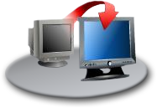
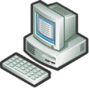









Managing the Server Lifecycle
Backup
Hardware Provisioning
Virtual Workload Provisioning
Server Management Suite Enterprise
Disaster Recovery
OS / Software Deploy, Patching and State Mgmt
Performance and Health Monitoring
Notes:
5

Slide 6




A Focus on Data Center Health & Performance
  Proactive IT service health monitoring
  Ensure your applications are healthy
  SLA monitoring dashboards and reports
  Built-in knowledge
Hosted Application
Databases
Servers
Web Servers
Order DB
App1
OTW-IIS-01
OTW-IIS-02

Slide 7










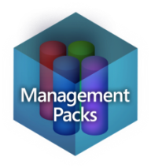


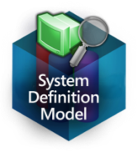





Operations Manager – Management Packs
IT Policies
Developer
Insights
Business
Requirements
Discovery and
Health Models
IT Service
Models

Slide 8
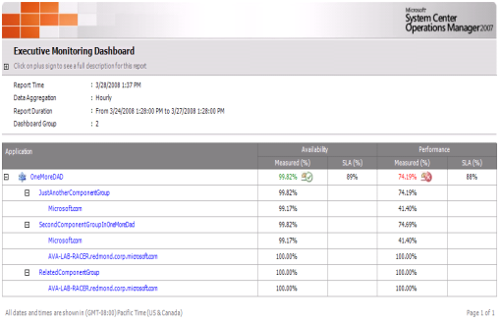
Operations Manager – Leveraging the Data Warehouse
Gain insight into your current usage and leverage better intelligence to predict future requirements
Identify problems before your customers do.
Add value and create a new revenue stream with deep reporting capabilities
Gain visibility into end-users application experience

Slide 9
System Center Operations Manager
DEMO!

Slide 10

















Configuration Manager '07 Key Investments
Simplicity
Up and running in minutes
Simplified UI
Advanced Task Sequencing
Improved scheduling and greater control including Wake-on-LAN
Common processes for Windows Mobile and embedded device
Simplicity
Deployment
Unified delivery of Windows operating system for clients and servers
Built on Windows Vista technologies including Windows Imaging
Offline media support for full offline provisioning
Deployment
Security
Integration with Windows 2008 Network Access Protection
Simplified, comprehensive software updating w/ templates for common tasks
Enterprise Vulnerability assessment
Securely managing devices across the Internet
Security
Configuration
IT policies for analyzing corporate and regulatory compliance
Out of the box configuration policies for server workloads i.e. Exchange
License and asset management
Configuration

Slide 11
SCCM - Automate Software Deployment
Integrated, policy-based solution to seamlessly deploy and update physical and virtual applications, ensuring IT systems are up-to-date and more secure.
Policy-based deployment of both locally installed and virtualized applications through integration with Microsoft SoftGrid (Application Virtualization)
Integrated software update management built on Microsoft Update improves speed and efficiency of update management and helps limit vulnerabilities
Easily add software updates through task sequencing to your OS image so that you don’t deploy out of date machines.
Together with Virtual Machine Manager, Configuration Manager provides a single process for updating your physical and virtual (VHD) systems.
Define, maintain and exceed company SLAs through the use of Maintenance Windows, controlling when change can happen to your managed environment.
Allows for explicit targeting, scheduling, and reporting.

Slide 12
Internet Based Client Management for SCCM
Manage your clients outside of Corporate boundaries:
  Leverage the same PKI infrastructure as SCOM uses for certificate based authentication
  Use HTTPS for client communication
  Offer this as a service to patch end customer servers and workstations
  Supports a subset of features when using IBCM

Slide 13
















Leverage DPM for Backup and Recovery
Online Snapshots (up to 512)
Disk-based
Recovery
Active Directory®
System State
Up to Every 15 minutes
DPM 2007
Tape-based
Archive
with integrated Disk & Tape
Windows XP
Windows Vista
Windows Server 2003
Windows Server 2008
file shares and directories
Offline tape
DPM 2007
Continuous Data Protection for Windows Application and File Servers
Rapid & Reliable Recovery from disk instead of tape
Advanced Technology for enterprises of all sizes

Slide 14
Key highlights – Exchange protection
DPM protects both Exchange 2003 and Exchange 2007
DPM supports stand alone, MSCS clusters, CCR and LCR
Protection continues after planned failover
Logs truncated after successful backups only
Eseutil runs on DPM – lower load on Exchange, faster completion
DPM supports recovery at the:
  SG level
  DB level
  Mailbox level

Slide 15
Key highlights – SQL Recovery
Transaction logs are continuously synchronized to the DPM 2007 server.
An “express full” uses SQL Server VSS Writer to identify which blocks have changed in the entire production database, and send just the updated blocks or fragments.
Ability to recover to the original location, rename and restore or alternate location.
Recovery will support
  Recovering DB and required logs and bring DB online
  Recovering DB and logs (to required PIT) and leaving DB in restoring state
  Supports “lossless recovery” of SQL Server data
    Restores your database to the latest 15 minute recovery point
    Reapply the surviving logs from the production server
Notes:
With only a few mouse clicks and DPM 2007, you can:
• Restore a SQL database directly back to the original server:
Databases are recovered back where they came from into the active SQL Server, with no additional work for the database administrator to do afterwards. This improves recovery time and reduces the number of people needed during a crisis recovery.
• Restore to a “recovery database” on the original server:
This provides an alternative where the active SQL database is untouched, but the older data can be restored onto the same SQL server but in an alternate database – allowing both versions of the data to be accessed independently but concurrently.
• Copy database files to an alternate server:
This option enables disaster recovery, compliance auditing, or software testing – without affecting the production environment.
• Copy the database file to tape:
Use this option to create a long-term archive or portable media of the data at any recovery point, even after the fact. For example, if the accounting department closes the quarterly books at 10:45 AM on a Tuesday, you can “recover” the data from that point, directly to tape – without backing up anything else or impacting the production server that is already serving new data.
Unique to DPM 2007 is “lossless recovery” of SQL Server data, meaning that after DPM 2007 restores your database to the latest 15 minute recovery point, it can automatically reapply the surviving logs from the production server to the very last committed transaction. Thus, the last completed database transaction is recovered and ready for business.

Slide 16
System Center Data Protection Manager
DEMO!

Slide 17
What’s missing???
System Center Virtual Machine Manager
  Vital part of the System Center Suite
  Enables end-to-end management of Hyper-V and VMWare
  We’ll discuss this in the Hyper-V module

Slide 18
Conclusion
System Center has evolved to support the datacenter lifecycle
  End to end management of IT Services
  Integrated solutions for both physical and virtual environments
  Complete lifecycle of IT Systems including desktops, servers and devices in any location
Backup
Hardware Provisioning
Virtual Workload Provisioning
Disaster Recovery
OS / Software Deploy, Patching and State Mgmt
Performance and Health Monitoring
Server Management Suite Enterprise supports transition to dynamic IT and delivers improved value with new licensing
  Monetize your management investment – new source of revenue

Slide 19
Thank you

