Slide 2
Multi-Touch In Windows 7
<speaker name>
<title>
Microsoft Corporation

Slide 3
Agenda
Multi-touch Overview
  Demo
  Now is the Time!
  Multi-touch Tenets
    Augmenting Windows
    Delivering Consistency
  Hardware and Software
Writing Drivers
Logo Considerations

Slide 4
Multi-Touch
In Windows 7
demo

Slide 5
Now Is The Time!
Customers are ready for touch
Multi-touch offers clear differentiation with
a high “Wow” factor for consumers
Multi-touch enhances on-the-go use and
opens up new scenarios for business
90% of people in focus groups claimed they would pay a 20-30% premium for a PC with multi-touch
Seeing is believing: Consumer purchase intent doubles after hands-on experience

Slide 6
Now Is The Time!
Mainstream digitizers are available
Multi-touch sensors are available today
for a range of form-factors from laptops
up to large all-in-ones
Windows 7 will work with any multi-touch digitizer meeting the logo requirements
We are working closely with several digitizer partners, including
  Elo, N-Trig, NextWindow, and Wacom
  Contact us to be added to this list

Slide 7
Now Is The Time!
ISVs are investing in multi-touch
ISVs are enthusiastic about multi-touch!
We are working with several ISVs today
on multi-touch applications, including
  AutoDesk
  Corel
  Sonic
  Cyberlink
  Avoco Secure
  Identity Mine

Slide 8
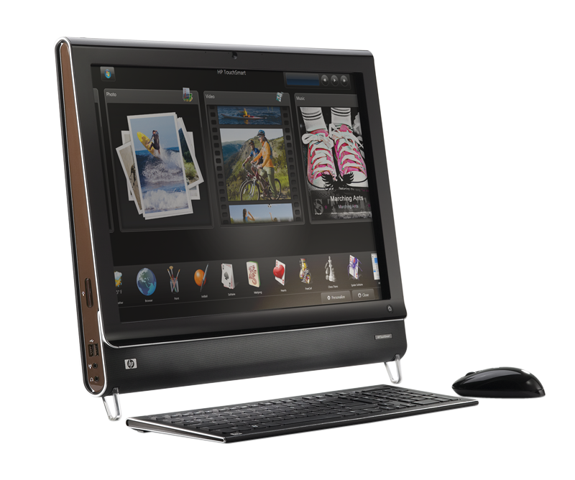
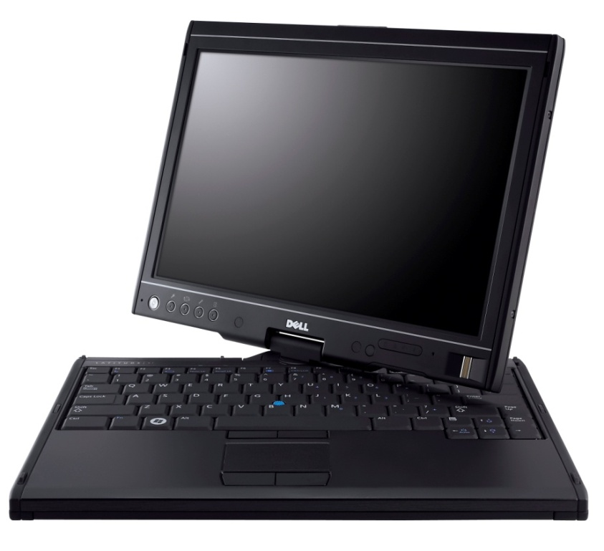
Multi-Touch Capable PCs
Are Available Today
HP TouchSmart
All-in-one PC with 2-touch digitizer from NextWindow
Dell Latitude XT
Laptop with multi-touch and
pen digitizer from N-Trig

Slide 9
Windows 7 Multi-Touch Goals
Augment the Windows experience
  Make routine activities easier with touch
  Delight customers with direct manipulation
Deliver consistency
  Consistent user experience
  Consistent developer, IHV, OEM platform
Succeeding with multi-touch is a team effort, we are working with many hardware and software partners

Slide 10
Augmenting The Experience
Simple gestures for everyday use
Single finger panning for touch
Consistent multi-touch gestures
  Gestures for double click, right click, panning, zoom, and rotate
  Designed for 2+ touch systems
Gestures are available across the operating system and available
“for free” to most applications

Slide 11
Augmenting The Experience
Optimize for consumption scenarios
Customers are most likely to use touch
for consumption activities
  Navigating and consuming the web
  Consuming photos, music, and video
  Reading and sorting e-mail
  Playing casual games
  Using Office applications
We’ve optimized these areas for touch

Slide 12
A Short List Of Investments…
Core Windows
Applications
Touch-optimized top-level UI
  Start menu, taskbar, window arranging, Explorer etc
  Ripple feedback, cursor updates
  Touch optimized flicks
Panning UX and feedback
  Boundary feedback, bounce, inertia
  Visually appealing and “fun”
Photo viewer
  MT zoom and rotation
Touch-optimized Media Player
  Touchable playback controls
Touch-friendly keyboard
  New visuals, improved look, launching and feedback
  Prediction and improved correction experience
Internet Explorer
  Pan and zoom and navigation gestures
  “Open link in new tab” gesture
  Address bar drag menu
Media Center
  Live gallery panning
  On-screen keyboard
  Larger transport controls and seek
  New Now Playing and details pages
Multi-touch pack
  Separate delivery of multi-touch games and
  surface style mapping – not part of Windows
Also
  Windows Live Photo Gallery
  XPS viewer
  MS Paint

Slide 13
Deliver Consistency
Consistent for partners
  IHVs and OEMs: Digitizers interface through HID
  Developers: Standard APIs regardless of the digitizer technology used
Consistent for customers
  Gestures that work the same in every application
  on any Windows Touch PC
Consistency through Windows Logo
  Logo ensures a minimum level of functionality
  New touch features are only enabled with
  Logo certified multi-touch digitizers

Slide 14
Multi-Touch Software
Good-Better-Best
Multi-touch offers a tangible way to differentiate, a Windows application can target one of 3 levels of touch integration
  Good: No specific touch APIs are used but the application UI is appropriately sized and
  works well with the built-in gestures
  Better: The gesture APIs are supported to give
  smooth natural interactions
  Best: Deep touch focused experiences designed
  to take advantage of multi-touch

Slide 15
Multi-Touch Hardware
Laptop and AIO form-factors are great for Multi-touch
Target form-factors: Laptops and all-in-ones
  Laptops: Users are closer to the screen and
  touch has high benefits in mobile situations
  AIOs: Often in high traffic areas of the home
  where walk-up use is common
Hinges and pen are optional
  Not all touch laptops need to be tablet PCs
More on Logo later

Slide 16
Tablet PC Hardware
A multi-touch and pen enabled tablet PC is the ultimate mobile PC
Windows 7 continues our investment pen and tablet PC
  Predictive text on soft keyboard
  Recognition for 13 new languages (25 total)
  Dramatically improved Asian recognition
  Handwriting personalization in all languages
  New math recognition
A tablet PC can have multi-touch but does not need to
  Touch is focused on mainstream users
  Tablet PC is best for verticals and education
Notes:
Additional languages handwriting recognition support represents larger addressable market for Tablet PCs.
East Asian accuracy improvements should fuel better market adoption and ISV engagement.
Math recognition presents opportunity for differentiated offering for Education Vertical.

Slide 17
Multi-touch Drivers in Windows 7
Great drivers are key to a great end-user experience!
How can we help?
  WDK samples and tools
  Driver guidance in this talk and WinHEC whitepaper
  Logo requirements represent min hardware bar to properly enable the multi-touch feature set

Slide 18
Driver Framework
KMDF
  Shim will ship in-box in Win7 (mshidkmdf.sys), also shipped as a sample with Vista SP1 WDK
  WDK Samples using the shim: WacomKMDF, EloMT, raw USB
  Removes power management and PnP handling code
  IRP cancelation logic goes away (see WacomPen samples)
UMDF
  Can’t write a HID miniport driver in UMDF
WDM
  Not recommended for new drivers

Slide 19
Exposing Your Multi-touch Device To Windows
Multi-touch devices are a superset of HID touch devices
Use existing HID touch usages, but additionally report HID contact id and max number of supported contacts
Configuration collection allows easier device configuration for down-level or other scenarios

Slide 20
Proposed Multi-touch Additions To HID Specification
Notes:
Contact identifier: The ID of the current contact. An ID must remain constant while it is detected by the device, and each separate concurrent contact needs a unique ID. IDs can be reused after a contact is no longer detected. If the device supports “in-air” packets, the ID must persist from the time the contact is detected until the time it goes out of range.
Configuration: The CA for the top level collection housing the feature report.
Input mode: A read/write value feature to get and set the current input configuration of a device.
Device index: Identifies the top level collection for which the configuration is intended. This addresses the scenario where a report descriptor contains more than one multi-input top level collection.
Actual contact count: This usage is specifically for devices that report all current contact information using the parallel or hybrid mode described below. Since the report count for each usage in this device’s top level collection will be less than or equal to the maximum number of contacts the device supports, this usage should convey the actual number of valid contacts in the current packet. A device that cannot provide this information must use NULL for all values in the first position that do not contain valid contact information. The usage should be in the top level collection.
Maximum number of contacts: A read only feature for getting the total number of contacts a multi-touch device supports. This usage must be included in a feature report that is part of the multi-touch top level collection regardless of the reporting mode being used.

Slide 21
Reporting Modes
Serial
  Each packet contains a single update, multiple contacts
  are streamed serially
  Can reduce per contact sample rate
Parallel
  Each packet is capable of reporting the total number of contacts the device can detect
  Large packets, often not fully utilized
Hybrid (Recommended)
  Packets are large enough to report some number of contacts
  Multiple packets can be reported serially in one logical frame
  Avoids issues with serial and parallel

Slide 22


HID Multi-touch
Required usages
  Touch collection
  (page 0x0D, usage 0x04)
  X (0x01, 0x30), Y (0x01, 0x31), Tip switch (0x0D, 0x42), In-range (0x0D, 0x32)
  Contact id
  (0x0D, 0x51)
  Max count
  (0x0D, 0x55)
Recommended
optional usages
  Confidence
  (0x0D, 0x47)
  Width and height
  (0x0D, 0x48 and 0x49)
  Pressure
  (0x0D, 0x30)

Slide 23
Tips And Tricks
For null values, set the null bit on all main items in the report descriptor
Use the physical dimensions property for X and Y usages
  If you cannot report accurate units, report 0 units
Report a top-level collection for each function your device supports (touch, multi-touch, pen)
  If the device does not have a mouse, add a mouse collection that does not send data
More in Digitizer Drivers for Touch, Multi-touch, and Pen Devices whitepaper!
Notes:
Null values
Null values should be specified as outlined in the HID specification. The null bit must be set on all main items in the report descriptor. Note that device can use either the actual count usage or null values to notify the host of actual number of valid contacts in a packet.

Slide 24
Capability Discovery And Configuration
If the configuration collection exists, Windows 7 will open it exclusively
  Windows 7 will attempt to set it to multiple input
  On Vista or XP Tablet Edition, 3rd party applications can set the configuration as necessary
The device index usage specifies the collection to configure
Multi-touch collections are identified via the contact
id usage
If set to mouse, route data through the mouse collection
Notes:
Multi-touch devices are identified via the contact id usage
Single touch is recommended for Windows XP Tablet PC Edition and Windows Vista. The mouse is recommended for Windows XP and Windows 2000.

Slide 25
General Guidance
Do as much in firmware as possible
For USB devices, consider selective suspend
Helpful WDK tools
  DriverVerifier, StaticDriverVerifier, PreFastForDrivers, CheckINF, and others
Notes:
A digitizer device reports proper physical dimensions by using the physical dimensions property of the x and y usage. Windows 7 uses these values in gesture recognition and other platform features. Inaccurate information about the physical dimensions may affect the performance of those features.
If for some reason a digitizer device cannot report accurate physical dimensions, report 0 units.

Slide 26
Driver Distribution
Millions of users worldwide automatically update their systems at http://windowsupdate.microsoft.com
Highly recommended: Distribute your logoed drivers through Windows Update
Manage settings for distributing your driver via Driver Distribution Center (DDC) on Winqual
  View download statistics and WER data
  For details, see Distributing Drivers on Windows Update

Slide 27
Logo Considerations

Slide 28
What's So Important?
The user experience
  Multi-touch technology will stand or fall on the quality of the user experience
  To succeed, touch must be simple, reliable and consistent
  The quality of the user experience begins with the digitizer and its drivers
New Windows 7 touch features will only work on PCs that have a Logo certified digitizer
Multi-touch is also an AQ – Additional Qualification
  Customers can find devices or systems that enable specific experiences, partners can communicate that their device/system supports the experience
  No extra requirements: get the Windows 7 Multi-touch logo - and you get the Windows 7 Multi-touch AQ for free
  We’ll do what we can to help you meet the quality bar

Slide 29
Logo Tools and Submission
Windows Logo Kit 1.3 (Windows 7 preview)
  Available later this year
  Preview changes to the logo program for Windows 7 and expected tests
    Automated tests querying HID values
Windows Logo Kit 1.4
  Will ship at same time as Windows 7 RC
  Comprehensive manual test set
    Placing contacts, drawing lines, circles, other patterns
    Complete validation of HID Usage and the user experience requirements
Multi-touch requirements apply equally to devices and systems
  Hardware integrations can introduce noise
  Keep testing at every phase of integration
Devices need to be submitted for manual logo verification test pass at Microsoft lab
  Also optional for systems – a free test and support resource!

Slide 30
HID Class
Multi-touch digitizers must appear to the OS as HID digitizers, and not as a mouse or other proprietary device.
Why?
  So Windows knows when to enable
  multi-touch capabilities
Design and test tips
  Standard device class in HID descriptor
  Automated descriptor query
  Observe all required HID and Multi-touch Extension usages

Slide 31
Screen Coverage
Input requirements apply equally to all areas, including edges and corners.
Why?
  To avoid blind spots or dead areas. The desktop experience in Windows relies on accurate touch at edges and corners
Design and test tips
  Crucial to test this at all integration phases - hardware placement can easily impact it
  Tests will include touch points throughout the screen area and at all extremes

Slide 32
Battery Operation
For battery-operated devices, the requirements must be met whether the device is running on AC or battery power.
Why?
  Mobile user scenarios are primary; the requirements are equally important for tethered or mobile use
Design and test tips
  If digitizer performance is impacted by power supply, design for both cases
  Tests must be run on both cases

Slide 33
Sampling and Resolution
Sample rate: at least 50hz per finger.
Resolution: At least 100ppi and at least display resolution.
Why?
  Packet rate determines responsiveness and ability to handle fast-moving fingers
  Resolution is a fundamental component of accuracy; pixel level accuracy is important for many user scenarios
Design and test tips
  50hz is really a minimum (USB supports up to 133hz)
  For the manual tests, sample rate will be measured for all contacts

Slide 34
Jitter
For all fingers, if a contact is stationary, the reported position data must not change
Why?
  Stationary contacts are an important class of interaction primitives; many applications need to be able to rely on stationary contacts
Design and test tips
  Manual test will require multiple stationary contacts, will log position data

Slide 35
Contact Accuracy
Tracing a line, circle, or other pattern should produce data that is within 0.5mm of the expected data pattern and without interruption to the pattern.
Why?
  Accuracy of contacts in motion is fundamental to almost all multi-touch scenarios.
  Incorrect up/down data destroys integrity of linear movements, including dragging and line drawing
Design and test tips
  Prioritize accuracy in design (meeting this generally buys you the other requirements)
  Manual tests following lines and patterns on a canvas (MSPaint good testbed)

Slide 36
Contact Offset
The physical contact with the device and the position the device reports must be within 2mm of each other for all fingers applies whether each contact is stationary or in motion, and when multiple fingers make contact simultaneously or separately.
Why?
  Reduced offset is crucial to accuracy (and user perceptions of accuracy)
  High accuracy in movement operations, and guaranteed correlation of x, y co-ordinates
Design and test tips
  No cheating! This is core to every requirement
  Manual test will require finger contact at known points on the screen

Slide 37
Ghost Points
No data must be reported for locations where contact is not made.
Why?
  Random input packets are guaranteed to destroy trust and turn users instantly against the technology
Design and test tips
  Ensure elimination of noise at all phases of construction/integration
  If mobile, move it around while testing
  Tests will specify periods of inactivity

Slide 38
Device Fundamentals
General core driver requirements for all
devices – satisfying another dimension of the
user experience
  Drivers must be secure, stable, reliable… architected to maximize reliability and stability and do not
  leak resources…
  Install/uninstall behavior
  In the wild: All drivers must maintain a high Driver Quality Rating (DQR) or the manufacturer must make a fixed driver available to customers within 90 days
  …

Slide 39
Beyond Logo
Lead the field with an even better user experience
  Support optional HID usages for richer applications
    Contact width/height, Pressure, Valid touch confidence
  Double-tapping should work with minimal uplift of the finger
    Many users lift the finger only a small distance off the screen to double-tap
  Performance
    Device-side gesture detection strongly discouraged
    Palm rejection should be especially fast
  Pen use on touch screen
  Input should not be triggered by dust or
  small insects

Slide 40
Call To Action
Put Multi-touch on your roadmap –
now is the time
Engage with us, we want to help
Build drivers following the guidance
and samples in the Windows Driver Kit
Run the tests in Windows
Logo Kit frequently
Contact us if you have any questions
Notes:
For drivers:
Build KMDF drivers that appear to Windows per the guidance here and in the whitepaper
Take full advantage of the samples and tools in the WDK
Do as much in firmware as possible

Slide 41
Additional Resources
WinHEC white papers:
  Digitizer drivers for touch, Multi-touch, and pen devices
  How to Design and Test Multi-touch Hardware Solutions for Windows 7
  Enabling USB Selective Suspend for Human Interface Devices
Specserver
  HID extensions for Multi-touch
Web sites
  Pen and touch driver guidance
  http://www.microsoft.com/whdc/device/input/PEN_touch.mspx
  Getting started with the Windows Logo program
  http://www.microsoft.com/whdc/winlogo/getstart/default.mspx
Contact us:
tab-ext@microsoft.com

Slide 42
Q&A

Slide 43


© 2008 Microsoft Corporation. All rights reserved. Microsoft, Windows, Windows Vista and other product names are or may be registered trademarks and/or trademarks in the U.S. and/or other countries.
The information herein is for informational purposes only and represents the current view of Microsoft Corporation as of the date of this presentation. Because Microsoft must respond to changing market conditions, it should not be interpreted to be a commitment on the part of Microsoft, and Microsoft cannot guarantee the accuracy of any information provided after the date of this presentation.
MICROSOFT MAKES NO WARRANTIES, EXPRESS, IMPLIED OR STATUTORY, AS TO THE INFORMATION IN THIS PRESENTATION.

