Slide 2
Presentation Outline (hidden slide):
Speaker instructions: Complete this slide to assist your SME (subject matter expert) in evaluating your presentation flow, topic coverage, demo integration and alignment of content to your session description and level.
Title: Windows Essential Business Server 2008 Deep Dive
Technical Level: 300
Intended Audience: Technologist
Objectives (what do you want the audience to take away from this session):
  1. In depth overview of EBS
  2. Best practices for implementation
  3. Understanding of Security and Messaging
Presentation Outline (including demos):

Slide 3
Windows Essential Business Server 2008 Deep Dive
Session Code: SRV324
Miguel Rojas
Partner Technology Specialist
Microsoft New Zealand

Slide 4
Agenda
What is Essential Business Server?
Planning
Choosing Hardware
Installation Approaches
Migration Assistance
Administration
Questions from the Field
Security
Messaging
Summary

Slide 5
What is
Essential Business Server?
Session Code: SRV324

Slide 6
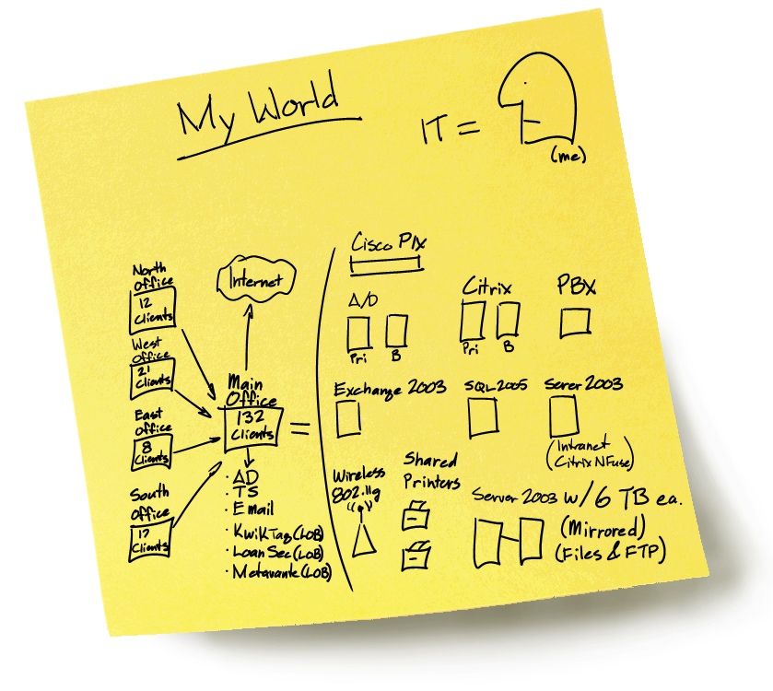

Slide 7
The choice…
Windows Essential Business Server 2008
Windows Small Business Server 2008
Number of PCs
25
50
100
250
Small Business Server
2008
Essential Business Server 2008
Built for Businesses without
internal IT Professional
Built for Businesses with
IT Professional
Simplified administration of
core server infrastructure
Unified administration of
multiple-server IT environment
Designed for 75 users or less
Designed for 300 users or less
Notes:
9/1/2008 4:56 PM
7

Slide 8






This is Essential Business Server…
Standard Edition
Premium Edition
    Management Server
    Windows Server 2008 Standard technologies
    Microsoft System Center Essentials 2007
    Messaging Server
    Windows Server 2008 Standard technologies
    Microsoft Exchange Server 2007 Standard Edition
    Microsoft Forefront Security for Exchange Server¹
    Security Server
    Windows Server 2008 Standard technologies
    Exchange Server 2007 Standard Edition
    Forefront Threat Management Gateway, Medium Business Edition²
    Standard Edition, Plus..
    Database Server
    Windows Server 2008 Standard
    SQL Server 2008 Standard Edition
¹ One year Microsoft Forefront Security for Exchange Server subscription included in the product.
² One year Web Antimalware Subscription for Forefront Threat Management Gateway, Medium Business Edition included in product.
Essential Business Server only software
Integrated Setup
Unified Administration
Security & Access
Extensible Console

Slide 9
The Short Answer on EBS
Replaces the core part of the customer’s infrastructure
Best practices setup and configuration
Creates a foundation to build on
Easier to manage
Helps admin to be proactive and able to focus on business demands

Slide 10
Planning for EBS Installation
Session Code: SRV324

Slide 11
The Wizards - The Preparation Tool
Examines the existing infrastructure
Checking for AD, DNS, Exchange, DC Health, etc.
Gives a “green/yellow” check when EBS can be installed without any blocking issues
  Don’t go on with yellow, fix them…
  The “Allow Replication with Divergent and Corrupt Partner” Registry value is enabled on the DC

Slide 12
The Wizards - The Planning Tool
Asks the questions that need to be answered during installation
Helps the Admin understand areas of the network that will change or that need extra planning
Helps the Admin document what needs to be done during installation
Pssst, the tools can be used for other “purposes” ☺

Slide 13
EBS 2008 Installation Sequence
Run Preparation Wizard
Run Planning Wizard
Create planning xml file
Install EBS 2008 Management Server
Install EBS 2008 Security Server
Install EBS 2008 Messaging Server

Slide 14
Demo
Tools of the Trade
EBS Preparation Wizard
WEBS Planning Wizard

Slide 15
Network
Session Code: SRV324

Slide 16
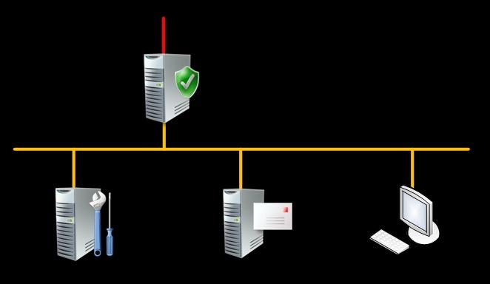

Network Design for EBS
?
Direct connect to Internet
Existing / New HW Firewall
Complex Edge Network

Slide 17
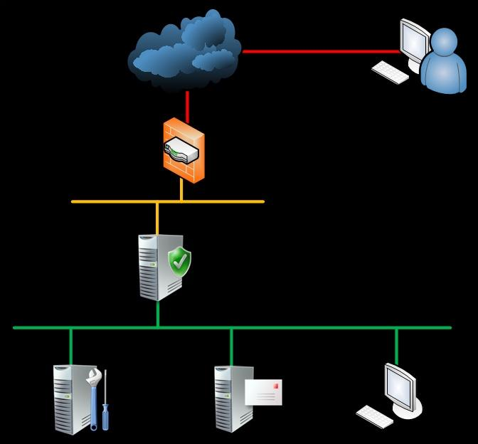
User Network Access
Internet
Remote User
Hardware Firewall
Short list of ports forwarded to SBS server
User VPN pass-thru (Optional)
Perimeter
Security Server
User VPN Endpoint
Policy-based VPN quarantine
Policy-based outbound access
LAN

Slide 18
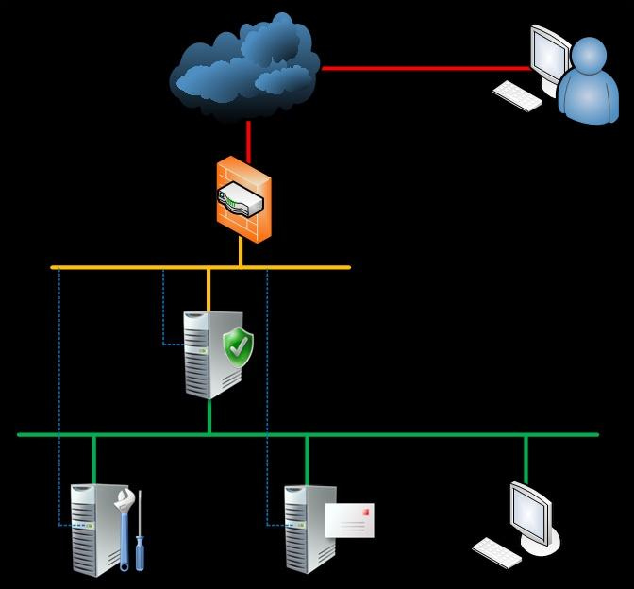
Remote Management Access
Internet
Hardware Firewall
VPN Endpoint for Administration
Local Credentials
Limited # of users (Admin/Partner)
Remote Administrator
Perimeter
Server Management Interfaces
e.g. HP iLO2, Lights-Out 100
Connect to Perimeter or dedicated MGMT segment
Console & power control regardless of server state
LAN

Slide 19
Choosing Hardware
Session Code: SRV324

Slide 20
Basic Requirements
MS Minimum (installs and functions)
  CPU: 2+ cores
  RAM: 4/2/4 (Mgmt/Sec/Msg)
Consider this for the real world
  2 socket servers
  RAM: 8/4/16 GB
  8 drive bays (or shared storage) for Mgmt & Msg

Slide 21
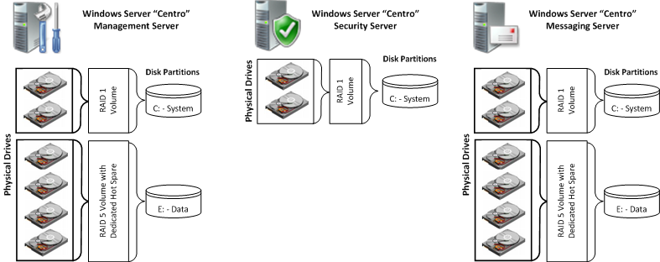
Storage
Installation with
Data Volume
Basic Installation

Slide 22
Digging Deeper
 | Data Item | Basic Installation | Data Volume Installation | Consider This:
Management Server | OS | C:\ on RAID 1 | C:\ on RAID 1 | C:\ on RAID 1
 | AD |  | E:\ on RAID 5 or Partition | E:\ Partition or separate RAID
 | SCE DB
 | WSUS Updates
 | File Shares & Home Folders |  |  | Separate RAID Host on NAS 4th Server
Messaging Server | OS | C:\ on RAID 1 | C:\ on RAID 1 | C:\ on RAID 1
 | AD |  | E:\ on RAID 5 or Partition | E:\ Partition or separate RAID
 | Exch Data |  |  | RAID 5
 | Exch Log |  |  | RAID 1

Slide 23
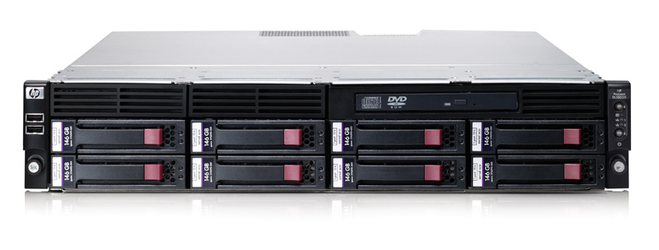
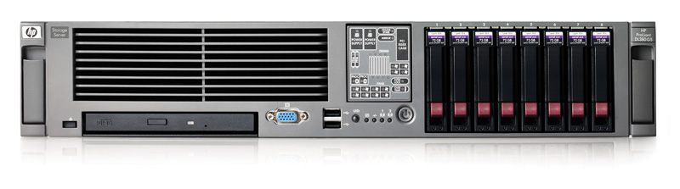

Rack Servers – Internal Storage
8 drive bays for Management & Messaging
HP ProLiant Rack Servers
2 Socket
Dual or Quad Core
Intel or AMD
Smart Array
Lights-Out Management
HP ProLiant DL180 / DL185
HP ProLiant DL380 / DL385

Slide 24
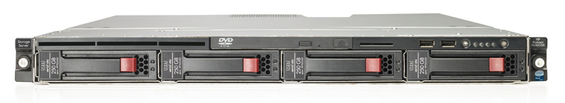
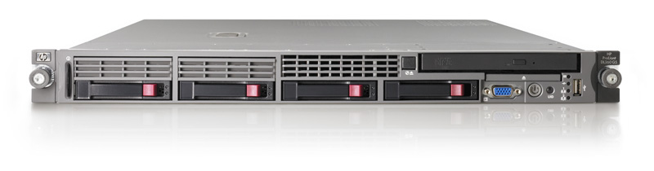
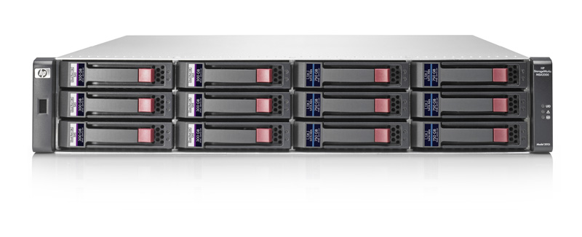
Rack Servers + SAN
HP ProLiant Rack Servers
2 Socket
Dual or Quad Core
Intel or AMD
Smart Array
Lights-Out Management
HP ProLiant DL160 / DL165
HP ProLiant DL360 / DL365
+
Management & Messaging Data + LOB/SQL, etc.
HP StorageWorks MSA2000i
iSCSI SAN

Slide 25
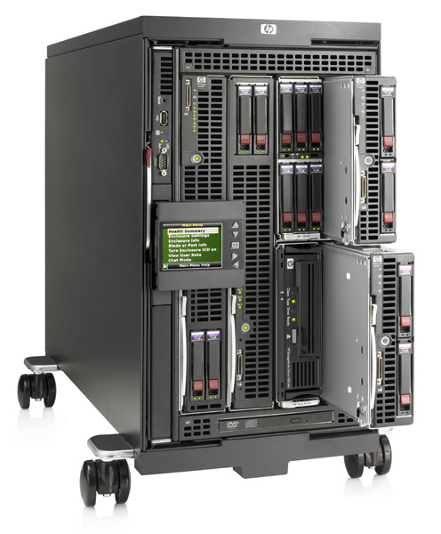
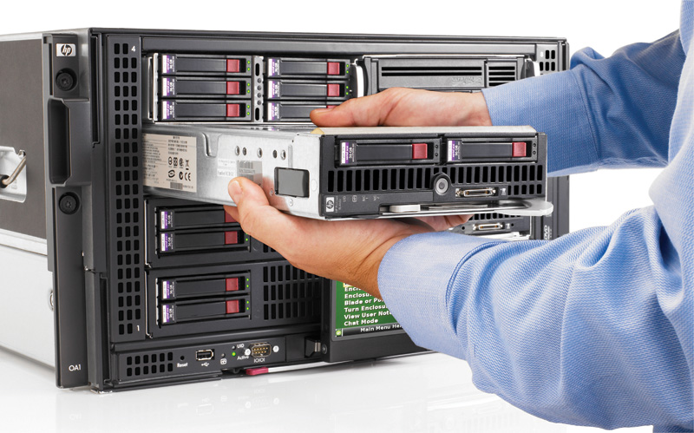
What about blades for EBS?
YES! Absolutely
HP BladeSystem c3000

Slide 26
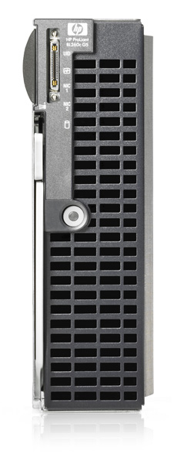
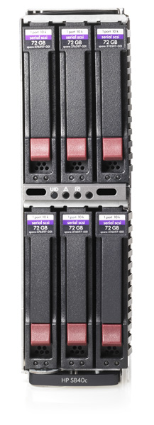
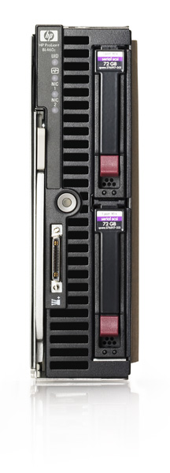
Blade Servers – Internal Storage
8 drive bays for Management & Messaging
HP ProLiant BL260c
+ SB40c Storage Blade
HP ProLiant Blade Servers
2 Socket
Dual or Quad Core
Intel or AMD
Smart Array (BL46x)
Lights-Out Management
HP ProLiant BL460c / BL465c
+ SB40c Storage Blade

Slide 27
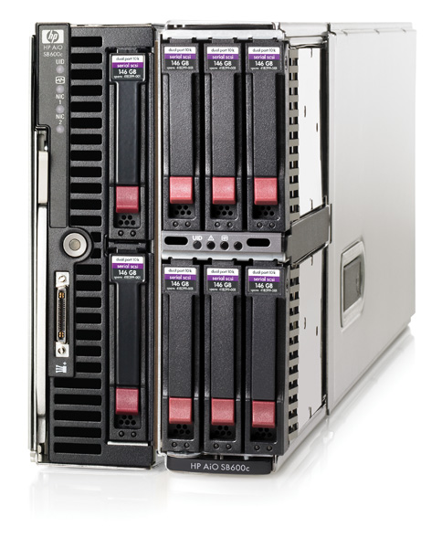
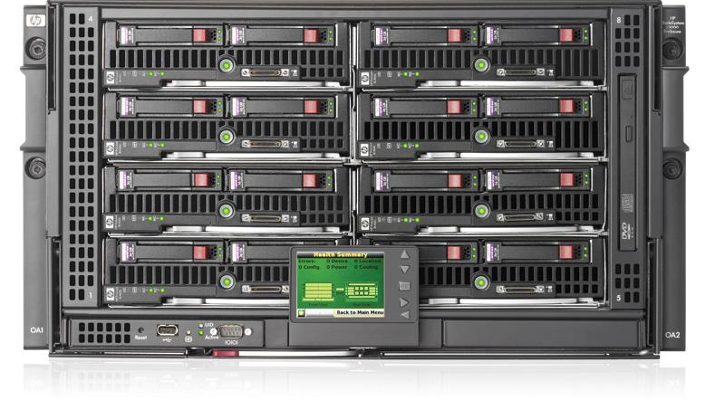
Blade Servers + NAS / SAN
Shared Storage
IN the Enclosure…. and OUT
HP BladeSystem c3000
+
MSA2000i iSCSI SAN
HP AiO SB600c
NAS + iSCSI SAN

Slide 28
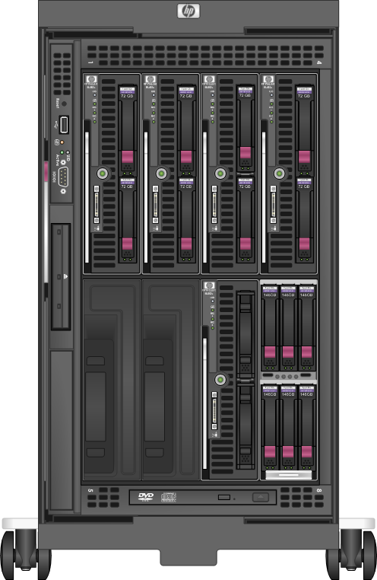
EBS on Blades
Security Server
Messaging Server
Management Server
4th Server
Future Expansion
iSCSI SAN
Shared Storage
Example c3000 configuration for
Windows Essential Business Server

Slide 29
Installation Approaches
Session Code: SRV324

Slide 30
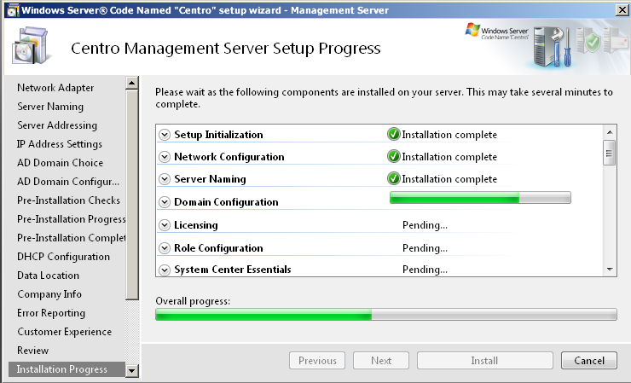
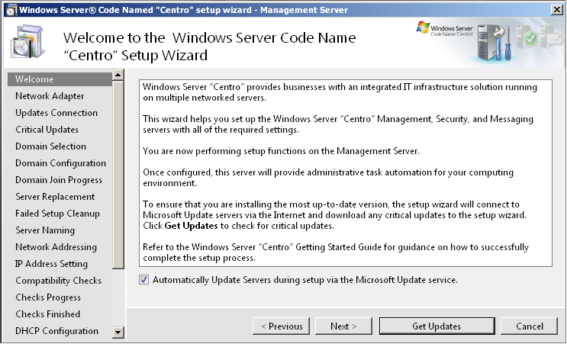
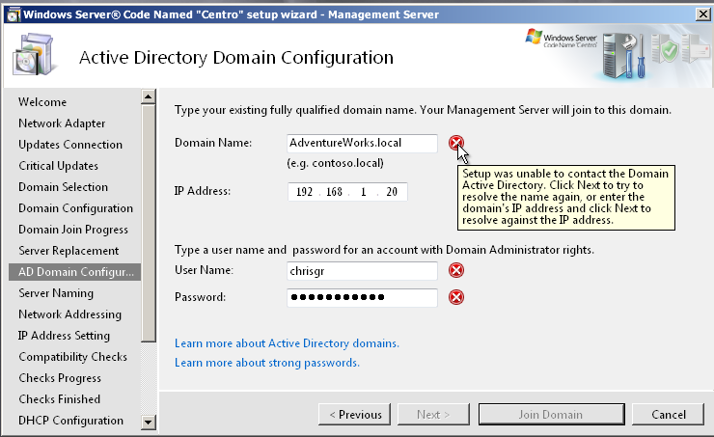
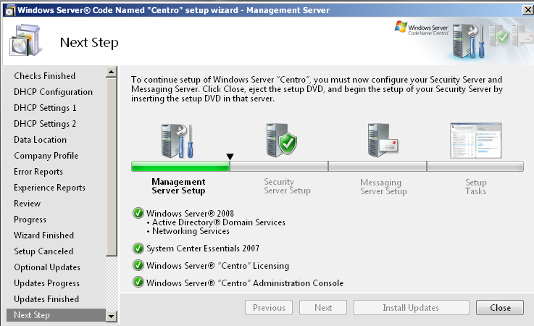
Streamlined Deployment
Reduce deployment and planning complexity and time
Intelligent checks on user’s inputs to reduce setup errors
  Planning worksheets
  Guidance
Role based configuration

Slide 31
Network install = Fast ☺
How?
  Share install folder from another computer
  Create WinPE with correct storage/nic drivers
  Boot WinPE – Connect to share – Run Setup
Pros:
  Simultaneous install for all servers
  Fast, really fast
Cons:
  Needs some Infrastructure
  May be somewhat advanced for some admins

Slide 32
Create the WinPE Image
Download WAIK
Download NIC and Storage drivers
Unpack and create folders and then...

Slide 33
Run this to create the bootimage
call copype.cmd amd64 C:\winpe
imagex /mountrw C:\winpe\winpe.wim 1 C:\winpe\mount
peimg /inf=C:\drivers\nic\amd64\*.inf C:\winpe\mount\windows
peimg /prep C:\winpe\mount\Windows /f
imagex /unmount /commit C:\winpe\mount
copy C:\winpe\winpe.wim C:\winpe\ISO\sources\boot.wim
oscdimg -n -bC:\winpe\etfsboot.com C:\winpe\ISO C:\winpe\winpe.iso
http://itbloggen.se/cs/blogs/micke/

Slide 34
Booting on a USB stick
Diskpart
Sel disk 2
Clean
Cre part pri
Active
Assign
Format fs=ntfs quick
Copy the content from the .ISO image to the USB stick

Slide 35
Migrating From an
Existing Environment
Session Code: SRV324

Slide 36
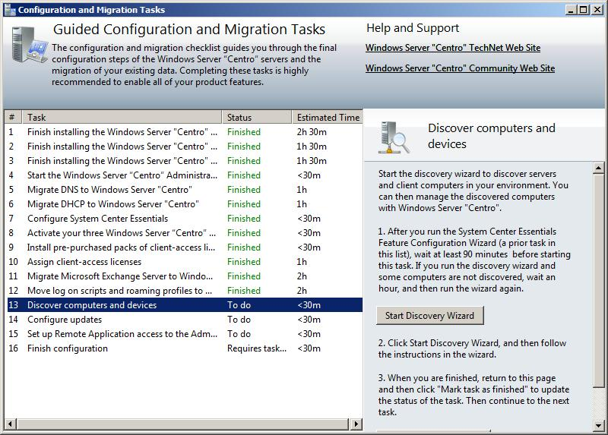
Migration
Simple checklist
  Follow best-practice methodology
  Detailed help with the complex tasks
Most common scenarios out-of-the-box
Utilise MS migration tools
Pre-requisite checker also in development
  Checks for locks & limit restrictions
  Recommends remediation work if required – AD, Exchange

Slide 37

Under the Hood
Setup And Configuration
The best mix of uniform and flexible
  Best practices enforced
  Uniformity for VAP and CSS supportability
  Flexibility for mid sized company environments
Uniform areas
  Workloads and versions installed
  Workload location and basic configuration
Flexibility Supported
  Multiple Subnets
  Branch offices
  Additional legacy firewall and DMZ
  Drive data flexibility
Prepare your environment
Install Management, Edge, and Messaging
Plan your network deployment
Configuration and Migration

Slide 38
Working as the Admin of Essential Business Server
Session Code: SRV324

Slide 39
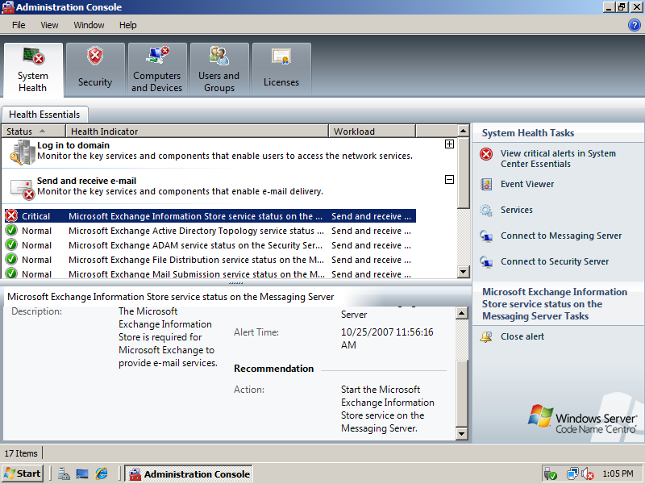
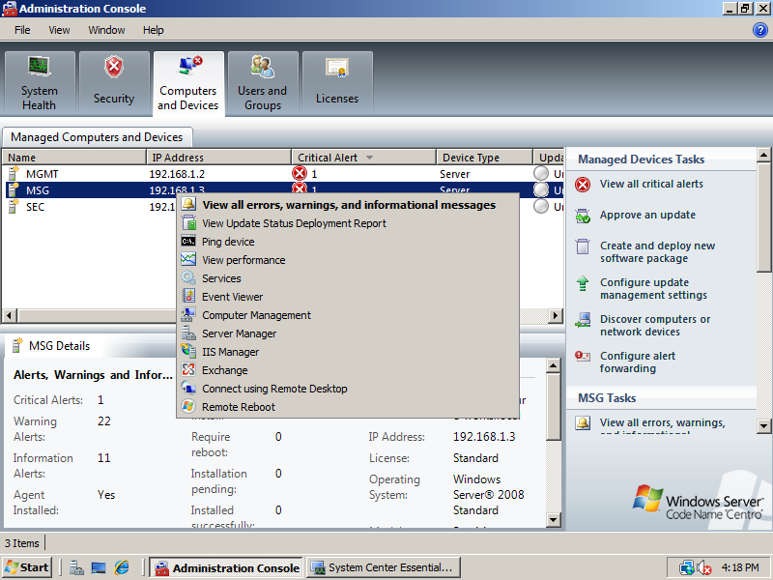
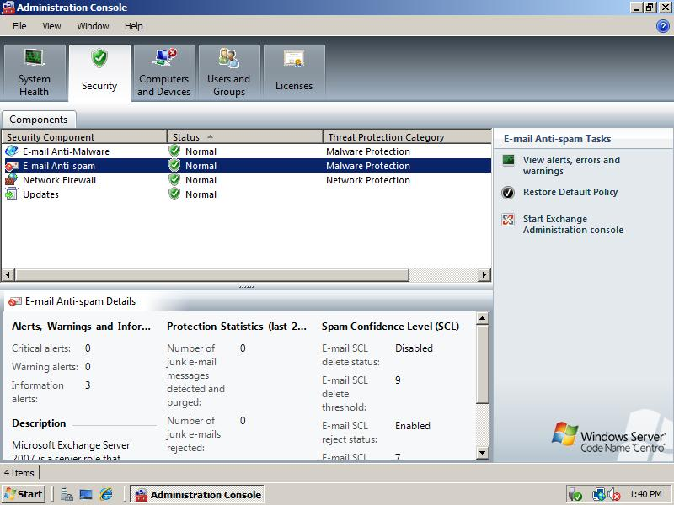
The Administrator's View

Slide 40
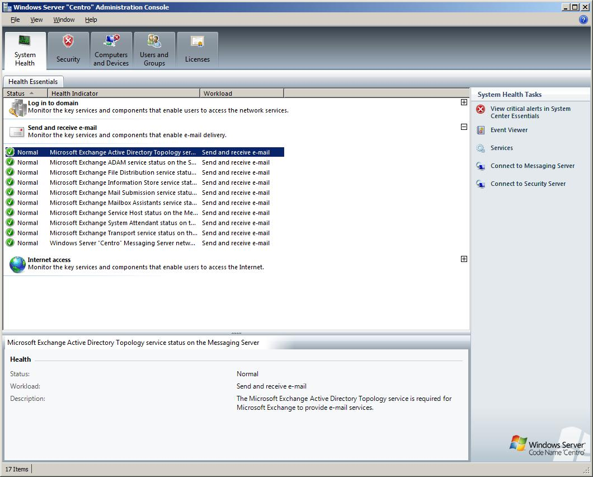
Environment Health
View health across your entire network
Focus on business services
  Sending & receiving email
  Log on to network resources
  Internet access
One console across all 3 servers
Resolve issues quickly by connecting to the right console
Built from SCE speeds and feeds

Slide 41
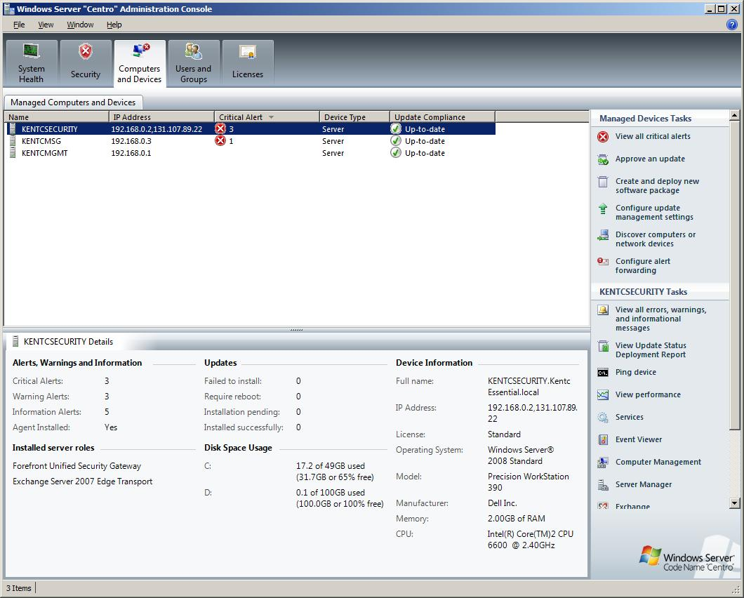
Computer and Device Management
Single view of all computers and devices on the network
Easily patch, manage and deploy software
  Patches console integrated
  Full access to SCE patching
Focus on day-to-day support
  Most midsized organisations spend a large amount of time here
Manage Windows Server, clients and printers

Slide 42
Security & Access
One of the broadest out of box security suites available
Integrated security best practices
All-up Security Dashboard – Integrating 3rd party via extensibility
Remote Access
  Remote Web Workplace
  Terminal Services Gateway

Slide 43
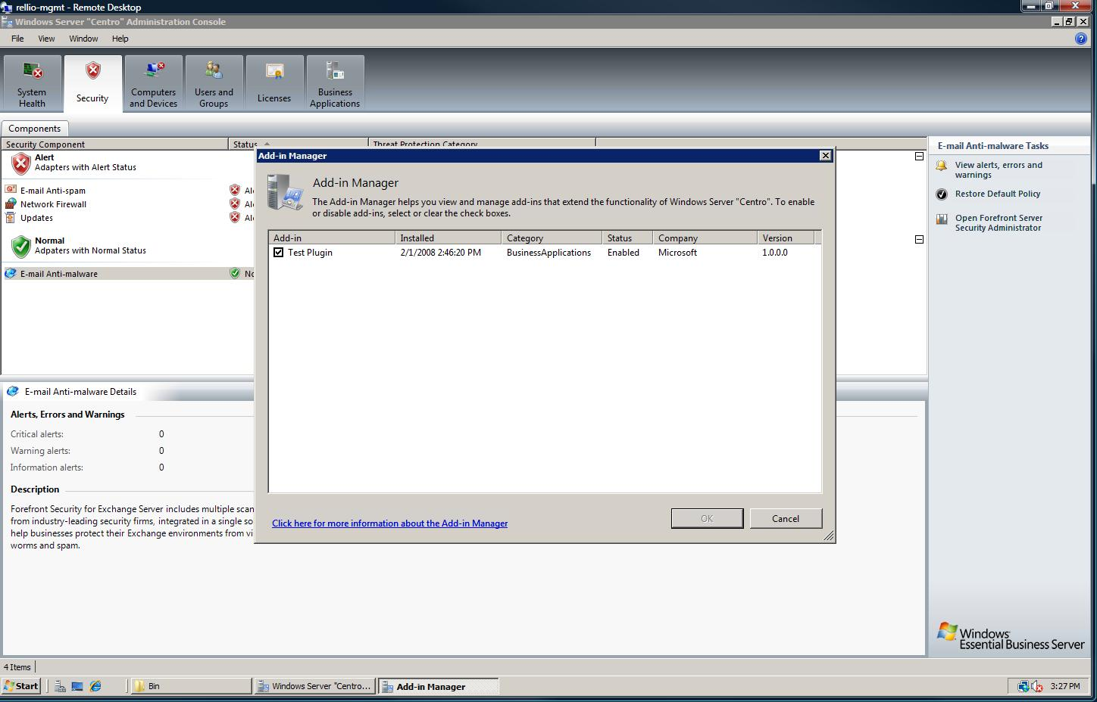
Extensible Console
Common user experience across all workloads
  Visually integrate Microsoft & 3rd party applications
Add-in manager for
admin control
  See all add-ins in one location
  Remove add-ins
  Safe mode to isolate any add on issues
Picture of add on manager and selecting add ons to load
SharePoint 1/20/08 System App Enable Microsoft 1.0.0
Dynamics CRM 1/20/08 System App Enable Microsoft 1.0.0

Slide 44
Demo
The Admin Console…

Slide 45
Questions from the Field
Session Code: SRV324

Slide 46
Questions that we have been asking ourselves…
Virtualisation
Backup/Restore
The “Recovery Feature”
Working Remotely

Slide 47
Virtualisation & Performance
Virtualisation is supported (Hyper-V whitepaper)
Why Virtualise?
  Backup & disaster recovery
  Hardware independence
  Light load
  ISP/ASP, Hosted scenarios
EBS Utilisation is already optimised
  15 workloads on 3 boxes
  Performance balanced
  Security considered

Slide 48
Backup and Restore –
Native
Built in version from W2K8
  No tape support, only disk backup
  No support for Exchange 2007
Built in Exchange 2007
  Local Continuous replication support (LCR)
    Not really a backup…

Slide 49
Backup & Restore –
Proven Solutions
Tape backup
  Tape device in one server
  Needs software (HP Data Protector, Backup Exec, etc.)
Data Protection Manager
  Protects data by backing up to disk trough snapshots over the network, requires a “little” bit more infrastructure (and patience)
Tape “Virtual Library”
  Emulates tape drive or tape library
  D2D or D2D2T

Slide 50
The Recovery Feature
Configuration of each server is kept in AD
If one server breaks, you can re-install that server in “recovery mode”
That means:
  Only default settings
  Same configuration as the first install

Slide 51
Demo
Recovery Data in Active Directory

Slide 52
Working Remotely
Remote Web Workplace
Outlook Web Access
VPN
Terminal Services Gateway

Slide 53
Demo
Remote Web Workplace

Slide 54
Security
Session Code: SRV324

Slide 55
Microsoft Forefront Threat Management Gateway
FKA Internet Security and Acceleration Server (ISA)
Feature set of ISA 2006 plus
  Native 64-bit
  Web-based anti-virus, anti-malware
  Enhanced UI, management, reporting
Notes:
© 2007 Microsoft Corporation. All rights reserved. Microsoft, Windows, Windows Vista and other product names are or may be registered trademarks and/or trademarks in the U.S. and/or other countries.
The information herein is for informational purposes only and represents the current view of Microsoft Corporation as of the date of this presentation. Because Microsoft must respond to changing market conditions, it should not be interpreted to be a commitment on the part of Microsoft, and Microsoft cannot guarantee the accuracy of any information provided after the date of this presentation.
MICROSOFT MAKES NO WARRANTIES, EXPRESS, IMPLIED OR STATUTORY, AS TO THE INFORMATION IN THIS PRESENTATION.

Slide 56
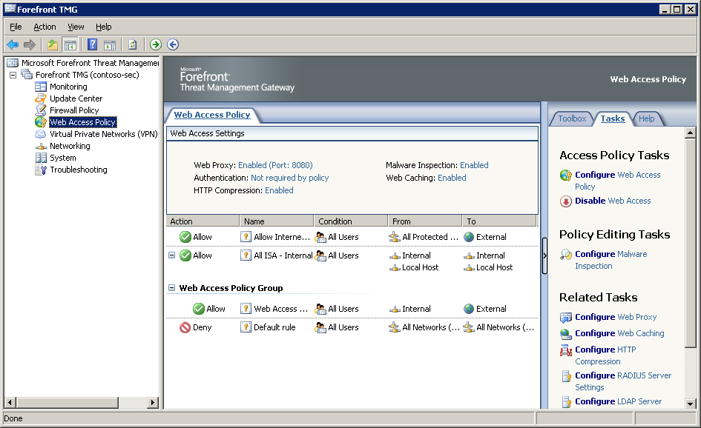
Web Access Policy
Notes:
© 2007 Microsoft Corporation. All rights reserved. Microsoft, Windows, Windows Vista and other product names are or may be registered trademarks and/or trademarks in the U.S. and/or other countries.
The information herein is for informational purposes only and represents the current view of Microsoft Corporation as of the date of this presentation. Because Microsoft must respond to changing market conditions, it should not be interpreted to be a commitment on the part of Microsoft, and Microsoft cannot guarantee the accuracy of any information provided after the date of this presentation.
MICROSOFT MAKES NO WARRANTIES, EXPRESS, IMPLIED OR STATUTORY, AS TO THE INFORMATION IN THIS PRESENTATION.

Slide 57
Web Access Policy
Port 8080
Malware inspection on by default
Ability to restrict sites
Web caching enabled by default
Authentication not enabled by default – allows non-Windows clients access
Notes:
© 2007 Microsoft Corporation. All rights reserved. Microsoft, Windows, Windows Vista and other product names are or may be registered trademarks and/or trademarks in the U.S. and/or other countries.
The information herein is for informational purposes only and represents the current view of Microsoft Corporation as of the date of this presentation. Because Microsoft must respond to changing market conditions, it should not be interpreted to be a commitment on the part of Microsoft, and Microsoft cannot guarantee the accuracy of any information provided after the date of this presentation.
MICROSOFT MAKES NO WARRANTIES, EXPRESS, IMPLIED OR STATUTORY, AS TO THE INFORMATION IN THIS PRESENTATION.

Slide 58
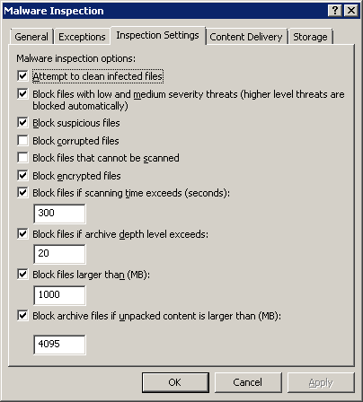
TMG MBE AV/Anti-Malware
Notes:
© 2007 Microsoft Corporation. All rights reserved. Microsoft, Windows, Windows Vista and other product names are or may be registered trademarks and/or trademarks in the U.S. and/or other countries.
The information herein is for informational purposes only and represents the current view of Microsoft Corporation as of the date of this presentation. Because Microsoft must respond to changing market conditions, it should not be interpreted to be a commitment on the part of Microsoft, and Microsoft cannot guarantee the accuracy of any information provided after the date of this presentation.
MICROSOFT MAKES NO WARRANTIES, EXPRESS, IMPLIED OR STATUTORY, AS TO THE INFORMATION IN THIS PRESENTATION.

Slide 59
Demo
TMG AV/Anti Malware

Slide 60
Messaging
Session Code: SRV324

Slide 61
Messaging
Seamless integration
Exchange 2007 SP1
  Security Server – Exchange Edge
  Messaging Server –
  Mailbox, Client Access, Hub roles
  Messaging Server –
  Forefront Security for Exchange Server
Common features published by default
Notes:
© 2007 Microsoft Corporation. All rights reserved. Microsoft, Windows, Windows Vista and other product names are or may be registered trademarks and/or trademarks in the U.S. and/or other countries.
The information herein is for informational purposes only and represents the current view of Microsoft Corporation as of the date of this presentation. Because Microsoft must respond to changing market conditions, it should not be interpreted to be a commitment on the part of Microsoft, and Microsoft cannot guarantee the accuracy of any information provided after the date of this presentation.
MICROSOFT MAKES NO WARRANTIES, EXPRESS, IMPLIED OR STATUTORY, AS TO THE INFORMATION IN THIS PRESENTATION.

Slide 62
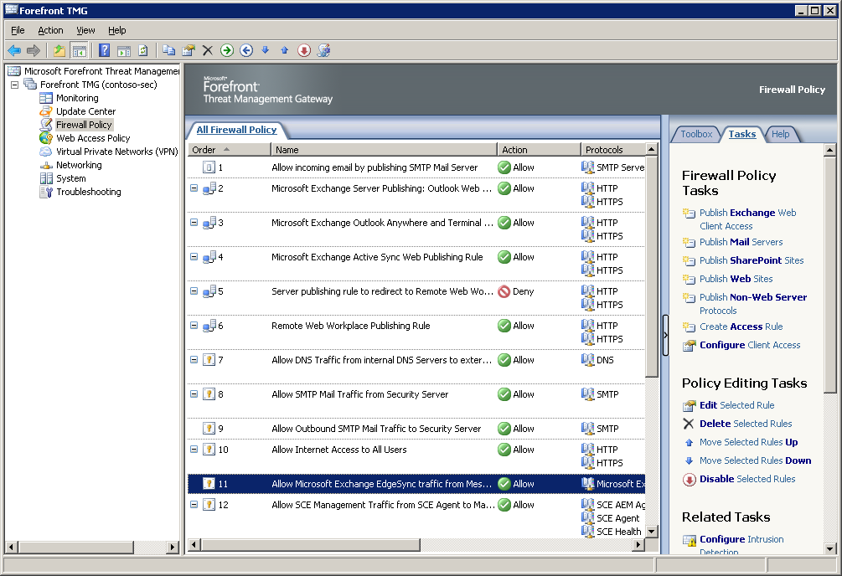
Firewall Policy
Notes:
© 2007 Microsoft Corporation. All rights reserved. Microsoft, Windows, Windows Vista and other product names are or may be registered trademarks and/or trademarks in the U.S. and/or other countries.
The information herein is for informational purposes only and represents the current view of Microsoft Corporation as of the date of this presentation. Because Microsoft must respond to changing market conditions, it should not be interpreted to be a commitment on the part of Microsoft, and Microsoft cannot guarantee the accuracy of any information provided after the date of this presentation.
MICROSOFT MAKES NO WARRANTIES, EXPRESS, IMPLIED OR STATUTORY, AS TO THE INFORMATION IN THIS PRESENTATION.

Slide 63
Demo
Firewall Policies

Slide 64
Summary
The Wizards
Storage & Network Planning
BladeSystem + EBS
Admin Console
Virtualisation and EBS Consolidation
Security and Messaging

Slide 65
Q & A

Slide 66
Notes
In addition to the Walk-in and Title slides, the following slides are required
Please add your content and include these in your final presentation
NEXT: <next slide title>

Slide 67




Resources
www.microsoft.com/teched
  Tech·Talks Tech·Ed Bloggers
  Live Simulcasts Virtual Labs
http://microsoft.com/technet
  Evaluation licenses, pre-released products, and MORE!
http://microsoft.com/msdn
  Developer’s Kit, Licenses,
  and MORE!

Slide 68
Related Content
SVR323 Introduction to Small Business Server 2008 03/09/2008 3:45PM-5:00PM

Slide 69
Track Resources
  EBS 2008 OEM Partner Portal:
  http://oem.microsoft.com/EBS08
  EBS 2008 on Partner Portal: https://partner.microsoft.com/multiplyyourpower
  EBS 2008 on Microsoft.com: http://www.mutliplyyourpower.com/
  Official EBS Blog: http://blogs.technet.com/essentialbusinessserver
  Migrating SBS2003 to EBS2008
  http://technet.microsoft.com/en-us/library/cc540100.aspx

Slide 70
Please complete an
evaluation

Slide 71

© 2008 Microsoft Corporation. All rights reserved. Microsoft, Windows, Windows Vista and other product names are or may be registered trademarks and/or trademarks in the U.S. and/or other countries.
The information herein is for informational purposes only and represents the current view of Microsoft Corporation as of the date of this presentation. Because Microsoft must respond to changing market conditions, it should not be interpreted to be a commitment on the part of Microsoft, and Microsoft cannot guarantee the accuracy of any information provided after the date of this presentation. MICROSOFT MAKES NO WARRANTIES, EXPRESS, IMPLIED OR STATUTORY, AS TO THE INFORMATION IN THIS PRESENTATION.

