Slide 2
Innovating High Availability with Cluster Shared Volumes
Steven Ekren
Senior Program Manager
Microsoft
Session Code: WSV313

Slide 3

Agenda
Overview of Hyper-V Live Migration
Challenges Hyper-V faces with today’s cluster model
How CSV delivers on these challenges
Additional resiliency CSV provides
Configuring Cluster Shared Volumes
Cluster Shared Volumes Demo

Slide 4
Hyper-V with Failover Clustering
Failover Clustering is the foundation that enables Hyper-V to accomplish:
  High Availability
  Disaster Recovery
  Quick Migration
  Live Migration

Slide 5
Agenda
Overview of Hyper-V Live Migration
Challenges Hyper-V faces with today’s cluster model
How CSV delivers on these challenges
Additional resiliency CSV provides
Configuring Cluster Shared Volumes
Cluster Shared Volumes Demo

Slide 6
Hyper-V Live Migration
announcing

Slide 7
What is Live Migration
Move a running Virtual Machine from one computer to another computer with no perceived downtime for the VM
  VM is not aware of the migration
  Maintain TCP connections of the guest OS
  Building block for Dynamic Data Center through business agility, cost reduction and increase in productivity
How is it different from Quick Migration?
  VM is saved and restored on destination
  Results in downtime for applications/workloads running inside VMs
Both leverage same storage infrastructure – easy to move from QM to LM

Slide 8


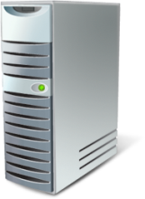




Live Migration
Initiate migration
Client accessing VM
Live Migrate this VM to another physical machine
SAN
IT Admin initiates a Live Migration to move a VM from one host to another
VHD

Slide 9
Live Migration
Memory copy: Full copy
Memory content is copied to new server
VM pre-staged
SAN
The first initial copy is of all in memory content
VHD

Slide 10
Live Migration
Memory copy: Dirty pages
Client continues accessing VM
Pages are being dirtied
SAN
Client continues to access VM, which results in memory being modified
VHD

Slide 11

Live Migration
Memory copy: Incremental copy
Recopy of changes
Smaller set of changes
SAN
Hyper-V tracks changed data, and re-copies over incremental changes
Subsequent passes get faster as data set is smaller
VHD

Slide 12
Live Migration
Final transition
Partition State copied
VM Paused
SAN
Window is very small and within TCP connection timeout
VHD

Slide 13
Live Migration
Post-Transition: Clean-up
Client directed
to new host
Old VM deleted once migration is verified successful
SAN
ARP issued to have routing devices update their tables
Since session state is maintained, no reconnections necessary
VHD

Slide 14
Agenda
Overview of Hyper-V Live Migration
Challenges Hyper-V faces with today’s cluster model
How CSV delivers on these challenges
Additional resiliency CSV provides
Configuring Cluster Shared Volumes
Cluster Shared Volumes Demo

Slide 15
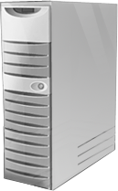



Failover Clustering Today
Failover Clustering has implemented a “shared nothing” storage model for the last decade
Each Disk is owned by a single node at any one time, and only that node can perform I/O to it
Only one node accesses a LUN at a time
SAN
Shared Storage

Slide 16

SAN Management Complexity
Flexibility
LUN is the smallest unit of failover
Scalability
Complexity with drive letters
Capacity
Poor SAN space utilization
Manageability
MPIO and Masking of large numbers of LUN’s

Slide 17
Agenda
Overview of Hyper-V Live Migration
Challenges Hyper-V faces with today’s cluster model
How CSV delivers on these challenges
Additional resiliency CSV provides
Configuring Cluster Shared Volumes
Cluster Shared Volumes Demo

Slide 18
Cluster Shared Volumes
announcing

Slide 19
Delivering Innovation
Cluster Shared Volumes (CSV)
Enabling multiple nodes to concurrently access a single ‘truly’ shared volume
Provides VM’s complete transparency with respect to which nodes actually own a LUN
Guest VMs can be moved without requiring any drive ownership changes
  No dismounting and remounting of volumes is required

Slide 20

Cluster Shared Volume Overview
Concurrent access to a single file system
SAN
Single Volume
Disk5
VHD
VHD
VHD

Slide 21
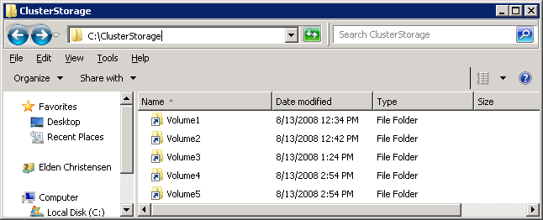
Single Name Space
CSV provides a single consistent file name space
  Files have the same name and path when viewed from any node in the cluster
  CSV volumes are exposed as directories and subdirectories under the “ClusterStorage” root directory
    C:\ClusterStorage\Volume1\<root>
    C:\ClusterStorage\Volume2\<root>
    C:\ClusterStorage\Volume3\<root>

Slide 22
Optimized Capacity Planning
In the past (2008) - 1 LUN for 1 VM
LUN smallest unit of failover
Run out of storage space
Wasted storage space
Storage management challenging
Free Space
Used VHD Space
VHD
Wasted Space
Out of Space
VHD
VHD
VHD
VHD
VHD
VHD
VHD
VHD
VHD
VHD
VHD
VHD
VHD
Many LUNs to Manage

Slide 23
Optimized Capacity Planning
The Solution (R2): 1 LUN for many VMs
VM smallest unit of failover
VMs share the pool of unused space
Flexible utilization and easy
management
Free Space
Used VHD Space
VHD
VHD
VHD
VHD
Free Space
VHD
VHD
VHD
VHD
VHD
VHD
VHD

Slide 24
Compatibility
No special hardware requirements
No file type restrictions
No directory structure or depth limitations
No special agents or additional installations
  Integration Components not required
No proprietary file system
  Uses well established traditional NTFS
It just works!

Slide 25
Agenda
Overview of Hyper-V Live Migration
Challenges Hyper-V faces with today’s cluster model
How CSV delivers on these challenges
Additional resiliency CSV provides
Configuring Cluster Shared Volumes
Cluster Shared Volumes Demo

Slide 26

Increasing Availability
CSV also delivers far more customer value in making Clusters more resilient to a wide variety of failure conditions
  Value prop beyond just solving the storage management challenges
99.9%
99.99%
99%
99.999%

Slide 27
Dynamic I/O Redirection
CSV implements a mechanism where I/O can be rerouted based on connection availability
Remote Node
Let’s route to the optimal available path
I/O dynamically redirected based on path availability
Local Node

Slide 28


I/O Connectivity Fault Tolerance
I/O Redirected via network
VM running on Node 2 is unaffected
Coordination Node
SAN
SAN Connectivity Failure
VMs can then be Live Migrated to another node with zero downtime
VHD

Slide 29

Node Fault Tolerance
Coordination Node Failure
VM running on Node 2 is unaffected
Brief queuing of I/O while volume ownership is changed
SAN
Volume relocates to a healthy node
VHD

Slide 30
Network Fault Tolerance
Rerouted to redundant network
VM running on Node 2 is unaffected
Coordination Node
Network Path Connectivity Failure
SAN
Fault-Tolerant TCP connections make a path failure seamless
VHD

Slide 31
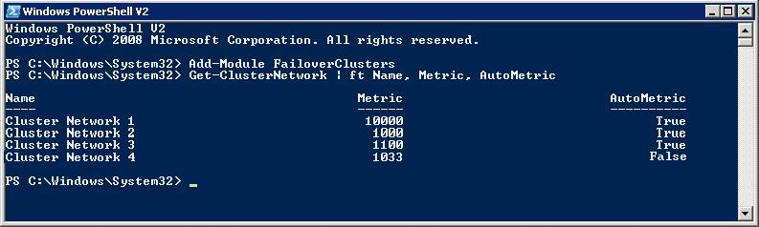
Network Prioritization
Plan your internal cluster networks for CSV use
Select the best network for your needs
Give networks a “cost” (Metric)
  Lower value, higher priority (private)
  Higher value, lower priority (public)

Slide 32
Agenda
Overview of Hyper-V Live Migration
Challenges Hyper-V faces with today’s cluster model
How CSV delivers on these challenges
Additional resiliency CSV provides
Configuring Cluster Shared Volumes
Cluster Shared Volumes Demo

Slide 33
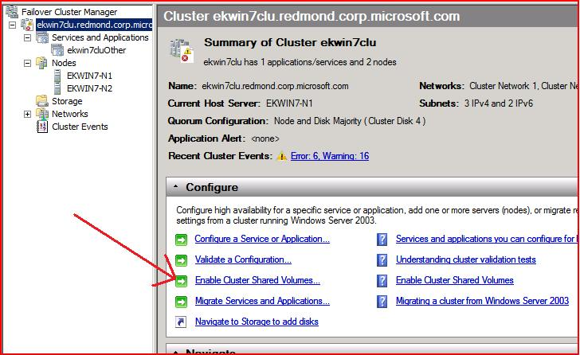
Enabling Cluster Shared Volumes
CSV is optimized for VHD access
  Only supported with Hyper-V
  Will be disabled by default on clean cluster install

Slide 34
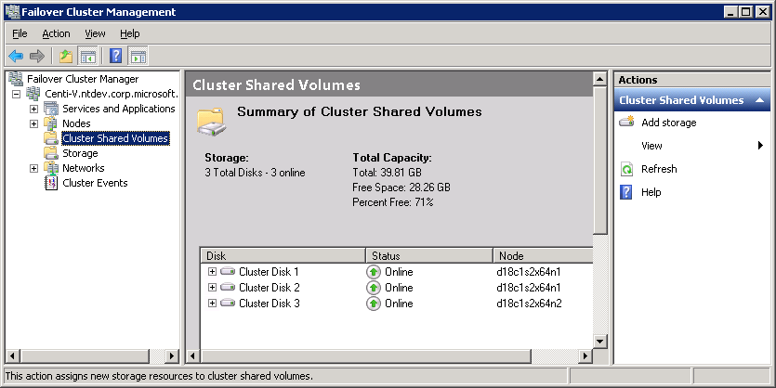
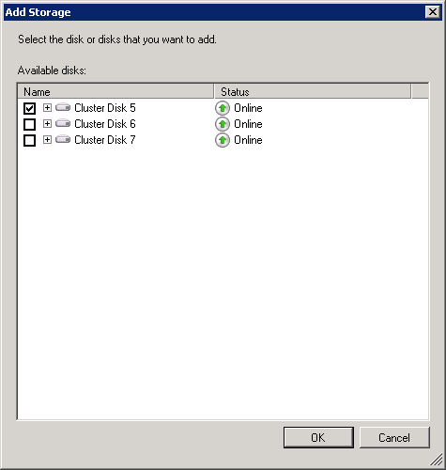
Setting up a Disk to be Shared
Select the Disk
It’s that easy!

Slide 35
Using Cluster Shared Volumes
Setup a cluster like you normally would
Enable CSV feature Within CluAdmin.msc click on “Cluster Shared Storage” and click “Add storage”
Create a VM and VHD under the C:\ClusterStorage directory structure

Slide 36
Cluster Shared Volumes in action!
demo
Notes:
If you would like to host your demo on the Virtual Server, please use the myVPC demo slide, not this slide.

Slide 37
Summary
Removes all barriers to Live Migration times
Seamlessly integrated with well established Failover Cluster technology that customers are familiar with today
Improved storage management
  Simplification and consolidation of storage with fewer LUNs
Compatibility
Scalability
Reliability
  No new hardware requirements
  No new application requirements
  Completely transparent
  Scales to large clusters, large numbers of LUN’s, and no restrictions beyond base OS
  High Performance I/O access
  Node Failures are transparent for all Guests that are not hosted on failed node
  Increased resiliency and high availability

Slide 38
question & answer

Slide 39




Resources
www.microsoft.com/teched
  Sessions On-Demand & Community
www.microsoft.com/learning
Microsoft Certification & Training Resources
http://microsoft.com/technet
  Resources for IT Professionals
http://microsoft.com/msdn
  Resources for Developers
www.microsoft.com/learning
Microsoft Certification and Training Resources

Slide 40
Related Content
WSV310 Failover Clustering Feature Roadmap for Windows Server 2008 R2
WSV313 Innovating High Availability with Cluster Shared Volumes (CSV)
WSV316 Multi-Site Clustering with Windows Server 2008 Enterprise
VIR311 From Zero to Live Migration. How to Set Up a Live Migration
DAT302 All You Need to Know about Microsoft SQL Server 2008 Failover Clusters
DAT306 Building a HA Strategy for Your Enterprise Using Microsoft SQL Server 2008
DAT322 Tips and Tricks for Successful Database Mirroring Deployments with Microsoft SQL Server
WSV311 High Availability and Disaster Recovery Considerations for Hyper-V
WSV315 Implementing Hyper-V on Clusters (High Availability)
UNC313 High Availability in Microsoft Exchange Server "14"
UNC402 Microsoft Exchange Server 2007 HA and Disaster Recovery Deep Dive
BOF52 Microsoft Exchange Server 2007 HA and Disaster Recovery: Are You Prepared?
WSV01-INT Failover Clustering Unleashed with Windows Server 2008 R2
UNC02-INT Designing Microsoft Exchange Server "14" High Availability Solutions
WSV16-HOL Windows Server 2008 R2: Failover Clustering
VIR03-HOL Implementing Windows Server 2008 Hyper-V HA and Quick Migration
DAT12-HOL Microsoft SQL Server 2008 Database Mirroring, Part 1
DAT13-HOL Microsoft SQL Server 2008 Database Mirroring, Part 2
UNC12-HOL Microsoft Exchange Server "14" High Availability and Storage Scenarios

Slide 41

Windows Server Resources
Make sure you pick up your copy of Windows Server 2008 R2 RC from the Materials Distribution Counter
Learn More about Windows Server 2008 R2:
www.microsoft.com/WindowsServer2008R2
Technical Learning Center (Orange Section):
Highlighting Windows Server 2008 and R2 technologies
Over 15 booths and experts from Microsoft and our partners

Slide 42
Track Resources
    Cluster Team Blog: http://blogs.msdn.com/clustering/
Cluster Information Portal:
http://www.microsoft.com/windowsserver2008/en/us/clustering-home.aspx
Clustering Technical Resources:
http://www.microsoft.com/windowsserver2008/en/us/clustering-resources.aspx
Clustering Forum (2008):
http://forums.technet.microsoft.com/en-US/winserverClustering/threads/
    Clustering Forum (2008 R2): http://social.technet.microsoft.com/Forums/en-US/windowsserver2008r2highavailability/threads/
    Clustering Newsgroup: http://www.microsoft.com/communities/newsgroups/list/en-us/default.aspx?dg=microsoft.public.windows.server.clustering
Failover Clustering Deployment Guide: http://technet.microsoft.com/en-us/library/dd197477.aspx
TechNet: Configure a Service or Application for High Availability:
http://technet.microsoft.com/en-us/library/cc732478.aspx
TechNet: Installing a Failover Cluster: http://technet.microsoft.com/en-us/library/cc772178.aspx
TechNet: Creating a Failover Cluster: http://technet.microsoft.com/en-us/library/cc755009.aspx
Webcast (2008 R2): Introduction to Failover Clustering: http://msevents.microsoft.com/CUI/EventDetail.aspx?EventID=1032407190&Culture=en-US
Webcast (2008 R2): HA Basics with Hyper-V: http://msevents.microsoft.com/CUI/EventDetail.aspx?EventID=1032407222&Culture=en-US
Webcast (2008 R2): Cluster Shared Volumes (CSV):
  http://msevents.microsoft.com/CUI/EventDetail.aspx?EventID=1032407238&Culture=en-US

Slide 43
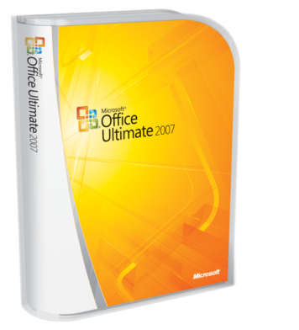




Complete an evaluation on CommNet and enter to win!

Slide 44

© 2009 Microsoft Corporation. All rights reserved. Microsoft, Windows, Windows Vista and other product names are or may be registered trademarks and/or trademarks in the U.S. and/or other countries.
The information herein is for informational purposes only and represents the current view of Microsoft Corporation as of the date of this presentation. Because Microsoft must respond to changing market conditions, it should not be interpreted to be a commitment on the part of Microsoft, and Microsoft cannot guarantee the accuracy of any information provided after the date of this presentation. MICROSOFT MAKES NO WARRANTIES, EXPRESS, IMPLIED OR STATUTORY, AS TO THE INFORMATION IN THIS PRESENTATION.

