Slide 2
WSV: 328 Windows Server 2008 R2 Hyper-V
Corey Hynes
HynesITe
Jeff Woolsey
Principal Group Program Manager
Windows Server, Hyper-V

Slide 3
Agenda
Microsoft Virtualization Strategy/Portfolio
Overview of Windows Server 2008 R2 Hyper-V
Features, features, features!
System Center Virtual Machine Manager R2
Microsoft Hyper-V Server 2008 R2
Q & A

Slide 4

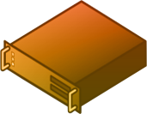
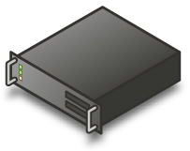
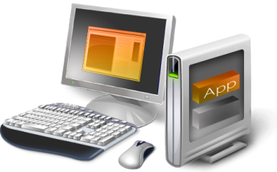
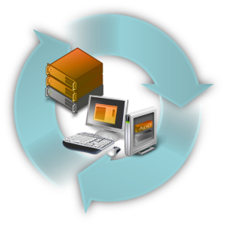
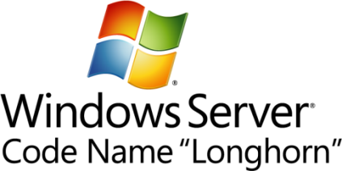




Microsoft Virtualization Strategy
It’s the Platform you know
Data center to desktop
End-to-End Management
Best TCO/ROI
Key feature
of platform
Full range of products & solutions
Physical and Virtual & Cross-hypervisor
1/3 the price
up front
Tools
you know
Large partner
eco-system
Interoperability
Lower ongoing costs

Slide 5

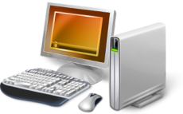
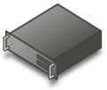
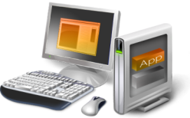


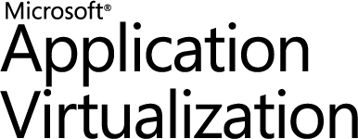

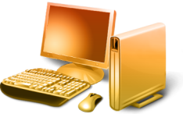


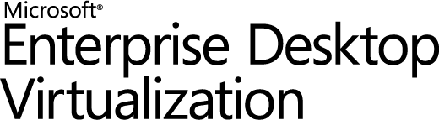
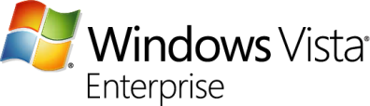
Microsoft Virtualization Products
From the Datacenter to the Desktop
Server
Virtualization
Application
Virtualization
Presentation
Virtualization
“Having one vendor for the hypervisor, operating system, and much of our application software was very appealing to us from a support and cost perspective.”
Bert Van Pottelberghe,
Sales Director, Hostbasket
Desktop
Virtualization
User State
Virtualization
Document Redirection and Offline Files
Notes:
Key points
Everyone thinks about server virt when they think about virt – we have history here w/ Virtual Server, and a big strength w/ Hyper-V
But, there’s more to virt than server virt…
As virtualization becomes more pervasive, management is much more critical to enable dynamic scenarios – System Center can sit at the heart of all of this
“When we think about virtualization, most of the hype in the industry today is focused on machine virtualization or server virtualization, and certainly server virtualization is a critical enabling technology where I'm able to encapsulate an operating system and application and my data all together.
Microsoft's solution there is that we have a solution, Virtual Server, in market, and now with Windows Server 2008, a key feature of Windows Server 2008 is Hyper-V, our hypervisor-based virtualization solution. That is in the process of coming to market and will be released to market within the next three to four weeks or so; which is great but that's just one kind of virtualization. Depending on the problem that you're trying to solve, there are a number of different virtualization technologies that are important to take advantage of.
So Application Virtualization: On clients the ability to do application isolation and to stream application on-demand is critical; if we think about the adaptive application delivery, which I'll talk to in a minute, and we have the leading virtualization capability here with Microsoft Application Virtualization.
Desktop virtualization: Virtual PC has been in market for awhile, and then we announced an acquisition of a company called Kidaro to really enable enterprise-class desktop virtualization solutions and scenarios.
Then presentation virtualization, which you may know of as Terminal Services, but the ability to centrally manage and host an application and the data, and just serve out the interaction with that, so present it up to a user remotely.
All of these different pieces can play a role in the solution that you're trying to solve for, but what's critical is at the heart of this is management. In a virtualized world, management becomes much, much more critical in enabling some of these dynamic scenarios that we talk about. So, take a broad view and think about desktop to datacenter.”

Slide 6
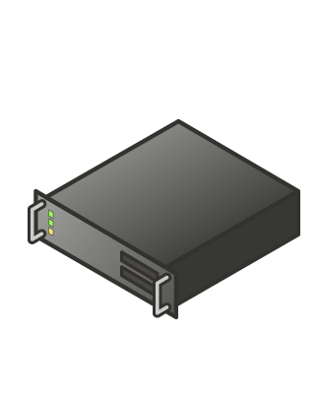
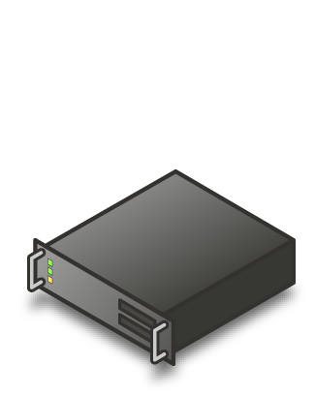
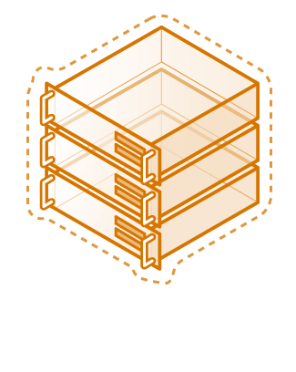
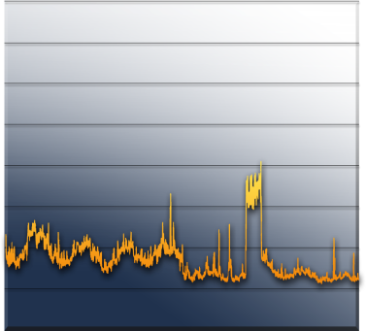
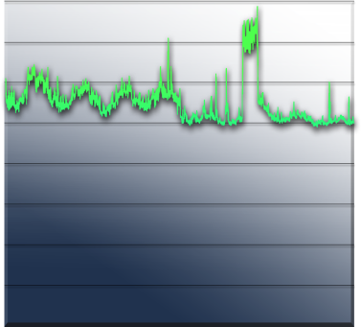
Server Consolidation
The Fastest Way to Reduce Costs
Challenges:
Underutilized hardware
Excessive power consumption
Expensive space across datacenter and branch offices
“We expect to consolidate an additional 75 servers using Hyper-V, which will lead to a cost savings of more than $325,000 annually. By the time we hit our fifth virtual machine, we’ve usually paid for the host.
Long term, we will be able to reduce our total data center holdings by 75 percent—from nearly 400 servers to fewer than 100 servers.”
Robert McShinsky Senior Systems Administrator, Dartmouth-Hitchcock Medical Center
Server Utilization

Slide 7
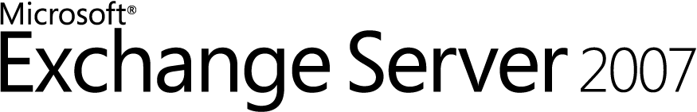

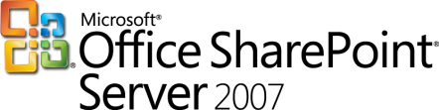

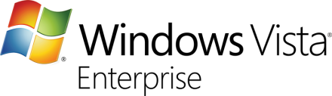

Virtualized Workloads
Microsoft fully supports our key server applications in a virtualized environment
Microsoft has updated server workload licensing to enable virtualization mobility
Management of the workloads is key, not just the virtual machine
“Maxol runs Exchange Server 2007, SQL Server 2005, Terminal Services, and file and print servers as key workloads in its virtual environment. Going forward, nearly every business application at Maxol will be a candidate for virtualization.”
Maxol Case Study
“We’ve seen first-hand that we can virtualize everything from file, print, and web servers to database servers running SQL Server and Oracle, and actually have the virtual machine run *faster* than what it ran on our original physical box.”
Janssen Jones, Indiana University

Slide 8
Windows Server 2008 R2
Hyper-V

Slide 9
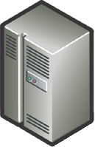



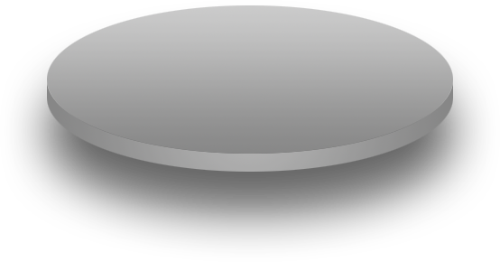




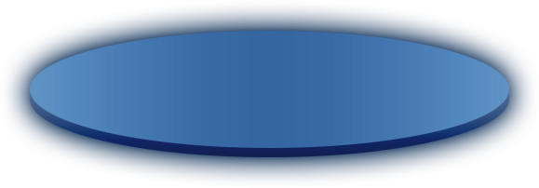
Windows Server 2008 R2 Hyper-V
Building on the rock-solid architecture of Windows Server 2008 Hyper-V
Integration with new technologies
Enabling new dynamic scenarios:
  Increased Server Consolidation
  Dynamic Data Center
  Virtualized Centralized Desktop
Customer Driven

Slide 10
Live Migration

Slide 11
Live Migration
#1 Customer Request
Moving a virtual machine from one server to another without loss of service
Enables new dynamic scenarios
  Load balancing VMs via policy

Slide 12
Live Migration
Live Migration via Cluster Manager
  In box UI
Live Migration via Virtual Machine Manager
  Orchestrate migrations via policy
Moving from Quick to Live Migration:
  Guest OS limitations?: No
  Changes to VMs needed?: No
  Changes to Storage infrastructure: No
  Changes to Network Infrastructure: No
  Update to Windows Server 2008 R2
  Hyper-V: Yes

Slide 13
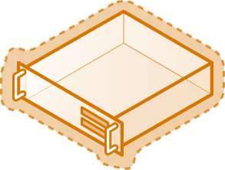

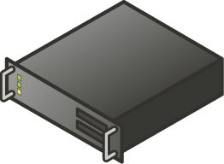

Live Migration
Create VM on target server
Copy memory pages from the source to the target via Ethernet
Final state transfer
  Pause virtual machine
  Move storage connectivity from source host to target host via Ethernet
Run new VM on target; Delete VM on source
Host 1
Host 2
Blue = Storage
Yellow = Networking
Shared Storage

Slide 14
Live Migration Memory Internals
Worker process on source host creates “dirty bitmap” of memory pages
  Iterates over pages, sending them to
  target worker process
  Registers for modify-notifications on pages to
  detect subsequent changes
    Source VM still active and can be modifying memory
  Repeats over newly modified pages
Stops iterating when one of the following:
  All pages sent
  Makes 10 passes

Slide 15
Live Migration Operation
Memory
Memory
Configuration
Configuration
State
State
Server 1
Server 2

Slide 16
Migration & Storage
Windows Server 2008 R2 Hyper-V
  NEW Cluster Shared Volume (CSV)
  CSV provides a single consistent file name space;
  All Windows Server 2008 R2 servers see
  the same storage
    Easy setup; Uses NTFS
    No reformatting SANs
    Create one big data store
    No more drive letter problems
    Existing tools just work

Slide 17
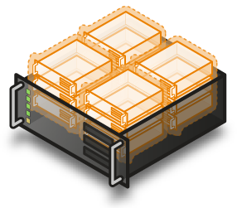
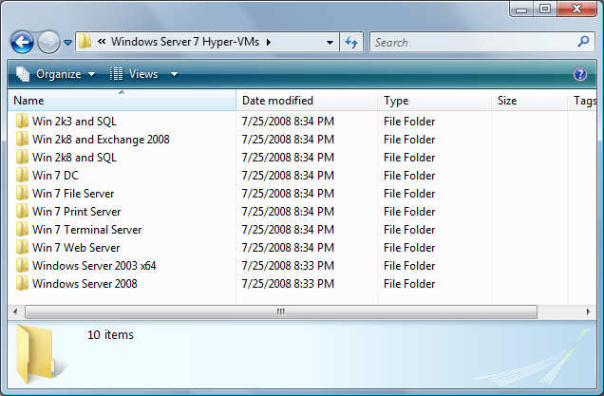
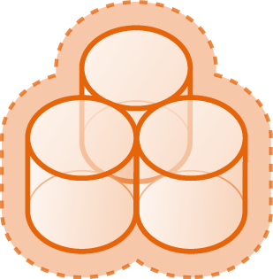
Cluster Shared Volumes
All servers “see” the same storage

Slide 18





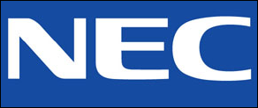

Failover Cluster Configuration Program (FCCP)
New for Windows Server 2008 Failover Clustering
Customers have the flexibility to design failover cluster configurations
  If the server hardware and components are logo’d and…
  it passes the cluster validation tool, it’s supported!
Or customers can identify cluster-ready servers via the FCCP
  OEMs have pre-tested these configurations and list them on the web
  Microsoft recommends customers purchase FCCP-validated servers
Look for solutions with this tagline:
  “Validated by Microsoft Failover Cluster Configuration Program”

Slide 19
New Processor Feature Support

Slide 20
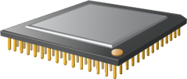
64 Logical Processor Support
Overview
  Provides Hyper-V the ability to utilizes up to 64 of the logical processor pool presented to Windows Server 2008 R2
Benefits
  Significantly increase host server density
  Easily provide multiple processors per virtual machine

Slide 21
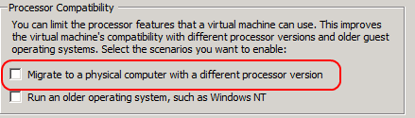

Processor Compatibility Mode
Overview
  Allows live migration across different CPU versions within the same processor family (i.e. Intel-to-Intel and AMD-to-AMD).
    Does NOT enable cross platform from Intel to AMD or vice versa.
  Configure compatibility on a per-VM basis.
  Abstracts the VM down to the lowest common denominator in terms of instruction sets available to the VM.
Benefits
  Greater flexibility within clusters
  Enables migration across a broader ranger of Hyper-V host hardware

Slide 22
VM Memory Management
Today, processors provide one level of
address translation, but hypervisor
needs to manage two
Guest Virtual Address
Guest Virtual Address
Guest OS defines GVA-to-GPA mappings
Shadow page tables combine these mappings because the processor knows how to perform only one level of translation
Guest Physical Address
Hypervisor defines GPA-to-SPA mappings
System Physical Address
System Physical Address

Slide 23
Shadow Page Tables
Hypervisor maintains a Shadow Page Table
  Combines two layers of translation into a
  single page table
  Demand-filled when Child OS touches a page
  Flushed any time the Child OS modifies
  its page tables
Shadow Page Table overhead
  Fills and flushes invoke the hypervisor
  Can account for up to 10% of total CPU time
  Consumes roughly 1MB of memory per VM

Slide 24
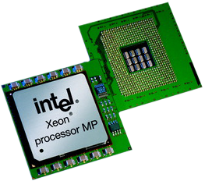
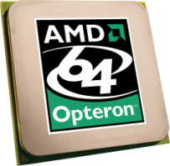
Second Level Address Translation
(SLAT)
Goes by several names
  Intel calls it Extended Page Tables (EPT)
  AMD calls it Nested Page Tables (NPT) or
  Rapid Virtualization Indexing (RVI)
Processor provides two levels of translation
  Walks the guest OS page tables directly
  No need to maintain Shadow Page Table
  No hypervisor code for demand-fill or flush operations
Resource savings
  Hypervisor CPU time drops to 2%
  Roughly 1MB of memory saved per VM

Slide 25

Windows Server 2008 R2
Core Parking
Overview
  Scheduling virtual machines on a single server for density as opposed to dispersion
  This allows “park/sleep” cores by putting them in deep C states
Benefits
  Enhances Green IT by reducing
  CPU power consumption

Slide 26
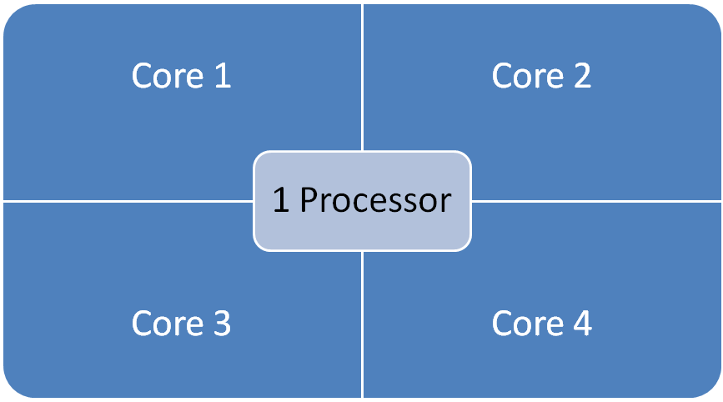
Windows Server 2008
16 LP Server

Slide 27
Windows Server 2008 R2 Core Parking
16 LP Server
Processor is “parked”
Processor is “parked”

Slide 28
Hyper-V Virtual Storage

Slide 29
Hot Add/Remove Storage
Overview
  Add and remove VHD and pass-through disks to a running VM without requiring a reboot.
    Hot-add/remove disk applies to VHDs and pass-through disks attached to the virtual SCSI controller
Benefits
  Enables storage growth in VMs without downtime
  Enables additional datacenter backup scenarios
  Enables new SQL/Exchange scenarios

Slide 30
Hyper-V Networking

Slide 31
Networking
TCP Offload support
Overview
  TCP/IP traffic in a VM can be offloaded to a physical NIC on the host computer.
Benefits
  Reduce CPU burden
  Networking offload to improve performance
  Live Migration is supported with Full TCP Offload

Slide 32
Networking
Virtual Machine Queue (VMQ) Support
Overview
  NIC can DMA packets directly into VM memory
    VM Device buffer gets assigned to one of the queues
    Avoids packet copies in the VSP
    Avoids route lookup in the virtual switch (VMQ Queue ID)
  Allows the NIC to essentially appear as multiple NICs on the physical host (queues)
Benefits
  Host no longer has device DMA data in its own buffer resulting in a shorter path length for I/O (performance gain)

Slide 33
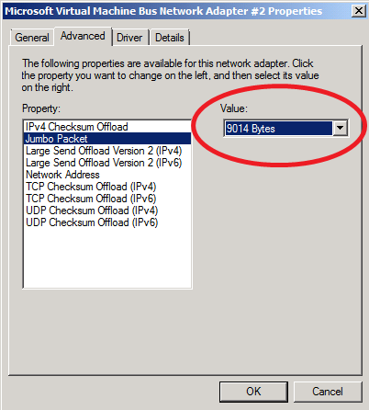
Networking
Jumbo Frame Support
  Ethernet frames >1,500 bytes
  Ad hoc standard is ~9k
Overview
  Enables 6x larger
  payload per packet
Benefits
  Improves throughput
  Reduce CPU utilization of large file transfers

Slide 34
Hosted Desktops aka Virtual Desktop Infrastructure(VDI)
Corey Hynes
HynesITe

Slide 35

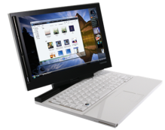
Desktop Virtualization – a key enabler
Focus: Reducing Costs
Roaming Profiles
Folder Redirection
Data, User settings
Microsoft Application Virtualization
Applications
Local Desktop Virtualization
OS
Microsoft Remote Desktop Services
Microsoft Virtual Desktop Infrastructure
Microsoft Enterprise Desktop Virtualization
Remote Desktop Virtualization
Hardware
Traditional Client Computing
Focus: Increasing Flexibility
Notes:
Traditionally, the desktop computing model has been one where the operating system, applications, and user data and settings are bonded to a single computer, making it difficult for users to move from one PC to another in case of upgrades or a lost or stolen laptop. This is a result of traditional OS/application installation and data storage technologies. With respect to desktop deployment, this means that the OS, application execution/presentation and user data are all self-contained within a single device. This model has the advantage of simplicity because it leverages well understood technologies that ship with Windows. In addition, because the PC is configured to be completely self-sufficient, this solution is well-suited to mobile use. However, the tight binding between the various layers may not be appropriate for all scenarios. Because of this, Microsoft has introduced new Windows deployment options that achieve similar results in terms of mobility but also enable increased flexibility.
By reducing the dependencies between computing layers, Microsoft enables IT to free the different elements of the system from one another. Each layer can then use other system resources generically and does not need to be configured individually for specific systems. Resources can be used on any system, in real-time, on an as-needed basis. The layers can be brought together dynamically on the users’ machines. IT can also manage the layers separately from each other.
Our competition (such as VMWare) uses Desktop virtualization in a very narrow frame, ie, Desktop Virtualization = VDI. At Microsoft, we understand that desktops are complex, and include various components such as the operating system, the applications and the users data. Desktop Virtualization is the process of separating out these individual components, and managing each one seperately. This reduces complexity, and improves management.
User state virtualization: separating the users profiles and data from the other layers, using Windows Vista roaming profiles and Folder redirection.
Application virtualization: seperating applications from the operating system, and managing them centrally. Microsoft App-V is the most popular application virtualization tool, with well over 14M units sold and has saved money for many of our customers.
Full Desktop virtualization: the process of running an operating system virtually. Local Desktop Virtualization is about running a virtual copy of Windows locally on the PC, using tools such as MED-V. Remote desktop virtualization is about running Windows client OS in the data center, and accessing it via protocols such as RDP. Remote desktop services (RDS, formerly known as Terminal Services) provides shared central desktops. VDI allows users to access their personal desktops that are hosted within the data center. Full Desktop Virtualization introduces new scenarios that traditional Windows licensing cannot take care of.
It is important to note that the drivers for use state virtualization and application virtualization are to reduce desktop TCO. The driver for Full desktop virtualization is improving desktop flexibility, since these solutions may be expensive to deploy.

Slide 36






Using Desktop Virtualization effectively
Managed Desktops
Managing Unmanaged Desktops
Task
Office
Mobile
Work from home
Contractor / Offshore
Lay the foundation for desktop optimization
User State Virtualization
Microsoft Application Virtualization
Shared Remote Desktops
(RDS)
Personalized Remote Desktops
(VDI)
Notes:
So how do you ensure you use desktop virtualization effectively? Its important to ensure you match technologies with your users, so as to ensure you pick the right technology to boost productivity. Although you can achieve productivity multiple ways, it’s a tradeoff between technology cost and benefit, snce some technologies can offer the same benefits as other, but at highly reduced cost.
It is also important to focus on technologies for a vast majority of your desktops, as opposed to a smaller use case percentage, such as managing unmanaged desktops.
As you can see, user state virtualization and application virtualization are technologies that are applicable to all users, and can offer tangible benefits immediately. Deploy these two technologies immediately to lay a foundation for the optimized desktop.

Slide 37
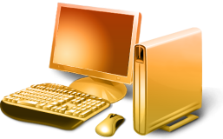

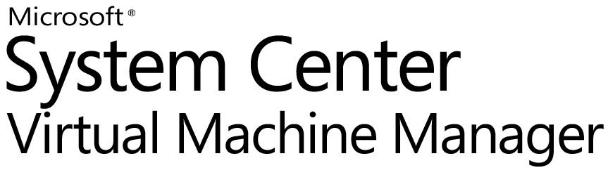
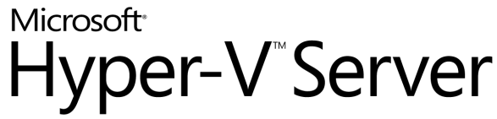
What is VDI
    What is it?
User PC or Thin Client
Server
    Running users’ desktops in server-based virtual machines and making them available remotely over a network
Presentation
Virtual Desktop
User State
Applications
  Key Benefits
Desktop experience is centralized and gets delivered to user’s PC or thin client
OS
    Access to data and applications from any device in the organization
    Improve data security and compliance
    Simplify management and deployment of applications
Hyper-V
Server OS
Virtual Machine Manager is a comprehensive management solution for the virtualized datacenter.
Windows Server Hyper-V, is the next-generation server virtualization technology.

Slide 38
Two VDI Solutions
Pooled Desktops
  Set of shared desktops
  User state is temporary (discarded at session end)
  Preservation of data is done via “roaming” technologies | Folder Redirection, Profiles, etc
Personalized Desktops
  Closest to physical
  One VM per user
  Different options for user state | In VM, roaming, etc

Slide 39
Citrix?
R2 provides VDI in box
XenDesktop is more scaleable, for enterprise implementations
Differences
  R2 relies on SCVMM to provision individual desktop VHD’s, even in pooled scenarios.
  XenDestkop uses shared vDisks over multiple VM’s, quicker, lighter provisioning
  XenDestkop has more features for VDI management

Slide 40
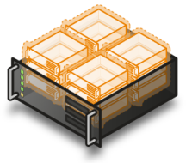
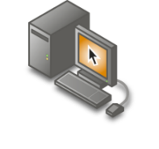

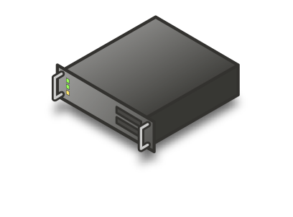
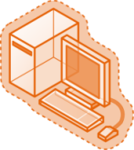
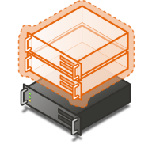


Connection Broker Infrastructure
TS Gateway
TS Session Broker
TS Users
Remote
TS Farm
Storage
Hosted Desktop
Users (Remote)
Hyper-V Farm
Hosted Desktop Users
TS Users

Slide 41
VDI in R2
Components
  RD WebAccess presents unified view
  Active Directory holds user desktop assignments
  RD Connection Broker collects and publishes all things a user can do
  RDS as Redirector proxies RDP connection to desktop
  RD Virtualization starts requested desktop on behalf of RD Connection Broker
  Client connects directly to VM via RDP
  Entire flow is RD Gateway friendly
Show me

Slide 42
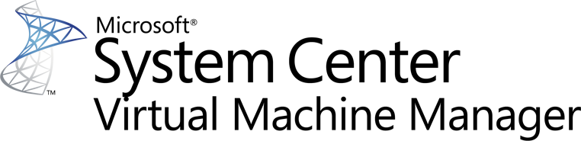

Slide 43
VMM 2008 R2 Objectives
Support New Features From Windows Server 2008 R2 and Microsoft Hyper-V R2
Address Major Customer Asks
Further Improve Customer Experience With Bug Fixes and Feature Enhancements

Slide 44
System Center Virtual Machine Manager 2008 R2
VMM 2008 Features
Hypervisor Management - Hyper-V, VMware | Cluster Integration
Host Configuration | Intelligent Placement
Library Management | Deployment and Storage
Virtual Machine Creation/Provisioning | Monitoring and Reporting
Conversions: P2V and V2V | Automation with PowerShell
Delegation and Self Service | Performance and Resource Optimization
New in VMM R2
Management of Windows Server 2008 R2 and Microsoft Hyper-V R2 | Multiple Virtual Machines Per LUN
Live Migration | Cluster Shared Volumes
Storage Migration | Maintenance Mode
SAN Related Enhancements | Network Optimizations
Hot Add of Storage | Rapid Provisioning

Slide 45
Storage Migration
Ability To Migrate VM Storage to New Location
VMM R2 Adds Support For Storage Migration
  Adds Quick Storage Migration for Hyper-V
  Enables storage vMotion for VMWare
Example Usage: Consolidation of VM Storage
  Prior to VMM R2, One VM Per LUN
  With CSV, VMs can Be Consolidated Into a Single CSV LUN
  Using QSM, VM Storage Can Be Migrated With Minimal Downtime

Slide 46
Comparing QSM with Storage vMotion
Quick Storage Migration
Storage vMotion
Migrate Virtual Machine Along With Storage
Yes
No
Zero downtime
No
Yes
Migrate Virtual Machines with Snapshots
Yes
No
Provided Without Additional Licensing
Included in Workgroup & EE Editions starting at $500 per server
Only Available in EE/EE+ starting at $2875 per proc

Slide 47
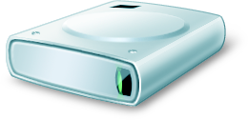
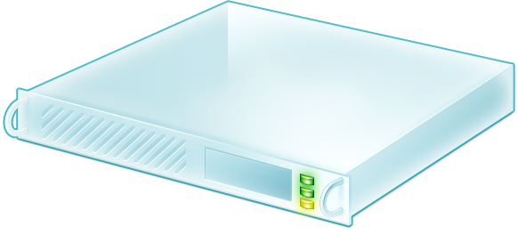
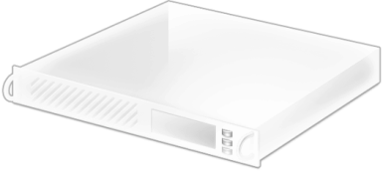
Quick Storage Migration
Source Disk
Destination Disk
Quick Storage Migration Enables VM Migration from one storage infrastructure to another!

Slide 48
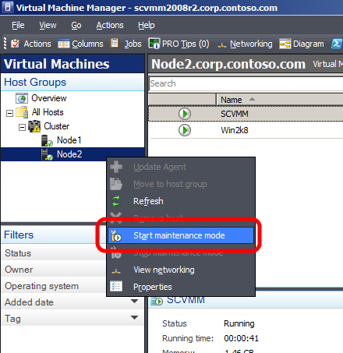
Maintenance Mode
VMM R2 Allows Host Servers To Be Put Into a Maintenance Mode
  Useful for Servicing Hardware, Software or Power Energy Management
  If Host Is Clustered VMs Running On The Host Are Automatically Live Migrated To Other Hosts
  If Host Is Standalone Admin Can Choose To Save State or Shutdown VMs
Placement
  Host in maintenance mode gets zero star ratings
Supported for Hyper-V, Virtual Server and VMWare Hosts

Slide 49
VMM 2008 R2 Timeline
Beta - Released in March ’09
RC - May ’09
RTM - 60 Days After Windows Server 2008 R2 RTM

Slide 50
Microsoft Hyper-V Server
R2

Slide 51
Microsoft Hyper-V Server 2008
Simplified, optimized and free
  Provides basic virtualization capabilities
  Great stand-alone hypervisor-based virtualization product
Streamlined
  Micro-kernelized hypervisor
Easily integrates into existing infrastructure
  Active Directory integration
  Leverage existing management tools (e.g,: System Center Virtual Machine Manager 2008)
  Leverage existing support tools & processes
  Leverage existing IT Pro skill-set and knowledge

Slide 52
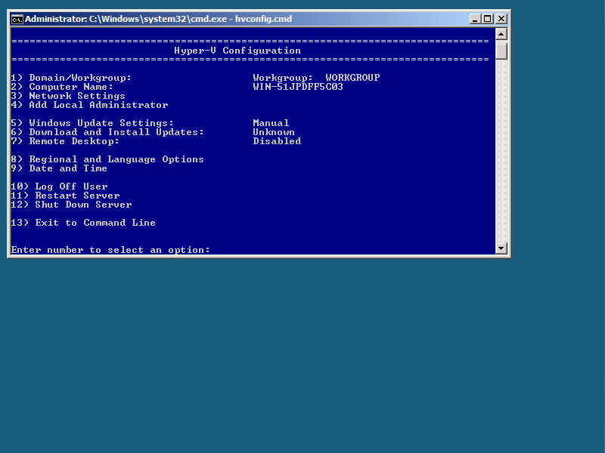
HVconfig
Automatic startup at login
Easy setup utility for server configuration
Localized in 11 languages

Slide 53




Manage Remotely…

Slide 54
Microsoft Hyper-V Server V2
New Features
Live Migration
High Availability
New Processor Support
  Second Level Address Translation
  Core Parking
Networking Enhancements
  TCP/IP Offload Support
  VMQ & Jumbo Frame Support
Hot Add/Remove virtual storage
Enhancements to HVCONFIG
Enhanced scalability

Slide 55
Hyper-V Server V1 vs. V2
 | Microsoft Hyper-V Server 2008 | Microsoft Hyper-V Server V2
Processor Support | Up to 4 processors | Up to 8 processors
Physical Memory Support | Up to 32 GB | Up to 1 TB
Virtual Machine Memory Support | Up to 32 GB total (e.g. 31 1 GB VMs or 5 6 GB VMs) | 64 GB of memory per VM
Live Migration | No | Yes
High Availability | No | Yes
Management Options | Free Hyper-V Manager MMC SCVMM | Free Hyper-V Manager MMC SCVMM

Slide 56
Live Migration $$ Comparison
 | Hyper-V Server R2 | VMware vSphere
3 Node Cluster 2 Socket Servers | Free | $13,470
3 Node Cluster 4 Socket Servers | Free | $26,940
5 Node Cluster 2 Socket Servers | Free | $22,450
5 Node Cluster 4 Socket Servers | Free | $44,900
For $500 add VMM 2008 R2 (Workgroup Edition) to manage MS Hyper-V Server R2:
Physical to Virtual Conversion (P2V); Quick Storage Migration; Library Management;
Heterogeneous Management; PowerShell Automation; Self-Service Portal and more…

Slide 57


















A centralized management application solution for the virtual data center
Heterogeneous Management
Manage Hyper-V, Virtual Server and VMware from a single console
Maximize Resources
Centralized virtual machine deployment and management
Intelligent placement of virtual machines
Fast and reliable Physical to Virtual (P2V) and Virtual to Virtual (V2V) conversion
Comprehensive service-level enterprise monitoring with Microsoft® Operations Manager
Increase Agility
Rapid provisioning of new and virtual machines with templates and profiles
Centralized library of infrastructure components
Take advantage and extend existing storage infrastructure
Allow for delegated management of virtual machines
Take Advantage of Skills
Familiar interface, common foundation
Monitor physical and virtual machines from one console
Fully scriptable using Windows PowerShell™
VM
VM
VM
VM
VM
VM
VM
VM
VM
VM
VM
VM
VM
VM
VM
VM
VM
VM
VM
VM
VM
VM
VM
VM
Notes:
System Center Virtual Machine Manager
Microsoft System Center Virtual Machine Manager is the latest addition to the System Center family of management products and provides centralized management of Windows Virtual Machine infrastructure. Virtual Machine Manager enables increased physical server utilization, centralized management of virtual infrastructure and rapid provisioning of new virtual machines by the administrator and end users.
Microsoft System Center Virtual Machine Manager is an enterprise management application for a virtualized data center. It enables increased physical server utilization, centralized management of virtual machine infrastructure and rapid provisioning of new virtual machines by the administrator and users. Virtual Machine Manager is fully integrated with the System Center product family.
Resource Optimization
Virtual Machine Manager delivers simple and complete support for consolidating physical hardware on virtual infrastructure and optimizing utilization.
Rapid Provisioning and Agility
Virtual Machine Manager provides rapid provisioning of virtual machines from physical machines, templates in the image library, or by users.

Slide 58
Summary
Microsoft Hyper-V Server 2008
  R1: Production ready & available now
  R2: Release Candidate Available Now
Windows Server 2008
  R1: Production ready & available now
  R2: Release Candidate available now
System Center Virtual Machine Manager 2008
  R1: Available now
  R2: RTM within 60 days of Windows Server 2008 R2

Slide 59
question & answer

Slide 60
Online Resources
Microsoft Virtualization Home:
  http://www.microsoft.com/virtualization
Windows Server Virtualization Blog Site:
  http://blogs.technet.com/virtualization/default.aspx
Windows Server Virtualization TechNet Site:
  http://technet2.microsoft.com/windowsserver2008/en/servermanager/virtualization.mspx
MSDN & TechNet Powered by Hyper-V
  http://blogs.technet.com/virtualization/archive/2008/05/20/msdn-and-technet-powered-by-hyper-v.aspx
Virtualization Solution Accelerators
  http://technet.microsoft.com/en-us/solutionaccelerators/cc197910.aspx
How to install the Hyper-V role
  http://www.microsoft.com/windowsserver2008/en/us/hyperv-install.aspx
Windows Server 2008 Hyper-V Performance Tuning Guide
  http://www.microsoft.com/whdc/system/sysperf/Perf_tun_srv.mspx
Using Hyper-V & BitLocker White Paper
  http://www.microsoft.com/downloads/details.aspx?FamilyID=2c3c0615-baf4-4a9c-b613-3fda14e84545&DisplayLang=en

Slide 61




Resources
Required Slide
Speakers,
TechEd 2009 is not producing
a DVD. Please announce that
attendees can access session
recordings at TechEd Online.
www.microsoft.com/teched
  Sessions On-Demand & Community
www.microsoft.com/learning
Microsoft Certification & Training Resources
http://microsoft.com/technet
  Resources for IT Professionals
http://microsoft.com/msdn
  Resources for Developers
www.microsoft.com/learning
Microsoft Certification and Training Resources

Slide 62





Required Slide
Complete an evaluation on CommNet and enter to win!

Slide 63

Required Slide
© 2009 Microsoft Corporation. All rights reserved. Microsoft, Windows, Windows Vista and other product names are or may be registered trademarks and/or trademarks in the U.S. and/or other countries.
The information herein is for informational purposes only and represents the current view of Microsoft Corporation as of the date of this presentation. Because Microsoft must respond to changing market conditions, it should not be interpreted to be a commitment on the part of Microsoft, and Microsoft cannot guarantee the accuracy of any information provided after the date of this presentation. MICROSOFT MAKES NO WARRANTIES, EXPRESS, IMPLIED OR STATUTORY, AS TO THE INFORMATION IN THIS PRESENTATION.

