Slide 2


Reduce Costs, Simplify IT,
and increase Your Value to the Business
Damir Bersinic
Senior IT Pro Advisor, Microsoft Canada
damirb@microsoft.com

Slide 3
Industry Trends
Macro Trends
Current Indicators
Virtualization Acceleration
#1 CIO priority in 2008 (up from #17)
Compliance
CIOs expect 10% of IT budget to be dedicated to compliance
IT Service Management
IT orgs can currently only correlate 30% of IT alerts to business problems
Anywhere Access
Converged mobile phones (Smartphones) growing
two times faster than mobile PCs
22% New
Software as a Service
>1/3 of Technical Decision Makers interested in using SaaS to support
customer-facing business processes
78% Maintenance
Data Center Build Outs
74% of enterprises mandate all servers
must reside in the data center
Implication
78% of IT budgets spent on maintenance activities, trends increase pressure
www.microsoft.ca/AlignIT
1 of 20

Slide 4
Technology Acquisition
Requested
feature set
More people
increase complexity
More tools also
increase complexity
RFP or RFQ
feature set
Complexity
$$$
RFP or RFQ
feature set
Implemented
feature set
RFP or RFQ
feature set
RFP or RFQ
feature set
Trained
feature set
Time

Slide 5


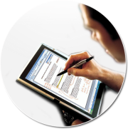

A Different Approach Is Needed
People
Process
Technology
Operational habits are what deliver results
An approach that…
  Holistic
  Addresses existing complexity
  Creates an integrated, uniform environment
  Adopts to proven Best Practices
  Recognizes Role Based Productivity
  Prioritizes and sequences IT projects in a structured, systematic manner

Slide 6

Agenda
What is Infrastructure Optimization and why is it important?
How do you implement Infrastructure Optimization -
Best Practices
Using Virtualization to optimize your IT operations

Slide 7

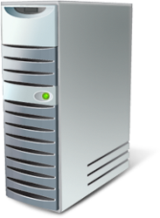
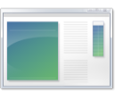









Infrastructure Optimization
Model-Based Approach
Provides capability framework to help you build an optimized infrastructure (not Microsoft-specific)
Establishes a foundation based on industry analyst, academic, and consortium research
Provides guidance and best practices for step-by-step implementation
Drives cost reduction, security and efficiency gains
Enables agility
Application Platform Optimization Model
User Experience
Business Intelligence
SOA and Business Process
Application Platform
BASIC
STANDARDIZED
ADVANCED
DYNAMIC
Data Management
Development
Business Productivity Infrastructure Optimization Model
Unified Communications
IT and Security Process
Collaboration
Enterprise Content Management
Business Productivity
BASIC
STANDARDIZED
RATIONALIZED
DYNAMIC
Enterprise Search
Business Intelligence
Core Infrastructure Optimization Model
Identity and Access Management
Desktop, Device, and Server Mgmt
BASIC
STANDARDIZED
RATIONALIZED
DYNAMIC
Core Infrastructure
Security and Networking
Data Protection and Recovery

Slide 8




What is Optimized IT?
Basic
Uncoordinated, manual
infrastructure
Standardized
Centrally Managed IT Infrastructure with some automation
Rationalized
Managed and consolidated IT Infrastructure
Dynamic
Fully automated IT management dynamic resource usage and business linked SLA's
Objective
React
Manage
Reduce complexity
Agility
Ability to
Change
Slow weeks/ months
Weeks
Days
Minutes
Resource
Utilization
Unknown
Known, poor
Optimized
High, As needed
Processes
& Automation
Ad hoc
Defined
Mature
Policy-based
Business
Alignment
No SLAs
Arbitrary SLAs
Class of Service SLAs
Business SLAs
Role of
IT
Cost Center
Efficient
Cost Center
Business Enabler
Strategic Asset

Slide 9
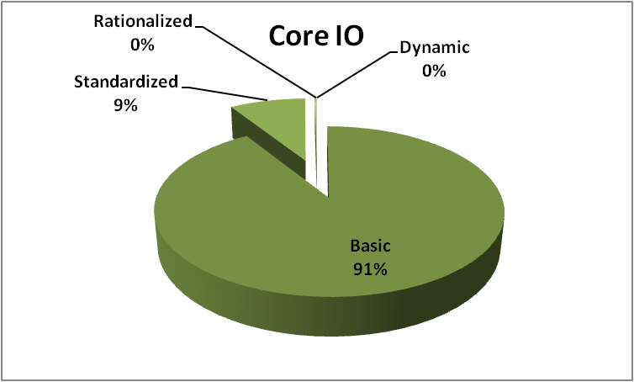
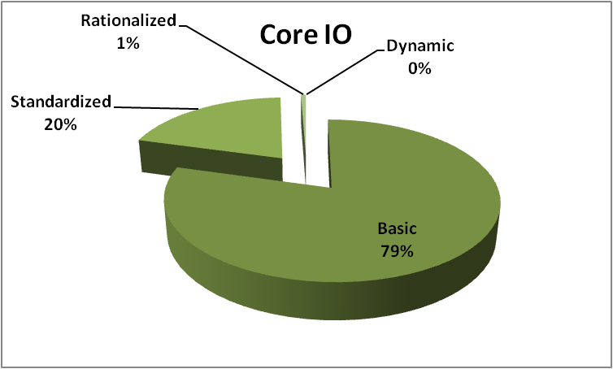
Core Infrastructure Optimization
Core Infrastructure
The World
Canada

Slide 10




The goal of any IT organization is to provide value services to the business
Users
Finance
Corporate
User
Sales
Mobile
Logistics
Corporate
User
Partners
Restricted
Service Catalogue
Business
Intelligence
Performance
Management
LOB Apps
Custom
Apps
Intra /Internet
Business
Intelligence
Collaboration
Communication
Network & Basic
Infrastructure
Infrastructure
IT AND
SECURITY
PROCESS
SECURITY
MANAGEMENT
BASIC
INFRASTRUCTURE
SERVICES
SERVICE &
DELIVERY
MANAGEMENT
REMOTE
INFRASTRUCTURE
MANAGEMENT

Slide 11
IT Governance Model enables for service delivery
ITIL 3.0 / MOF
Services Strategy
Service Catalogue
Service Design
Service Transition
Change Management
Service Portfolio
Financial Management
Availability Management
Continuity Management
Capacity Management
Security Management
Release Management
Configuration Management
Knowledge Management
Service Operation
Incident Management
Problem Management
Request fulfillment
Continual Service Improvement
Service Reporting
Service Measurement
Service Level Management

Slide 12
Core Infrastructure: 5 capabilities
Basic
Standardized
Rationalized
Dynamic
IT and Security Process
Best-practice guidance on cost-effective solution design, development, operation, and support
Identity and Access Management
Directory services, User provisioning, Directory-based authentication
Desktop, Device, and Server Management
Software distribution, Patch management, Mobility, Imaging, Virtualization
Security and Networking
Policy, Antimalware, Firewall, Access control, Network protection, Quarantine
Data Protection and Recovery
Backup, Restore, Storage management

Slide 13




Core Infrastructure maturity
Basic
Standardized
Rationalized
Dynamic
Unstructured and lacking central control, infrastructure based on manual processes, ad hoc security, and disparate resources
Policies for security and compliance are inconsistent or nonexistent
Health of services is unknown due to the lack of tools and resources
There is no vehicle for sharing accumulated knowledge across IT
Environments are extremely hard to control
Organization is very reactive to security threats
Software deployments, security updates, and services are provided through high touch

Slide 14
Core IO – Service Delivery Capabilities
ITIL 3.0 / MOF
Basic
Services Strategy
Service Design
Service Transition
Limited Security Accountability
Service Operation
Ad Hoc Incident Management
Ad Hoc Problem Management
Continual Service Improvement
Ad Hoc Change Management

Slide 15



Core Infrastructure maturity level
Basic
Standardized
Rationalized
Dynamic
Standards and policies to manage desktops, mobile devices, and servers introduce controls and operational consistency
Microsoft® Active Directory® is used to manage resources, security policies, and network access
The value of basic standards and policies is recognized but not yet implemented broadly
Deployments, security updates, and desktop services are provided at medium touch
Inventory of hardware and software assets is maintained, and license use is managed
Security is improved with a locked-down perimeter, though internal security may still be at risk

Slide 16
Core IO – Service Delivery Capabilities
ITIL 3.0 / MOF
Standardized
Services Strategy
Service Design
Service Transition
Limited Change Management
Ad Hoc Financial Management
Ad Hoc Continuity Management
Defined Security Management
Limited Configuration Management
Service Operation
Defined Incident Management
Limited Problem Management
Request fulfillment
Continual Service Improvement

Slide 17
Core Infrastructure maturity level
Basic
Standardized
Rationalized
Dynamic
Costs involved in managing desktops and servers are at their lowest, with integrated IT management policies, tools, and processes
Security is proactive and response to threats is rapid and controlled
The use of zero-touch deployment helps minimize cost and time
Minimal number of desktop images and low-touch management
Hardware and software inventory is managed, with optimal license use
Security measures involve strict policies and control

Slide 18
Core IO – Service Delivery Capabilities
ITIL 3.0 / MOF
Rationalized
Services Strategy
Service Catalogue
Service Design
Service Transition
Change Management
Financial Management
Continuity Management
Capacity Management
Security Management
Release Management
Configuration Management
Knowledge Management
Service Operation
Incident Management
Problem Management
Request fulfillment
Continual Service Improvement
Service Reporting
Service Level Management

Slide 19
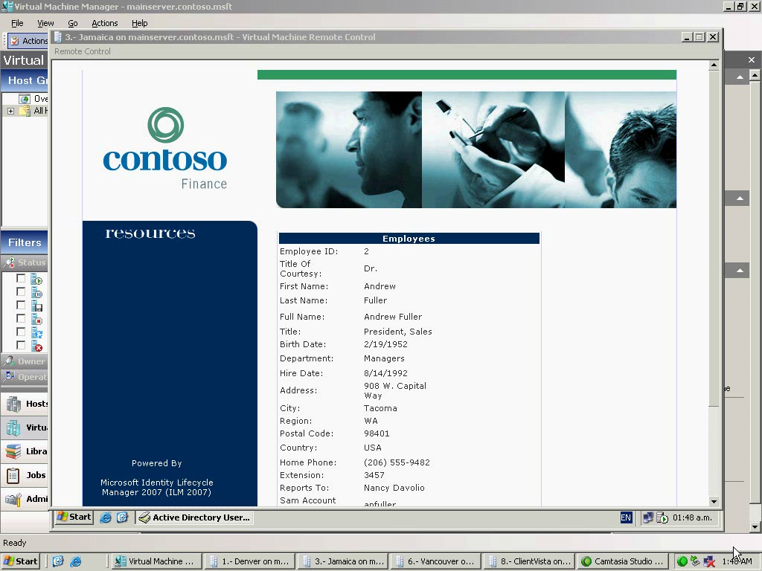
Policy-Based Management
Rationalized Identity and Access
real-world example

Slide 20

Core Infrastructure maturity
Basic
Standardized
Rationalized
Dynamic
Highly responsive and efficient IT infrastructure; automated processes and flexible resources drive business agility and competitive advantage
Costs are fully controlled
Collaboration is pervasive; integration exists between users and data, desktops and servers
Mobile users have nearly on-site levels of service and capabilities
Processes are fully automated, often incorporated into the technology itself
Additional investments in technology yield specific, rapid, and measurable benefits
Self-provisioning software and quarantine-like systems allow automated processes

Slide 21
Core IO – Service Delivery Capabilities
ITIL 3.0 / MOF
Dynamic
Services Strategy
Service Catalogue
Service Design
Service Transition
Change Management
Service Portfolio
Financial Management
Availability Management
Continuity Management
Capacity Management
Security Management
Release Management
Configuration Management
Knowledge Management
Service Operation
Incident Management
Problem Management
Request fulfillment
Continual Service Improvement
Service Reporting
Service Measurement
Service Level Management

Slide 22
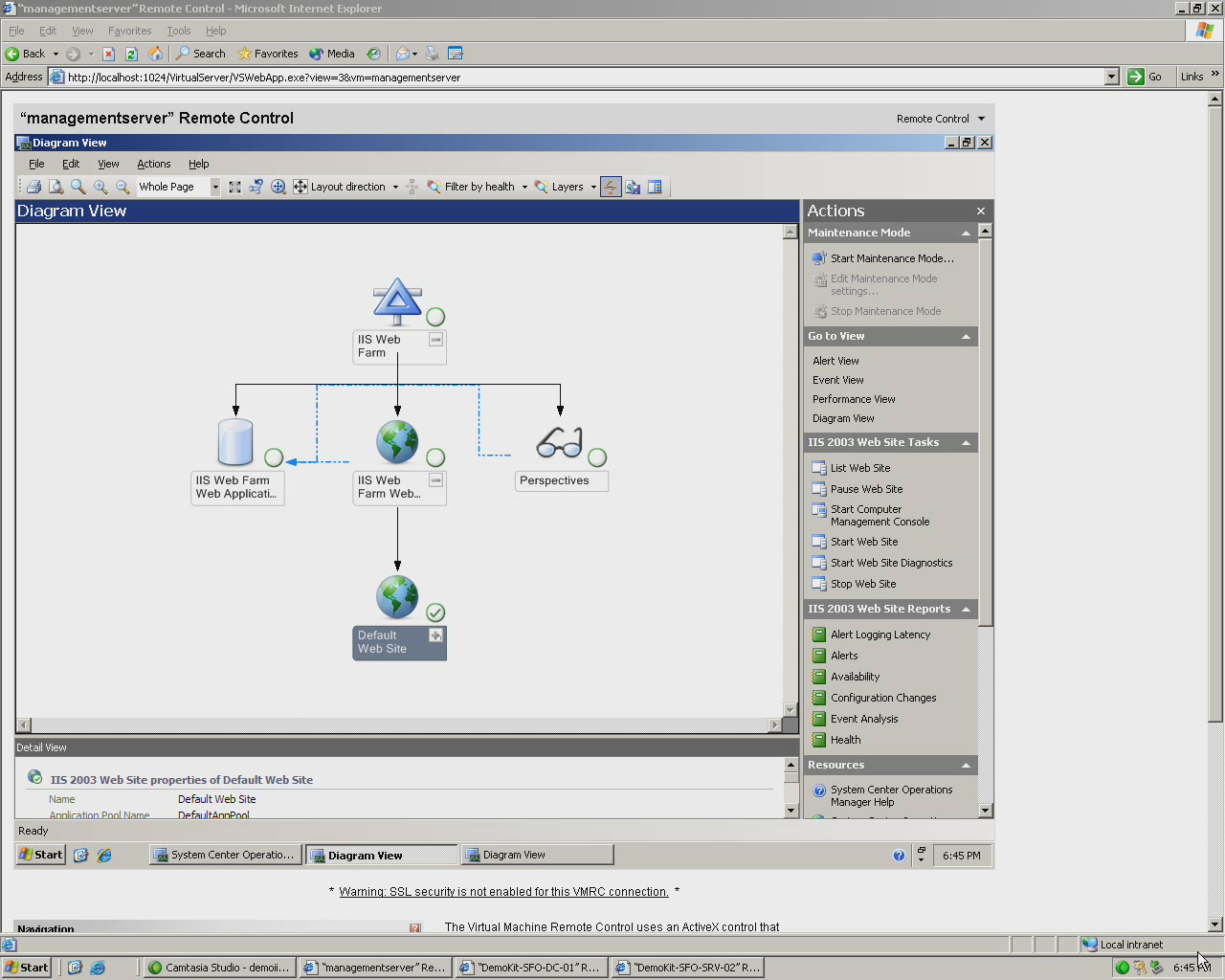
Load-Based Resourcing
Dynamic Server Onboarding
real-world example

Slide 23




Infrastructure Optimization Model
Stages and capabilities
Basic
Standardized
Rationalized
Dynamic
Many ways of achieving the same objective, often in reaction to problems
Fully automated
management,
dynamic resource
usage , business
linked SLAs
A standardized, repeatable process
Managed and
consolidated through automation

Slide 24














Who’s using the IO Model?
30+ World Wide Reference Success Stories

Slide 25

Desjardins group is the largest integrated cooperative financial group in Canada. The Quebec-based financial institution was struggling with bandwidth limitations at some of its more remote service points.
Solution
Desjardins began looking for a solution that would provide data compression and traffic prioritization at an affordable cost. The financial institution decided that Microsoft ISA Server 2004 SP2 was the product best suited to its needs.
Benefits
Optimized bandwidth utilization
Improved budget expenditures
Enhanced growth opportunities

Slide 26

Based in Toronto, Cineplex Entertainment LP owns, leases or has a joint-venture interest in 132 movie theatres across Canada.
Business Situation
With widely dispersed operations, Cineplex Entertainment wanted to consolidate information silos and better position itself to handle rapid growth.
Solution
Cineplex Entertainment upgraded to the 2007 Office system, including Office SharePoint Server 2007.
Benefits
Searching made easy
Streamlined workflow
Enhanced productivity

Slide 27
Best Practices Drive Down IT Cost
Best Practice Research Supports IT Maturity
  Enhanced infrastructure enables lower desktop TCO
Best Practice | Annual Benefit per PC | IT Tasks Improved | Enabling MS Technology
1: OS Standardization | $52 | Image Management Desktop Administration Service Desk/Deskside Support | Vista WIM Image Management Vista Virtualization
2: Centrally Managed PC Firewall | $39 | Security & Patching Desktop Administration Service Desk/Deskside Support | Vista Firewall Active Directory Group Policies
3: Automated Password Reset | $29 | Service Desk/Deskside Support | 3rd Party
4: Users Cannot Install Software | $50 | Application Management Desktop Administration Service Desk | Vista User Account Protection Active Directory/Group Policies Automated SW Deployment
5: Users Cannot Change Settings | $30 | Application Management Desktop Administration Service Desk/Deskside Support | Vista User Account Protection Active Directory Group Policies
6: Automated Software Distribution | $26 | Application Management Desktop Administration Security & Patching | Active Directory/Group Policies Vista Windows Installer Service Configuration Manager/SMS
http://download.microsoft.com/download/d/2/9/d2906b8a-38cf-4824-b698-3f55f6a079e4/PC_TCO_Best%20Practices.pdf

Slide 28
Industry Trends
Macro Trends
Current Indicators
Virtualization Acceleration
#1 CIO priority in 2008 (up from #17)
Compliance
CIOs expect 10% of IT budget to be dedicated to compliance
IT Service Management
IT orgs can currently only correlate 30% of IT alerts to business problems
Anywhere Access
Converged mobile phones (Smartphones) growing
two times faster than mobile PCs
22% New
Software as a Service
>1/3 of Technical Decision Makers interested in using SaaS to support
customer-facing business processes
78% Maintenance
Data Center Build Outs
74% of enterprises mandate all servers
must reside in the data center
Implication
78% of IT budgets spent on maintenance activities, trends increase pressure
www.microsoft.ca/AlignIT
1 of 20

Slide 29
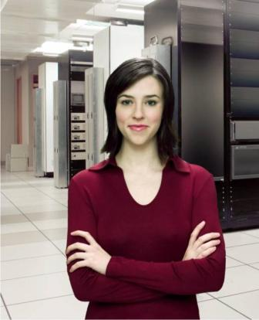
Benefits Of An Optimized
Core Infrastructure
Control Costs
Improve
Service Levels
Drive Agility
Simplify, automate,
and centralize IT operations to optimize
resource utilization
Integrate management and security tools to maximize system uptime
Adapt the IT infrastructure rapidly according to business needs
Service Levels
Cost
Agility
Infrastructure Maturity

Slide 30




Next Steps
  Assess your Core Infrastructure maturity with the Microsoft Infrastructure Optimization Model (new online tool!)
  Prioritize infrastructure capabilities for further analysis
  Let us provide methods to develop an integrated implementation roadmap
Notes:
30

Slide 31
Resources
Infrastructure Optimization TechCenter
http://technet.microsoft.com/en-ca/infrastructure/default.aspx
IO Self Assessment
http://technet.microsoft.com/en-us/infrastructure/bb736011.aspx
Microsoft Operations Framework
http://technet.microsoft.com/en-us/library/cc506049.aspx

Slide 32

© 2008 Microsoft Corporation. All rights reserved. Microsoft, Windows, Windows Vista and other product names are or may be registered trademarks and/or trademarks in the U.S. and/or other countries.
The information herein is for informational purposes only and represents the current view of Microsoft Corporation as of the date of this presentation. Because Microsoft must respond to changing market conditions, it should not be interpreted to be a commitment on the part of Microsoft, and Microsoft cannot guarantee the accuracy of any information provided after the date of this presentation. MICROSOFT MAKES NO WARRANTIES, EXPRESS, IMPLIED OR STATUTORY, AS TO THE INFORMATION IN THIS PRESENTATION.

