Slide 1
Content
Vertical Market specialization
FS market and Microsoft
Call to action/Discussion

Slide 2
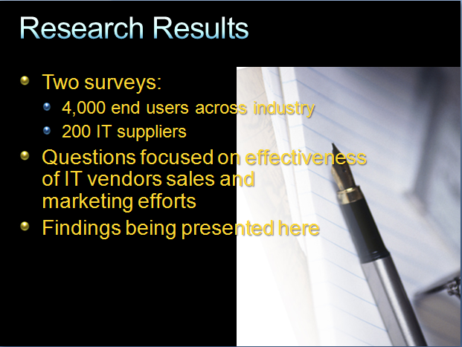
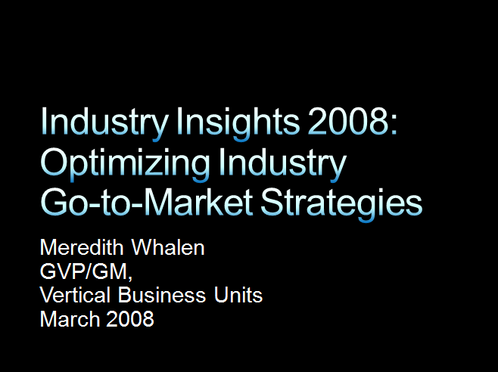
Vertical Specialization?

Slide 3
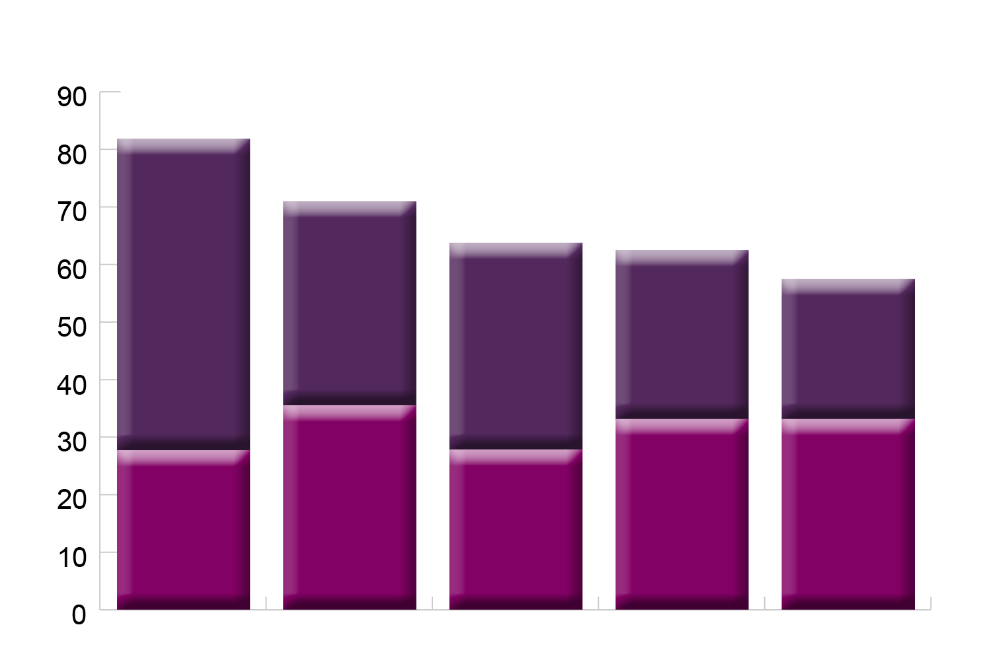

Getting Industry Strategies Right
How important is it for each of the following types of vendors to understand your industry specific needs?
5 — Very important
4 — Important
Application
Services
Hardware
Telecom
Other Software
Source: IDC’s Annual Vertical Survey, Feb. 2008; Preliminary results; n = 3789 IT technology buyers

Slide 4
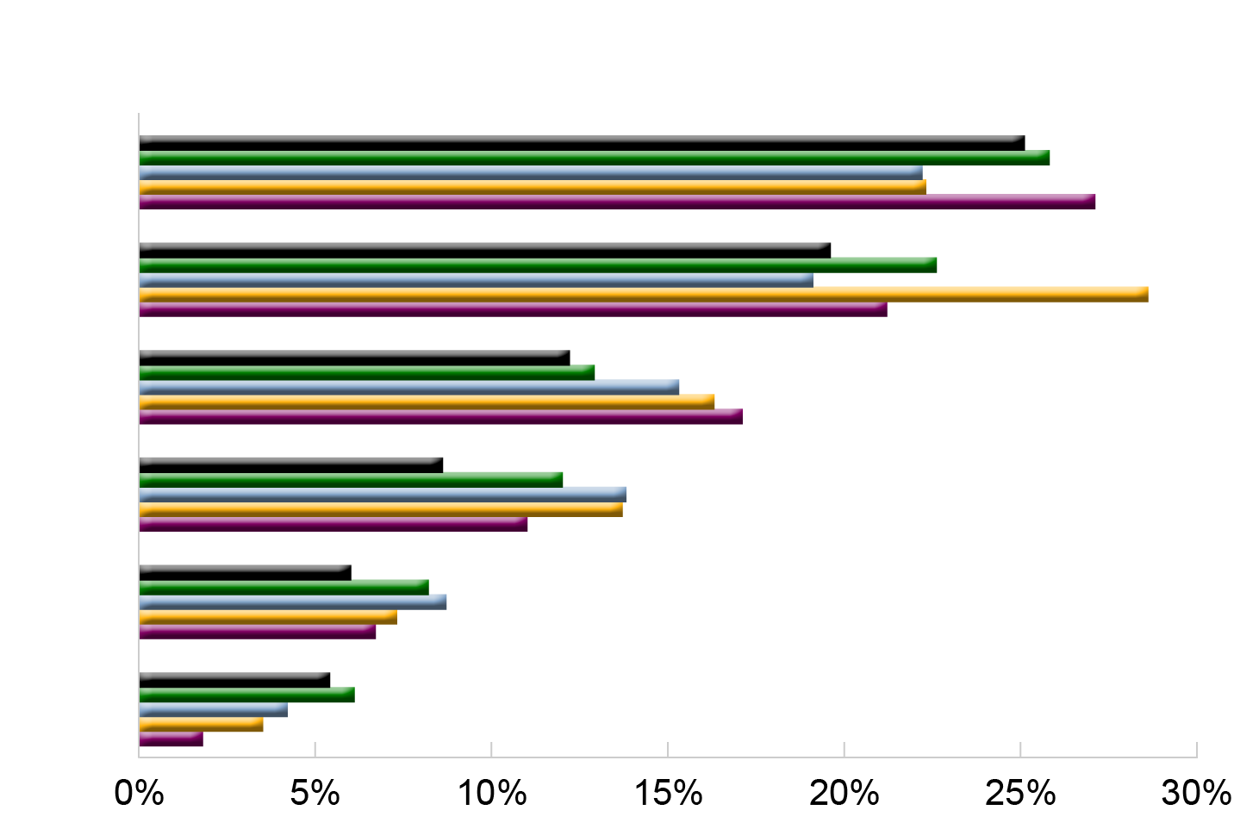


The Price of Getting It Wrong
What is the impact of a vendor's sales personnel not understanding your industry-specific business issues
I send part of my business somewhere else
Lose Part of the Deal
The vendor never initially wins my business or I stop doing business with them
Lose the Deal
Longer Sales Cycle
It lengthens the sales cycle
It lengthens the deployment time due to inadequate scoping
Longer Projects
The vendor incurs unexpected development costs before or after the sale
Unexpected Costs
The vendor loses the ability to use my site as a reference
No Reference
Source: IDC’s Annual Vertical Survey, Feb. 2008; Preliminary results; n = 3789 IT technology buyers

Slide 5

The Price of Getting It Wrong
What is the impact of a vendor's sales personnel not understanding your industry-specific business issues
I send part of my business somewhere else
The vendor never initially wins my business or I stop doing business with them
It lengthens the sales cycle
Telecom
It lengthens the deployment time due to inadequate scoping
IT services
Other SW
The vendor incurs unexpected development costs before or after the sale
Application
Hardware
The vendor loses the ability to use my site as a reference
Source: IDC’s Annual Vertical Survey, Feb. 2008; Preliminary result; n = 3789 IT technology buyers

Slide 6
How We Sell: BDMs and TDMs
BDM
TDM
People Ready Business & Industry POV
Role-Based Productivity
Dynamic IT
Solution Area Led
Capability Led
People Ready Business
Industry POV / Imperatives
IT2B
Bridge
Solution Areas
Capabilities
Deployment Adoption
Enterprise Standard

Slide 7



Connecting End-to-End
BDM
People Ready Business
Industry
POV
Solution Areas
Bridge
Deployment Adoption
Enterprise Standard
Bridge
Capabilities
TDM
People-Ready Business – a conversation starter
Industry POV – Customer messaging
Solution Areas – Specific to business needs
Bridge – Creating a link to technology/capabilities

Slide 8
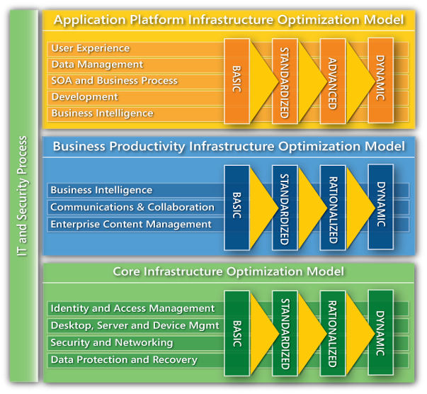
How are we evolving and how will this help us sell solution areas?
People Ready Business
Industry POV / Imperatives
Bridge
Solution Areas
Customer Business Discussion
Capabilities (IO Model)
Solution Area
Industry Specific Value Prop
Microsoft
Applications
(Dynamics, PPS, OBA, Project)
Partner Ecosystem
Support
(GSI, LSI)
Partner
Applications
(GISV, LISV)
Microsoft
Application Platform and Infrastructure
(Windows, SQL, BTS, VS, AD, MOM,…)
IT2B Bridge
People Ready Business
Industry POV / Imperatives
IT2B
Bridge
Solution Areas
Capabilities
Deployment Adoption
Enterprise Standard
End-to-End Business / Technology Discussion
Notes:
Where the Industry PoV aligns to our Solution Area Selling Focus
At the high-level, start with the People-Ready Business overarching message
Financial Services Industry Point of View -
A unique view of what the future holds for Financial Services (Banking, Insurance, Capital Markets). Uniquely positions Microsoft as a thought leader. “What does Microsoft have to say about this”
Why is our platform the platform of choice for today and why will it be for the future (in context of why our platform is the right platform for Financial Services.)
Solution Areas – What are we selling.
Standardized
connected to Industry Specific Value Prop
Includes 4 key components (3 pertaining to Microsoft bits, the 4th to Partner applications)
Consistent BOM
Simplified
Aligned to business imperatives by industry
Aligned to BDM role type (i.e. Sales, Finance)

Slide 9
Capabilities Vs Solution Areas
Rank | Solution Area | User Experience | Business Intelligence | Service Oriented Architecture | Data Management | Development | Unified Communication | Collaboration | Enterprise Content Management | Search | Identity and Access Management | Desktop, Device & Server Management | Security and Networking | Data Protection & Recovery
5 | Advisor Platform | X | X |  |  |  | X | X
38 | Agent/Broker Services | X |  | X |  |  |  | X
14 | Branch | X |  |  | X |  |  |  |  |  |  | X | X
20 | Claims Servicing | X |  | X | X |  |  | X
29 | Core Banking |  |  | X | X | X |  |  |  |  |  |  | X
6 | Customer and Performance Insight | X | X |  | X |  |  | X
17 | Customer Knowledge | X | X |  | X |  |  | X
4 | Document and Records Retention |  |  |  |  |  |  | X | X | X
35 | Institutional Client Platform | X | X |  |  |  | X | X
41 | Internet Banking | X |  | X | X | X
49 | Order Management & Trade Execution | X | X | X | X
32 | Payment Services Factory |  | X | X | X | X
47 | Portfolio/Investment Management | X | X |  | X | X |  |  | X
44 | Product Design & Development |  |  | X |  | X |  | X
50 | Regulatory Compliance & Controls for Financial Services |  |  |  | X |  |  |  |  |  | X |  | X | X
23 | Risk Analytics & Reporting | X | X |  | X |  |  | X
26 | Underwriting |  |  | X | X |  |  | X

Slide 10
Market size and trends (Colombia)
Primary Market | Secondary Market | Individual Market | Revenues in US Dollar [USD]
 |  |  | FY09 | FY10 | FY11 | FY08 Mix | CAGR | Total Sw
Hardware |  |  | $ 1,818,820. k | $ 1,975,326. k | $ 2,092,038. k | 31.4% | 6%
Services |  |  | $ 2,852,076. k | $ 3,175,196. k | $ 3,525,843. k | 49.0% | 8%
Application Development & Deployment |  |  | $ 420,084. k | $ 463,354. k | $ 507,749. k | 7.3% | 8% | 37%
 | Application Deployment Software | [6 Individual Mkts] | $ 135,875. k | $ 152,250. k | $ 169,736. k | 2.3% | 9%
 | Application Development Software | [5 Individual Mkts] | $ 30,828. k | $ 33,571. k | $ 36,643. k | 0.5% | 7%
 | Data Access, Analysis, and Delivery | [3 Individual Mkts] | $ 34,961. k | $ 40,065. k | $ 45,373. k | 0.6% | 11%
 | Information & Data Management | [5 Individual Mkts] | $ 187,452. k | $ 203,215. k | $ 218,327. k | 3.3% | 6%
 | Quality and Life-Cycle Tools | [2 Individual Mkts] | $ 23,595. k | $ 26,657. k | $ 29,921. k | 0.4% | 10%
Applications |  |  | $ 222,236. k | $ 252,048. k | $ 281,761. k | 3.7% | 10% | 19%
 | Collaborative Applications | [5 Individual Mkts] | $ 31,129. k | $ 34,331. k | $ 37,509. k | 0.5% | 8%
 | Content Applications | [5 Individual Mkts] | $ 88,981. k | $ 102,162. k | $ 115,054. k | 1.5% | 11%
 | Customer Relationship Management (CRM) Applications | [4 Individual Mkts] | $ 28,944. k | $ 32,737. k | $ 36,532. k | 0.5% | 10%
 | Enterprise Resource Management (ERM) Applications | [8 Individual Mkts] | $ 56,340. k | $ 63,702. k | $ 71,142. k | 0.9% | 10%
 | Operations and Manufacturing Applications | [2 Individual Mkts] | $ 7,975. k | $ 9,268. k | $ 10,685. k | 0.1% | 12%
 | Supply Chain Management (SCM) Applications | [2 Individual Mkts] | $ 8,868. k | $ 9,848. k | $ 10,839. k | 0.2% | 8%
System Infrastructure Software |  |  | $ 507,003. k | $ 566,927. k | $ 628,276. k | 8.6% | 9% | 44%
 | Security Software | [4 Individual Mkts] | $ 73,998. k | $ 87,949. k | $ 103,336. k | 1.2% | 14%
 | Storage Software | [8 Individual Mkts] | $ 90,213. k | $ 102,728. k | $ 115,953. k | 1.5% | 10%
 | System and Network Management Software | [7 Individual Mkts] | $ 146,642. k | $ 163,681. k | $ 181,642. k | 2.5% | 9%
 | System Software | [6 Individual Mkts] | $ 196,150. k | $ 212,569. k | $ 227,346. k | 3.4% | 6%
GRAND TOTAL |  |  | 5,820,221. k | 6,432,850. k | 7,035,667. k | 100.0% | 8%
Total number of entities for your selection |  | 233 | 1,149,324. k | 1,282,329. k | 1,417,787. k |  | 9% | 100%

Slide 11
Market size (Colombia)
Primary Market | Secondary Market | Revenues in US Dollar [USD]
 |  | FY09 | FY10 | FY11 | FY08 Mix | CAGR
Hardware |  | $ 120,634. k | $ 133,646. k | $ 142,766. k | 32.3% | 7%
Services |  | $ 184,319. k | $ 202,987. k | $ 223,063. k | 53.0% | 9%
Application Development & Deployment |  | $ 22,504. k | $ 25,148. k | $ 27,814. k | 6.3% | 29%
 | Application Deployment Software | $ 7,567. k | $ 8,687. k | $ 9,778. k | 2.0% | 12%
 | Application Development Software | $ 1,813. k | $ 1,952. k | $ 2,091. k | 0.5% | 11%
 | Data Access, Analysis, and Delivery | $ 1,470. k | $ 1,673. k | $ 1,870. k | 0.4% | 10%
 | Information & Data Management | $ 10,050. k | $ 11,099. k | $ 12,201. k | 2.9% | 6%
 | Other Development Tools | $ 376. k | $ 384. k | $ 390. k | 0.1% | 8%
 | Quality and Life-Cycle Tools | $ 1,228. k | $ 1,353. k | $ 1,482. k | 0.4% | 7%
Applications |  | $ 7,568. k | $ 8,599. k | $ 9,590. k | 2.1% | 14%
 | Collaborative Applications | $ 2,485. k | $ 2,765. k | $ 3,040. k | 0.7% | 8%
 | Content Applications | $ 2,670. k | $ 3,110. k | $ 3,520. k | 0.7% | 11%
 | Customer Relationship Management (CRM) Applications | $ 303. k | $ 338. k | $ 372. k | 0.1% | 7%
 | Enterprise Resource Management (ERM) Applications | $ 1,468. k | $ 1,675. k | $ 1,894. k | 0.4% | 16%
 | Operations and Manufacturing Applications | $ 533. k | $ 590. k | $ 632. k | 0.1% | 9%
 | Supply Chain Management (SCM) Applications | $ 109. k | $ 120. k | $ 131. k | 0.0% | 9%
System Infrastructure Software |  | $ 22,942. k | $ 26,274. k | $ 29,893. k | 6.3% | 19%
 | Security Software | $ 5,438. k | $ 6,801. k | $ 8,411. k | 1.4% | 24%
 | Storage Software | $ 2,733. k | $ 3,085. k | $ 3,470. k | 0.8% | 6%
 | System and Network Management Software | $ 6,024. k | $ 6,983. k | $ 8,043. k | 1.6% | 11%
 | System Software | $ 8,748. k | $ 9,405. k | $ 9,969. k | 2.6% | 4%
GRAND TOTAL |  | 357,968. k | 396,654. k | 433,125. k | 100.0%
Total number of entities for your selection |  | 53,015. k | 60,022. k | 67,296. k

Slide 12
Market size and trends (Venezuela)
 | Primary Market | Secondary Market | Revenues in US Dollar [USD]
 |  |  | FY09 | FY10 | FY11 | FY08 Mix | CAGR
 | Hardware |  | $ 154,592. k | $ 162,645. k | $ 168,783. k | 56.1% | 4%
 | Services |  | $ 64,399. k | $ 67,632. k | $ 70,620. k | 23.1% | 4%
 | Application Development & Deployment |  | $ 25,288. k | $ 28,138. k | $ 31,070. k | 8.6% | 8%
 |  | Application Deployment Software | $ 7,579. k | $ 8,572. k | $ 9,585. k | 2.5% | 10%
 |  | Application Development Software | $ 1,612. k | $ 1,746. k | $ 1,892. k | 0.6% | 6%
 |  | Data Access, Analysis, and Delivery | $ 1,358. k | $ 1,529. k | $ 1,692. k | 0.5% | 9%
 |  | Information & Data Management | $ 12,699. k | $ 14,002. k | $ 15,315. k | 4.4% | 8%
 |  | Other Development Tools | $ 329. k | $ 332. k | $ 335. k | 0.1% | 1%
 |  | Quality and Life-Cycle Tools | $ 1,712. k | $ 1,957. k | $ 2,251. k | 0.6% | 11%
 | Applications |  | $ 13,252. k | $ 14,805. k | $ 16,437. k | 4.5% | 9%
 |  | Collaborative Applications | $ 2,488. k | $ 2,723. k | $ 2,965. k | 0.9% | 7%
 |  | Content Applications | $ 3,063. k | $ 3,482. k | $ 3,911. k | 1.0% | 10%
 |  | Customer Relationship Management (CRM) Applications | $ 1,383. k | $ 1,520. k | $ 1,670. k | 0.5% | 7%
 |  | Enterprise Resource Management (ERM) Applications | $ 4,627. k | $ 5,089. k | $ 5,571. k | 1.6% | 7%
 |  | Operations and Manufacturing Applications | $ 222. k | $ 249. k | $ 280. k | 0.1% | 9%
 |  | Supply Chain Management (SCM) Applications | $ 1,470. k | $ 1,743. k | $ 2,040. k | 0.5% | 14%
 | System Infrastructure Software |  | $ 21,662. k | $ 23,398. k | $ 24,982. k | 7.6% | 6%
 |  | Security Software | $ 2,795. k | $ 3,034. k | $ 3,267. k | 1.0% | 7%
 |  | Storage Software | $ 4,492. k | $ 5,141. k | $ 5,699. k | 1.5% | 10%
 |  | System and Network Management Software | $ 4,049. k | $ 4,181. k | $ 4,305. k | 1.5% | 2%
 |  | System Software | $ 10,326. k | $ 11,042. k | $ 11,711. k | 3.7% | 5%
 | GRAND TOTAL |  | 279,193. k | 296,619. k | 311,891. k | 100.0% | 5%
 | Total Software |  | 60,203. k | 66,342. k | 72,489. k |  | 8%

Slide 13
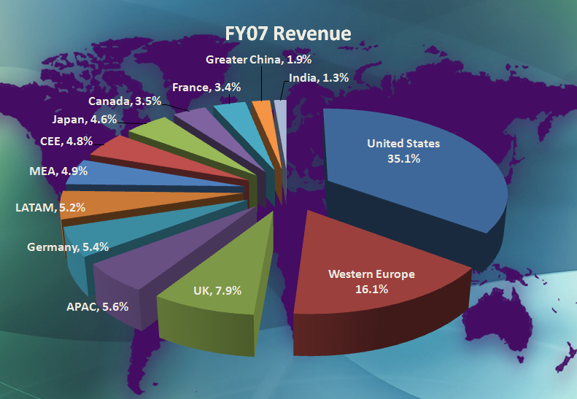
Global Business in FSI
Growing absolute revenue size
Qualitative shift in our business – into more and more “mission critical” transactional roles
Focus on Industry Solution to solve real Business Problems
People are noticing
Analysts, customers, partners
Increasingly influential in Microsoft’s core technology, marketing and product direction
Increasing importance of FS Industry partners

Slide 14
What does the future look like? EFMA banking advisory council:
Significantly lower cost base
Much greater customer-centricity
Process excellence
Easier cross border operations
Truly integrated customer and channel experience
Any sales or service request in any channel
Simpler product and service value propositions

Slide 15







Banking Industry Architecture Network
Business Agility
Non-disruptive and aligned
Improved time to market with new products
Flexible product definition based on orchestration of common services
Increased operational efficiency and reduced cost
Externalised process definition and management
Enhanced customer service through better technology support for people
Standards-based integration and access to information
IT Standardisation
Open and non-proprietary
Make SOA a reality
Convergence to a common ‘banking enterprise services’ landscape
Commercial availability of services which meet the requirements of the world’s leading banks
Integration based on semantics endorsed by the industry
SAP and Microsoft Join Together with Leading Industry Players and Global Banks in a New Association to Help Banks Establish a Service-Oriented Architecture
WALLDORF, Germany and REDMOND, Wash. — Apr. 30, 2008
BIAN

Slide 16
So what is a solution? In MSFT speak
Partners
LOB Apps, AML app, portfolio pricing, OMS, Core Policy etc
MSFT product
SQL, BTS, Office, Server etc
Horizontal
Vertical
Frameworks, Accelerators, Adapters, Guidance, Bundles
“Assets that reduce project cycle times”

Slide 17
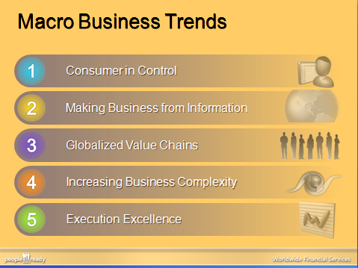
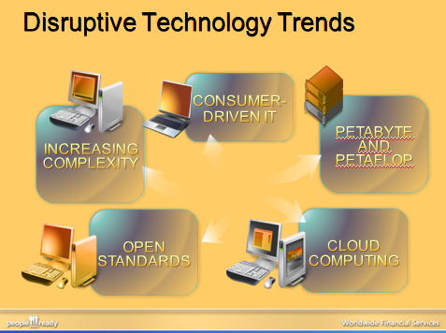
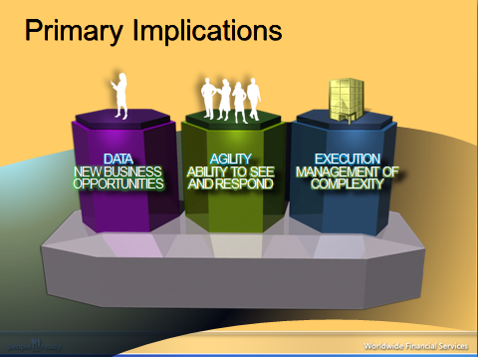
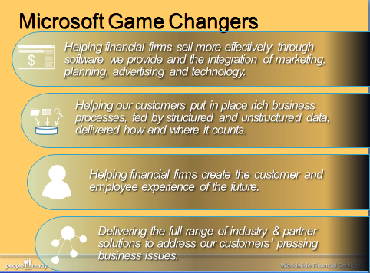
MS Industry Point of view

Slide 18



FY09 FSI Solutions Taxonomy
5 Business Imperatives
Customer Experience
Product and Service Innovation
Corporate Performance Management
Governance, Risk Management and Compliance
Operational Excellence
Advisor Platform
Internet Banking
Portfolio/Investment Management
Document and records Management
Order Management and Trade Execution
Institutional Client Platform
Product Design and Development
Customer and Performance Insight
Regulatory Compliance and Controls
Payments Services Factory
These are the focus
Execute SA
EAF aligned
Investment
Proactive
Branch
Underwriting
Core Banking
Customer Knowledge
Risk Analytics and Reporting
Claims Servicing
Agent/Broker Services
Customer Service
Payments Channels
Insurance Data Warehousing
Insurance Licensing and Compensation
Loan Origination
Quoting and Illustrations
Market Research and Credit Ratings
Core Banking Services
These are the solutions in the remaining “catalog”
Optional
Best efforts
Recruit and Build
ATMs
Treasury and Cash
Mobility in Banking
Reinsurance
Policy Administration
Clearing and Settlement
Exchanges, ECNs and Market Data
Notes:
FY08 Financial Services Industry Taxonomy (FINAL – April 1 2008)

Slide 19
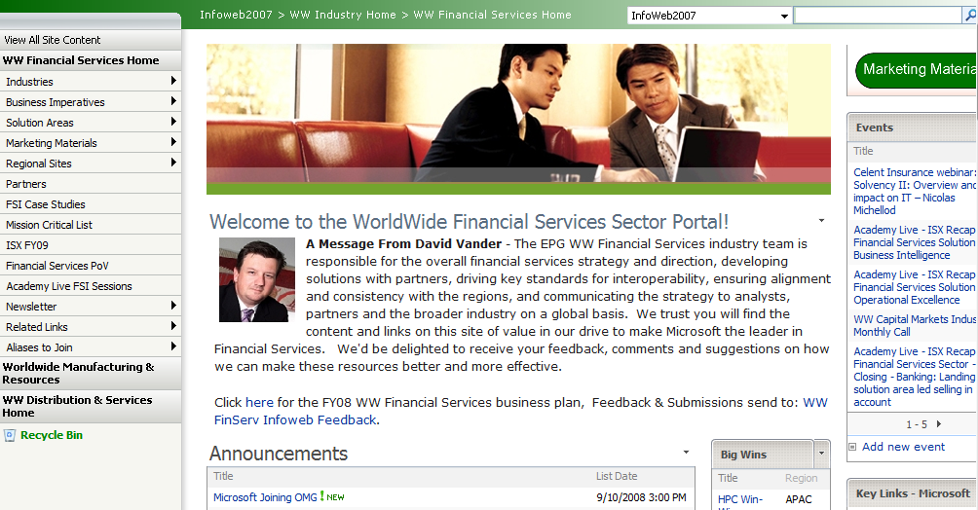
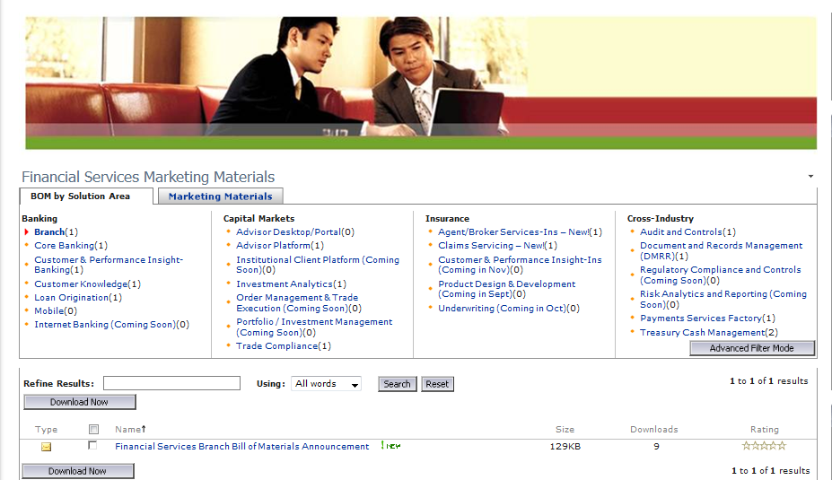
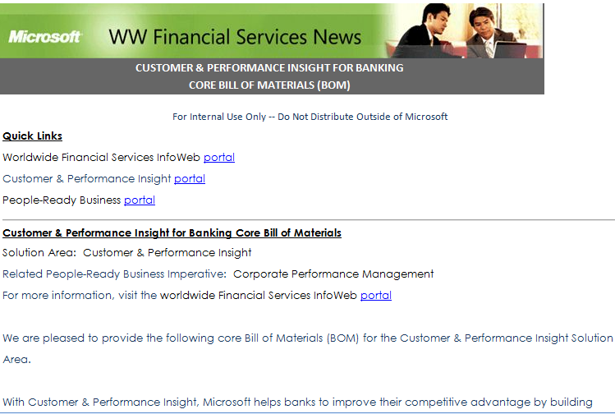
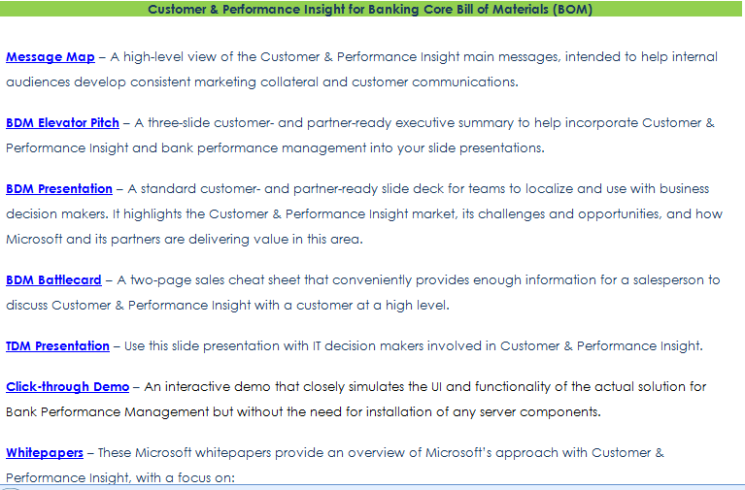
Sales and Marketing tools

Slide 20
Mission Critical Deployment in FSI
Santander – common payment backbone 62m message p/day, 1156 tps
London Stock Exchange – TradElect 3000 trades per second; 10ms down from 140ms
UniCredit (HVB) – 996 node cluster - reduced time to market for structured derivatives cross asset
SWIFT - Gold Certified
Central Bank of Spain - High Value Payments
CheckFree – 1000 tps and 24% less TCO
Nasdaq – Market Data Service handles 5,000 tps at market open
Garanti Bank - Turkey’s Garanti Bank Reduces Mainframe Loads Using SQL Server 2005 Solution
Banco Azteca - 64-bit Platform for Bank’s Core Transactions
DenizBank – Migrates Core Banking System to SQLServer 2005 (64 Bit) and .NET
SAP Core Banking Benchmark 8,279,000 postings to bank accounts per hour
Nationwide (UK) - Basel II Compliance Solution with SQL 2005 consolidating 80 different systems data & storing for 7 years
Fiserv CBS - Banking Software Scales to 10,000+ Concurrent Users with SQL 2005
Citi - Market Montage Solution Supports 200,000 msg per sec (70tb on SQL and growing)
Citi – CitiVision Integrates 270 Different Sources of Information for 12,000+ Global Investment Bankers
Citi - Corporate and Investment Banking Develops New Digital Identity Solution
Equifax - Equifax Sees 14 Percent Lower TCO Deploying Supercomputers on Windows Instead of Linux
Bank of Montreal: 18,000 users on .NET Smart Client for Branch (.NET Framework)
Merrill Lynch: - High-Performance Database Helps Brokerage House Position for Future Growth
Bank of America automates customer call center – 18,000 agents using Microsoft Customer Care Framework (CCF)
Equens - 25 TB Payment System
JPMorganChase – equities trading platform
Allstate – Producer Connectivity network leverages .NET while helping enable Policy Management solution in record time.
Barclays Capital Trade and Positioning System processing 200 trades/sec up to 1000 trades/sec
Reuters - Reuters Equities Research High Availability for 10 Tb on 64bit
Notes:
All blue text are hyperlinks to externally reference-able content
Enterprise-class performance and reliability
The latest SAP Sales and Distribution three-tier standard application benchmark running on HP and Intel hardware delivered record-breaking results with 93,000 concurrent users which is 3.5 times more scalable than SQL Server 2000. In addition, the SAP Transaction Banking benchmark showed 2,300 multi-transaction postings per second managing the typical daily volumes in a retail bank.
Superior Value
Microsoft, with industry partners AMD, Bull, HP, Intel, NEC and Unisys, announced several new TPC benchmarks running SQL Server 2005 that demonstrate its industry-leading value and performance.
Leadership in Web Services
Validating the integration of SQL Server 2005 and the .NET Framework 2.0, new benchmarks show the platform provides 183 percent better performance than equivalently coded EJB-applications running on IBM WebSphere 6.0 against and Oracle 10G backend at half the cost of IBM WebSphere running on RedHat Linux Advanced Server.
Deep embrace of 64-bit computing
New benchmark demonstrates the significant advantage the 64-bit architecture provides in terms of memory addressability and the specific midtier and data-tier scenarios where customers can look to 64-bit systems to significantly outperform 32-bit systems.
Integration of the Front, Middle and Bank Office
Worldwide, 42% of mission critical apps run on Windows, .NET is the #1 answer to the question, "What software application platforms will your company's mission critical apps run on in the Future?“. The top, most important criteria for selecting a software application platform were: Reliability, Interoperability, Function/capability, cost. (IDC November 2005)

Slide 21
FY09 Commitments
Notes:
Last month we showed our commitments, this slide shows the next level of detail and how we will measure our success in meeting our commitments

Slide 22
Call to action/Discussion
Identify your major vertical markets (and eventually geographies ) of interest
Identify your competencies/capabilities and find the related SAs (or vice versa)
Consider the convenience of partnering with others to rapidly gain access to expertise or new markets
!!Microsoft partner team can help!!

Slide 23

© 2007 Microsoft Corporation. All rights reserved. Microsoft, Windows, Windows Vista and other product names are or may be registered trademarks and/or trademarks in the U.S. and/or other countries.
The information herein is for informational purposes only and represents the current view of Microsoft Corporation as of the date of this presentation. Because Microsoft must respond to changing market conditions, it should not be interpreted to be a commitment on the part of Microsoft, and Microsoft cannot guarantee the accuracy of any information provided after the date of this presentation. MICROSOFT MAKES NO WARRANTIES, EXPRESS, IMPLIED OR STATUTORY, AS TO THE INFORMATION IN THIS PRESENTATION.

