Slide 1
An Architectural Lap Around Windows Server 2008
Stephen Lamb, IT Pro Evangelist, Microsoft UK Ltd.
http://blogs.technet.com/steve_lamb
+44 7812 980621
James O’Neill, IT Pro Evangelist, Microsoft UK Ltd.
http://blogs.technet.com/jamesone
+44 118 9093080

Slide 2
Agenda
Hyper-V
Network Access Protection
Branch Office
Terminal Services
BitLocker
Read-only Domain Controllers
Q&A

Slide 3
Hyper-V

Slide 4
Hyper-v
The technology formerly known as “Windows Server virtualization”
Where is Microsoft going with virtualization ?

Slide 5


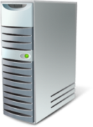



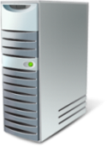




Server 2008 Virtualization Technologies
Server Virtualization
Presentation Virtualization
Hyper-V
Management
Desktop Virtualization
Application Virtualization

Slide 6
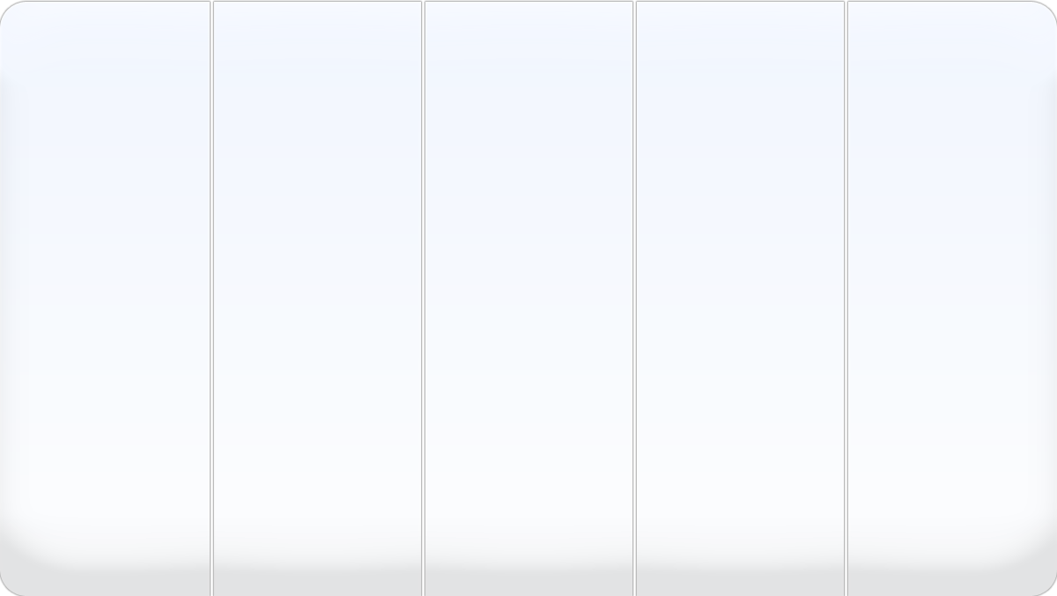








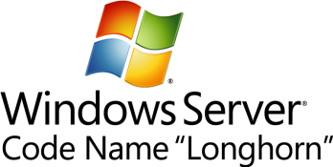










Virtualization Investments
A Multi-level Approach
Licensing
Infrastructure
Management
Interoperability
Applications
Terminal Services
Deliver cost-effective, flexible and simplified licensing
Royalty Free VHD format
Create agility
Better utilize server resources
Partner with AMD and Intel
Ease consolidation onto virtual infrastructure
Better utilize management resources
Support heterogeneity across the datacenter
OSP (Open Specification Promise) VHD
Accelerate deployment
Reduce the cost of supporting applications

Slide 7


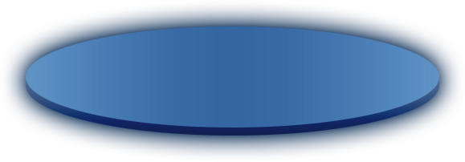


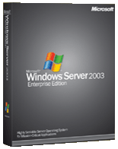

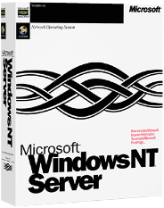



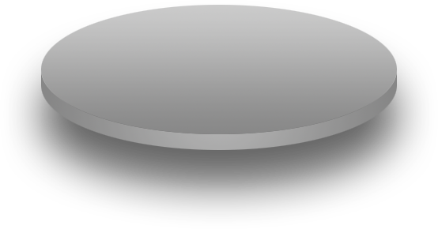


Introducing Virtualization Config and Architecture Challenges
Test and development automation
Server consolidation
Legacy application
migration

Slide 8
Introducing virtualization: Config & Architecture Challenges
Maintaining test / training environment
Segmenting from production
Quick rebuild / duplication
Supporting legacy line-of-business applications on aging hardware
Applications only supported on NT 4.0
Server sprawl
“One server, one application”

Slide 9
Server Sprawl ...
The Data-centre is FULL
Full of under-utilized servers
Greater wattage per unit area than ever
Cooling at capacity
In some places, electricity is maxed out
We can’t all move to Iceland
Companies worrying about environmental record

Slide 10
Hardware drivers
Multi-core architectures can deliver their best with virtualization
Many work loads are “a bit parallel” but not “Embarrassingly parallel”
Processors are going “Embarrassingly parallel”
Wattage goes up with Square of clock speed
Moore’s law gains will give more cores, not faster clock speed
Virtualization support on chip from Intel and AMD

Slide 11
Software maturity
The need is there, the hardware is there ...
Software is maturing too
More than one credible player in the market
We have moved beyond “Virtual PC”
It’s not just the Virtualization technology...
Management tools
High availability
Interoperability

Slide 12




Configuration and Architecture Virtual Server 2005
Guest OS:
Runs all major x86 operating systems
3.6GB RAM
4 NICs
56.5TB storage (IDE -SCSI)
2-N failover MSCS clustering
Industry-standard device models
Intel 440BX motherboard
DEC 21140 NIC
S3 Trio64 SVGA
IDE/ATAPI controller
Adaptec 2940 SCSI controller
Legacy devices
KBD, Mouse etc
No custom drivers needed
Up to 32 host CPUs
Up to 64GB host RAM
VS leverages existing system storage, networking and security infrastructure
Teamed NICs, teamed HBAs
VS Standard Edition Optimized for Windows Server 2003 Standard Edition (2-4P/32GB)
VS Enterprise Edition Optimized for Windows Server 2003 Enterprise Edition (<8P/64GB)
Application Guest OS
Application Guest OS
Virtualization infrastructure
VM monitor
COM API
Resource management
WMI/event log integration
Multiple Threaded Support
Virtual H/W
Virtual H/W
VS works with Windows:
Heartbeat from kernel/ scheduler
Windows Device drivers
x86/x64 server

Slide 13
Configuration and Architecture Virtual Server Performance & scale
R2 increasedScalability with 64-bit
x64 hosts - 32-bit guests
Windows Server 2003 Standard/Enterprise x64 Edition
Windows XP Professional x64 Edition
64-bit port of VMM and service
Better scaling from larger kernel address space
x64 systems typically can have more RAM
Increased Performance
Improved shadow page table management
Improved performance of guest process switching and memory intensive application
Early customer saw a 50% drop in CPU utilization

Slide 14
Virtual Server 2005 R2 interoperability
Wider Guest OS support
Linux VM Additions
Additional guests supported
Windows NT4
Windows Server 2000
Windows Server 2003 (& SP1)
Windows XP Professional Service Pack 2
Emulated Ethernet card supports PXE booting
Integrates VMs into deployment infrastructure

Slide 15
Virtual Sever 2005 R2 – SP1
Hardware-assisted virtualization support (Intel VT / AMD Pacifica)
Additional Guest and Host Operating Systems
Support for greater than 64 virtual machines on x64-based hosts
VHD Mount command-line tool and APIs
Tested for interoperability with SCVMM Beta 2 RC
Interoperability with Volume Shadow Copy Service.
Service Publication using Active Directory Service Connection Points
Host clustering whitepaper
Virtual SCSI fix for Linux guests
Larger default size for dynamically expanding virtual hard disks
VMRC ActiveX control and Internet Explorer Security Zones
API’s returns more operating system information

Slide 16




Configuration and Architecture Windows Server R2 EE Licensing (1)
Windows Server R2 Enterprise Edition INCLUDES 4 Instances
Windows
Windows
Windows
Windows
Virtualization Layer
Windows Server 2003 R2 EE
Hardware
Pre R2 License Model : Total: 5 Windows Licenses
Windows Server R2 EE: Total: 1 License

Slide 17


Configuration and Architecture Windows Server R2 EE Licensing (2)
License by “running instances”
Promotes the use of virtualization and a more dynamic data centre
Create and store images as needed
License the machine used instances
Library with 100 images of Windows
7 Servers running images
(1 per server)
Pre R2 License model
Total: 107 Windows Licenses
New License rights:
Total: 7 Windows Licenses

Slide 18
Application Licensing
App. Vendors beginning to account for virtualization
E.g. Microsoft SQL Server BizTalk® Server ISA Server Licensed per virtual processor in virtual machines

Slide 19
Virtual Machine management
Microsoft System-Center Virtual Machine Manager
Powershell applets, built on existing APIs to manage Servers, VMs and Libraries
Scripting interface to support Data centre automation
MMC user interface built on top
V1 for VS2005-R2/SP1. New API in WSV 2008 – support in V2.

Slide 20








Hyper-V
Greater Scalability and improved performance
SMP & x64 bit guest support
Increased reliability and security
Minimal Trusted Code base
Better flexibility and manageability
New UI
Integration with SCVMM
(Dynamically Add resources)
(Live OS/App Migration )
VM 2 “Child”
VM 3 “Child”
VM 2
VM 3
VM 1 “Parent”
Virtual Server 2005 R2
Windows Server 2003
Hardware
Windows Hypervisor
AMD-V / Intel VT
Virtual Hard Disks
(VHD)

Slide 21
Hyper-V vs Virtual server

Slide 22
Drivers and enlightenments
VMs in virtual server see emulated hardware
S3 Trio Graphics, DEC 21140 ethernet etc
Significant overhead
Enlightened VMs in Hyper-V see a Software bus
VM bus devices for network, graphics etc
VM bus links “stub” in child partition to driver in parent partition
Can can still emulate for unenlightened VMs

Slide 23
Demo
Hyper-V Management, Configuration and VM bus

Slide 24
VMWare comparison
 | Windows Server 2008 Virtualization | VMware V13 Starter | VMware V13 Standard | VMware V13 Enterprise
Volume Shadow Service Support for Host backup? | Yes | No | No | Proprietary Solution
Quick Migration? | Yes, RTM | No | No | N/A
Live Migration ? | RTM +1 | No | No | Yes
Unplanned downtime failover | Yes, RTM; Parity with VMware V13 EE | No | No | Yes; Parity with Windows Virtualization
Cost | $28 | $1000 / 2 sockets $2000 / 4 sockets | $3,750 / 2 sockets $7,500 / 4 sockets | $5750 / 2 sockets $11,500 / 4 sockets
Additional Comments: | High Availability Built In | No SAN support Limited to 8 GB of physical memory support | No migration or server side backup capabilities

Slide 25
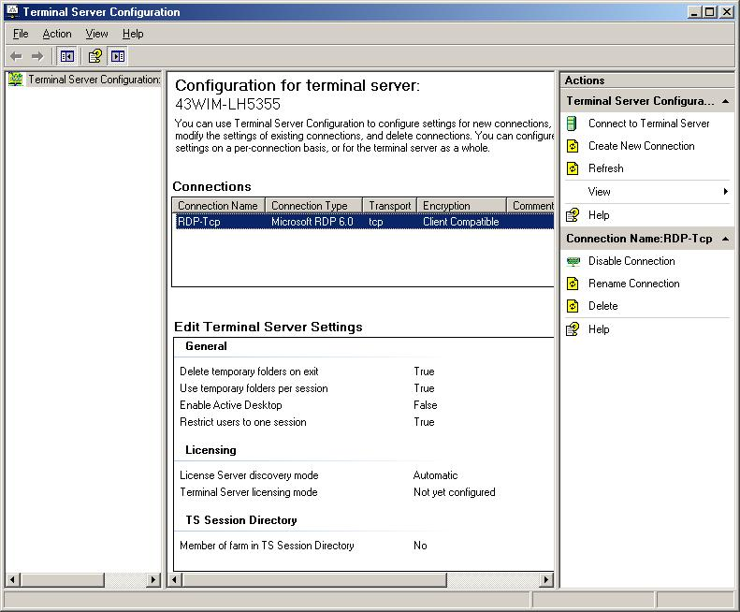
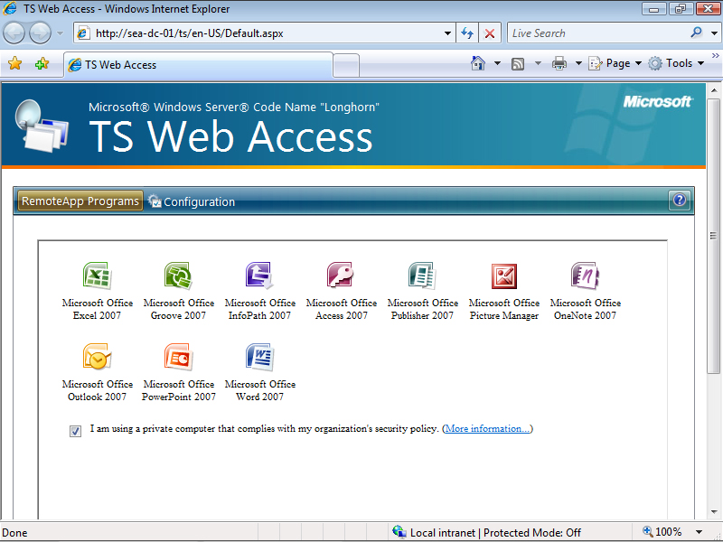
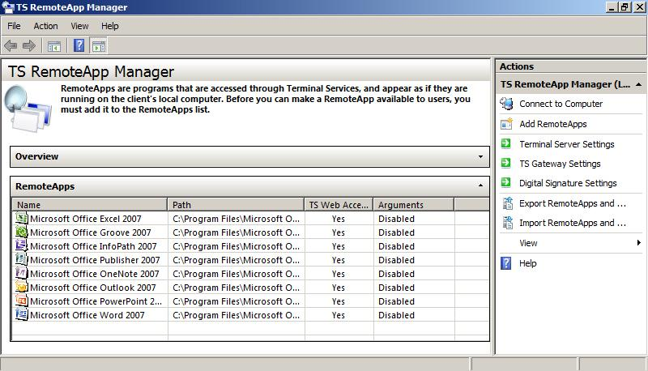
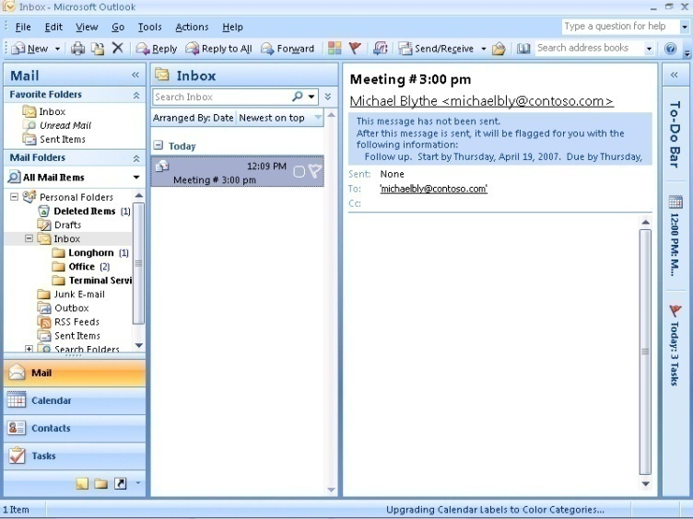



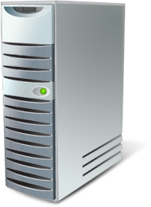
Terminal Services RemoteApp
Greater Flexibility
RemoteApp console used to make application available
Also used to make programs available via TS Web Access
Programs look like they are running locally
Only supported by Remote Desktop client 6.0, or newer
Remote programs integrated with local computer
Centrally configure a terminal server with the Terminal Server Configuration console
Remote Desktop client required
Terminal Services
Gateway Server
Notes:
25

Slide 26

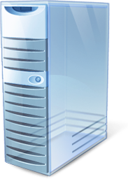
Terminal Services Gateway
Perimeter Network
Corporate Network
Internet
Tunnels RDP over HTTPs
Strips off RDP / HTTPs
RDP traffic passed to TS
External Firewall
Internal Firewall
Terminal Servers and other RDP Hosts
Internet
Remote/ Mobile User
Terminal Services Gateway
Network Policy Server
Active Directory DC
Notes:
26

Slide 27


Application Virtualization: Softgrid
Application Isolation
Dynamic Streaming
System Center Integration
Software as a Centrally-managed Service
Available through…

Slide 28
Network Access Protection

Slide 29






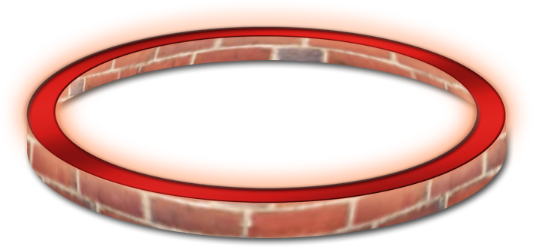



Integrating the Edge Policy, not topology, defines the edge
Notes:
Policy enforcement @ point of entry
802.1x
DHCP
IPSec
RRAS
The way we think about the perimeter is changing. Businesses are global, physically dispersed and are increasingly becoming logical constructs. Assets are global, workers are mobile, a growing number of devices proliferate, and threats to the network are becoming more sophisticated. The traditional concept of the “edge” is blurring. Firewalls are becoming inadequate protection in this new connectivity paradigm. Microsoft shares the vision that the edge is increasingly no longer a physical boundary.

Slide 30


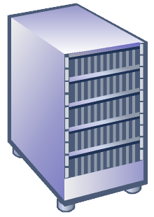

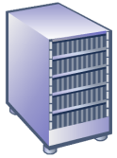
Network Access Protection Walk-through
Corporate Network
Restricted Network
Remediation
Servers
System Health
Servers
Here you go.
Can I have updates?
Ongoing policy updates to Network Policy Server
May I have access?
Here’s my current
health status.
Should this client be restricted based
on its health?
Requesting access. Here’s my new
health status.
According to policy, the client is up to date.
Grant access.
According to policy, the client is not up to date. Quarantine client, request it to update.
Client
You are given restricted access
until fix-up.
Network
Access
Device
(DHCP, VPN)
Network
Policy
Server
Client is granted access to full intranet.
Notes:
This is a build of Network Access Protection in action (DHCP/VPN example).
Health policy is set by the IT administrator. It is asynchronously plumbed by the system health servers to the Network Policy Server (NPS). The NPS server keeps a health cache at any given time.
The client tries to come in and requests network access. It passes across its statement of health (SoH). The Network Access Device ships this information over to the Network Policy Server (NPS). NPS compares it to what’s in cache and makes certain determinations. If the SoH doesn’t meet health policy, the Network Policy Server (NPS) tells the Network Access Device to restrict the client. The client could be put in a VLAN or separate subnet. The Network Policy Server (NPS) also tells the Network Access Device what the client needs to be healthy.
The NAP system information passed to the client by the NAP platform tells it how to access the fix up servers. The client contacts the fix-up server and requests update(s). Once updated, the client then presents a new SoH to the Network Access Device. This time, the health declarations match policy so the client gains full access to network resources.
The SoH is re-used to continue to access network resources until the policy is updated. The cycle continues to go to provide ongoing assessment and protection. When the client requests network access presenting an up-to-date SoH that matches policy, the client is granted immediate access to the network. Changes to policy may dynamically trigger the scan and remediate process.

Slide 31
IPsec-based NAP Isolation Model
Quarantine
Zone
Boundary
Zone
Protected
Zone
ALLOWED
ALLOWED
ALLOWED
BLOCKED
Notes:
Uses Kerberos
Integrated with Active Directory and Group Policy
Policy Definitions
Protected
Zone
All systems possess a Health Certificate
Authentication required to connect into a system
Boundary
Zone
All systems possess a Health Certificate
Authentication requested but not required to connect into a system
Quarantine
Zone
No Health Certificates
No IPsec policies

Slide 32
Terminal Services

Slide 33
What’s new in Terminal Services ?
Because it isn’t new, is it ?
Device Support
True Type
Server Roles
Display Changes
Single Sign-on
Session Broker
Remote App
TS Gateway
TS Web- Access

Slide 34
Support for Client side improvements
Making Terminal Services a first class citizen

Slide 35
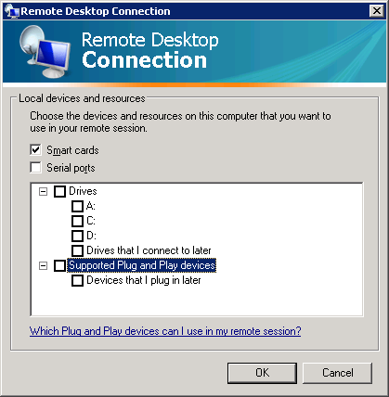
Device support
Can use client’s
Audio
Printer
Clipboard
Smart Card
Serial port
Drives
Camera / MP3 player

Slide 36
RDC display changes
Display improvements
Display was 4:3 and capped at 1600x1200
Now can be any size, including spanned monitors
ClearType supported
Vista-style desktop experience supported
Display prioritization
Print jobs don’t affect user experience

Slide 37
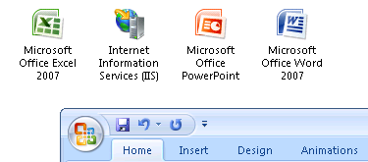
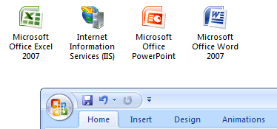
Experience options (off vs. on)

Slide 38
Single sign-on
Requires Vista or Server 2008 as the client
Group Policy setting
/Computer Configuration /Administrative Templates /System /Credentials Delegation.
In “Allow Delegating Default Credentials” Add termsrv/Servername

Slide 39
Server Changes

Slide 40
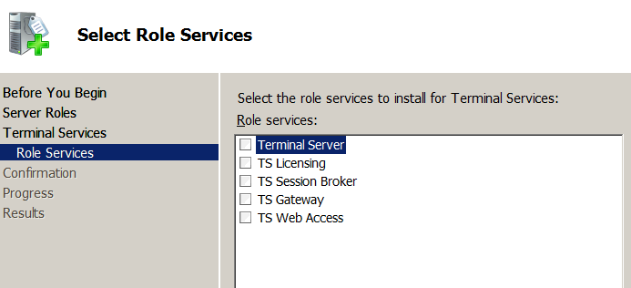
Terminal Services Roles

Slide 41
TS Remote App

Slide 42
TS Remote App
Client sees an application not a desktop
Applications identified at the server
Published in one of 3 ways
.MSI file
.RDP file
TS Web access

Slide 43
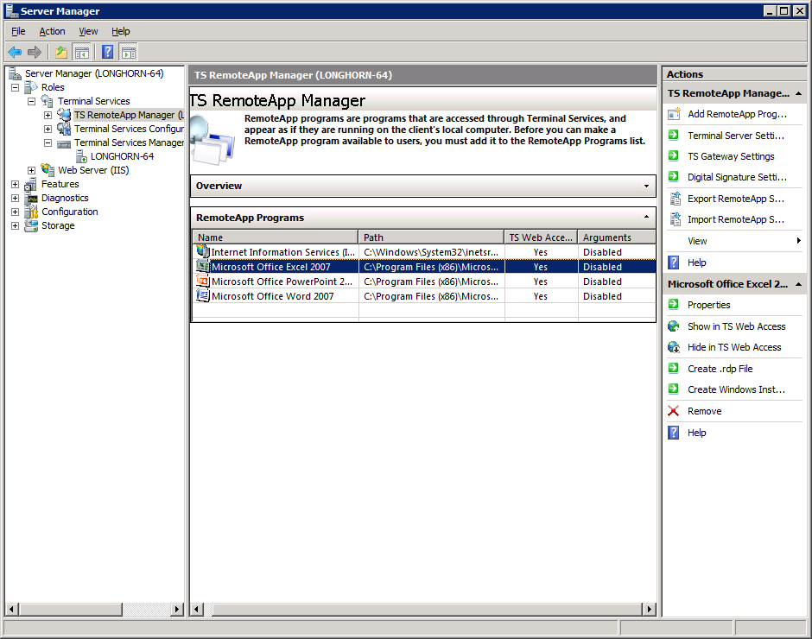
TS Remote App
Manage Apps Manage Config
Manage Sessions
Add app.
Connection settings
Copy apps
Create Install files

Slide 44
Demo
TS Remote App

Slide 45
TS Web access
Making available apps browsable

Slide 46
TS Web Access
Can embed TS client object on web page
Since NT 4.0 !!
Now have ability to launch apps or desktop
Pull down RDP file from web page
Run normal client

Slide 47
Demo
TS Web Access

Slide 48
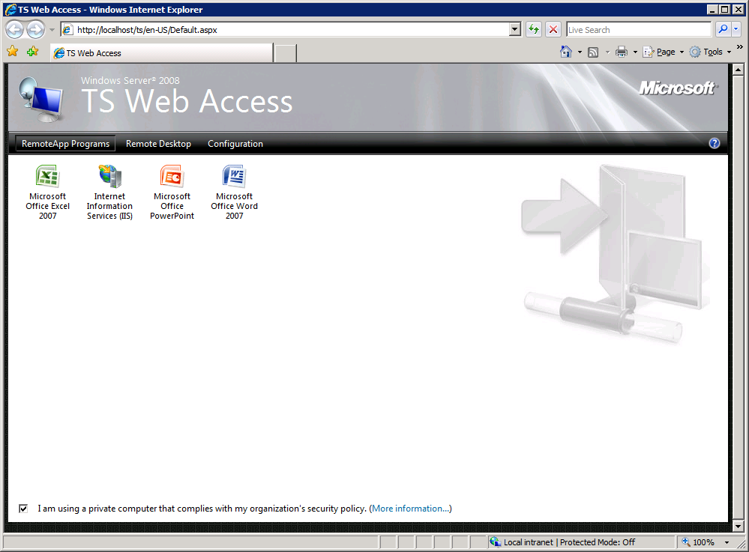
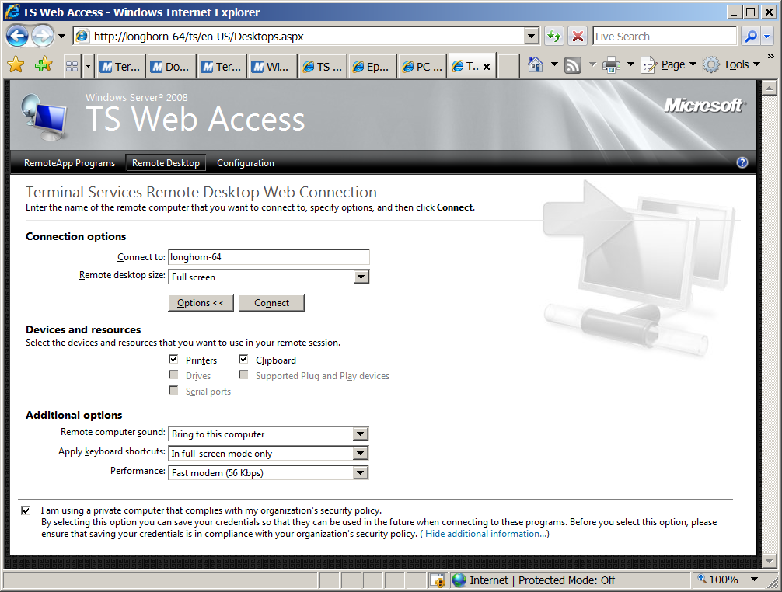

Slide 49
TS Session broker
Moving from servers to farms

Slide 50
TS Session Broker
Load balances sessions to terminal servers
Basic operation
User connects to a terminal server
Server knows it is in a farm
Server asks broker “where should this go ?”
User session is re-directed

Slide 51
Broker’s decision process
Does this user have a session ?
Reconnecting an open session
Second TS App session
If so connect to the same server
Does the server participate in load balancing ?
If not let it have the session
Otherwise, which servers allow new sessions ?
Calculate sessions / relative weight
Connect to server with lowest relative load

Slide 52
Server roles in a farm
Broker
Tracks sessions
Redirector
All servers which users initially connect to
Connection might be round robin DNS or more sophisticated
Terminal server
Runs the user’s workload

Slide 53
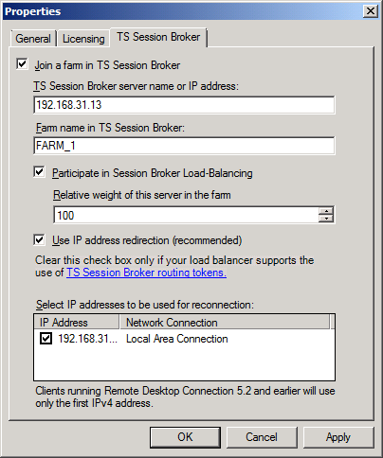
Configuring Farm membership
Group Policy
Or TS configuration

Slide 54
TS Gateway
Or “VPN considered harmful”

Slide 55
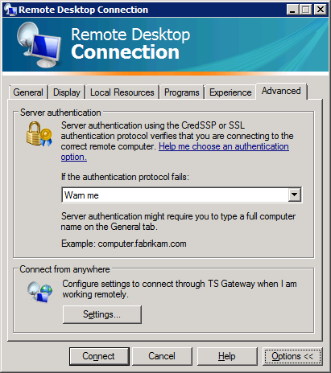
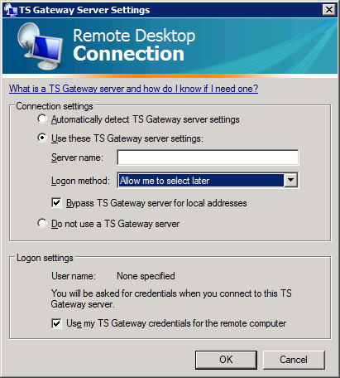
TS Gateway
Tunnel RDP using “RPC over HTTP” technology
Allow client to connect from anywhere

Slide 56
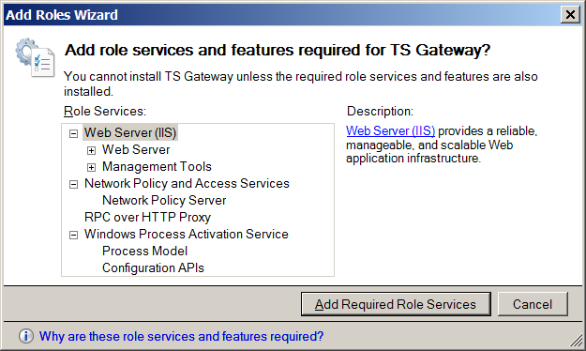
Adds Additional roles...

Slide 57
Configuration
Client
Setting in Group policy, or per connection
Server
Install role
Choose a Certificate
Set a Connection Access policy
Who and How
Set a Resource Access Policy
What
Multiple Servers can form farms
Publish with ISA...

Slide 58
Demo
TS Gateway

Slide 59
Combining Web Access with gateway
The Apps on offer in Web access can specify the gateway
(And can specify the TS Farm)
So publish the Web Access page and publish the gateway ....
Users get a portal of published LOB apps Accessible from wherever they are

Slide 60
Conclusions
Publish Apps: not desktops
Better client experience
Multiple publication options
Anywhere Access
Access Mail, IM anywhere, why not L.o.B apps ?
Scale with server farms
Third parties (e.g. Citrix) still add value

Slide 61
BitLocker

Slide 62

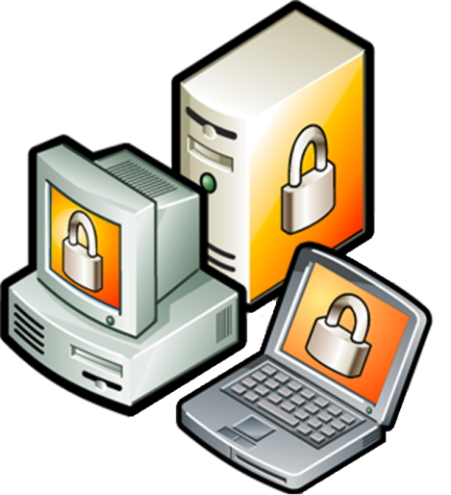




BitLocker™ Drive Encryption
BitLocker

Slide 63
BitLocker™ Drive Encryption Static Root of Trust Measurement of early boot components

Slide 64


Keys and Protectors (“Authenticators”)
USB Key (Recovery or Non-TPM)
TPM+PIN
TPM+USB
4
TPM
123456-789012-345678-
Recovery Password (48 Digits)
Notes:
Where’s the Encryption Key?
Data is encrypted with the FVEK
The FVEK is encrypted with the VMK and then stored in the volume metadata.
The VMK is encrypted by one or more key protectors, then stored in the volume metadata.
The Trusted Platform Module will not decrypt the VMK if the system integrity check fails.

Slide 65
Branch Office

Slide 66
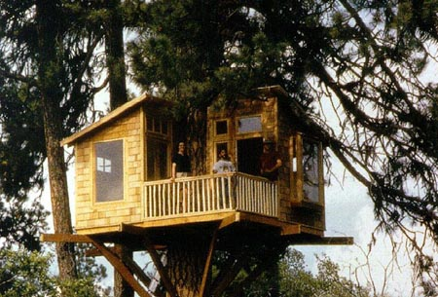

Slide 67
Technologies for the Branch Office
Virtualization
Read-Only Domain Controllers
Which run on Server Core
Admin Role Separation
Let Server admins be server admins
DFS-R for FRS
Cut WAN traffic, reduce exposure
DNS
Write-forwarding DNS servers in branch offices
Bitlocker
Blanket encryption

Slide 68
Read Only Domain Controller
Allows you to control three key things
Location of credentials
Resistance to WAN failure
Security

Slide 69
RODC Deployment Considerations
Bitlocker host
RODC DNS for clients
Notes:
Protect and RODC with BitLocker
If running as VM, protect host
RODC *must* be in a site adjacent with a writeable WS08 DC
If site link bridging is turned on, then all sites are adjacent
If using manual site links, take care!
Auto Site Coverage (WS03)
WS03 hub DC should not cover a site with an RODC
DNS
Clients should use RODC DNS as primary DNS
DNS is read-only, but will write-forward updates and immediately replicate them down
If WAN fails, name resolution may fail in a multi subnet branch

Slide 70
Choose Password Replication Policy
No passwords cached (default)
Most passwords cached
Few passwords (branch-specific accounts) cached
Notes:
No passwords cached (default)
Pro: Most secure, still provides fast authentication and local policy processing
Con: No offline access for anyone. WAN required for Logon
Most passwords cached
Pro: Ease of password management. Intended for customers who care most about manageability improvements of RODC and not security
Con: More passwords potentially exposed to RODC
Few passwords (branch-specific accounts) cached
Pro: Enables offline access for those that need it, and maximizes security for other
Con: Fine grained administration is new task
Need to map computers per branch
Requires watching Auth2 attribute list to manually identify accounts, or use ILM to automate.
There is an enhancement to Repadmin under development to help automate moving from Auth2 to Allow

Slide 71
How Many Domain Admins do you have?
?
Notes:
Admin Role Separation
Problem
Customers have too many Domain Admins
Most Domain Admins are really server admins (patch management, etc)
Solution
Provides a new “local admin” level of access per RODC
Also includes all Built-in groups (Backup Operators, etc)
Prevents accidental AD modifications by machine administrators
Does not prevent “local admin” from maliciously modifying the local database
This is a true security feature for Read-only DC

Slide 72
That’s All ☺
Stephen Lamb
http://blogs.technet.com/steve_lamb
James O’Neill http://blogs.technet.com/jamesone

Slide 73
Reference Material

Slide 74







Network Access Protection Components
Client
SHA – Health agents check client state
QA – Coordinates SHA/EC
EC – Method of enforcement
Remediation Server
Serves up patches, AV signatures, etc.
Network Policy Server
QS – evaluates client health
SHV – evaluates SHA answer
System Health Server
Provides SHV
Remediation
Servers
System Health
Servers
Updates
Health policy
Network
Access
Requests
Client
Health
Statements
Network Policy
Server
(RADIUS)
System Health Agent (SHA)
MS and 3rd Parties
Health
Certificate
System Health Validator
(SHV)
Quarantine Agent (QA)
Network Access Device &
Health Registration Authority
Quarantine Server (QS)
Enforcement Client
(DHCP, IPSec, 802.1X, VPN)
Notes:
Static NAP architecture slide – no build

