Slide 1
Presentation Guidelines
You can and should customize this presentation to speak to your local business audience. Insert your information where there is currently red text and feel free to add or delete anything else as suits your needs.
Here are some suggestions:
Add your own products that are relevant to the customer issue you are discussing (Slides 9, 12, 15, 28).
Add your own Tips and Tricks (Slide 17).
Update the next steps with the latest product offers from www.mslocalmidoffers.com (Slide 18).
Remove any Microsoft product slides that you do not want to feature (Slides 9, 12, 15, 22-28).
Add your own offers for your products or Microsoft products (Slide 29).
Add your own purchasing options (Slide 33).
This presentation is designed to be an interactive session between the speaker and attendees. Use the speaker notes to guide the discussion and encourage everyone to participate in sharing their experiences.

Slide 2
Successful businesses move at the speed of thought.
Presenter’s Name
Partner Name
Date
Insert Partner Logo
Insert Partner Logo
Insert Partner Logo
Insert Partner Logo
Notes:
In order to be successful, a business needs to be able to quickly make strong business decisions and adapt to meet challenges. I think we can all agree on that. But does your business move at the “speed of thought,” so to speak?

Slide 3

Notes:
Or do you feel more like this – that you have all the right ingredients and resources, but find it hard to translate that into business growth and success?

Slide 4
Welcome To Your Local Team
Meet other business people in your area
Share stories and insights
Find solutions to some of your biggest challenges
Tap into a local network full of resources
  [List Presenters & Introduce them here]
Notes:
We’re holding these events so you can create new, interesting networks of people with very similar challenges. Consider this a forum to share ideas and insights. It is also a place to find answers to critical business problems, with the help of local assistance.

Slide 5









How The Local Engagement Team Works
130,000+
Microsoft Partners
Local Business Community Organizations
Strategic Alliances
Microsoft Partners, complementary companies, and business community organizations are brought together at a local level to cater to customers’ needs.
Local Engagement Team Model
Notes:
The Local Engagement Team works to bring together Microsoft partners, complementary companies, and non-profit organizations to provide some of that assistance.

Slide 6
What Challenges Are You Facing Today?
These days, there’s constant pressure to get more value out of our existing staff. I need a solution that empowers our employees without adding more demands on my time.
It’s already difficult to manage our many applications and processes. There’s no way we can handle any growth. I need a solution that helps me take control.
Managing our customer relationships is key to our survival, especially in this economy. I need to optimize our customer service.
Notes:
When it comes to business growth, what’s keeping you awake at night? Many businesses have told us employee productivity is a major concern, as the state of the economy puts constant pressure on them to get more value out of existing staff. We’ve also heard about growing pains and the difficulty in managing an increasing number of applications and processes. Finally, customer service has come under scrutiny as managing customer relationships is especially crucial to business success in an economic slowdown.

Slide 7
Employees that use wireless notebook PCs increase their productivity by 100 hours per year.
--Dr. Jan Stringer
Notes:
How’s adding about 2 weeks of work per year sound for a productivity gain? Have any of you implemented similar changes? What were the results?

Slide 8
Pressure to Get More Value Out of Existing Staff
Increase the individual impact and productivity
of all your employees
Empower your team members by allowing them to customize their tools to suit their own work styles
Make better decisions by integrating your critical business information
Boost IT administrator effectiveness with more flexibility to set e-mail retention policies
Notes:
As the pressure to get more value out of existing staff increases, every little bit helps. Increase the productivity of your employees and you can increase the impact they make on your organization. Empower them with customizable tools and help them make better decisions by integrating critical business information from disparate sources. And don’t let the IT folks get left behind. Give them the advanced management tools that can boost their productivity too.

Slide 9
Increase The Individual Impact And Productivity Of All Your Employees
Empower your
team members
Make better decisions
Boost IT administrator effectiveness
Microsoft Dynamics® CRM and Microsoft Dynamics® GP business software give employees familiar tools and the power to customize their interface so they can work more efficiently.
Microsoft® Office SharePoint® Server 2010 allows you to create live, interactive business intelligence portals that assemble and display information from disparate sources.
Microsoft® Exchange Server 2010 increases flexibility and functionality allowing retention policies to be applied to e-mails individually or at the folder level.
[Insert Partner
product here]
[Insert Partner
product here]
Insert Partner
product here]
Notes:
Increasing the productivity of all your employees sounds nice, but how do you actually do that? The interfaces in Microsoft Dynamics CRM and Microsoft Dynamics GP can be customized so employees can work in an environment that suits their style and makes them as efficient as possible. The live, interactive business intelligence portals in Microsoft Office SharePoint Server 2007 do the work of assembling information from across your organization and present it so your staff can make better business decisions in less time. And the completely updated graphical management console in Microsoft Exchange Server 2007 includes a work center that integrates diagnostics, monitoring, and troubleshooting tools , enabling your IT administrators to increase their productivity.

Slide 10
Organizations waste up to $14,000 per knowledge worker each year because those workers are unable to find information and need to
recreate existing data.
--Source: IDC, The Hidden Costs of Information Work,
Doc # 201334, April 2006
Notes:
Ever have the feeling that what you’re working on has already been done by someone else? That’s a lot of time and money that could be put to better use.

Slide 11
Difficult to Manage Many Applications and Processes
Simplify your workflow at an organizational level
Standardize and streamline your processes
Simplify your document review process with
built-in collaboration tools
Focus on your core competencies and reduce operating costs with hosted IT services
Notes:
Don’t get buried in your organization’s build-up of applications and processes. Simplify your workflows by standardizing and streamlining your processes so team collaboration and information sharing is easy and streamlined. Take the hassle out of document review with tools built especially for this time-consuming process. Give yourself time to focus on your core competencies by offloading some of your IT services to an expert.

Slide 12
Simplify Your Workflow
At An Organizational Level
Standardize and streamline
Simplify your document review
Focus on your
core competencies
Microsoft Office Word 2007 in conjunction with Microsoft SharePoint Server 2007 provides built-in workflow services for tracking feedback and approval.
Microsoft Office SharePoint Server 2010 provides predefined workflows for common business scenarios to help your people collaborate and manage project tasks.
Microsoft® Office Professional 2010 in conjunction with Microsoft SharePoint Server 2010 includes built-in workflow services for tracking feedback and approval.
Microsoft® Business Productivity Online Suite lets you offload
the time and costs associated with managing and maintaining business systems.
[Insert Partner
product here]
Insert Partner
product here]
[Insert Partner
product here]
Notes:
So how can you take control of your organization’s many applications and processes? Predefined workflows for common business scenarios, available in Microsoft Office SharePoint Server 2007, are a great start to standardizing and streamlining your processes. In conjunction with Microsoft Office Professional 2007, it can also automatically track feedbacks and approvals for simplified document review. Give yourself more time to focus on developing your core competencies with the Microsoft Business Productivity Online Suite, a set of hosted applications that takes some IT services off your shoulders.

Slide 13
In 2004, only three out of five customers (59%) were satisfied with the response they received when contacting a company for assistance.
--Portland Research Group
Notes:
That means that potentially 2 out of every 5 customers you connect with will have an unsatisfactory experience. Do you really know how you measure up on this issue? How do you measure customer satisfaction?

Slide 14
Need to Optimize Customer Service
Enhance customer service and improve each customer’s experience
Respond quickly to customer service issues
Serve your current and potential customers better with all their history and contact information you need collected in one place
Automatically keep your staff apprised and your customers informed of important issues
Notes:
Regardless of how you measure up, optimizing customer service and keeping your customers happy is critical in the current economy. Improve each customer’s experience with quick responses to any service issues, and enhance service by having all your customer information collected in one, easily accessible place. Automatically alert customers to important issues, and always keep your staff informed of any open customer requests.

Slide 15
Enhance Customer Service And
Improve Each Customer’s Experience
Respond quickly
Serve your current
and potential customers better
Automatically keep your staff apprised and your customers informed
Microsoft Office Word 2007 in conjunction with Microsoft SharePoint Server 2007 provides built-in workflow services for tracking feedback and approval.
Microsoft Exchange Server 2010 enables employees to respond to customers from almost anywhere by providing access to important applications from a variety of clients and devices.
Microsoft® Office Outlook® 2010 with Business Contact Manager provides a central place to collect and control all contact, prospect, and customer information.
Microsoft Dynamics CRM gives you the option to keep your employees apprised of open customer issues and automatically send important e-mail messages to customers.
[Insert Partner
product here]
[Insert Partner
product here]
Insert Partner
product here]
Notes:
There are many ways to improve each customer’s experience with your company. Consider using Microsoft Exchange Server 2007 to give employees access to e-mail, voice mail, and other communications technologies from almost anywhere so they can respond to customers even when they’re out of the office. Equip them with Business Contact Manager, a feature of Microsoft Office Outlook 2007 that collects all customer history and contact data in one place, so they have all the information they need to adequately address customer concerns. Plus, take advantage of the powerful options in Microsoft Dynamic CRM that allow you to automatically send important e-mail messages to customers.

Slide 16
Tips And Tricks
Don’t forget to keep an eye on your human resources.
  Providing career paths will help keep your top talent in-house, and you can even consider fast-tracking your most productive employees with management induction programs. If possible, implementing an incentive-based remuneration plan for key staff lets people know you’re really serious about keeping them.¹
What’s the most efficient way to manage your data growth and storage?
Classify your data according to its business value and use a 3 tier storage system. The top tier, with the best availability, reliability, and performance, is where your most business-critical data should reside. The lowest tier can consist of the lowest-cost, highest-volume storage devices for data with the least value.²
It may take time to revamp your document management system
Here are some document-management questions to consider: What are the rules for creating documents? Should new documents be dated or time-stamped? What should the procedures for sharing or reviewing documents be? How are documents filed and stored? Are your storage devices reviewed at least yearly?³
¹“Ten tips for managing rapid growth,” William Buck; ²“Managing data growth: Nine tips for mid-market organizations,” Tim Smith; ³“3 Steps to Creating a Document Management System,” Susan Ward.
Notes:
What else can you do, perhaps as soon as you get back to your office, to start improving your business productivity and management? Here are some helpful tips to keep in mind. Your people are your most valuable resource, so make sure you reward them and keep top talent in-house. As your data needs grow, you may need to classify your data according to its business value so you can use the most cost-effective storage method for each type. Don’t get frustrated if your document management system takes some time to revamp, as there are a number of issues you should take into account.

Slide 17
More Tips And Tricks
Planning an IT change that will affect your employees?
When preparing for a change, be clear on the reasons behind it. When sending e-mails or other communications about the change, always relate it to the benefit you expect for the business. However, be honest about the difficulties ahead.⁴
Putting the green in “green.”
Your local utility company probably offers free energy audits that will pinpoint areas where you could reduce your energy usage. It’s estimated that many businesses could cut energy costs up to 60% by replacing outdated and inefficient electrical equipment.⁵
[Insert Partner Tip]
  [Insert Partner tip]
⁴“Communicating an IT system change: eight tips for success,” Nicholas Ranken;
⁵“Five Simple Ways to Make Your Business Greener,” Barbara Swenson.
Notes:
Change is never easy, and communicating it appropriately to your employees is important to getting everyone on board. Going green is not only good for the environment, but can help you save money too.
(Did you know? Every 10 PCs that switch to Windows Vista is the equivalent of taking an automobile off the road, in terms of greenhouse gases.)

Slide 18
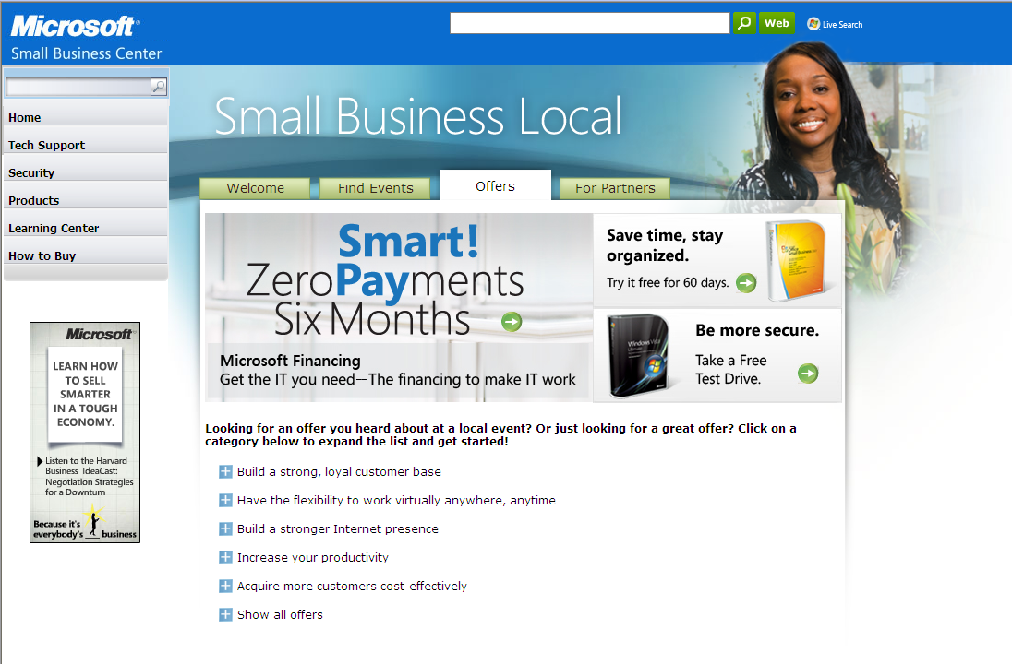
Take The Next Step
Go to www.mslocalmidoffers.com for more information about Microsoft offers for midsize businesses.
Microsoft Office Professional 2010 Offer A
Microsoft Office SharePoint Server 2010 Offer B
Microsoft Exchange Server 2010 Offer C
Microsoft Dynamics CRM Offer D
Microsoft Business Productivity Online Suite Offer E
Microsoft Dynamics GP Offer F
Notes:
Now that you’ve been equipped with all this information, take the next the next step and visit www.mslocalmidoffers.com. You’ll find special offers for midsize businesses on these and other Microsoft products.

Slide 19
Notes:
So if you think you have all the right ingredients for a highly successful business…

Slide 20

Notes:
…get the right productivity and management tools, and who knows, you might start moving at the speed of thought and bring the next big idea to the world!

Slide 21
Successful businesses move at the speed of thought.
Microsoft Product Details

Slide 22
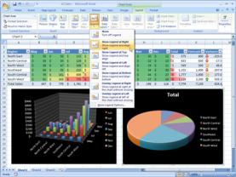
Microsoft Office Professional 2010
Bring your data to life so you can see the big picture. Quickly track data and run reports with Office Access’s intuitive interface—and discover patterns and highlight trends in your data with visual tools in Office Excel.
Find what you need, no matter where it’s hidden in your system. Scour your entire organization—from file servers to corporate enterprise systems— for the documents, business intelligence, social networking information, and people you need to get your work done.
Simplify document review with sophisticated comment tracking. Using Office Word 2007 in conjunction with Office SharePoint Server 2010, you can take control of your document review processes with built-in workflow services for tracking feedback and approval.
Accomplish more with innovative interface enhancements.
The new Ribbon keeps tools for common tasks at your fingertips. Visual galleries make it easier to get dramatic results. Live Preview saves time by showing you how changes will look before you make them.
Notes:
(Want more help demonstrating the productivity benefits of upgrading to Microsoft Office Professional 2007? Check out the Microsoft Office 2007 Productivity Boost Ready-to-Go Campaign in the Microsoft Partner Portal at: http://www.mspartnerdirect.com/action/microsoft/Default?go=220F64DFB4143939807F07862B1DF1F5.www2)

Slide 23
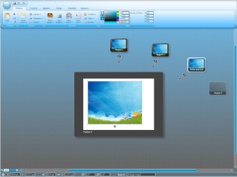
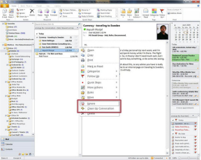
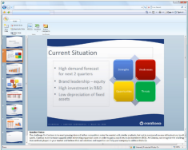

Microsoft Office Professional 2010
Increase productivity. Make it easier for employees to find and use the software features they need most often.
Give your business a competitive advantage. Deliver proposals and reports to customers faster. Edit documents at the same time and see who else is working on which sections.
Save time and money. Effortlessly produce compelling presentations, proposals and reports yourself.
Notes:
Increase productivity. Make it easier for employees to find and use the software features they need most often.
Give your business a competitive advantage. Deliver proposals and reports to customers faster. Edit documents at the same time and see who else is working on which sections.
Save time and money. Effortlessly produce compelling presentations, proposals and reports yourself.

Slide 24
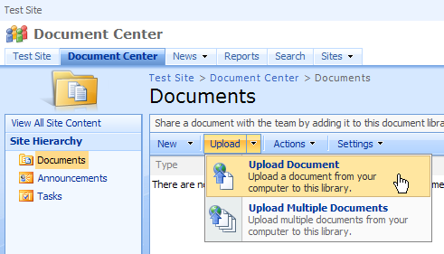
Microsoft Office SharePoint Server 2010
Enable more informed decisions with business intelligence portals. Create live, interactive business intelligence portals that assemble and display business-critical information from disparate sources, integrating dashboards, scorecards, key performance indicators, and other important data.
Manage and repurpose many different kinds of content. Get enhanced document authoring, business document processing, Web content management and publishing, records management, policy management, and support for multilingual publishing.
Streamline processes to empower more efficient collaboration. Provide predefined workflows for common business scenarios to help your people collaborate on documents and manage project tasks.
Give your people access to information throughout your company. Give users access to business data found in common line-of-business systems and enable them to create personalized, interactive views of your business systems through a Web browser.

Slide 25
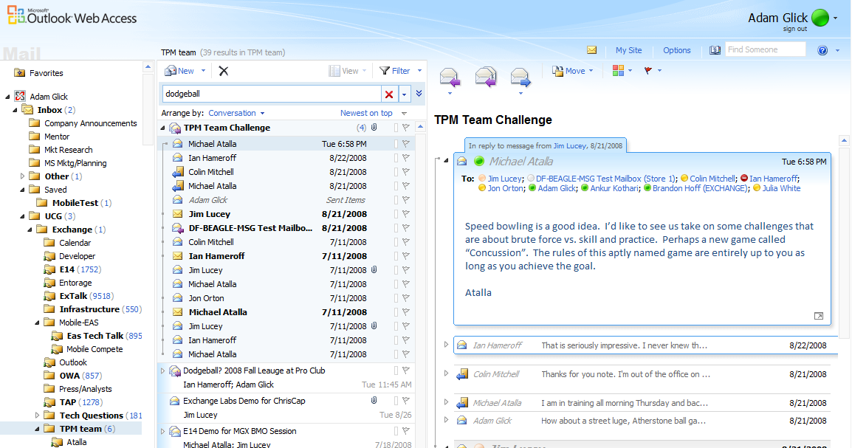
Microsoft Exchange Server 2010
Boost administrator effectiveness with new capabilities. Exchange increases flexibility and functionality allowing retention policies to be applied to e-mails individually or at the folder level.
Lower supports costs. Role-Base Access Control (RBAC) capabilities allow Exchange administrators to give selective self-management capabilities to end-users allowing organizations can reduce the costs for helpdesk support, and allow IT staff to focus on more important tasks.
Develop applications quickly. Enable rapid deployment for custom and third-party applications with the Web services-based application programming interface and .NET integration.
Get more out of the system you already have. Powerful new ways to filter, view, organize and manage their email allows systems to more efficiently handle the larger amount of information they are receiving and effectively handle and interact with that information.

Slide 26
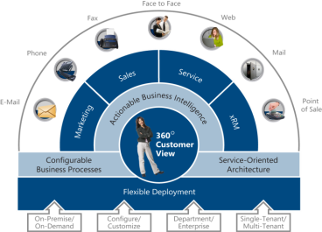
Microsoft Dynamics CRM
Make smart marketing choices by keeping tabs on your customers.
Get a clear view of customers with segmentation tools, give sales professionals real-time access to leads and complete customer data, and generate compelling data reports from Microsoft SQL Server.
Be more responsive—and valuable—to your customers. Respond faster to customer service issues and ensure service appointments are never missed with a centralized, all-in-one view of requests and service professional calendars.
Standardize and streamline your processes. The Microsoft Dynamics CRM adaptive workflow engine enables you to automate business processes in ways that make a real difference to every employee—and customer.
Achieve the best fit for your people. Familiar Microsoft Outlook, Word, and Excel environments enable users to get started fast—and even create their own dashboards and analyze customer information.
Notes:
(Not completely comfortable with selling Microsoft Dynamics CRM? For more information, check out the Microsoft Dynamics CRM 4.0 Ready-to-Go Campaign in the Microsoft Partner Portal at: http://www.mspartnerdirect.com/action/microsoft/Default?go=220F64DFB4143939807F07862B1DF1F5.www2)

Slide 27
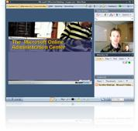
Microsoft Business Productivity Online Suite
Better information sharing yields more powerful teams. Enable your employees to create intranet sites to efficiently manage projects and processes, post calendar information, work together on documents, and maintain version control for shared files.
Get users started faster.
The Microsoft Online Services Sign In application automatically sets up services and allows users to access all of their services with no need to sign in each time they use them.
Centrally manage services and users. From the Administration Center, you can import multiple user accounts, use e-mail migration tools, create distribution lists, create Microsoft SharePoint site collections, and submit service requests.
Minimize the time and money you spend managing your software. Microsoft hosts and manages your software applications, so you can offload the daily headaches and cut your investment in on site IT costs.
Notes:
(Want more resources to help you educate customers on the benefits of Microsoft Online Services and the Business Productivity Online Suite? Check out the Microsoft Online Services Ready-to-Go Campaign in the Microsoft Partner Portal at: http://www.mspartnerdirect.com/action/microsoft/Default?go=220F64DFB4143939807F07862B1DF1F5.www2)

Slide 28
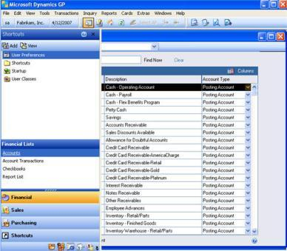
Microsoft Dynamics GP
Get the numbers you need for confident decision-making.
Access current, complete information from all areas of your business, and use a large number of pre-formatted reports to help generate insights.
Increase customer loyalty with more efficient service. By giving your account representatives easy access to customer information, you enable them to address customer needs and concerns more thoroughly, which increases customer satisfaction.
Accounting without busywork. Automate and standardize many recurring accounting tasks.
Unlock employee potential with a familiar work experience. Equip employees with familiar tools and empower them to customize their interface so they can work more efficiently.

Slide 29
Additional Products
[Partners – add your own products here, related to the customer issues you are addressing at this event]

Slide 30
Additional Offers
[Partners – add your own offers here, related to the products you are demonstrating during the event]

Slide 31
How To Purchase: Open Programs
The Open Programs are a convenient and simple way for small and midsize organizations with five or more desktop computers to acquire the latest Microsoft technology. With a customizable platform and volume discounts for minimal up-front purchases, Open Programs provide value and flexibility in a convenient Microsoft Volume Licensing program.
Open License | Open Value | Open Value Subscription
Provides an easy, one-time transaction process with the flexibility of acquiring licensing from a broad reseller channel. Offers the minimum license requirements and volume pricing with the flexibility to pay as you go. Allows you to acquire additional software products as needed to grow with your changing business needs. | Offers simplified license management for more control over your IT investment and better management of your software costs. Includes Software Assurance, the enhanced maintenance program that helps you get the most out of your software spending through each phase of the software lifecycle. | Offers the lowest up-front costs with the flexibility to reduce your total licensing costs in years when your PC count declines. Pay a single price per desktop PC to deploy Microsoft technology as the standard across your organization. Subscribe to, rather than acquire, the latest Microsoft technology. Includes Software Assurance.
Notes:
(Looking for more information on the different Open Programs? Check out the Volume Licensing sections under Licensing in the Microsoft Partner Portal at: https://partner.microsoft.com/US/licensing/40066884)

Slide 32




How To Purchase: Hosted Services
With Microsoft hosted services, you can offload the time and costs associated with managing and maintaining business systems.
Get more value out of your IT people.
By choosing a hosted solution, you can free your IT professionals from busywork and enable them to focus on strategy-level initiatives that can deliver a real competitive advantage for your organization.
Reliability you can bank on.
Each Microsoft data center, located strategically throughout the world, houses a highly reliable complex of equipment that provides seamless connectivity to the Microsoft Online suite of services.
You maintain complete control.
The central administrative panel includes consoles for provisioning, usage, monitoring, and support. You can continue to manage user policies centrally, and control which services are available to individual users.
No additional hardware needed.
With a hosted solution, there’s no additional hardware to pay for, and no additional server software to buy, install, or configure. Instead, you’ll have straightforward services that are easily deployed and scaled, without having to make a big upfront investment.
Notes:
(Want more resources to help you educate customers on the benefits of Microsoft Online Services and the Business Productivity Online Suite? Check out the Microsoft Online Services Ready-to-Go Campaign in the Microsoft Partner Portal at: http://www.mspartnerdirect.com/action/microsoft/Default?go=220F64DFB4143939807F07862B1DF1F5.www2)

Slide 33
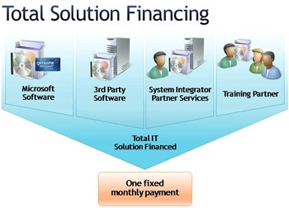
How To Purchase: Total Solution Financing
Total Solution Financing provides an easy, affordable way to get everything you need from one simple source. When you finance your IT solutions through Microsoft Financing, you get predictable monthly payments that are spread over the life of your IT investment, so you avoid straining your credit lines and making big upfront cash investments. That's technology financing that makes good business sense.
Finance one or more parts of the solution that includes Microsoft software for
improved scalability.
Take advantage of competitive rates.
Simplify financing with a streamlined process.
Use one resource for all your solution needs.
Spread payments over an extended
period of time.
Preserve financing resources and improve
cash flow.
Balance project results with cash outflows.
Notes:
(Need to learn more about Total Solution Financing and how you can offer it to customers? Check out the Customer Financing Options under Licensing in the Microsoft Partner Portal at: https://partner.microsoft.com/US/licensing/liccustomerfinancingoptions)

Slide 34
How To Purchase: Partner Solutions
[Partners – add your own purchasing options here, related to the products you are demonstrating during the event]

Slide 35
Insert Partner Logo
Insert Partner Logo
Insert Partner Logo
Insert Partner Logo
Insert Partner Logo

