Slide 1
Unified Communication: An essential tool in EHR roll-out and adoption as well as Caregiver Collaboration
Bradley Dick, CIO
Resurgens Orthopaedics
March 3, 2010

Slide 2
About Resurgens Orthopaedics
Founded in 1986
20 Offices around Metro Atlanta
  94 Physicians
  900+ Employees
  Largest Orthopaedic Practice in GA and one of the largest in the Nation
Ancillaries
  6 Surgery Centers
  16 Rehabilitation Clinics
  8 MRI Facilities

Slide 3
What is Unified Communications?
Unified communications (UC) is the integration of real-time communication services such as instant messaging (chat), presence information, IP telephony, video conferencing, call control and speech recognition with non real-time communication services such as unified messaging (integrated voicemail, e-mail, SMS and fax). UC is not a single product, but a set of products that provides a consistent unified user interface and user experience across multiple devices and media types. (Wikipedia)

Slide 4
EHR Implementation Challenges
Development
  Workflow Development
  Clinical Content Development
Support
  Systems Support
  Remote Management
Training
  Training Content Development
  Training Logistics

Slide 5
Development Challenges
Provider & clinical staff involvement
  Getting the right resources engaged
Camping out consultants
  Hotel, Travel, Hourly Rate
Quality of consultants
  The best SME are the hardest to get dedicated
Re-inventing the wheel
  Leveraging others experience and content

Slide 6
Support Challenges
Support Administration
  Timely resolution of issues
Remote Support
  Seeing what the provider is seeing
Support Staff
  Ensuring sufficient support coverage

Slide 7
Support with UC
Support Staff Collaboration
  Real time communication for support staff
  Audit trail of communication for documentation
Remote Support
  Desktop and Application sharing
Staff Management
  Presence

Slide 8
Training Challenges
Content Distribution
  Printing out large training manuals or emailing large screen shot documentation
Staff Accessibility
  Accessing clinical staff during clinic
Staff Location Disparity
  Travel costs, loss of productivity

Slide 9
Training with UC
Record Training Session
  Post recorded training sessions to portal for self service training
Train Multiple Sites at Once
  Save on lost productivity and travel costs
Offer Multiple Sessions
  The more sessions offered the more staff trained

Slide 10
Not Just For EHR
Provider Collaboration
  Chart & Case Reviews
  Specialty Consults
Committee & Board Meeting
  Flexible scheduling enabling remote attendance
  Documentation through recording

Slide 11
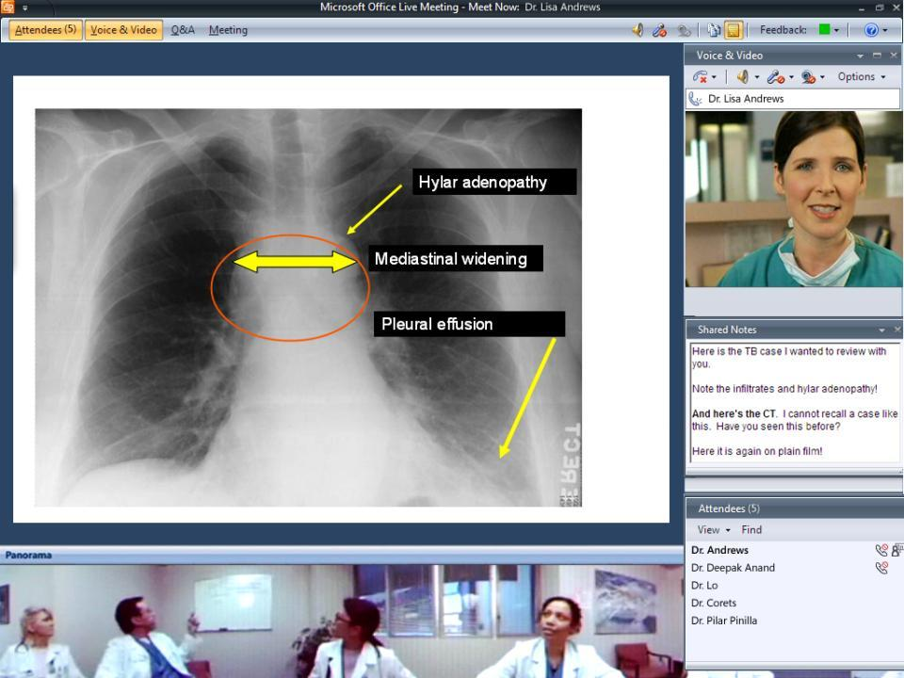
Notes:
Dr. Andrews uses mark-ups to highlight important areas

Slide 12
Summary
Utilization of Unified Communication Technologies enables efficiencies through greater collaboration.
Real-Time communication and presence expedites resolution and improves quality of support
Web Audio/Video conferencing enable greater adoption by offering greater opportunities to consume training content.

