Slide 1


Designing and Creating Enterprise Portal Solutions on Microsoft Office SharePoint Server 2007

Slide 2
Session Objectives
Learn how you can build and run usable, award winning portals on MOSS
Dynamic IT: Learn how to stay flexible and meet requirements with minimal custom code to get the most out of the platform
Learn from real enterprise portal implementations done within Microsoft

Slide 3
Agenda
Planning & Portal Design
Web Content Management
Dealing with Dynamic Data
Build & Deployment
Portal Architecture/Hardware Topology
Operational Lessons Learned

Slide 4
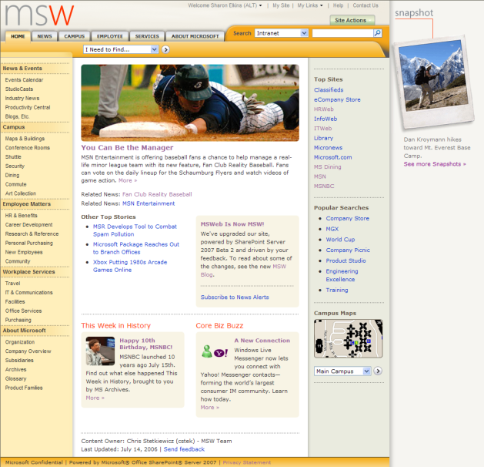
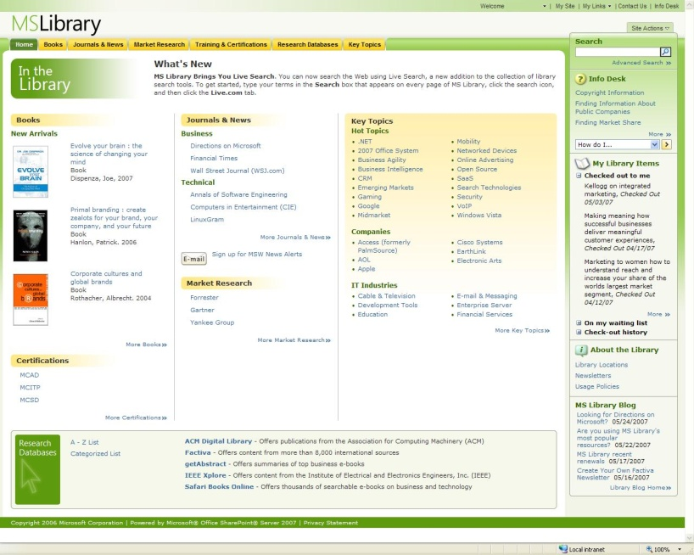
Microsoft Internal Employee Portals
Microsoft Web (MSW)
MS Library
Company portal
Employees use MSW to find information, stay informed and make productive use of the intranet
Library portal
Employee’s primary access point to business & technical research resources
eBooks, print books, industry reports, company information, conference proceedings, journals and more

Slide 5
Planning
Upgrade vs. net new
Built net new portals on SharePoint Server 2007 (MOSS)
MSW on Office SharePoint Portal Server 2003 had lots of baggage
No longer needed custom solutions, site definitions and layouts
MS Library - Previous site was a custom application
Goal: Re-think and re-architect based on SharePoint Server 2007
Meet business needs as simply as possible
Get close to out-of-the-box SharePoint Server 2007 as possible
Simpler to operate, cheaper to build, sustain and upgrade with the platform
Build solutions following SharePoint Server 2007 models
New information architecture & design

Slide 6
Planning
Branding your site
Plan the brand strategy
Voice, tone, character, other brand guidelines
Know your platform
SharePoint Server and Office SharePoint Designer (SPD) are flexible, but make sure you don’t just get Photoshop images
Work with designers who can leverage SPD
Try out content variety
First iterations more for rough design rather than real content placement
Place real content on the pages (not just Latin!)
Long strings, multi-levels of headings, tables

Slide 7
Planning
Evaluating your content
Know your content
Review business goals
Do a full content audit
MSW and MS Library built content maps
Design your Information Architecture
Determine basic navigation flow
MSW & Office SharePoint Server usability study indicated Top and Left navigation combined provided best results
Organize your content
Watch and plan for content depth

Slide 8
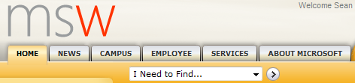
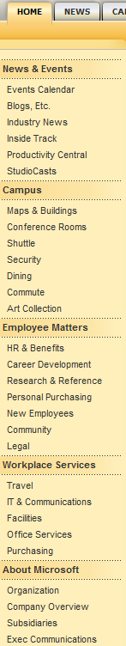
Planning
Content organization
MSW: Uses both global and Left (current) navigation to expose deeper site content
Global top remains consistent
Local left varies depending upon location in Site Collection
Tasks & Tools List feature used to provide direct access to popular pages
MS Library also uses headings feature to provide category structure to pages within a site library

Slide 9
Web Content Management
Site design: Page Model
Separation of content and presentation
Master page defines common site elements like navigation, the header, and the footer
Page layouts are templates that define how a page looks and what content is displayed on the page
Both portals designed with only a few custom master pages, but several page layouts
Created custom master files using the BlueBand.master as a template (not default.master)
3 master files across both portals (Branded with nav, branded with no nav, & unbranded)
Custom layouts enable flexible management of content with consistent design

Slide 10
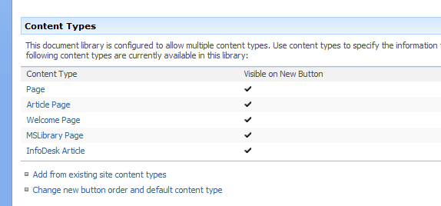
Web Content Management
Site Design: Content Types
A set of fields grouped together to define metadata, behavior, and content workflow
Content Types support inheritance
We created custom content types—derived from the OOB Pages—and used these throughout the portals to drive dynamic page display
Helps manage data by centralizing shared field content
We use common field types for content targeting and workflow management
Document Property Panel
Apply Document Information Panel settings to libraries for specific content types to ensure consistency of content

Slide 11
Web Content Management
Site design: Page layouts
Templates for a content page
Based on a content type defining the column elements available
These are made available on the page as editable content areas called field controls
Content controls include both field controls and web part zones
These content controls can be modified through property settings
Page content and properties are stored in the pages document library
We have ~20 layouts / portal

Slide 12
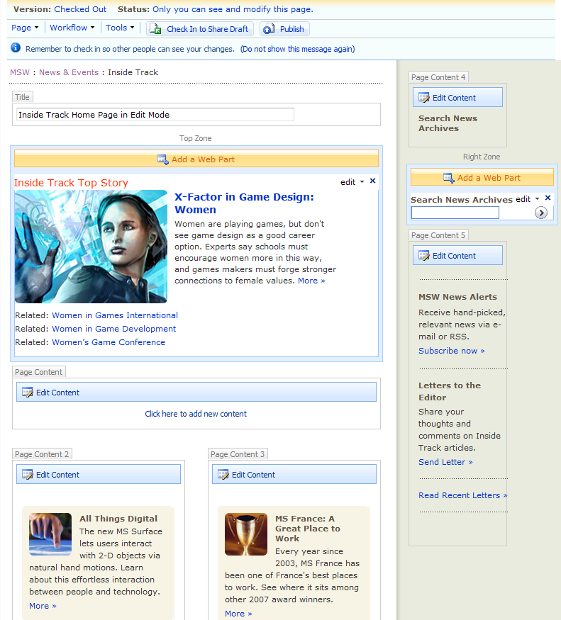
Web Content Management
Content Controls: Web Parts & Field Controls
Web Part zones: groupings of Web Parts; a defined area for the insertion of Web Parts on a page
Field controls: specific, editable parts of the page associated with a column defined in the content type the page layout is based on
Field control contents can be versioned
Examples include
HTML Editor
Page properties (Metadata)

Slide 13
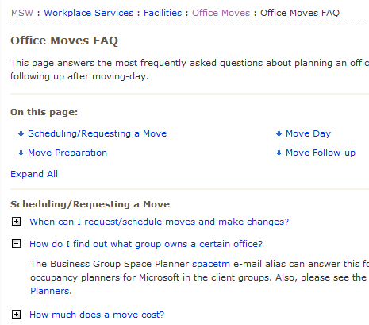
Web Content Management
Page design: Layout example – MSW FAQ
Illustrates flexibility of MOSS layout model
Dynamically builds page based on application of styles to content in a HTML Editor
JavaScript referenced in page layout
Builds a TOC of intra-page jump links
Renders expand-collapse display of questions and answers

Slide 14
Web Content Management
Site Design: Style management
All CSS and XSLT files are maintained in a central style library
Both portals use a global CSS file that defines custom styles and overrides out-of-box ones
Can be referenced using the CSS Link Server control or the alternate CSS path settings
<Sharepoint:CssLink runat="server" DefaultUrl="<% $SPUrl:~sitecollection/Style Library/~language/Core Styles/msw_custom.css %>"/>
All custom formatting for the roll-up Web Parts is added directly to the out-of-box XSL files

Slide 15
Web Content Management
Content caching
Page Output and Object Caching
Used to improve page load performance and eliminate trips to the database by persisting compiled pages in memory
We use out-of-box (OOB) Intranet cache profile to ensure permission settings are honored
Page Output caching is set to the site level so we can disable or modify in select sub-sites
Object/Disk caching is used to persist static files like images. We set this to 350 MB maxSize
We use the Debugger feature to verify in cache profile settings in the source code

Slide 16
Publishing Takeaways
Lessons learned
Navigation: flexible provider(s) to support front- and back-end needs
Layout design is critical and will change as portal develops
Content display: How content should be stored is important (baked into layout, stored in Web Parts, stored in page via field controls) and how it will be accessed
Content controls support attributes for locking down properties

Slide 17

Dynamic Data Creating a More Dynamic Portal

Slide 18
Dynamic Web Parts
New Office SharePoint Server 2007 features allow content to be more easily distributed and re-used
Examples
Content by Query (CBQ) Web Part
List viewer Web Part
BDC Web Part(s)
Search
Table of Contents (TOC) Web Part

Slide 19

MSW's "Dynamic" Home Page

Slide 20
MS Library's Version of "Dynamic"

Slide 21
Dynamic Portal Design
New Web Parts & features
Both portals rely on query Web Parts to display filtered views of items stored in sub-site libraries and lists
Query Web Parts allow building of dynamic pages w/ centralized content management and consistent formatting
List columns can be declared in the Web Part properties and then filtered on for the desired page
Reusable Content feature allows storing centrally and reusing HTML fragments in page field controls

Slide 22
Dynamic Portal Design
Content Query Web Part (CBQ)
We love this new Web Part!!
Customized to expose promo, calendar event, resource pages, and blog post roll-ups on other pages
Specific tags on items used in filter, i.e., MSW home page promotion containers
Filters on list columns to populate right rail of MS Library pages
Used to provide custom displays of news across site
Provided means of automatically building archive pages and categorized content without repetitive manual entry

Slide 23
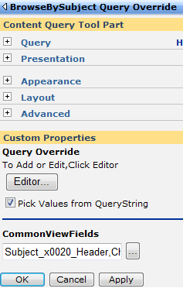
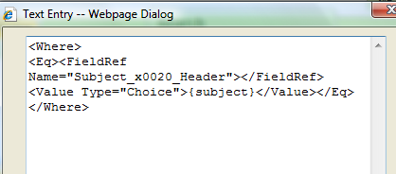
Dynamic Portal Design
How we customize the CBQ
Configured query parts re-posted to galleries in both portals to facilitate re-use
Created an extended version with more properties exposed
Added a query override call to dynamically update same page contents based on URL parameters

Slide 24
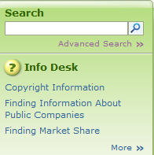
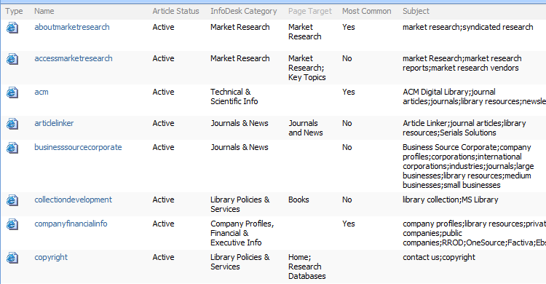
Dynamic Portal Design
How we customize the CBQ (Cont.)
Use target and status fields to enable content filtering and display

Slide 25
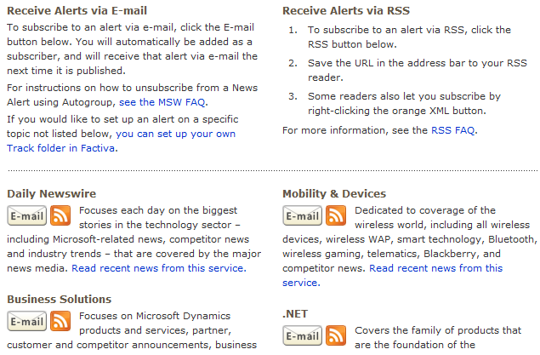
Dynamic Portal Design
Content delivery
Leveraging RSS
All lists and libraries can be enabled to emit RSS
Content Query (CBQ) Web Part can emit RSS stream of displayed results
Created a custom remote list query Web Part to display content from different site collections (where RSS viewer not able to, due to authentication issues)

Slide 26

Dealing with Dynamic Data
Case Study on MSW
Content Delivery Challenges on MSWeb 2003
Home page was manually created every day
Stories were copied to every category specific page
Stories were copied off of primary news pages onto news archive pages
News e-mails handcrafted daily with selected stories often being hand added to multiple e-mails
Goal for MSW 2007: content delivery automation
MSW Home page
MSW targeted news pages & archives
Future Library portal Topics pages
Daily MSW Newswire e-mail/Targeted MSW News Alert e-mails

Slide 27

Dealing with Dynamic Data
Case Study (Cont.)
News Workbench
Custom solution design to automate manual processes for the consumption, selection, and delivery of external news content
Sent using a custom Web Part that pulls list items via CAML and generates the HTML using a pre-designed template
Supports page targeting of selected content via query web parts
 | Solution | Description
Content Consumption | Data pump (custom) | Consume XML feeds and insert into SharePoint list
Content Discovery | Search | Index list twice daily
Tagging | Item tagger (custom form) | Selected items copied to new list w/ tagged values
Delivery | News mailer (custom WP) | Displays a filtered set of tagged items for e-mail

Slide 28
Build & Deployment How We Configure and Maintain Our Portal Properties

Slide 29
Build and Deployment
Challenges we had to learn from
When we first started with MOSS 2007, we had no consistent approach to building or deploying SharePoint components
CAB and DDF files generated manually
Install scripts were manually created and maintained
Each solution had unique deployment documentation
Deployment process was error-prone, especially when rebuilding an entire site
Most bugs were due to deployment and found late in testing

Slide 30
Build and Deployment
Our approach
We exclusively use SharePoint solutions packages
Build process is customized with custom target files to dynamically generate solution package
Deployed through single batch file that
Handles multiple solutions
Establishes repeatable install workflow
Generated by build process
Supports rapid farm or WFE build

Slide 31
Build and Deployment
Web Part development
Package resource files with the solution (i.e., images, CSS and JavaScript files)
Add a caching expiration time as Web Part property
Use PortalLog and SPSException for error handling
Separate UI presentation layer
XSLT Web Part property to format structured result sets where it applies (i.e., search result scenarios)
Use User Controls to encapsulate the UI for server controls
Put all labels & strings in resource files (i.e., localization)

Slide 32
Build and Deployment
Web Part development (Cont.)
Support web part connections
Use web part connections when passing variables between Web Parts
Accept filter connections (i.e., current users & user profile property filters)
Use delegate controls (i.e., welcome control)
Give security access as appropriate and use CAS policies
Reference with “using” statements or dispose objects properly after use

Slide 33
Build and Deployment
Internal vs. External Storage - To list or not to list?
Content storage really depends on complexity of data
SharePoint lists work great for simple, flat data
Advantages of using lists
Tight integration with search
Good OOB roll-up and display functionality (no custom code)
Large lists (~200K items) do work if
Display is carefully managed through custom views or code
Use folders, this will keep the crawler from timing out when indexing
Crawler goes through the UI
Allows the expiration policy to work properly
Use search rather than CAML based UI when interacting with large lists
Faster but dependent upon crawls

Slide 34
Operations Portal Architecture Hardware Topology

Slide 35

Shared Services at Microsoft
Shared Services
Search
Directory import
User profile synch
Audiences
Business Data Catalog
Excel Services
Usage Reporting
Web Apps
Web App
MSW
Sales
My
HR

Slide 36
MSW and MS Library Topology

Slide 37
Operations Lessons Learned

Slide 38
Operations
Lessons learned: Performance
Change CBQ Defaults for large sites
The default of the CBQ is to run a query against every list in a site collection
Either change default to be opt-in instead of opt-out or ensure your Site Publishing rules accommodate this
Large lists can be a source of performance issues if not designed with the following in mind:
No folder should exceed 2000 items (an item being either a list item or sub-folder)
Use item expiration where appropriate
Index fields to be used in CAML queries

Slide 39
Operations
Lessons learned: Performance (cont'd.)
Schedule regular maintenance of your SQL databases, including
Database defragmentation
Update statistics/re-index key tables (see soon-to-be-released whitepaper on this topic)
Disk subsystem is top investment for high-traffic Web sites
For busy sites, watch virtual memory and consider more frequent application pool recycles

Slide 40
Operations
Lessons learned: Deployment
Use of Solution Packages enables rapid portal build/clone
MS Library ~40 solutions can be deployed in approximately 20 minutes
New code deployed automatically when new servers added to the farm
Easy upgrade/removal of custom code when needed

Slide 41

Operations
Lessons learned: Security
Simplify your permissions structure
General site permissions at the top
Limit the # of break-away sites
Use a security tracer script to trace permissions across portal
Use AD security groups where possible
Ease of management
Minimizes change log entries and improves crawl performance
NOTE: Nested DLs do not expand properly

Slide 42
Operations
Lessons learned: Security (cont.)
Plan your SharePoint groups carefully
Minimize the # of groups
Give Approvers “Manage Hierarchy”
Setup ALT accounts for administrative & publishing access
Enforces thought before changes to portal can be made BUT workflow approvers need email
Easy to login under ALT account in SharePoint Server 2007
Site Collection Admin should really be reserved for ops management but…
Best Bet managers and Report viewers need the security level for access

Slide 43
Operations
Lessons learned: Best practices
Use dedicated Web front-end servers for indexing large or busy sites
Backup/restore content DB only to build dev/test environments
Run stsadm –preparetomove before detaching content databases
Monitor service uptime with Microsoft Operations Manager 2005
Implement fault tolerance with SQL Clustering or mirroring use NLB for improved site availability

Slide 44
Q & A

Slide 45
Resources
Technical Communities, Webcasts, Blogs, Chats & User Groups
http://www.microsoft.com/communities/default.mspx
http://blogs.msdn.com/ecm/
Microsoft Learning and Certification
http://www.microsoft.com/learning/default.mspx
Microsoft Developer Network (MSDN) & TechNet
http://microsoft.com/msdn
http://microsoft.com/technet
Trial Software and Virtual Labs
http://www.microsoft.com/technet/downloads/trials/default.mspx

