Slide 1
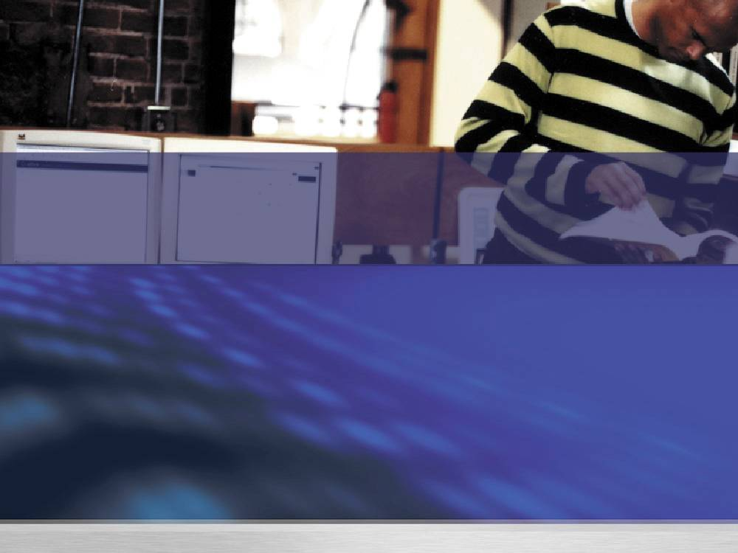

Microsoft's Vision and Strategy for Virtualization
Howard Chow
Microsoft Most Valuable Professional
Notes:
Slide Title: Title Slide
Keywords:
Key Message:
Slide Builds: 0
Slide Script:
Hello and welcome to this Microsoft TechNet session on Exchange 2007. My name is {insert name}.
Slide Transition: Let’s start this session by going into more detail on what we’ll be covering.
Slide Comment:
Additional Information:

Slide 2

Session Objectives and Agenda
Discussion of Microsoft’s Virtualization Vision
Desktop to Datacenter
Physical and Virtual Management
Microsoft Virtualization Products
Virtual Server
Windows Server virtualization / Windows Server 2008
Virtual PC
System Center Virtual Machine Manager
Microsoft SoftGrid
Terminal Services

Slide 3

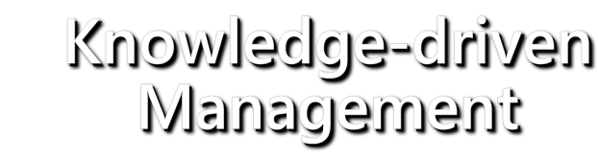


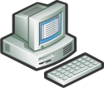



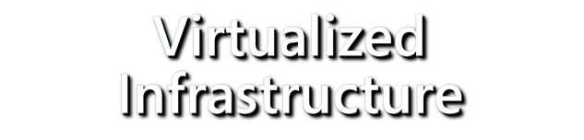

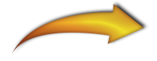

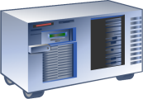



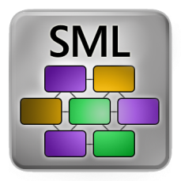
Dynamic Systems Initiative
Virtualized Infrastructure
Design for Operations
Knowledge-driven Management
ITIL-based Process and Knowledge Embedded
WS- Management
Capture knowledge in models
Multi-level: operating systems, applications
Notes:
Dynamic Systems Initiative
A dynamic system is Microsoft’s vision for what an agile business looks like—where IT works closely with business in order to meet the demands of a rapidly changing and adaptable environment. The Dynamic Systems Initiative (DSI) is Microsoft’s technology strategy for products and solutions that help businesses enhance the dynamic capability of its people, process, and IT infrastructure using technology.
People
For the CIO, it’s a journey. If you run your shop well, earn your stripes, then you get a seat at the table with the CEO. This is where IT drives business growth. You have to start somewhere—so start with us and our vision to enable infrastructure for the people-ready business: Dynamic Systems Initiative. We will help you get your IT shop fit, keep it fit, and give you the platform to innovate.
Process
Using the IT life cyle, DSI provides the process guidance that businesses need to be successful in the journey towards the dynamic system. Through a continuous cycle of process improvement, design processes are dedicated to planning and implementing enhancements to the IT environment.
By reducing incompatible or conflicting changes and streamlining release efforts, deployment processes help businesses manage changes to their IT infrastructure. By protecting IT infrastructure assets, operating processes provide ongoing maintenance, monitoring and control. And through the resolution of user and system-generated issues, processes and practices required to fully support efficient use of an IT infrastructure are instituted.
Technology
Microsoft’s blueprint for the Dynamic Systems Initiative has three parts: virtualized infrastructure, design for operations, and knowledge-driven management.
Virtualized Infrastructure
With infrastructure virtualization, businesses will attain greater flexibility and agility with the ability to draw upon resources, as needed, from a virtual service pool. Server consolidations, rapid provisioning, and live migrations will reduce incremental costs while providing a level of business readiness and scalability unattainable within a purely physical infrastructure.
Design for Operations
With design for operations, businesses will improve knowledge-sharing between application architects, IT managers, and information workers by embedding information about system structure, constraints, policies, and best practices in the IT infrastructure itself though the use of common software models.
Knowledge-driven Management
With knowledge-driven management, businesses will create systems that abide by best practices and maintain Service Level Agreements, detecting potential problems, self-diagnosing, and ultimately, self-healing. By comparing the actual state of systems to their desired states as defined in models, systems will automatically detect inconsistencies before they become problems, minimizing manual monitoring efforts, and preventing unnecessary downtime.

Slide 4
What is Virtualization?
Without Virtualization
With Virtualization
With Microsoft’s
Virtualization Solution
Virtual Applications
Any application on any computer on-demand
Applications installed to
Specific hardware and OS
Infrastructure
Virtual Presentation
Presentation layer separate from process
Interface bound to process
Management
Operating System assigned
to specific hardware
Virtual Machine
OS can be assigned to any desktop or server
Licensing
Storage assigned to specific
locations
Interoperability
Virtual Storage
Storage and backup over the network
Network assigned to specific
locations
Support
Virtual Network
Localizing dispersed resources

Slide 5









Virtualization: Business Benefits
Enable
Agility
Increase
Availability
Reduce Total Cost of Ownership
Dynamic provisioning
Live migration
Self-managing dynamic systems
Backup
Recovery
Business continuity
Power
Asset utilization
Application testing
Notes:
10/30/2007 11:28 AM
5
© 2006 Microsoft Corporation. All rights reserved.
This presentation is for informational purposes only. Microsoft makes no warranties, express or implied, in this summary.
MGX 2006
10/30/2007 11:28 AM
5
© 2004 Microsoft Corporation. All rights reserved.
This presentation is for informational purposes only. Microsoft makes no warranties, express or implied, in this summary.
What makes it ‘Dynamic’
Visual Studio
Design for operations
Modeling (development, pre-deployment analysis and testing)
Team System
Vista
Built in management (SDM, and DCM)
Imaging
Virtualization
System Center
Knowledge-driven management (through Models)
Health monitoring, desired configuration monitoring
Service Desk
Dynamic Provisioning
SoftGrid (application virtualization)
Service Desk
Orchestration of ITIL
Connecting the IT lifecycle through models
Longhorn (Windows Server)
Role-based configuration (through modeling)
Virtualization
Active Directory
Forefront
Policy-enabled security
MIIS
Dynamic identity, federation capabilities

Slide 6
Building a Virtualization Farm
If you could build a virtualization infrastructure how would you do it?
What hardware would you use?
How would you manage it?
Bare metal deployment
Virtualization deployment
Overall Systems Management
Servicing
Backup
Geo-cluster replication

Slide 7
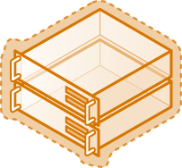


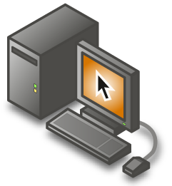
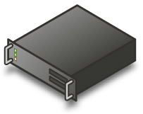

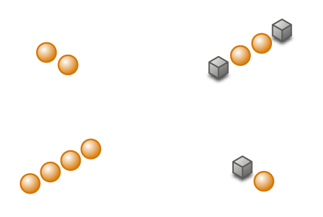



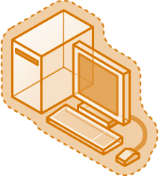
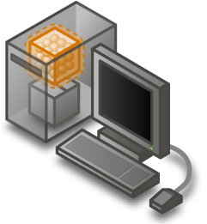


Microsoft Virtualization Products
A comprehensive set of virtualization products, from the data center to the desktop
Assets – both virtual and physical – are managed from a single platform
Server Virtualization
Presentation Virtualization
Management
Application Virtualization
Desktop Virtualization

Slide 8
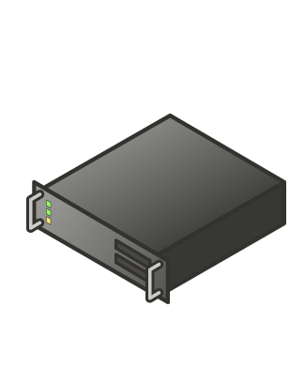
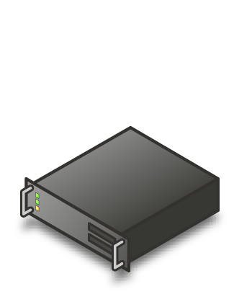
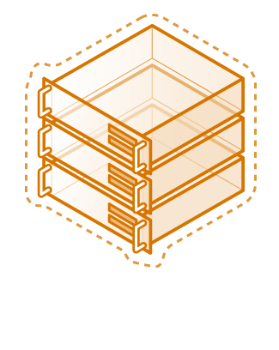
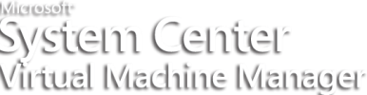

Reduce Total Cost of Ownership
Challenges:
Underutilized hardware
Excessive power consumption
Expensive space across data
Center or branch office
Server Virtualization
Solution: Server consolidation through virtualization and physical and virtual machine management
Case Study: AtlantiCare
Eliminated need to expand or relocate data center
Virtual Server 2005 used to consolidate infrastructure and legacy application servers
Consolidation ratio achieved of 33:2

Slide 9
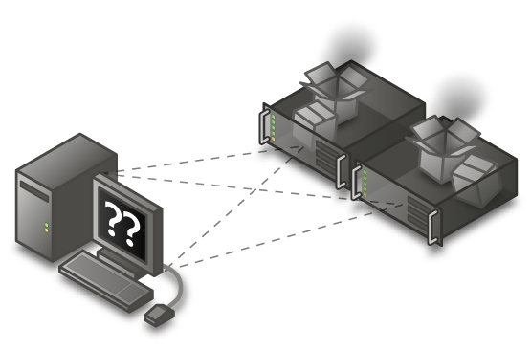
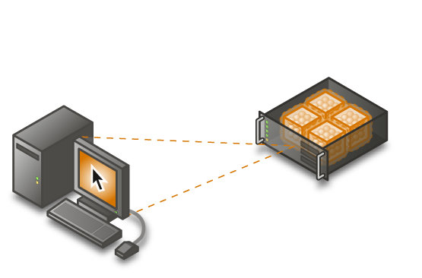


Reduce Total Cost of Ownership
Challenges:
Terminal server siloing
Server underutilization
Application Virtualization
Solution: Enable any applications to run side-by-side on any server at the same time
Presentation Virtualization
Case Study: Russell Investment Group
Consolidated servers by over 40%

Slide 10


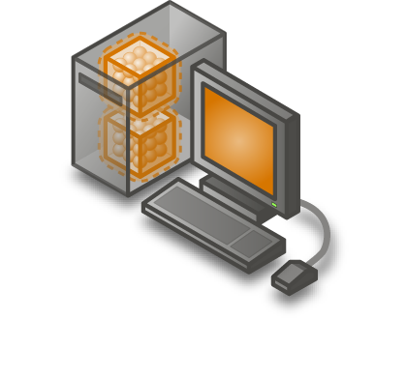

Reduce Total Cost of Ownership
Challenges:
Application incompatibilities
Lengthy testing
Application Virtualization
App-to-app
incompatibilities
Solution: Eliminate application conflicts and testing by using desktop and application virtualization
Case Study: Alamance Regional Medical Center
Eliminated regression testing
Eliminated 5,000 hours of end-user downtime per year
Desktop
Virtualization
App-to-OS incompatibilities

Slide 11
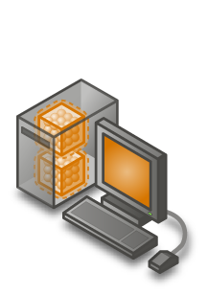
Reduce Total Cost of Ownership
Challenge:
Multiple management tools and learning curves
Application Virtualization
Server Virtualization
Presentation Virtualization
Solution: A single management platform that leverages existing investments
Desktop Virtualization
Application Virtualization

Slide 12
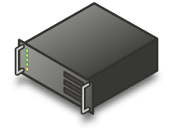

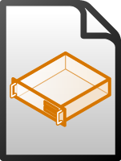

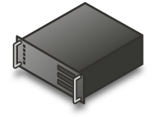
Increase Availability thru Backups
Challenge:
Providing disaster recovery for business continuity for operating systems and applications
Backup
Solution: Virtualize operating systems and applications – enabling easy backup, replication and moving to available servers
Server A
Server B

Slide 13

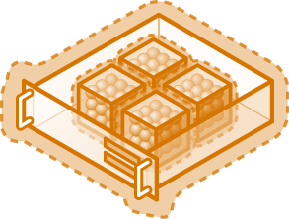
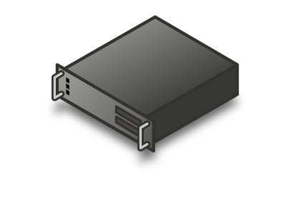
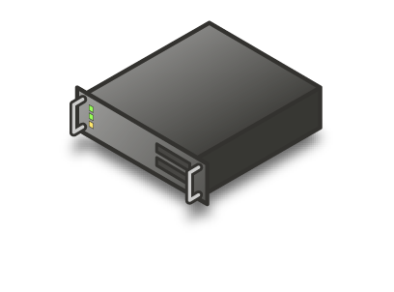
Increase Availability thru Backups
Backup
Challenge:
Providing disaster recovery for business continuity for operating systems and applications
Solution: Virtualize operating systems and applications – enabling easy backup, replication and moving to available servers

Slide 14
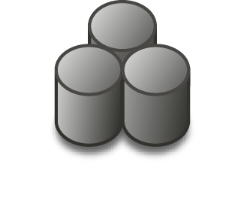
Increase Availability thru Clustering
Challenge:
Planned and unplanned downtime affecting server uptime
Data Store
Solution: High availability options include host or guest level failover, or Migration for predicted downtime or load balancing
Today: High Availability Clustering with Virtual Server 2005 and Windows Server Enterprise or Data Center editions allow clustering for planned or unplanned downtime
Tomorrow: Windows Server virtualization allows Migrations as well as High Availability
Server A
Server B

Slide 15
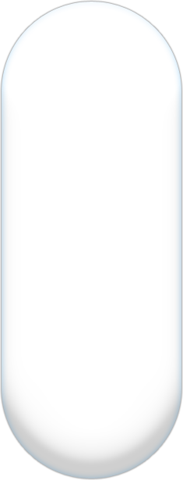













Virtualization Investments
A Multiple Level Approach
Infrastructure
Applications
Management
Interoperability
Licensing
Virtual Server 2005 and Windows Server 2003 make cost effective virtualization combo
Windows Server virtualization is a component of Windows Server “Longhorn”
Accelerate deployment
Reduce the cost of supporting applications
Turn applications into dynamic, real-time services
Ease consolidation onto virtual infrastructure
Better utilize management resources
Free up IT spend
Heterogeneous support for Linux
VHD Open Specifications Promise
Standards Efforts DMTF: Standard APIs for VM management PCI-SIG: Standards for I/O virtualization
Instance based licensing for Windows Server
Unlimited instances with Windows Server Data Center Edition and SQL Server Enterprise Edition
Support
Notes:
10/30/2007 11:29 AM
15

Slide 16
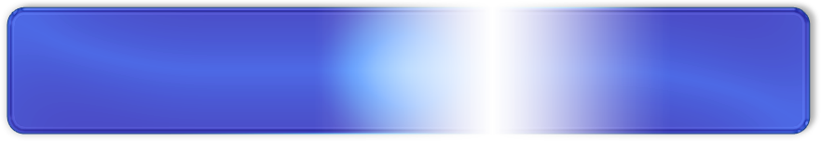
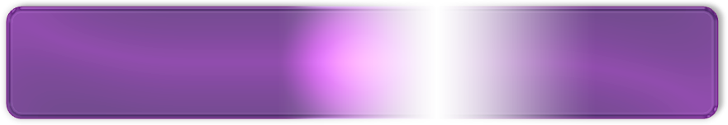

Microsoft Virtualization
Microsoft offers a comprehensive set of virtualization products,
from the datacenter to the desktop.
Microsoft allows you to manage both virtual and physical
computing resources from a single management platform
Microsoft’s comprehensive virtualization offering
combined with a single management framework
enables customers to solve critical technology and business issues
including cost reduction, increasing availability and enabling agility

Slide 17
Server Virtualization Products
Virtual Server
Windows Server “Longhorn”

Slide 18


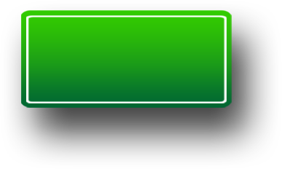
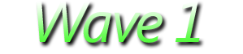
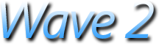
Virtual Server 2005 R2 SP1
Beta 1
Beta 2
Available today
New Features
Intel Virtualization Technology support
What does it provide?
Increased reliability and performance
Much better experience when consolidating Linux
When will be ready
Beta 1 – April 28
Public Beta
Coupled with a TAP
New Features
AMDV support
VSS support
VHD Mounting on host
What does it provide?
All Beta 1 features – now also on AMD platform
Improved Backup and DR scenarios
When will be ready
Beta 2 – September
Public Beta

Slide 19

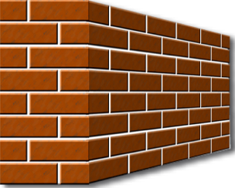




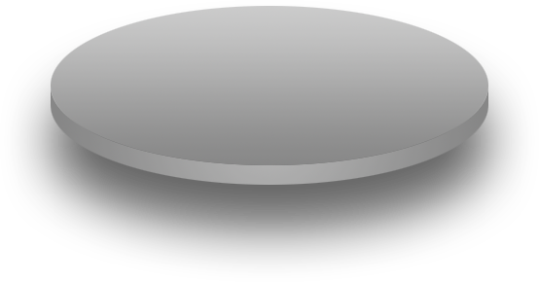


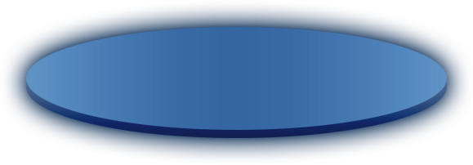






Windows Server Virtualization Scenarios
Business Continuity Management
Production Server Consolidation
Test and Development
Dynamic Datacenter
We continue to address key scenarios that help customers build a dynamic and agile datacenter
Notes:
<SLIDETITLE INCLUDE=7>Windows Virtualization Scenarios</SLIDETITLE>
<KEYWORDS>windows virtualization, scenarios, future</KEYWORDS>
<KEYMESSAGE> Future Windows virtualization usage scenarios.</KEYMESSAGE>
<SLIDEBUILDS>3</SLIDEBUILDS>
<SLIDESCRIPT>
As we develop new virtualization technologies, we look at our vendors needs and then try to fulfill them with virtualization.
The first is production server consolidation.
You will be able to reduce the total cost of ownership by maximizing hardware utilization and consolidating workloads. This could apply to applications in a Datacenter that need to be consolidated.
[BUILD 1]
Next is business continuity management.
We are trying to eliminate the impact of scheduled and unscheduled downtime. Windows virtualization in the future will enable disaster recovery abilities to eliminate downtime.
[BUILD 2]
Windows virtualization will continue to improve your ability to test and develop.
Future virtualization will help maximize test hardware, reduce costs, improve lifecycle management and improve test coverage.
[BUILD 3]
The final scenario we will look at is the dynamic datacenter.
You will be able to leverage the benefits of virtualization to create a more agile infrastructure. New management capabilities will allow you to move virtual computers without impacting the users. Virtual computers will also be able to automatically manage themselves.
</SLIDESCRIPT>
<SLIDETRANSITION>
<TRANSITION LENGTH=1> Now let’s return to our demonstration environment.</TRANSITION>
<TRANSITION LENGTH=2> Now let’s return to our demonstration environment.</TRANSITION>
<TRANSITION LENGTH=4> Now let’s return to our demonstration environment.</TRANSITION>
</SLIDETRANSITION>
<COMMENT></COMMENT>
<ADDITIONALINFORMATION>
<ITEM>http://www.microsoft.com/presspass/press/2005/Apr05/04-20VirtualizationInvestmentsPR.mspx</ITEM>
</ADDITIONALINFORMATION>

Slide 20
Monolithic vs. Microkernelized
Monolithic hypervisor
Simpler than a modern kernel, but still complex
Contains its own drivers model
Microkernelized hypervisor
Simple partitioning functionality
Increase reliability and minimize TCB
No third-party code
Drivers run within guests
VM 1
(“Admin”)
VM 2
VM 3
VM 1 (“Parent”)
VM 2
(“Child”)
VM 3
(“Child”)
Virtual-
ization
Stack
Hypervisor
Drivers
Drivers
Drivers
Drivers
Drivers
Drivers
Drivers
Drivers
Drivers
Drivers
Drivers
Drivers
Hypervisor
Hardware
Hardware
VMware ESX Approach
Windows Server Virtualization Approach
Microkernelized Hypervisor has an inherently secure architecture with minimal attack surface

Slide 21
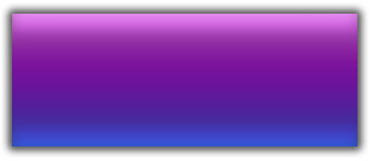

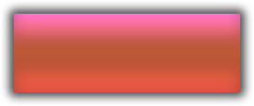


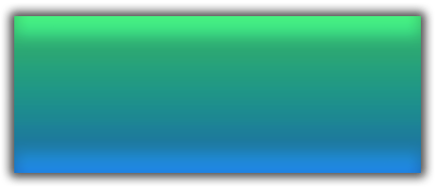


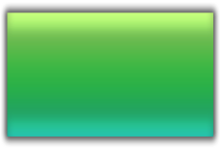
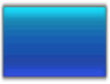


Microsoft and XenSource collaborate on Xen-enabled Linux
Provided by:
OS
Applications
Windows
virtualization
Applications
Applications
MS/XenSource
Longhorn Server
Windows Server 2003, “Longhorn”
Basic
Linux Kernel
Xen-enabled
Linux Kernel
ISV/IHV/OEM
Windows Kernel
Windows Kernel
VSP
VSC
VSC
VMBus
VMBus
Emulation
VMBus
Windows hypervisor
“Designed for Windows” Server Hardware

Slide 22
Virtual Server vs WSV
 | Virtual Server 2005 R2 | Windows Server virtualization
Performance / Scalability
32-bit VMs | Yes | Yes
64-bit VMs | No | Yes
Multi-processor VMs | No | Yes
VM memory support | 3.6 GB per VM | 32 GB per VM
Resource Management | Yes | Yes
Availability
Guest to Guest Failover | Yes | Yes
Host to Host Failover | Yes | Yes
Host Migration | Yes | Yes
VM Snapshots | Yes | Yes
Management
Scriptable/Extensible | Yes, COM | Yes, WMI
User interface | Web Interface | MMC 3.0 Interface
SCVMM Integration | SCVMM v1 | SCVMM v2

Slide 23

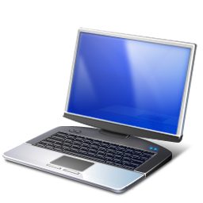
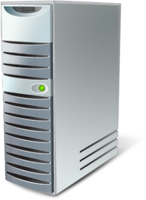

Failover Clustering
Greater Flexibility
Node A
Node B
Active Node
Heartbeat
Passive Node
New Validation Wizard
Support for GUID partition table (GPT) disks in cluster storage
Improved cluster setup and migration
Improvements to stability and security – no single point of failure
IPv6 support
Geographically dispersed clusters
Notes:
Title: Failover Clustering
Talking Points: In Windows Server "Longhorn,” improvements to failover clusters (formerly known as server clusters) are aimed at simplifying clusters, making them more secure, and enhancing cluster stability. Cluster setup and management are easier. Security and networking in clusters have been improved, as has the way a failover cluster communicates with storage.
What Does a Failover Cluster Do? The slide graphic shows that a failover cluster is a group of independent computers that work together to increase the availability of applications and services. The clustered servers, called nodes, are connected by physical cables as well as by software. If one of the cluster nodes fails, another node begins to provide service, a process known as failover. Users experience a minimum of disruptions in service.
[BUILD1] New Validation Feature: By using the new validation wizard in failover clusters, IT Professionals can perform tests to determine whether a system, storage, and network configuration is suitable for a cluster. The wizard includes tests for servers, network tests, and storage tests. This enables IT Professionals to discover potential setup issues and deal with them before trying to implement failover clustering.
[BUILD2] Support for GUID partition table (GPT) disks in cluster storage: In Windows Server "Longhorn,” GPT disks can have partitions larger than two terabytes (TB), and have built-in redundancy, unlike master boot record (MBR) disks.
[BUILD3] Improved cluster setup and migration: In Windows Server "Longhorn,” improvements make it simpler to get started with a new cluster or migrate an existing one. Enhancements in the interfaces and management of clusters let IT staff focus on managing their applications rather than focusing time on managing clusters.
[BUILD4] Improvements to stability and security, resulting in increased availability: Failover clusters include improvements to the way the cluster communicates with storage, improving the performance of a Storage Area Network (SAN) or direct attached storage (DAS). There are also more choices in configuration, so that the quorum resource no longer needs to be a single point of failure. In addition, improvements to the underlying software infrastructure and to networking and security increase the reliability and availability of failover clusters.
[BUILD5] IPv6 support: Failover clusters fully support IPv6, which is fully integrated into failover clusters, for both node-to-node and node-to-client communication.
[BUILD6] Geographically dispersed clusters: Geographically dispersed clusters are now available. In Windows Server "Longhorn,” cluster nodes can now reside in different subnets. This allows cluster nodes to communicate across network routers and frees IT staff from having to connect nodes with VLANs.
The enhanced infrastructure also allows stretching cluster nodes over greater distances to remove cluster distance limitations.
Additional Information:
SVR324_Kala.ppt
Changes in Functionality to Windows Server Longhorn (January 2007).doc (also called the Book of Longhorn)
SVR326_Christensen.ppt

Slide 24
System Center
Virtual Machine Manager
Data Protection Manager

Slide 25


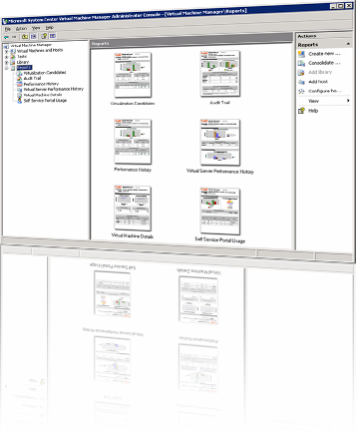







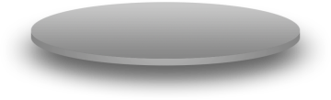









A centralized management application solution for Microsoft virtual server software.
Increased Physical Server Utilization
Deploys multiple virtual servers on 1 physical server
Increases flexibility
Sets up servers for testing
Decreases hardware costs
Centralized Management of Virtual Infrastructure
Uses MOM pack for reporting and health monitoring
Reports on consolidation candidates, utilization trending optimization opportunities
Rapid Provisioning of New Virtual Machines
Enables end users to use Self Service Provisioning UI to request and place VMs
Enables administrators to configure rules and boundaries for provisioning
VM
VM
VM
VM
VM
VM
VM
VM
VM
VM
VM
VM
VM
VM
VM
VM
VM
VM
VM
VM
VM
VM
VM
VM
Notes:
System Center Virtual Machine Manager
Microsoft System Center Virtual Machine Manager is the latest addition to the System Center family of management products and provides centralized management of Windows Virtual Machine infrastructure. Virtual Machine Manager enables increased physical server utilization, centralized management of virtual infrastructure and rapid provisioning of new virtual machines by the administrator and end users.
Microsoft System Center Virtual Machine Manager is an enterprise management application for a virtualized data center. It enables increased physical server utilization, centralized management of virtual machine infrastructure and rapid provisioning of new virtual machines by the administrator and users. Virtual Machine Manager is fully integrated with the System Center product family.
Resource Optimization
Virtual Machine Manager delivers simple and complete support for consolidating physical hardware on virtual infrastructure and optimizing utilization.
Rapid Provisioning and Agility
Virtual Machine Manager provides rapid provisioning of virtual machines from physical machines, templates in the image library, or by users.

Slide 26
Virtual Machine Manager Feature Summary (V1)
Management Area | V1 Features
Host Configuration | Automate Host setup/configuration Global host settings (VHD paths, VM Additions etc.)
Virtual Machine Creation | Wizard-based user interface Rapid creation of VMs using P2V, Media, Templates Ability to save definitions as templates for rapid deployment
Library Management | Store offline VMs, templates, ISO images Create, update, delete and store objects in the distributed library
Virtual Machine Placement and Deployment | Recommendation based on host capacity and utilization Manual admin override Movement of VM files over LAN or SAN
Monitoring and Reporting | Centralized view of all VMs in the environment and their status Host/VM groupings scalable to thousands of VMs MOM pack for reporting and health monitoring Reports on consolidation candidates, utilization trending, optimization opportunities
Rapid Recovery | VM “checkpoints”
Self Service Provisioning User Interface | User interface allowing end users to request and place VMs Admin configures rules and boundaries for provisioning
Automation | Completely scriptable user model

Slide 27

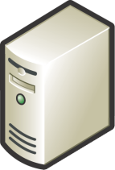
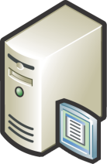

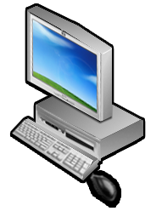
System Center Data Protection Manager - Protected Platforms
Active Directory & System State
Windows 2003 File Services
Longhorn File Services
Linux
Notes
Netware
2000
Oracle
NT4
Exchange 2003
Exchange 2007
Virtual Server 2005 R2 sp1
SQL Server 2000
SQL Server 2005
DPM 2007
DPM 2007
SharePoint 2003 & WSS 2.0
SharePoint 2007 & WSS 3.0
XP Desktops
Vista Desktops

Slide 28
SoftGrid

Slide 29

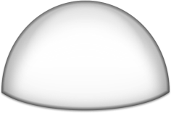










Microsoft SoftGrid Application Virtualization and Streaming
Remove barrier of installation and compatibility testing between applications
Virtualized applications with a zero installation footprint
Simplified packaging
No alteration of the operating system
Elimination of application conflicts and associated regression testing
Application Virtualization
Transforms software into a centrally managed, policy based service
Software available dynamically via streaming technology
Provisioning tied to user identity - separating hardware from users & apps
Support disconnected mobile users
Fully integrated into Systems Management Server 2003
Dynamic
Software Streaming
Make Windows more cost-effective and adaptable to application and operating system changes
New applications and updates delivered based on real-time needs
Safe self-provisioning
Ease OS migration by streamlining deployment and reducing application compatibility challenges
Accelerated Responsiveness & Reduced TCO

Slide 30

















What Is SoftGrid Application Virtualization?
Turning Windows applications into a centrally-managed dynamic service
Application Virtualization
Standard Format (.SFT)
Streaming delivery
Connected & Disconnected support
Identity/policy-based centralized mgmt
Tracking & Monitoring
Terminal Servers & Desktop PCs

Slide 31
Terminal Services and SoftGrid Myths
“I have to pick between TS and SoftGrid.”
“SoftGrid and TS do the same thing.“
“I can use SoftGrid on TS too?“

Slide 32




Myth 1: TS and SoftGrid Do the Same Thing
SoftGrid Server
Reality
App X
App Y
App X
App Y
SoftGrid is used for application virtualization and delivery to execution point
Streaming
Application Virtualization
Terminal Services is used for presentation virtualization to get application UI to local device
Terminal Server
Desktop
App X
App Y
App X
App Y
Presentation Virtualization
TS client Desktop
App X
App Y

Slide 33




Myth 2: I Have to Pick TS or SoftGrid
Reality: Decision is “Do I put application on Terminal Services, desktop, or both?”
“What criteria do I use to decide this?”
Bandwidth
Low | High | None
Terminal Services | Desktop and/or Terminal Services | Desktop
Data security
Centralized | Decentralized
Terminal Services | Desktops
Thin | Rich | Notebook (disconnected)
Terminal Services | Desktop and / or Terminal Services | Desktop
Device
Data Intensive | Standard | Graphical /Processor Intensive
Terminal Services | Desktop and / or Terminal Services | Desktop
Application Type

Slide 34

Myth 3: TS and SoftGrid Can't Be Used Together
Reality: Microsoft now offers a total application delivery solution, all managed with a single infrastructure
Decision Points
Application on: Desktop or TS or both?
Do I manage my application with SoftGrid?

Slide 35



Improve Application Compatibility
Strong isolation with controlled OS Interaction
Applications are virtualized per instance:
Files (incl. System Files)
Registry
Fonts
.ini
COM/DCOM objects
Services
Namespace, Semaphores & Mutexes
Applications do not get installed or alter the operating system
Yet tasks process locally on the host computer (desktop or terminal server)
Case Study: The Medical Center at University of Illinois cut 100 hours of regression testing that was previously required to roll out new applications

Slide 36

Mitigate TS User Profile Issues
Softricity “extracts” application preferences from Windows profiles
Allows preferences to persist on the network
Reduces or eliminates profile corruption
Change from per profile to per application settings
Makes roaming profiles effective—only operating system settings roam

Slide 37
Consolidate Terminal Servers
Application compatibility issues
Often requires separate servers for separate applications
Underutilized servers and spare capacity
SoftGrid for TS:
Enables applications to run side-by-side
Reduce server silos
Case Study: Russell Investments reduced their terminal servers by 40% with SoftGrid

Slide 38



Reduce Time to Solution, Increase Agility, and Reduce Cost
Eliminate installations and dramatically reduce compatibility testing
Updates are now one file change on a server
De-installs are one change to the management console
Case Study: sanofi-aventis accelerated application deployments and updates from 2 weeks to 3 hours

Slide 39




On-Demand Streaming of Virtual Apps
Permission-based
User clicks on desktop shortcuts—authentication, authorization and licensing checked every time
Centrally served
The first time the server streams “just enough” code (20-40%) to client or TS machine. As more code is needed, it is dynamically delivered.
Locally executed
App executes on desktop, laptop and/or terminal server, not on SoftGrid server
Cached for performance
App code is cached for repeated use—even without a network
Disconnected user support
Entire set of applications are cached for limited time before expiring

Slide 40

SoftGrid and Microsoft Management Products
SoftGrid for Desktops and TS share infrastructure
Flexible application deployment:
Pre-cached to clients with traditional updates
Pre-cached with dynamic updates
Pure dynamic delivery
Integrated reports and metering
Enterprise scale

Slide 41




Application Also Becomes Dynamic
SoftGrid makes it possible for users to share Windows desktops and laptops
Any user can access any computer on the network to get their applications
Machines become generic instead of user-specific
Useful for office hoteling, business continuity, computer labs and branch servers
Case Study: Northeastern University uses SoftGrid to provide access to any application from any computer on campus.

Slide 42





Microsoft SoftGrid Application Virtualization*
Turning Windows applications into a centrally-managed dynamic service
Life without traditional software installation
Runs on local desktop
Consolidate and standardize images
Build business continuity for applications
Applications can be taken offline
Applications to users at log-on
Centralized permissions
Sandboxed applications
Runs on Terminal Server*
Enable Server Consolidation
Mitigate Roaming Profile Issues
Transform TS into a dynamic system
Designed for low bandwidth
*SoftGrid Application Virtualization CAL for Terminal Services is available and sold separately from MDOP

Slide 43
Availability and Pricing
SoftGrid Application Virtualization for Desktops
Available as a component of Microsoft Desktop Optimization Pack for SA
Does not include SoftGrid CAL for Terminal Services
SoftGrid Application Virtualization for Terminal Services
Available in same channels as TS CAL
SoftGrid for TS licensed as CAL;
CAL required for every user who connects to a TS managed with SoftGrid
Terminal Services CAL still required
Does not include SoftGrid for Desktops
Pricing
Microsoft Desktop Optimization pack:
~$10 per year (requires Windows Software Assurance)
SoftGrid CAL for TS:
~$25

Slide 44
Session Summary
SoftGrid for Desktops and SoftGrid for Terminal Services are complimentary
SoftGrid improves Terminal Services manageability:
Improved application compatibility
Consolidate terminal servers
Mitigate profile issues
Reduce time to solution
Reduce help desk calls
SoftGrid for Terminal Services integrates with SoftGrid for Desktops/Microsoft Desktop Optimization Pack and Microsoft management tools

Slide 45

Q&A

