Slide 1

Welcome
xxx-xx
Notes:
<SLIDETITLE INCLUDE=0>Entry Slide</SLIDETITLE>
<KEYWORDS></KEYWORDS>
<KEYMESSAGE></KEYMESSAGE>
<SLIDEBUILDS>0</SLIDEBUILDS>
<SLIDESCRIPT></SLIDESCRIPT>
<SLIDETRANSITION>
</SLIDETRANSITION>
<COMMENT></COMMENT>
<ADDITIONALINFORMATION>
<ITEM></ITEM>
</ADDITIONALINFORMATION>

Slide 2
Microsoft® Office Enterprise Project Management Solution
游振昌 Gibson
資訊平方有限公司 執行總監

Slide 3
什麼是專案管理
為達成專案目標所從事的所有活動規劃、排程以及控制的過程

Slide 4

您或許多少都有參與過專案 以往您會怎麼做?
專案的啟動先口頭問別人該怎麼做? 或者 就開幹吧!
需要做的任務,就記在腦中或是用便條紙寫下
做好的成果用E-mail 對傳
進度情形用Excel 撰寫報告,再用e-mail 傳送
用 開會 來報告進度,或掌握狀況
這樣的專案運作模式… 還是可以生存得很好 但是…

Slide 5
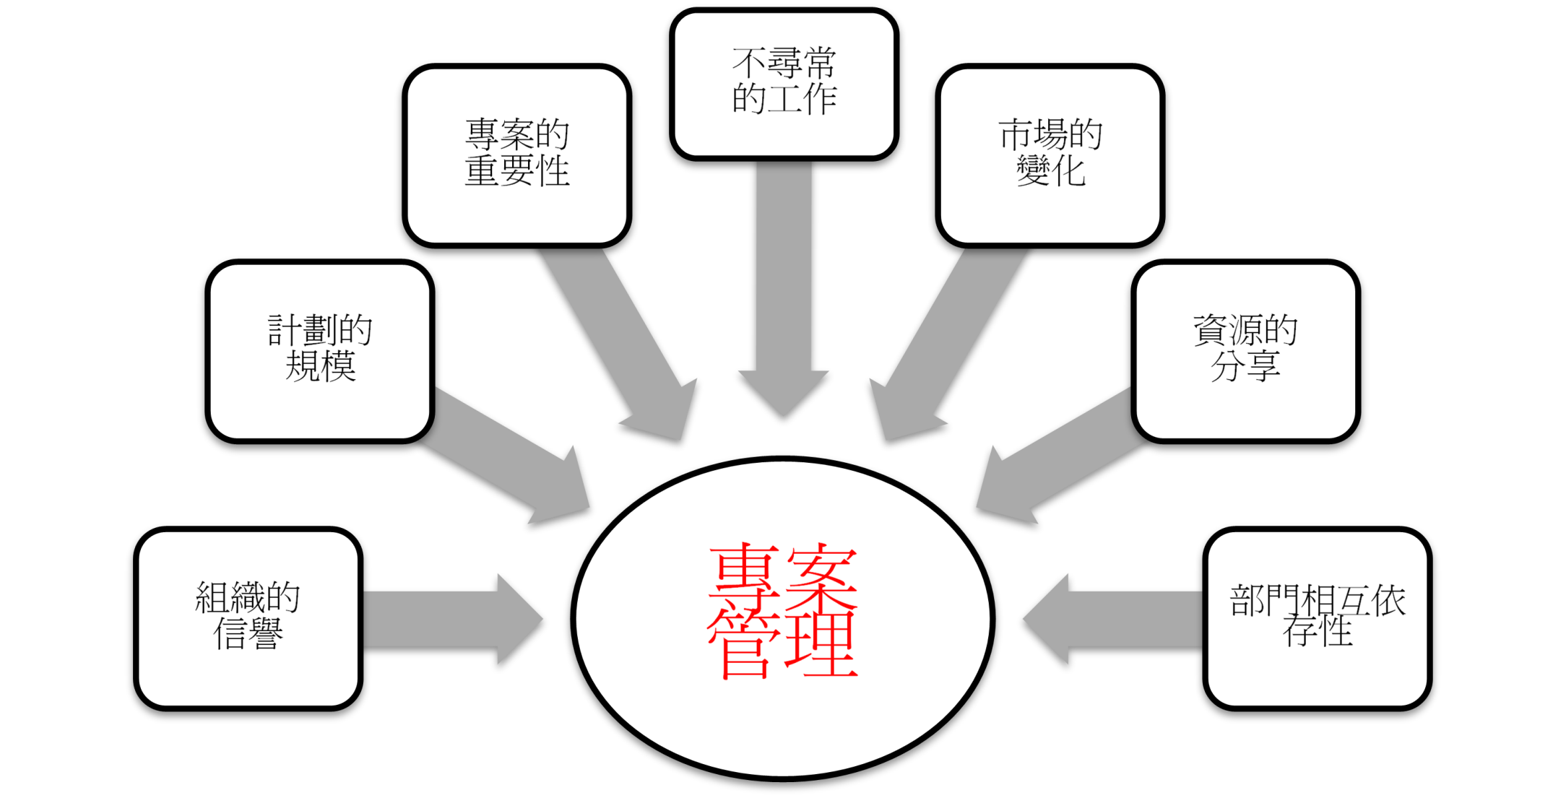
什麼狀況下,您才會體會需要專案管理

Slide 6
這時..如果您用對工具(Microsoft Project) 就可以幫助您在進行專案管理時
以按圖施工的方式學習如何有效規劃專案
清楚的掌握小組成員工作負載
清楚的紀錄歷史與現在的專案資訊
透過一個溝通平台讓專案資訊有效分享與控管
傳承前人的經驗
…
6

Slide 7



專案管理模式的比較
 | Project Desktop | Enterprise Project Management (EPM)
使用狀況 | 單一管理者 多專案管理 | 多個管理者與執行人員 需要集中的專案管理
應用情境 | 個別的專案經理單打獨鬥 | 考慮到組織的整體性 提供專案所需要的協同合作 以更宏觀的角度來檢視企業內的專案執行與資源分派狀態

Slide 8

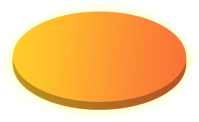

















EPM 技術架構
Line of Business Systems
Connections
Executives
Resource Managers
Team Members
Executives
Portfolio Analysts
Web Clients
Applications
Services
Platform
Notes:
8
Three Tier Architecture
Users can work in Office applications and still participate in the EPM Solution with integration adding value…
The Front End
Office Project Server 2007 provides a rich set of browser based functionality through its component Office Project Web Access, a Microsoft ASP.NET application that uses Project Server Web Services through Microsoft Internet Explorer and Project Server Web Parts in Microsoft Windows SharePoint Services 3.0. As Office Project Web Access is built on top of Windows SharePoint Services 3.0 it offers all the advantages that come with WSS 3.0 (e.g. rich browser experience by using AJAX development techniques, WebPart and Integration framework). In addition to the web based client Office Project Server 2007 is accessed by Office Project Professional 2007, and by other Win32 clients such as Visual Studio.
Office Project Portfolio Server 2007 capabilities are accessed via Office Project Portfolio Web Access, the ASP.NET based front end of Office Project Portfolio Server 2007.
The Middle Tier
Office Project Server 2007 provides a real application server that includes the new Project Server Interface (PSI), discrete business objects, server-side events, a common data access layer (DAL) and queuing services. The PSI provides web services which can be consumed by other applications. Office Project Portfolio Server 2007 delivers the Portfolio Server Interface (PPSI) which helps organizations to integrate with other line of business applications. Office Project Server 2007 and Office Project Portfolio Server 2007 are connected via those middle tier components. This out of the box connection is known as the Project Server Gateway, a bidirectional link that enables administrators to associate multiple Office Project Servers to Office Project Portfolio Server 2007, providing executives with a consolidated view of all projects within the organization. Further information on Project Server Development can be found in the Software Development Kit (SDK) posted on MSDN.
Additional details on the Office Project Portfolio Server 2007 includes the Project Server Gateway, a bi-directional link with Office Project Server 2007. This link helps ensure that detailed data in Project Server (such as Named Resources or Detailed Tasks) can be automatically aggregated to the summary level in Office Project Portfolio Server 2007 for reporting and portfolio analytics. For example:
Schedule Data: Office Project Portfolio Server 2007 provides organizations with phase and milestone level scheduling capabilities. While Office Project Server 2007 helps ensure organizations can plan and track their projects at the detailed level (such as create a detailed project plan), the Project Server Gateway ensures the detailed task data (in Project Server 2007) is automatically synchronized with the relevant phases and milestones in Office Project Portfolio Server 2007.
Enterprise Custom Fields. The Project Server Gateway maps enterprise custom fields (in Office Project Server 2007) with the attributes in Office Project Portfolio Server 2007.
The Back End
Office Project Server 2007 and Office Project Portfolio Server 2007 use SQL Server 2000 SP4 or SQL Server 2005 (SP1) (note: Office Project Portfolio Server 2007 requires SQL Server 2005). Office Project Server 2007 takes advantage of some of the new features in SQL Server 2005 such as security enhancements and improved Analysis Services and Reporting Services.
The EPM Solution provides customers and partners with an end-to-end project and portfolio management solution.

Slide 9
部門主管所關心的專案問題
有多少專案正在進行？ 專案的進度以及成本情形
當專案發生狀況時，誰可以提供我足夠的資訊，協助我做出正確的因應對策

Slide 10
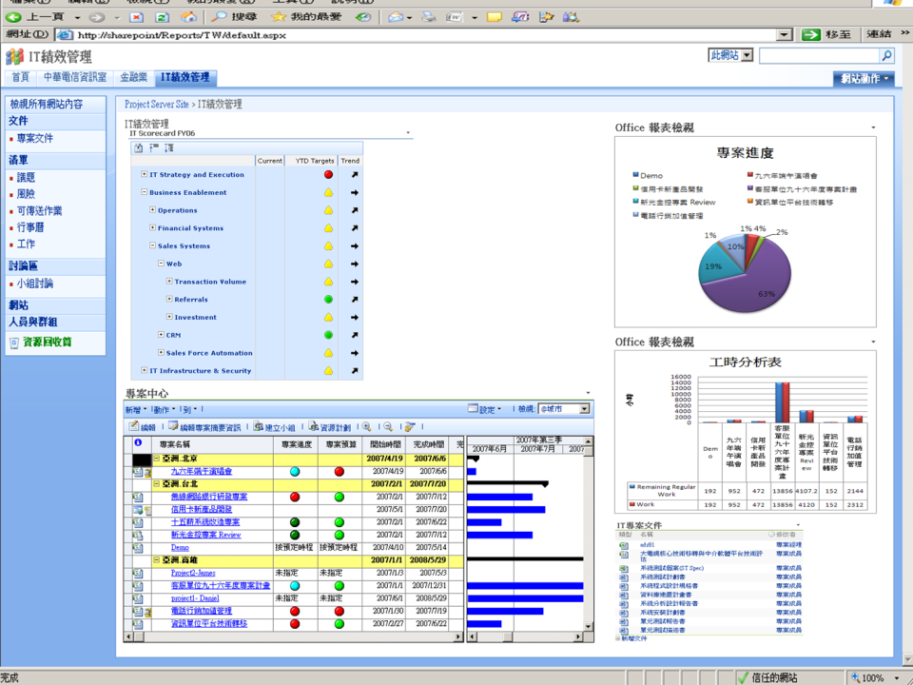

Slide 11
DEMO

Slide 12
專案經理所關心的專案問題
如何有效的規劃專案所需時間與資金
如何掌握人力資源狀況
如何有效控管進度 讓小組定期回報工作進度狀況
如何撰寫一份專案結案報表

Slide 13
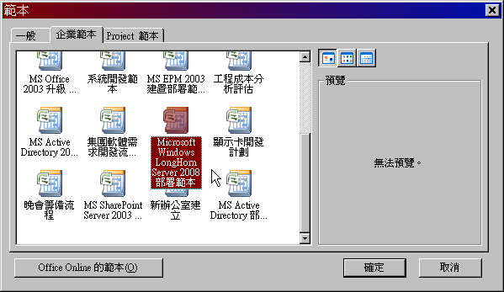

Slide 14
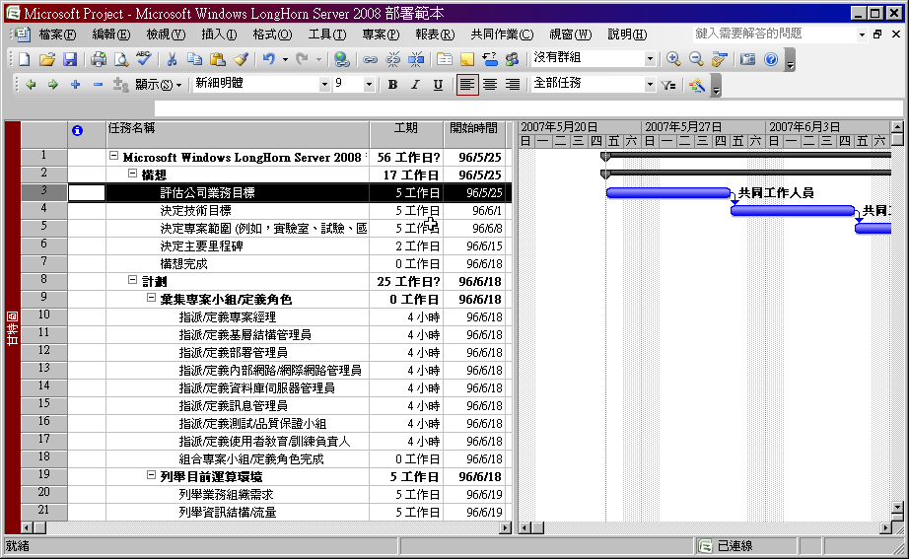

Slide 15
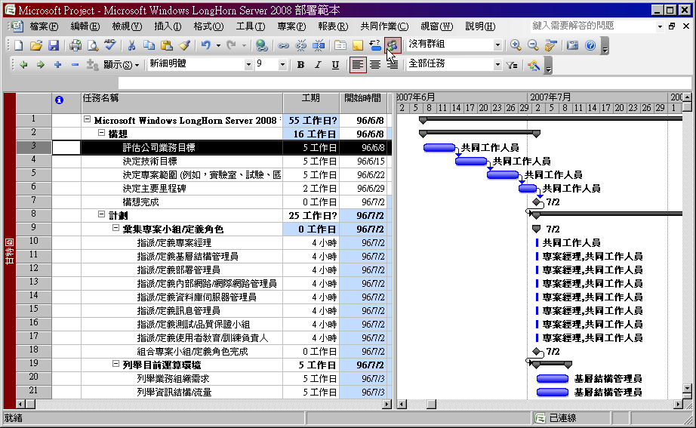

Slide 16
DEMO

Slide 17
小組成員所關心的專案問題
如何將完成的工作進度與文件讓專案經理審核
如何把遇到的專案問題快速反應給專案經理

Slide 18
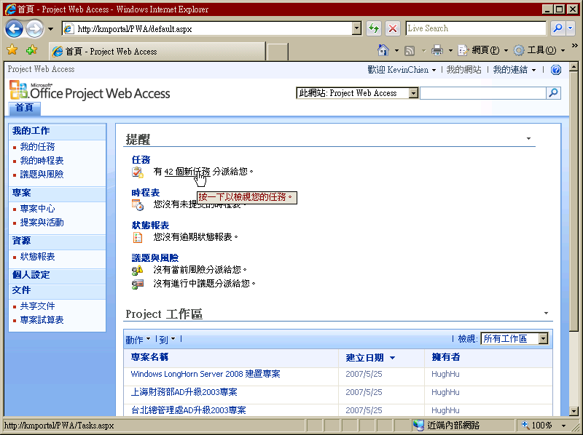

Slide 19
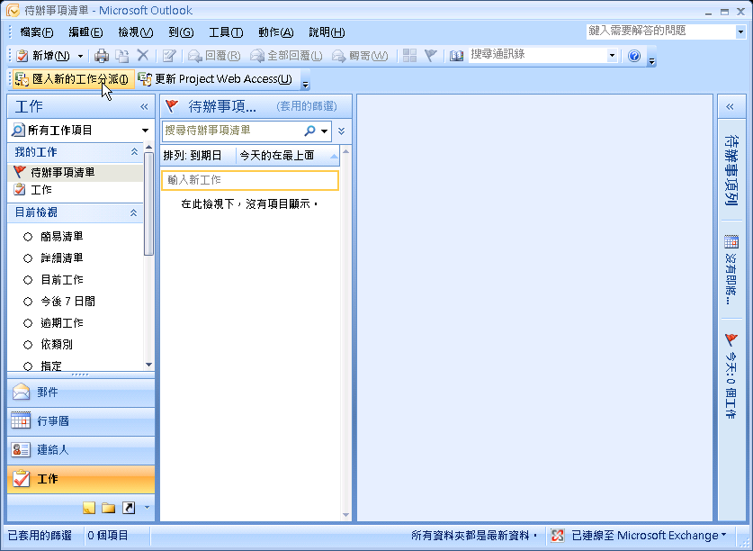

Slide 20
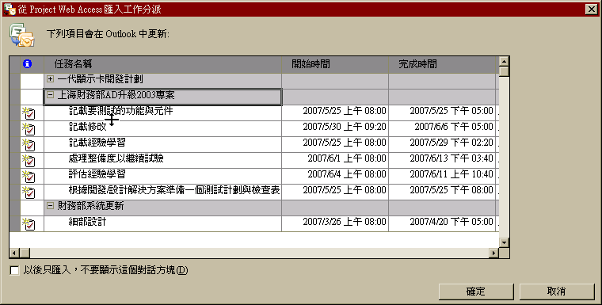

Slide 21
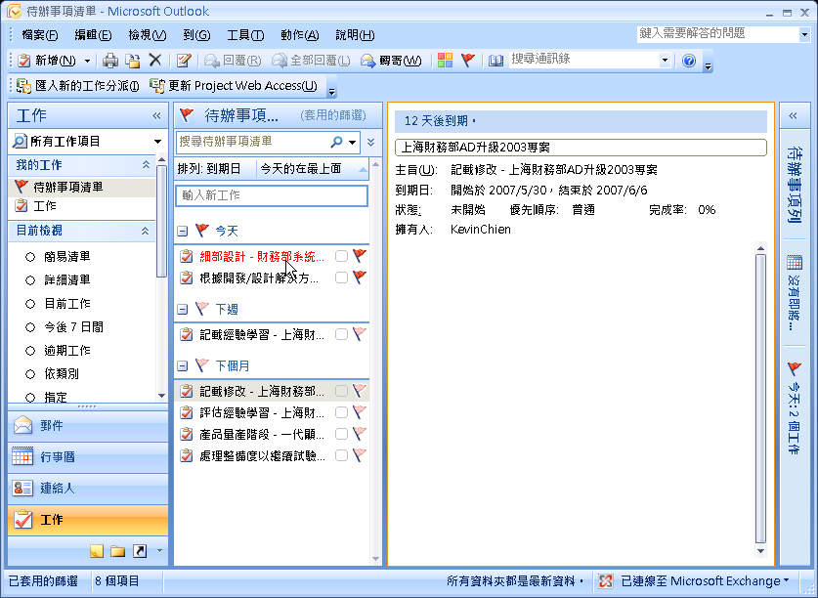

Slide 22
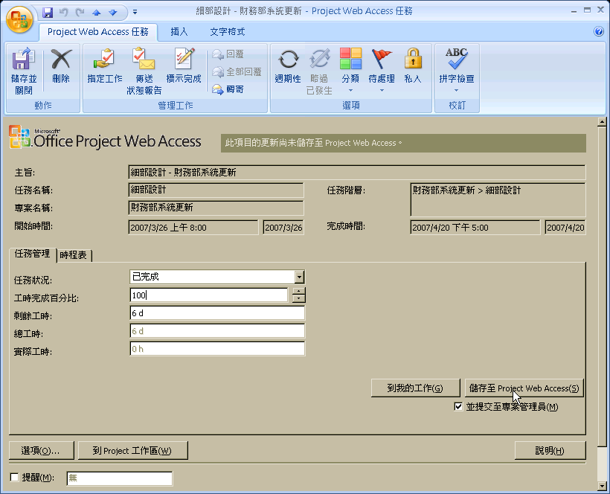

Slide 23
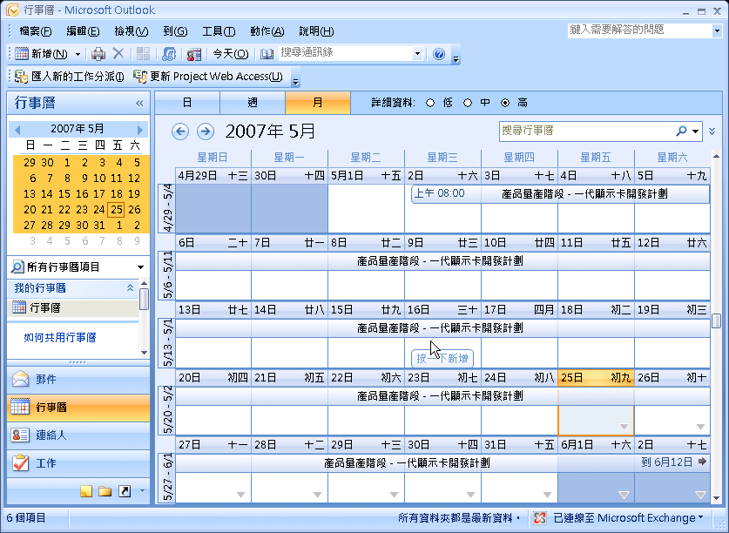

Slide 24
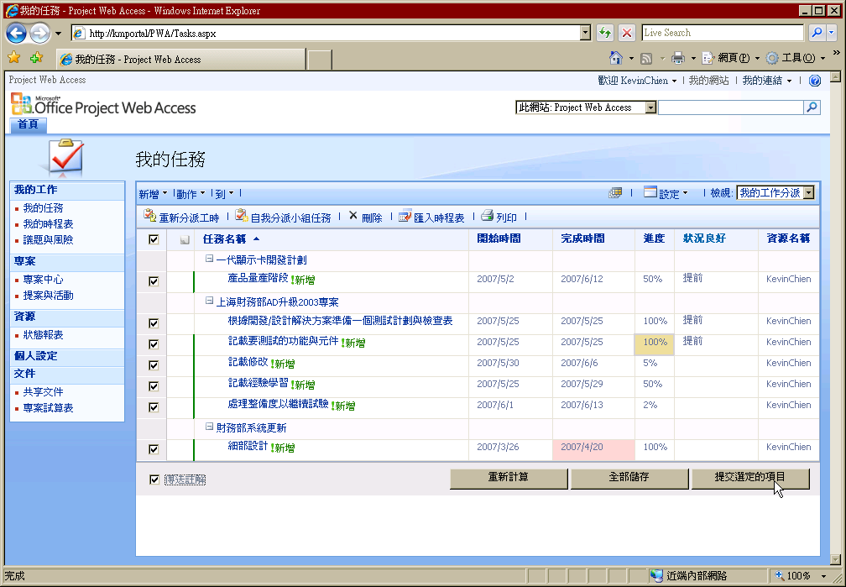

Slide 25
DEMO

Slide 26
在何處取得 TechNet 相關資訊？
訂閱 TechNet 資訊技術人快訊 http://www.microsoft.com/taiwan/technet/flash/
訂閱 TechNet Plus
http://www.microsoft.com/taiwan/technet/
參加 TechNet 的活動 http://www.microsoft.com/taiwan/technet/
下載 TechNet 研討會簡報與錄影檔 http://www.microsoft.com/taiwan/technet/webcast/

Slide 27

Notes:
<SLIDETITLE INCLUDE=0>Tag line</SLIDETITLE>
<KEYWORDS></KEYWORDS>
<KEYMESSAGE></KEYMESSAGE>
<SLIDEBUILDS>0</SLIDEBUILDS>
<SLIDESCRIPT></SLIDESCRIPT>
<SLIDETRANSITION>
</SLIDETRANSITION>
<COMMENT></COMMENT>
<ADDITIONALINFORMATION>
<ITEM></ITEM>
</ADDITIONALINFORMATION>

