Slide 1
The Business Case
Creating a business case for investment in Windows 7
David Downs Director Microsoft Services
ddowns@microsoft.com
May 28-30th, 2009

Slide 2
Introduction
How to create the business case for a desktop deployment of Windows 7
Sample ideas of the benefits, and how they might be translated to a return on investment
Not exhaustive at this stage – figures indicative only
Benefits are suggested based on the net differences between WinXP and Windows 7 with MDOP

Slide 3
Does this sound familiar?
…so, you can see it provides cool directory services, great XML support and reduces reboots.
Windows sounds just like what we need, but what does it do for the business?!

Slide 4
Why do good IT ideas die?
Lack of alignment with the business goals
Excessive technical focus
Insufficient process consideration
Failure to translate technical design into financial terms
Excessive optimism (fiscal facts not proven)
A business case is a financial argument to people who are paid to be sceptical

Slide 5
The 4 reasons to do anything in business
Increase or protect Revenue
Reduce Cost or increase efficiency
Reduce Risk
Compliance
Usually measured by CSF (Critical Success Factors) and KPI (Key performance indicators)
Note: Government – different exact metrics, but same general concept
Everything in a business case must relate directly to proving one (or more) of these

Slide 6
Value = Benefit - Cost
“If you can’t measure it, you can’t prove it. If you can’t prove it, it isn’t real. If it isn’t real, why would I spend money on it?”

Slide 7
Desktop TCO breakdown
Desktop costs go beyond hardware and software
70% of desktop TCO is labor-related
Desktop TCO ($4600 - $5000/year)
50%
100%
(US$/desktop/year)
20%
30%
HW/SW
IT costs
End-user
Total
Cost of hardware and software
Cost of IT labor and administration
Cost of self support and downtime
Source: Leading analyst firm, December 2005
Note: Excludes server and network costs for centrally managed services

Slide 8
What is the process for creating a business case?

Slide 9
Basic Process
Understand the business problem
Define the solution
Technology
Process
Transition
Cost the solution
Quantify the benefits
Assess the risks
Present the problem and the solution

Slide 10
Example
Sample Co Ltd

Slide 11
Sample Co Ltd
Situation
Legal textbooks
29 employees, 15 remote
WinXP with Software Assurance
Mix of older hardware, laptops
Business needs
Lower cost of IT
Increased productivity from remote sales
Decreased cost of backoffice support
Security is important

Slide 12
Proposed Technology Solution
Windows 7, with MDOP
Terminal Services for some activities
Windows Sharepoint services
Put web-based mail in place, VPN
Use BranchCaching and DirectAccess
Retain some older hardware

Slide 13
Basic Process
Understand the business problem
Define the solution
Technology
Process
Transition
Cost the solution
Quantify the benefits
Assess the risks
Present the problem and the solution

Slide 14
What is benefit?
Benefit is usually financial, e.g.
Costs are reduced
Sales are increased
HR turnover is reduced
Customer satisfaction is increased
Risk is reduced
Benefit should be measurable
Comes in two flavours
Direct benefit (I get this NOW)
Indirect benefit (I will get that later...)

Slide 15
Direct Benefit (less spend)
Can be tangible...
Save on Hardware / software
Be specific on what savings / when / for how long
Or intangible
Increase productivity
Use fully-burdened salaries (real cost)
PS - Cost avoidance is a valid direct benefit
Deferred costs are savings
Be clear when/how the saving will be achieved.

Slide 16
Windows 7 – direct benefits¹
Feature | Benefit | Calculation
End user productivity | More stable platform; faster isolation and resolution of issues – less downtime, faster restore time, access to corporate systems remotely | More productive work time 2 hours per user per month
Runs on older hardware | ‘Sweat’ the assets of the business; lengthen refresh cycle from 3 years to 4. | ¼ cost of new Laptop – $500 per user
Runs on lower form factor hardware | Buy smaller, cheaper ‘netbooks’ for mobile workers, managers etc | Saving from full form to low form - $1,000 per user

Slide 17
Windows 7 – direct benefits²
Feature | Benefit | Calculation
DirectAccess | Seamless VPN saves time, but also saves on other VPN providers | Saving ($100) per user compared to purchasing 3rd party
Branch Caching & Transparent Caching | Cut down on network usage with advanced caching | Reduced bandwidth cost (or avoidance of upgrade) $10 per user per month
Remote application (Terminal Services) | Users can run applications over remote connections, seamlessly | Saving ($100) per user compared to purchasing 3rd party
IT Management savings | Creation of images, user migration, machine setup etc | Saving 20 hours per IT staff per month

Slide 18
Windows 7 – MDOP*
Feature | Benefit | Calculation
Application Virtualisation | Run applications in a virtual environment; reduce compatibility issues | Compared to purchasing 3rd party $30 per user
Advanced Group Policy Management | Save IT costs; reduce downtime | Compared to purchasing 3rd party $5 per user
Asset Inventory Service | Accurately measure the use of software, and the assets in your organisation | Compared to purchasing 3rd party $7.50 per user
Diagnostic and Recovery Toolset | Repair machines and recover to ‘last known good’ state | $8.33 per user
Desktop Error Monitoring | Consolidate error reports from Windows for analysis | $45 per user
Microsoft Enterprise Desktop Virtualization (formerly Kidaro) | Enterprise scale virtual desktop with integrated UI | $60 per user
* Figures from Gartner study Quantifying the Value of Microsoft's Desktop
Optimization Pack; USD converted at 0.6

Slide 19
Sample Co Ltd – Benefits (1)
End user productivity
2 hours per month (1 extra sales call)
* 15 people * 12 months
@ fully loaded cost of $100k pa
= $17,300 per year
Keeping older hardware
$500 per user per year (or $2000 per user every 4 years)
* 14 people (back office)
= $7,000 per year
Putting some staff on netbooks
$1,000 per user per refresh cycle
* 15 people (sales people)
/ 4 year cycle
= $3,750 per year

Slide 20
Sample Co Ltd – Benefits (2)
DirectAccess
Save $100* per user (up front) plus 18% per annum
* 15 people
= $770 per year
Virtualise application
$60 per user per year
* 15 people (sales people)
= $900 per year
IT efficiencies
Problem Steps recorder; Windows Troubleshooting platform; Remoteable Reliability Data
Resulting in 5 hours less IT support per month
* $100 per hour
= $6,000 per year
* Assumed savings compared to purchasing 3rd party VPN

Slide 21
Sample Co Ltd – Intangible or Non-Quantified Benefits
Increased security
BitLocker and BitLocker to go
AppLocker
Longer battery life
‘Green IT’ – lower power consumption
Etc etc

Slide 22
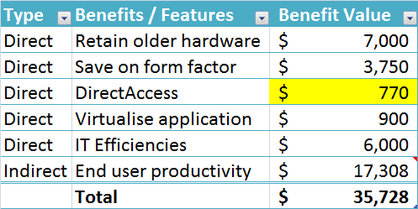
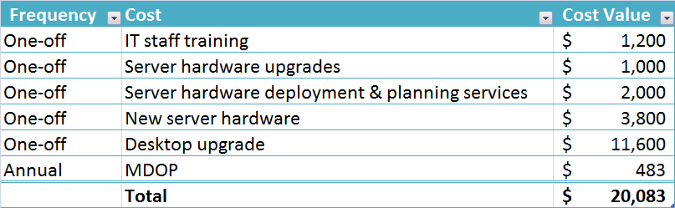
Sample Co – Benefits & Costs

Slide 23
Basic Process
Understand the business problem
Define the solution
Technology
Process
Transition
Cost the solution
Quantify the benefits
Assess the risks
Present the problem and the solution

Slide 24
Risks
Two Types:
Risks averted when we ‘do it’
Really – benefits…
Risks to ‘doing it’
Risks as potential hazards to the success of a project.
Risks to the successful implementation of the project as well as the expected business benefits should be identified and mitigation plans should be made

Slide 25
Calculate Exposure
Risk Factor | Impact | Probability | Exposure
The servers may not be delivered on time, resulting in deployment staff being underutilised | Downtime Costs $10,000 | 60% | $6,000
Impact is expensive because the deployment schedule is crucial to the success of the project
Probability is medium because the schedule for has some built-in lag time
Impact * Probability

Slide 26
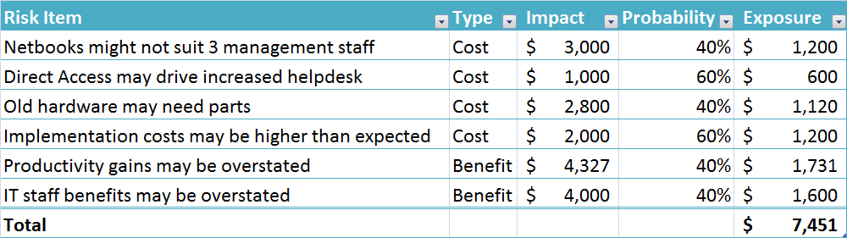
Sample Co – Risk Analysis

Slide 27
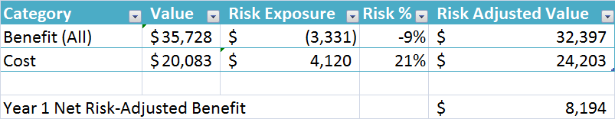
Sample Co – Final Analysis
Year 1

Slide 28
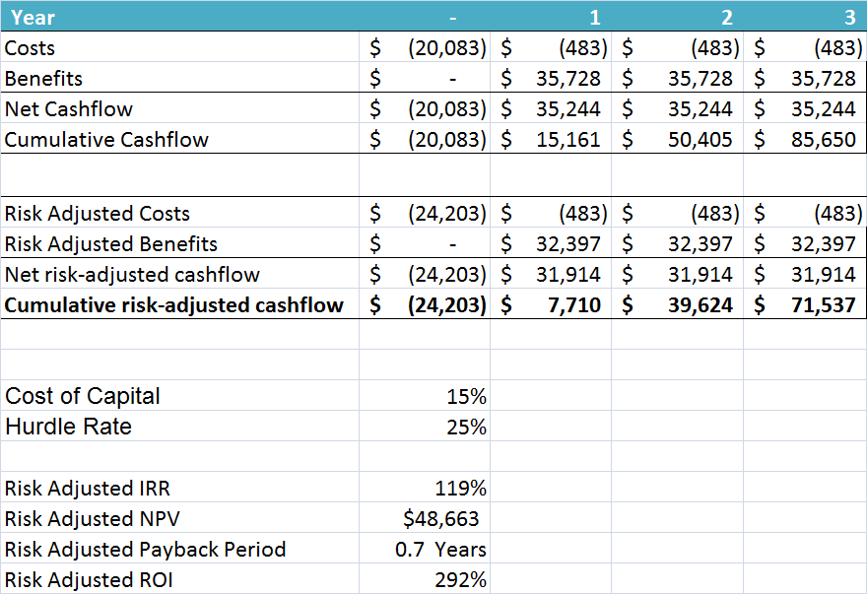
Sample Co – 3 year summary

Slide 29
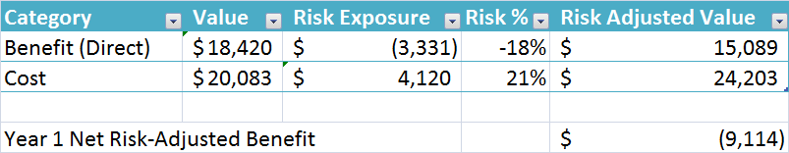
Sample Co – Final Analysis (excluding Productivity)
Year 1

Slide 30

Sample Co – 3 year summary (ex Productivity)

Slide 31

© 2008 Microsoft Corporation. All rights reserved. Microsoft, Windows, Windows Vista and other product names are or may be registered trademarks and/or trademarks in the U.S. and/or other countries.
The information herein is for informational purposes only and represents the current view of Microsoft Corporation as of the date of this presentation. Because Microsoft must respond to changing market conditions, it should not be interpreted to be a commitment on the part of Microsoft, and Microsoft cannot guarantee the accuracy of any information provided after the date of this presentation. MICROSOFT MAKES NO WARRANTIES, EXPRESS, IMPLIED OR STATUTORY, AS TO THE INFORMATION IN THIS PRESENTATION.

