Slide 1
Windows 7 Enterprise Briefing
9:30 am Event Commences
Ben Green - Windows 7 for the Enterprise
David Downs – Making the Business Case for upgrading the Desktop
10:30 am Tea and Coffee Break
10 :45 am Stu Fox - Windows 7 Demo Session 1
Management and Deployment
11:15 am Deannah Templeton - Windows 7 Demo Session 2 Productivity and Security
Noon Event Close

Slide 2



Key Solutions for Today's Uncertain Economy
Windows 7 Enterprise Briefing
Ben Green
NZ Windows Business Group Manager

Slide 3








What We Heard from Customers
“My users are becoming more savvy and have more diverse needs. How do I keep people connected to what they need?”
“How can I enable the software and devices my users require and minimise their risk?”
“How can I reduce costs and take advantage of new technologies like virtualisation?”

Slide 4





The Desktop Optimisation Vision
The Challenge:
Deliver an infrastructure that enables people to be successful in their jobs
Creates Tension:
  End-users want flexibility
  IT needs greater control
The Solution:
Desktop Optimisation
  Empowering both end-users and IT
Desktop Optimisation

Slide 5
Desktop TCO breakdown
Desktop costs go beyond hardware and software
70% of desktop TCO is
labor-related
Desktop TCO
($4600 - $5000/year)
50%
100%
(US$/desktop/year)
20%
30%
HW/SW
IT costs
End-user
Total
Cost of hardware and software
Cost of IT labor and administration
Cost of self support and downtime
Source: Leading analyst firm, December 2005
Note: Excludes server and network costs for centrally managed services

Slide 6




Windows Optimised Desktop
Flexible offerings to meet unique needs
Core Infrastructure Optimisation best practices:
PC Lifecycle Planning
Standard Image Deployment
Desktop Virtualisation
Automation of IT Management
Comprehensive Security
For Software Assurance Customers:
Windows Optimised Desktop
Flexible client computing scenarios to meet your unique needs
Available By Subscription to Software Assurance Customers:

Slide 7






Cost Savings Scenarios
Windows® and MDOP can save you money, now
  Partial list of Cost-saving Scenarios
  Cost-saving through MDOP
  and Windows
  Examples with short-term savings potential⁽³⁾
  Rapidly reduce the major buckets of desktop cost:
    End-user
    IT costs
    HW/SW
    Overhead / Facilities (Electricity)
  Microsoft is offering to demonstrate the short-term savings potential:
    Use existing MDOP Proof of Concept program ⁽¹⁾
    Focus on fast ROI scenarios
    Leverage PoC materials from Microsoft including new guidance and examples
    Deploy Microsoft-funded PoC in your location with a Microsoft® Certified Partner
  Helpdesk
  Group
  Policy Management
  Quicker diagnosis and recovery of desktops resulting
  Centralised Group Policy Management procedures
  Software Asset Management
  Green PC
  Automated, multi-site asset management
  Power policy management and centralised control
  Opportunities in Reducing Desktop TCO ⁽²⁾
Impact from a broad set of TCO reduction best practices as described by the Optimised Desktop
Note: Depicted TCO reduction is not exclusively from the four examples given
$4,600-$5,000
End-user (support,
lost time)
50%
(US$ /desktop/year)
$3,200-$3,300
IT costs
(IT labor and admin)
20%
Note : (1) Ask your WPS/WDDS Partner or Microsoft Account Manager for details
(2) Leading Analyst Firm, December 2005
  (3) Refer “Quantifying the Value of Microsoft's Desktop Optimisation Pack” for more information
HW/SW
30%
Typically-Managed
Locked &
Well-managed

Slide 8
Windows 7 Development Process
New approach for Windows development and disclosure
  Spend more time on planning & vision phase analysing trends and needs before building features.
  Focus on end-to-end business scenarios – not just new features and technologies.
Planning
  Give our customer and partners a timeframe for the release and stick to our plan – 3 years for Windows 7.
  Disclose with higher degree of certainty and minimise changes
Predictability
  Engaging with partners earlier and more closely to enable seamless experiences and compatibility across hardware, software and services
Ecosystem
We are here
Vision Development & Test Pre-Beta Beta Release Candidate Release

Slide 9




Windows 7 Builds on Windows Vista
Deployment, Testing, and Pilots Today Will Continue to Pay Off
  Similar Compatibility:
  Most software that runs on Windows Vista will run on Windows 7. Exceptions will be low level code (AV, Firewall, Imaging, etc).
  Hardware that runs Windows Vista well will run Windows 7 well.
Few Changes: Focus on quality and reliability improvements
Deep Changes: New models for security, drivers, deployment, and networking

Slide 10
Feedback from Customers
Works The Way
You Want
“I just want it to work.”
“I want an OS that gets me to my stuff faster, and then gets out of my way.”
Everyday Tasks are
Faster & Easier
Top 5 Customer Needs
Windows 7 Goals
“Make the tasks I do everyday easier.”
“Don’t tell me about every new feature.
Just tell me about a few that will
make my life easier.”
New Things Possible
“I like the idea of being able to do new things, but only if I don’t have to spend
a lot of time figuring them out.”

Slide 11
Customers Told Us What They Wanted & We Listened
Works The Way
You Want
Faster & More Responsive
Broad Compatibility
More Reliable
Fewer Interruptions
Reflects Your Style
Everyday Tasks are
Faster & Easier
More Intuitive Navigation
Simpler Home Networking
Improved Device Experience
Keep Your Life in Sync with Windows Live
Faster Web Browsing with IE8
Windows 7 Goals
New Things Possible
More choices in how you interact with your PC
Easier to enjoy Photos, Music & Videos almost anywhere
Easy Upgrades with Windows Anytime Upgrade

Slide 12
Works The Way You Want
    Memory Consumption Comparison (Lower bars are better)
Windows 7 Pre Beta
Windows Vista
Preliminary data gathered on
Windows 7 pre-release builds
Windows 7 memory consumption
is independent of number of open windows

Slide 13
Battery Life Increase Example
Works The Way You Want
DVD Battery Life
(Taller bars are better)
DVD Rundown
Battery Life (Minutes)
System A System B System C
Windows Vista SP1
Windows 7 Pre-Beta
Preliminary data gathered on
Windows 7 pre-release builds
on sample of test systems.

Slide 14
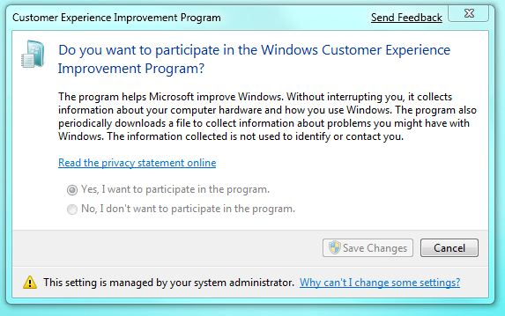
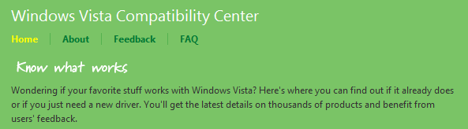
Works The Way You Want
    Broad Compatibility
“All my applications
and devices should just work with my PC.”
Improved compatibility
& easier troubleshooting
If it works with Windows Vista,
it should work with Windows 7
New Program Compatibility Troubleshooter
Effortless updates to applications
& device drivers

Slide 15














Windows 7 for the Enterprise
Makes the things you do today faster and easier, and new things possible
Make Users Productive Anywhere
Enhance Security & Control
Streamline PC Management
  At their desk
  In a branch
  On the road
  Protect data & PCs
  Built on Windows Vista foundation
  Easy migration
  Keep PCs running
  Virtualisation

Slide 16



Make Users Productive Anywhere
Remove Barriers
to Information
Faster & Easier for Everyday Tasks
  Search your PC and intranet
  Internet Explorer 8 retrieves data beyond the page
  Responsive, reliable performance
  Intuitive UI and navigation
Access Information
From Anywhere
  DirectAccess™ mobile connectivity
  BranchCache™ network boost

Slide 17




Enhance Security & Control
Protect Data on PCs
& Devices
  BitLocker To Go™ protects data
  on removable drives
  BitLocker™ simplifies encryptions and key management for all drives
Protect Users
& Infrastructure
Build on Windows Vista Security Foundation
  AppLocker™ controls what applications run
  Internet Explorer 8 helps keep users safe online
  User Account Control prompts less
  Security Development Lifecycle for defense in depth

Slide 18





Streamline PC Management
Keep PCs Running Smoothly
Easier Deployment from Windows Vista
  Compatibility with Windows Vista hardware, software, tools
  New tools speed image creation,
  migration, and deployment
  PowerShell & Group
  Policy management
  ease configuration
  Troubleshooting platform reduces help desk issues
  Better Support for Client Virtualisation
  Improve VDI experience with multi-monitor and mic support
  Same tools to manage and service VHD & WIM images

Slide 19








Increased Value in Optimised Desktop
SA Customer Satisfaction
Make Users Productive Anywhere
  DirectAccess
  BranchCache™
  Enterprise Search Scopes
Enhance Security and Protect Data
  BitLocker & BitLocker To Go
  AppLocker
Streamline PC Management
  MUI Language Packs
  VDI Enhancements
  (VDI requires VECD license)
  Boot from VHD
  Subsystem for UNIX
  4 Virtual Operating Systems
  Network Boot License

Slide 20
Windows 7 SKU Descriptions
All Windows 7 versions are a super set of the version below with no trade off on features when you upgrade from one version to the next
Windows® 7 Enterprise
Windows® Ultimate
“Enterprise” provides advanced data protection & information access for businesses that use IT as a strategy asset “Ultimate” is the no-compromise SKU for technical enthusiasts
“Professional” is the business-focused SKU for small and lower mid-market companies and users who have networking, backup, and security needs and multiple PCs or servers
“Home Premium” is the standard consumer SKU, providing full functionality on the latest hardware, easy ways to connect, and a visually rich environment
“Starter” is an entry-level OEM SKU with a 3 program limit for small form factor PCs in all markets
Windows® 7 Professional
Windows® 7 Home Premium
Windows® 7 Starter

Slide 21





What to do Today
Microsoft guidance to optimise desktop infrastructure
 |  | Take advantage of MDOP products to optimise your existing PC infrastructure and ease future upgrades. Project scope to deploy is small with rapid payback on investment.
 |  | On track for release 3 years after Windows Vista general availability. When Windows 7 Enterprise ships, active Software Assurance customers will have rights to deploy it. Deploy Windows Vista today in preparation for Windows 7.
 |  | Service Pack 2 available now. Deploy today to experience security, search, mobility, and TCO benefits as soon as possible. Be ready to deploy on new PCs you purchase this year. Investments in Windows Vista will ease migration to Windows 7.
 |  | Post Windows XP end of sale (July 30, 2008) downgrades still available for businesses. Per standard Microsoft lifecycle policy, support and critical updates available until April, 2014. Service Pack 3 released in April 2008
 |  | Migrate Windows 2000 PCs to Windows Vista as soon as possible. Extended support ends Q2 2010.

Slide 22

© 2008 Microsoft Corporation. All rights reserved. Microsoft, Windows, Windows Vista and other product names are or may be registered trademarks and/or trademarks in the U.S. and/or other countries.
The information herein is for informational purposes only and represents the current view of Microsoft Corporation as of the date of this presentation. Because Microsoft must respond to changing market conditions, it should not be interpreted to be a commitment on the part of Microsoft, and Microsoft cannot guarantee the accuracy of any information provided after the date of this presentation.
MICROSOFT MAKES NO WARRANTIES, EXPRESS, IMPLIED OR STATUTORY, AS TO THE INFORMATION IN THIS PRESENTATION.

Slide 23












DirectAccess™
IPv6 Devices
IPv4 Devices
Support IPv4 via 6to4 transition services or NAT-PT
IT desktop management
Native IPv6 with IPSec
DirectAccess provides transparent, secured access to intranet resources without a VPN
Allows desktop management of DirectAccess clients
AD Group Policy, NAP, software updates
IPv6 Transition Services
Supports direct connectivity to IPv6-based intranet resources
DirectAccess
Server
Internet
Allows IPSec encryption and authentication
Supports variety of remote network protocols
Windows 7 Client

Slide 24



Improving Branch Performance
Distributed Mode
Second client downloads identifiers from main office server
Client 1
Main Office
First client downloads data from main office server
Branch Office
Client 2
Second client searches local network for data and downloads from first client

Slide 25
Improving Branch Performance
Hosted Caching
Second client downloads from hosted cache
Content pushed to hosted cache from first client
Client 1
Main Office
First client downloads data from main office server
Client 2
Branch Office
Second client downloads identifiers from main office server

Slide 26
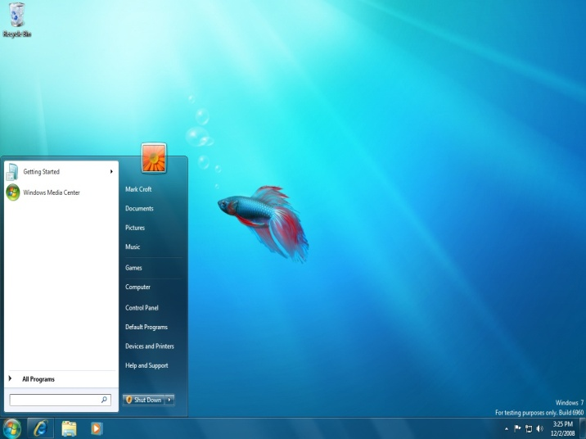
Works The Way You Want
    Faster & More Responsive
“I want my PC to be
fast and responsive.”
Better performance
Faster startup & shutdown
Quicker task management
Improved battery life
Closer development
with PC Manufacturers

