Slide 1
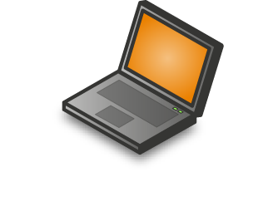




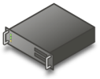









Microsoft Virtualization
Profile
Mobility
Document Redirection
Offline files
Server Virtualization
Presentation Virtualization
Management
Desktop Virtualization
Application / Desktop Virtualization
Windows Vista Enterprise
Centralized Desktop

Slide 2
Virtualizace aplikací
Microsoft Application Virtualization
Ondřej Výšek
Systems engineer, Microsoft ČR

Slide 3





Desktop vs. Application Virtualization
  Co poskytuje
  Kompletní balík s OS a aplikacemi
  Pro co je určena
  Vyřešení problémů s kompatibilitou mezi aplikacemi a OS
  Spouštění dvou prostředí na jednom počítači (e.g. corporate and personal)
  Co poskytuje
  Balíčky jednotlivých aplikací
  Není nutná instalace SW
  Pro co je určena
  Vyřešení konfliktů mezi aplikacemi
  Zjednodušení doručení aplikace a testování kompatibility
Aplikace
Operating System
®
Hardware
Notes:
Another distinction I’d like to make is between Desktop and App vt.
Well, in this case, not only that the technology is different, but also the use-cases are different
<click>
App-v takes an app and builds a package out of it, isolating the application from other apps in the system
It’s a great way to resolve conflicts between applications (for instance, diff versions of the same app).
You can also run virtualized apps without actually installing them – so it makes apps very portable and provides a whole new way to deliver apps to endpoints
<click>
DV – which in MS is MED-V + VPC, actually creates a package of a full desktop OS as I mentioned.
Its useful when you wish to run applications that are incompatible with the desktop OS, since you can run two OS concurrently on one device
Or levearge the same quality, to run two environments on a single PC (e.g. corporate and personal
To summarize – 2 diff tech, different use-cases.

Slide 4
Aplikace v IT prostředí
Tradiční scénář
  + Využití lokálního výkonu, předinstalace s OS
  - Pouze jedna verze, správa lokálních instalací
Server scénář
  + Malý počet instalací, snadná správa
  - Velký počet serverů, multiuživatelské aplikace
Web scénář
  + Centralizace, spouštění pomocí internet. prohlížeče
  - Nutno přepsat aplikace, limitovaná funkčnost
App-V
  + Nasazení a správa z jednoho místa, oddělení aplikací, využití lokálního výkonu
  - Nelze virtualizovat systémové služby a ovladače

Slide 5











Správa všech vrstev zlepšuje efektivitu IT a zvyšuje možnosti uživatelů
Windows PC – Tradiční pohled
Windows PC - 2007+
Aplikace
Aplikace
Data,
Nastavení
Data,
Nastavení
OS
OS
Hardware
Hardware
Dependencies, stickiness
Jednotlivé vrstvy jsou na sobě závislé
OS a aplikace jsou instalované lokálně; data jsou umístěna lokálně
Uživatelský počítač má jedinou kopii informací
Snížení závislostí mezi vrstvami a centralizovaná správa konfigurace a informací umožňuje
    Přistupovat uživatelům k aplikacím, datům na jakémkoliv zařízení odkudkoliv
    Snížení TCO

Slide 6
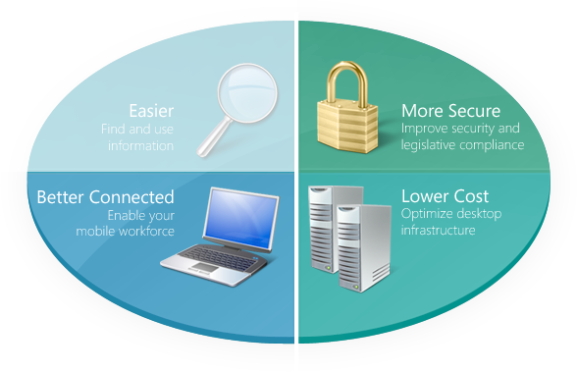

Microsoft Application Virtualization
Dynamically streaming software as a centrally managed service
Život bez tradiční instalace software
Aplikace dostupné při přihlášení
Centralizovaná oprávnění
Izolované aplikace
Rychlý desktop deployment
Minimalizace testování kompatibility aplikací
Reporty o využití aplikací
Možný přechod mezi zařízeními
Kompatibilita aplikací
Spravovatelnost PC
Modely flexibilního počítače
Software asset management
Notes:
Microsoft Application Virtualization changes the face of application lifecycle management. It enables a world without traditional software installation where users can access their applications from any licensed machine in seconds and where the user no longer has to be concerned with new software installation because nothing is installed locally – New patches and new versions can be provided to the user the moment they click on their desktop icon and when the session terminates, the code, settings, and profiles are saved on the PC in a virtual “sandbox”. This enables the employee to use the program even when they are not connected to the network.
This has several benefits to IT:
It accelerates desktop deployment and enables IT to take control of the desktop
It minimizes application conflicts through application isolation at streaming server
It minimizes significant application compatibility testing and scripting, multi-platform packaging, or significant regression testing
It enables IT to run real time usage reports on any application that is streamed
And it enables device roaming
Let’s take a look at the top 7 pain points and see what Microsoft Application Virtualization does to address them.
Between the BDD, the ACT, the Virtual OS’ in Vista Enterprise and Microsoft Application Virtualization rounds out the equation for addressing application compatibility by minimizing the application to application compatibility issues through the application isolation.
Microsoft Application Virtualization simplifies corporate image management by separating the application layer from the OS and enabling. It also controls access and centralizes application permissions and policy based management with AD integration
It enables customers to run a mixed environment of rich and thin clients with a centralized mechanism to manage the applications for both
And it helps with software asset management by enabling real time usage reporting on those applications that are administered via Microsoft Application Virtualization
But that software asset management capability is only a small portion of what customers need so we also added…(flip slide) the asset inventory services

Slide 7

Microsoft Application Virtualization*
Dynamically streaming software as a centrally managed service
Život bez tradiční instalace software
Spouštěno na lokálním PC
Konsolidace a standardizace instalačních obrazů
Zajištění business continuity pro aplikace
Aplikace mohou být dočasně odstaveny
Aplikace dostupné při přihlášení
Centralizovaná oprávnění
Izolované aplikace
Spouštěno na Terminal Serveru
Konsolidace serverů
Zmenšení problémů s uživatelskými profily
Transformace TS do dynamického systému
Připraveno pro malá přenosová pásma
For Terminal Services
*Application Virtualization for Terminal Services is available and sold separately from MDOP
Notes:
Microsoft Application Virtualization is a virtual application delivery and management platform which packages the applications, delivers them to the users when needed and runs them inside of an abstracted environment so even though the application functionality is available to the user, the application is not installed on local operating system. This is greatly minimizes application conflicts and acelerates the time it takes to bring an application from purchase to production.
MS App Virt comes in two separate products, first as part of the Microsoft Desktop Optimization Pack, and as a separate SKU for Terminal Services use in the form of the MS Application Virtualization for Terminal Services.

Slide 8
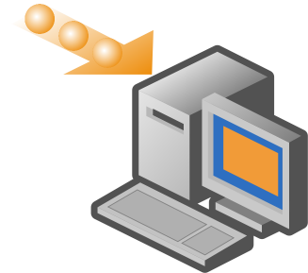

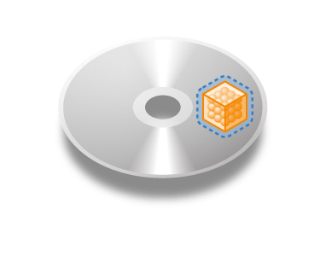

Microsoft Application Virtualization
Dynamically streaming software as a centrally managed service
Virtualizace aplikací
Více možností pro doručení aplikace včetně sreamovaní
Policy Based application management
Standalone Mode
Microsoft Application Virtualization Platform
Notes:
The platform provides the following general capabilities:
Application Virtualization
The ability to abstract and applications dependencies, except for the OS, from Windows so that even though the application is running using the resources of the PC or the Terminal Server, the application is not installed into the OS.
Multiple Delivery Options
Multiple delivery options exist enabling full infrastructure or lightweight infrastructure options and interoperability with existing ESD systems.
Policy Based Management
Whether it’s assignment of virtual applications based on group association in Active Directory or management choices in ESD systems, the virtual applications may be centrally managed.
Standalone Mode
Microsoft Application Virtualization now offers a standalone mode which targets rarely connected users.

Slide 9
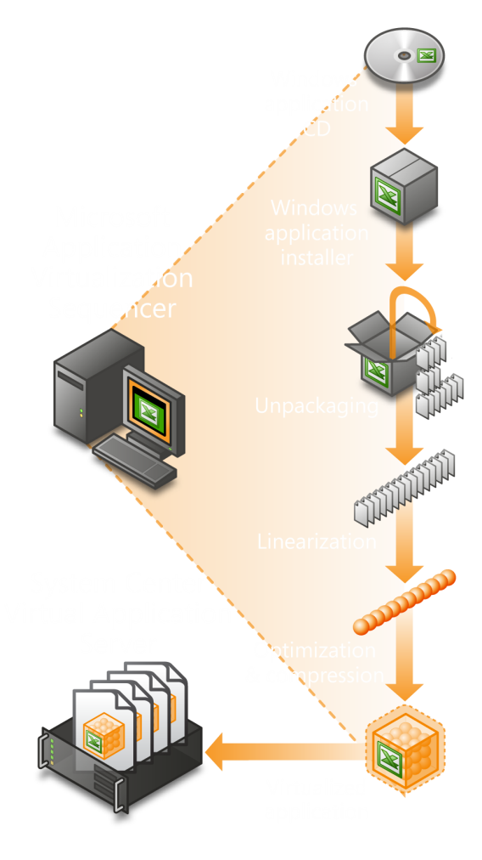
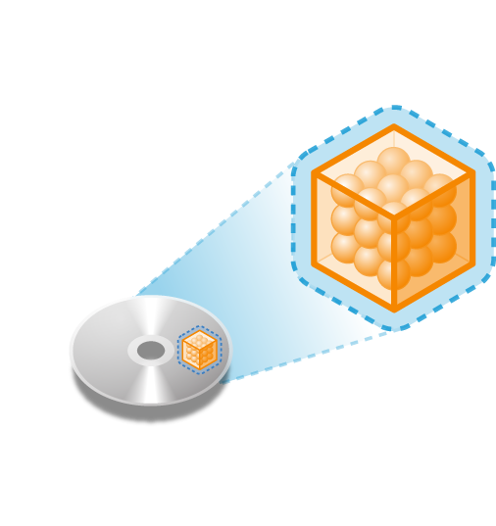
Microsoft Application Virtualization
Sequencing – Brána k Microsoft Application Virtualization
Virtuální aplikace
(SPRJ, OSD, ICO and SFT)
Rychlá příprava balíčků pomocí technologie active watch včetně závislostí při spouštění.
Výstupem Sequenceru je virtuální aplikace, která obsahuje aplikace a jejich závislostí.
Administrátor má možnost vytvoření MSI wrapperu pro distribuci bez serveru (standalone).
Notes:
The Sequencer is a wizard-based tool that packages and virtualizes Windows applications for real-time delivery as network services. Application virtualization uses a once-per-application process to protect the application's integrity and does not modify its source code. The Sequencer performs several functions:
Creates the Virtual environment: The Sequencer monitors and records all interactions between the application and operating system during application installation and execution. It analyzes which OS components are used and set by the application. It also analyzes patterns and dependencies, such as the specific version of a DLL. The Sequencer uses this information to create a virtual application package.
Prepares an application package for on-demand delivery: In an unobtrusive process, the Sequencer converts the hierarchical file system data into the application virtualization multimedia file format, optimized for efficient delivery. Applications such as the Office 2003 suite can be available for on-demand deployment in less than 20 minutes. In addition, enterprise IT departments that support hundreds of applications for thousands of users can automate the sequencing of new applications, as well as updates and patches, accelerating their delivery and use.
Transforms existing application package libraries into virtual applications without having to re-configure their existing packages: The Sequencer supports MSI files, enabling these packages to be virtualized without new coding or reconfiguration. Existing enterprise packaging groups can continue to focus on their core packaging expertise in MSI, Wise, Installshield and many others.
MSI Capability
The 4.5 Sequencer now has an option to create an MSI control point which enables standalone operation. This MSI contains metadata that describes the virtual application to an ESD system so it can be treated like any other MSI. It also can be burned onto a CD and sent to a rarely connected user so they can add virtual applications with the highest chance for success.

Slide 10



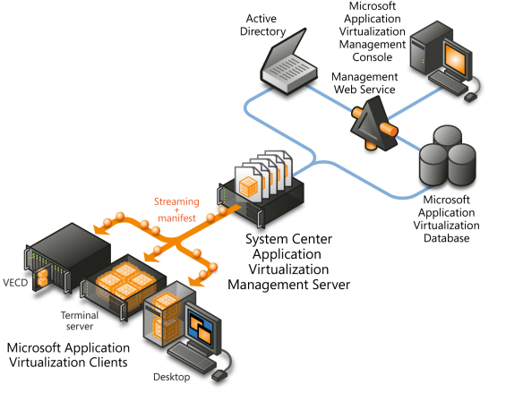
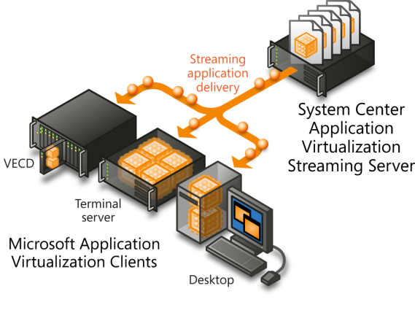
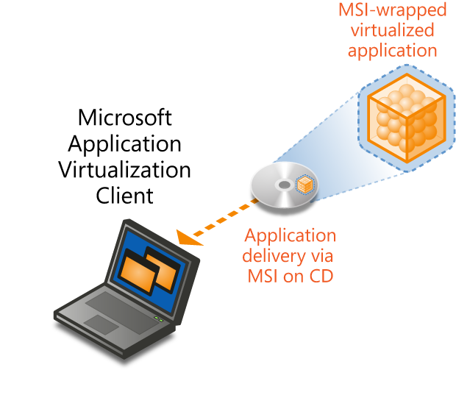
Extending Scalability
Více možností doručení
Úplná infrastruktura
Standalone Mode
Jednoduchá infrastruktura
Desktop Configuration (DC) Service
Vyžaduje Active Directory a SQL Server
Dynamic Delivery
Dynamic Delivery
Není DC Service (XML konfigurace)
MSI wrapper řídí konfiguraci
Package/Active Upgrade
Package/Active Upgrade
Spolupráce se SMS/SCCM & 3rd party ESD
Spouštění samostatné aplikací
Není dynamic delivery, DC service nebo package/active upgrade
Umožňuje sreaming po rozšíření SMS/SCCM & 3rd party ESD
Nezávisí na Active Directory nebo SQL Server
Není vyžadován server
Notes:
MS App Virt provides multiple infrastructure options for delivery of the virtual application. These include:
Full Infrastructure
This option includes the Microsoft System Center Application Virtualization Management Server which includes full streaming capabilities, Desktop Configuration service, Package/Active Upgrade, basic licensing and metering. This infrastructure requires Active Directory and SQL server and is an update to the existing SG VAS that 4.2 customers are familiar with using.
Lightweight Infrastructure
The lightweight infrastructure consists of the Microsoft System Center Application Virtualization Streaming Server. This server has streaming capabilities including active/package upgrade without the Active Directory or SQL Server requirements; however it does not have a Desktop Configuration Service, licensing or metering capabilities. This service relies on the manual or scripted addition of a manifest file for virtual application configuration. The Desktop Configuration Service of the MSCAV Management Server may also be used in conjunction with the MSCAV Streaming Server so the Management Server configures the application, but the Streaming Server delivers it.
Standalone Mode
The Sequencer now has an option to create an MSI file which automates the addition of the virtual application. The MSI contains metadata so an ESD system can recognize it and control the virtualized applications. Standalone mode requires the client to go into standalone mode which only allows MSI based updates of the virtual applications and streaming is not allowed while in standalone mode. This mode is meant for those rarely connected users that need the power of virtualized applications, but do not have access to a server.

Slide 11
Streaming
Zavaděč
Aplikace 1
Aplikace 2
Vždy uložen v cache ihned po publikaci aplikace
Obsahuje informace o aplikacích a streamovaní
Aplikace je postupně spouštěna
Po přenesení aplikace po síti je uložena v lokální cache
Aplikace je postupně spouštěna
Po přenesení aplikace po síti je uložena v lokální cache
Při dalším spuštění aplikace nejsou informace přenášeny po síti

Slide 12
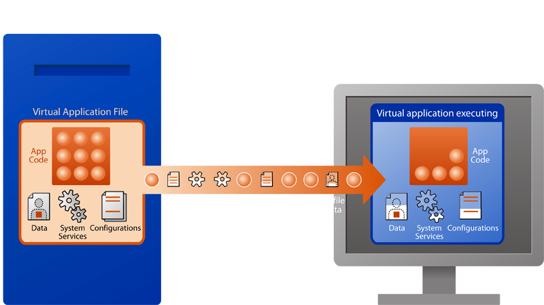
Microsoft Application Virtualization
Dynamický streaming software – centrálně spravovaná služba
Rozdílná klientská základna
  Microsoft Application Virtualization podporuje Windows XP Pro, Windows Vista, Windows Server 2003 and 2008 Terminal Services a Vista Enterprise Centralized Desktop
Založeno na oprávněních
  Uživatel klikne na shortcut na desktopu – autentikace, autorizace a kontrola licence je prováděna při každém spuštění aplikace uživatelem
Centrálně doručováno
  The first time the Server delivers “just enough” code (20-40%) to client or TS machine. As more code is needed, it is dynamically delivered.
Spouštěno lokálně
  App executes on desktop, laptop and/or Terminal Server, not on the Application Virtualization Server
Kešováno pro výkon
  App code is cached for repeat use
  Options to cache at login or on first launch
Podpora pokud není PC připojeno
  Entire set of applications are cached for limited time before expiring
Notes:
Dynamic delivery of the virtual application is a first order distribution mechanism in MS App Virt. The client is approximately 10 MBs and can service Windows XP, Pro, Windows Vista Enterprise and above, and Windows Server 2003 and 2008 Terminal Services.
The client is permission based meaning it will look at the published application for the user based on their Active Directory membership. The shortcuts can be published in any number of ways including the built in publishing feature.
Once the user double-clicks the virtual application shortcut, the server will stream just enough of the application bits to reach the launch threshold of the application. This is usually 5-40% of the application footprint depending on how the application was written.
The application then creates the application process wherever the client is loaded. If it is loaded on the PC, the virtual application is using the resources of the PC, but if the client is loaded on a Terminal Server, then the virtual application runs using the resources of the Terminal Server and RDP will remote redraw the application screen.
The virtual applications will then subsequently call additional bits as needed if they have not already been delivered to the client. These bits are stored in a non-volatile, hard drive based cache so the next the virtual application is launched, is is pulled rom the local hard drive and it feels like a locally installed application to the user.
The virtual application may also be fully pre-cached and then the laptop system can be disconnected from the network. The user may continue to use the virtualized applications in disconnected mode while away from the network.

Slide 13
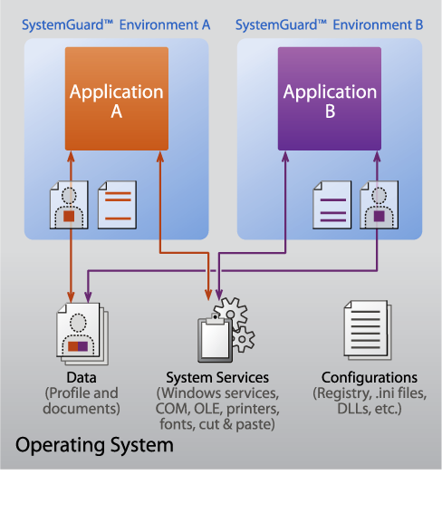
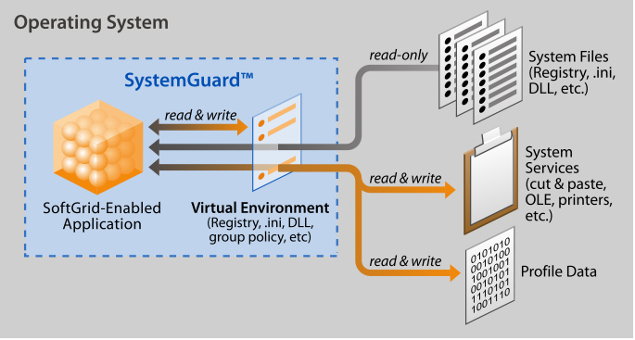
Microsoft Application Virtualization
Aplikace jsou virtualizovány jednotlivě:
  Soubory (včetně systémových)
  Registry
  Fonty
  .ini
  COM/DCOM objekty
  Služby
  Semaphores, Mutexes
  Name Spaces
Aplikace nejsou instalovány a nijak neovlivňují OS
Všechny úkoly jsou spouštěny na lokálním počítači
Dramaticky snižuje konflikty mezi aplikacemi
Notes:
Application Virtualization
Application virtualization is at the heart of the product. It decouples applications from the operating system and enables them to run as network services.
To be clear, Microsoft Application Virtualization is different than machine virtualization (such as VMware and Microsoft’s Virtual Server), which virtualizes the machine on which you are installing an operating system (and applications). Machine virtualization provides an abstraction layer between the hardware and the operating system that’s running on top of it. It also allows you to manage and simultaneously operate multiple environments on a single machine.
MS App Virt takes this concept and moves it up the logical stack. In fact, many customers, such as Fidelity National Financial, use both application and machine virtualization to maximize server and IT management efficiencies. The abstraction layer created by application virtualization lies between the operating system and the applications that run within it. By virtualizing all the aspects of an application, it doesn’t affect the operating system or other applications running on that machine. The power of Microsoft Application Virtualization is that it allows applications to be delivered dynamically as services that can be added or removed without leaving a trail on the client system. This in turn reduces the total cost of deploying and maintaining applications and systems.
Microsoft Application Virtualization is enabled by two key technologies: the virtual environment and the Sequencer.
The virtual environment enables each application to bring its own set of configurations and run within a protective virtual memory "sandbox" on the client, so there is no dependency or effect on the configuration of the machine running them. However, since applications execute locally, they run with full performance, functionality, and access to local services — including cut and paste, OLE, printing, network drives and attached devices.
The application is virtualized per user and per application instance, 18 different application components including:
Registry: application virtualization creates a virtual Registry for each application. Registry settings created by one application cannot be seen by other applications — including Regedit. Rather than copying the entire Registry, application virtualizations virtual registry utilizes an "overlay" method — items in the real registry may be read by the application as long as a virtual copy of that item is not available. All application writes to the Registry are contained within the virtual Registry.
File System: application virtualization handles requests made by applications to files in specific directories by redirecting the requests. For example, if an application looks for a file located in a specific directory on the local C drive, application virtualization can redirect any requests to the corresponding directory inside of its virtual file system. Dynamic Link Libraries (DLLs) specifically needed by the application are made available within the virtual environment, avoiding conflicts with different versions of the same DLL that may be installed locally. These components are shared and tracked inside of the Virtual File System.
COM/IPC: application virtualization enables programs to redirect communication requests through services such as COM/ DCOM or IPC methods such as Named Pipes. This alleviates versioning problems and other conflicts at these interfaces.
.INI: application virtualization allows each application or instance to have private settings within virtual copies of standard Windows .ini files.
Process Environment: application virtualization stores private environment variables — including paths, port values and addresses.
Fonts: Installation of fonts can consume valuable resources as they are done on a machine-wide basis. application virtualization can make fonts available individually on a per-application basis.

Slide 14
Dynamic Virtualization
Uvedení Dynamic Suite Composition (DSC)
Izolované aplikace mohou být administrativně nastaveny ke sdílení stejného virtuálního prostředí
Povinné a volitelné závislosti
Virtuální aplikace mohou sdílet běžné závislosti
Výhody:
  Možnost aplikací „one to many“
  Greatly improve the ability deploy and manage an application with multiple plug ins and/or add ins
  Reduce cost of patching dependent application (i.e. plug ins, middleware, etc)
  Improve management of plug in distribution to different user groups
Notes:
Dynamic Suite Composition (DSC) provides a way for administrators to control which virtual applications will be combined on the fly to create a working environment for the applications. DSC provides a way for the admin to specify mandatory or optional dependencies between virtual applications. Once these applications are run on the client, they will launch the dependent virtual application’s environment, allowing the combination of both virtual environments. This enables the one to many scenario for middleware applications. A good example of these use cases include the Java Runtime Environment (JRE) and applications that require the JRE. In Softgrid 4.2, you would have to add the JRE to each virtual application that needed it. This meant multiple sequencings and when you had an update to the JRE, you would have to update multiple packages.
However in MS App Virt 4.5 and DSC, these requirements get much simpler. The admin would sequence the JRE into it’s own virtual application. They would then reset the sequencer, install the JRE locally and then sequence the dependent application. They would then do the same with the subsequent applications. The admin would then specify a dependency between the single virtual JRE package and the different virtual dependent applications. This essential achieves a one to many scenario where multiple virtual applications are sharing the same virtual JRE package. This reduces the sequencing overhead as only one JRE needs to be sequenced instead of sequencing the JRE into each individual package.
As for updates, the single JRE package would be updated instead of multiple packages as was required in the previous version.

Slide 15
Application Virtualization 4.5
Stand Alone (MSI)Scénář
Sequencer generuje MSI
Neexistuje Streaming server
Nahrávání ze souboru
Manuální deployment (nebo ESD)
Výhody
  Zachovává virtualizaci
  Jednoduché nasazení
  Není potřeba síť nebo server při běhu aplikace
  Pre-cached a dostupné všem uživatelům

Slide 16
Microsoft Application Virtualization Spolupráce se SMS 2003/SCCM 2007…
Více možností spolupráce
Spolupráce se SMS 2003 R2 a SCCM 2007
Možnosti streamování aplikací mohou být přidány na SMS/SCCM 2007 Distribution points
Sequencer může generovat MSI wrapper jako řídící bod pro virtuální aplikace (System Center Application Virtualization Server není vyžadován)
Virtuální aplikace mohou být inventarizovány pomocí WMI provideru nebo v Add/Remove Program (pouze pro MSI)
Third party ESD systémy mohou také řídit virtuální aplikace pomocí skriptu nebo MSI wrapperu
Nativní podpora pro Application Virtualization a plná integrace bude v SCCM 2007 R2
Notes:
16
Multiple options now exist for integration into SMS 2003 R2, SCCM 2007 and third party ESD systems. The MSCAV Streaming Server may be added to any supported Windows Server including SMS/SCCM distribution points. The admin can then script the addition of virtual application configuration files, called manifests, with ESD systems such as SMS, SCCM or other third party systems. When the application is launched on the client, the application will be streamed from that server. The MSI capability and standalone mode may also be used with ESD systems as well. The MSI contains the metadata necessary to describe the virtual application to an ESD system. Once the virtual application is added thorugh the MSI data, the virtual application is treated just like any other MSI in the ESD system. Please ntoe that the streaming, licensing and metering functions as well as active upgrade are not enabled in the standalone scenario.
MS App Virt will integrate deeply with SCCM 2007 R2 (Q3 2008). More information will become available on the integration as we get closer to that release.

Slide 17
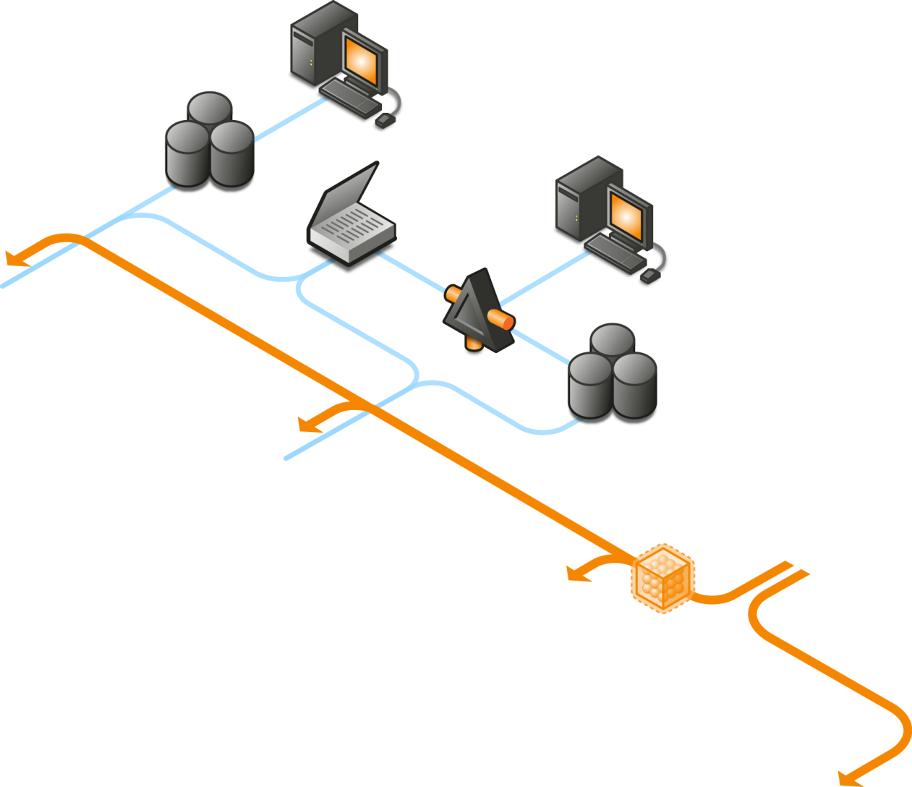
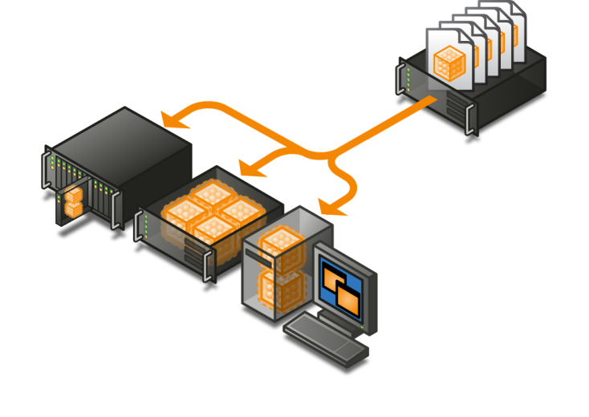
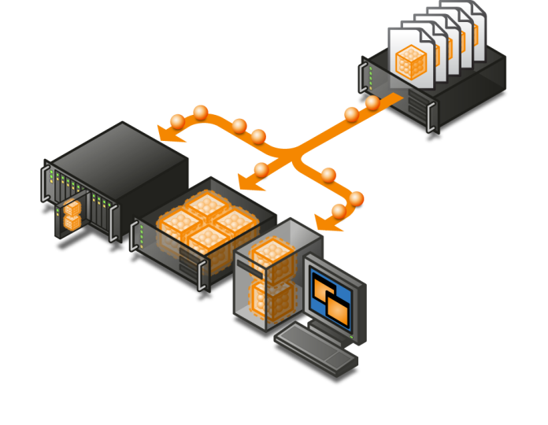

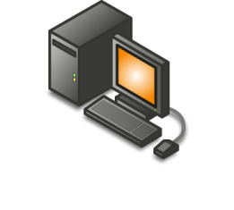
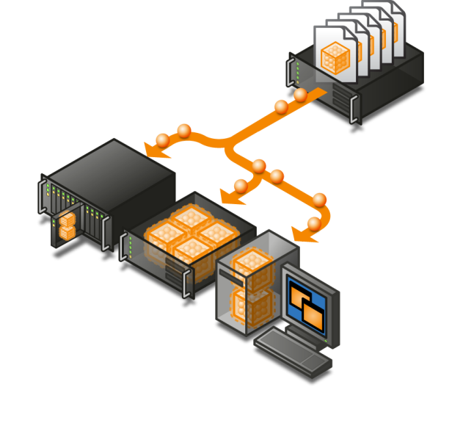
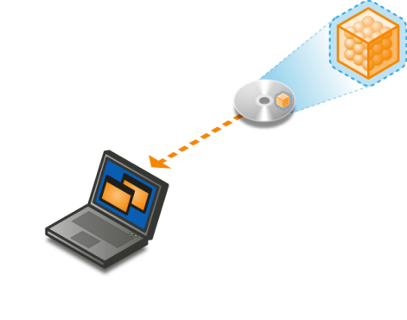
The Microsoft Application Virtualization Platform
SMS/SCCM Database
SMS/SCCM Management Console
Microsoft
Application Virtualization Management Console
SMS/SCCM Distribution Point
Active Directory
Management Web Service
SMS/SCCM application delivery
System Center Application Virtualization Management Server
Microsoft
Application Virtualization Database
Windows application
VECD
Streaming
+
manifest
Terminal
server
System Center Application Virtualization Streaming Server
Microsoft Application Virtualization Clients
Microsoft
Application Virtualization Sequencer
Desktop
VECD
Virtualized application
Terminal
server
Streaming
Microsoft Application Virtualization Clients
MSI-wrapped virtualized application
Desktop
Standalone
Microsoft Application Virtualization Client
VECD
Terminal
server
Microsoft Application Virtualization Clients
Application delivery via MSI on CD
Desktop
Notes:
MA APP Virt is ideal for common and critical business projects faced by all corporate IT environments, from reducing the costs of application deployment to centralizing and accelerating application availability.

Slide 18








Řešení problémů pomocí Application Virtualization
Snížení nákladů na správu aplikací
Možnost Free Seating uživatelů
Zjednodušení a urychlení migrací aplikací a OS
Vybudování Business Continuity pro aplikace
Redukce testování
kompatibility aplikací
Snížení počtu volání na HelpDesk
Konsolidace, standardizace instalací OS
Konsolidace terminálových služeb
Notes:
Microsoft Application Virtualization is ideal for common and critical business projects faced by all corporate IT environments, from reducing the costs of application deployment to centralizing and accelerating application availability.
Click on each icon to get more details about how application virtualization can help with each project.

Slide 19
UKÁZKA

Slide 20


Ondřej Výšek
Systems engineer
Microsoft ČR

Slide 21
Desktop vs. Application Virtualization
  Co poskytuje
  Kompletní balík s OS a aplikacemi
  Pro co je určena
  Vyřešení problémů s kompatibilitou mezi aplikacemi a OS
  Spouštění dvou prostředí na jednom počítači (e.g. corporate and personal)
  Co poskytuje
  Balíčky jednotlivých aplikací
  Není nutná instalace SW
  Pro co je určena
  Vyřešení konfliktů mezi aplikacemi
  Zjednodušení doručení aplikace a testování kompatibility
Aplikace
Operating System
®
Hardware
Notes:
Another distinction I’d like to make is between Desktop and App vt.
Well, in this case, not only that the technology is different, but also the use-cases are different
<click>
App-v takes an app and builds a package out of it, isolating the application from other apps in the system
It’s a great way to resolve conflicts between applications (for instance, diff versions of the same app).
You can also run virtualized apps without actually installing them – so it makes apps very portable and provides a whole new way to deliver apps to endpoints
<click>
DV – which in MS is MED-V + VPC, actually creates a package of a full desktop OS as I mentioned.
Its useful when you wish to run applications that are incompatible with the desktop OS, since you can run two OS concurrently on one device
Or levearge the same quality, to run two environments on a single PC (e.g. corporate and personal
To summarize – 2 diff tech, different use-cases.

Slide 22
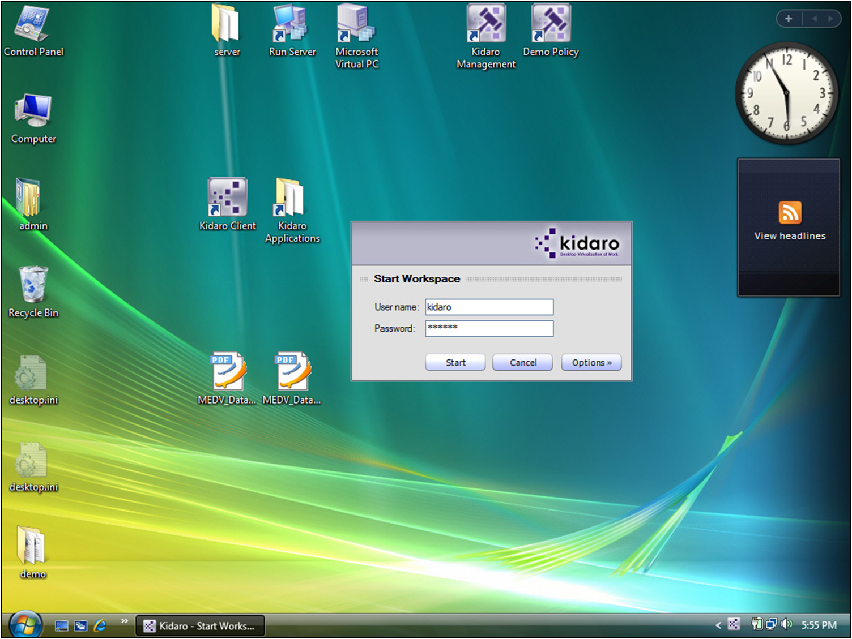
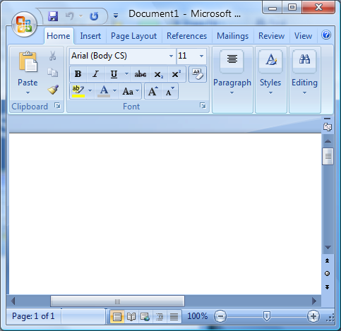
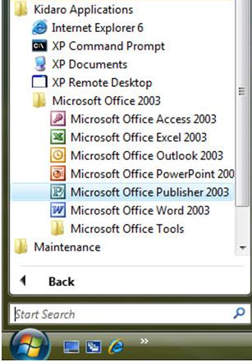

Vyřešení konfliktů Application-to-OS
Applications installed in
the virtual machine
become available through
the Start Menu.

Slide 23
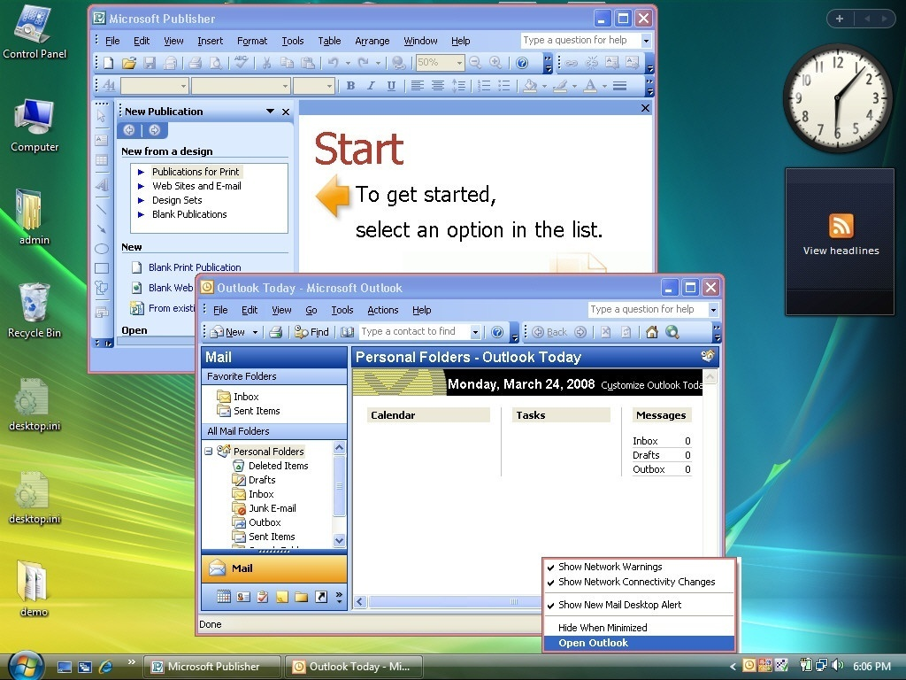
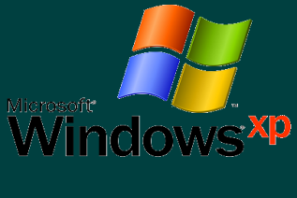
Vyřešení konfliktů Application-to-OS
Applications from the XP VM
appear on the user’s desktop as if they were running natively.

Slide 24
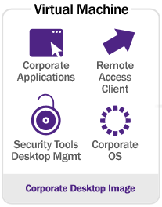
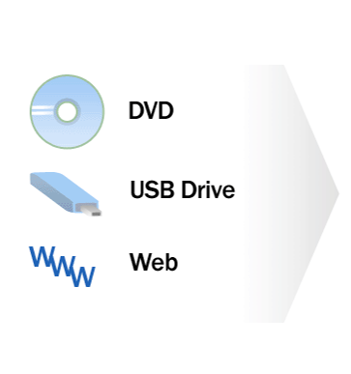
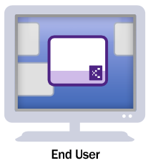
Spravovatelnost a využitelnost PC
Corporate network
Distribuce virtuální kopie firemního počítače na jakékoliv cílové PC
Deliver corporate-managed desktops to third-party / unmanaged PCs
  Increase productivity for contractors, offshore, branch offices
  Enable work-at-home and increased mobility
Drive business continuity
  Rapidly reconstitute corporate desktops on any PC in case of emergency
Increase manageability and usability of corporate laptops
  Eliminate historic trade off between IT control and user flexibility
  Enable employee-owned model, using a virtual corporate desktop

Slide 25


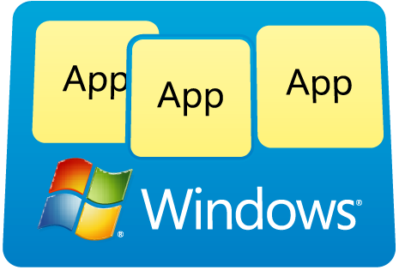
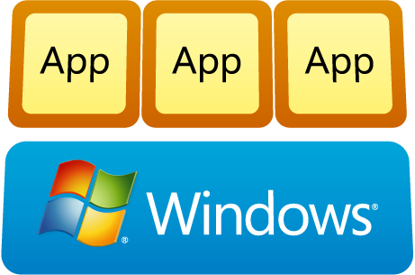
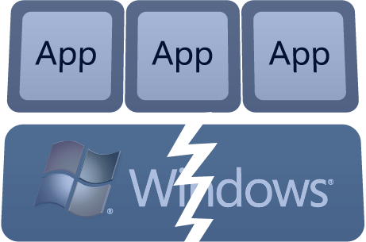

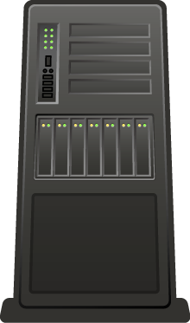


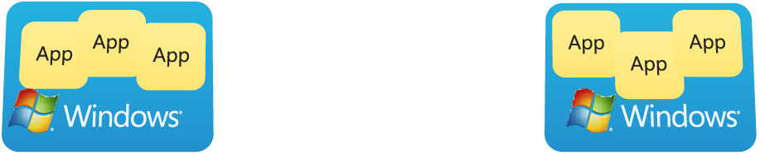
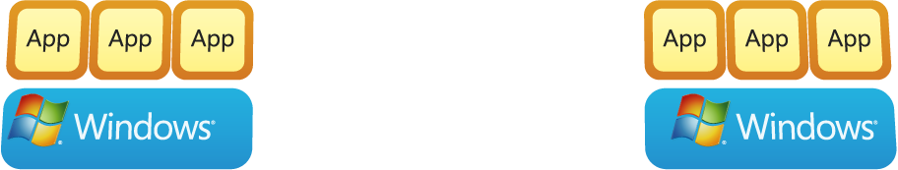


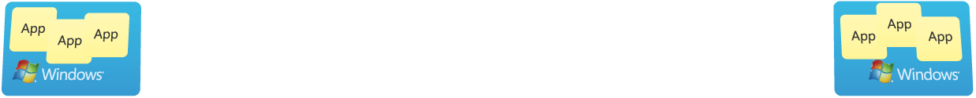







App
App
App
App
App
App
App
App
App
App
App
Translating software inventory
into business intelligence
Enhancing group policy through
change management
Dynamically streaming software as a centrally managed service
Proactively managing application and operating system failures
Powerful tools to accelerate desktop repair
Simplifying deployment and management of Virtual PCs

Slide 26






Optimalizovaný desktop
Flexible Offerings to Address Customer Needs
Asset Inventory Services
Application Virtualization
Diagnostic & Recovery Toolset
Advanced Group Policy Management
Desktop Error Monitoring
Includes all features of Windows Vista Business plus:
New! Diskless PCs & Remote Boot
Four Virtual Operating Systems
Windows BitLocker™ Drive Encryption
Multi-lingual User Interface (MUI)
Subsystem for Unix-Based Apps (SUA)
Enables business to:
Find and Use Information
Enable Mobile Workforce
Improve Security and Compliance
Optimize Desktop Infrastructure
*
Předplatné v rámci
Software Assurance
Dostupné pouze v rámci
Software Assurance
Pro všechny zákazníky
Optimized Desktop
*Subscription Access within SA is required for VECD for Rich Clients only
Notes:
To mitigate this tension Microsoft has invested in innovative methods to optimize your desktop from both an End User perspective and deployment perspective for IT Pros.
The combination of the features in Vista and Vista Enterprise and those in the Desktop Optimization Pack stack on top of each other to optimize the desktop experience and deliver on Microsoft’s promise
To deliver the most cost effective and flexible desktop management solution
(While these technologies deliver the highest value experience when they work together, they also can work independently. Even if the customer is not yet ready to deploy Vista the Desktop Optimization Pack is still compatible with both Windows 2000 and XP.)

Slide 27
Dostupnost a zdroje
Microsoft Application Virtualization dostupná
Microsoft Application Virtualization 4.5 Beta
  http://connect.microsoft.com
Website for Microsoft Desktop Optimization Pack for Software Assurance
  http://www.windowsvista.com/optimizeddesktop
Microsoft Virtualization 360
  http://www.microsoft.com/virtualization

Slide 28

závěr a otázky
Windows Server 2008 Hyper-V

