Slide 1
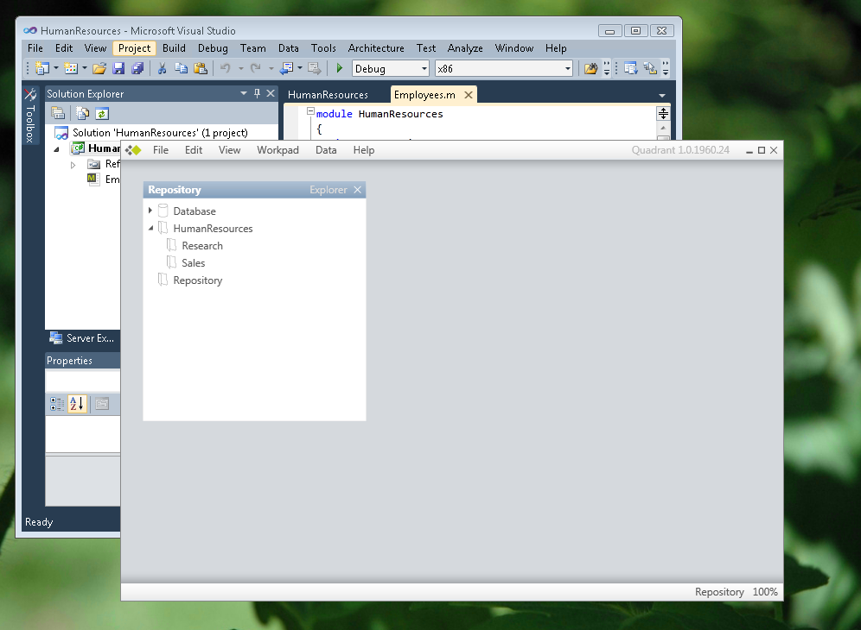
 | 200 | SQL Server Modeling Services | Understanding Folders Jason Roth Senior Programming Writer Microsoft SQL Server Modeling CTP (November 2009)

Slide 2
Understanding Folders
Folders
Addresses
Id
Name
Folder
Id
Columns
Folder
200
…
200
1
…
1
Repository
NULL
1
…
200
2
…
200
150
HumanResources
NULL
2
200
3
…
200
200
Sales
150
3
…
4
4
…
…
300
300
Research
150
300
300
…
300
5
…
5
Employees
Benefits
Id
Columns
Folder
Id
Columns
Folder
200
…
200
1
…
200
1
…
200
1
…
1
…
300
2
…
300
…
2
…
300
2
300
2
200
3
…
200
300
3
…
3
…
300
3
…
4
4
…
…
200
4
200
4
…
…
200
200
300
5
…
300
200
5
…
5
…
200
5
…

Slide 3
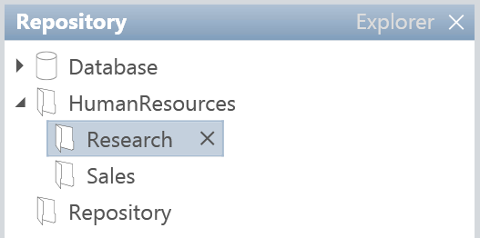
Understanding Folders
Modeling Services Folders
  Contain rows of data across tables.
  Have a hierarchical structure.
  Provide flexibility to match existing taxonomies.
    HumanResources/Sales
    HumanResources/HRApp/1.0
  Can be secured to specific users and groups.

Slide 4
Resources
Using Folders and Ids:
  http://msdn.microsoft.com/en-us/library/dd894380(VS.85).aspx
SQL Server Modeling Services Patterns:
  http://msdn.microsoft.com/en-us/library/ee713121(VS.85).aspx
How to: Create and Use Modeling Services Folders:
  http://msdn.microsoft.com/en-us/library/dd129548(VS.85).aspx
How To: Use Folders to Organize Data in "Quadrant“:
  http://msdn.microsoft.com/en-us/library/dd894393(VS.85).aspx
Data Developer Center:
  http://msdn.microsoft.com/en-us/data/ee461169.aspx
For questions, comments, feedback:
  http://social.msdn.microsoft.com/Forums/en-US/oslo/threads/

