Slide 2
Microsoft Office Communications Server 2007 Deployment Overview
Name Title Microsoft Corporation

Slide 3
Before you begin
OCS-STD
Open Setup wizard for Demo
Run C:\SE_VOLUME\setup\i386\setup.exe
Click on “Deploy Standard Edition Server”
Run Validation test – and leave IE window open
OCS-CWA
Open Setup wizard for Demo
Run C:\SE_VOLUME\setup\i386\setup.exe

Slide 4
Session Objectives
In this session, you will…
Learn how to run an OCS 2007 pilot
Understand how to plan for an enterprise deployment
See various enterprise deployment options
Learn how to finalize your deployment
See tools that are available to help manage deployments
Notes:
Introduction:
The Microsoft Office Communications Server 2007 keynote session and other launch sessions – provide us with a wealth of information about the functionality delivered in this product and why it is essential to the business process infrastructure in the organization.
In this session, we will talk about how can deploy Microsoft OCS 2007 in the organization.
Here are the session objectives:
Exploring OCS 2007: How do I run a pilot? The first step in evaluating and deploying OCS 2007 is to run a Pilot program in the organization. Based on organizational needs, a Pilot size deployment may also be sufficient in some cases. In this section, we’ll see how you can go about deploying a pilot for OCS 2007.
Next we’ll see - How we can plan the enterprise deployment? This section talks about the steps beyond the pilot. We’ll look at a list of “Key Considerations” – questions that you should address in planning the enterprise deployment in your organization.
Then we’ll look at the various deployment options that are available for enterprise deployment: in this section, we’ll talk about options for deployment – such as high availability, scalability, performance, remote access, PSTN connectivity etc and look at how each scenario would influence the topology for the deployment.
The next section provides a list of steps that you can perform after the planned installation completes – such as setting policies, configuring IM, voice, user-access etc to finalize the OCS 2007 deployment.
And finally, we’ll take a peek at some of the wide variety of tools that are available with the product- which can help in the deployment process.

Slide 5
Session Objectives
In this session, you will…
Learn how to run an OCS 2007 pilot
Understand how to plan for an enterprise deployment
See various enterprise deployment options
Learn how to finalize your deployment
See tools that are available to help manage deployments
Notes:
Let us first look at how we can run a Pilot and explore the features delivered by OCS 2007 in a proof-of-concept deployment.

Slide 6

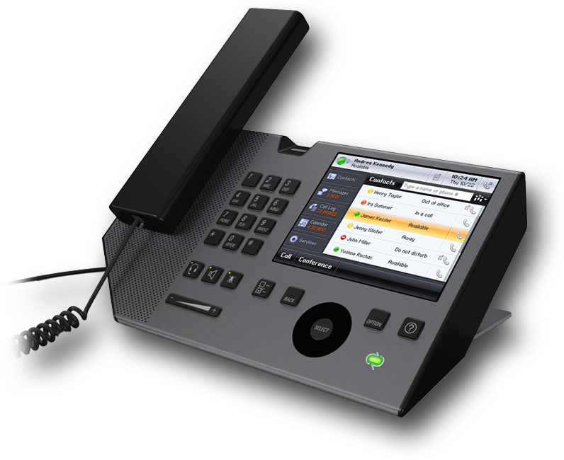


Standard Edition Deployment
Ideal For
Proof of Concept/ Pilot
Branch Office
Functionality
IM, presence, Peer-to-peer Voice, Conferencing
Scalability
No PSTN, No External Access, Not Highly Available
1 Server
Up to 5000 users (Planning guide)
Co-located on one server: Presence
Server Roles
IIS Share Conferencing A/V
Ideal for
AD
Proof of Concept/Pilot
Branch Office
Functionality
IM, Presence, Peer-to-peer Voice, Conferencing
No External Access, Not Highly Available
PSTN requires Mediation Server
Standard Edition
Server Roles
Co-located on one server
Presence, IIS Share, Conferencing, A/V
Scalability
1 Server
Up to 5,000 users
Notes:
For a pilot, the recommended installation topology is the Standard Edition Deployment.
This deployment is also ideal for running a pilot or for use with branch offices in a global deployment.
The product installation requires one machine running Microsoft Windows Server 2003 that meets the minimum hardware requirements, and Microsoft Active Directory where users, groups and devices are already managed.
With this single server installation, - provisioned users have the ability to use the following features: IM, presence information, peer-to-peer voice using Office Communicator and conferencing.
In this deployment topology – the features that are not available (and which can be added by extending the deployment) include – PSTN Access, Remote or External Access, and high availability /fail over.
All server roles of the product are co-located on a single server in this installation and the installation scales to about 5000 users (based on standard usage described in the planning guide).

Slide 7
OCS 2007 Standard Edition
demo
Notes:
Now that we’ve seen the Standard Edition deployment topology, let us jump into a demo where we explore the Standard Edition deployment steps.
Demo steps:
Show the setup wizard – with the 5 steps in deployment of standard edition.
Voice over talks about: logical organization of setup steps, built-in verification after each step and detailed logs & information available right the setup wizard.
Another Image – setup wizard is in the final step. Deployment finishes.
Open MMC and talk about how information is easily available for configuring server roles, users etc
3. Provision 2 users for Communications.

Slide 8
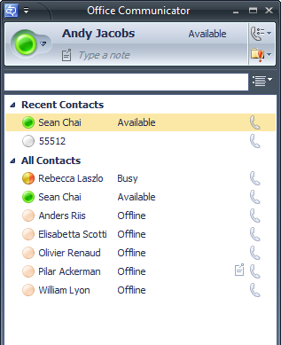
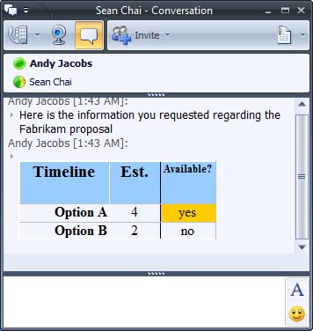
Microsoft Office Communicator Client
Part of premium Office 2007 editions
Office Professional Plus
Office Enterprise
MSI driven setup
Roll out Communicator 2007
SMS package
Desktop deployment wizard
Client settings are auto configured
Notes:
As we saw in the demonstration, the standard edition deployment is driven through a guided setup process and the administrator can enable users for communications using the Active Directory Users and Computers wizard.
On the client desktop, these enabled users can now start using the functionality provided by OCS 2007 with the Office Communicator client.
This client is a part of the Office 2007 premium editions including – Office Professional Plus and Office Enterprise.
The Office Communicator client is installed with an MSI setup. This allows for broad distribution – with remote command-line automation (msiexec) or with desktop software rollout solutions such as SMS (or Microsoft System Center Configuration Manager) and the desktop deployment wizard.
With the in-band provisioning feature of OCS 2007, client-side settings are automatically downloaded from Active Directory and Office Communications Server back-end during user logon. So the administrator does not need to provision/configure anything on the client-side for each user.

Slide 9
Session Objectives
In this session, you will…
Learn how to run an OCS 2007 pilot
Understand how to plan for an enterprise deployment
See various enterprise deployment options
Learn how to finalize your deployment
See tools that are available to help manage deployments
Notes:
We just saw the Standard Edition deployment of Office Communications Server 2007.
In this next section, let us look at the steps involved in planning and deployment an enterprise deployment.

Slide 10












OCS 2007 Architecture Overview
UC endpoints
Public IM Clouds
QOE Monitoring Archiving
CDR
MSN
DMZ
AOL
Yahoo
Data
Audio/Video
Inbound
Routing
SIP
Outbound
Routing
Remote
Users
Voice Mail
Routing
Access
Server
Front-End Server(s)
(IM, Presence)
Conferencing
Server(s)
Backend
SQL server
Active Directory
Mediation Server
Exchange
2007 Server UM
Federated
Businesses
(SIP-PSTN GW)
Voicemail
PSTN
PRI
PBX
Notes:
Before we dig into the enterprise deployment options – let us go through the OCS 2007 Architecture as well as the Server Roles in the product. This will gives us an idea of the various product pieces and how each server role can be managed to meet the requirements in the organization.
Active Directory – shown on the right hand side of this architecture diagram – servers as a single point for managing identity of users, devices, group etc. It is also used by the messaging and communications infrastructure - as we saw in the demo earlier.
The OCS 2007 deployment – includes the Front-end roles, the back-end roles as well as the conferencing, data and voice roles.
This gives the ability for end-points (Office Communicator and a variety of phone devices – to utilize the services provided by OCS back-end).
Advanced Media Gateway (aka Mediation Server) helps the interoperation with an existing PBX and a PSTN system. This provides the ability for OCS enabled users and to dial-out and call non-OCS enabled users inside & outside the organization through a PBX or PSTN setup.
With Exchange Unified Messaging integration – a rich set of functionality becomes available for OCS users. This includes voice mail & missed call notification, auto-attendant and other call management features.
With the File Share – users can share content to be used in Conferences. The Archiving/Call Detail Records role is useful in capturing information – such as capturing all IM conversations, recording call related information – for helping with compliance requirements in the organization
With the “Edge” roles in OCS 2007, remote users, federated business users and public IM clouds can now utilize the features provided by OCS outside the corporate firewall as well. The launch session on “Anywhere Access” and the launch session on “Security and Organizational Governance” provide more information about Anywhere Access features of the product.

Slide 11
Server Roles
Role | Scenario | Purpose
Standard Edition | All | All-in-one functionality for proof-of-concepts
Enterprise Edition: Front End | All | SIP communications between client and servers
Enterprise Edition: Back End | All | SQL Server: Back End store for state information
Director | External Access | Authentication of external users
Edge Server | External Access | Remote access, federation, PIC, media traversal
Mediation Server | Voice | Interoperability with IP-PSTN Gateways
Archiving Server | All | Compliance and Call Detail Records
Communicator Web Access | Web Access | Web Access for IM and Presence functionality
Notes:
Now, let us look at a description of each server role in the product. To be exhaustive, we’ve tried to list all server roles in the product. During deployments, we can decide to co-locate many server roles on the same physical machine. Similarly, we may want to install the same server role on multiple physical machines for scale and availability.
Standard Edition We saw the Standard Edition deployment already. This all-in-one server deployment is – ideal for a pilot/branch office.
Enterprise Edition Front End Provides high availability in a typical enterprise deployment. Contains all core server functions except storage. A pool of Front-end servers are load balanced.
Enterprise Edition Back End
Microsoft SQL Server™ stand-alone or cluster that stores users, meetings, and configuration state. Director
Optional security role that facilitates external user logins and isolates the internal deployment from external authentication traffic.
Access Edge Server
Security role for external access. Transports SIP signaling through the perimeter network in a secure manner.
Mediation Server
Provides mediation services for IP-PBX gateways that enables voice calls and conference calls to work on traditional telephony systems.
Archiving Server
Provides the ability to archive all Instant Messages and Voice Call details to a SQL Server database.
Communicator Web Access (CWA) Server Communicator Web Access Server delivers Instant Messaging (IM) and rich presence functionality using the Web browser (similar out OWA – Outlook Web Access).

Slide 12
Server Roles
Role | Scenario | Purpose
Web Conferencing Server | Conferencing | Dedicated MCU for web (data) conferencing in high-scale deployments
Audio/Video Conferencing Server | Voice and Conferencing | Dedicated MCU for Audio/Video conferencing in high-scale deployments
IIS Server | Conferencing | Dedicated IIS Server for Conferencing data
Web Conferencing Edge Server | Conferencing | Transports Web Conferencing (PSOM) traffic through the Perimeter Network for external/anonymous/federated access
A/V Conferencing Edge Server | Voice and Conferencing | Transports A/V traffic (RTP) through the Perimeter Network for external access
QoE Monitoring Server | Voice | Monitors Quality of Experience for Voice and media. Rich reporting and historical analysis
Exchange Unified Messaging | Voice | Integration with Exchange UM – voicemail, missed call notification, auto-attendant features
Notes:
Web Conferencing Server
Dedicated Multi-point Control Unit (MCU) for Web (data) conferencing in large-scale deployments.
Audio/Video Conferencing Server
Dedicated MCU for audio/video conferencing in large-scale deployments.
IIS Server
Dedicated IIS Server for conferencing functions such as slide access and services such as Distribution List Expansion, etc., in large-scale deployments.
Web Conferencing Edge Server
Optional server role to support high availability External access. Transports Web conferencing (PSOM) traffic through the perimeter network for external, anonymous and federated access.
A/V Conferencing Edge Server
Optional server role to support high availability External access. Transports audio/video traffic (SRTP) through the perimeter network for external, anonymous and federated access.
QoE Monitoring Server
Monitors Quality of Experience for Voice and media. Rich reporting and historical analysis
Exchange Unified Messaging
This is not a specific server-role. But the integration on the Front-end server with Exchange UM provides – voicemail, missed call notification, auto-attendant features

Slide 13
Key Planning Considerations
Functional requirements
Will I deploy Voice?
Audio/Video Multi Control Unit (MCU), PSTN integration, Mediation Server
Will I deploy Video?
Audio/Video MCU, scale-out configuration, network bandwidth for video
Will I deploy Conferencing?
Conferencing MCU, External Access (outside corporate firewall), IIS
Do I need to provide access outside the corporate firewall?
External Access (Edge Servers, Audio/Video and Conferencing MCU)
Do I have compliance requirements for IM and conferencing?
Archiving Server Role and configuration, Policies
Notes:
At this point, we’ve already looked at the OCS 2007 Architecture and walked through the various Server Roles available for installation.
To plan our OCS 2007 enterprise deployment, let us walk over the “Key Planning Considerations”.
–which of these server roles do I need for the deployment? (Functional Requirements).
Voice:
When deploying voice we want to think about the Audio /Video Multi Control Unit (MCU) Server. If the voice usage (PC to PC or PC to PSTN) is likely to be high we’d want more than one A/V MCU server. To integrate OCS users with PSTN access, we’ll want to setup a mediation server to work with a Gateway. More details on the configuration and management aspects are providing in the following sessions: “ UC Management Experience” and “Voice Interoperability”
Video:
When deploying video we again want to think about the Audio/Video MCU. To scale out the A/V MCU – we may require multiple servers. Another important consideration is to verify whether the existing network supports the bandwidth required for Video. We’ll talk about bandwidth requirements for video shortly.
Conferencing:
Conferencing MCU, External Access (outside corporate firewall), IIS
When deploying conferencing, a big deployment consideration is the ability for federated business users (such as partners, suppliers and others) as well as anonymous users to participate in the conference. This would dictate setup for edge access and edge conferencing server roles.
External access - outside the corporate firewall:
For External Access we would require setup of Edge Servers – Edge Access Server, Audio/Video Edge Server and Conferencing Edge Server. Deployment also includes configuring the internal and external firewalls to open the right ports for communication and ISA server configuration.
Compliance requirements for IM and conferencing:
Archiving Server Role needs to be installed and enabled – to collect/record IM and call detail records. This would be used in combination with configuration policies that are applied at the organization level, pool level and at each user level.
-Once we’ve decided on the functional requirements – we can plan out what server-roles are needed and how are they located (co-located on a single machine, located on a separate machine, located on a set of machines to meet availability and scalability needs)

Slide 14
Key Planning Considerations
Site Analysis
How many sites do I have?
Define # of global deployments
What is the bandwidth at each site?
Audio = 45Kbps, Video = 250Kbps, Data ~ 45Kbps, Signaling = 10 Kbps
Total = 350Kbps each way
How many users at each site?
Dictates which topology to deploy
Deployment Path
Am I migrating from Live Communications Server 2005?
Side-by-side install; follow migration guide steps to move users
Is this a proof-of-concept deployment?
Pilot with Standard Edition – all roles co-located on the same server
Notes:
With Site Analysis, we look at each site in the organization and decide on the right topology based on functional requirements.
How many sites do I have?
This defines the # of global deployments. We could pick different deployment topologies for different sites based on usage, requirements etc.
What is the bandwidth at each site? This defines the list of services that could be offered at each site.
Audio – 45Kbps, Video – 250Kbps, Data ~ 45Kbps, Signaling 10 Kbps
Total (for Audio + Video + data) – 350Kbps each way
How many users at each site?
Decides which topology to deploy – Standard Edition, Enterprise Consolidated, Enterprise Expanded etc.
The next set of questions deal with the deployment path taken for the OCS 2007 deployment:
Am I migrating from Live Communications Server 2005?
Side-by-side install; In this case we start migration from the firewall–inwards. After each step, more servers are freed up to be used for the new OCS 2007 deployment.
Is this a proof-of-concept deployment?
Pilot with Standard Edition – all roles co-located on the same server
Answering these questions ahead of time – is a key part of the planning process. In the field deployments – we encourage Administrators to go through these “Key Planning Considerations” questions and get a holistic picture of the deployment first – before starting any part of the work.

Slide 15
Microsoft Active Directory Integration
OCS 2007 uses AD for centralized identity management
Leverages AD authentication and authorization services
Installs schema extensions to AD to store per-user data
SIP URI
Meeting policy
Per user settings
OCS guided setup performs AD schema update
Step-by-step wizard to complete Forest prep, Domain prep, Schema update
Wizard also verifies AD replication after each step
AD schema updates are at the forest level
Multiple OCS pools in the same forest share AD schema settings
Notes:
This is also an ideal opportunity to explore the OCS 2007 integration with Microsoft Active directory.
With AD integration, there is only one identity to manage for the IT Administrator. This immensely simplifies administration and enables easy integration with existing business processes in the organization.
OCS 2007 leverages AD for authentication and authorization services.
As a part of OCS 2007, schema extensions are installed to Active Directory. These extensions are irreversible.
OCS 2007 guided setup helps perform and verify each step. - <read from slide>
When installing multiple OCS 2007 pools in the same AD forest – the schema extensions need to be applied only once. Setup will automatically detect this and skip the necessary steps automatically for you.

Slide 16
Session Objectives
In this session, you will…
Learn how to run an OCS 2007 pilot
Understand how to plan for an enterprise deployment
See various enterprise deployment options
Learn how to finalize your deployment
See tools that are available to help manage deployments

Slide 17
Choosing A Site Topology
Start
> 5K users
No
High Availability?
No
Standard Edition
Small Branch or
Proof of Concept
Yes
Yes
No
Enterprise Edition:
Consolidated
Regional
Datacenter
> 30K users
Yes
Enterprise Edition:
Expanded
Central
Datacenter
** Repeat as necessary for each site
Notes:
This simple flowchart provides a good starting point for choosing site topologies based on Availability and Scale requirements.
Please note that this flowchart should be repeated as necessary for each branch site – as we may choose a different deployment topology for each site based on requirements at that site.
To the results of this planning exercise– we’ll add other features such as External or Remote Access, PSTN integration at various sites –based on functional requirements.
<Read from slide>

Slide 18

Enterprise Edition Consolidated Configuration
AD
Example Deployment
Example Deployment
Medium Size Business
Regional Deployment
Functionality
IM, presence, Peer-to-peer Voice, Conferencing
Server Roles
Presence IIS Share
Scalability
5 Servers
Up to 30,000 users
Conferencing
Audio/Video
Highly Available, Medium Scale
No PSTN, No External Access
Medium Size Business
Regional Deployment
Functionality
SQL
IM, Presence, Peer-to-peer Voice, Conferencing
Highly Available, Medium Scale
No External Access
PSTN requires Mediation Server
Enterprise Edition Front-End Servers: Consolidated
Server Roles
IIS Share
Audio/Video
Presence
Conferencing
Scalability
5 Servers
Up to 30,000 users
Notes:
The Enterprise Edition Consolidated Configuration provides high availability and medium scale for organizations.
In this deployment, we have multiple front-end servers that are servicing requests for IM, PC to PC voice and conferencing – which are all connected to the SQL back-end.
All front-end servers in this deployment are running identical workloads (IM, Presence, Conferencing, IIS Share and Audio/Video). PSTN interop and External Access are added as additional components when needed.
Scales up to 30,000 users using 5 servers - when running standard workloads described in the Planning and Deployment guide.

Slide 19

Enterprise Edition Expanded Configuration
Example Deployment
Large Enterprise
Central Datacenter
Functionality
IM, presence, Voice, conferencing
No external access, No PSTN
Server Roles
Scaled out across servers
Scalability
14 Servers
Up to 125,000 users
High Availability, High scale
AD
Example Deployment
Large Enterprise
Central Datacenter
Active
Passive
Functionality
Enterprise Edition Front-End Servers: Expanded
IM, Presence, Voice, Conferencing
No external access, No PSTN
Server Roles
IIS Servers
A/V Conferencing Servers
Web Conferencing Servers
Scaled-out across servers
High Availability, High scale
Enterprise Pool: Expanded
Scalability
14 Servers
Up to 125,000 users
Notes:
The Enterprise Edition Expanded Configuration provides high availability and high scale for organizations.
In this deployment, we have server roles that are split across multiple physical machines. For example – the IIS servers, A/V conferencing Servers and the Web Conferencing Servers have more than 1 machine servicing client requests. The SQL database back-end is clustered for high availability.
This servers as an example deployment for a large enterprise or a central datacenter.
Again – PSTN Connectivity, External Access can be added to this topology based on functional requirements.
Scales up to 125,000 users using 14 servers - when running standard workloads described in the Planning and Deployment guide.

Slide 20

Global Deployment With Voice
External
Access
(Primary)
AD
Enterprise Pool: Expanded
Active
Passive
Primary Site
PSTN
Region I
Loc 1
A
Enterprise Edition Front-End Servers: Expanded
IP-PSTN GW
Loc 2
B
IIS Servers
A/V Conferencing Servers
Web Conferencing Servers
IP-PSTN GW
Mediation
Server
Loc 3
B
IP-PSTN GW
Mediation
Server
Secondary Site
Directors
External Access (Secondary)
PSTN
Region II
Loc 1
A
IP-PSTN GW
Loc 2
B
Enterprise Pool: Consolidated
IP-PSTN GW
Mediation
Server
Loc 3
B
IP-PSTN GW
Notes:
Here is an example of a Global Deployment with Voice and PSTN access:
For this deployment example – we have 2 sites: Primary and Secondary
The Primary site has about 50k users and is using the Enterprise Expanded topology
The secondary site has about 20k users and is using the Enterprise Consolidated topology
The Directors (2 in this example) direct traffic to the right site (or pool) based on incoming requests.
We’ve added External Access servers to enable remote users, federated businesses to connect with the enterprise while outside the corporate firewall. We’ve also added PSTN integration for call to traditional telephony networks inside and outside the corporation.
External Access and PSTN Connectivity are enabled for both sites (Primary and secondary).

Slide 21
Finalizing Deployment
Instant Messaging
Intelligent IM Filter for URL, File transfer
Voice
PSTN Connectivity
Location Profile, Dial Plan, Policy, Routes
Covered in session – “VOIP Topologies and Interoperability”
Policies
Archiving
Conferences and meetings
Call Detail Records
Notes:
Configuring IM
This involves – enabling users for communications as well as configuring Intelligent IM Filter:
This Filter can be used to block or modify URLs in IM conversations. This feature is usually in counteracting SpIM attacks.
The Intelligent IM Filter can also be allowed to block some or all file extensions. The administrator controls these configuration settings through policies.
Configuring Voice
PSTN Connectivity – this involves setting up a Location Profile for the site location, Dial Plans for normalizing phone numbers that are dialed, Policy that determines what users are allowed to call which area/numbers and Routing information that helps identify the right gateway/mediation server to use in order to minimize telephony cost.
This information is session in session – “VOIP Topologies and Interoperability”
Configuring Policies
Policies are configured by IT Administrators at the following levels – Forest, Pool and per-user. So the settings that we’ll see in this section can be specified at any of these levels.
Archiving policies can enforce archiving as required or vary based on per-user settings.
Conferences and meetings – Administrators can specify policy about anonymous users participating in conferences, as well as the ability to include voice/video or application data as a part of conferences.
Call Detail Records – setting policies for CDRs helps the IT Admin collect data that helps meet organizational governance goals.

Slide 22
Session Objectives
In this session, you will…
Learn how to run an OCS 2007 pilot
Understand how to plan for an enterprise deployment
See various enterprise deployment options
Learn how to finalize your deployment
See tools that are available to help manage deployments
Notes:
Looking at the key planning considerations and the enterprise deployment options available, administrators can decide on the final topology of the deployment.
The actual deployment steps can be carried out using the guided setup interface that we saw earlier - as well as using command-line automation.
After the various server-roles are installed as per the chosen topologies, let us look at the various steps required to finalize deployment. In this section, we will look at settings to configure the enterprise deployment – such as IM, Voice, Policies, Conferencing, Certificates etc.

Slide 23
Finalizing Deployment
Certificates
Wizard to create/deploy from certificate authority
External Access
Firewall Configuration, Reverse Proxy
Exchange Server 2007 UM integration
Routing setup, dialing rules
QoE Monitoring Server
Reporting, data collection
Notes:
Certificates
Traffic (both media and control information ) is secured using TLS (Transport Layer Security) and MTLS (Mutually authenticated TLS). The new certificate wizard helps administrators deploy the certificates necessary for TLS.
External Access
Configuring External access include opening specific ports on the internal and external Firewalls, configuring the ISA server and setting up Reverse Proxy for phone number lookup.
Exchange Server 2007 UM integration
To configure Exchange 2007 UM, we can point Exchange UM to OCS front-end. OCS can act as a gateway for Exchange UM and carry all the routed traffic in & out of Exchange. This requires setting up location profile, dialing & normalization rules.
QoE Monitoring Server
Quality of Experience Monitoring Server can collect a wealth of near real-time data about call metrics, call quality and provided aggregated reporting on top of this. With a Microsoft Operations Manager 2005 Management Pack, administrators can receive alerts on observed call quality at locations and set their own thresholds to monitor voice quality in the deployment.

Slide 24
Finalizing OCS 2007 Deployment
demo
Notes:
Intelligent IM Filter overview
Quick overview of location profile, dial-plan etc
Archiving global policy and per –user settings
External access settings

Slide 25
Session Objectives
In this session, you will…
Learn how to run an OCS 2007 pilot
Understand how to plan for an enterprise deployment
See various enterprise deployment options
Learn how to finalize your deployment
See tools that are available to help manage deployments
Notes:
We’ve seen
How to run a pilot
How to plan for the enterprise deployment
The options available for deployment and
How the deployment can be configured and finalized
Now let us look at tools that are available with the product to simplify and manage the deployment process.

Slide 26
Deployment Tools
Validating deployment configuration
Validation tools in MMC console
Simulates workloads (IM, login, presence, A/V etc)
Checks configuration settings
Provides detailed drill-down reports
Best Practices Analyzer tool
Automating deployment tasks
With LcsCmd.exe
Delegate Administration – server admin, user admin, setup admin
Check status of deployment
Prepare Active Directory for deployment
Backup/Restore operations
Notes:
Deployment configuration can be validated using tools that are built into the MMC administration interface.
Validation can be triggered by the administrator to simulate real workloads – for example: two users logging on to OCS, looking at presence information and then having an Instant Messaging conversation or a voice conversation. The output of validation is a detailed drill –down report that can viewed on Internet Explorer.
A Best Practices Analyzer tool is available with the product for analyzing deployments.
In this section, we also look at automating deployment tasks:
LcsCmd.exe is the command-line tool that provides a wealth of options to manage the deployment of OCS 2007. Features provided via the command-line interface include - Delegating Administration rights during deployment such as – server admin, user admin, setup admin. The features are useful when multiple administrators/teams are involved in the deployment process (for example: Server administrator is different from User administrator).
The tool also provides status checks on the deployment health, prepares Active Directory for deployment and performs backup/restore operations.

Slide 27
Deployment Tools
demo
Notes:
Now let us look at a demo that features some of the tools we’ve just talked about – that we can use to Manage the OCS 2007 deployment.

Slide 28
Key Takeaways
Use Standard Edition. Also ideal for a branch office/site
Exploring OCS 2007: How do I run a Pilot?
Fill out “Key Deployment Considerations” section
How do I plan my enterprise deployment?
Consolidated, Expanded, External Access, PSTN, Multi-site
What deployment options are available for my enterprise?
Configure settings for IM, Voice, External Access, etc.
How do I finalize my deployment?
Leverage tools for validation and automation
What tools can I use to manage the deployment process?
Exploring OCS: How do I run a Pilot ?
How do I plan my enterprise deployment ?
What deployment options are available for my enterprise ?
How do I finalize my deployment ?
What tools can I use to manage the deployment process?

Slide 29
Call To Action!
4P’s of OCS 2007 deployment:
Pilot with Standard Edition
Plan your deployment topology and sites
Proceed with Enterprise deployment
Provide configuration to finalize deployment
Notes:
Here is another way to summarize the Key Takeaways from this session – with a “Call to Action” using the 4P’s of OCS 2007 deployment:
Pilot with Standard Edition
Plan your deployment topology and sites
Proceed with Enterprise deployment
Provide configuration to finalize deployment

Slide 30
Q&A

Slide 31
Resources
Visit the OCS 2007 Tech Center
http://technet.microsoft.com
Visit the OCS 2007 Technical Library
http://technet.microsoft.com/en-us/library/bb676082.aspx
Notes:
9/6/2007 8:23 AM
© 2005 Microsoft Corporation. All rights reserved.
This presentation is for informational purposes only. Microsoft makes no warranties, express or implied, in this summary.
31

Slide 33

© 2007 Microsoft Corporation. All rights reserved. Microsoft, Windows, Windows Vista and other product names are or may be registered trademarks and/or trademarks in the U.S. and/or other countries.
The information herein is for informational purposes only and represents the current view of Microsoft Corporation as of the date of this presentation. Because Microsoft must respond to changing market conditions, it should not be interpreted to be a commitment on the part of Microsoft, and Microsoft cannot guarantee the accuracy of any information provided after the date of this presentation.
This document may contain information related to pre-release software, which may be substantially modified before its first commercial release. Accordingly, the information may not accurately describe or reflect the software product when first commercially released MICROSOFT MAKES NO WARRANTIES, EXPRESS, IMPLIED OR STATUTORY, AS TO THE INFORMATION IN THIS PRESENTATION.

Slide 34
Backup Slides
BACKUP

Slide 35
Deployment Dependencies
Component | Scenario | Purpose
Active Directory | All | Enterprise Directory – users and configuration
Load Balancer | All | 3rd-party (e.g. F5) Hardware for High Availability
HTTP Reverse Proxy | IM and presence, Conferencing | Reverse Proxy (e.g. ISA, or 3rd-Party like CheckPoint) in the DMZ for access to CWA and Conferencing Web functions. Hardware or Software
IP-PSTN Gateway | Voice | 3rd-party (e.g. AudioCodes) gateway to connect enterprise IP network w/ PSTN. Hardware or Software
RCC Gateway | Voice | 3rd-party SIP/CSTA gateway (e.g. Genesys) for Remote Call Control; Software
File share | Conferencing | Standard Windows File Share for storing meeting content

Slide 36
Capacity
Topology | Servers Required | Maximum Endpoints Supported
Standard Edition Server | 1 Standard Edition server | 5,000
Enterprise Edition Pool: Consolidated Configuration | 4 Enterprise Edition Front-End servers running all server roles 1 Backend SQL Server | 30,000
Enterprise Edition Pool: Expanded configuration With Mid-Range Performance SQL Backend | 4 Front-End Servers 2 Web Conferencing Servers 2 A/V Conferencing Servers 2 IIS Servers 1 Backend SQL Server | 50,000
Enterprise Edition Pool: Expanded configuration With High Performance SQL Backend | 6-8 Front-End Servers 4 Web Conferencing Servers 4 A/V Conferencing Servers 2 IIS Servers 1 Backend SQL Server | 125,000

Slide 37
Hardware
Backend Server | Frontend Server, Mediation Server, IIS Server Access Edge Server | Conferencing Server, A/V Edge Server, Archiving Backend
CPU Quad processor, dual-core 2.6 GHz | CPU Dual processor, dual core 2.6GHz + | CPU Dual processor, dual core 2.6GHz +
Disk Drive 1 (2 × 18 GB) for OS Drive 2 (4 x 36GB, 15K RPM, RAID 0+1) for database log file Drive 3 (4 x 36GB, 15K RPM, RAID 0+1) for database log file Drive 4 (8 x 36GB, 15K RPM, RAID 0+1) for database files | Disk 2 x 18 GB | Disk 2 x 18 GB (Additional disk for archiving and CDRs)
Cache 2 MB L2 per core | Cache 1 MB L2 per core | Cache 1 MB L2 per core
Memory 16 GB | Memory 2 GB (4GB for consolidated) | Memory 4 GB (16 GB for archiving)
Network GBit NIC | Network GBit NIC | Network GBit NIC

Slide 38
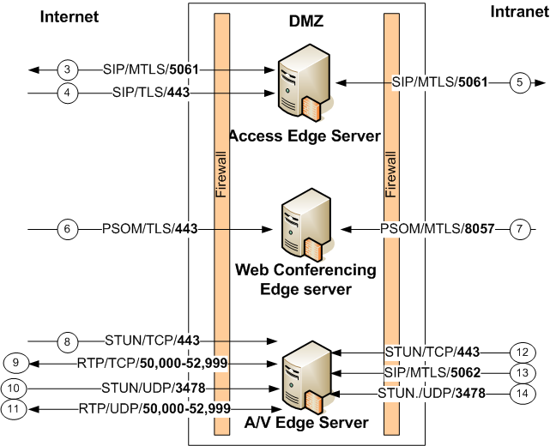
Edge Server Firewall Policy

Slide 39
© 2007 Microsoft Corporation. All rights reserved. Microsoft, Windows, Windows Vista and other product names are or may be registered trademarks and/or trademarks in the U.S. and/or other countries.
The information herein is for informational purposes only and represents the current view of Microsoft Corporation as of the date of this presentation. Because Microsoft must respond to changing market conditions, it should not be interpreted to be a commitment on the part of Microsoft, and Microsoft cannot guarantee the accuracy of any information provided after the date of this presentation.
This document may contain information related to pre-release software, which may be substantially modified before its first commercial release. Accordingly, the information may not accurately describe or reflect the software product when first commercially released MICROSOFT MAKES NO WARRANTIES, EXPRESS, IMPLIED OR STATUTORY, AS TO THE INFORMATION IN THIS PRESENTATION.

