Slide 1
Windows
Display Driver Model
Key Features
Rudolph Balaz
Lead Program Manager
Windows Graphics Infrastructure
Microsoft Corporation

Slide 2
Agenda
Introduction
Displays
Graphics Cards
D3D Directions
Desktop Composition
Call to Action

Slide 3
Gratuitous Architecture
WPF
Microsoft-
written code
IHV-written
code
DWM
PIX
Media
Foundation
MIL
OpenGL
GDI
Legacy
D3D APIs
DXVA
D3D9
D3D9
EX
Direct3D
10
DXGI
OPM
COPP
UAB
etc
OpenGL
ICD
Common pipeline (DDI)
User-Mode
Driver
Win32 Kernel
DXG Kernel
Kernel-Mode
Driver

Slide 4
Displays

Slide 5
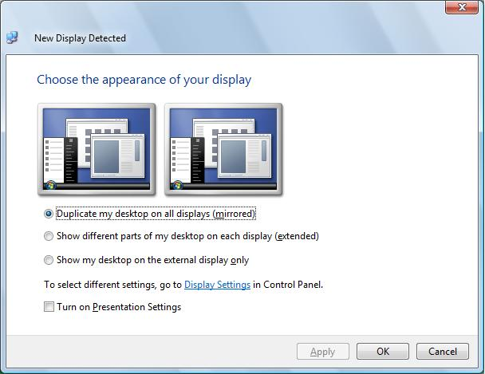
Transient MultiMonitor Manager (TMM)

Slide 6
Monitor Hot Plug Detect
Call To Action
HPD - Analog connector should “just work”
Great opportunity to complete the “projection” story for the user
Laptop OEMs: Detect monitor arrival/departure and send
ACPI notification
Graphic IHVs: Recognize ACPI events and treat it just like a digital HPD

Slide 7
Monitor EDIDs
Windows Vista relies on EDID even more than XP
  TMM
  Media Center
  WDDM (Modes)
Monitor naming
  “Generic PnP Monitor” – EDID present
  “Generic Non PnP Monitor” – no EDID
  “Manufacturer_name ABC 123” – INF present
Use Windows Update for Monitor INF distribution

Slide 8
Monitor EDID Overrides
Monitors and TV must have EDIDs
Common problem - No EDID/broken EDID
  Updating the EDID is tricky at best
Monitor Manufacturer can update the EDID through a Monitor INF
WDDM drivers and Operating System(OS) will use updated EDID blocks from INF
Call To Action
  Use EDID overrides if the EDID is incorrect
  Use Windows Update to deliver Monitor INFs

Slide 9
Improvements In ACPI
Notifications
  More extensive than XP – driver gets all notifications from ACPI events - New DDI for WDDM
    ACPI Event: Lid Close, Hotkey switch etc
    Docking Event: Dock/Undock
    Power State Event: Switch from AC to DC etc
  WDDM Driver has more control
Method Evaluations
  WDDM Driver can now directly execute any ACPI method
    Can execute method on the adapter itself or its children
  No more int10! / SMI not recommended / Use
  ACPI instead
  New DDI for WDDM

Slide 10
Mobile Graphics
Brightness control
User scenarios in Windows Vista
  Mobility Center Brightness Slider
  Device Power Policy (Automatic on AC/DC state change)
  Hot Keys/Buttons (OEM specific)
  Ambient Light Sensor (OEM specific)
Ambient Light Sensors are supported
Note: External display brightness is controlled by MCCS

Slide 11
Mobile Graphics
Brightness control
System Logo Requirements
  Brightness control via ACPI or WDDM drivers need to be supported
  WDDM needs to be informed of any brightness changes via
  hotkeys/ALS/OEM buttons
Call To Action
  Proper SBIOS support
  Avoid Private Interfaces!

Slide 12
Graphic Cards

Slide 13
History
WDDM 1.0
Designed to work on existing generation of GPUs
  2003 ~ 2006
  Broad coverage and 90% + device support
Stability of Display Drivers was the key objective
GPU is now a shared resource
  Desktop now utilizes the GPU (Aero Glass)
Huge step ahead of XPDM

Slide 14
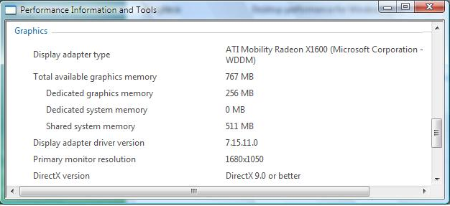
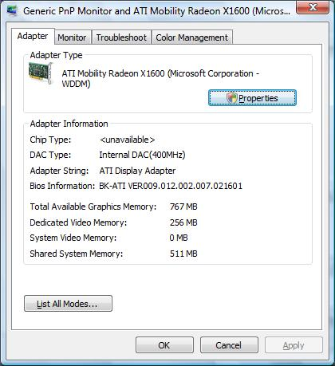
Graphics Memory Reporting
Graphics memory reported in the Display applet and the “Performance Information and Tools” applet
Detailed and true picture of Graphics Memory
Broken down into –
  Dedicated graphics memory
  Dedicated system memory
  Shared System Memory
Applications can use the DirectX 10 API - DXGI_ADAPTER_DESC to retrieve these values directly

Slide 15
Multi-GPU - LDA
LDA: Linked Display Adapter
Link multiple physical GPUs into a single (faster) virtual GPU
GPU workload distributed across the physical GPU in a link
  Rendering split frames
  Rendering alternate frames/blocks
NVIDIA SLI and AMD Crossfire

Slide 16
Rebootless Driver Upgrades
One Less reboot of Windows!
WDDM Driver to new WDDM Driver only
Disabling WDDM driver results in VGA
Requires support in WDDM driver
Call To Action
  Applications should handle “Device Lost”
  Don’t cause reboot unnecessarily

Slide 17
Timeout Detection And Recovery
Increased reliability of Windows
Windows detects video hardware hangs
Provide a “Seamless” experience in the case of a video hardware hang
  User does not have to reboot the system
  User can resume work as soon as possible
Timeout period = 2 seconds
  Configurable through registry for testing only

Slide 18
WDDM Versus XPDM Recovery
WDDM
  Better Recovery
    Based on Scheduler Based Recovery architecture
    Drivers resets the GPU
    No need to reboot
    Mini-dump information sent immediately (debug report 0x117)
  Recovery Failure
    OS bugchecks with bugcheck code 0x116
XPDM
  VGA Recovery
    Recover to VGA mode
    Suggest reboot to user after saving his/her work
    Mini-dump saved and sent on reboot
    Bugcheck code 0xEA
  Recovery Failure
    OS bugchecks with
    bugcheck code 0x100000EA

Slide 19
TDR
Call To Action
Graphics Hardware vendors
  Graphics operations < 2 seconds
Graphics Software vendors
  Ensure that the DirectX application does not run at a low frames per second (FPS) rate
  Use TDR registry control for running benchmarks only – do NOT use them in a production environment
System Manufacturers
  Work with Graphics IHV to diagnose TDRs

Slide 20
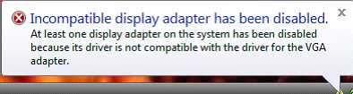
Multi-Adapter Support
All graphics adapters in a system must use the same display driver model
If multiple graphics
adapters are present
in a system, all of
them must use the
same WDDM driver
  Two PCIe ATI Radeon x600 cards, each in an x16 PCIe slot
  One PCIe NVIDIA GeForce 7600 in an x16 slot and another PCIe NVIDIA GeForce 6600 in a second x16 slot

Slide 21
Directx 10

Slide 22
Direct3D 10
Complete re-architecture of hardware and software to deliver
  A single platform to target - consistent behavior and feature set
  Massively improved small batch performance
  Unprecedented visual effects and capability – beyond the latest consoles
On new DX10-class GPUs and drivers
  Performance-focused API: No downlevel hardware support
  Clean and consistent API: All features guaranteed
Direct3D 10 takes full advantage of WDDM
  Direct3D 10 is Vista/WDDM-only
  WDDM-basic guaranteed to D3D 10 developers

Slide 23
Direct3D 10
New Features include
  Geometry shaders, texture arrays, shader model 4.0, better texture compression, stream output and others
RTM in Windows Vista
  Tech Previews provided to developers since 12/2005
  First DTM kit published in Feb 2007
  IHV/Microsoft demos available today
  Key titles under active development (Crysis, Company of Heroes, Flight Simulator X, Conan, Eve Online, Supreme Commander…)

Slide 24
Windows Logo Program
DX10 Test content released in WDK 07
Linked Display Adapters – June WLK 07
824 Vista Display Submissions Processed
  x86 – 476 total
    455 Premium
    21 Basic
  x64 – 348 total
    343 Premium
    5 Basic

Slide 25
Direct3D Directions
Incremental hardware and software update to Direct3D 10
Strict superset of Direct3D 10 features
API support for Direct3D 10 and 10.1 hardware
Goals
  Boost image quality: Improved anti-aliasing
  Increase capability and performance
Features include: Pixel output coverage mask, 4x MSAA required, cubemap arrays…

Slide 26
Desktop Composition

Slide 27
Scalable Desktop Composition
First Windows to gracefully scale the UX based on HW capabilities
The DWM monitors the system configuration and composition performance. It makes scaling decisions based on performance versus UX
Example: Aero is automatically enabled on a single monitor system, but may scale back if a 2nd is attached exceeding the graphics memory bandwidth thresholds

Slide 28
Requirements For Composition
The primary graphics adapter supports Microsoft DirectX® 9
The primary graphics adapter supports pixel shader 2.0 in HW
The system is running with WDDM
The system is configured for a color depth of 32 bits per pixel
The primary monitor’s refresh rate > 10 Hz
Composition is enabled by group policies (the default configuration)

Slide 29
Automatic Conditions
DWM automatically enables composition and transparency when the preceding six conditions are met and
Greater than 512 MB of system memory available to the OS
Monitor configuration should be supported
  Enough Graphics Memory
  Enough measured performance

Slide 30
Some Thresholds For Desktop Composition And Transparency
 |  |  | Opaque window borders |  | Transparent window borders
 | Total pixels | Equivalent resolution | Gfx mem (MB) | Perf (MB/s) | Gfx mem (MB) | Perf (MB/s)
Single monitor | 786,432 | 1024x 768 | 32 | 89 | 32 | 363
 | 1,310,720 | 1280x1024 | 32 | 146 | 64 | 500
Dual monitor | 1,572,864 | 1024x 768 | 64 | 135 | 64 | 477
 | 2,621,440 | 1280x1024 | 64 | 223 | 128 | 665

Slide 31
Aero Over Remote Desktop Connections - Requirements
Both systems are running Windows Vista
The local system (the "client" or "display" system) is Aero capable
The remote (or "server" system) meets the minimum DWM memory requirements
The remote (or "server" system) is an Enterprise or Ultimate client SKU
The connection is one to one
  Desktop composition is not supported for "multi-hop” scenarios

Slide 32
Events That Affect Composition
An application uses a mirroring driver
  Composition disabled till application closed
An app deliberately disables composition by calling the Windows API
  Composition disabled till application closed
  Composition disabled till app re-enables it
  User is notified

Slide 33
Events That Affect Composition
An app is run that has the Disable desktop composition option set in its properties
  Composition disabled till the application is closed
  User is notified
The user changes to non-composited theme or appearance
  Composition disabled till the theme reverts back to one using Composition

Slide 34
Events That Cause DWM To Scale The User Experience
Change of Monitor resolution or Addition of a new Monitor
  Composition or transparency disabled if thresholds exceeded
  Restored when the configuration changes and thresholds are met
System transitions to DC power and “Power Saver” policy is in effect
  Opaque window borders
  Transparency returns if power policy is reverted or AC power is used

Slide 35
Call To Action

Slide 36
Call To Action
HPD on Analog Connectors
  ACPI notification 0x81 with ACPI_NOTIFY_DEVICE_HOTPLUG flag
Make sure your device have good EDID
Provide EDID overrides if your device doesn't
Brightness
  Proper SBIOS support
  No more private interfaces

Slide 37
Call To Action
New platforms should be legacy-free
  SMI is highly discouraged
Rebootless driver upgrade
  make sure you are doing your part
Track down causes of TDR and fix them
Do your part in keeping Desktop Composition On

Slide 38
Additional Resources
Web Resources
  Whitepapers: http://www.microsoft.com/whdc/device/display/default.mspx
    BIOS Communication for Display Drivers in Windows Vista
    Brightness Control in WDDM
    Enabling and Troubleshooting Windows Aero
    Graphics Memory Reporting through WDDM
    Multimonitor Support in Windows Vista
    Timeout Detection and Recovery of GPUs through WDDM
Related Sessions
  CLN-T359 Windows Display Driver Model Drivers: Key Features
  CLN-T361 Windows Graphics Architecture
  CLN-C362 Kernel Graphics Infrastructure for Display Devices and Mobiles
  CLN-C364 Direct3D Test
Feedback:
Directx @ microsoft.com

Slide 39

FACT:
5,061 devices carry the “Certified for Windows Vista” logo as of April 1

Slide 40

© 2007 Microsoft Corporation. All rights reserved. Microsoft, Windows, Windows Vista and other product names are or may be registered trademarks and/or trademarks in the U.S. and/or other countries.
The information herein is for informational purposes only and represents the current view of Microsoft Corporation as of the date of this presentation. Because Microsoft must respond to changing market conditions, it should not be interpreted to be a commitment on the part of Microsoft, and Microsoft cannot guarantee the accuracy of any information provided after the date of this presentation.
MICROSOFT MAKES NO WARRANTIES, EXPRESS, IMPLIED OR STATUTORY, AS TO THE INFORMATION IN THIS PRESENTATION.

