Slide 1
Certified For Windows Vista Customer awareness
Justin Jed, Group Product Manager
Connie Pohl, Lead Program Manager

Slide 2
Agenda
Genesis for the Windows Logo Program
Statistics on product submissions
Windows Logo Program Process Improvements
Customer demand activities
Resources for you

Slide 3

The Virtuous Software And Hardware Ecosystem
“The strength of Windows has always come from the ecosystem around it.”
-Bill Gates, CES 2007
Perception of the best hardware selection
Windows Loyalty
Partner Growth Opportunity
New markets and customers
More Windows Compatible Products

Slide 4
Microsoft Commitment To Partners
Customer Excitement: Drive customer confidence and excitement for the ecosystem as a key Windows pillar
Perception of the best hardware selection
Windows Loyalty
Partner Growth Opportunity
New markets and customers
More Windows Compatible Products
Ecosystem Support: Invest in programs that make it easier to build compatible products

Slide 5


Genesis For The Windows Logo Program
Communicate to customers that specific products provide superior experiences with Windows Vista
Help customers easily identify the hardware tested for compatibility
Enable manufacturers opportunities to differentiate products

Slide 6
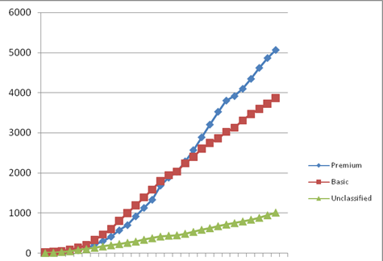

Thank You For Working With Us
Windows Logo Program Submissions (April 11, 2007)
600+ Companies
9000+ Submissions
4,242
3,788
Sept
Nov
Jan
Mar

Slide 7
Improvements In Windows Logo Program
New Windows Logo Kit
New Driver Test Manager (DTM) automated self certification
5 sold out Logo Fests
New Contingency Process
New Errata Filtering Process
Highest % of Devices Logo’d with drivers – for Windows Vista Launch
Largest Number of Logo’d Systems for Sale at Launch

Slide 8
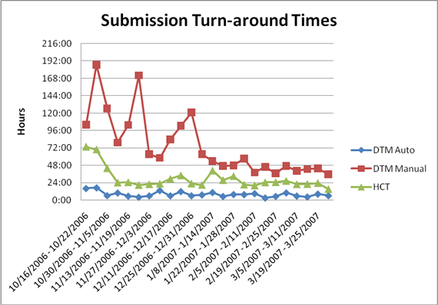
Submission Times Are Decreasing
Jan
Mar
Nov

Slide 9
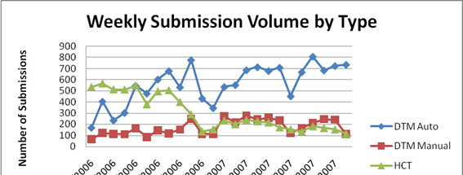
We Continue To Improve
Nov
Jan
Mar

Slide 10
Continue the Momentum in Windows Logo Program
Definitions of RTM month
Aug 2001 XP
Nov 2006 Vista

Slide 11

Ideation For New Program Requirements
OEM
IHV
Concept
New Program concepts
Market Req’ts
Market Assessment
Technology Requirements
Prioritization
Prioritization Metrics
Business Plan
Internal/External Feedback
Improvements Needed
Approval Board
Implementation Process
No Go

Slide 12
Logo Prioritization Criteria
New Market Trends
Better with Windows
Marketing Assessment
Market Input

Slide 13
Implementation Process
Approved by Board
Team in Place
GO
Req’t
Logo requirements in LogoPoint
Collect Feedback
Test
Develop Tests
Check into Winqual
RTM
Adjust with Feedback
Approve and Release
Release Preview Tests

Slide 14
Annual refresh To Logo Requirements
New Requirements June 1st every year
Better Alignment with Hardware Refresh Cycles
6 months
Updates to existing requirements
For Drivers, Aesthetic, Usability changes
12 months
Most Hardware Requirements
Except major ones
18 months
Major Chipset, Architecture, or Chassis Changes

Slide 15
Microsoft Marketing Objectives
Create awareness of “Certified for Window Vista” and “Works with Windows Vista” logos
Drive purchase intent for products that feature the logo
Create partner opportunity to tell the story about products that carry the logo and why they deliver a better experience

Slide 16
Hardware Purchases Can Be Overwhelming
Numerous product choices
Information and marketing overload
Time necessary to sort through it all

Slide 17
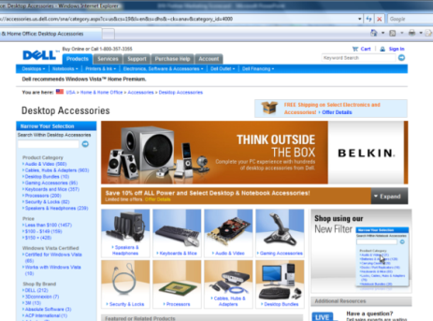
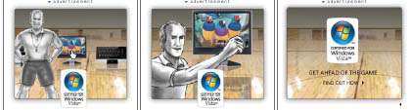

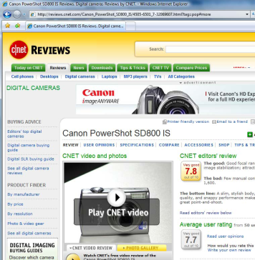
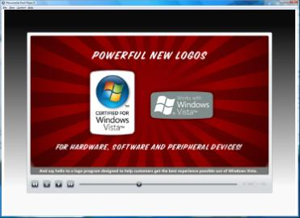
Spring Activities
New campaign launching at WinHEC
Community and bloggers
Etail partner engagement
Retail
PR and Reviews

Slide 18
Consumer Advertising Campaign
6+ month awareness and demand generation campaign
Kickoff in April
Target audience: enthusiasts, early adopters
Focus on proof-based messaging that enthusiasts crave/appreciate

Slide 19

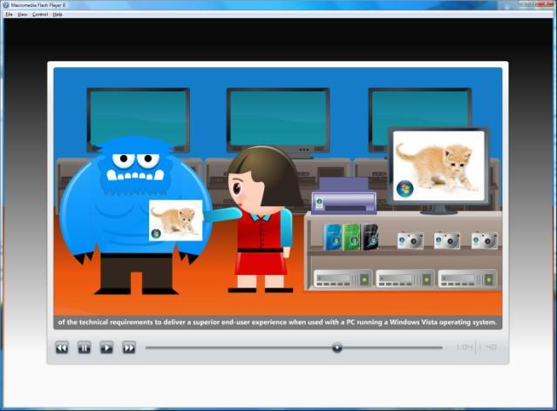

Logo Program Retail Promotion
Merchandising Assets
Sales People Assets
Sales Training
Demos

Slide 20
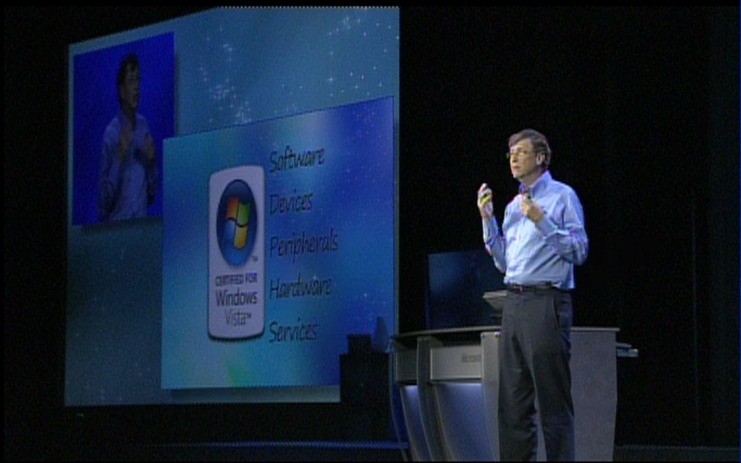
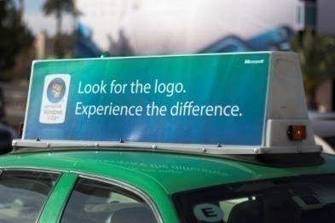
PR – Reviews – Community
PR
Product placement
Joint releases
Reviews
Device reviews
Community
Blogger events
Device seeding

Slide 21
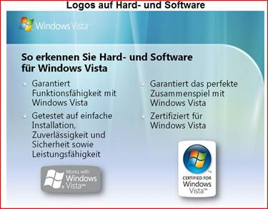
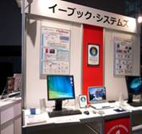
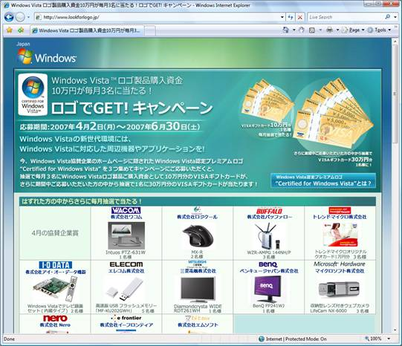
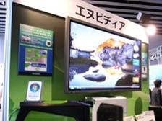

Global Perspective

Slide 22

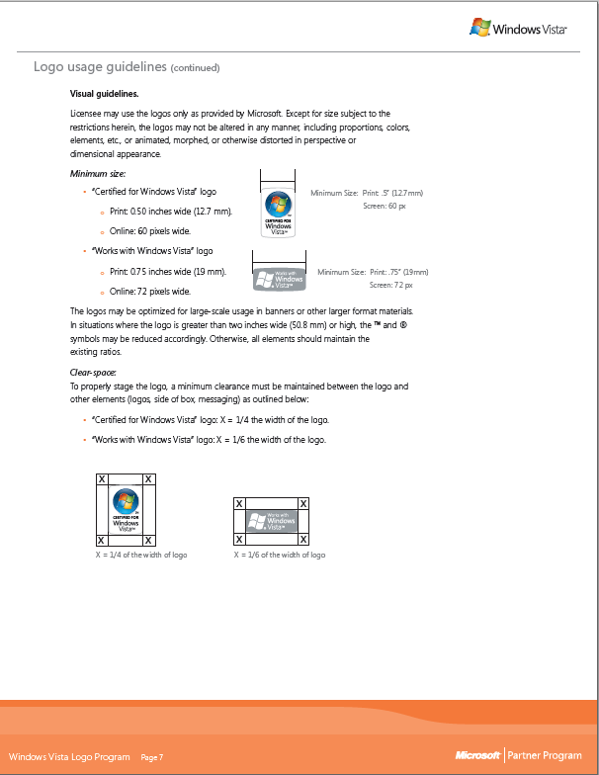
Windows Vista Logo Program Partner Marketing Guide
Customers are looking for the latest devices for their Windows Vista-Based PCs
Submit your products at https://winqual.microsoft.com
For marketing information e-mail:
WLPbrand @ microsoft.com

Slide 23
Questions

Slide 24
Additional Resources
Windows Logo Program
New Marketing website goes here
LogoPoint (need to logo in) https://winqual.microsoft.com/member/Logopoint/
Windows Logo Program Requirements: http://www.microsoft.com/whdc/winlogo/hwrequirements.mspx
About Driver Test Manager (DTM): http://www.microsoft.com/whdc/DevTools/WDK/DTM.mspx
DTM videos https://winqual.microsoft.com/HowTos.aspx
E-mail regarding Winqual or basic logo questions
Microsoft Support
Support can be reached through: http://www.microsoft.com/services/microsoftservices/srv_support.mspx
winqual@microsoft.com

Slide 25

© 2007 Microsoft Corporation. All rights reserved. Microsoft, Windows, Windows Vista and other product names are or may be registered trademarks and/or trademarks in the U.S. and/or other countries.
The information herein is for informational purposes only and represents the current view of Microsoft Corporation as of the date of this presentation. Because Microsoft must respond to changing market conditions, it should not be interpreted to be a commitment on the part of Microsoft, and Microsoft cannot guarantee the accuracy of any information provided after the date of this presentation. MICROSOFT MAKES NO WARRANTIES, EXPRESS, IMPLIED OR STATUTORY, AS TO THE INFORMATION IN THIS PRESENTATION.

