Slide 1
Microsoft FlexGo™ Technology Update
Dr. David Foster
General Manager FlexGo
Jeff Westerinen
Director Hardware Architecture New Business & Products Group
Microsoft Corporation

Slide 2
Agenda
Microsoft FlexGo: Version 1.0 findings
The next release of Microsoft FlexGo
Software and services
Demonstration: Manufacturability
Hardware and hardware partners
Call to action

Slide 3

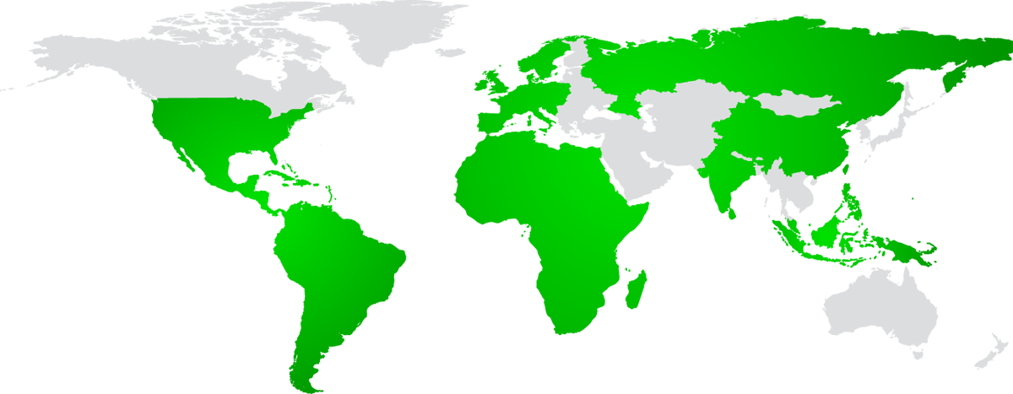
The Digital Divide–Worldwide…
Households without a PC
Russia
>90%
Western Europe
~70%
United States
~40%
China
>90%
Africa
>90%
India
>98%
Asia Pacific
>90%
Latin America
~90%

Slide 4


Our Mission
Dramatically address digital divide challenges to help individuals, communities, and nations realize their potential through improved access to technology

Slide 5
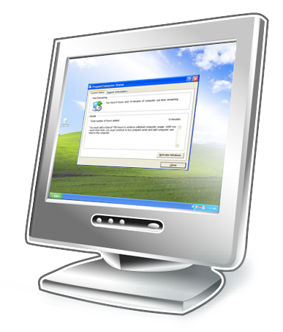

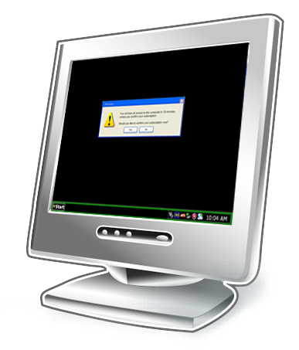

What Is FlexGo Technology?
FlexGo Technology is a combination of hardware, software, and web services
Monitors the customer’s account status (prepaid minutes added to the PC or the subscription account balance).
Keeps the customer up-to-date on account status via convenient desktop tool and notifications.
Limits the customer’s PC usage if the account goes unpaid..

Slide 6




FlexGo Computing Models
Pay-as-you-go computing
Subscription computing

Slide 7


Findings Pay-as-you-go Computing
Strong focus in 2006-2007
Trials completed or in progress: Brazil India Mexico Russia
Pay-as-you-go computing
Topic | Findings
Access to credit | Credit is more widely available to consumers now than when we launched our first FlexGo trials
Hardware Configurations | Different hardware configurations are needed for different locales
Cost Adder | The market required low or no cost-adder to the overall system cost
Implementation model and partner ecosystem | Model has high consumer appeal, needs tweaking for banks

Slide 8


Findings Subscription Computing
Existing marketing program in place with 20 Telcos (400K units)
FlexGo technology trials currently planned for: Brazil India Mexico
Subscription computing
Topic | Findings
Telco Interest | Telcos are interested in selling PCs in installments/ subscription to gain new customers
FlexGo Value | Helps mitigate risk of default by limiting PC use when out of policy Can help expand a program’s reach to incremental customers or improve the program’s financing conditions
Partner Opportunities | FlexGo can help make existing subscription programs stronger and open the door to new programs and market opportunities in the future

Slide 9
The Next Release Of Microsoft FlexGo

Slide 10
Pillars And Scenarios
Telco-billed renewable subscription
Day-by-day unlimited usage
Scenarios
MSN Tokens
Online (Web site) purchase
Offline purchase (such as ATM, SMS, EPOS)
Scale
New hardware platforms
Windows Vista
All 32-bit SKUs,
Windows XP to Windows Vista upgrade
User Experience
Improved user experience, removed dependence on technician setup
Pillars

Slide 11
User Experience Improvements
Area | Improvement
User Interface | Replaced the Wizard with an integrated UI element (the FlexGo Toolbar) Easier methods for adding time directly into the UI Error reporting improvements Simplified metering
User Experience | Concealed Passport sign-in for the Pay-as-you-go model Improved how users connect to the Internet Removed FlexGo’s dependency on Windows activation

Slide 12
New User Interface Highlights
Convenient display of current time left on system
Aero Interface (on supported systems)
“Grippy” allows horizontal movement of display
Easy access to “sleep” to conserve time (on pay-as-you-go systems)
Easy menu access to: add more time, find support contact info, view computer status…
Notifications appear for important and critical messages, such as time running out
(not shown)
Partner-configurable URL enables users to buy time online, find locations from which to buy time, view their latest bill...

Slide 13


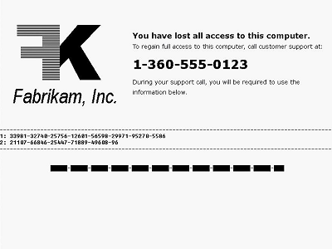
New Policy Enforcement Model
Call
support
Add
time
Notify
Reboot
Normal mode
Borrowed Time
Hardware locked
mode
Full PC operation
Can add or extend time via Telco / Web site / ATM
As time decreases, warnings remind user to add time
Additional time before being locked out
No logoff
Full use of PC
Replaces “RFM mode”
PC does not boot
Shorter challenge and response strings

Slide 14
Changes In Hardware
Area | FlexGo 1.0 | FlexGo: Next Release
OS Integration | Shipped as a standalone SKU on Windows XP Home Edition | Shipping as an application that runs on all 32-bit versions of Windows Vista
Computer identifier (HWID) | Generated by the computer | Pre-programmed along with a symmetric key pair
Client Authentication | Client certificate stored on the hard disk | Symmetric key pair linked to the HWID
Client Activation | Dependant on Windows activation | Integrated into FlexGo protocol
Metering | Limited Access Mode enabled “gaming” for more time on the system | Borrowed time is set within the LPM; re-paid when the computer leaves Hardware Locked Mode (HLM)
Lower Provisioning Module (LPM) Installation | LPM installed during system manufacturing | LPM installed during component manufacturing; dormant until system manufacturing

Slide 15
Manufacturing Improvements
Area | FlexGo 1.0 | Next Release of FlexGo
OEM Licensable | Windows XP Home Edition for Prepaid and Subscription Computers | Microsoft FlexGo (licensed under OEM Tools Agreement runs on all 32-bit versions of Windows Vista)
Installation | Full OS Installation (i.e. new OS image) | Windows Installer (.msi) based installation
Customization | Used Windows OPK Techniques | Uses XML configuration files
Windows Activation | Requires COA (Non-SLP) based activation of Windows | Supports all forms of Windows Activation (e.g. OEM Activated)
Image Management | Unique OS image per partner | Easily added existing OS images during preinstall or manufacturing
LPM Installation | LPM installed during system manufacturing | LPM installed during component manufacturing
LPM Configuration | Part of the LPM install | LPM is sealed for use similar to an OS image

Slide 16

The Next Release Of Microsoft FlexGo
demo
Martin Hall
Lead Program Manager
Microsoft FlexGo

Slide 17
FlexGo Hardware Support
Jeff Westerinen
Director
FlexGo Hardware Architecture

Slide 18
Microsoft FlexGo Architecture
Windows Operating System
Upper Provisioning Module (UPM)
LPM Device Driver
Microsoft
Joint
Hardware
Hardware
Manufacturer
Secure
HWID
Platform Specific Layer
Secure
Storage
LPM Firmware
Random
Number
Generator
Lower Provisioning Module (LPM)
Trusted
Clock
Secure Execution Environment (SEE)
HW Locked
Mode Control

Slide 19






Microsoft FlexGo Hardware Roadmap – Today
Phoenix BIOS-based implementations
Transmeta Efficeon® processor-based implementations
2006
2006-based implementations plus…
AMD-based implementations
Infineon ASIC-based implementations
Intel®-based implementations
2007
2007-based implementations plus…
SEE’s in high-value components
2008
All of the above plus more
2009
Security Robustness Increases

Slide 20

AMD And FlexGo Partnership Highlights
50x15 Initiative, founded by AMD
Aiming to accelerate affordable internet connectivity and computing for 50 percent of the world’s population by 2015
Microsoft has been a key 50X15 partner starting in 2004
AMD partnership with Microsoft in Emerging Markets
AMD Personal Internet Communicator managed platform (2004)
AMD has been a key FlexGo partner since early 2006
AMD’s FlexGo plans for 2007 and beyond
AMD-based platform will deliver a superior experience for the upcoming release of FlexGo
FlexGo improvements will improve the model for both Consumers and business partners
More affordable
More choices
Enhanced security

Slide 21


Infineon FlexGo Hardware Platform
Infineon has worked closely with Microsoft and other partners to develop a FlexGo Solution that leverages Infineon security technology. Infineon is a leader in Security Chip Technology
Infineon enables secure e-business transactions by providing security ICs for state-of-the-art PKI (Public Key Infrastructure) solutions
Security ICs from Infineon feature integrated security mechanisms providing multiple levels of physical protection and encryption
The Infineon FlexGo solution will be available to support all major CPU Platforms giving OEM’s the flexibility to choose
Pay-as-you-go
Subscription

Slide 22
Cash Canyon (D945GZCCL) Mainstream FlexGo board with Integrated Graphics
Intel® Pentium® D and Celeron® D processors (LGA 775)
Support for Intel® Core™2 Duo processor
Four-layer board with 945GZ and ICH7
DDR2 533/400MHz single Channel Memory
No PCIe & No PCI
uATX
Product highlights
FlexGo Compliant board
800 MHz system bus support
2 Serial ATA (3.0Gb/s)
Sigmatel STAC9227 Audio
Multi-function secure chip using Winbond 8374S MCM
Hi-speed USB 2.0 ports x 6
Intel® 10/100 Ekron C LAN
Product positioning
Mainstream Microsoft FlexGo with integrated graphics
Customer transition
Entering into new Microsoft FlexGo business model
Production: Q3’07 (FlexGo1.0)
Q4’07 (FlexGo2.0)
PS/2
Parallel
RJ45
Serial
VGA

Slide 23
What You've Heard Today
There are new opportunities for PC market expansion in emerging economies and geographies
FlexGo offers a new approach to making PCs affordable
Take advantage of the growing partnership opportunities FlexGo will create for PC design and manufacturing for these new business models

Slide 24
Call To Action
Evaluate how Microsoft FlexGo Technology can increase your TAM in emerging markets
Work with Microsoft, AMD, Infineon and Intel to enable your 2008-2009 designs to be “FlexGo ready”
Visit AMD’s and Infineon’s booths on the show floor
Respond to Telco requests for PCs that are optimized for Microsoft FlexGo
Visit http://www.microsoft.com/flexgo for more information

Slide 25
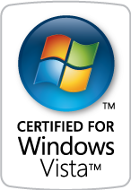
FACT: 277 TV tuner cards carry the “Certified for Windows Vista” logo as of April 1

Slide 26

© 2007 Microsoft Corporation. All rights reserved. Microsoft, Windows, Windows Vista and other product names are or may be registered trademarks and/or trademarks in the U.S. and/or other countries.
The information herein is for informational purposes only and represents the current view of Microsoft Corporation as of the date of this presentation. Because Microsoft must respond to changing market conditions, it should not be interpreted to be a commitment on the part of Microsoft, and Microsoft cannot guarantee the accuracy of any information provided after the date of this presentation. MICROSOFT MAKES NO WARRANTIES, EXPRESS, IMPLIED OR STATUTORY, AS TO THE INFORMATION IN THIS PRESENTATION.

