Slide 1
Ultra-Mobile PC (UMPC) Ecosystem
Vikram Madan
Development Manager
Microsoft Corporation
Notes:
MS-Internal UMPC goals for this session:
If you’re unfamiliar or partially familiar with the UMPC, you’ll be super excited at the end of it
If you’ve been getting messages about running alternate Oses like Linux or Xpe on UMPC/MID hardware, you’ll come away understanding why Windows is a better alternative
If you’re interested in UMPC hardware, you’ll come away understanding how it’s advancing and what you need to think about for the future
If you’re a software or services person, you’ll some away with a list of requirements and guidelines you can follow for targeting UMPC opportunities…

Slide 2
Agenda
UMPC Overview
UMPC Hardware
UMPC OS: Windows Vista
UMPC Software
Summary
Notes:
MS-Internal UMPC goals for this session:
If you’re unfamiliar or partially familiar with the UMPC, you’ll be super excited at the end of it
If you’ve been getting messages about running alternate Oses like Linux or Xpe on UMPC/MID hardware, you’ll come away understanding why Windows is a better alternative
If you’re interested in UMPC hardware, you’ll come away understanding how it’s advancing and what you need to think about for the future
If you’re a software or services person, you’ll some away with a list of requirements and guidelines you can follow for targeting UMPC opportunities…

Slide 3
Agenda
UMPC Overview
UMPC Hardware
UMPC OS: Windows Vista
UMPC Software
Summary
Notes:
1. Create excitement for UMPC category
clarify reason why MS (and many other incl. Intel) are investing in UMPC --> to drive towards 1 PC per person -->
identify key scenarios
personal digital media entertainment
internet browser & rss/news reader
Internet communicator: email VoIP IM
casual gaming
navigation
show market size opportunity: 300 million PC's sold WW per year --> could easily go to 1 billion PCs by targeting multiple PCs per household
multiple single use devices can be replaced by 1 multi function device
MP3 player
portable dvd/video player
portable TV
photo frame
personal navigation device
Internet tablet
etc etc etc
show accessory opportunity
show service opportunity

Slide 4

Understanding Growth Drivers
Digital Lifestyle
A Mobile PC Per Person
Digitization
Miniaturization
Applications
Social Trends
Technology & Tools
Social / Anonymous Networking
Connected Lifestyle
Globalization
…..PC Shipments.....
Digital Media
E-mail/IM
Internet
Gaming
A PC on every Desk, in every Home
Notes:
Technology industry is a very exciting, super-fast growing industry.
3 elements can be recognized in the growth engine: technology that drives social behavior that utilizes applications which fuel innovation that leads to new technology and changing behavior. A perpetual motion machine.
Industry leader have the responsibility to drive growth, to eliminate the obstacles and to invest in the future.
Digital lifestyle is being embraced world wide. Trends show mobility is a key aspect of technology use.
Concept of a computer in a fixed location is becoming as outdated as that of a phone in a fixed location. Opportunity here to meet the computing needs of users with truly personal computing experiences. Putting the personal back into personal computer. PCs havent been truly personal – they are shared when they’re on a end-point/base.
Opportunity to take a PC from shared, fixed use to a pc-per-person digital lifestyle
Customer demand is very clear: they want it all, all the time, wherever they go. And it must be delivered in a simple way!
Customers look to solve problems with end to end solutions.
Today customer choice is limited to single function devices – and lots of them: mp3 player, dvd, personal navigation, internet tablet, portable tv, …
Some devices trying to add more functionality but not a complete and versatile experience…
Mobility is key for customers
Q; What is MS doing for Mobility?

Slide 5
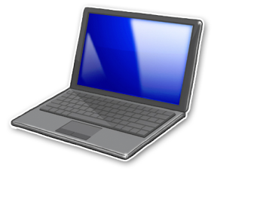
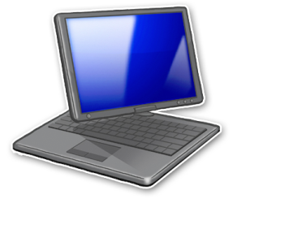

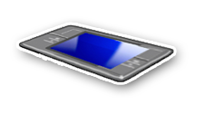


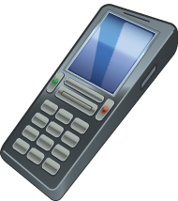
Microsoft Mobility Solutions
Windows Mobile
Windows Vista
(~ 1 Billion / year)*
…Portability versus Functionality… .
Notebook PC
Pocket PC
Ultra Portable PC
Smartphone
UMPC
(~ 300 Million / year)*
Optimized for Individual Mobility
Limited Applications
Optimized for Shared Use + Performance
Over 100,000 Compatible Applications
* Entire Phone/PC category totals
Notes:
Slide objective: How to position all of Microsoft’s mobile platform offerings.
Talk about portability vs. functionality – smart devices on one side, rich application functionality and hardware capability on the other. There is a gap that is filled by the UMPC
Focus on Smart Devices
Fully data and service-aware
Connecting users and data in a meaningful way
The best mobile companions to Outlook
Integration with other Microsoft Assets such as Exchange Server 2003
Rich Runtime Environment – On and Offline
Differentiated “form factors” and software designed for different usage scenarios
Pocket PC & Pocket PC Phone Edition
SmartPhone
Tablet PC
Tablet PCs – best when full PC applications are required, a larger screen is necessary, and battery life (especially coupled with constant wireless connectivity) as well as weight are sufficient to support the user’s typical tasks and working environment.
Pocket PCs – best for PIM, e-mail, and vertical application data access and data entry when a smaller, wireless device is required
Smartphones – best when voice communications, PIM, and e-mail are needed in a small, wireless device. Appropriate for data viewing and very limited data entry
SPOT watches – best for an extended clock experience including PIM and specific consumer information

Slide 6
Microsoft UMPC Vision
Fully-functional, highly-portable Windows PC
  General purpose PC-alternative to single (or limited) function devices
  Runs full Windows Vista
  Provides familiar, compatible PC experience
  Leverages existing PC Ecosystem
High consumer appeal
  Device-like designs
  Truly personal, digital-lifestyle companion
Notes:
Q: Should I mention Premium SKUs?
0 learning curve for users/OEMs/ODMs/Retailers – it’s windows
Multifunctional –
Price as a function of ecosystem? Standard building blocks & components?
Intel and VIA are both doing custom cpu/chipsets and the LCD panels are new for umpc.

Slide 7
Microsoft UMPC Vision
Ultra-Mobile
  Small, convenient form-factor
  Always connected: go everywhere, do everything
On-the-go usage
  True handheld operation;
  Natural interaction
  Multiple input methods (stylus, touch, keyboard, buttons, pointing device, voice…)
Target audience
  Consumers, Dual (Work/Home) Users
Notes:
Q: Should I mention Premium SKUs?
On-the-go – extends familiar experience to On-The-Go usage, more places more times
0 learning curve for users/OEMs/ODMs/Retailers – it’s windows
Multifunctional –
Price as a function of ecosystem? Standard building blocks & components?
personal digital media entertainment
internet browser & rss/news reader
Internet communicator: email VoIP IM
casual gaming
navigation

Slide 8
Microsoft UMPC Vision
Key scenarios
  Digital Consumption
  Communicate: E-mail, VOIP, IM
  Personal digital media/entertainment: Music, Photos, Video, TV, Gaming
  Information: Productivity, Web Browsing, RSS, eBook/News readers
  Location: Navigation, Maps, Directions, POI
  + Extend familiar desktop/laptop experience to more places and times
Notes:
<todo> Mention Navigation & Location or leave them out ?
<todo> Mention Nth? Companion? Personal PC?
Consumers lead technology adoption
Consumption oriented
personal digital media entertainment
internet browser & rss/news reader
Internet communicator: email VoIP IM
casual gaming
navigation

Slide 9
Opportunities
Hardware: New form-factors, latest standards and technologies, consumer-appeal, design and functionality based differentiation…
Software: Tailored, un-tethered experiences; on-the-go + digital consumption scenarios; optimized applications…
Peripherals: Bluetooth, USB…
Content: Media, Games, Books, Entertainment…
Accessories: Personalization, customization…
Services: Roaming, connectivity, web-based…
Notes:
Lots of storage available
<?> More Suggestions welcome

Slide 10
Virtuous Cycle
New Opportunities
  Hardware
  Software
  Peripherals
  Accessories
  Content
  Services
Ecosystem Expertise and Capability
  Familiarity for Users, OEMs, ODMs, IHVs, ISVs
  Economies of scale
  Existing assets and knowledge
  Faster cycles
New Scenarios and Markets
  Non-traditional, on-the-go use
  Increased digital consumption (More places, more hours)
  Increased PC penetration
  (N^{th} PC, Companion PC…)
UMPC Form-Factor and Experience Innovation
  Latest technologies
  Capable hardware
  Optimized experiences
  Appealing designs

Slide 11
Microsoft UMPC Investments
Hardware reference designs
Mobility support in Windows
Optimized value-add UMPC experiences (OOB value)
Tools, guidelines, UMPC-specific developmental assistance and resources
Biz-dev partnerships with OEMs, ODMs, IHVs, and ISVs
Notes:
Anything about user research?
What about marketing?
Should I mention Microsoft Origami UMPCs

Slide 12
Agenda
UMPC Overview
UMPC Hardware
UMPC OS: Windows Vista
UMPC Software
Summary
Notes:
Hardware characteristics
v1 vs. v2 UMPC improvements
MS UMPC definition
Lessons from v1
User feedback and recommendations
Share hardware requirements, user feedback and recommendations
show improvements of V2 devices
Samsung Q1 Ultra vs. Q1
Q1 Ultra = Q1 + integrated keyboard + HSDPA + WiMax + 2 camera's + biometrics + 60% resolution (1024 x 600) + 50% brightness + 100% battery life (4 Hrs) + OX v1.0 - 20% weight (690gr) - 10% thickness (23mm)
HTC Shift
MS UMPC definition
100% compatible PC running full Vista OS
7" LCD recommended
readability
touchability
size required to make device thin --> no stacking
cost <-- many devices already use 7" LCD (in car navi, portable DVD players, portable DVB-T TVs)
touch digitizer support --> HID driver!
user feedback & recommendations
battery life -> ca. 4 hrs with 3 cell, VIA and McCaslin can do it
ultra mobility = sub 700 gram with 7" LCD (Samsung can do it!)
buttons
mouse
programmable keys (1 for Origami Experience, 1 for software keyboard)
SAS button
hold switch <-- avoid accidental touch
volume up/down
radios: WiFi, Bluetooth (for accessories), 3G

Slide 13
Microsoft UMPC Definition
100% Compatible PC running full Windows
  Windows Vista Premium SKUs recommended (for ink, touch, reco)
  Windows Logo Program 3.0 references UMPC category
7” LCD display recommended
  Readable, Touchable, Usable
  Size required to make device thin (no stacking)
  Cost - 7” LCD standard for many other devices (car navigation, portable DVD players, etc)
Touch digitizer support
Weight < 2.5 lbs
Notes:
TBD: Can I mention the Home Premium recommendation?
From the WHQL logo requirements, following are required for Premium logo on UMPC:
HD Audio, LAN – Ethernet, WLAN 802.11g, Graphics, Display, Audio, Storage
Resumes from S3 < 2s
High precision timer
512MB, 1GB RAM after June 1 2007 + lots of other stuff
XPDM drivers can be shipped on UMPCs till June 1 2007
Touch digitizer support

Slide 14
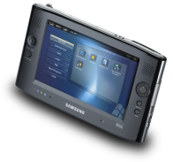
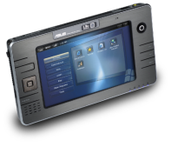
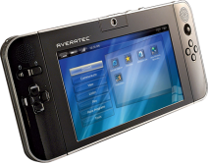
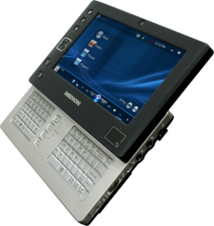
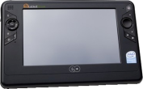
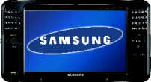
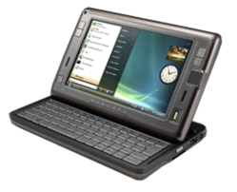
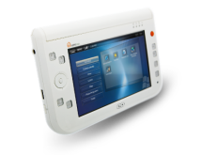
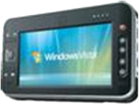
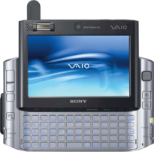
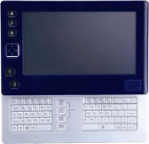
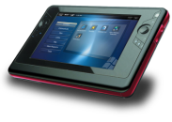
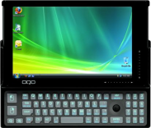
Hardware Momentum
1st Wave of UMPCs released 2006
  Shipped with Windows XP Tablet Edition
  Specs in line with MS guidelines
2nd Wave 2007+
  Smaller, ‘better specs’, feature rich
  Innovative design and differentiation
Notes:
PCs shown:
Q1, Asus R2H, Paceblade, Founder, Tabletkiosk, Medion, HTC, Q1-Ultra, U60, Amtek , OQO, Sony-UX
<?> Suggestions for anything useful on this slide…

Slide 15
UMPC Hardware Evolution 1/3
 | 2006 | 2007+ Possibilities
Display | 7” | 7”, 5” … LED-Backlit (lower power)
Resolution | 800x480 minimum | 1024x600…
Digitizer | Resistive (Touch Screen) | Touch panel integrated with LCD (to reduce thickness)
Connectivity | 802.11 b/g Wireless Bluetooth | (More connected) WiMax Integrated WWAN
Interaction | Touch Stylus Thumb-based controls | + Integrated Thumb/QWERTY Keyboard
Notes:
OLED displays?
Where MS wants to see the hardware go: smaller, faster, cheaper <- already happening
Where is the biggest opportunity for HW ecosystem: differentiation! Logo requirements for UMPCs are flexible

Slide 16
UMPC Hardware Evolution 2/3
 | 2006 | 2007+ Possibilities
RAM | 512MB – 1GB | 1GB+ …
CPU | ~1 GHz-class low-voltage Intel Celeron M Intel Pentium M VIA C7-M | Maintain* MHz, reduce power requirements Optimized for Windows Vista Passive cooling, fan-less
Graphics | Integrated graphics | WDDM + DX9+ support
Battery Life | 2-3 hours (3-cell) | 3-4 hours (3-cell) Increasingly power efficient
Weight | < 2 lbs | <1.5 lbs
Dimensions | Varies | Possible: 18-20mm thickness
Notes:
Via & Intel improvements (e.g. Macaslin)
MHz may go down 600Hz -800MHz
Amazed by battery life of samsung q1 –ultra – use this section for setting min-bar expectation …
<?> What is the CEA connector?
<?> What is the ultra battery life?

Slide 17
UMPC Hardware Evolution 3/3
 | 2006 | 2007+ Possibilities
Storage | 1.8” or 2.5” HD | 100% solid-state…
OEM-Specific Basic | Headphone connector VGA connector CF/SDIO slots Ethernet Docking connector TV out USB 2.0 | (Same)
OEM-Specific Advanced | Camera Microphone array Built-in GPS receiver Digital TV tuner Fingerprint reader | Combination of advanced features much more common (e.g. Multiple cameras + GPS + Biometric)
Notes:
<T>

Slide 18
User Feedback (HW Wants)
Battery life: 4 hrs with 3-cell
Ultra-mobility: <700 grams weight with
7” LCD
Buttons, mouse, programmable keys
  Launch apps, software keyboard
  Hold switch! – avoid accidental touch
  Volume up/down
  Control radios: Wi-Fi, Bluetooth, 3G…
Cost: High interest at lower price points
Notes:
84% of 3081 users surveyed by Microsoft in an online survey in 2005 were interested, very interested, or extremely interested at $499-$599
Battery life: want 4 hrs with 3-cell - VIA & McCaslin can do it
Ultra-mobility = sub-700 grams with 7” LCDs (Samsung can do it)
Buttons, mouse, programmable keys
OX button, software keyboard button
SAS button
Hold Switch! – avoid accidental touch
Volume up/down
Radios: Wifi, bluetooth, 3G <- <?> Did oscar mean control radios???

Slide 19
HW Differentiation Opportunity
UMPC Logo requirements offer flexibility
Potential for innovative design
  Form-factors tailored for on-the-go, personal, hand-held usage
  Capabilities tailored for scenarios and user segments
  Unique combinations of HW features
Current UMPC offerings highlight differentiation potential
Notes:
Already a wide divergence in available hardware capabilities
Want to push this further – room for innovation
Brighter screens for outdoor use
Scnerios: Gaming, entertainment, communication, information, media, navigation

Slide 20
Agenda
UMPC Overview
UMPC Hardware
UMPC OS: Windows Vista
UMPC Software
Summary
Notes:
2. Show Windows Vista is the right OS
importance of compatibility
re-use of ISV, OEM, ODM investments
no user learning
no retailer learning
compatibility with PC software (100'000+ applications)
compatible with PC accessories
compatible with PC components (graphics, cpu, ram, usb, etc)
compatible with PC drivers & support
MS commitment & investment to deliver software for key scenarios
Vista Mobility Center
Show expandibility, customization
Vista Network Center
Vista ink, touch & reco support
Show improvement over XP
Vista fast resume capability
Origami Experience, MS Reader, Live Mail, Street & Trips
Demo
emphasize "for free"
3rd party Windows (Vista) app's
example & demo NY times reader

Slide 21
Windows Vista UMPC…
Part of extensive Windows ecosystem
Windows brand trust
  Established, known Operating System (OS) with OEM support
  Ongoing Microsoft commitment and investment
Well-differentiated from other-OS choices
  Feature-rich, mobility-aware OS
  Robust, secure, familiar
  Information, expertise, help easily available
  Preserves user knowledge and learning
Notes:
importance of compatibility
re-use of ISV, OEM, ODM investments
no user learning
no retailer learning
compatibility with PC software (100'000+ applications)
compatible with PC accessories
compatible with PC components (graphics, cpu, ram, usb, etc)
compatible with PC drivers & support

Slide 22
Windows Vista UMPC…
Provides compatibility with
  Windows applications (100,000+ titles)
  Windows Experiences
  Existing user data
  PC accessories and peripherals
  Drivers and support
  Existing PC components (Graphics, CPU, RAM, USB, etc)
Leverages retailer and channel familiarity
Allows re-use of existing ISV, IHV, OEM, ODM investments
Notes:
importance of compatibility
re-use of ISV, OEM, ODM investments
no user learning
no retailer learning
compatibility with PC software (100'000+ applications)
compatible with PC accessories
compatible with PC components (graphics, cpu, ram, usb, etc)
compatible with PC drivers & support

Slide 23
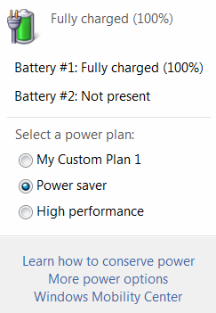
Windows Vista Mobility Features
Windows Vista-based UMPCs automatically benefit from ongoing MS investment in Windows mobility. For example:
Improved Power Management UX
  Simplified Power Schemes
  Improved Battery Meter, Power CPL UX
  Default Off State = Sleep
Notes:
MS commitment & investment to deliver software for key scenarios
Vista Mobility Center
Show expandibility, customization
Vista Network Center
Vista ink, touch & reco support
Show improvement over XP
Vista fast resume capability
Origami Experience, MS Reader, Live Mail, Street & Trips
Demo
emphasize "for free"

Slide 24
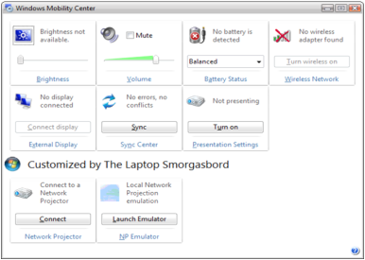
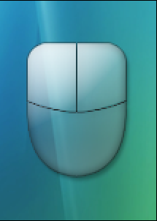
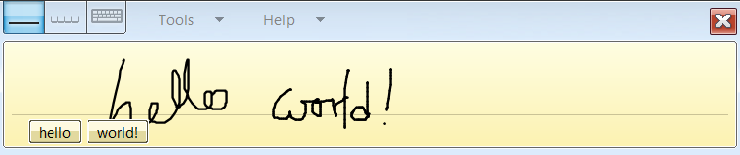
Windows Vista Mobility Features
Mobility Center
  Single place for changing key mobile settings
  OEM customization and branding
Touch Support
  Touch pointer enables precise interaction
  Flicks and Panning optimized for touch
Ink Support
  Tablet Input Panel
  Dramatically improved handwriting recognition
Notes:
MS general investments in mobility space automatically carry over to the UMPC when you use Windows Vista.
A quick gallery of features
MS commitment & investment to deliver software for key scenarios
Vista Mobility Center
Show expandibility, customization
Vista Network Center
Vista ink, touch & reco support
Show improvement over XP
Vista fast resume capability
Origami Experience, MS Reader, Live Mail, Street & Trips
Demo
emphasize "for free"

Slide 25
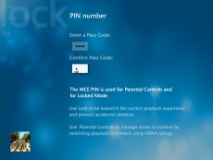
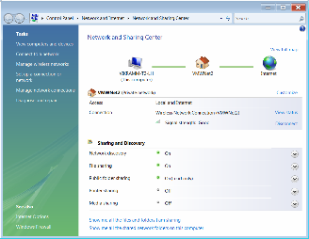
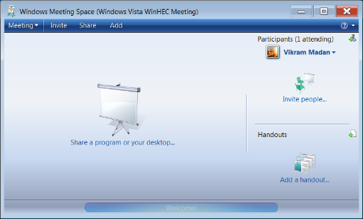
Windows Vista Mobility Features
Windows HotStart
  Launch user into Windows experiences from any ON / OFF / Sleep state
Network Center
  Central place for managing all Network Connections
  Streamlined, simplified networking
Meeting Space
  P2P, Collaboration, Document Sharing
Notes:
MS commitment & investment to deliver software for key scenarios
Vista Mobility Center
Show expandibility, customization
Vista Network Center
Vista ink, touch & reco support
Show improvement over XP
Vista fast resume capability
Origami Experience, MS Reader, Live Mail, Street & Trips
Demo
emphasize "for free"

Slide 26

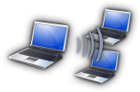
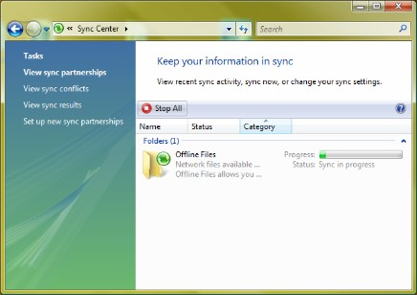
Windows Vista Mobility Features
Displays and Presentation
  External display management
  Network Projection
  Presentation Settings
Sync Center
  Single place to manage data sync
  between multiple PCs and/or devices
And many, many others…
  Fast resume, Blocked shutdown resolver, Security and protection (IE7, Security Center, Defender), Reliability (Service hardening), Speech, Ready Boost…
Notes:
MS commitment & investment to deliver software for key scenarios
Vista Mobility Center
Show expandibility, customization
Vista Network Center
Vista ink, touch & reco support
Show improvement over XP
Vista fast resume capability
Origami Experience, MS Reader, Live Mail, Street & Trips
Demo
emphasize "for free"

Slide 27
Agenda
UMPC Overview
UMPC Hardware
UMPC OS: Windows Vista
UMPC Software
Summary
Notes:
Share software requirements, user feedback, recommendations and Microsoft resources
Vista Premium (Home Premium, Business, Ultimate) --> because of ink, touch & reco support
basic approach --> perfection is achieved, not when there is nothing more to add but when there is nothing left to take away
touch optimization
minimum touch target size
800 x 480 optimization
no dialog box clip-off's
do not forget installation/setup
UMPC simulator software
Sudoku source
low power design

Slide 28
UMPC Software Development
Full Windows Vista PC – you already know how to develop for it!
Follow Mobile PC development guidelines
Most apps work well as-is, but some things are different
  HW capabilities diverge widely from desktops
  Form-factor impacts interaction
  More use → smarter power management
  More portable → more transitions
Optimized apps → superior experience

Slide 29
UMPC Optimized Applications
Optimize for
  Non-traditional displays
  Input and interaction differences
  Power-consumption and system-load
  Frequent transitions
  Scenarios

Slide 30
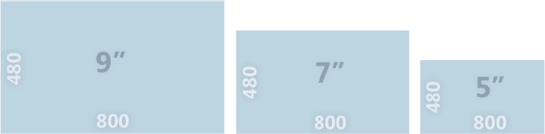
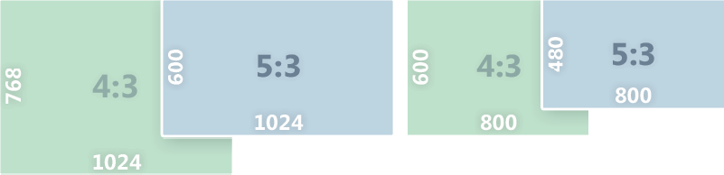
Form-Factor
Display
Display characteristics → design challenges
  Small display area (7”, 5”…)
  Non-standard resolution (800x480, 1024x600…)
  Non-standard aspect ratio (5:3)
Notes:
Don’t add
Don’t clip or forcibly center UI; make it scrollable
5:3 screen ratio not 4:3; resolution checks in setup
Fat-finger UI; MRUs; auto-complete; don’t ask user to type text ..
Tablet SDK platform allows distinguishing between finger, stylus, and pen
Can app be navigated using buttons only?
Don’t assume 4:3 ratios or make your UI non-resizable or assume minimum UI size

Slide 31
Form-Factor
Display
Display size and resolution optimizations
  Intelligent layout; Reduce UI clutter and information density
  Work well on 800x480, 1024x600 resolutions
    No dialog clipping, fixed-size or forcibly-centered windows, …
  Run full-screen, provide exit control
  Anticipate screen rotation
  Test on a range of resolutions and screen sizes
    Don’t hardcode resolution or size assumptions, especially in setup
Notes:
Don’t clip or forcibly center UI; make it scrollable
5:3 screen ratio not 4:3; resolution checks in setup
Fat-finger UI; MRUs; auto-complete; don’t ask user to type text ..
Tablet SDK platform allows distinguishing between finger, stylus, and pen
Can app be navigated using buttons only?
Don’t assume 4:3 ratios or make your UI non-resizable or assume minimum UI size

Slide 32
Form-Factor
Input and Interaction
Don’t assume keyboard or mouse
  No hover; context-menus and modifier keys difficult to access
  Minimize need for text input
  Accommodate on-screen keyboard
  Hardware Button-based UI navigation and control
Optimize for touch
  Resolution-independent, finger-friendly targets
Consider alternate input methods
  Speech, gestures, ink …
Notes:
Finger-friendly -> independent of resolution
Don’t put stuff on the screen edges
Windows generally not optimized for touch
Text input: auto-complete, mrus
Don’t hide UI under the hand or fingers
Text input areas obstructed by on-screen keyboard
Handwriting reco works very well on Vista…
Don’t clip or forcibly center UI; make it scrollable
5:3 screen ratio not 4:3; resolution checks in setup
Fat-finger UI; MRUs; auto-complete; don’t ask user to type text ..
Tablet SDK platform allows distinguishing between finger, stylus, and pen
Can app be navigated using buttons only?
Don’t assume 4:3 ratios or make your UI non-resizable or assume minimum UI size

Slide 33
Power Management
Minimum: Same as any Windows Vista Mobile PC
Tune app behavior based on power scheme and power events
Minimize system load; reduce resource usage
  Avoid polling and high-resolution timers
Hardware power control via drivers
  Keep devices in low power state or off
  Suspend/resume performance
Lots of guidelines available for apps and drivers…
Notes:
Invest in performance optimizations
Adjust to user power policy.
Reduce resource usage when the system is on battery power.
Do not render to the display when it is off.
Avoid polling and spinning in tight loops.
Do not use high-resolution periodic timers.
Allow the system to idle the display and idle to sleep.
Respond to common power management events.

Slide 34
Transitions
Connectivity and bandwidth are variables
Expect frequent suspend/resume
  Optimize suspend/resume performance
  Drivers must not block power transitions
  Handle ever-changing environment: network, peripherals, displays, data-access…
On-the-go usage implies reduced attention
  Short, burst interactions
  Make info glance-able
Notes:
Suspend/resume are key to machine being always available and appearing always on

Slide 35
Agenda
UMPC Overview
UMPC Hardware
UMPC OS: Windows Vista
UMPC Software
Summary
Notes:
Slide Purpose: Set the Agenda for the Session

Slide 36
UMPC Value Proposition
UMPC
Windows Vista
PC Ecosystem Value
Familiar user experience + compatibility
Connectivity
Natural Interaction, on-the-go usage
Convenient,
personal,
digital companion
New scenarios and opportunities
Go Everywhere
Do Everything
Notes:
<todo> Is this slide providing any value at all ?

Slide 37
Summary
New UMPC category gaining momentum: huge growth opportunity for PC Ecosystem
Hardware will continue to advance and diversify
Windows Vista is the right UMPC OS
Microsoft committed to investing in UMPC category and in Windows mobility
Optimized UMPC experiences provide OOB value today
Notes:
<?> Summary seems weak – any suggestions?
. Summary
UMPC momentum is here and big
UMPC business opportunity is huge
Windows Vista fulfills the customer & suppliers demand
Origami eXperience takes a big load of the OEM shoulder
MS is offereing the right development resources

Slide 38
Call To Action
Design for –
  Mobility: Mobile by design, mobile by default!
  Power efficiency; low cost; consumer market
  Scenarios and end-to-end solutions
  Form-factor flexibility; truly-personal usage
  Touch and non-traditional interaction methods
Consider –
  New and emerging technologies
  Consumer industry trends
  Hardware based differentiation
Notes:
<?> suggestions welcome

Slide 39
Additional Resources
UMPC Resources
  Microsoft: http://www.microsoft.com/windows/products/winfamily/umpc/default.mspx
  Community: http://origamiproject.com
  UMPC & Mobile PC development center: http://msdn2.microsoft.com/en-us/windowsvista/aa905027.aspx
  Mobile PC Platform Design: http://www.microsoft.com/whdc/system/platform/mobilepc/default.mspx
  Windows Logo Program 3.0: http://www.microsoft.com/whdc/winlogo/hwrequirements.mspx
  Application power management tips: http://www.microsoft.com/whdc/system/pnppwr/powermgmt/PM_apps.mspx
Related Sessions
  CLN-C458: Origami Experience on UMPC
Notes:
<?> Is it kosher to put in a link to Code Magazine?
<?> UMPC App development tips: http://www.code-magazine.com/Article.aspx?quickid=0704042

Slide 40

© 2007 Microsoft Corporation. All rights reserved. Microsoft, Windows, Windows Vista and other product names are or may be registered trademarks and/or trademarks in the U.S. and/or other countries.
The information herein is for informational purposes only and represents the current view of Microsoft Corporation as of the date of this presentation. Because Microsoft must respond to changing market conditions, it should not be interpreted to be a commitment on the part of Microsoft, and Microsoft cannot guarantee the accuracy of any information provided after the date of this presentation.
MICROSOFT MAKES NO WARRANTIES, EXPRESS, IMPLIED OR STATUTORY, AS TO THE INFORMATION IN THIS PRESENTATION.

