Slide 1
Media Center Extender Device Design
Jonathan Aroner
Program Manager
Microsoft Corporation

Slide 2
Session Agenda
The importance of design in building Media Center Extender devices
A day in the life of our customer
Available resources from Microsoft

Slide 3
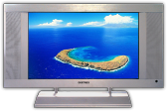

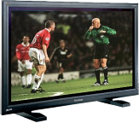






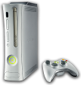



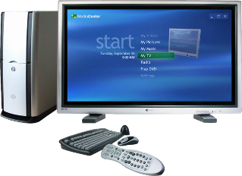


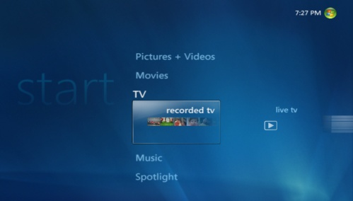

PC Uniquely Suited To Distribute Content Around The Home
content
devices
Photos
Videos
TV
Music
PlaysForSure devices
Smartphones
Portable Media Players
Media Center Extenders
Xbox 360

Slide 4
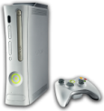



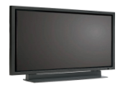

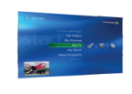



Media Sharing On Windows Two technology options available
PlaysForSure Network Devices
CON-T418: PlaysForSure Network Devices and Windows Vista
Media Center Extenders
CON-T411: Media Center Extender Technology: Overview
CON-T412: Media Center Extender Device Design

Slide 5
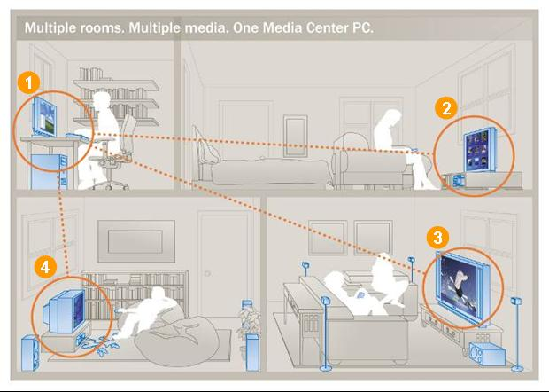
Media Center Extender Technology Whole home, high-definition entertainment
Windows Vista PC with Media Center
DVD Player with built-in MCX streams online music and movies
Xbox 360 with MCX streams music and live and recorded TV
Digital TV with built-in MCX streams photos and home videos

Slide 6
Connected Consumer Electronics An emerging market
So far – many products but no breakout successes
Today is a turning point – increased media availability and improving technology
New players are bringing visibility to the space and setting new customer expectations

Slide 7
You Can Create Great End-to-End Experiences
Knowing the customer is key to designing great products
Sophisticated technologies don’t translate into market successes without positive customer experiences
Every piece of the experience is an opportunity to please the customer

Slide 8
Design Matters
Well-received design translates into strong sales
Product strengths can be masked by poorly-received design
Well-executed and unique designs build brand identity and recognition
Good design results in positive customer experiences, building long-term brand loyalty

Slide 9
A Day In The Life Of Your Customer
On the shelf at retail
Out-of-box experience and initial setup
Everyday use: Living with the product

Slide 10
Retail A key opportunity to engage with your customers
Typical sequence of events*
“I want it!”
“What does it do?”
“How much does it cost?”
Why do we gravitate toward some products and simply dismiss others?
Visceral reactions and the “I want it!” effect
Within a product category, how the product looks is a key differentiator
New product categories need new designs that speak to their purpose
*Donald Norman, Emotional Design 2004

Slide 11
Retail Drive customers to your product
Designing a device for the family room means thinking about color, size, and noise
The evolution of TV design has learnings for Digital Media Adapters (DMAs)
TV Design: From disguised furniture to art
DMAs trend: Smaller and less intrusive

Slide 12

“The details are not the details. They make the design.”
–Charles Eames Influential 20th Century American designer

Slide 13
Details “Close The Deal”
Materials should be high quality and represented truthfully
LEDs should be used conservatively
Antennae should, if possible, be internal
Warning labels and specifications should be printed on the bottom of the device
Ports should be cleanly lined up, clearly labeled, and kept to the back of the device

Slide 14
Unpacking Is An Experience
This is the first opportunity for a customer to really interact with your product
Critical pieces need visibility
Well illustrated quick start guides help users get setup quickly without a manual
Manuals
Where to begin setup needs to be obvious
Accurate product setup illustrations are key

Slide 15
Setup Your customer’s first interaction with the User Interface (UI)
Unfortunately, setup is also a primary driver of product support calls
A good setup experience has key characteristics
Contains as few steps as possible
Advanced features and options not included in the main setup flow
Provides insight into the process and its progress

Slide 16
Wireless Setup A major driver of support calls
Wireless is the preferred connection for 4 out of 5 users*
Users expect device wireless setup to be simple and consistent with other wireless setups
New technologies like Windows Rally make the process easier, but consumers may not have them in place yet
Any advanced options should be segregated from the main setup flow
*Xbox 360 support data

Slide 17
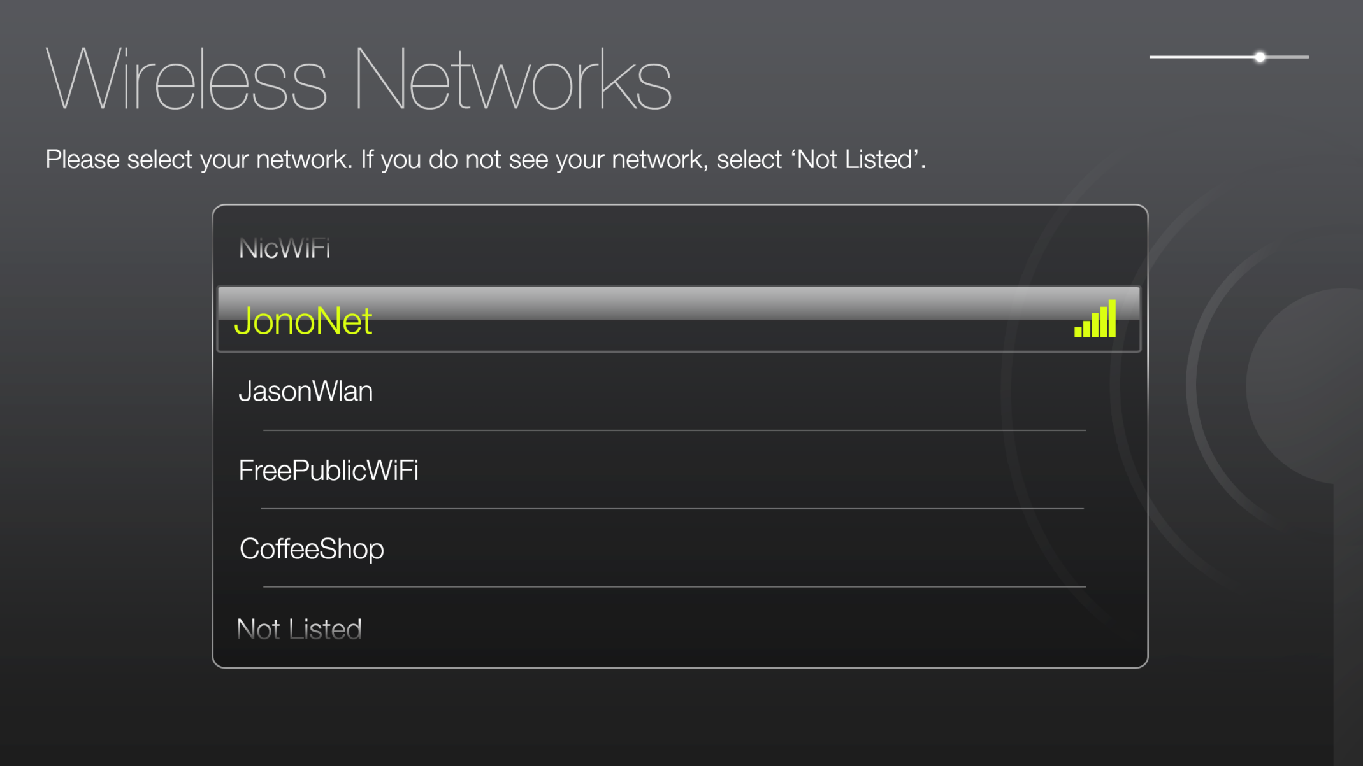
Wireless Mockup Concept
Clear title, one purpose
Progress bar
Simple and clear Instructions
Show only the important information
Sophisticated visual effects

Slide 18
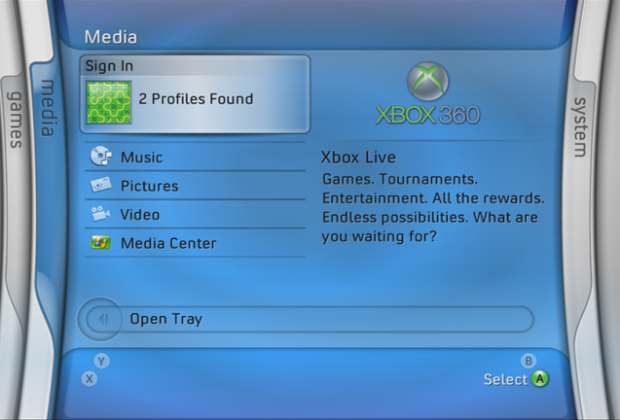
Everyday Use Usability research on discoverability
Extender entry points need to be within experiences such as music, pictures, and video

Slide 19
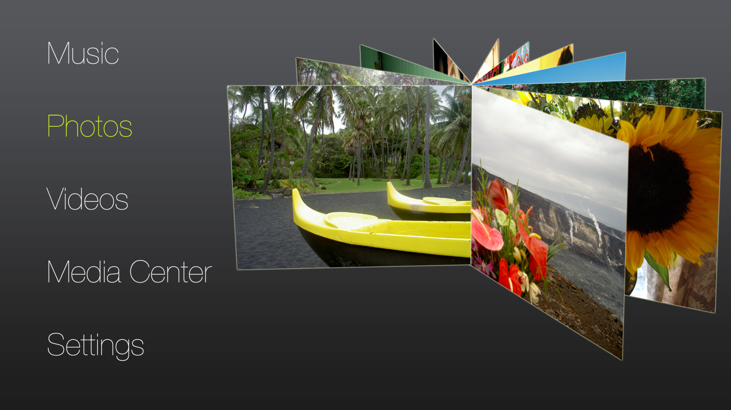
Entry Point Design Mockup Concept
Preview the experience
Simple list

Slide 20
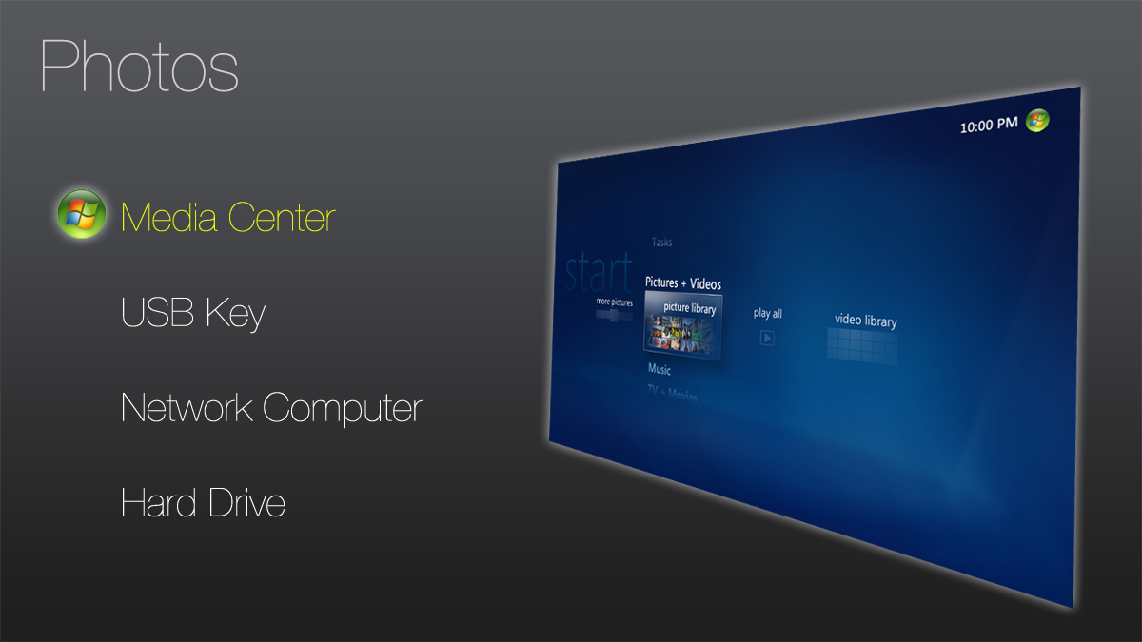
Entry Point Design Mockup Concept
Preview the experience
Simple high level list

Slide 21
Settings Infrequently accessed but critical
Good organization and language is key in the settings menu
Network settings should be accessed through one point in the settings menu
Device updates need to be highly visible and messaged concisely

Slide 22
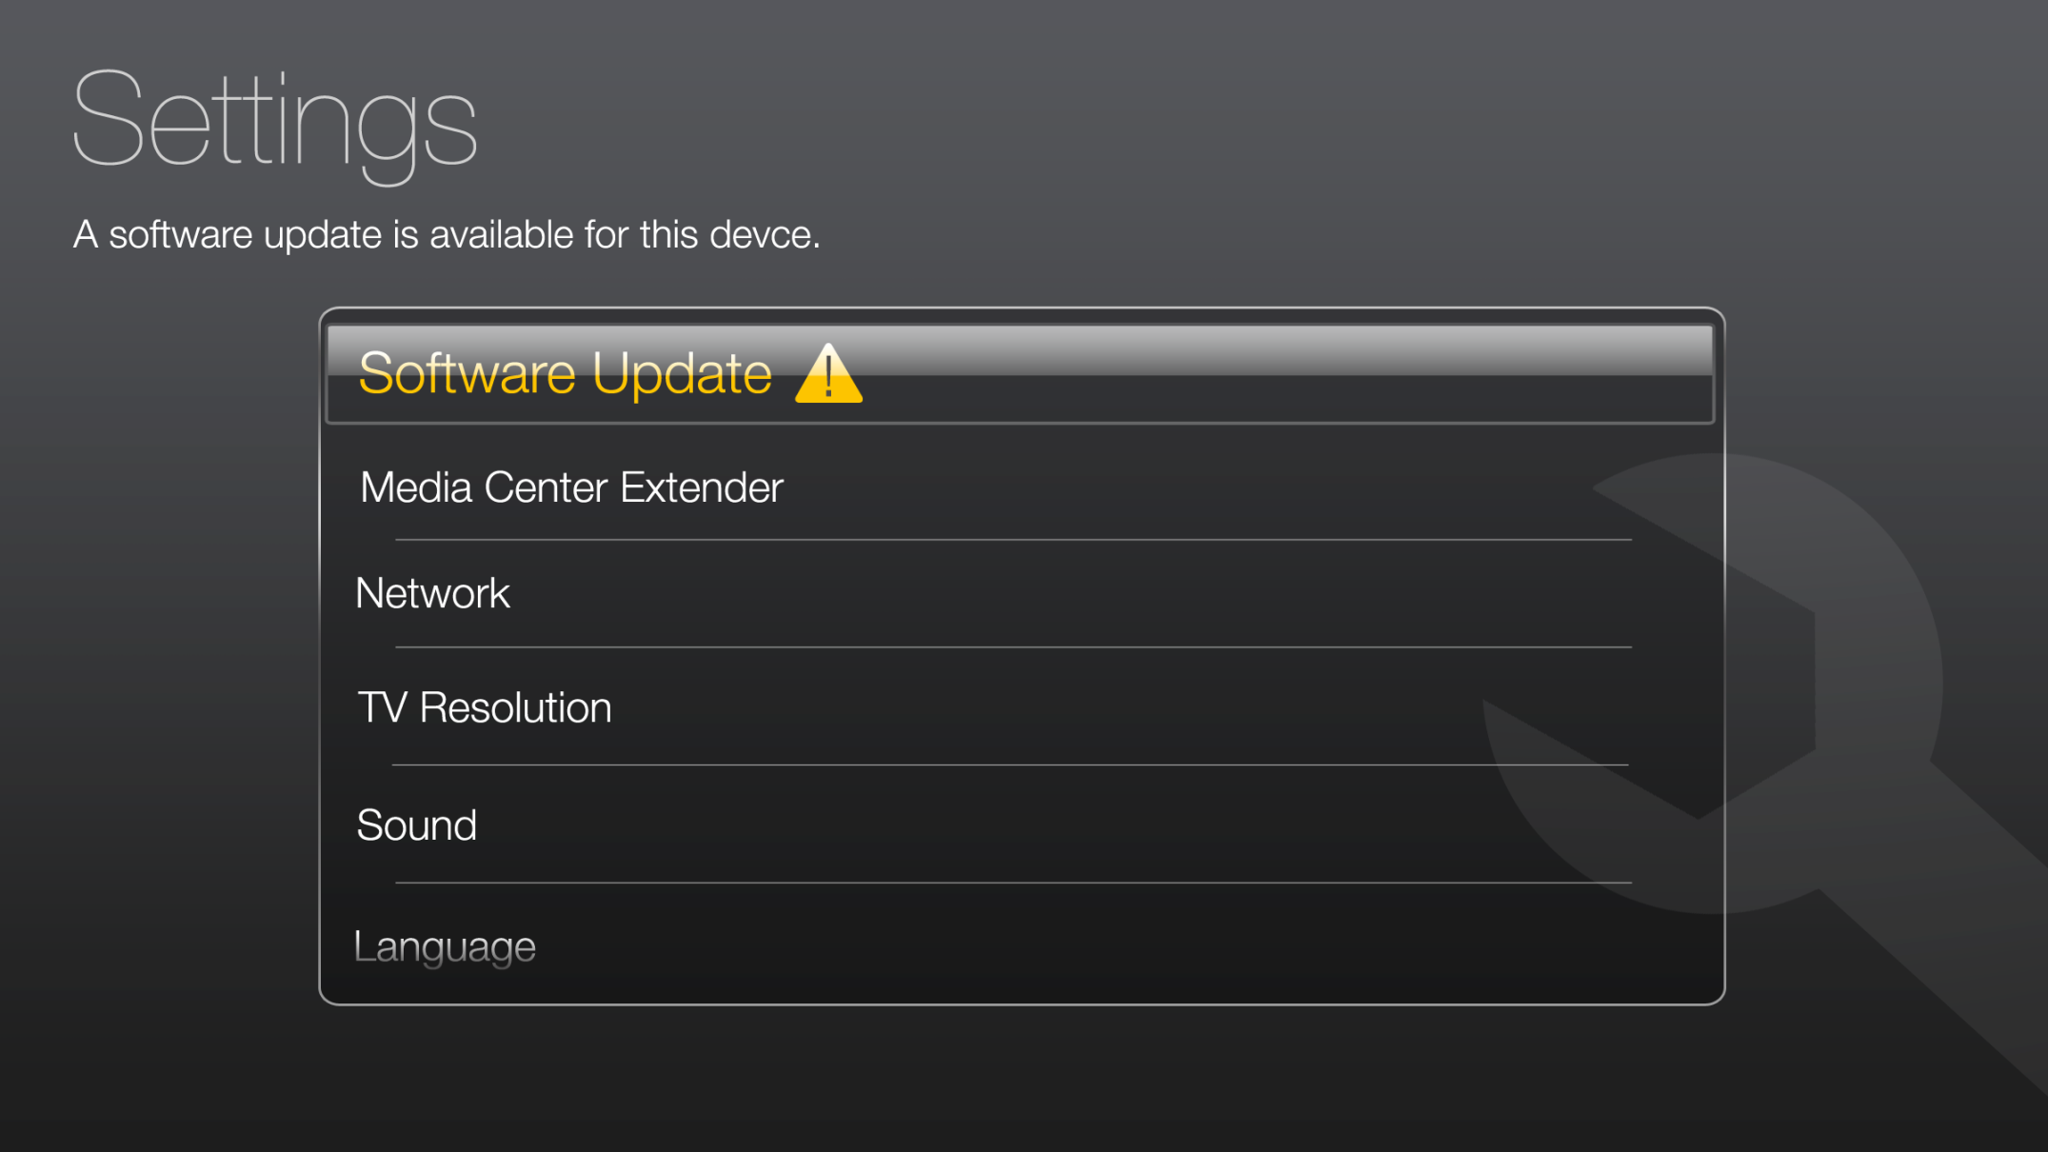
Settings Mockup Concept
Clear instructions
Clear and simple menu options
Restrained visual indicators

Slide 23
Attractive Interfaces Are Easier To Use
A design study evaluated several equally usable bank cash machine interfaces: Some attractive; some not*
Results
Users were more successful at tasks on the attractive interfaces
Results were replicated internationally
More complex interfaces are likely to benefit even more when aesthetically-pleasing designs are implemented
Key takeaway: Make your interface beautiful and it will be more usable
*Masaaki Kurosu and Kaori Kashimura, Apparent Usability vs. Inherent Usability: Experimental Analysis on the Determinants of the Apparent Usability, 1995

Slide 24
Remote Controls An extension of the UI
Remote controls are an often overlooked but crucial part of creating a satisfying and usable experience
If a remote control is hard to use, the entire device experience is negatively impacted
Questions to ask when evaluating a remote control
Is the remote too heavy or too light? Does it fit equally well in both big and small hands?
While watching a movie in a dark room, could the remote be operated without turning on a light?
Are related buttons such as transport controls grouped together?
Are buttons sized according to their use?
Can the remote learn other devices or is juggling remotes inevitable?

Slide 25
Media Center Extender Design Resources
Microsoft provides resources to enable Extender partners’ devices to have great experiences
Media Center Extender Device User Experience Requirements
Usability research and Product Support data
Device UI and hardware recommendations
Media Center Extender Platform Requirements Document

Slide 26
Key Takeaways
Great opportunities exist in the emerging category of connected media devices
Design plays a critical role throughout the entire purchase and use cycle
Sophisticated, usable, and well-executed end-to-end experiences will likely dominate the product space

Slide 27
Call To Action
Carefully consider design and user experience throughout your product cycle
Capture potential customers at retail with innovative and well-executed designs
Ensure your out-of-box and setup experiences are understandable and enjoyable for your customer
Make everyday living with your device usable and fun

Slide 28
Additional Resources
Related Sessions
CON-T411: Media Center Extender Technology: Overview
CON-T418: PlaysForSure Network Devices and Windows Vista
MCX Partner Program Information
E-mail:
Website: http://www.microsoft.com/mcxpartner
Related Websites
Digital Living Network Alliance: http://www.dlna.org/
PlaysForSure: http://www.playsforsure.com
Books on Design
Emotional Design by Donald Norman, 2004
Designing Interactions by Bill Moggridge, 2006
Universal Principles of Design by William Lidwell, Kristina Holden, and Jill Butler, 2003
mcxprtnr @ microsoft.com

Slide 29

© 2007 Microsoft Corporation. All rights reserved. Microsoft, Windows, Windows Vista and other product names are or may be registered trademarks and/or trademarks in the U.S. and/or other countries.
The information herein is for informational purposes only and represents the current view of Microsoft Corporation as of the date of this presentation. Because Microsoft must respond to changing market conditions, it should not be interpreted to be a commitment on the part of Microsoft, and Microsoft cannot guarantee the accuracy of any information provided after the date of this presentation. MICROSOFT MAKES NO WARRANTIES, EXPRESS, IMPLIED OR STATUTORY, AS TO THE INFORMATION IN THIS PRESENTATION.

