Slide 1
Short-Range Wireless Device Connectivity
Zach Little
Kristina Hotz
Program Managers
Microsoft Corporation

Slide 2
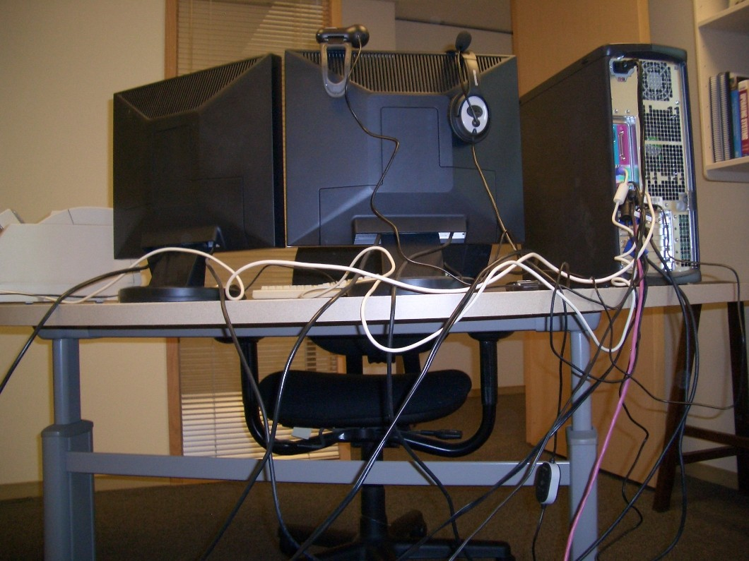
Look Familiar?

Slide 3
Key Takeaways
Lead in advancement of 64-bit computing
Adopt best practices and new tools
Partner on new hardware directions
Free the world from wires

Slide 4
Agenda
Bluetooth in Windows Vista
New Short-Range Wireless Device
Connectivity Specifications
  Bluetooth 2.1
  Wireless USB
Wireless USB Certification Process

Slide 5

Bluetooth In Windows Vista
New interfaces
Enabled Audio Profiles
  Added SCO support for Headset (HSP)
  Added L2CAP interfaces for Stereo Audio (A2DP)
Silicon vendors have audio profiles available today

Slide 6
Bluetooth In Windows Vista
Available profiles
And More
DUN ● HCRP ● HID ● OPP ● PANU ● SDP ● Serial
A2DP ● A/V ● BIP ● BPP ● FAX ● FTP ● HS ● HF ● SYNC
● 3rd Parties
● Microsoft Partners
● Microsoft

Slide 7

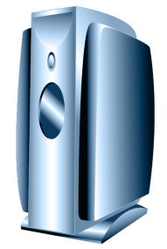
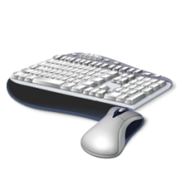
Bluetooth In Windows Vista
Channel avoidance
Bluetooth will not use noisy channels
2.4 GHz Spectrum

Slide 8
Bluetooth In Windows Vista
Radio installation
Hardware ID and Compatible ID support
  Use Microsoft OS Descriptor
  Supply Compatible ID and SubCompatible ID
  Windows Vista generates a Compat ID
  Bluetooth INF will match on Compat ID
Vendor provided INF
  Create INF that references Bth.inf
  Upload INF to Windows Update

Slide 9
New Connectivity Scenarios
Improved Experiences in Bluetooth 2.1
New Scenarios Enabled by Wireless USB
  Keep the same Wired ‘ease of use’
  Remove the hassle of wires

Slide 10
New Connectivity Scenarios
Bluetooth 2.1
Improved Pairing
Increased Quality
Better Battery Life

Slide 11
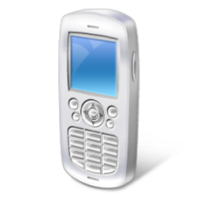
New Connectivity Scenarios
Bluetooth 2.1 – Improved Pairing
Extended Inquiry Response
Secure Simple Pairing
  Just Works
  Passkey
  Out of Band
  Numeric Compare
123456
123
456

Slide 12
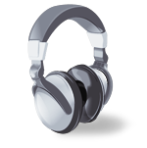
New Connectivity Scenarios
Bluetooth 2.1 – Increased Reliability
Non-Flushable Packet Boundary Flag
ACL
F
N

Slide 13
New Connectivity Scenarios
Bluetooth 2.1 – Better Battery Life
Sniff Subrating
Active
Sniff
Sniff Subrate

Slide 14
Wireless USB
Transition to Zach Little

Slide 15
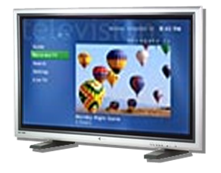
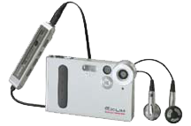
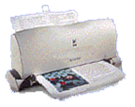

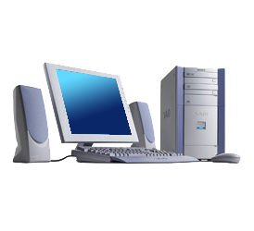

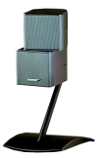

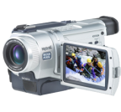



Wireless USB Overview
Up to 127 devices
USB Wire
Replacement Technology
Hub-and-spoke
connection relationship
Connection model is a
wire replacement
  Point-to-point connections
  Between Certified Wireless USB host and peripheral
Certified Wireless USB Cluster
  Certified Wireless USB Host with one or more peripherals (up to 127 addressable devices)
Support for legacy USB Host and Devices
Host scheduled data communications
Dual Role
Devices

Slide 16

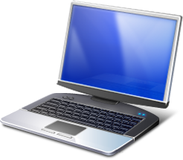

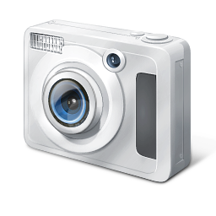
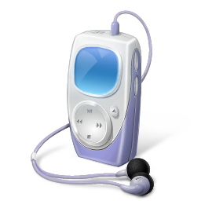
New Connectivity Scenarios
Wireless USB enabled scenarios
Streaming of HD-quality video from a wireless
storage device
Photo sync from
camera wirelessly
Laptop docking stations
  Partners demoing these in
  the expo hall
Opportunity for interaction between Smartphone/pocket PC and the PC
This is just the beginning

Slide 17
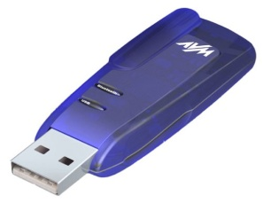
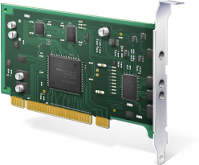
Wireless USB - Hosts
HWA (Host
Wireless Adapter)
  USB interface to the PC
  Enabler for the market
  Reference designs available from many companies today
  USB dongle or Express card form factors generally
WHCI (Wireless Host Controller Interface)
  PCI interface to the PC
    Enables better performance
  Required interface for non-removable devices for WLP certification
  Potential for better power management

Slide 18
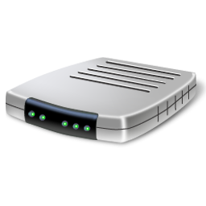
Wireless USB - Devices
DWA (Device
Wireless Adapter)
  Enables existing wired USB connections to be wireless
  Many implementations are in a hub form factor
    Could also be implemented within the device
  Some performance limitations
  Enables the market
Native Device
  Best option for optimal performance
  Integrated directly into device
  Custom power management possible
  Less hardware

Slide 19

Wireless USB Certification
USB-IF Wireless USB certification program now online
Helps communicate
the brand promise
to consumers
Sign that the industry
is getting ready to
ship products
Required for Microsoft WLP certification
The time is now!
Companies that have obtained Wireless USB Certification
  NEC
  Intel
  Alereon

Slide 20
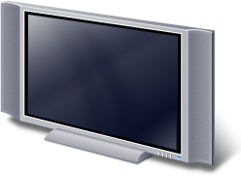
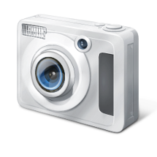

Long-Term Scenarios
Ultrawide-Band Enables Next-Gen Scenarios
  Wireless Desktops
  Wireless Monitors
  Wireless Docking
  for Laptops
    Bluetooth for HID Devices
    UWB for Monitors,
    Storage devices
  Video Streaming
    Laptop/Camera to TV

Slide 21
Call To Action
OEMs
  Adopt Microsoft stack for Bluetooth on Windows Vista
  Prepare for Wireless USB and Bluetooth 2.1
Device vendors and IHVs
  Begin using Compatible IDs for Bluetooth radio installation
  Support Bluetooth 2.1
  Support Wireless USB

Slide 22
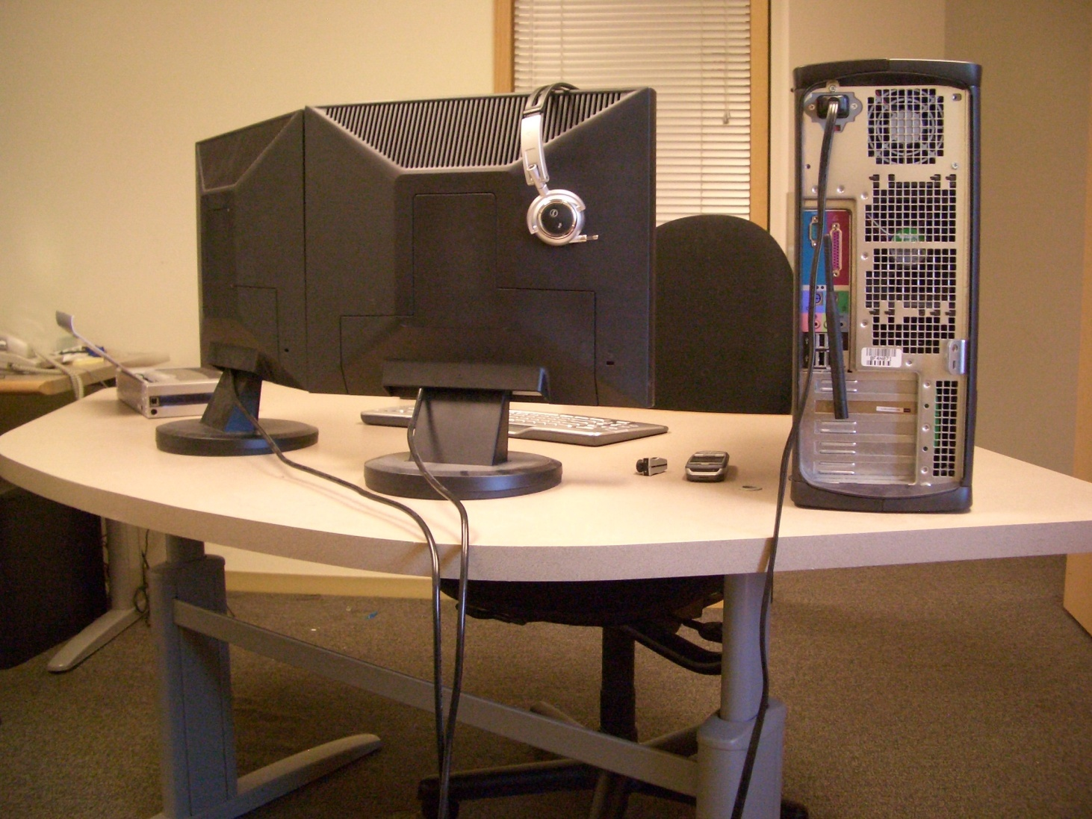
Look Familiar?

Slide 23
Questions?
CON-C430 – Windows Device Connectivity Chalk Talk

Slide 24
Additional Resources
Related Sessions
  Windows Logo Program for Wireless USB: Best Practices (CON-T429)
  Windows Device Connectivity (CON-C430)
Contact Information
  Microsoft Bluetooth Stack:
  Bluetooth Windows Vista Driver Kit:
  Wireless USB:
  UWB Feedback:
bthapi@microsoft.com
bthddi @ microsoft.com
wusbbeta@microsoft.com
uwbfb@microsoft.com

Slide 25
Additional Resources
Web Resources
  Bluetooth Specification: http://www.bluetooth.org/
  Wireless USB Specification: http://www.usb.org
  Wireless USB PDK: http://www.usb.org/developers/estoreinfo/
  Whitepapers: http://www.microsoft.com/whdc/
  Windows Logo Program: http://www.microsoft.com/whdc/winlogo/default.mspx
  WDK and Developer Tools: http://www.microsoft.com/whdc/DevTools/default.mspx
  Partner Hardware and Software Information
    www.broadcom.com/products/Bluetooth
    www.csr.com

Slide 26

© 2007 Microsoft Corporation. All rights reserved. Microsoft, Windows, Windows Vista and other product names are or may be registered trademarks and/or trademarks in the U.S. and/or other countries.
The information herein is for informational purposes only and represents the current view of Microsoft Corporation as of the date of this presentation. Because Microsoft must respond to changing market conditions, it should not be interpreted to be a commitment on the part of Microsoft, and Microsoft cannot guarantee the accuracy of any information provided after the date of this presentation.
MICROSOFT MAKES NO WARRANTIES, EXPRESS, IMPLIED OR STATUTORY, AS TO THE INFORMATION IN THIS PRESENTATION.

