Slide 1
PlaysForSure
Network Media Devices And Windows Vista
Craig Murphy
Program Manager
Microsoft Corporation

Slide 2
Key Takeaways
Be a leader in advancing 64-bit computing
Adopt best practices and new tools
Let’s partner on new hardware directions
Understand Windows Media Player
Sharing technologies
Understand relationship with PlaysForSure for Network Devices
Create Windows Vista-friendly
multimedia experiences

Slide 3
Agenda
Media Sharing on Windows
PlaysForSure Network Devices
Windows Media Player Sharing architecture and formats
Metadata and device compatibility settings
Digital Living Network Alliance (DLNA)
and Windows support

Slide 4
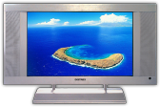

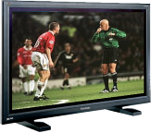






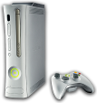



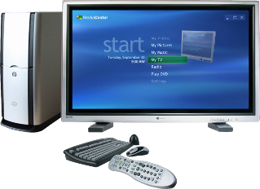


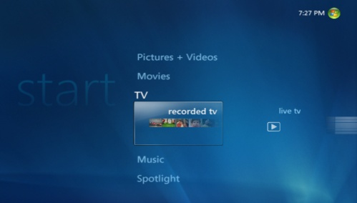

PC Uniquely Suited To Distribute Content Around The Home
content
devices
Photos
Videos
TV
Music
PlaysForSure devices
Smartphones
Portable Media Players
Media Center Extenders
Xbox 360

Slide 5
Media Sharing On Windows
Guiding principles
“It just works”
Simple, intuitive and easy to use
Seamless
Content Flow
Platform for media devices
Quality
Consumer Electronics-grade multimedia experiences
Device Reach
Extend content throughout the home media ecosystem

Slide 6
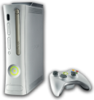



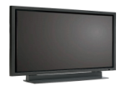




Media Sharing On Windows
Connecting network devices
PlaysForSure Network Devices
CON-T418 PlaysForSure Network Devices and Windows Vista
Media Center Extenders
CON-T411 Media Center Extender Technology: Overview
CON-T412 Media Center Extender Device Design

Slide 7
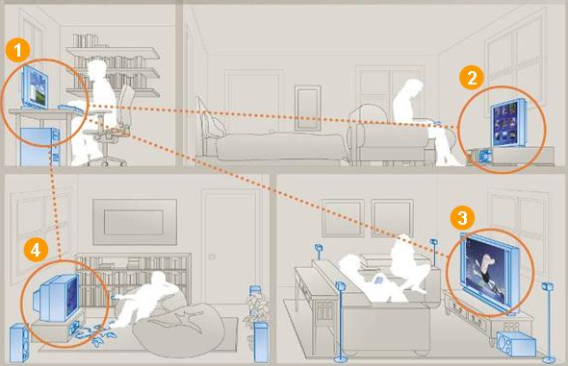
Media Sharing On Windows
Whole home entertainment
Windows Vista PC with Media Sharing enabled
PlaysForSure media player streams music and movies
Xbox 360 streams music, pictures and video
PlaysForSure Digital TV streams photos, videos and music

Slide 8

Windows Media Player 11
Media sharing feature
Available on Windows Vista/Windows XP
Integration of Windows Media Connect
Access to Windows Media Player (WMP) library
  Music, photos and videos
  Clear, Windows Media DRM, URGE, etc.,
  Album art, enhanced metadata, more…
Single media management point

Slide 9
WMP Sharing
Baseline technologies
WMA, MP3
PCM, WAV
WMV, AVI
MPEG-1/2
JPEG, PNG
YUV
Codecs
Windows Media DRM
for Network Devices
Windows Media Player
Metadata Store
Content Services
UPnP AV 1.0
UPnP 1.0
RTSP/RTCP
Control, Discovery
and Eventing
HTTP 1.0/1.1, RTP
A/V Transport
TCP
UDP
Network Protocols
IP

Slide 10
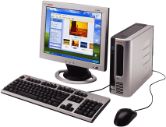


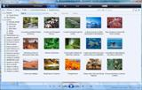

PlaysForSure
Network devices
Enables content flow from a Windows PC to a network device
  Windows Media DRM-protected content is downloaded and stored on PC
  Protected content is streamed from PC to network device

Slide 11

PlaysForSure
Network devices
Requirements ensure base-level of Windows media sharing interoperability
  Uses certified WMA/WMV decoders
  Supports Windows Media DRM for Network Devices (Cardea)
  Implements UPnP/DLNA technologies
  Required for Media Center Extender

Slide 12
PlaysForSure
Network devices
2.x Requirements Categories
  DLNA compliance
  Network connectivity and discovery
  Authorization and registration
  Content playback
Requirements verified by Test Kit
PlaysForSure links at end of presentation

Slide 13

PlaysForSure And Windows Vista
Certified for Windows Vista logo
PlaysForSure is the platform for Network Devices to get the Certified for Windows Vista logo
Network devices passing PlaysForSure 2.x can use the Certified for Windows Vista logo
Microsoft Marketing efforts are focused on the Certified for Windows Vista logo

Slide 14

WMP Sharing
Architecture
WMP Network Sharing Service
per user
WMP database
provider
Metadata
UPnP discovery
Browse/Search
WMP Sharing
(UPnP MediaServer:1)
ContentDirectory:1
X_MS_MediaReceiverRegistrar:1
Content request and delivery
Media Delivery Engine
(HTTP, RTSP/RTP)
c:\foo.wma

Slide 15
Supported Formats
Audio: WMA, MP3, WAV, PCM
Pictures: JPEG, PNG, RAW*
Video: WMV, MPEG1/2, AVI
Playlists: WPL, M3U
WMP Sharing format support is extensible
  Requires codec and metadata handler
  Additional information in whitepaper
  * Windows Vista Only

Slide 16
Metadata
Container hierarchy
Root (0)
Music (1)
Video (2)
Pictures (3)
Playlists (12)
All Music (4)
All Video (8)
All Video(B)
All Playlists (13)
Genre (5)
Genre (9)
Date Taken (C)
Folders (17)
Artist (6)
Actor (A)
Albums (D)
Album (7)
Series(E)
Keyword (D2)
Playlists (F)
Playlists (10)
Playlists (11)
Folders (14)
Folders (15)
Folders (16)
Contrib.Artists (100)
Rating (200)
Rating (300)
Album Artist (107)
1+ stars (301)
2+ stars (302)
(star ratings)
Composer (108)
3+ stars (303)
4+ stars (304)
Rating (101)
5+ stars (305)
Unrated(306)
(star ratings)

Slide 17
Metadata
Searching
WMP Sharing supports Search action
  Variety of searchable attributes
  Specific operators for some metadata
  Only “simple” searches allowed
  Search can be disabled by device

Slide 18
Metadata
Sorting
Containers and content items can be sorted based on metadata
  Not all metadata attributes sortable
  “Top level” containers not sortable

Slide 19
Metadata
Filtering
Filtering containers
  WMP Sharing supports upnp:searchClass
  searchClass tag provided for each UPnP object under a container
Filtering content
  GetProtocolInfo action
  Use res@protocolInfo
  Inspect file extension in URL

Slide 20
Metadata
String Lengths
Maximum string lengths used by WMP Sharing are either
  256 Unicode characters
  1024 Unicode characters
After conversion of Unicode to UTF-8, number of bytes may be higher
Set buffer sizes accordingly

Slide 21
Microsoft Metadata Extensions
General
Microsoft namespace-specific
media content properties
Difficult to express with existing
UPnP/DLNA attributes
Contained with <desc> element
Attributes searchable, sortable and filterable unless otherwise noted

Slide 22
Microsoft Metadata Extensions
Microsoft attributes
Artist
  Album artist
  Performer (a.k.a. contributing artist)
  Conductor
Author
  Composer
  Writer

Slide 23
Microsoft Metadata Extensions
Microsoft attributes
Ratings
  UserRating
  UserEffectiveRating
  UserRatingInStars
  UserEffectiveRatingInStars
Service Provider
Source URL
Year

Slide 24
Codec Identification
“res@microsoft:codec” attribute
  Represents codec used for the associated media file
  Expressed as a GUID
  Links to media type GUIDs and descriptions at end of presentation

Slide 25
Compatibility Flags
Used to define per-device behavior
Two types of compatibility flags values
  User – set by a user or an application
  Device – provided via device-description using “microsoft:X_DeviceCaps” attribute
User type has highest priority in defining device behavior
Stored in the registry
HKLM\Software\Microsoft\Windows Media Player NSS\
3.0\Devices\<DeviceMACAddress>\

Slide 26
Compatibility Flags
Flag behaviors
Exclude URLs for
  HTTP/RTSP
  Protected or non-transcoded WMA
  Lossless content
Exclude DLNA tags or PCM parameters
Return no search capabilities
Disable device notifications
“Fake” playlist count

Slide 27
Retrieving Thumbnail Images
Available for music, pictures and video
  Device must be validated by WMDRM service to get album art for music
Retrieval method #1: AlbumArt URI
  root item URL + “?albumart=true”
  Faster, but JPEG only
Retrieval method #2: Parameterized URL
  root item URL + “?formatID=z,width=x,height=y”
  Slower, but more flexible

Slide 28
WMP Sharing
Windows operating system support
Windows XP Service Pack 2
Windows Vista Home Basic
  Limited network QoS support
Windows Vista Home Premium/Ultimate
  Home Basic features, plus
  Advanced network QoS support
Windows Vista Business/Enterprise
  Group Policy may block sharing

Slide 29
WMP Sharing
Differentiating features on Windows Vista
Support for RTSP/RTP streaming
Unique device Model Number
  4 → WMP Sharing on Windows Vista
  3 → WMP Sharing on Windows XP
Media Sharing “bootstrapped” on
network type selection
Port exceptions “pre-plumbed” in
Windows Firewall

Slide 30
WMP Sharing And DLNA
DLNA 1.0 compliance is required for
PlaysForSure 2.x network devices
WMP Sharing device description includes <dlna:X_DLNADOC> element
WMP Sharing includes DLNA tags and resource elements for media exposed to other devices
DLNA Guidelines for DLNA Digital Media Server (DMS) device not fully supported

Slide 31
Call To Action
Keep making devices that are fun and useable!
Comply with PlaysForSure 2.x Requirements for Network Devices
  Get certified as a PlaysForSure device
Refer to the “Building a Device” whitepaper
  Use Compatibility Flags, Microsoft metadata extensions, and Search capabilities
  Link to whitepaper at end of presentation

Slide 32
Additional Resources
Web Resources
  “Building a Network Device Compatible with Windows Media Player 11”:
  http://go.microsoft.com/fwlink/?LinkId=87957
  UPnP MediaServer and MediaRenderer-related specifications: http://www.upnp.org/standardizeddcps/mediaserver.asp
  Windows Media Player 11 – Media Sharing feature: http://www.microsoft.com/windows/windowsmedia/devices/athome/
  default.aspx
  GUID values for Windows Media-supported media types: http://msdn2.microsoft.com/en-us/library/Aa390521.aspx
  Descriptions of Windows Media-supported media types: http://msdn2.microsoft.com/en-us/library/Aa390528.aspx
  PlaysForSure 2.x Resources and Test Kits: http://www.playsforsure.com/product/specifications/default.aspx
  Technical Overview of Windows Media DRM 10 for Devices
  http://go.microsoft.com/fwlink/?LinkId=28570

Slide 33
Additional Resources
Related Sessions
  CON-T411: Media Center Extender Technology: Overview
  CON-T412: Media Center Extender Device Design
  CON-T419: PlaysForSure Portable Devices and Windows Vista
  CON-H421: Certification Tests for Portable Devices: Workshop
Questions?
pfsinfo @ microsoft.com

Slide 34

© 2007 Microsoft Corporation. All rights reserved. Microsoft, Windows, Windows Vista and other product names are or may be registered trademarks and/or trademarks in the U.S. and/or other countries.
The information herein is for informational purposes only and represents the current view of Microsoft Corporation as of the date of this presentation. Because Microsoft must respond to changing market conditions, it should not be interpreted to be a commitment on the part of Microsoft, and Microsoft cannot guarantee the accuracy of any information provided after the date of this presentation.
MICROSOFT MAKES NO WARRANTIES, EXPRESS, IMPLIED OR STATUTORY, AS TO THE INFORMATION IN THIS PRESENTATION.

