Slide 1
PlaysForSure Portable Devices And Windows Vista
Jerry D. Smith
Senior Program Manager
Microsoft Corporation

Slide 2
Key Takeaways
Be a leader in advancing 64-bit computing
Adopt best practices and new tools
Let’s partner on new hardware directions
Adopt Windows Portable Devices (WPD) technologies for advancing new scenarios and new products
Utilize PlaysForSure test tools and take credit with PlaysForSure or Windows Vista logos

Slide 3
Agenda
Product Background
Core Architecture
Conceptual Model
Kits and Logos
Call to Action

Slide 4
Product Background

Slide 5
What Is WPD?
WPD = Windows Portable Devices
An end-to-end infrastructure focused on portable multi-function devices with fixed and removable storage
A pluggable abstraction for portable devices providing a consistent application programming model
Initially focused on
Mobile Phones
Portable Media Players
Digital Still Cameras

Slide 6
What Is WPD? Enabled scenarios
Scenarios
Sync Media with Windows Media Player
Photo Acquisition
Shell: Browse contents and drag n’ drop files
XBOX 360: Play device music in my game
Automotive Head Unit: Play device music through my car speakers

Slide 7











Portable Device Connectivity In Windows XP
Still Cameras
Digital Memories
WIA w/ PTP, MSC
Media Players
Media Applications
WMDM w/ MTP, MSC,
3rd party SPs
Cell Phones/PIM
PIM Data
Vendor Proprietary
SW Stack
Multi-function
File Sync
?
?

Slide 8
Portable Device Connectivity In Windows Vista
Still Cameras
Digital Memories
Windows Portable
Devices
Architecture
Media Players
Media Applications
Cell Phones/PIM
PIM Data
Multi-function
File Sync

Slide 9
Core Architecture

Slide 10
Basic Architecture
WPD is an end-to-end solution. It’s more than just drivers!
Components
Platform
User mode Class Drivers
User Experience
Toolkits
Specifications
Windows Logo Certification
Compatibility

Slide 11
Extensibility
Vendor extensibility is a 1st class citizen
WPD commands are GUID/DWORD pairs
New Data Types, Commands, Events
New UI Experiences, Icons, Logos
Protocol Extensions
Device Icon
DRM Extension, App Specific Extension (Windows Media Player)

Slide 12
Platform
WPD API
An in-proc COM server that uses standard Win32 File I/O APIs to communicate with drivers
WPD Libraries
Application and Driver Libraries are provided to handle WPD IOCTLs
WPD Serializer
Used to pack/unpack data into buffers for inter-process communication
Class-Installer / Co-Installer
Installs WPD device drivers via normal Windows PnP mechanisms
Device capabilities are queried at install time

Slide 13
Basic Architecture Diagram
WPD Application
Provided by:
Process 1
WPD API
Microsoft
WPD Serializer
ISV
IHV
WDF Host
WDF Host
3rd Party Driver
MS Driver (MTP, etc…)
WPD Serializer
WPD Serializer
Process 2
OEM
I/O Stack (e.g. USB)
Kernel

Slide 14
WPD User Mode Class Drivers
WPD Removable Media Driver
Extracts file metadata
Special handling for camera directory layout (DCF) and RAW photo images
WPD RAPI
Class Protocol for Microsoft Smartphone and PocketPC
Media Transfer Protocol (MTP)
Class Driver for Mobile Phones, Media Players, Cameras
USB and TCP/IP
Developed by Microsoft, but is now being standardized by USB-IF

Slide 15
USB-IF MTP Working Group
Allion Computer Inc.
American Megatrends
AVM GmbH
Axalto
Belcarra Technologies Corp.
Broadcom Corp.
Cornice
Cypress Semiconductor
Ericsson AS
Genesys Logic, Inc.
Infineon Technologies AG
Iomega Corp.
Kawasaki Microelectronics
Lexar Media
Matsushita Electric Industrial Co., Ltd.
Maxim Integrated Products
MCCI
Mentor Graphics Corp.
Microsoft Corporation
M-Systems Flash Disk Pioneers Ltd.
NEC Corporation
Nokia
NTT DoCoMo, Inc.
Nucore Technology
NXP
Oxford Semiconductor
PARROT
SanDisk
SigmaTel, Inc.
Silicon Motion, Inc.
Standard Microsystems Corp. (SMSC)
Symbian
Synopsys
Victor Company of Japan, Limited

Slide 16
Media Transfer Protocol (MTP) Implementations
Wired and wireless (cable replacement) protocol for Object Exchange
Client (Responder) Implemented in
Cameras
Media Players
Cell Phones
Host (Initiator) Implemented in
Windows Media Player 10/11
Windows Vista
XBOX360
Automotive Head Units

Slide 17
WPD Custom Drivers
WPD provides a robust driver model
Class drivers are recommended for media, image, and cell phone devices
Custom WPD drivers are a supported option
Custom drivers/applications can support very simple to complex devices
Personal devices (e.g. GPS, pedometers, heart rate monitors)
Simple sensors
See WinHEC white paper “Creating a WPD Driver for a Microcontroller-Based Sensor”

Slide 18
WPD And DRM
WPD directly supports DRM transfers to portable devices
No special DRM operations required
Meets the needs of many device applications
WMDRM (Windows Media DRM) operations are required for subscription functions
Metering, license sync and DRM updates on device
Query specific DRM status on device
See white paper and sample
“Accessing WMDRM APIs from a WPD Application”

Slide 19
User Experience
Shell Extension
Exposes WPD devices in Explorer
Enables file drag and drop to and from devices
Single device icon groups all device storages
Property Pages
Standard Device Property Pages
ISV / IHV Extensible
Specialized Experiences
Exposed only when device supports experience
Playlist Creation for Media Player Devices
Album and Playlist manipulation

Slide 20
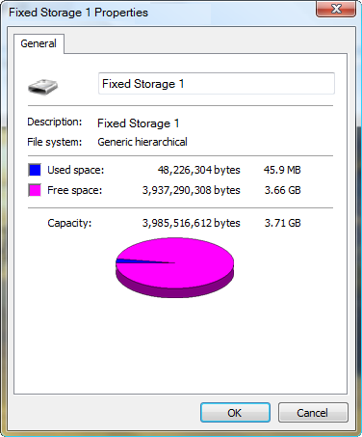
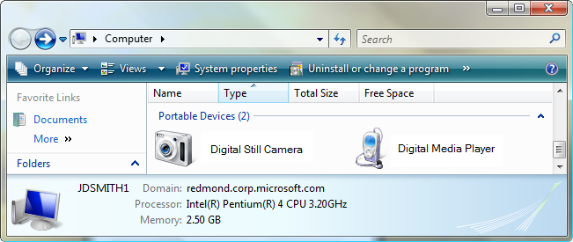
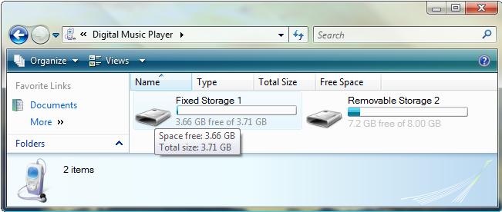
Example User experience
WPD devices are accessible through the Windows Explorer

Slide 21
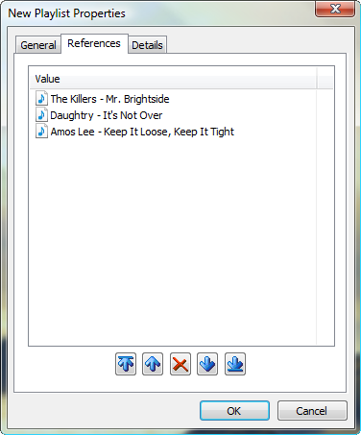
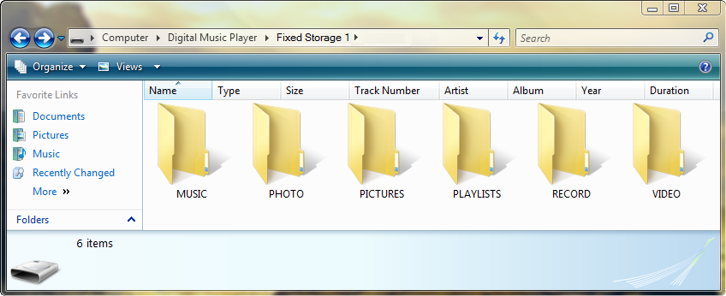
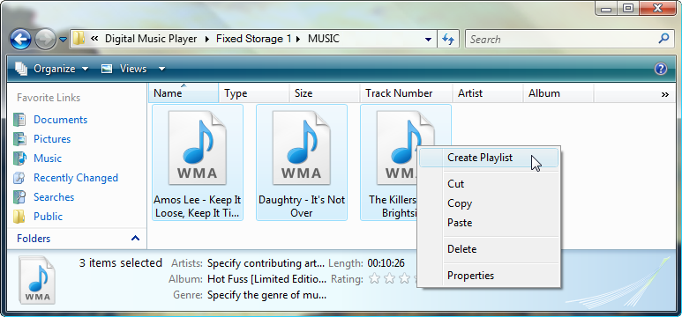
Example User experience
Explorer property pages allow specialized device features (e.g. playlist creation)

Slide 22
Legacy API Compatibility
WPD devices are supported through legacy API Compatibility layers
Windows Image Acquisition (WIA) API for Imaging applications (e.g. Adobe Photoshop)
Windows Media Device Manager (WMDM) API for Media applications (e.g. Windows Media Player)
WPD API does not support legacy WIA drivers or WMDM Service Providers

Slide 23
WPD API Compatibility
WIA
WMDM
Process 1
WIA Application
(e.g. Adobe Photoshop)
WMDM Application
(e.g. WMP / Napster)
WIA Service
WMDM Service Provider
– WPD Compat
WMDM Service Provider – WPD Compat
WIA Driver – WPD Compat
Process 1
Process 2
WPD API
WPD API
WPD Serializer
WPD Serializer
WDF Host
WDF Host
3rd Party Driver
MS Driver (MTP, etc…)
WPD Serializer
WPD Serializer
Process 3
Process 2
Kernel
I/O Stack (e.g. USB)

Slide 24
Conceptual Model

Slide 25
Device Interactions
WPD interacts with the device in four ways
Program/Control the device
Query and Object Exchange
Monitoring and status
Asynchronous Device Events and Changes

Slide 26

Conceptual Model - Diagram
Device
Storage
Functional Objects
Folder
Data Objects
Image File
Image File
Rendering Info
SMS

Slide 27
Objects
Data Objects
Represent content on the device (e.g. Files, Folders)
Functional Objects
Logical representation of capabilities (e.g. Storage, SMS)
Resources
Logical representation of the object’s Binary Data
Objects can have more than one resource
Properties
Metadata describing the object
A property has a current value and can reference other objects

Slide 28
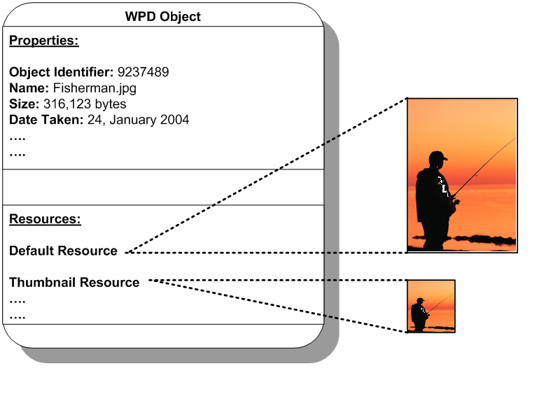
Object Diagram
WPD Object
WPD Object
Properties:
Object Identifier: 9237489
Name: Fishman.jpg
Size: 316,123 bytes
Date Taken: 24, January 2004
….
….
Resources:
Default Resource
Thumbnail Resource
….
….

Slide 29
Tools And Logos

Slide 30
Development Kits
Kits
MTP Porting Kit
ANSI C Reference design for MTP devices
Tools for device and driver development and compliance testing
Documentation and FAQs
Specialized documentation on meeting certification requirements
Shipped outside of DDK
See white paper on “Building Portable Devices using the MTP Porting Kit”
Windows Platform SDK
WPD Documentation, samples, headers and libs
Windows Format SDK
Redistributable includes WPD support for Windows XP

Slide 31
PlaysForSure/Windows Vista Logo
New PlaysForSure 2.2 test suite has the same requirements as 2.01
2.2 enables product testing on 3 different computing platforms
Windows XP with Windows Media Player 10
Windows XP with Windows Media Player 11
Windows Vista with Windows Vista Media Player

Slide 32
PlaysForSure/Vista Logo
PlaysForSure V2.2 test suite is used to certify media devices for either the PlaysForSure or Certified for Windows Vista logos
For PlaysForSure, submit test logs from all three platforms
For Certified for Windows Vista, submit logs from the Windows Vista platform only
Partner Support Help Desk exists to support development & certification efforts
Sign up by sending an e-mail to
Pfsinfo @ microsoft.com

Slide 33
Call To Action
Use WPD for connecting portable devices to Windows applications
Use class drivers for an “it just works” user experience with established devices
Insure your MTP device works well with Windows by running the PlaysForSure V2.2 test suite
Take credit with either the PlaysForSure or Windows Vista logos
Use custom drivers where useful to enable new device scenarios

Slide 34
Additional Resources
Web Resources
Media Transfer Protocol Porting Kit: Media Transfer Protocol Porting Kit
http://go.microsoft.com/fwlink/?LinkId=87962
PlaysForSure test tools and specifications
http://www.playsforsure.com/product\specifications
Related Sessions
Instructor Lab: CON-H420 Building Portable Devices with MTP Porting Kits
Instructor Lab: CON-H421 Certification Tests for Portable Devices

Slide 35
Additional Resources
White Papers
Creating a WPD Driver for a Microcontroller-Based Sensor
http://go.microsoft.com/fwlink/?LinkId=87959
Accessing WMDRM APIs from a WPD Application
http://go.microsoft.com/fwlink/?LinkId=87960
Building Portable Devices with the MTP Porting Kit
http://go.microsoft.com/fwlink/?LinkId=87961
Partner Support Help Desk
Submit questions to http://connect.microsoft.com/pfs

Slide 36

© 2007 Microsoft Corporation. All rights reserved. Microsoft, Windows, Windows Vista and other product names are or may be registered trademarks and/or trademarks in the U.S. and/or other countries.
The information herein is for informational purposes only and represents the current view of Microsoft Corporation as of the date of this presentation. Because Microsoft must respond to changing market conditions, it should not be interpreted to be a commitment on the part of Microsoft, and Microsoft cannot guarantee the accuracy of any information provided after the date of this presentation. MICROSOFT MAKES NO WARRANTIES, EXPRESS, IMPLIED OR STATUTORY, AS TO THE INFORMATION IN THIS PRESENTATION.

