Slide 1
Network Infrastructure Device (NID) Windows Vista Logo Requirements and Windows Rally
Glenn Ward
Rally Team

Slide 2
Key Takeaways
Provide Brief Rally Overview
Communicate the capabilities of NID devices which bear the Windows Vista logo
Clearly explain the requirements and tests applied to Network Infrastructure Device (NID) candidates for the Windows Vista logo

Slide 3
Agenda
Industry Trends
Windows Rally Summary
Component Technologies
Intel ViiV technology and Windows Rally
Demonstration
Logo Requirements Deep Dive

Slide 4
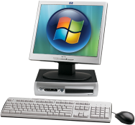





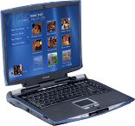









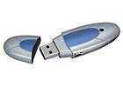










Device Evolutionary Trends
Rich, Connected, Mobile
Wireless Scenarios
Connectivity for Mobile User
Multi-transport and Multi-function Devices
Digital Content Proliferation

Slide 5

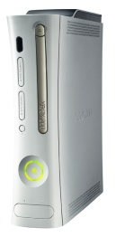








Convergence Model
Unification of IP and directly connected devices
IP Network
Directly Connected
Notes:
5

Slide 6








Result: need ‘New Bar’ For IP Connected Devices
Effortless
Device setup is unintuitive today
Multiple points of failure on networks are hard to diagnose
Secure
Configuring devices for secure networks is difficult
Security for devices is paramount
Reliable, Quality
Connectivity across wired and wireless transports
QoS for bandwidth constrained networks
Seamless access to data where ever you are

Slide 7





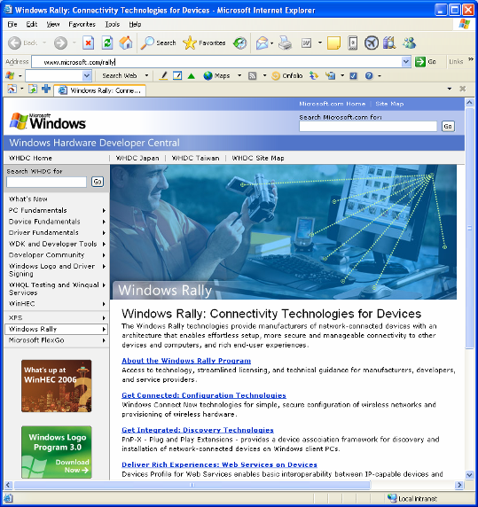




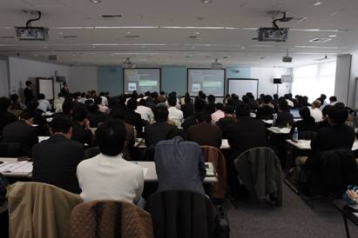
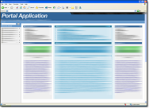





Program Engagement
Access to Technologies
Summits & PlugFests
Technical Guidance
http://www.microsoft.com/RALLY
Notes:
5/29/2007 1:13 PM
© 2006 Microsoft Corporation. All rights reserved. Microsoft, Windows, Windows Vista and other product names are or may be registered trademarks and/or trademarks in the U.S. and/or other countries.
The information herein is for informational purposes only and represents the current view of Microsoft Corporation as of the date of this presentation. Because Microsoft must respond to changing market conditions, it should not be interpreted to be a commitment on the part of Microsoft, and Microsoft cannot guarantee the accuracy of any information provided after the date of this presentation. MICROSOFT MAKES NO WARRANTIES, EXPRESS, IMPLIED OR STATUTORY, AS TO THE INFORMATION IN THIS PRESENTATION.
7

Slide 8
Windows Rally Value Summary
Abstracting the network away from consumers
Take the pain out of setup!
Intuitive discovery and control
Rich functionality (via seamless driver installs)
Quality audio/video streaming, inherent QoS
Graphical tools for device and network management

Slide 9
Experiences
Applications
Management Interfaces
Device Specific Drivers
Quality of Service
Network Map
Wireless Setup
Discovery
Legacy Devices
New or Rich devices
IP Network
(IPv4, IPv6)
Ethernet/Wireless
Windows Rally Experiences

Slide 10
Technologies
Applications
Management Interfaces
Plug and Play Extensions
LLTD: QoS
LLTD: Presence, Topology
Windows Connect Now / WPS
Function Discovery
UPnP
Device Profile for Web Services
IP Network
(IPv4, IPv6)
Ethernet/Wireless
Windows Rally Technologies

Slide 11






Drive Quality Via Vista Logo (NIDs)
Enables Premium Experiences
Wireless Video Streaming: MCE to Extender (360, MCEv2/’Pika’)
5Ghz support ensures minimal traffic contention
“Certified For” (Premium)
Indicates compatibility, reliability, product quality
Ensures Interop with Windows Vista, Xbox Live!
Provides baseline setup, security, diagnostics, performance
“Works With” (Basic)

Slide 12




Requirements at-a-glance
Experience | Enabling Technology | Requirements Alignment
Fast, Secure Wireless and Device Setup | WCN-Config 2.0
Seamless Internet Connectivity and Sessions | Xbox Live Compatible
Whole-Home Streaming Media over Wireless | Wi-Fi Perf Coverage, Throughput, Stress 5Ghz Radio; WMM
Fast Network Diagnostics, Problem Remediation | Link Layer Topology Discovery (LLTD)
Quality Streaming Experiences | qWave, packet handling policies
Future Network Foundation | IPv6 Transition Technologies
Windows Vista, Windows XP, Xbox
IETF

Slide 13
NID Scenario Enablement

Slide 14
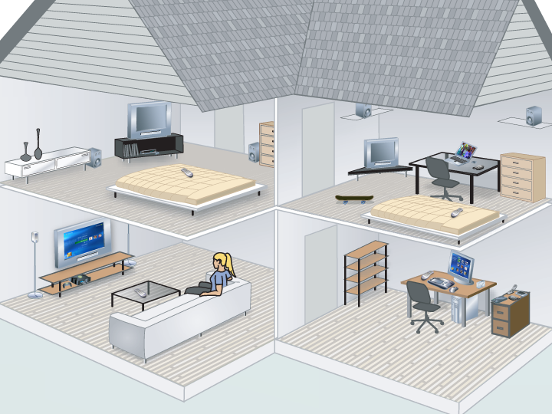
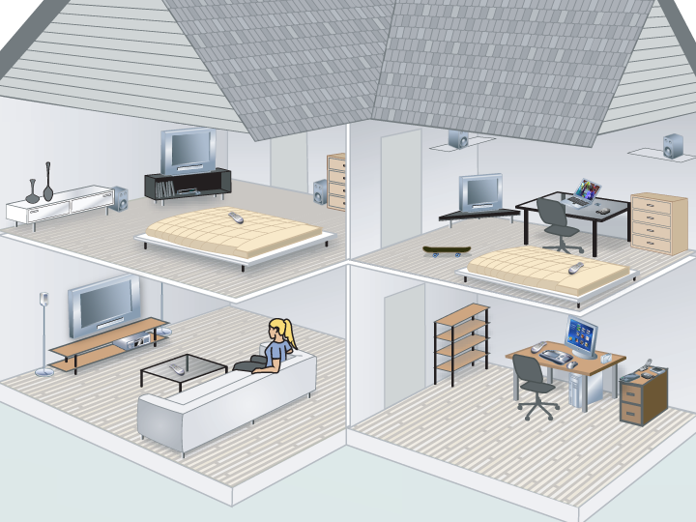
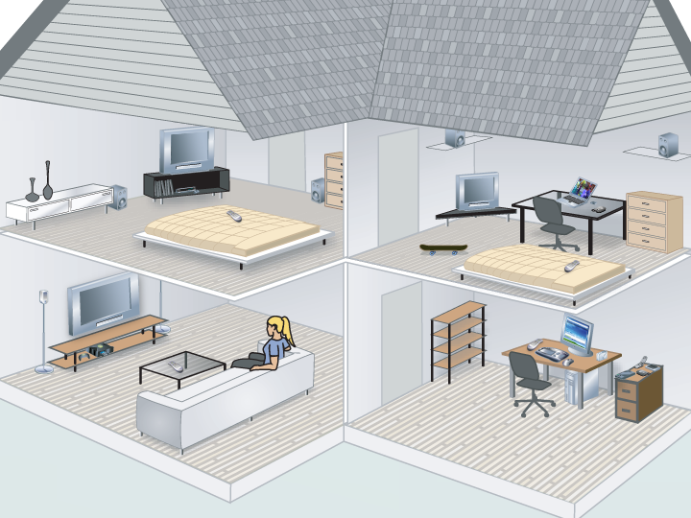

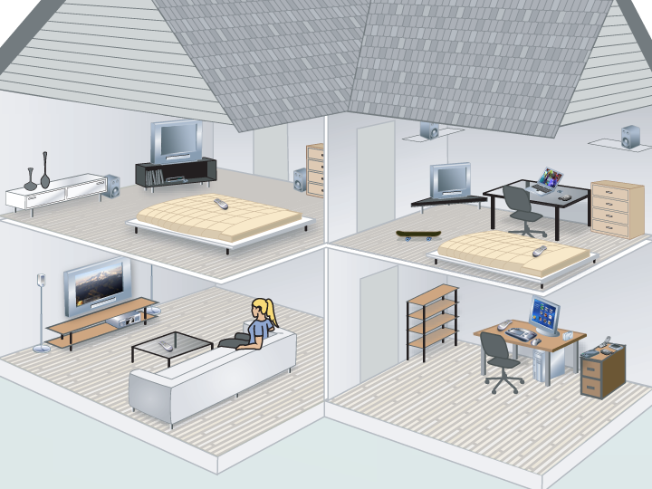

Scenarios

Slide 15
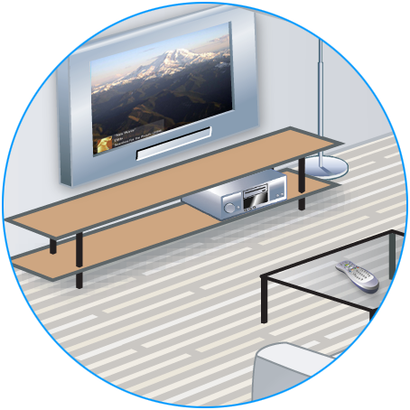
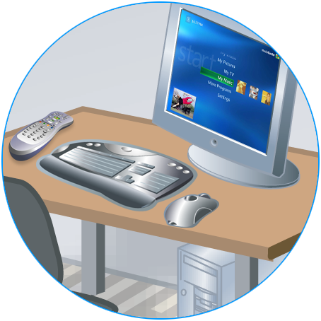
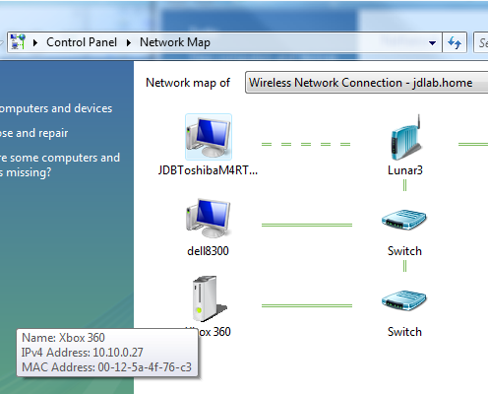

1) Quality Online Connectivity: Xbox Live!, Router Basics
2) Easy Home Network Setup, Diagnostics (LLTD, WCN)
2) Easy Home Network Setup, Diagnostics (LLTD, WCN)
Scenarios

Slide 16


1) Quality Online Connectivity: Xbox Live!, Router Basics
2) Easy Home Network Setup, Diagnostics (LLTD, WCN)
3) Stream Prioritization, Inherent QoS (LLTD, WMM)
Scenarios

Slide 17
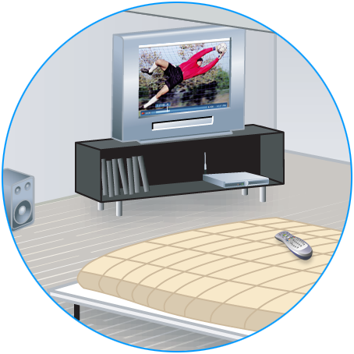
1) Quality Online Connectivity: Xbox Live!, Router Basics
2) Easy Home Network Setup, Diagnostics (LLTD, WCN)
3) Stream Prioritization, Inherent QoS (LLTD, WMM)
4) Wi-Fi Perf for Video Streaming (5 Ghz -> 802.11n)
Scenarios

Slide 18
Intel® Viiv™ Technology and Windows™ Rally®
Ken Knowlson Principal Engineer and Chief Architect
Intel™ Viiv® Processor Technology Software
Intel Digital Home Group
Notes:
18
5/29/2007 1:13 PM
© 2006 Microsoft Corporation. All rights reserved. Microsoft, Windows, Windows Vista and other product names are or may be registered trademarks and/or trademarks in the U.S. and/or other countries.
The information herein is for informational purposes only and represents the current view of Microsoft Corporation as of the date of this presentation. Because Microsoft must respond to changing market conditions, it should not be interpreted to be a commitment on the part of Microsoft, and Microsoft cannot guarantee the accuracy of any information provided after the date of this presentation. MICROSOFT MAKES NO WARRANTIES, EXPRESS, IMPLIED OR STATUTORY, AS TO THE INFORMATION IN THIS PRESENTATION.
18

Slide 19


Maximize Your Digital Media Experience
Performance for today and tomorrow
Enjoy digital media with optimized audio & video capabilities
Connect with confidence: Intel® Viiv™ verified devices and services

Slide 20
Intel® Viiv™ Processor Technology in 2007: Best Mainstream AV PC
Performance:
40% more performance for multitasking
Up to 50% faster video editing¹
2006 Viiv™ Ramp
Up to 1080p high definition video support
Up to 7.1 surround sound audio
Improved quality with Intel Clear Video tech
1500Ku
Optimized Audio and Visual:
1250Ku
1000Ku
750Ku
Enjoy photos and home movies on your TV
Simply synch media between an DT & NB
Access premium movies, music, and news
500Ku
250Ku
Connectivity:
Q1
Q2
Q3
Q4
Capabilities to take advantage of Web 2.0!
Not legally approved

Slide 21

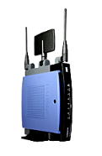
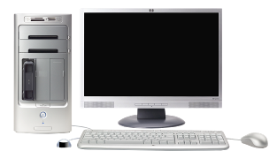


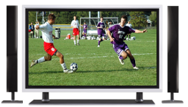




Growing Ecosystem
38 Routers
23 Standalone DMAs verified

Slide 22

Intel® Viiv™ Technology and Microsoft® Rally™
Microsoft Rally raises the quality bar for networking in the Digital Home
Intel Viiv Technology provided enhanced streaming usages for the home network
Microsoft and Intel are committed to improving the Digital Home networking experience
Microsoft Rally and Intel Viiv Technology provide complementary solutions for improving Digital Home networking usages

Slide 23
Intel® Viiv™ Technology and Microsoft® Rally™ - Complimentary
LLTD
Supports qWAVE, Intel Viiv Technology devices are recommended to support LLTD in 2nd Half ’07 and will be required to support in ‘08
Device Discovery
Intel Viiv Technology software will use PnP-X at the PC, devices will add support for discoverability in ‘07
Network Infrastructure device requirements
Great alignment on NID requirements

Slide 24
Intel® Viiv™ Technology and Microsoft® Rally™ - Complimentary (cont’d)
Quality of Service – qWAVE
Intel Viiv Technology uses legacy Microsoft QoS APIs today, targeting qWAVE migration in ’07
Simple Config – WiFi Protected Setup
Originally a joint Intel / Microsoft proposal to the WFA
Much of the ecosystem enabling done with Intel tools
Intel Viiv Technology recommends WiFi Protected Setup in devices by 2nd Half ’07 and requires in first half of ‘08

Slide 25
Intel® Viiv™ Technology + Microsoft® Rally™ = Great Consumer Experience
Intel Viiv technology utilizes key Rally technologies, and adds additional capabilities that further enhance networked media
Intel® Smart Streaming technology adds support for a number of different, complimentary feedback mechanisms for streaming feedback
Intel® Media Optimized Wireless technology improves video stream usages and scenarios via direct link setup and best channel selection
Intel® Media Server supports transcoding and transrating to help deliver media over available network bandwidth

Slide 26
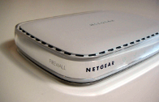

Summary Requirements
 | Standard Tier | Premium Tier
Wired Router / RG | Connectivity UPnP IGD on by default, with byte counters QoS Packets tagged with 802.1Q can’t be dropped Diagnostics Layer 2 discovery and topology via LLTD NAT Type Cone or Restricted (not symmetric) NAT Router basics MTU size, DHCP lease, etc. (Xbox compatible) IPv6 Teredo support via NAT type | Standard requirements, plus IPv6 Transition technologies, Native IPv6 on WAN
Wireless Router / RG | Above wired requirements plus Connectivity Wi-Fi Simple Config (WSC) / WCN-Config v2 support QoS WMM certified | All other requirements plus Video-Capable = WiFi Perf Sustain max throughput at range; max throughput for 8 hours; throughput at range for 1 hour; dual-band / MIMO QoS Time-probe diagnostics (LLTD QoS extensions)

Slide 27

demo

Slide 28
Additional Resources
Testing: NIDTEST@microsoft.com
Next Rally Summit/PlugFest: July 30th – Aug 1st, Redmond
Add to alias: Rally@microsoft.com; subject=mail distro add request
Web Resources
All Rally content: www.microsoft.com/rally
DPWS http://specs.xmlsoap.org/ws/2006/02/devprof
Web Services on devices: http://www.microsoft.com/whdc/rally/rallywsd.mspx
Related Sessions
CON-T415 Windows Rally Overview and Implementations
CON-T475 Web Services on Devices: Rally Implementation
CON-T417 Web Services on Devices: Rally Overview
CON-H488 Web Services on Devices: Rally Workshop
Chalk Talk: CON-C487 Windows Rally – Best Practices

Slide 29

© 2007 Microsoft Corporation. All rights reserved. Microsoft, Windows, Windows Vista and other product names are or may be registered trademarks and/or trademarks in the U.S. and/or other countries.
The information herein is for informational purposes only and represents the current view of Microsoft Corporation as of the date of this presentation. Because Microsoft must respond to changing market conditions, it should not be interpreted to be a commitment on the part of Microsoft, and Microsoft cannot guarantee the accuracy of any information provided after the date of this presentation. MICROSOFT MAKES NO WARRANTIES, EXPRESS, IMPLIED OR STATUTORY, AS TO THE INFORMATION IN THIS PRESENTATION.

Slide 30
Appendix

Slide 31
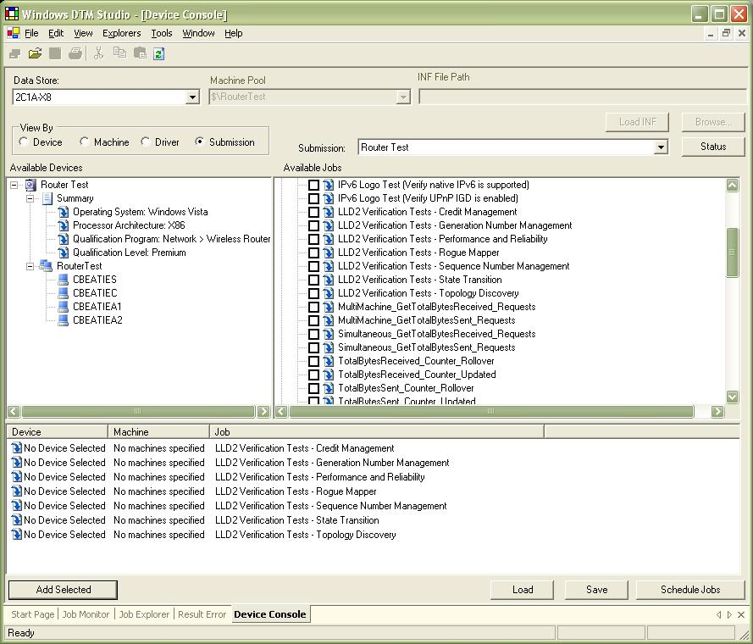
Device Testing WTT / DTM

Slide 33
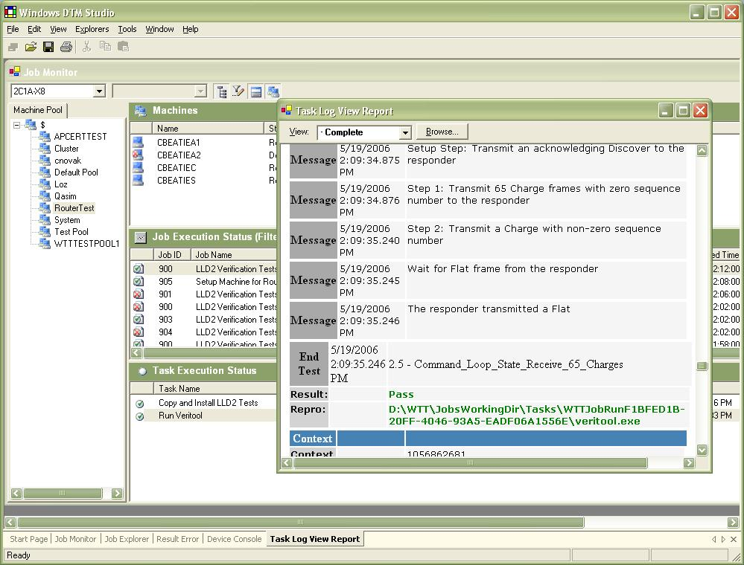
Device Testing WTT / DTM

Slide 35
Requirements Detail
Simple Wireless Setup
Basic Routing Behavior
Video-Capable Requirements
Bootstrapping, Discovery, and Diagnostics
Quality Streaming Experiences
IPv6 Transition Technology Support

Slide 36
Simple Wireless Setup Fast, Secure wireless and device setup
Today’s Wi-Fi experience problems
Inconsistent and incompatible setup experiences
Custom web interfaces exist for different devices
Custom device management applications
Security is not enabled by default
Most home networks do not have security enabled
Wireless settings can not be transferred in a easy and secured fashion
Too much manual configuration
Setup difficulty → poor user experience and product returns

Slide 37
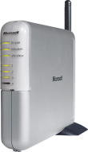


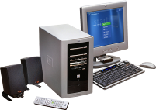
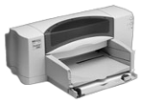

Simple Wireless Setup
Windows XP and Windows Vista
USB Flash Drive
Windows Vista
Ethernet
Ethernet
USB

Slide 38
Basic Routing Behavior Seamless internet connectivity and sessions: Wired router requirements
Strategy: Build on Xbox Live requirements, certified products
NAT type Cone NAT required
UDP Test Can packets from multiple IP addresses traverse through device’s NAT implementation
ICMP Proper response to ICMP port-unreachable packets
MTU Support MTU size? (max 1365)
Ports Ability to download packets on ports 80 and 3074
DHCP Is the same IP received; Lease duration
Session policy Does port association stay open when only “keep alive” traffic is present
TCP FIN response Is the socket association kept even after internal client sends a TCP FIN

Slide 39
Video-Capable Requirements
1) Overall
Wi-Fi Dual-band simultaneous operation 802.11a AND 802.11g (and 802.11n when ratified)
Wi-Fi WPA-Personal, WPA-2-Personal (Note WPA2-Personal is mandatory as of March 2006)
Wi-Fi WMM
DLNA (Digital Living Network Alliance) certification
2) TV UI
If the router or AP has an HTML web-based user interface, it must be usable on a standard-definition TV output – 640x480i. Font size must be 16px or greater

Slide 40
Video-Capable Requirements
3) Range – HD Video for 1 hour at 30 feet and two obstacles
Each radio must be able to transmit a simulated high-definition video stream (20 – 22 Mbps) on UDP and TCP at range for one hour with less than 1% packet loss per second at a range up to 30 indoor feet with two walls or obstacles
4) Long-term Usage – HD Video for 8 hours
Each radio must be able to transmit a simulated high-definition video stream (20 – 22 Mbps) on UDP and TCP at 22 Mbps for eight hours with less than 1% packet loss per second at a range of five feet with no obstacles

Slide 41
Video-Capable Requirements
5) Reliability – HD Video and Two Internet Surfers 1 hour
Each radio must be able to transmit a simulated high-definition video stream (22 – 20 Mbps) on UDP and TCP for one hour with less than 2% packet loss per second while two additional wireless stations are connected to the wireless router simulating typical internet usage
6) Heavy Load – Maximum throughput all interfaces
Each radio and each wired interface must be able to simultaneously transmit at maximum capacity on UDP for one hour with less than 1% packet loss per 10 seconds at a range of 5 feet with no obstacles. The streams will be run simultaneously to simulate a heavy load

Slide 42
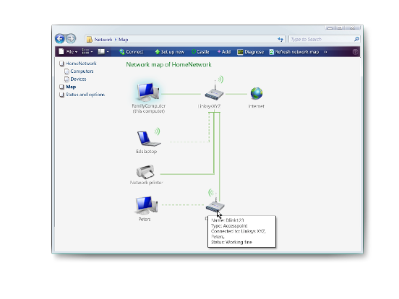
Bootstrapping, Discovery, And Diagnostics Link Layer Topology Discovery (LLTD)
Topology Discovery: Key Windows Vista diagnostic technology
Locates connectivity failures
Provides baseline network image
No dependence on IP connectivity
NID devices provide following data
Discover collocated devices (AP, Bridge, Modem)
Brand, model, firmware of RG
Representative device graphic
Ensures fewer support calls
Users can self-remediate
Ensures ‘wrong device’ isn’t blamed for problem!

Slide 43
Additional Resources
Web Resources
All Rally content: www.microsoft.com/rally
DPWS http://specs.xmlsoap.org/ws/2006/02/devprof
Web Services on devices: http://www.microsoft.com/whdc/rally/rallywsd.mspx
Related Sessions
CON-T415 Windows Rally Overview and Implementations
CON-T475 Web Services on Devices: Rally Implementation
CON-T417 Web Services on Devices: Rally Overview
CON-H488 Web Services on Devices: Rally Workshop
Chalk Talk: CON-C487 Windows Rally – Best Practices

Slide 44
© 2007 Microsoft Corporation. All rights reserved. Microsoft, Windows, Windows Vista and other product names are or may be registered trademarks and/or trademarks in the U.S. and/or other countries.
The information herein is for informational purposes only and represents the current view of Microsoft Corporation as of the date of this presentation. Because Microsoft must respond to changing market conditions, it should not be interpreted to be a commitment on the part of Microsoft, and Microsoft cannot guarantee the accuracy of any information provided after the date of this presentation. MICROSOFT MAKES NO WARRANTIES, EXPRESS, IMPLIED OR STATUTORY, AS TO THE INFORMATION IN THIS PRESENTATION.

