Slide 1
Enriching Devices With Windows SideShow
Dan Polivy
Program Manager
Microsoft Corporation

Slide 2
Key Takeaways
Understand where SideShow is and where it is going
Integrate new enabling technologies into your products
Learn how to enrich your devices without additional (hardware) cost

Slide 3
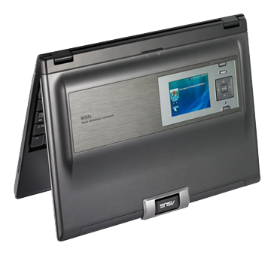
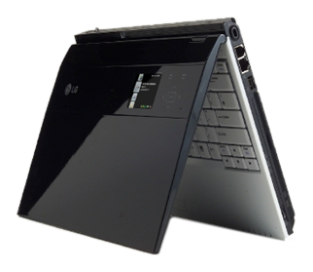
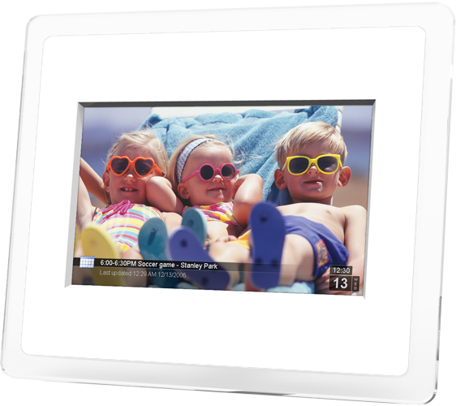
Congratulations To Our Partners!

Slide 4
What Is Windows SideShow?
Enables instant access to important information on a variety of display devices connected to a computer
Enables new two-way remote control scenarios
Provides end-user control of gadgets via
Control Panel
Completely extensible architecture
  Anyone can write gadgets using the API
  Anyone can build devices using the
  Device Driver Interface
Frees developers from writing device-specific code

Slide 5
State Of The Platform
Devices
.NET Micro Framework
  “Landscape” firmware released
  “Portrait” firmware in development
Connectivity
  USB
  Bluetooth (RFCOMM)
Silicon partners
  Freescale Semiconductor
  NVIDIA
  Winbond

Slide 6
State Of The Platform
Devices
“Build your own”
  i-mate: WiFi and Bluetooth, Windows CE, Windows Mobile
  ASUS ScreenDUO, AiGuru S2
  Logitech G-15, Z-10
  Many explorations
Silicon partners
  Renesas

Slide 7
State Of The Platform
PC
Windows Vista has RTM’ed!
Solid platform with lots of growth potential
Knowledge Base articles written for some minor issues
  QFE for issue with USB Selective Suspend
MSDN Magazine and CoDE Magazine articles
Windows SideShow .NET Framework Components
  C#/.NET API for writing gadgets

Slide 8
State Of The Platform
Gadgets
Much slower adoption amongst developers due to lack of hardware
  Even development boards in very high demand!
  Windows Mobile: hardware problem solved?
Engage potential candidates directly
  Developers want to bundle gadgets with devices
Inflection point is now

Slide 9
State Of The Platform
Gadgets
Microsoft
  Media Player, Windows Mail, Outlook 2003, and 2007, PowerPoint, Media Center, Feed Viewer, Stocks (Sidebar)
WeatherBug (Sidebar)
Travelocity
Franklin Covey Task Planner
CompanionLink

Slide 10
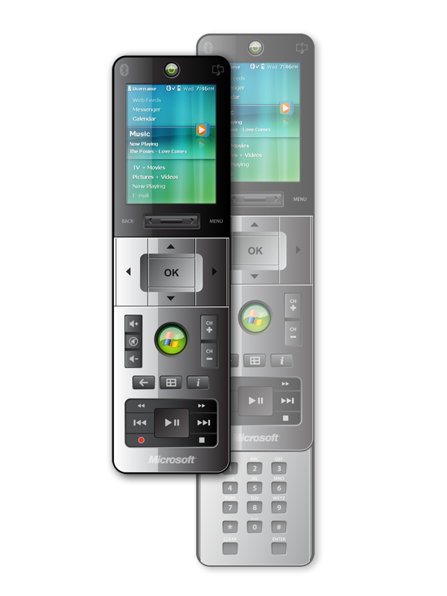
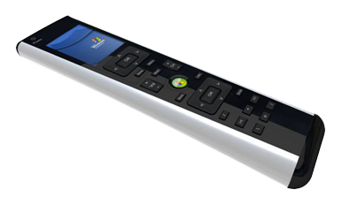
Remote Controls
First devices now expected in Q3/Q4
Target Q3 for software release
Evaluating alternate RF technologies
  Profiling suggests 250kbps sufficient
Profiling data courtesy Cypress Semiconductor

Slide 11
Logos And Trademarks
“Certified For Windows Vista”
  Logo requirements for Windows SideShow part of Windows Logo Program
Windows SideShow is trademarked
  DO: follow use guidelines doc for all references
    (hint: it’s not “Windows Vista SideShow”)
  DON’T: put the SideShow logo/icon on your devices (including UI)
  DO: use Certified For Windows Vista logo to indicate compatibility with Windows Vista

Slide 12

en·rich [ in rích, en rích ]
to supply with riches, wealth, abundant or valuable possessions, etc. :Commerce enriches a nation
to supply with abundance of anything desirable: to enrich the mind with knowledge
to add greater value or significance to: Art enriches life
to adorn or decorate: a picture frame enriched with gold
to make finer in quality, as by supplying desirable elements or ingredients: to enrich soil
"enrich." Dictionary.com Unabridged (v 1.1). Random House, Inc. 20 Apr. 2007.
<Dictionary.com http://dictionary.reference.com/browse/enrich>

Slide 13
Pillars Of Innovation
Platform
Display
Input
Connectivity

Slide 14
Platform
Windows CE
SideShow implementation available in 2H 2007
Support for Bluetooth, USB, IP transports
Extensible platform components
  Build your own UI
  Custom endpoints
  Additional transports
Built in native code
Support for Windows CE 5.0 and 6.0

Slide 15
Platform
Windows Mobile
Bluetooth connection to PC
Combination of native and managed code
  Built on our Windows CE platform
  Application UI built on .NET Compact Framework 2.0
Application provides UI for gadget interaction
  Remotely control PC
  Browse content cached from PC
  Basic configuration options
Home screen plug-in to display glance content

Slide 16

Windows Mobile
demo

Slide 17
Platform
.NET Micro Framework
Don’t want QVGA? No problem!
  Display flexibility: OLED, Mono LCD…
Targeted at low-cost (sub U.S.$100) devices
Tradeoff: You’ll have to design and build your own UI
  Microsoft will provide samples, reference designs, and PC communication code

Slide 18
Pillars Of Innovation
Platform
Display
Input
Connectivity
Windows CE
Windows Mobile
.NET Micro Framework

Slide 19
Display
Primary display
Difficult to engineer additional QVGA display into the laptop, impossible for Tablets
  Use the main display instead!
Still requires SideShow silicon, but output MUX’ed to main display LVDS lines
  Up to 800x600 for SideShow display
  Can use smaller portion of larger display
  However, selective backlight still an issue

Slide 20
Windows SideShow on the Primary Display
demo

Slide 21
Display
E-Ink
Biggest pain points with LCDs
  Power consumption
  Readability (size/resolution/washout)
  Thickness (embedding in lid)
800x600x16 monochrome E-Ink display
  .NET Micro Framework with Reader-optimized UI for refresh characteristics
Intel Mobile Metro Concept platform

Slide 22
Reader
demo

Slide 23
Display
Large format
QVGA is too small to hang on the wall or for more active user interaction
CE-based devices
  More connectivity options
  More input options (touch)
  More media options (Media Connect)
Richer user experience
  RDP client
  Picture frame

Slide 24
Pillars Of Innovation
Platform
Display
Input
Connectivity
Windows CE
Primary Display
E-ink
Windows Mobile
Large format
.NET Micro Framework
Small format

Slide 25
Input
Keyboard
E-mail, IM, alerts are great gadgets—but you can’t write back!
  Strong interest in peripherals which are always connected to the PC (home)
Extending input capabilities on device allow real-time responses using free-form keyboard input
Creation of new ‘input endpoint’ for gadgets to receive input

Slide 26
Chatter
demo

Slide 27
Input
Touch
Existing UI is not designed to support touch (2.5” is too small)
Very natural input means for many devices
Adding touch support is device-only change
  .NET MF: Designing flexible touch UI
  CE: Built in, can design UI accordingly

Slide 28
i-mate View 2010
demo

Slide 29
Input
Stylus
Possibility for ink input using stylus
Richer interaction with lower device computing power
  Tablet model: “Ink as Ink”
  Reco done where power is, on the PC
Provides rich input capability for small form-factor devices

Slide 30
Scribbler
demo

Slide 31
Pillars Of Innovation
Platform
Display
Input
Connectivity
Windows CE
Primary Display
Keyboard
E-Link
Windows Mobile
Touch
Large format
.NET Micro Framework
Stylus
Small format

Slide 32
Connectivity
Active notifications
V1: Toshiba R400
  3G Exchange connectivity in S3-S5
  No support for other SideShow gadgets
Short term
  V1 plus support for other SideShow gadgets
  Still small OLED
Long term
  Integration with full SideShow experience

Slide 33
Connectivity
"Class" driver
Microsoft will provide licensable protocol with standard driver
  USB: bulk in, bulk out
  Bluetooth: RFCOMM
  TCP/IP: WiFi, wired, secure (SSL)
  Extensible for future transports
Available June/July timeframe
Eliminates need for any PC side code!
Royalty bearing license

Slide 34
Pillars Of Innovation
Platform
Display
Input
Connectivity
Windows CE
Primary Display
Keyboard
Active Notifications (3G/WiFi)
E-Link
USB
Windows Mobile
Touch
Large format
Bluetooth
.NET Micro Framework
Stylus
Small format
IP

Slide 35
Call To Action
Utilize new enabling technologies to enrich your existing devices
Build new devices using the expanded range of SideShow technology
Work with gadget ecosystem to take advantage of new capabilities and devices
Make 2008 the “Year of SideShow”
    We’ve been amazed by what the hardware community has done so far—keep it coming!

Slide 36
Resources
One stop shop for Windows SideShow development information:
http://www.microsoft.com/whdc/device/sideshow/default.mspx
Windows CE and Windows Mobile contact:
Business contact:
showmobx @ microsoft.com
sshowext @ microsoft.com

Slide 37

© 2007 Microsoft Corporation. All rights reserved. Microsoft, Windows, Windows Vista and other product names are or may be registered trademarks and/or trademarks in the U.S. and/or other countries.
The information herein is for informational purposes only and represents the current view of Microsoft Corporation as of the date of this presentation. Because Microsoft must respond to changing market conditions, it should not be interpreted to be a commitment on the part of Microsoft, and Microsoft cannot guarantee the accuracy of any information provided after the date of this presentation.
MICROSOFT MAKES NO WARRANTIES, EXPRESS, IMPLIED OR STATUTORY, AS TO THE INFORMATION IN THIS PRESENTATION.

